Slide 1
Plans for upcoming reviews of FLASH 9mA program
John Carwardine
14 April 2010

Slide 2
Upcoming reviews
DESY Machine Advisory Committee: May 6th
  Largely a technical review
GDE Program Advisory Committee: May 13th
  Programmatic review
Other upcoming talks...
  Report on LBT workshop at XFEL project meeting
  LINAC 2010 invited talk

Slide 3
Next 9mA studies items…
Next opportunity for heavy beam loading studies:
  One week of 9mA studies proposed for Jan 2011
  One more week may become possible later in 2011
The biggie study items….
  Gradient overhead, RF power overhead
  Gradient tilts: how flat can we get the fields?
  Bunch compressor RF stability
Before we can do anything…. Need get the machine running stably with long bunch trains and heavy beam loading
Long bunch train studies for FEL users are scheduled for July

Slide 4
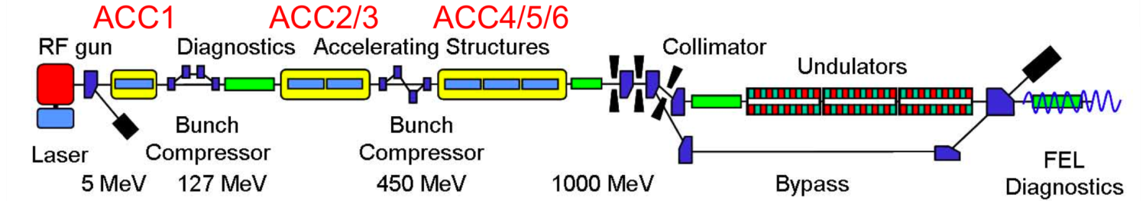
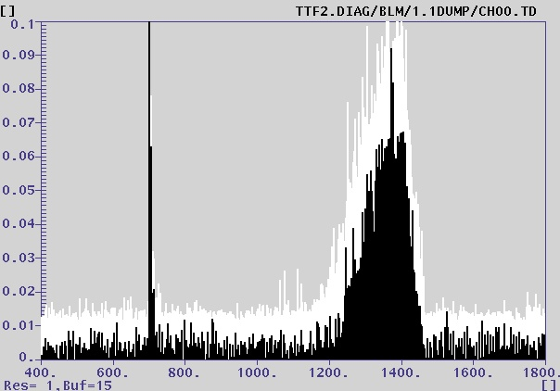
Beam loss
Spent a lot of time fighting beam loss alarms, mainly in three locations
  Bunch compressor BC3; first dipole of bypass line; dump line
Largely about trying to find good operating points…
(2)
BLMs pick up gun dark current from gun
(1) Beam loss signal from bunch
(2) Gun dark current loss signature at the end of the RF flat-top
(1)

Slide 5
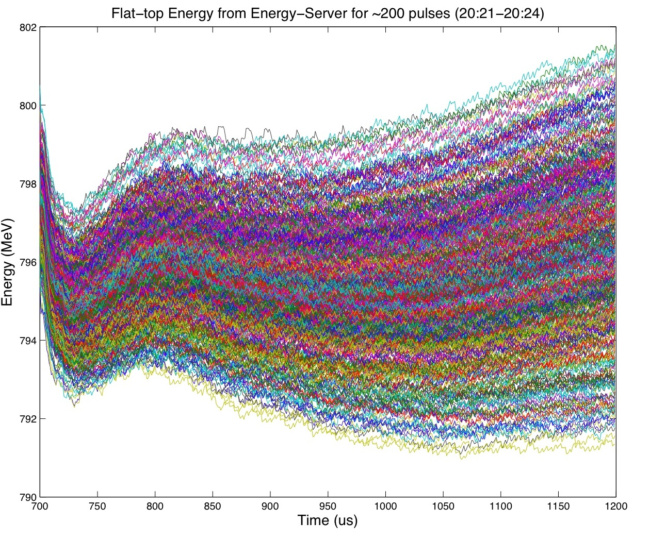
Example of pulse-to-pulse energy jitter
500 bunches @ 1MHz, 3nC/bunch
(overlay of 200 consecutive pulses)
802MeV
Jitter (first bunch): 4MeV
Jitter (all bunches): 10MeV
Energy spread within bunch-train: 5MeV
4MeV
10MeV
Single-bunch: tune a single point in the RF flat-top (profile doesn’t matter)
Bunch train: minimize deviations over RF flat-top
790MeV
500us

Slide 6
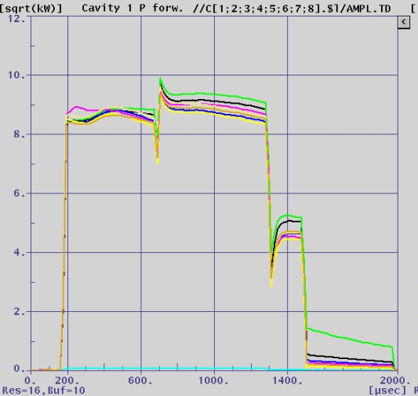
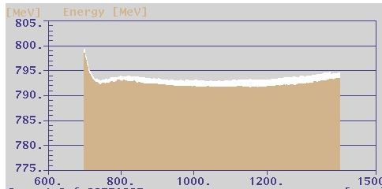
Beam loading transient example
(7.5mA ~2100 bunches, 3MHz)
Cavity Forward Power
LLRF tuning/optimization:
RF feed-forward waveforms
Beam loading compensation
Cavity pre-detuning
…
Beam-loading
Cavity fill
Beam-induced transient
Response of
LLRF regulator
Beam energy

Slide 7
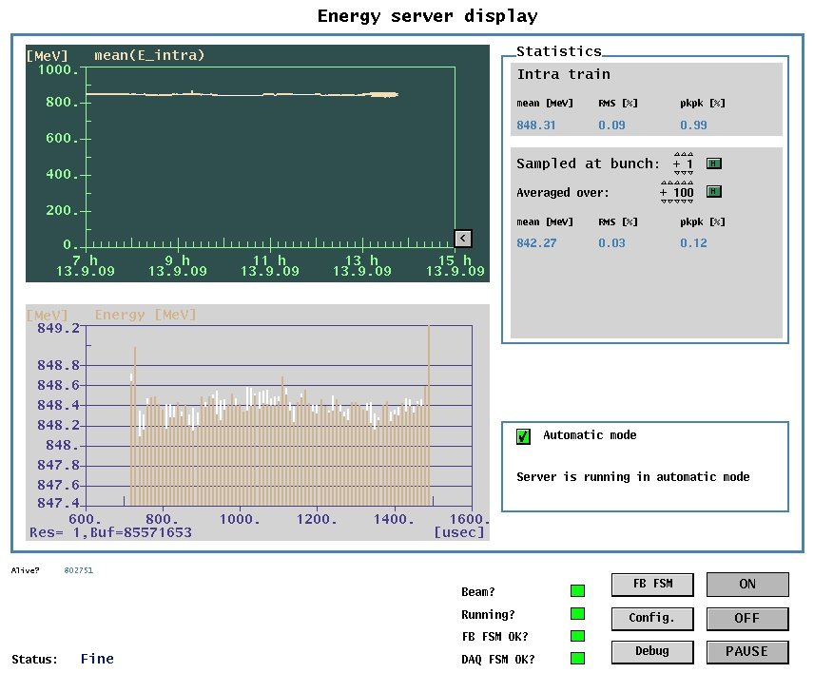
Energy deviation along bunch train (examples)
80 bunches,100kHz, ~3nC/bunch (0.3mA)
1.8
MeV
Along pulse: 0.035% p-p
800us
2100 bunches, 3MHz, ~2.5nC/bunch (7.5mA)
30
MeV
Along pulse: 0.5% p-p
Pulse-pulse: 0.13% RMS
700us

Slide 8
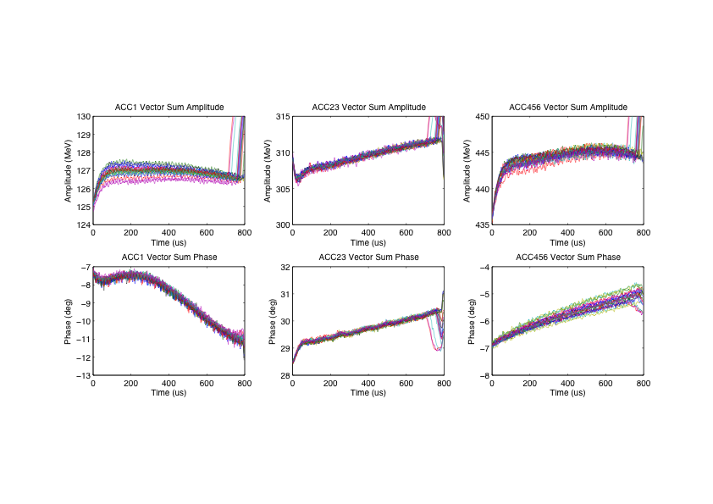
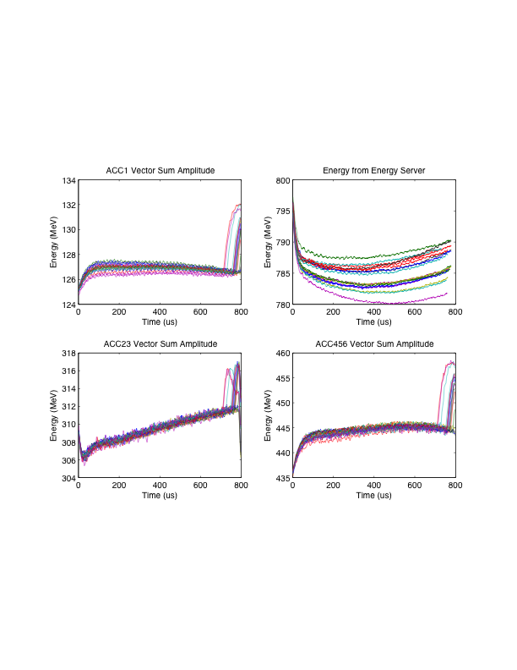
How do we match the final energy with the RF vector sums?
ACC1 + ACC23 + ACC456 = …?
Three measurements of energy:
1. D1 bypass dipole
2. RF vector sums
3. Energy server
The measurements were consistently not in agreement

Slide 9
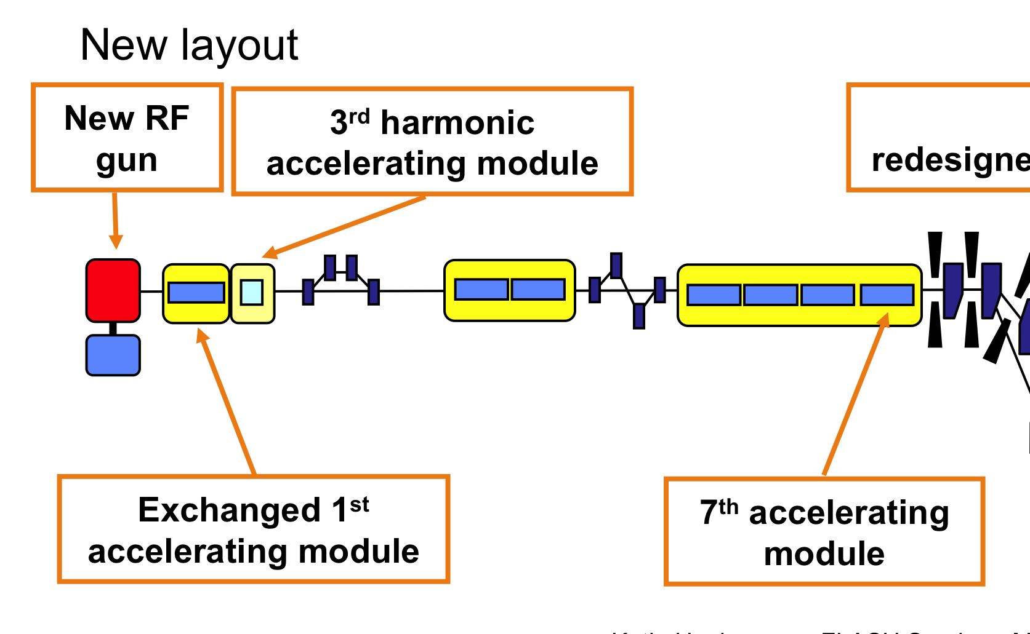
FLASH layout (now)
K
K
K
K

Slide 10
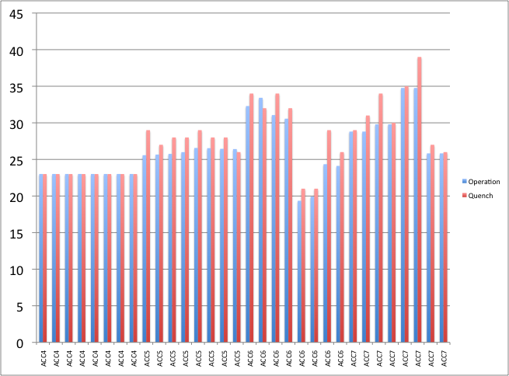
FLASH cavity gradients now
23.0 MV/m
26.1 MV/m
26.9 MV/m
29.8 MV/m
At the threshold of many cavities quenching

Slide 11
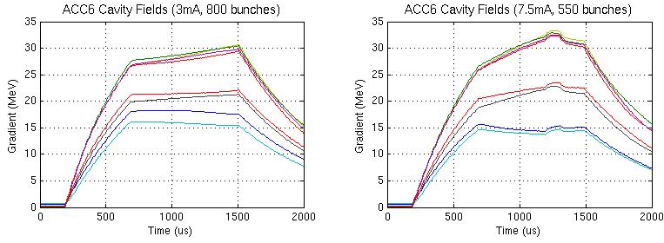
Cavity tilts with long bunch trains and heavy beam loading (3mA and 7.5mA, long bunch trains)
ACC6 gradients (3mA, 800 us)
ACC6 gradients (7.5mA, 550 us)
Gradient tilts are a consequence of using a single RF source to power cavities running at different gradients
Many open questions, eg how well can we…?
  Set the cavity loaded Qs and RF forward powers
  Calibrate the individual cavity field measurements
Other questions
  Charge stability, energy stability
All questions could be studied at FLASH
Notes:
Can we explain the tilts by simple formulae?

Slide 12
We need practice running long bunch trains!
No ILC/9mA studies before Jan 2010, but there is FEL study time
Joint FEL studies with photon scientists has been propsed
  0.5-1nC/bunch 800 bunches @ 1MHz, (or as many bunches as possible)
Studies focus
  Build tuning and operations experience with SASE and long bunch trains
  Establish working points and machine save sets for long bunch trains
  Photon experiment set-up, data taking, and processing with 1MHz long bunch trains
  Test beam-based feedback systems of energy, bunch compression, bunch arrival
Technical focus
  Stability and reproducibility of LLRF: feedback; adaptive feed-forward
  Exception handling
  Expanded Save/Restore, beginning with LLRF, energy,…
  Photon experiment data-taking and processing for 1MHz bunch rates

Slide 13
Second workshop on long bunch train operation at FLASH
Tentative date: Oct 4-6th (DESY MAC is Oct 7-8)
Three full days (all plenary)
Follow-ups from Feb workshop
Main theme for ILC/9mA: preparing for Jan studies
FEL studies reports

