Slide 1
PM Report
Nick Walker
Accelerator Systems TAG Leaders WebEx Meeting
21.04.2010

Slide 2
PM Report
10Hz low-energy running summary doc
R&D Plan Release 5 (June)
Beamline Assessment Workshops
TD Phase 2: ILC-EDMS plans
Meetings & other announcements

Slide 3
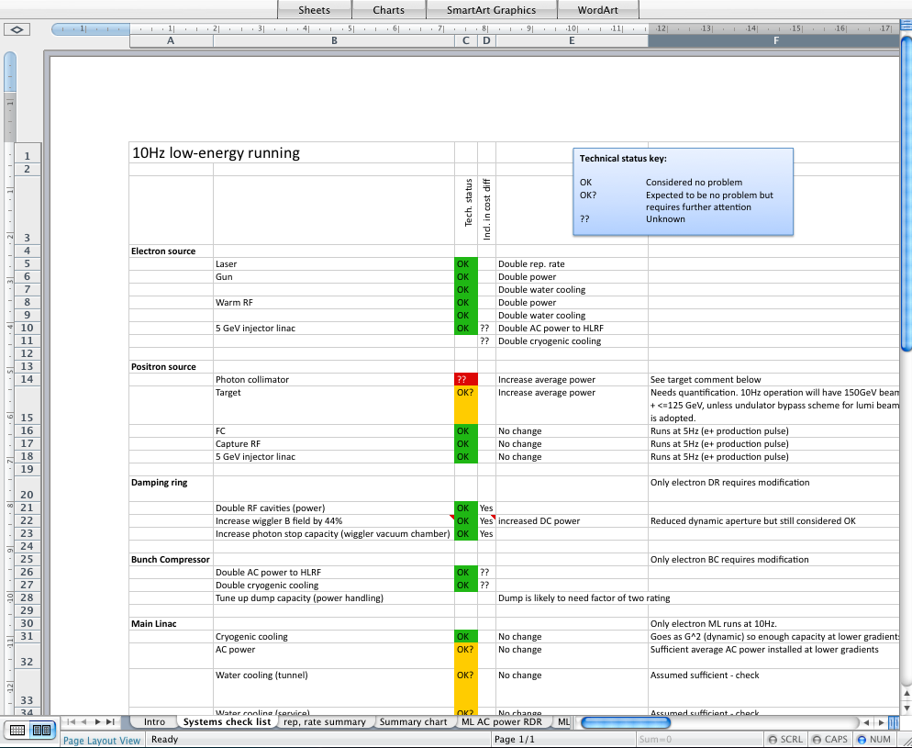
10 Hz Running
Part of SB2009 evolution for positron source re-location
  Beijing discussions (A. Seryi)
This document focused on running high-rep rate
  Impact analysis across all systems
  Hardware etc.
Not the entire picture (→ future docs.)
  Part of step-wise approach to develop SB2009 supporting arguments
  Factors into the final luminosity
  Being treated independently from other (lumi related) issues
    Beam-beam parameters (incl. TF)
    Low-power option(s) in general
Email comments received (thank you!)
  Please keep dialogue/discussions going
http://ilc-edmsdirect.desy.de/ilc-edmsdirect/file.jsp?edmsid=*907775
Notes:
Check the date!
General time scale to converge on this is the second BAW in January 2011.

Slide 4
10 Hz Running
AS specific actions requiring further clarification (see spreadsheet):
Positron source
  Power on target
  Photon collimator?
  Dumping of e+ production pulse
  Hi rep-rate pulsing of capture section (currently only ≤5Hz assumed)
  (use of undulator by-pass for lumi production pulse)
BDS
  Dumps and collimators
Simulations
  Further studies on running different energy beams in linac.
http://ilc-edmsdirect.desy.de/ilc-edmsdirect/file.jsp?edmsid=*907775
Focus meeting will be held in May (TBD)
Expect to return to these issues periodically in preparation for Change Control
Notes:
Check the date!
General time scale to converge on this is the second BAW in January 2011.

Slide 5
R&D Plan Release
Current Rel. 4 published July 2009
Major re-write of front-document now required (TD Phase 2 centric)
  Two-year plan to ‘deliver’ identified TDR documents
  Consolidation of R&D work
  Design, cost and schedule
Next-level of detail planning now required
  Plan must converge to produce desired results
  Currently being discussed by PMs
  Your input and support will be required
Appendix B (TAG leaders responsibility)
  These also need review (WPs etc.)
  Bring into alignment with top-level TD Phase 2 goals for TDR production.
Currently being discussed at PM level.
Hopefully more directions and homework by early next week
Please begin to review your Appendix B sections.

Slide 6
Baseline Assessment Workshops
BAW-1 | Accelerating Gradient | KEK September 7-10
BAW-2 | Single tunnel & HLRF
BAW-3 | Positron source location | Early 2011 (January) TBD
BAW-4 | Low beam-power option
Part of PMs Top-Level Change Control process
Two scheduled mini-workshops (four themes)
Detailed charge and agenda for KEK meeting in preparation
More details next week’s AD&I meeting (28.04)
Notes:
Something more to say here?

Slide 7
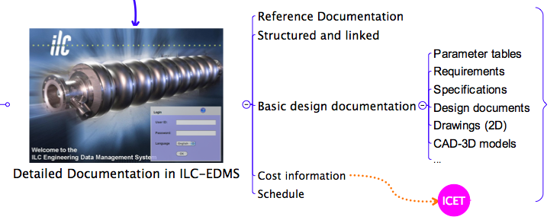
ILC-EDMS – part of the TDR!
DESY ILC-EDMS team (in assoc.) developing list of mandatory documents (and hopefully templates) for TDR technical documentation.
WBS also being developed
Guidelines and actions items to be distributed

Slide 8
ILC-EDMS Document Access
Public technical documents available to ‘the World’ via web interface
Non-public documents (cost etc.) will still required ILC-EDMS account
Upload, release, sign-off etc. will still require ILC-EDMS account
Open and easier public access (web)
Non-public documents internal only to ILC-EDMS system
Workflow etc.

Slide 9
Meetings & other Announcements
AAP
  Report from Jan. review (SB2009) distributed last month
  PMs to work closer with AAP in dealing with recommendations
    At AAP WebEx meetings over next 6-months
  Next AAP review: ML SCRF Tech –late 2010 (tbd)
ILCSC PAC review
  May 13-14 Valencia
  “Management” level review of GDE (and Detectors)
  Agenda available on ILCAgenda:
    http://ilcagenda.linearcollider.org/conferenceDisplay.py?confId=4509
    Home > Machine Design > Management > PAC
  (Special thanks to John C. and Mark P. for attending)
CFS
  Review at KEK of Japanese site (June 1-2).
  Further CFS requirements meetings:
    Daresbury Lab. July 12-13
    SLAC August 2-3
Interim report
  TD Phase 1 review of R&D status and progress
  Now end 2010 (exact date TBD)
  Outreach document (communicator’s to help)
  “glossy” and “up-beat”

