Slide 1
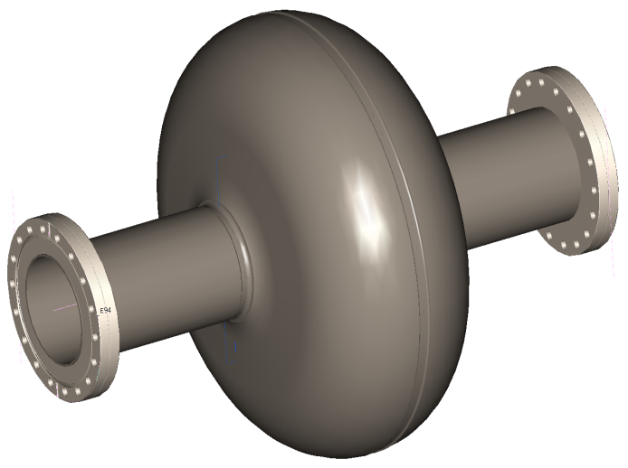
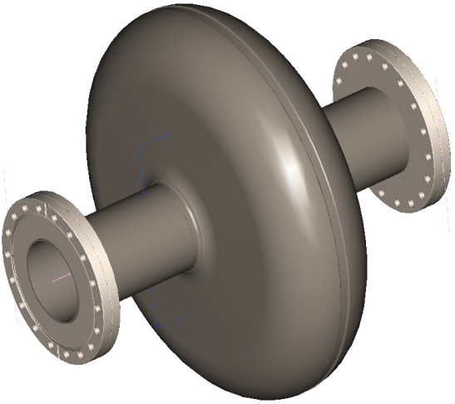
650MHz Single Cell Cavities
650 MHz β=0.6
650 MHz β=0.9

Slide 2
Overview
650-325MHz Cavity Team – Monday Afternoons
CAD Project/Library in Place on the Fermi TDM
Folder Structure Set-up on Q:\650MHz
Developing Serialization and Travelers for “On Base” & “Vector” Systems
Met with Jefferson Lab to Discuss Fabrication Issues
Preliminary Single-Cell Fabrication Spec.

Slide 3
Overview
Drawings are Complete For β=0.6 & β=0.9
  Under Review
Req. Written for Niobium and Nb-Ti
  Cavities – 5 Each Style
  Currently have material on-hand for 2 cavities

