Slide 1
ATF2 SC Magnet Upgrade Update
Brett Parker, BNL-SMD
One hour ATF2 SC FD Webex meeting on 20 April, 2010,
10pm (KEK), 9am (BNL), 6am(SLAC), 3pm(CERN)
URL : http://ilcagenda.linearcollider.org/conferenceDisplay.py?confId=4544

Slide 2
ATF2 SC Upgrade Baseline
Status: Main coils are now wound and their harmonic content looks to be very good.
Dipole and
Skew-Dipole
Main Quadrupole
Skew-Quadrupole
Quadrupole
Skew-Sextupole
Main Sextupole
Will start winding the Dipole and Skew-Dipole corrector layers soon; now we need to decide on the rest of the corrector package (skew-octupole, dodecapole etc.).

Slide 3
ATF2 SC Upgrade Baseline
Consider all the coils inside the cryostat...
Dipole and
Skew-Dipole
Main Quadrupole
Skew-Quadrupole
Quadrupole
Skew-Sextupole
Main Sextupole
... the quadrupole corrector looks to be redundant.

Slide 4
ATF2 SC Upgrade Option 1
Substitute a skew-octupole for the quad corrector.
Dipole and
Skew-Dipole
Main Quadrupole
Skew-Quadrupole
Skew-Sextupole
Skew-Octupole
Main Sextupole
It is best to wind the skew-octupole before the other skew-layers to maximize its strength.

Slide 5
ATF2 SC Upgrade Option 2
Substitute a dodecapole for the quad corrector.
Dipole and
Skew-Dipole
Main Quadrupole
Skew-Quadrupole
Skew-Sextupole
Dodcapole
Main Sextupole
It is best to wind the dodecapole before the other skew-layers to maximize its strength.

Slide 6
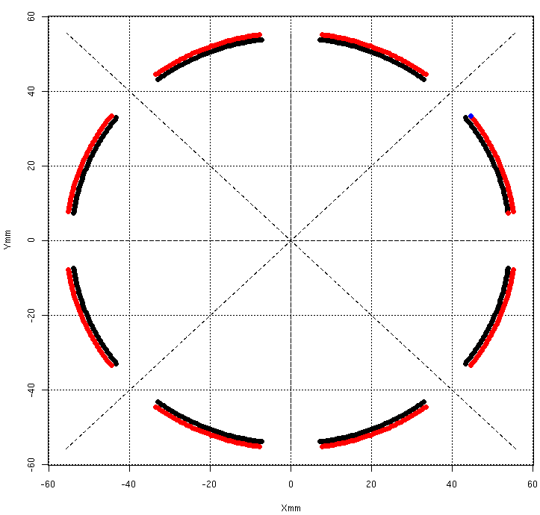
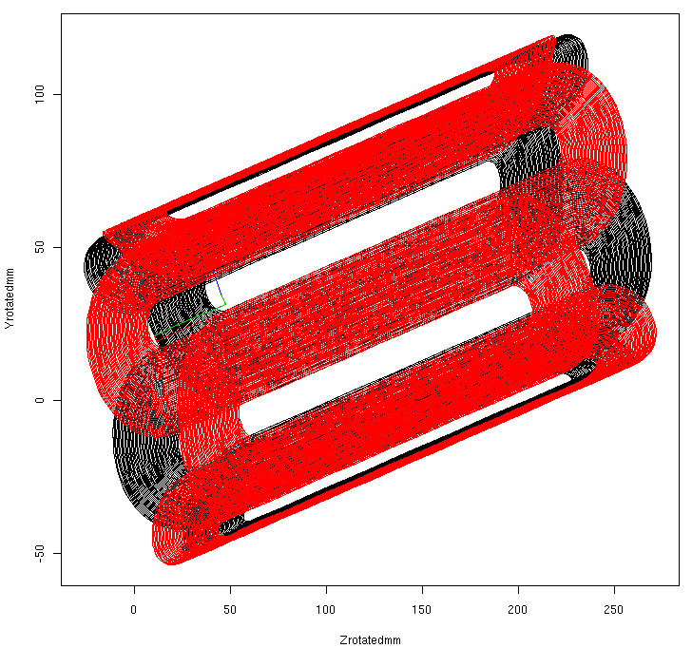
Skew-Octupole Details
Coil Radius = 54. mm
Integral TF = 3.620 T/m²/Amp
Body TF = 14.84 T/m³/Amp
Magnetic L = 0.244 m
Pattern L = 0.280 m
At R=25 mm and I = 20 Amp
B = 46. Gauss
Is this strength useful?

Slide 7
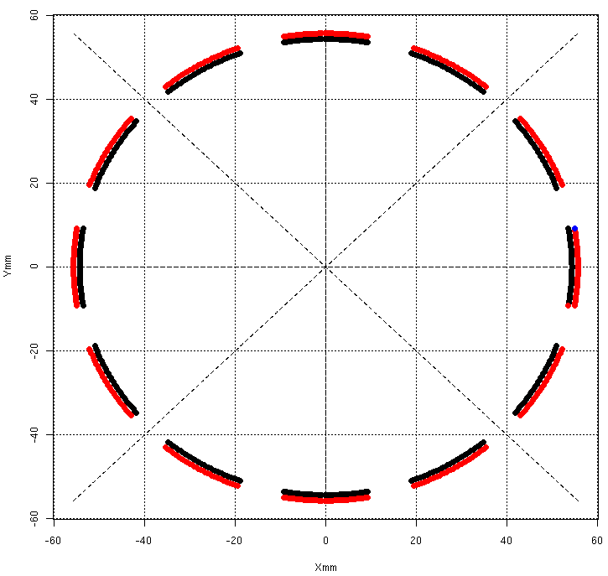
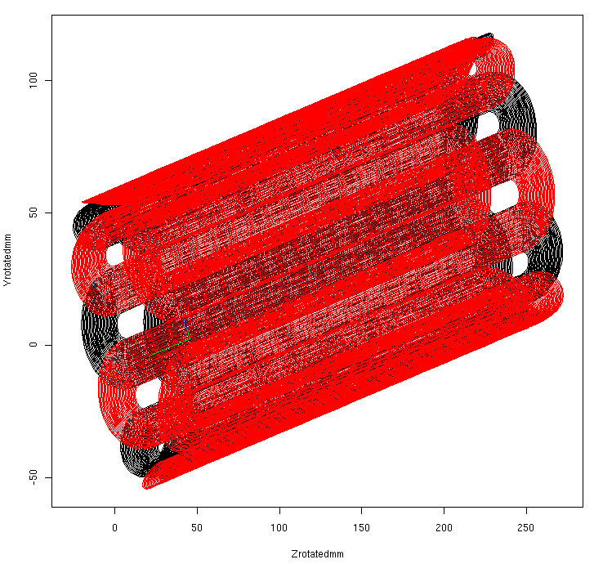
Dodecapole Details
Coil Radius = 54. mm
Integral TF = 1260 T/m⁴/Amp
Body TF = 4919. T/m⁵/Amp
Magnetic L = 0.256 m
Pattern L = 0.280 m
At R=25 mm and I = 20 Amp
B = 10. Gauss
Is this strength useful?

Slide 8
Dodecapole or Skew-Octupole
Can we have both?
If dynamic heat leak scales as I² then we trade off...
5 Pairs of leads at 20 Amps: 5*20² = 2,000 Amp²
6 Pairs of leads at 18 Amps: 6*18² = 1,944 Amp²
For operation come up with heat budget.
If we decrease I² for some correctors, then we can increase I² for some others.
Remember to include static (I=0) load.
Best to prioritize & pick just one (soon!).

Slide 9
Correctors Run at a Few Hertz
Recently evaluated prospect for exciting the corrector dipoles with frequencies of the order a few Hertz (for low frequency feedback) by using both analytic formula, from Animesh Jain, and via Opera2d simulations.
For ATF2, found that inner copper heat shield is enough to block excitation frequencies of a few Hertz from reaching the beam (predict eddy field larger than drive, excessive heating).
For the ILC QD0, if we neglect the copper in the quadrupole coil, can expect 10 Hz to get through tube with only minor attenuation & phase shift; also fraction of a milliwatt heating.
However with a simple model for the copper distribution in the quadrupole coil, found that there is significant attenuation for frequencies above 2 Hz and an increased sextupole component (heat load is still ok though).

Slide 10
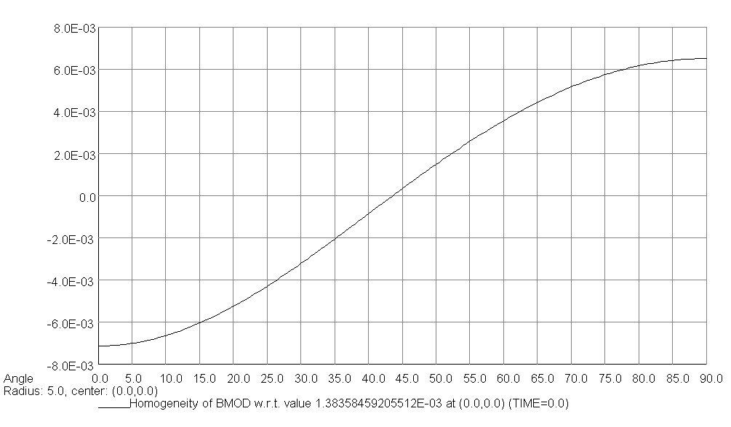
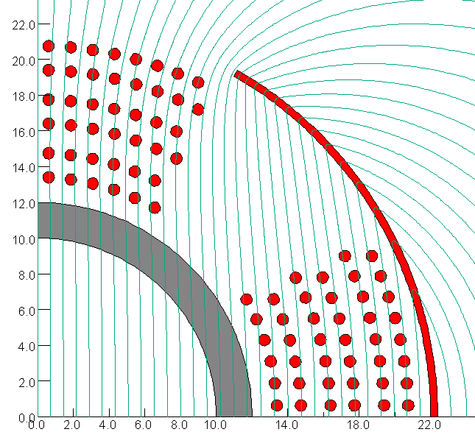
Final Observations & Questions
Delta B / B_{o} @ 5 mm
B_{o} = 14.4 Gauss for
10. micron center offset at G = 144 T/m
QD0 Dipole Corrector Field Lines @ 5 Hz
4.% Attenuation
Y (mm)
Plot shows distortion relative to the small, 14.4 gauss, dipole field. Is this level ok?
Impact of superconductor?
What if we wound correctors directly on the support tube (i.e. inside quadrupole coil)?
Is it worth winding dipole on existing short prototype and making AC measurements?
X (mm)

Slide 11
Backup slideS

Slide 12
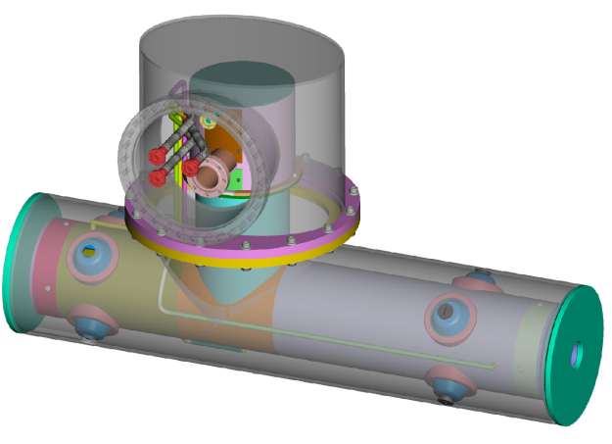
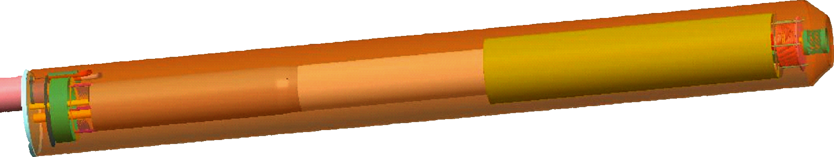
ILC R&D Prototype and ATF2 Comparison
Both are compatible with 1.9K testing via
an ILC-style Service Cryostat (SC) at BNL.
ATF2 magnet should be 4.2K tested at BNL
with SC and the ATF2 Cryogenic Box before
being shipped to KEK.
The ATF2 magnet can be tested with beam;
there is no way to beam test R&D prototype.
ATF2 Upgrade Magnet
(concept test with beam)
ILC QD0 Full-Length R&D Prototype Magnet Program
(a full-scale, instrumented, 1.9K ILC SC, systems test)

Slide 13
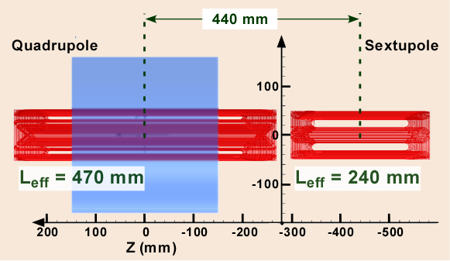
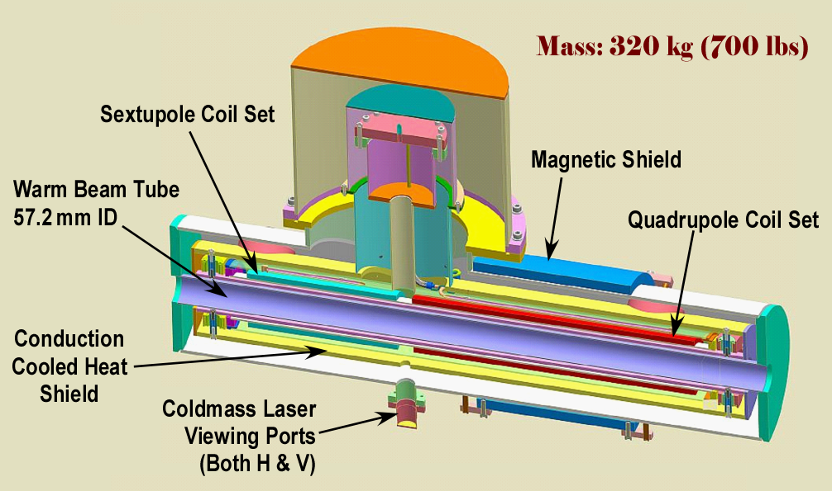
ATF2 Upgrade Production/Design Status
Main coil winding now complete.
Measured harmonics are small.
A first pass cryogenic interface made at ‘09 face-to-face meeting.
Magnetic shielding calculations (homework) done; results indicate we can make both Hor./Vert. laser penetrations (through the quad’s magnetic shield) at the center of each magnet coil without spoiling their good harmonics and still ensuring sufficiently low B-field at the external geophone locations.

Slide 14
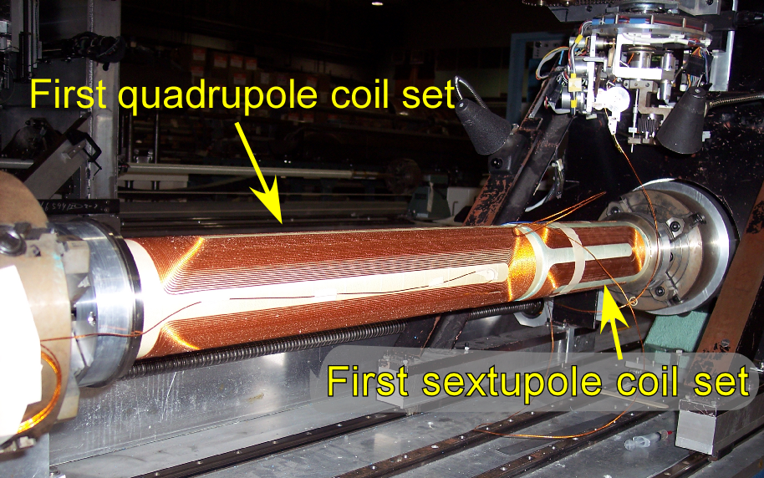
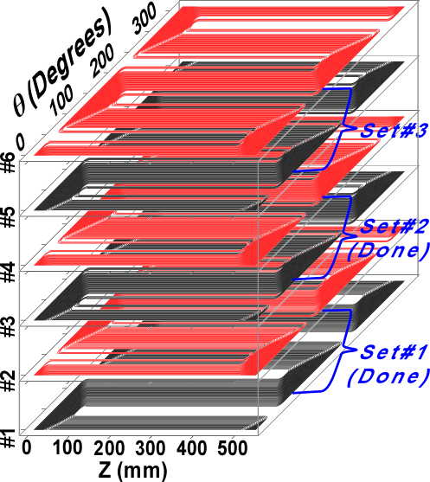
ATF2 Coil Winding Overview
Winding of the main quadrupole (six layers) and sextupole (four layers) coils now complete.
Production measurement results for field harmonics are consistent with our understanding of the requirements for future ATF2 “pushed β* optics” studies.
In order to keep to a “2012 delivery schedule,” we do need to start winding corrector layers soon (have resource conflict with QD0 long-coil winding).
Under the most aggressive delivery schedule, we would want to vertically cold test later this year (also resources).
All 3 coil sets now complete

Slide 15
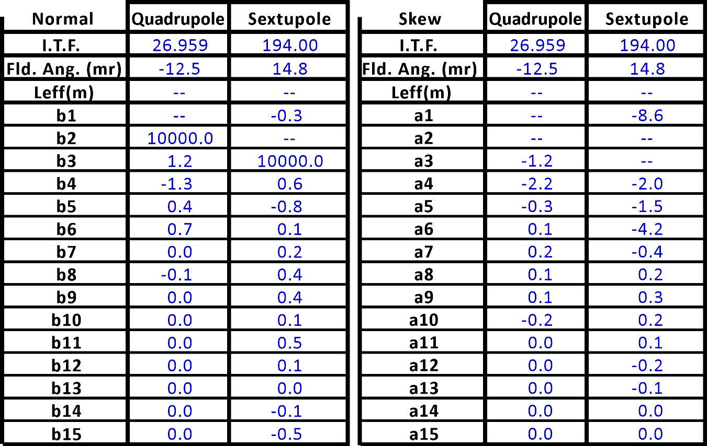
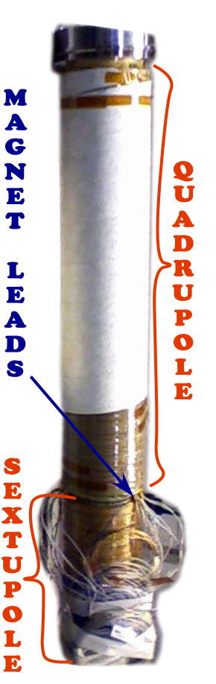
Summary of Integral Field Quality in ATF2 Magnet
ATF2 Coils
Harmonics are in "Units" of 10⁻⁴ of the main field at 25 mm as seen from the lead ends of respective magnets (yielding opposite sign of field angle in the two magnets). I.T.F for Quadrupole is in T/kA; ITF for Sextupole is in T/m/kA (Integral of B" in sextupole is two times the value reported for the I.T.F).

Slide 16
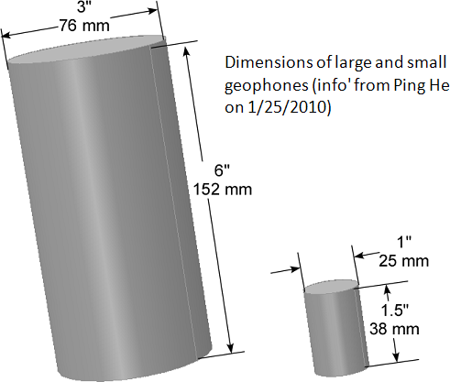
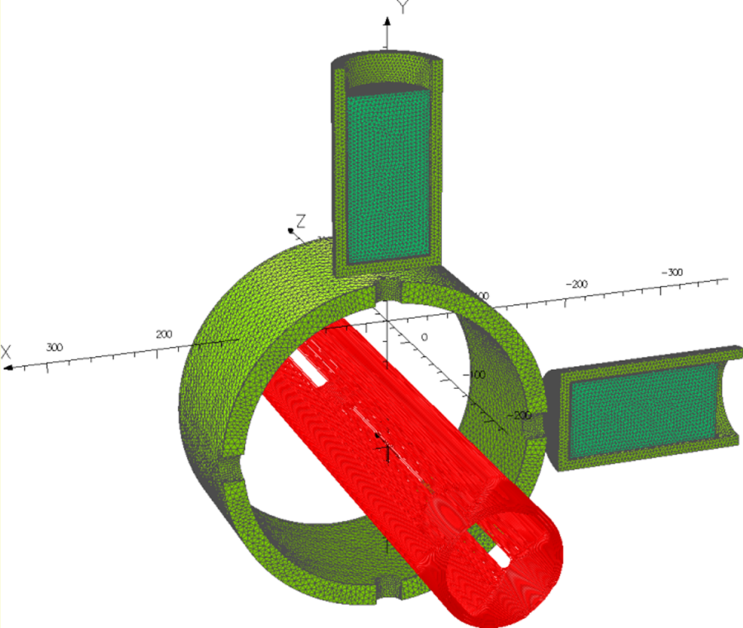
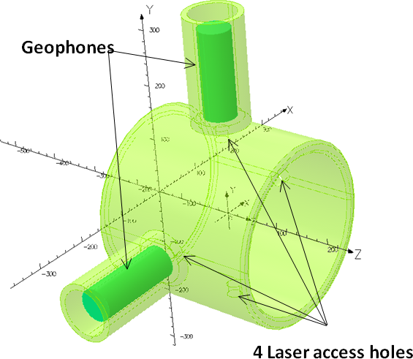
Laser View Port & Geophone Status
Our largest and
most sensitive geophones
Only two holes are needed for the laser access but we make four holes to keep quad’ symmetry.
At R_{ref} = 25mm, the harmonics change by less than 0.1 unit.
External field is low enough, even for our largest geophone.
Passive shielding still works even with 25 mm ID holes!

Slide 17
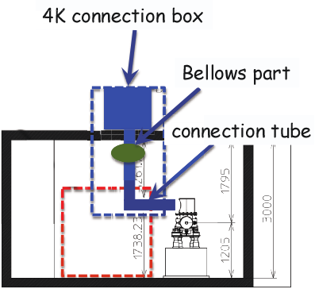
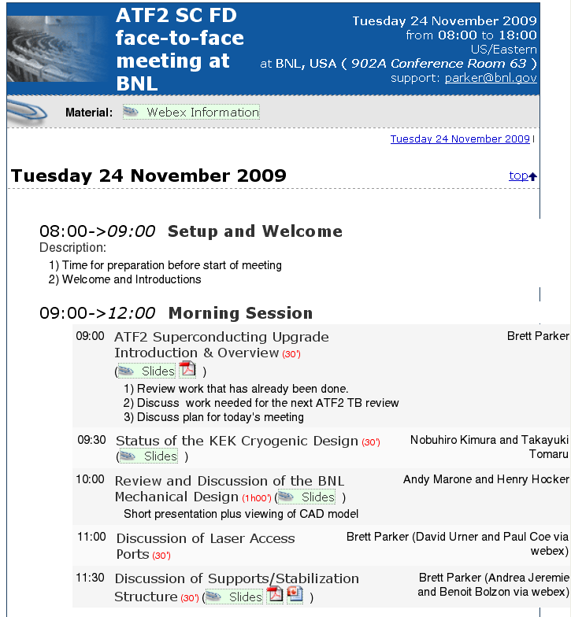
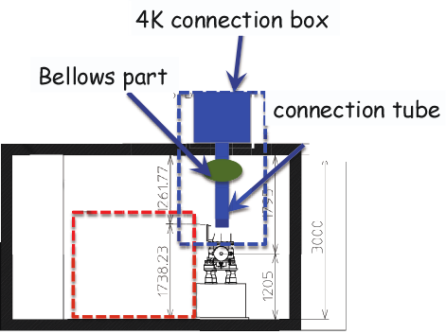
Cryogenics Interface Update
ATF2 Option 1
Our last meeting at BNL
ATF2 Option 2
(now the preferred
option)
Face-to-face meeting at BNL was very productive; do we need to schedule a new meeting? At KEK?

Slide 18
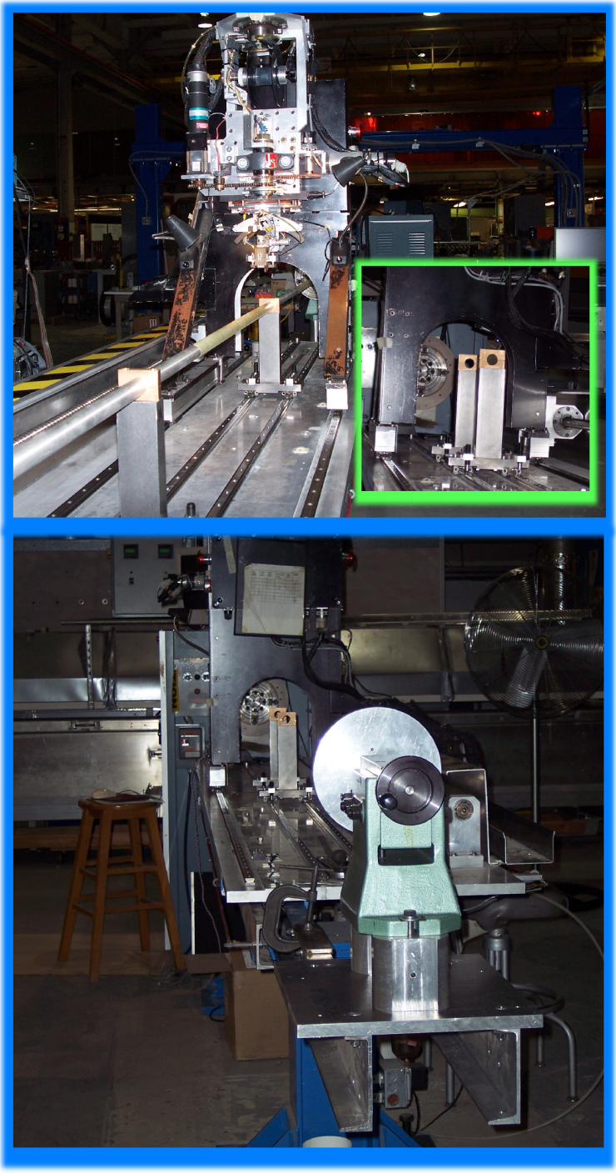
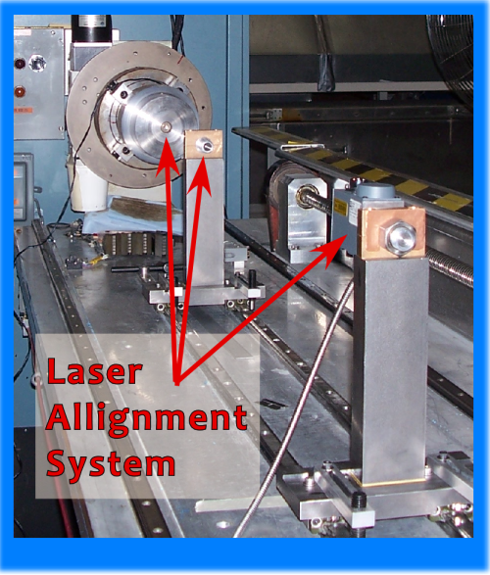
ILC QD0 R&D Prototype Long Coil Winding Challenges
We did not adequately control the coil support tube position (even with orthogonal machine-controlled rolling supports). Our first R&D coils had substantial harmonic errors.
We have therefore decided to go back to using a few fixed, rigid supports and have made modifications (shown here) to the ATF2
short coil winding machine.
We extended the machine & carefully positioned fixed supports between the coils.
The 2.2 m long QD0 R&D coil will be wound in two sections on a common tube.

Slide 19
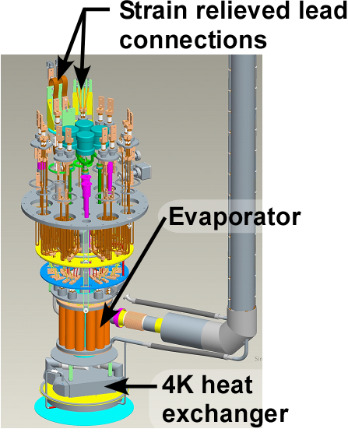
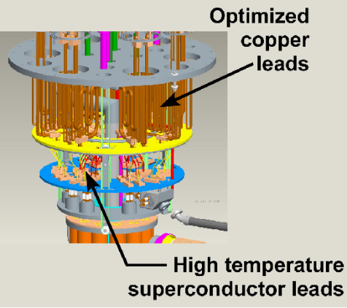
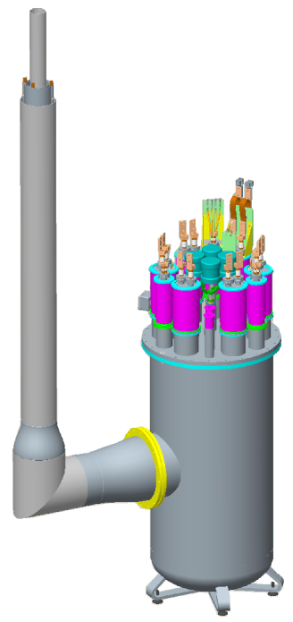
Service Cryostat & Other ILC Activities at BNL
SC design features for ATF2 mode nearly finished.
Detailed drawings for SC and QD0 now underway.
SC and QD0 long lead time items are identified (initiate critical orders).
For MDI, look to restart work on QF1 cryostat and the cryogenic transfer lines.
Demonstrate ILC-like FF magnet system production and operation.
Common ILC/CLIC work.
Service Cryostat Under Construction at BNL
Develop option that allows for ILC-like 1.9K tests at BNL and 4.2K operation at ATF2 (KEK) with cryo-coolers.

Slide 20
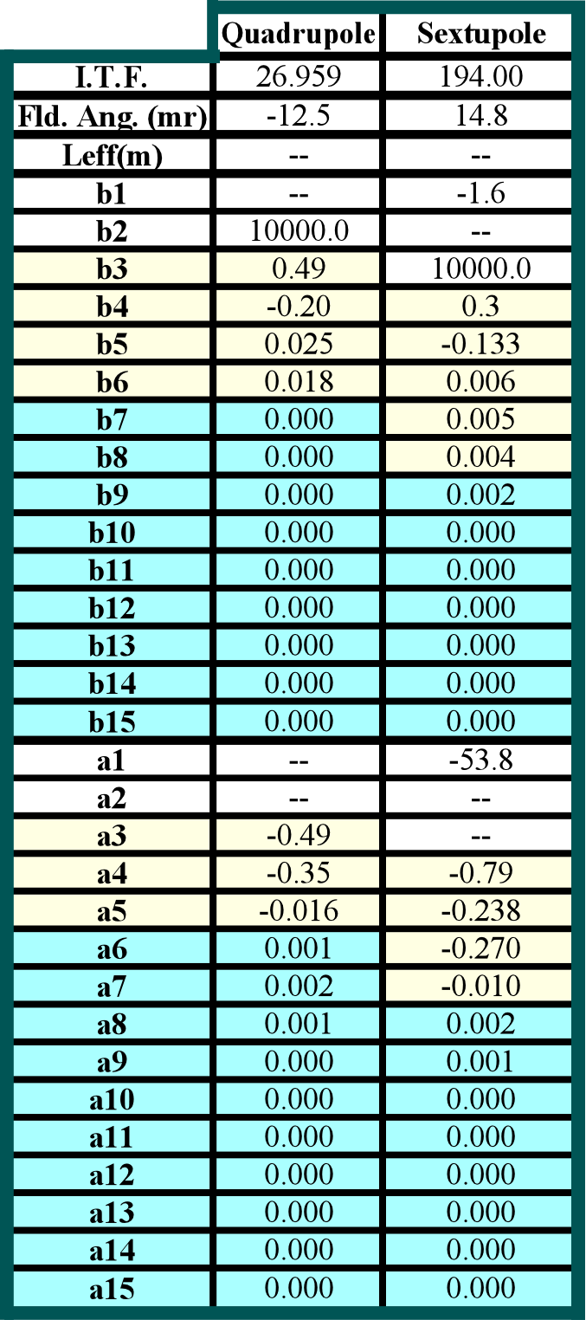
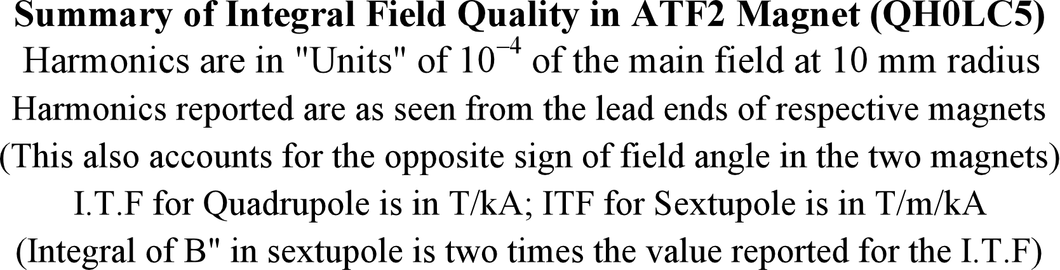
Summary of Integral Field Quality in ATF2 Magnet
Because field harmonics change rapidly with reference radius, we recalculated the measurements for R_{ref} = 10 mm (for easy comparison to the present ATF2 magnets).
The poorest quad harmonics (b3,a3), are now only 49. parts per million.
The areas highlighted in blue are all smaller than 200 parts per billion.

