Slide 1
T-1004 initial results
Adam Para,
Fermilab, April 20, 2010

Slide 2
Two Components of the Test Beam Program
EM calorimeter with different crystals, different photodetectors, different geometries. Calibration of a segmented calorimeter. Position and angle measurement.
Single crystal exposure. Different crystals, different photodetectors, different geometries, different surface treatment, different filters. Separation of Cherenkov and scintillation. Light collection, uniformity. Cherenkov light yield, Angular dependence of the Cherenkov signal.

Slide 3
EM Calorimeter, version 1.0
PbWO4 crystals (Iowa), former CMS test beam calorimeter
7 x 7 crystals array, read out via light guides and PMT’s. Beam along the crystal axis
Crystals of varied quality (yellowness), check the energy resolution as a function of the crystal quality
Future developments:
equip with SiPM’s, check the energy resolution SiPM vs PMT
Couple PMT’s directly , rotate by 90 degrees, 6 x 9 matrix, study the position and angle measurement

Slide 4
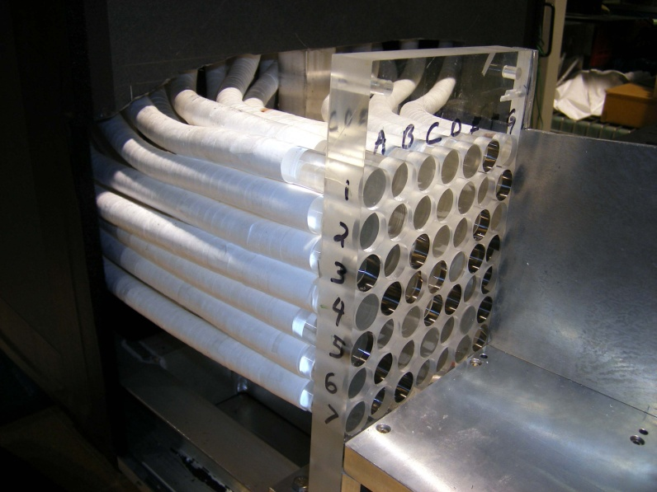
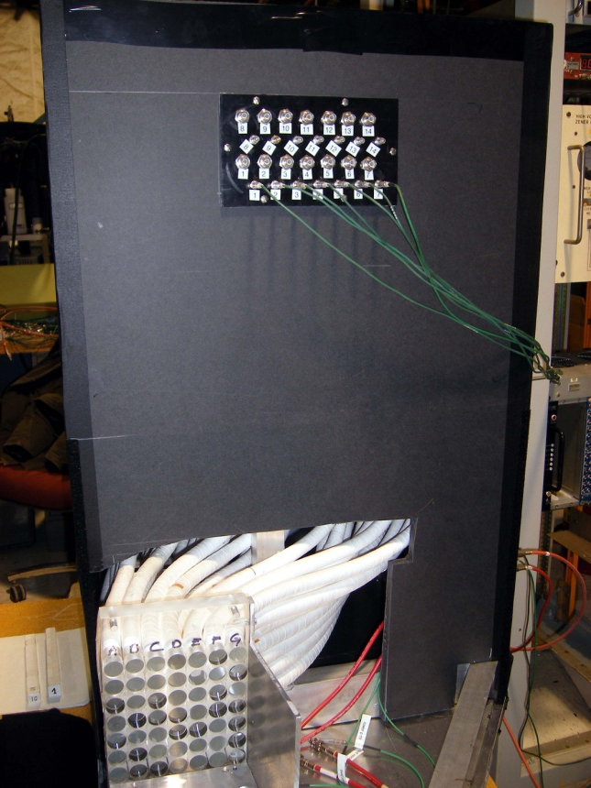
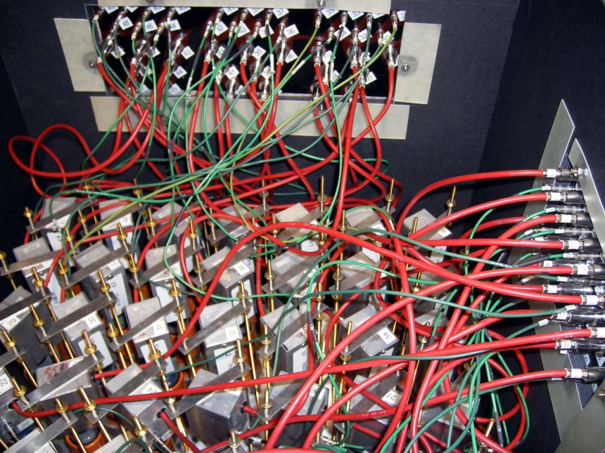
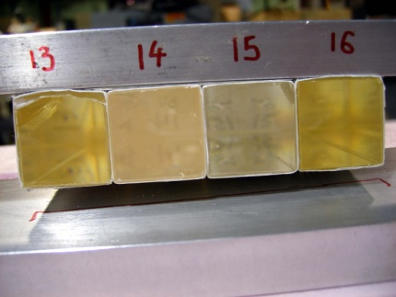
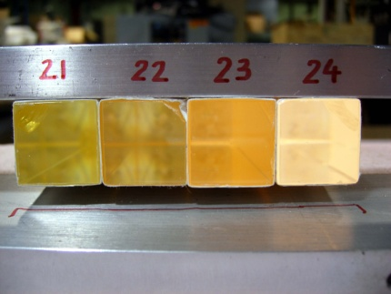
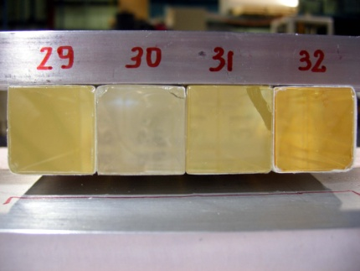
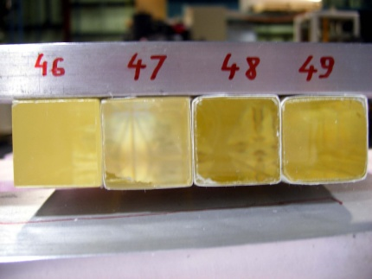

Slide 5
Useful Data Taken
Front face of the calorimeter illuminated with muons. Runs 10149, 10151, 10152, 10153, 10156, 10190, 10191, 10192.
(Mostly electron) beam, 4 and 2 GeV directed to the center of the inner 3 x 3 array (tower 17, 18, 19, 24, 25, 26, 31, 32, 33). 4 GeV runs: 10270, 10271, 10272, 10273, 10274, 10275, 10314, 10315, 10316, 10317, 10318, 10319, 10320, 10321, 10322, 10323, 10324, 10325.

Slide 6
Known Problems and Issues
ADC (Lecroy 2249W) have ‘beam on’ pedestal dependent on the history of the input pulses. Quite serious effect in a central tower (i.e. the one beam is directed towards)
HV on the crystal #18 raised by over 100V (!!) in the early days
One Cherenkov dead, the other has only one PMT. This PMT is very noisy (until the last day of running). The ADC reading out the Cherenkov particularly vulnerable to the floating pedestal problem
Beam spread not well known, probably bigger that the resolution of the calorimeter
CAPTAN system not working

Slide 7
Electron Showers
Signal size (total energy deposited in a calorimeter) as a function of a number of crystals with signal more than 3 counts above the pedestal
Electron showers involve 15-25 crystals: relative calibration will be important
Electrons
Pedestal events
Pion interactions
Multiple particles

Slide 8
Calibration Effects

Slide 9
Observed signals, different crystals (central)
Tower 25
Tower 32
Tower 18

Slide 10
Relative Calibration
It is clear that to attain the ultimate energy resolution it is necessary to equalize the response of all crystals. Finding a robust procedure for the cross-calibration is a primary goal of the studies.
Method 1: use muons (analysis underway)
Method 2: throw all electron runs together, fit 48 constants of relative calibration to minimize the resulting width (very time consuming and unstable fitting)
Method 3: select one beam position, use 5x5 array, fit 24 relative calibration constants. Repeat for different beam positions
Method 4: select one beam position, fit. Add the second beam position, fit togeter, add third beam position, fit.. Etc..etc..

Slide 11
‘Some’ calibration (example)
Tower 25
Mean = 1021.2
σ = 43.25
Tower 32
Mean = 999.40
σ = 41.81
Tower 18
Mean = 1002.6
σ = 43.02
Relative cross-calibration good to ~ 1%. Energy resolution at 4 GeV is ~ 4.3% (probably dominated by the beam spread.

Slide 12
Spatial Development of EM Showers
Difference between the signal in the entire detector and the 5x5 array. For electrons, some 1-2% of energy is deposited outside the 5x5 array
Total signal vs difference between 5x5 and 3x3 arrrays (both centered on the crystal with maximal energy). For showers centered on a crystal some 5-10% of energy is deposited outside 3x3 array

Slide 13
Conclusion
Even with very crude initial cross-calibration it is possible to reduce the spread of responses of different crystals fro more than a factor of two to 1-2%
The resolution of the order of ~4% at 4 GeV can be attained
The energy resolution is likely to be dominated by the beam energy spread

