Slide 1
SLAC Production of WHIZARD Data Sets
Tim Barklow
SLAC
Apr 20, 2010

Slide 2
Monte Carlo Production
WHIZARD Monte Carlo is used to generate all 0,2,4,6-fermion and t quark dominated 8-fermion processes.
100% electron and positron polarization is assumed in all event generation. Arbitrary electron, positron polarization is simulated by properly combining data sets.
Fully fragmented MC data sets are produced. PYTHIA is used for final state QED & QCD parton showering, fragmentation, particle decay.

Slide 3
For Each New Machine Parameter Set There are 4 Steps Needed to Create the Files Needed by our Beamstrahlung Simulation Code
Run Guinea-Pig on a new set of Machine Parameters
Determine how much Guinea-Pig output is needed for Guinea-Pig Integration jobs and copy data to files such as /nfs/slac/g/lcd/ilc_data/whizdata/ILC500/guinea-pig/SB2009_500_TF_extbunches/lumi/ilc500n_lumi_0x.dat
Submit Guinea-Pig MC Integration Jobs
  /afs/slac/g/nld/whizard/ILC/guinea-pig_ini
Copy .grd files produced by Guinea-Pig MC Integration Jobs to the directory /nfs/slac/g/lcd/ilc_data3/whizdata/ whizard/guinea-pig/energy_spread and give them names lumi_linker_nnn, photons_beam1_linker_nnn, etc. where nnn is (our) 3 digit machine identifier.

Slide 4
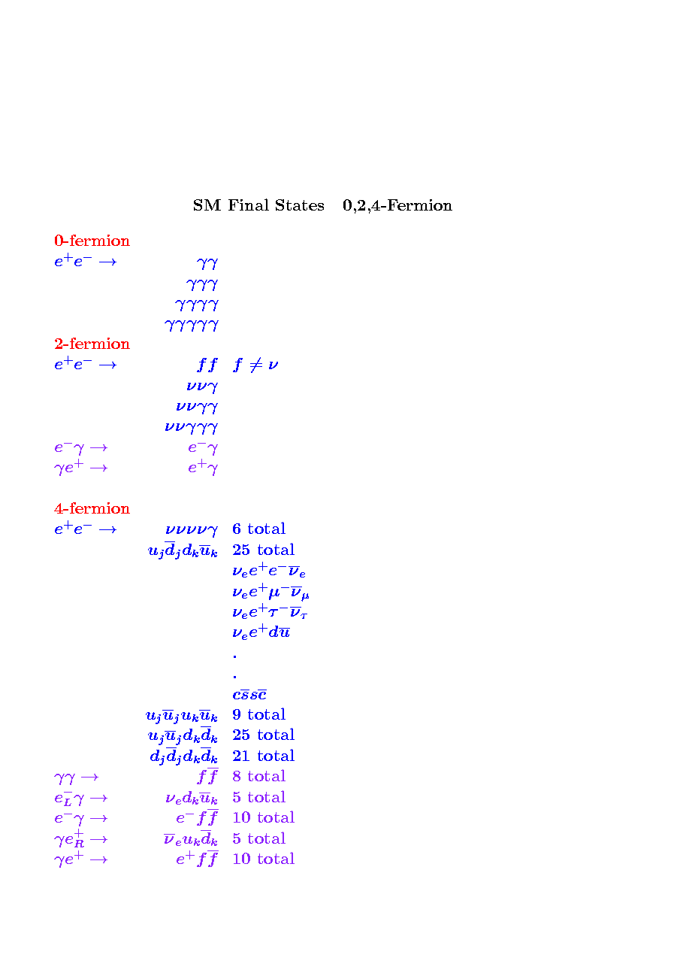
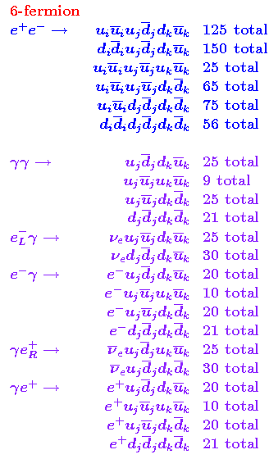
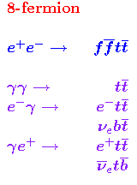

Slide 5
There are currently 14 MC production groups:
0-2-4-fermion
6-fermion/ddi-udj-duk
6-fermion/eminus-gamma
6-fermion/gamma-eplus
6-fermion/gamma-gamma
6-fermion/uui-udj-duk
6-fermion/zzz_1
6-fermion/zzz_2
8-fermion/
bench-point-5
ffh
ffhh
tesla_bosons
tth
The production group directories are located in
/afs/slac/g/nld/whizard/xxxx
where xxxx=0-2-4-fermion e.g.
(xxxx will stand for a production group from here on)

Slide 6
For each Production Group There are 5 Steps Needed to Produce (Raw) MC Stdhep Data Sets: (corresponding shell script is shown in italics)
Generate Executable
  /nfs/slac/g/lcd/mc/prj/sw/dist/whizard/v1r4p0/whizard-v1r4p0/remake_process_class
Submit MC Integration Jobs
  /afs/slac/g/nld/whizard/ILC/multiple_whiz_ini
Repair MC Integration Jobs
  /afs/slac/g/nld/whizard/ILC/multiple_whiz_ini_cleanup
Submit MC Event Generation Jobs
  /afs/slac/g/nld/whizard/ILC/multiple_whiz_run
Repair MC Event Generation Jobs
  /afs/slac/g/nld/whizard/ILC/multiple_whiz_run_repair

Slide 7
remake_process_class copies the file xxxx/whizard.prc to WHIZARD’s conf directory, does ‘make prg’, and then copies the results of the make to xxxx/results.
1. Generate Executable

Slide 8
2. Submit MC Integration Jobs
multiple_whiz_ini loops through the processes in xxxx/results/whizard.prc and submits 4 batch jobs for each process (1 job for each initial state e⁺e⁻ helicity combination).
For each job a directory /afs/slac/g/nld/fa/mmmm/whizyyyyy is created where mmmm is the center-of-mass energy in GeV and yyyyy is a unique 5-digit job number.
multiple_whiz_ini uses the file xxxx/results/multiple_cardswhiz_in
to build the batch job’s whizard.in file
multiple_whiz_ini uses the file /afs/slac/g/nld/whizard/ILC/iniwhiz
to build the batch job’s executable script.

Slide 9
3. Repair MC Integration Jobs
multiple_whiz_ini_cleanup loops through the job output in the directories /afs/slac/g/nld/fa/mmmm/whizttttt through /afs/slac/g/nld/fa/mmmm/whizyyyyy and verifies that the integration was completed successfully. Here
mmmm, ttttt, yyyyy are input arguments to the script.
If the integration failed then multiple_whiz_ini_cleanup resubmits the job. WHIZARD saves intermediate integration results, so the
new job essentially picks up where the old one left off.

Slide 10
4. Submit MC Event Generation Jobs
multiple_whiz_run loops through the MC integration job output directories /afs/slac/g/nld/fa/mmmm/whizttttt through /afs/slac/g/nld/fa/mmmm/whizyyyyy and submits a run job for every MC integration job which had a cross-section above some minimum value.
For each run job a directory /afs/slac/g/nld/fa/mmmm/run_output/wkkkkk/run_01 is created where mmmm is the center-of-mass energy in GeV and kkkkk is the 5-digit MC integration job number.
multiple_whiz_run copies most of the files in the directory /afs/slac/g/nld/fa/mmmm/whizkkkkk into the directory /afs/slac/g/nld/fa/mmmm/run_output/wkkkkk/run_01 .
Parameters specific to event generation are added to the whizard.in file before it is copied to /afs/slac/g/nld/fa/mmmm/run_output/wkkkkk/run_01.
multiple_whiz_run uses the file
/afs/slac/g/nld/whizard/ILC/runwhiz
to build the batch job’s executable script.

Slide 11
5. Repair Event Generation Jobs
multiple_whiz_run_repair loops through the MC run job output directories /afs/slac/g/nld/fa/mmmm/run_output/wttttt/run_01 through /afs/slac/g/nld/fa/mmmm/run_output/wyyyyy/run_01 and verifies that the jobs completed successfully. If the job failed multiple_whiz_run_repair resubmits the job. If the job completed successfully but additional runs are required it will submit new run jobs after creating directories of the form
nfs/slac/g/lcd/mc/mmmm/run_output/wkkkkk/run_02
nfs/slac/g/lcd/mc/mmmm/run_output/wkkkkk/run_03
.
.
.
nfs/slac/g/lcd/mc/mmmm/run_output/wkkkkk/run_nn

Slide 12
Within SiD 2 Additional Steps are Needed to Produce Derived Stdhep Files with Randomized Final States
Calculate start and end readout positions for each raw stdhep file given a desired beam polarization, final state composition, and luminosity
  /afs/slac/g/nld/whizard/ILC/ inv_ab_stdhep_ascii_ini
Copy raw stdhep files on mstore to /nfs / disk, create necessary directories, and produce derived stdhep files with randomized final states
  /afs/slac/g/nld/whizard/ILC/create_derived_files_ini

