Slide 1
T-1004 initial results
Adam Para,
Fermilab, April 26, 2010
Total Absorption Dual Readout Calorimetry R&D
Fermilab, Caltech, University of Iowa, Argonne National Laboratory, Fairfield University, CERN, INFN Trieste/Udine, INFN Roma, Shinshu University and University of Cyprus
Phase 1 principal participants: Burak Bilki and Ugur Akgun(Iowa), Diego Cauz and Giovanni Pauletta (Udine), Fotios Ptochos (Cyprus), Erik Ramberg, Paul Rubinov, Hans Wenzel and Adam Para (Fermilab)

Slide 2
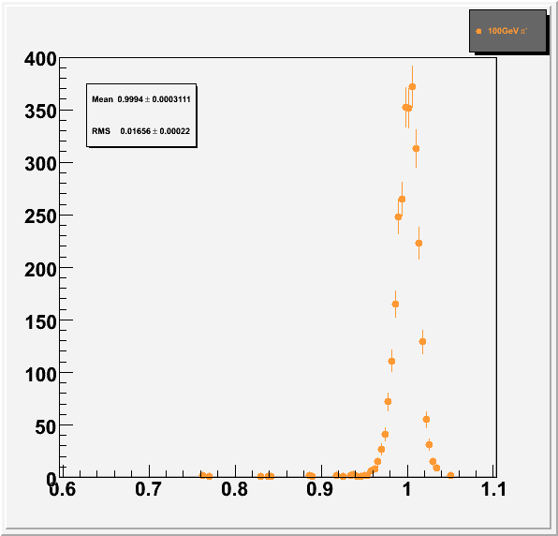
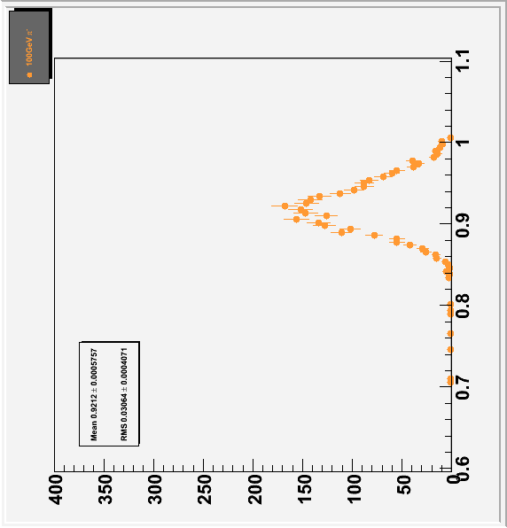
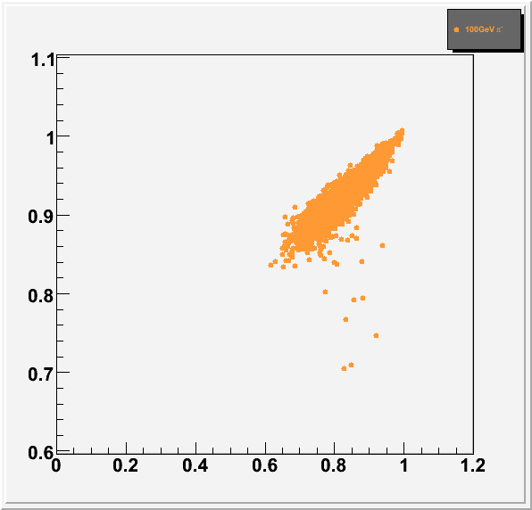
TAHCAL at Work: Single Particle Measurement
100 GeV π-
Full Geant4 simulation
Raw (uncorrected)
ΔE/E ~ 3.3%
but significant non-linearity, E~ 92 GeV
After dual readout correction, correction function (C/S) determined at the appropriate energy:
Linear response: S/B=1 for all energies
energy resolution ΔE/E~α/√E (no constant term)
α~12-15%
S/B
S/B
S/B
C/S

Slide 3
Motivation
Total absorption hadron calorimeter with dual readout (scintillation + Cherenkov) appears (on paper, in the simulation) to offer a possibility for hadron/jet calorimetry with the energy resolution approaching ~10%/sqrt(E)
Development of inexpensive dense scintillators and compact photodetector is necessary to construct a real-life detector
Practical problems of relative calibration of a segmented calorimeter and of light collection and of scintillation and cherenkov components may prove to be limiting factors. The goal of T1004 is to provide some experimental input in these areas.

Slide 4
Two Components of the Test Beam Program
EM calorimeter with different crystals, different photodetectors, different geometries. Calibration of a segmented calorimeter. Position and angle measurement.
Single crystal exposure. Different crystals, different photodetectors, different geometries, different surface treatment, different filters. Separation of Cherenkov and scintillation. Light collection, uniformity. Cherenkov light yield, Angular dependence of the Cherenkov signal.

Slide 5
EM Calorimeter, version 1.0
PbWO4 crystals (Iowa), former CMS test beam calorimeter
7 x 7 crystals array, read out via light guides and PMT’s. Beam along the crystal axis
Crystals of varied quality (yellowness), check the energy resolution as a function of the crystal quality
Future developments:
equip with SiPM’s, check the energy resolution SiPM vs PMT
Couple PMT’s directly , rotate by 90 degrees, 6 x 9 matrix, study the position and angle measurement

Slide 6
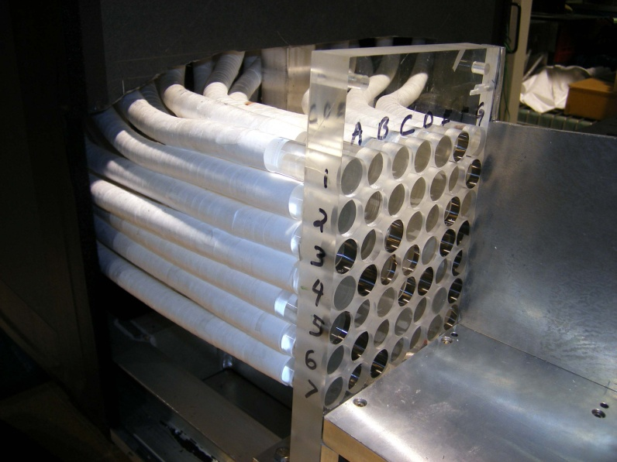
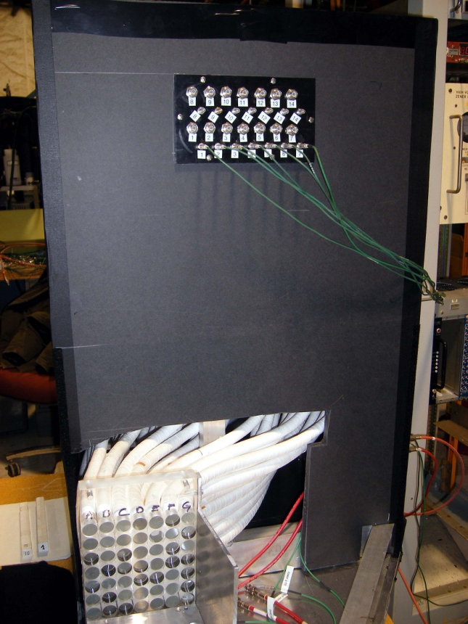
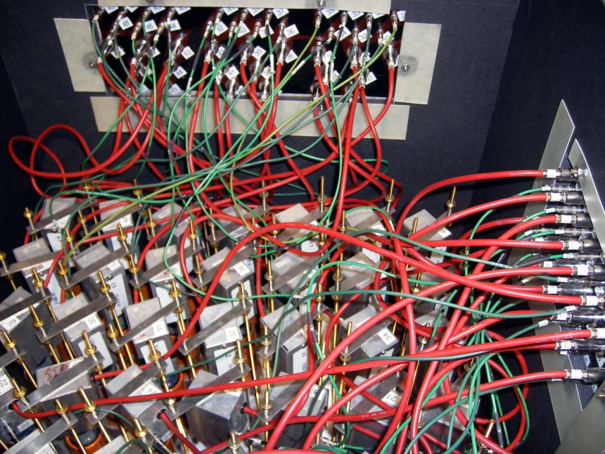
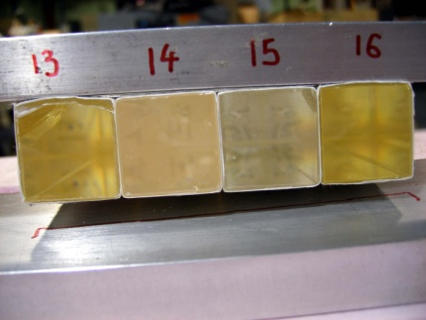
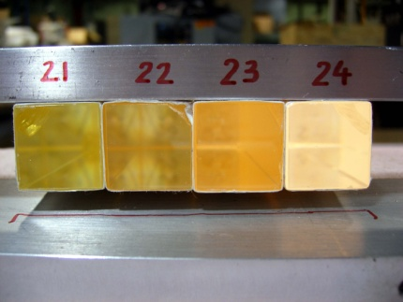
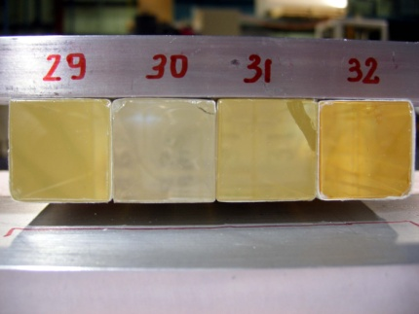
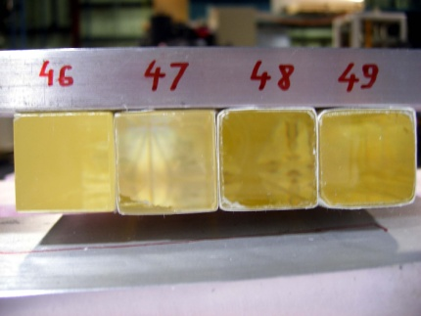

Slide 7
Useful Data Taken
Front face of the calorimeter illuminated with muons.
(Mostly electron) beam, 4 and 2 GeV directed to the center of the inner 3 x 3 array
Signals of 120 proton beam registered in 2 phototubes and 20 SiPM,s at various locations on a surface of 5 x 5 x 5 cm BGO crystal (from Caltech). Visible and UV filters used. Crystal oriented at 0, 30 and 60 degrees with respect to the proton beam.

Slide 8
Known Problems and Issues
ADC (Lecroy 2249W) have ‘beam on’ pedestal dependent on the history of the input pulses. Quite serious effect in a central tower (i.e. the one beam is directed towards)
One Cherenkov dead, the other has only one PMT. This PMT is very noisy (until the last day of running). The ADC reading out the Cherenkov particularly vulnerable to the floating pedestal problem
Beam spread not well known, probably bigger that the resolution of the calorimeter
CAPTAN system working marginally. Very little of particle position information available, if any.

Slide 9
Electron Showers
Signal size (total energy deposited in a calorimeter) as a function of a number of crystals with signal more than 3 counts above the pedestal
Electron showers involve 15-25 crystals: relative calibration will be important
Electrons
Pedestal events
Pion interactions
Multiple particles

Slide 10
Raw observed signals, different crystals (central)
Tower 25
Tower 32
Tower 18
Relative calibration is crucial to attain good energy resolution

Slide 11
Relative Calibration
It is clear that to attain the ultimate energy resolution it is necessary to equalize the response of all crystals. Finding a robust procedure for the cross-calibration is a primary goal of the studies.
Some possible calibration methods:
Method 1: use muons to illuminate crystals one-by-one, use the average or peak
Method 2: throw all electron runs together, fit 48 constants of relative calibration to minimize the resulting width (very time consuming and unstable fitting)
Method 3: select one beam position, use 5x5 array, fit 24 relative calibration constants by minimizing resolution. Repeat for different beam positions
Method 4: select one beam position, fit. Add the second beam position, fit together, add third beam position, fit.. Etc..etc..
If everything is done correctly and understood, all methods should give consistent results, within their systematic errors

Slide 12
Electron calibration (an example)
Tower 25
Mean = 1021.2
σ = 43.25
Tower 32
Mean = 999.40
σ = 41.81
Tower 18
Mean = 1002.6
σ = 43.02
Relative cross-calibration good to ~ 1%. Energy resolution at 4 GeV is ~ 4.3% (probably dominated by the beam spread).

Slide 13
Spatial Development of EM Showers
Difference between the signal in the entire detector and the 5x5 array. For electrons, some 1-2% of energy is deposited outside the 5x5 array
Total signal vs difference between 5x5 and 3x3 arrays (both centered on the crystal with maximal energy). For showers centered on a crystal some 5-10% of energy is deposited outside 3x3 array

Slide 14
Muon Calibration (An Attempt)
Observed signals in a single crystal, when this signal is the largest one in the event.
‘Muon signal’ is clearly visible (in most of the crystals) but the observed signals are dominated by the light generated in the bundles of light guides behind the crystals.

Slide 15
Cross Talk in the Light Guides
Signals observed in various towers when the maximal signal in the event is located in a ‘black’ tower.
All the events taken at the same time with the muon beam illuminating the detector.
Clear proximity pattern, consistent (roughly, no detailed analysis) with the routing of lightguides

Slide 16
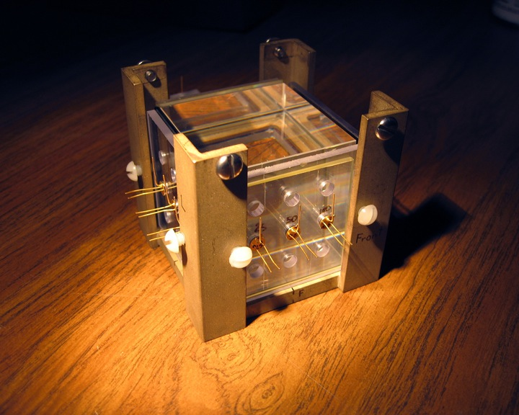
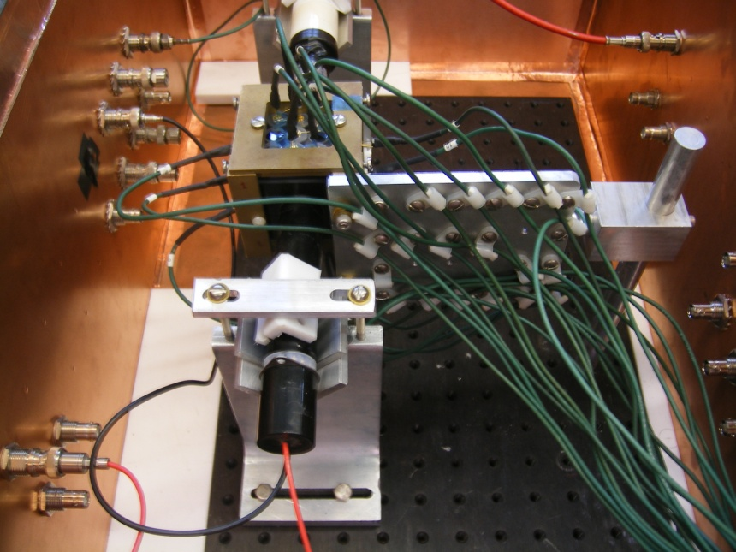
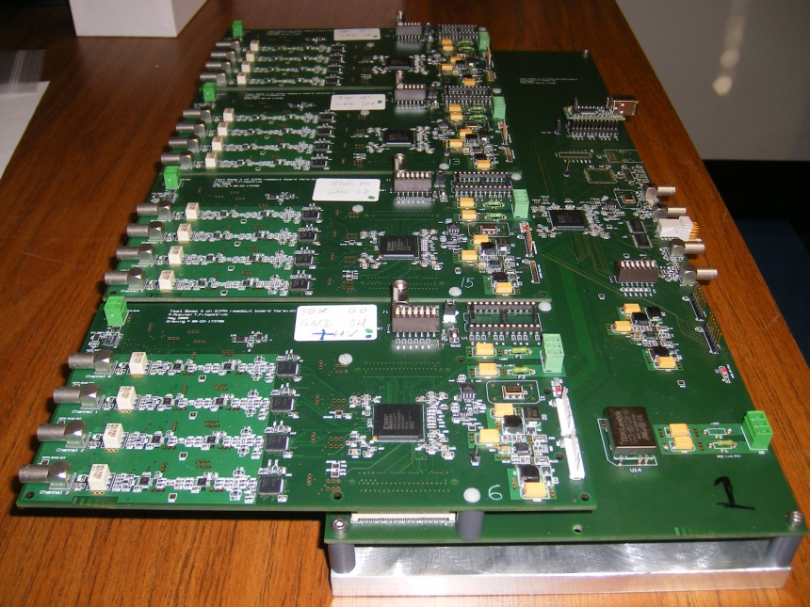
Single Crystal Setup
BGO crystal (from Caltech)
visible and UV filters
two PMT’s
20 Hamamatsu SiPM’s
TB4 readout boards (P. Rubinov)

Slide 17
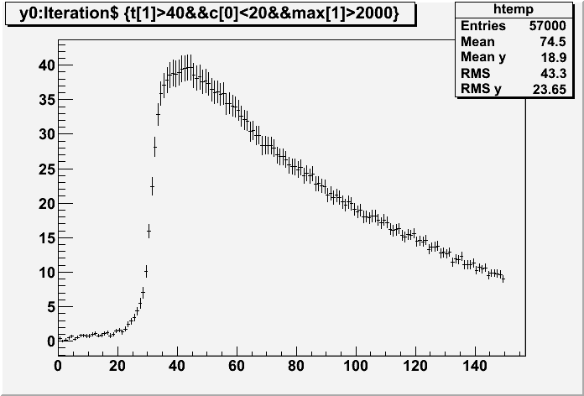
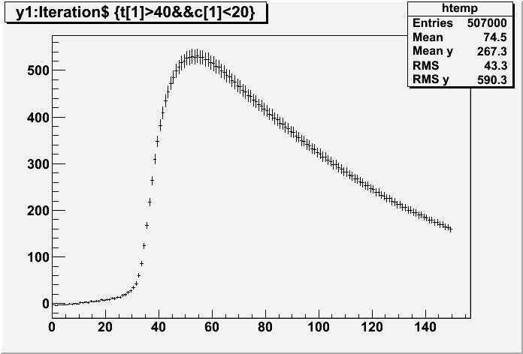
Data (Analysis Just Started)
Average pulse shape recorded in PMT with UV filter (5 ns bins)
Average pulse shape recorded in PMT with visible light filter
Both PMT’s show similar fall time, characteristic of BGO (300 nsec). This is an evidence for significant comoponent of scintillation below 400 nm
‘UV’ PMT shows a significant ‘prompt’ component
Quantitative analysis, including the SiPM,s position and angle dependence coming soon..

Slide 18
Conclusions
Segmented crystal calorimeter has significant cross-calibration potential. It can be even used to identify various flaws and imperfections of the real detector.
Even with very crude initial cross-calibration it is possible to reduce the spread of responses of different crystals from more than a factor of two to 1-2%
The resolution of the order of ~4% at 4 GeV can be attained, likely dominated by the beam energy spread
This is just a beginning: a lot of careful and interesting studies need to be carried out. Come and join!

