Slide 1
New Muon Lab Camera Server
Experimental implementation with Prosilica GE 1350

Slide 2
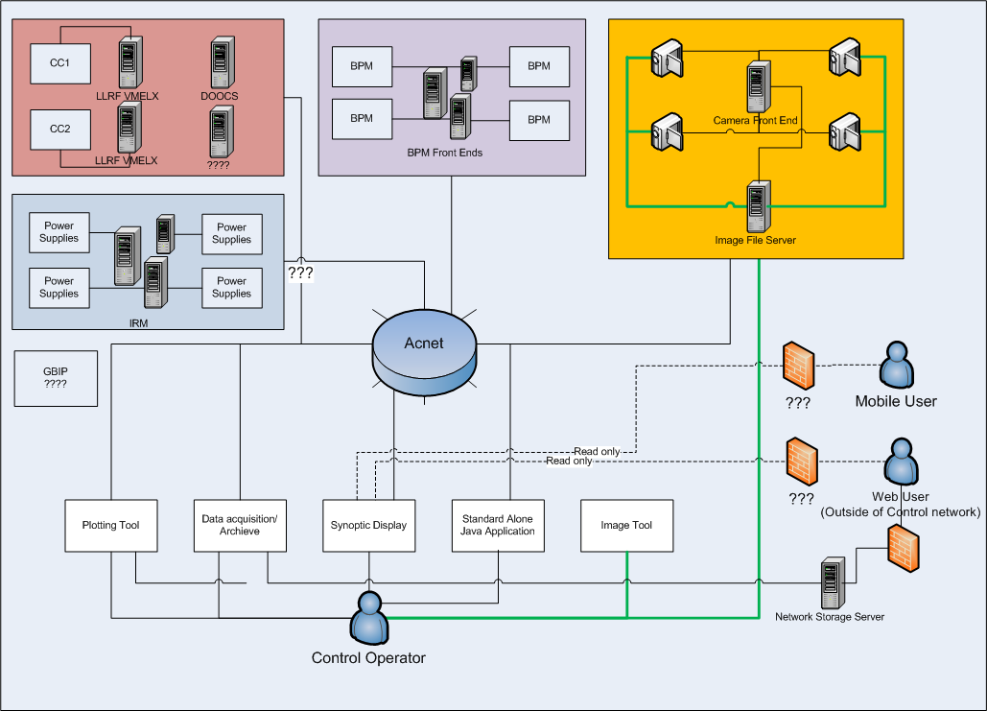
Proposed Structure

Slide 3
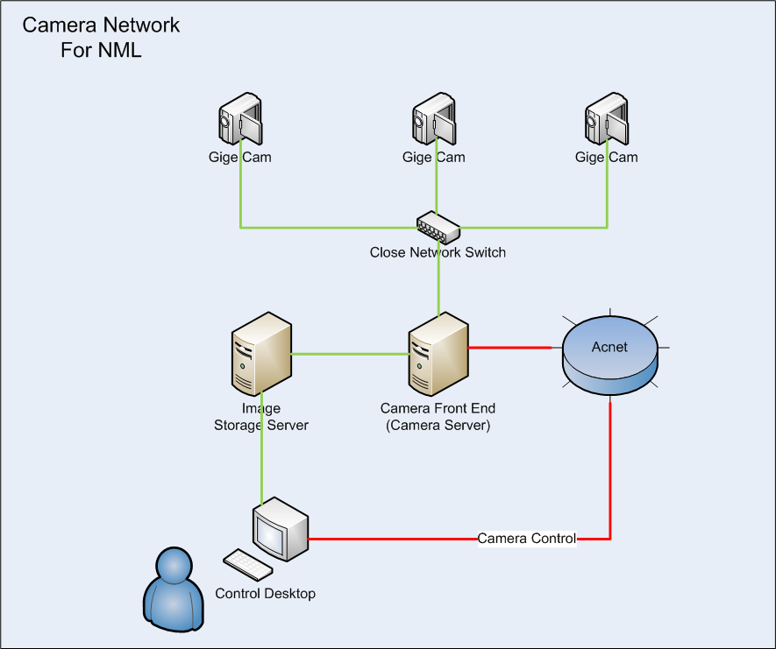
Proposed Camera network in Detail

Slide 4
Components
Switch
Cisco Catalyst 2960 G Switch
Connectivity
24 or 48 ports of Gigabit Ethernet desktop connectivity
Industry first PoE+ with up to 30W per port to support the latest PoE+ capable devices
Optional four 1 Gigabit Ethernet SFP or two 10 Gigabit Ethernet SFP+ Uplinks
Camera Server PC
Dell Precision T3400
Dual Ethernet cards
Connect to both control network and camera network

Slide 5
Camera Front End
Area Detector – Developed by CAR9 at U of C
An extended module on top of EPICS system
Provide a standard interface defining the functions and parameters that a detector driver must support.
Provide a set of base EPICS records that will be present for every detector using this module. This allows the use of generic EPICS clients for displaying images and controlling cameras and detectors.
Allow easy extensibility to take advantage of detector-specific features beyond the standard parameters. Have high-performance.
Applications can be written to get the detector image data through EPICS, but an interface is also available to receive the detector data at a lower-level for very high performance.
Provide a mechanism for device-independent real-time data analysis such as regions-of-interest and statistics.

Slide 6
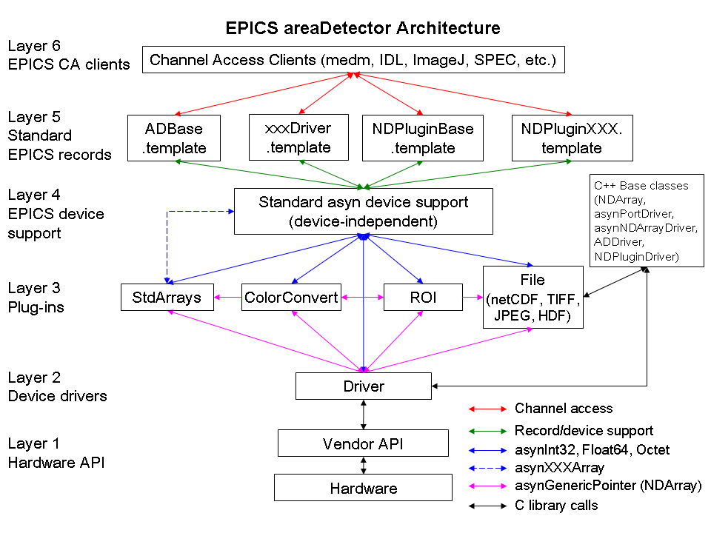
Camera Front End –cont.
Layer 7 Acnet to EPICS Interface
Acnet Clients (EDM, Image J)
Very Problematic
Vendor’s Linux Driver

Slide 7
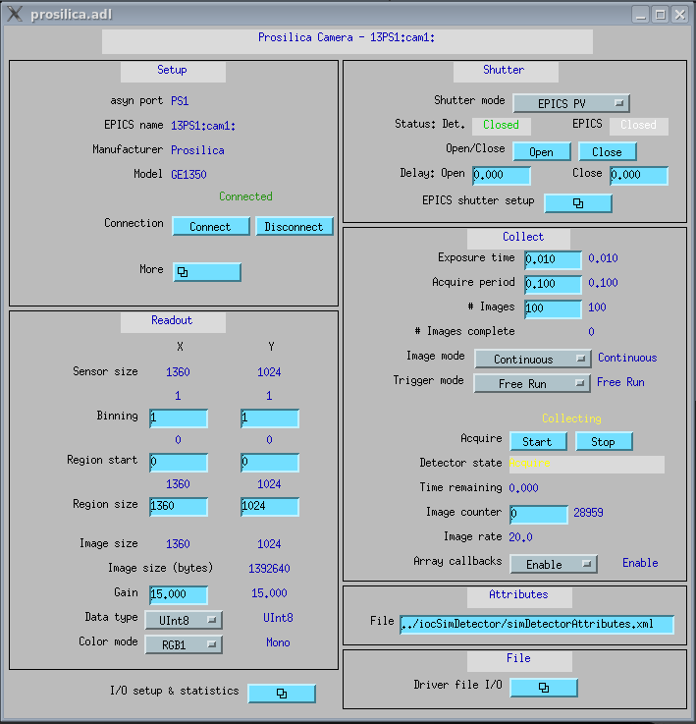
Camera Main Control
Notes:
#Images
Image mode:
Single
Multiple
Continuous
Trigger Mode:
Free Run & Sync Trigger

Slide 8
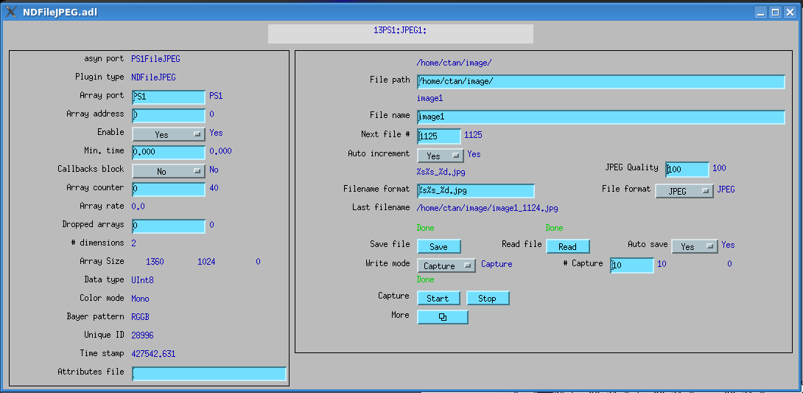
Image Acquisition
Notes:
File Path
File Name Format
Write Mode:
Capture – Writing to computer buffer first, not saved until push “Save”
Single – Capture a single file
Stream – Capture and save the number of file defined in # of capture

Slide 9
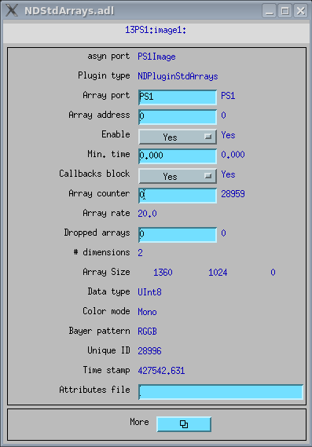
Image Viewer – Image J (Java based)
Notes:
EPICS end configuration
AreaDetector created a plug in for Image J

Slide 10
DEMO
Start and stop
Single, Continuous, Stream
Image J viewer launch from apc-con01.fnal.gov
Can’t dump image to clx system right…
At 20 Hz (free run)
1.3 MB X 20 per second = 26 MB per second
1 min consume = 1560 MB = 1.5 GB
30 min lunch without shutting off the image acquisition will cost 46.8 GB.
At 5 Hz
1.3 X 5 = 6.5 MB per second
1 min consume = 390 MB
30 min lunch without shutting off the image acquisition will cost 11.7 GB
Notes:
Start and stop
Single, Continuous, Stream
Image J viewer launch from apc-con01
Can’t dump image to clx system right…
1.3 MB X 20 per second = 26 MB per second
1 min consume = 1560 MB = 1.5 GB
At 5 Hz
1.3 X 5 = 6.5 MB per second
1 min consume =

Slide 11
Major Problems
EPICS Getaway
BUSY module (allows CA clients to indicate completion in a way that works with EPICS putNotify/ca_put_callback mechanism) -- the CA gateway converts ca_put() into a ca_put_callback() to the IOC
“.. for most records the ca_put_callback() will complete almost immediately and you won't notice the difference. However the busy record type is deliberately designed to not report completion until all of the underlying operations kicked off by your put have completed, and in your case that probably means until the camera's exposure has completed, which I'm guessing is taking longer than the default 1 second time-out that caput() waits for the CA operation to complete..”
Workaround
Go through non-gatewayed path (disabled a lot other features that need use BUSY)
Proposed Solutions
Upgrade Fermi lab EPICS version to 3.14.11 that supports latest BUSY module.

Slide 12
Major Problems
MEDM
Lab only support EDM
MEDM to EDM convector tool is not bullet proof
Storage
What is the best mechanize for image retriever?
Storage space?

Slide 13
Future Action
Camera
Resolve compatibility issues between EPICS and Acnet
Ensure all EDMs running from CLX system
Deploy 2nd camera to the network and analysis the network traffic
Move existing camera setting to A0 south cave
Obtain images, use MatLab to determine the image quality
Define the constraints for camera use.
Rules for how operator should use the camera
Image limits, concurrency limits, continuous run limits

