Slide 1
Cold BPM development in KEK
H. Hayano, March 2011
Jung Keun Ahn (PNU), Sun young Ryu (PNU),
Eun San Kim (KNU), Young Im Kim (KNU), Jin yeong Ryu (KNU),
Hitoshi Hayano (KEK)

Slide 2
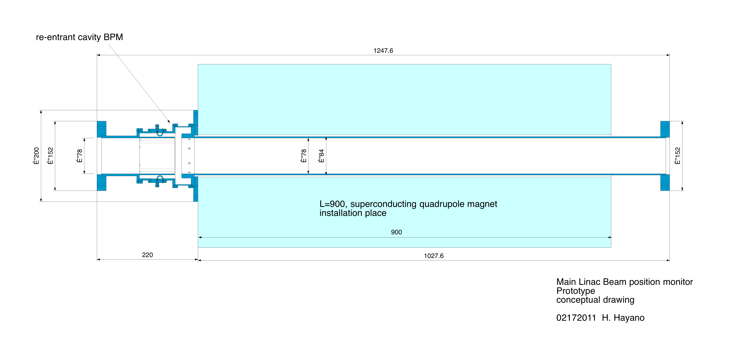
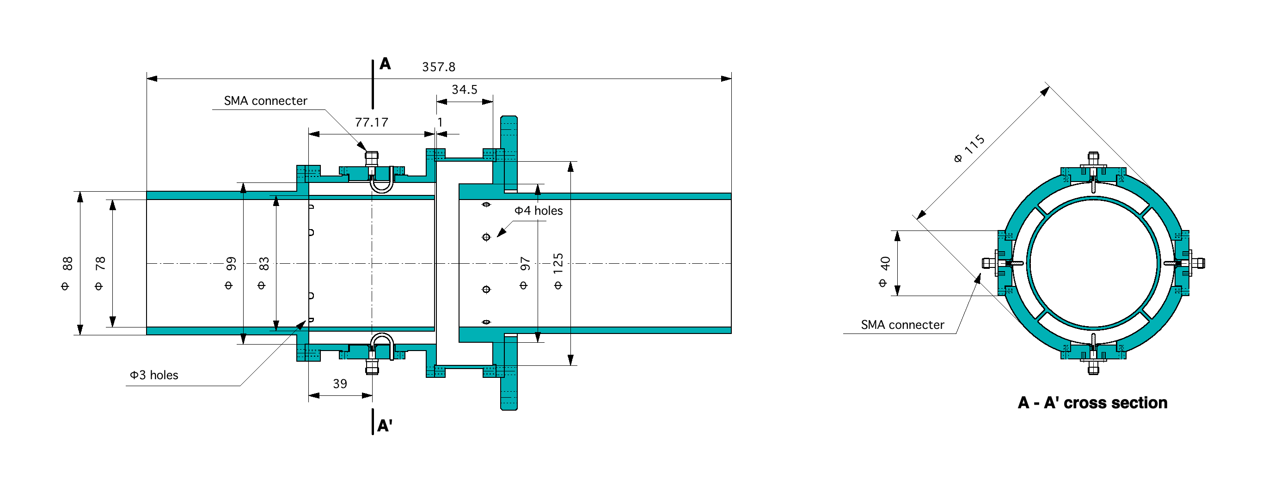
STF cold-BPM for phase-2 cryomodule
4-way cylindrical coupling wave-guide
4-way cylindrical coupling wave-guide
Re-entrant type cavity BPM

Slide 3
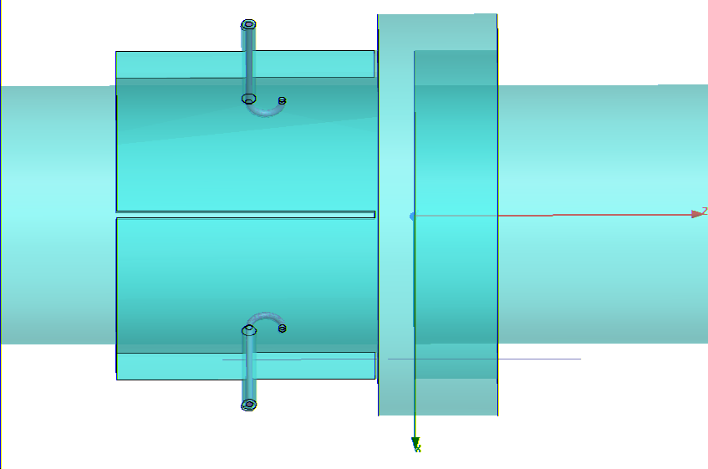
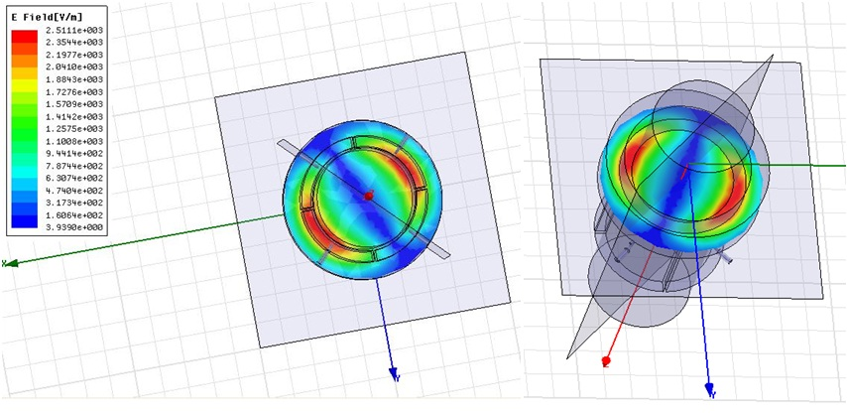
re-entrant cavity + coupling waveguide structure
115mm
Modification from Saclay re-entrant BPM
(2) common-mode rejection by coupling WG
(3) More compact than cylindrical cavity BPM
(4) HPR washable simple structure
(5) ø78mm big beam pipe
(6) < 1µm resolution for each bunch in the train
(7) low-Q value for less interference between bunch
Φ78mm
Port1 to Port3
Frequency: 2.049 GHz
QL : 205
β : 0.635
isolation to other port : -27dB
Eigen-mode of re-entrant cavity: dipole mode
Frequency selection :
Avoid dark current freq. , Avoid cavity HOM freq.
Appropriate freq for re-entrant structure.

Slide 4
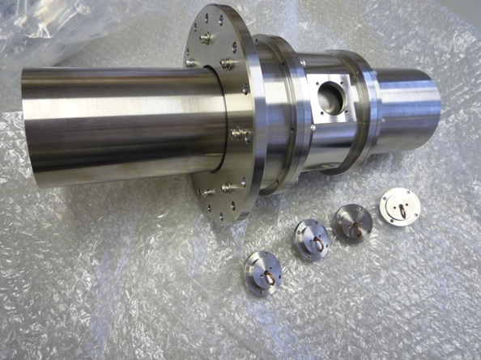
Prototype-BPM : building block type (non-vacuum tight)
Material: SUS

Slide 5
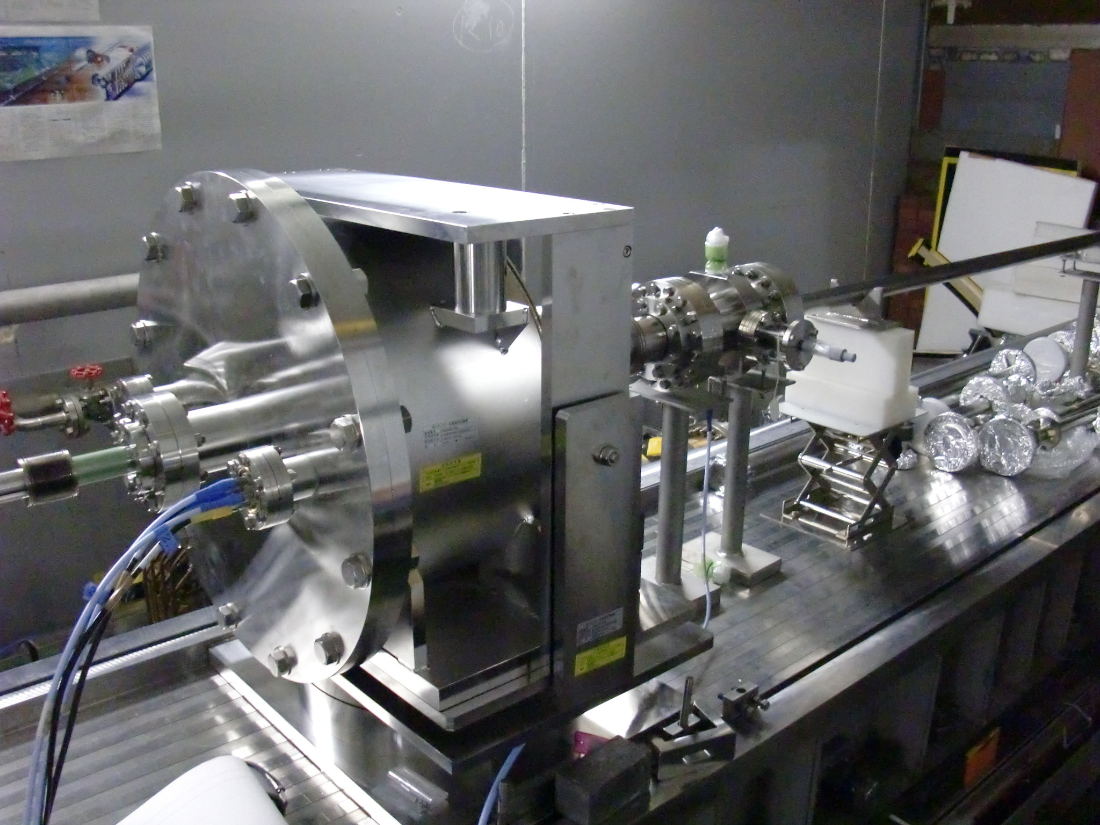
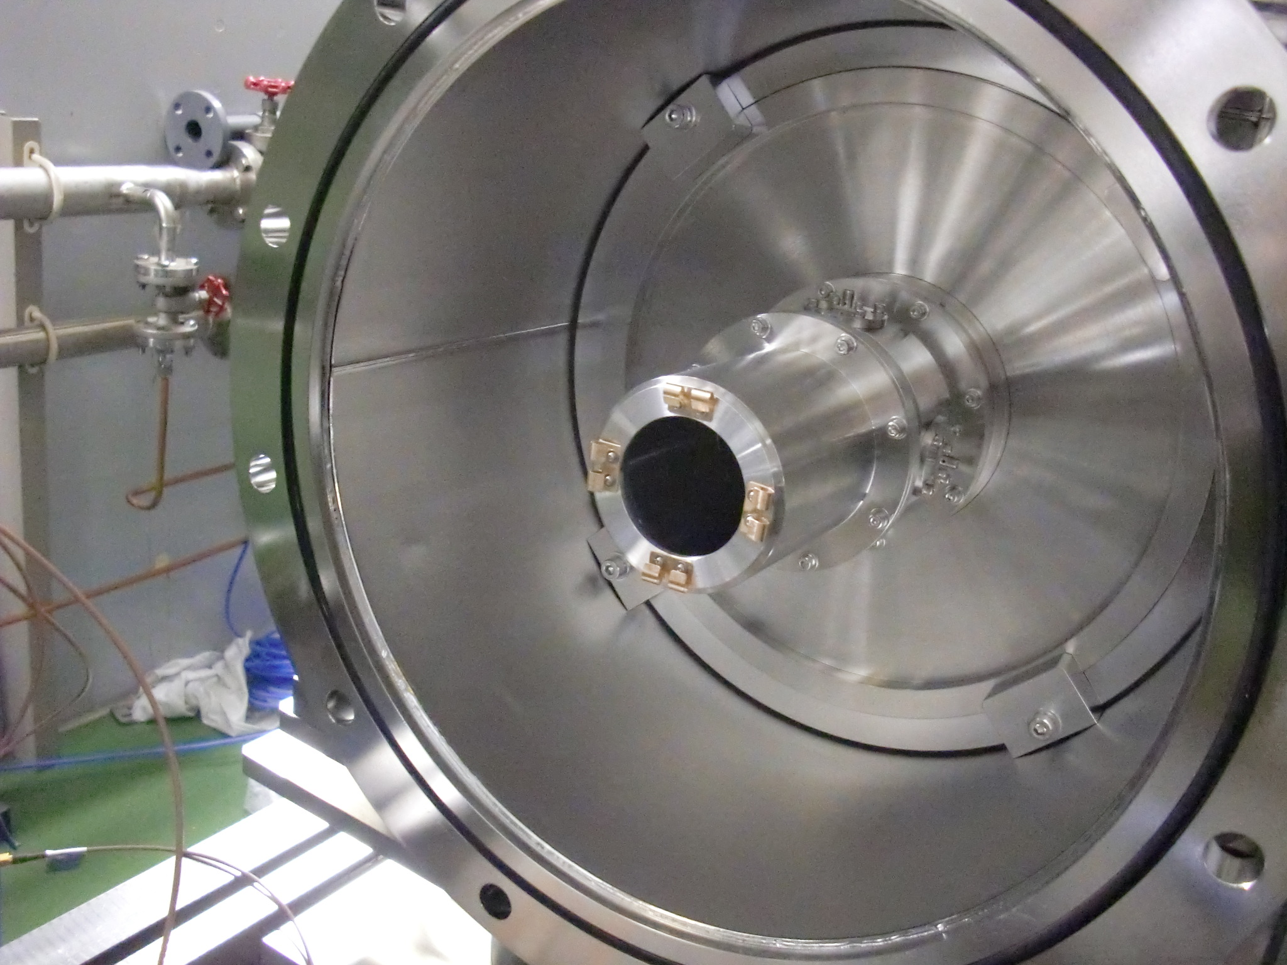
Beam test set-up in ATF Linac
Reference cavity
Proto-type BPM installed
in the vacuum chamber housing
Vacuum chamber housing
with tilt and yaw angle adjuster
Signal cables

Slide 6
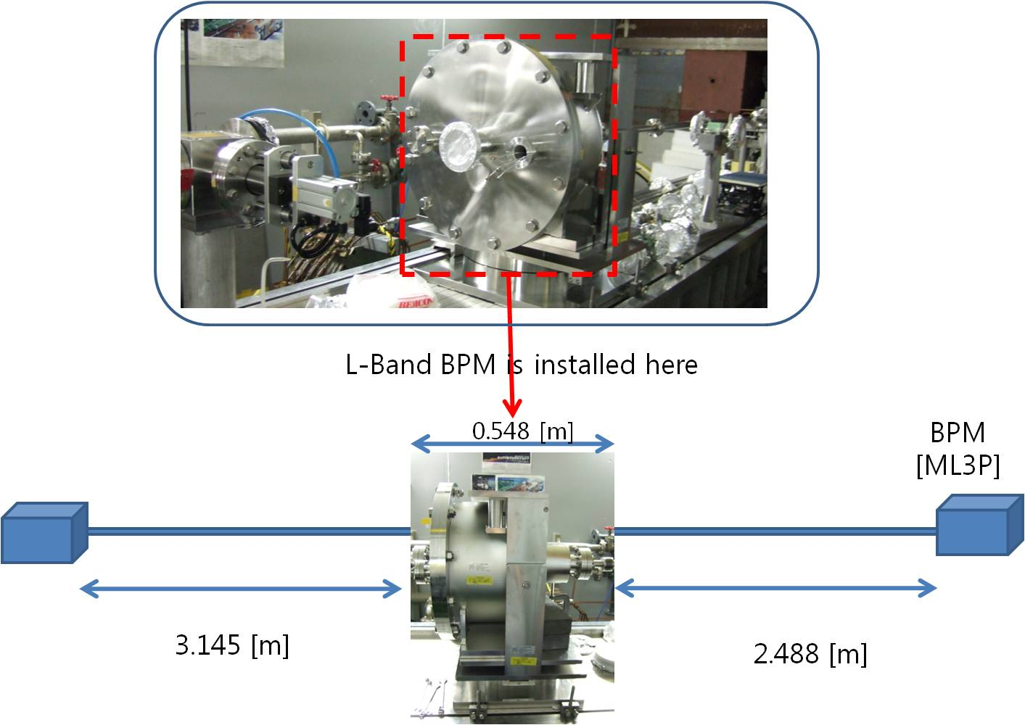
Beam test set-up using two strip-line BPM
Upstream
Strip-line BPM
Downstream
Strip-line BPM

Slide 7
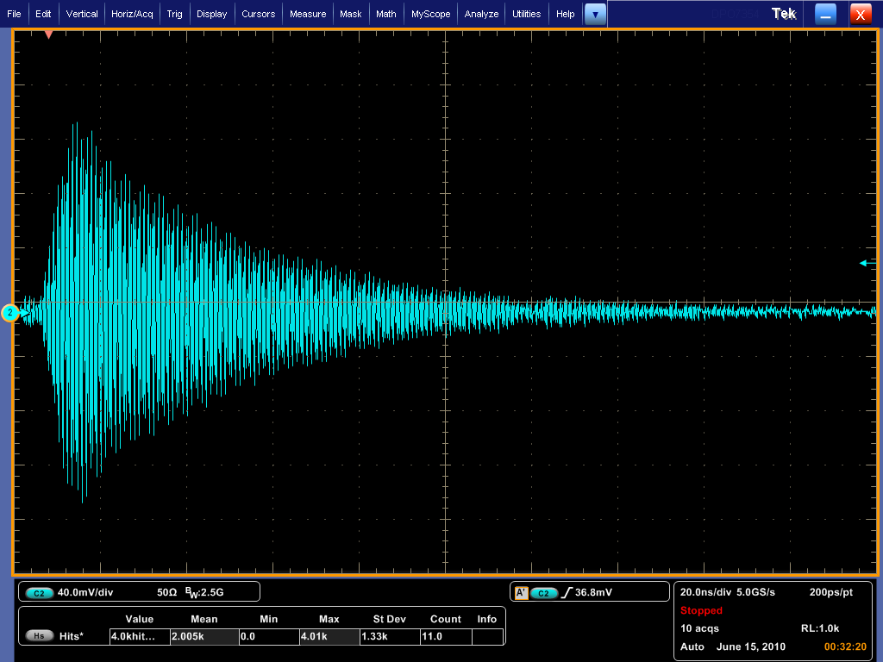
Dipole signal from re-entrant BPM with Band-pass-filter
2.04 GHz signal with beam intensity 0.5x10¹⁰ electrons/bunch
dipole mode: 2.04GHz signal
in 200ns full span
signal is well damped
after 300ns next bunch position

Slide 8
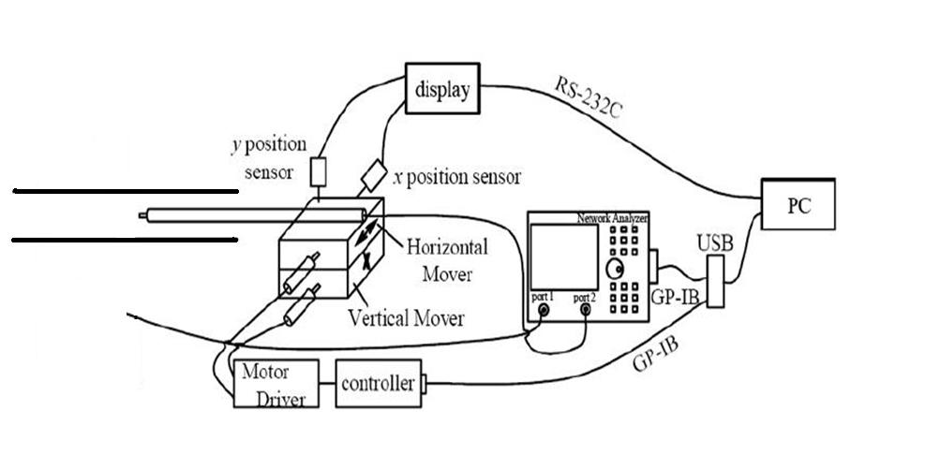
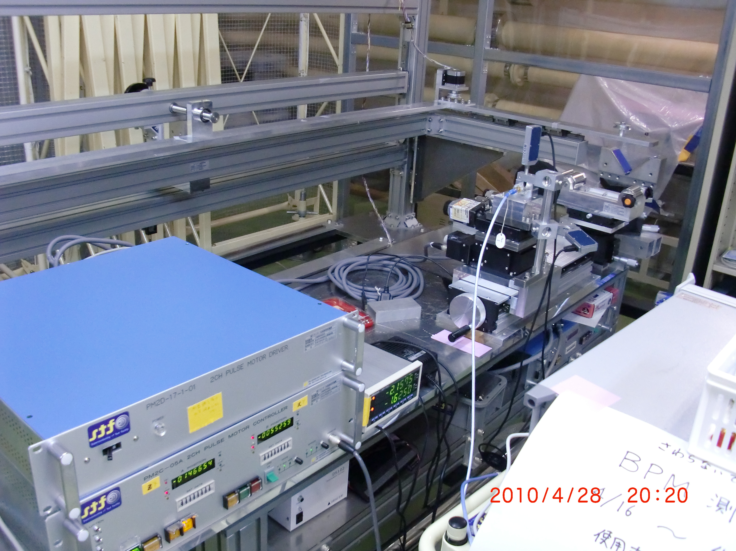
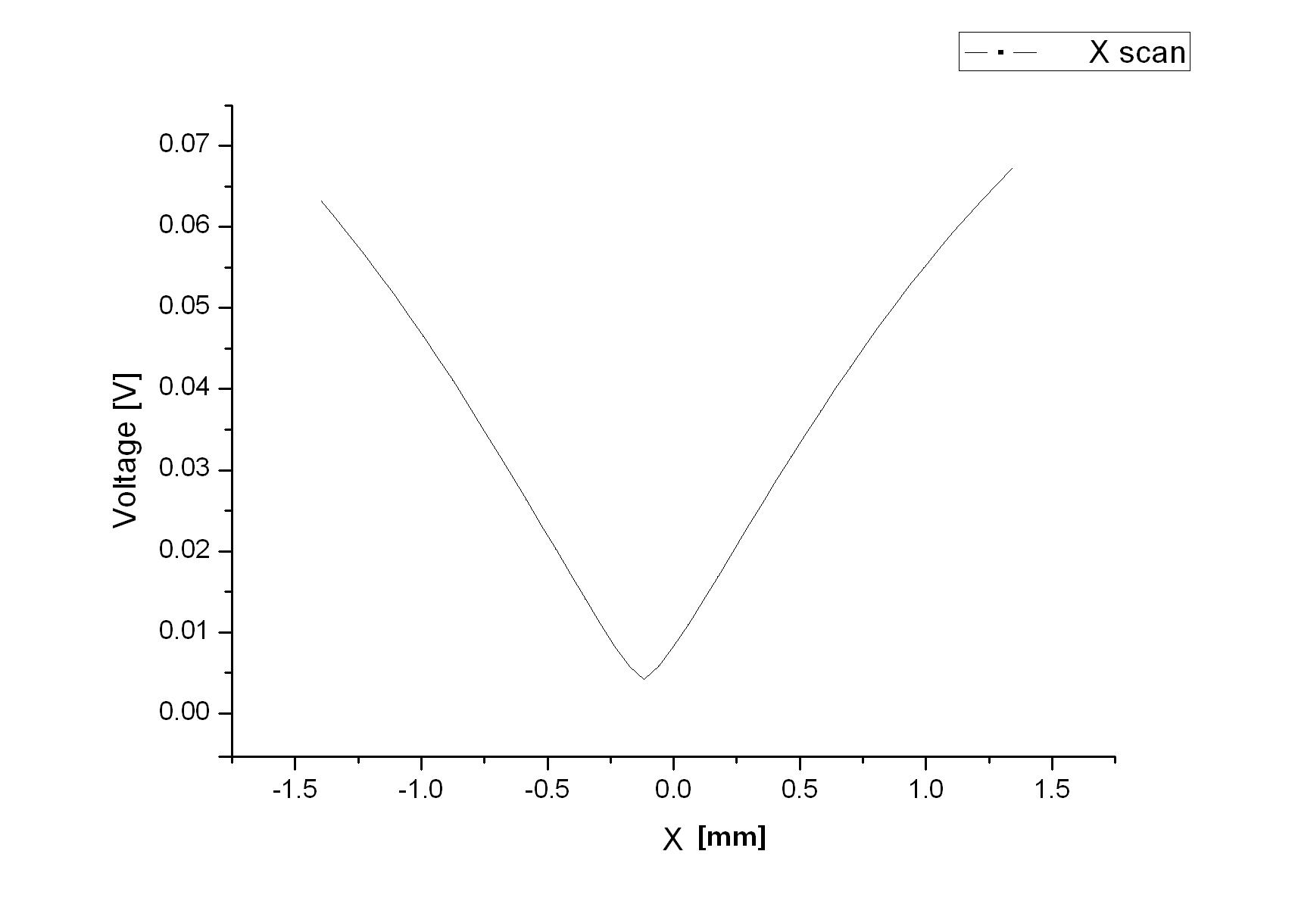
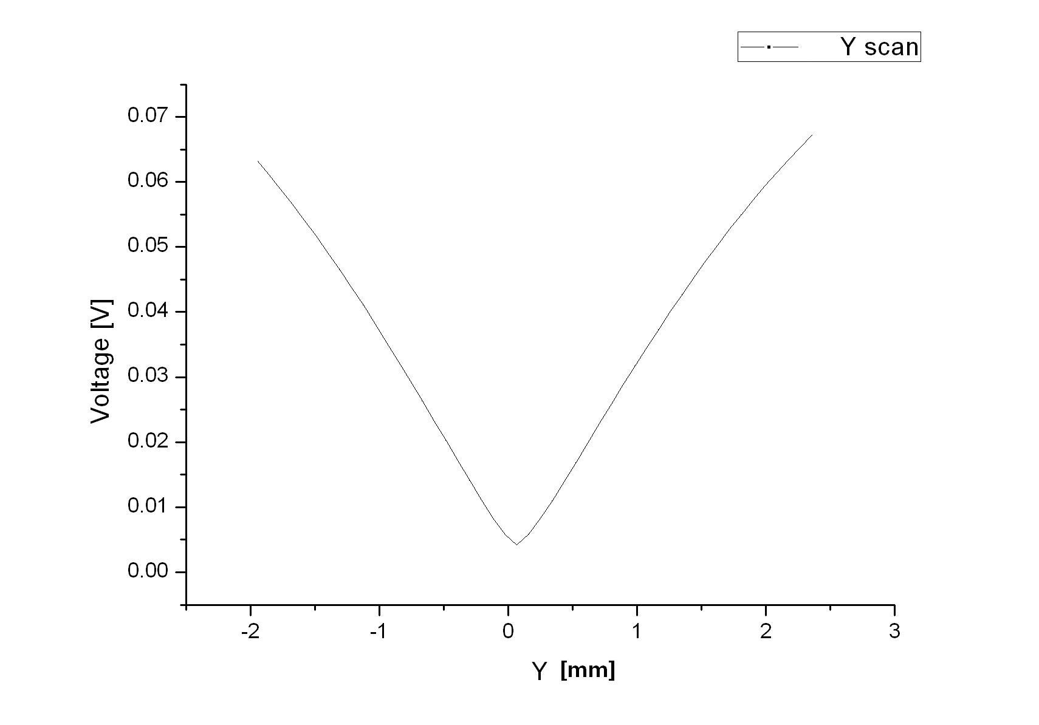
Antenna scan for electrical center confirmation
X-scan
Y-scan
-120µm
+82µm

Slide 9
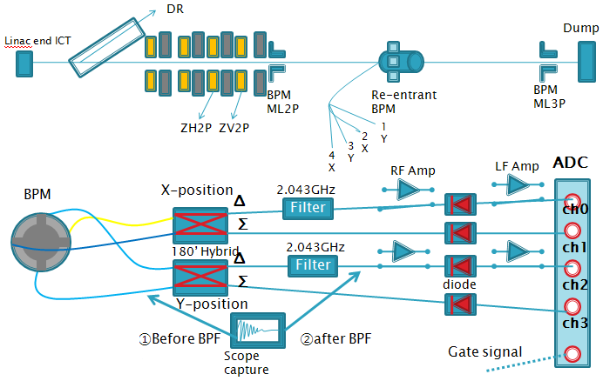
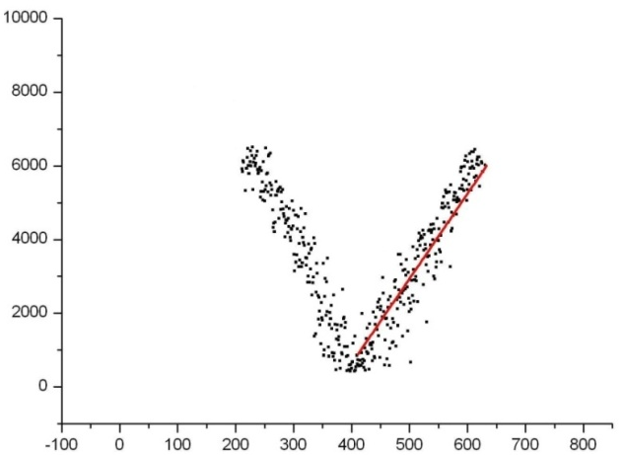
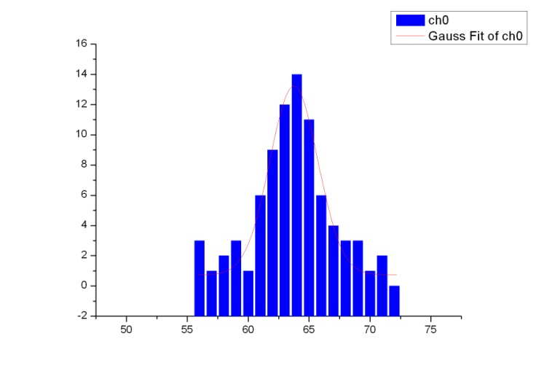
Simple analog signal detection for resolution measurement
Setup: Hybrid , BPF, RF Amplifier, diode, ADC
1.96/5.33=0.36µm resolution
at 1x10¹⁰ beam intensity
2.04GHz detected signal [ADC count]
Pedestal noise
Slope=5.33 ADC-count/µm
σ = 1.96 count
Estimated beam X position from strip-line BPM [µm]

Slide 10
Summary of re-entrant BPM development
(1) Re-entrant cavity BPM + cylindrical coupling wave-guide pickup was designed by HFSS.
(2) Proto-type (building-block type) BPM was fabricated by stainless-steel.
(3) Antenna scan was done to confirm small electrical center offset from mechanical center.
(4) ATF beam test was done using simple electronics setup,
and confirmed good position resolution less than 1µm and small common-mode mixture.
(5) Phase detection relative to the reference cavity signal was also tried.
The results are still under analysis.
Future Plan
(1) Vacuum tight proto-type is under design and start fabrication.
(2) Cool-down test and beam test at ATF are planned.
(3) Installation into STF phase-2 CM1 in fall 2012, is a primary target.

