Slide 1
Results from 9mA studies on achieving flat gradients with beam loading
P_{K} |Q_{L} studies at FLASH
during the Feb. 2011 test in DESY
J. Branlard ALCPG11 – 19-23 March 2011 – Eugene OR, USA
Notes:
Present results obtained during FLASH 9mA run last February

Slide 2
OVERVIEW
Problem statement and historical background
  Why do we care about individual flat gradients?
  What solutions were offered to achieve flat gradients with beam loading?
  What can we actually implement at FLASH?
The Feb.’11 study at FLASH
  What approach have we followed during the FLASH test studies?
  Results of the P_{K} |Q_{L} studies
Conclusions and lessons learnt
  Study insights
  Approach limitations
  Improvements
Notes:
Historical background, presentation of study goals and recap of proposed solutions
Study achievements and results
Conclusions and improvements

Slide 3
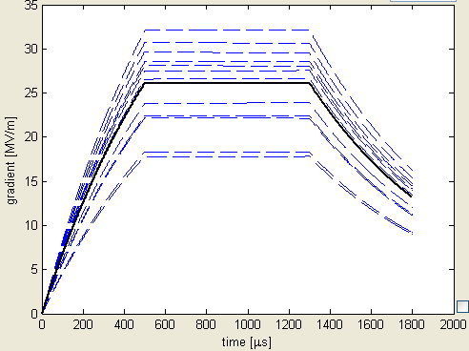
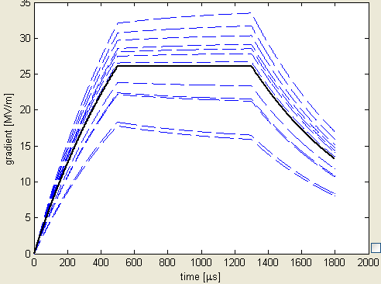
Introduction: problem statement
Why do we care about individual flat gradients?
“Effect of Cavity Tilt and RF Fluctuations to Transverse Beam Orbit Change in ILC Main Linac”
K. Kubo, Jan. 2010
FLASH ACC6 & ACC7
all Q_{L} ≈ 3x10⁶
no beam
no tilts
all Q_{L} ≈ 3x10⁶
I_{b} = 3 mA
tilts +/- 2MV/m
+/- 10 %
Notes:
Default FLASH setup, all same Ql’s results in tilts as beam current increases
Individual tilts are an issue for cavity alignment because result in transverse beam kick
Goal of study is to flatten individual tilts, and maintain VS

Slide 4
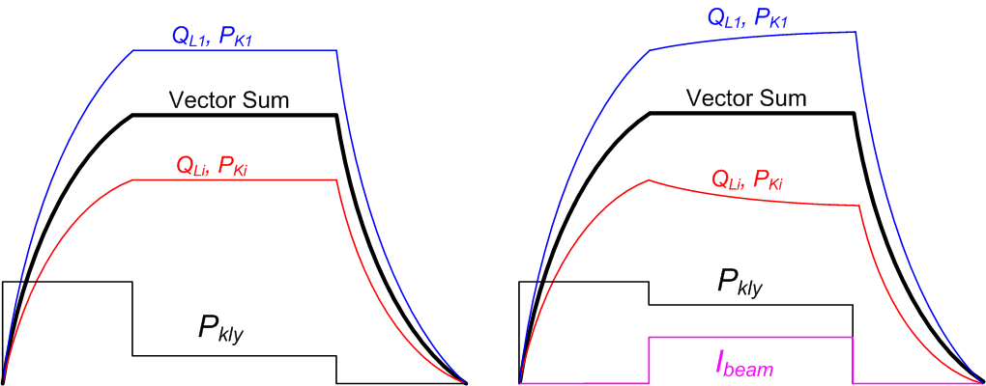
Introduction: problem statement
FNAL approach to cavity quench due to beam ON/OFF operations
“Optimal Coupler and Power Settings for Superconductive Linear Accelerators”, J. Branlard, B. Chase, Linac 2008
produces fixed P_{K}/Q_{L} settings (unique to each cavity) which is safe for all beam loadings
(i.e. no tuning action required to prevent quench)
individual cavities gradients have tilts with beam
Beam OFF
Beam ON
Notes:
Fermilab approach on preventing cavity quenches but not on keeping gradient flats → not the FLASH study goal

Slide 5
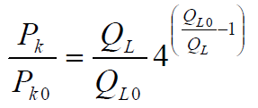
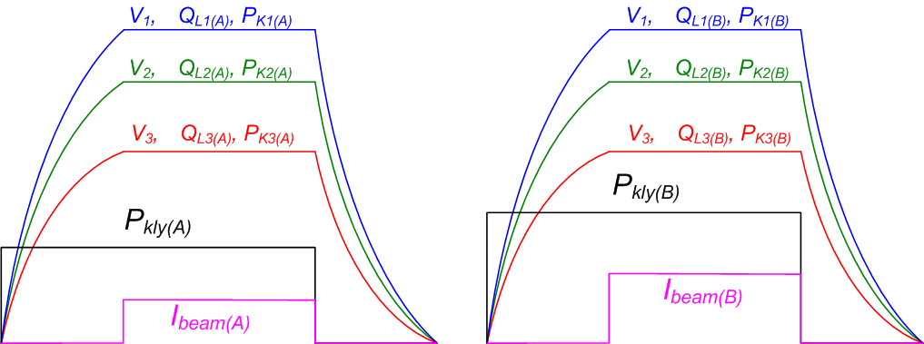
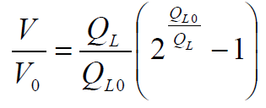
Introduction: problem statement
Published “solutions” to flat cavity gradient with beam
“RF Distribution Optimization in the Main Linacs of the ILC”
Bane, Adolphsen, Nantista - WEPMS037.pdf, 2007
    → Assumes a square forward power pulse
    → Assumes adjustable P_{K}’s
Notes:
There is an analytical solution to flattening all gradients, but requires Ql and Pk adjustements

Slide 6
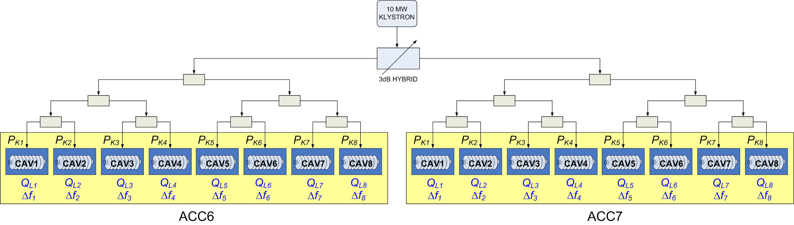
Introduction: problem statement
Problem space at FLASH
→ Focus on ACC6 and ACC7
→ Motorized couplers (Q_{L} adjustments, limited range)
→ Fixed power distribution (i.e. P_{K}), except for 3dB hybrid
Motorized static tuners
Dynamic cavity resonance control with piezo
Notes:
But at FLASH, Pk’s distribution is fixed (focus only on ACC6 and ACC7 which have motorized Ql and motorized frequency tuners (slow and fast)

Slide 7
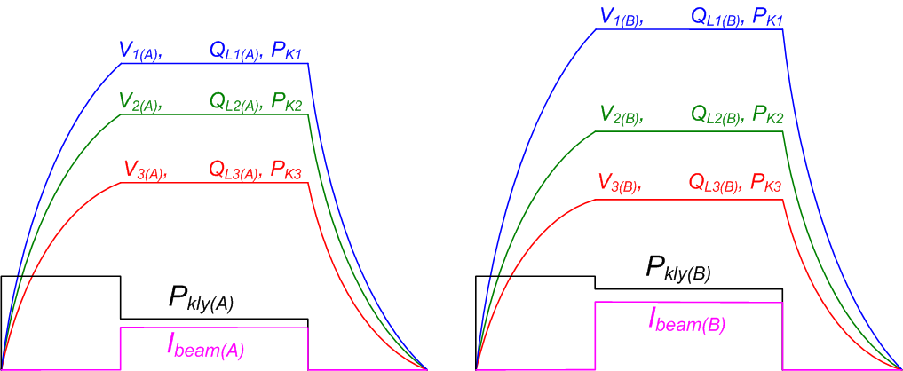
Introduction: problem statement
Published “solutions” to flat cavity gradient with beam
“PkQl-like control for ACC6/7 at FLASH” PkQl_FLASHver3.docx Shin Michizono, Sept. 2010
  “To flatten the cavity gradient for ACC6/7” FLASH101022BV2.pdf Shin Michizono, Nov. 2010
    solves the same problem but using existing P_{K} distribution
    no PK adjustments for different beam loading, only Q_{L} changes
    version1: assumes a square forward power pulse
    yield very low Q_{L} values
    version2: assumes a fill time / flat top power step
    yield Q_{L} values within acceptable range
Notes:
KEK proposed to solve flat gradient with fixed Pk’s → produces Qls in the limit of tuning range as beam current increases
The solution chosen to be implemented for the study

Slide 8
Introduction: problem statement
Published “solutions” to flat cavity gradient with beam
“PkQl-like control for ACC6/7 at FLASH” PkQl_FLASHver3.docx Shin Michizono, Sept. 2010
  “To flatten the cavity gradient for ACC6/7” FLASH101022BV2.pdf Shin Michizono, Nov. 2010
    solves the same problem but using existing P_{K} distribution
    no PK adjustments for different beam loading, only Q_{L} changes
    version1: assumes a square forward power pulse
    yield very low Q_{L} values
    version2: assumes a fill time / flat top power step
    yield Q_{L} values within acceptable range
Notes:
What changes between 2 beam currents (left and rigth) : Ql’s and V’s but VS remains constant because of FB: note Pks are kept constant

Slide 9
FLASH studies: 5 shift overview
Friday 2/4 night shift: no beam, low gradient
  no beam
  ACC6/7 vector sum calibration 100 bunches, 1 MHz, 1.6 nC
  QL tuners characterization for ACC6/7
  simulator calibration to reflect ACC6/7 power distribution
Saturday 2/5 night shift: 1 mA , low gradient
  1mA beam, low gradient (100 MeV – 200 MeV)
  Successfully implemented QL adjustments to flatten cavity gradients
  beam loading tilts correction (all tilts below 1%) using simulator predicted values
  Simulated values are reliable
Sunday 2/6 night shift: 1.6 mA , mid-gradient
  1.6mA beam, low gradient (200 MeV)
  low gradient, beam loading tilts Q_{L} correction (below 1%)
  beam current scan
  QL scan
Monday 2/7 night shift: 3.0 mA - 4.5 mA, mid and high gradient
  3.0mA beam, 200 MeV
  QL adjusted for gradient flat at 3mA
  beam scan from 0.9 to 4.5 mA
  4.5mA beam, 300 MeV
  QL adjusted for gradient flat at 4.5 mA
  beam current scan
Tuesday 2/8 afternoon shift: 4.2 mA, highest gradient
  4.2mA beam, 360 MeV
  Lorentz force detuning compensation
  Use calculator to predict QL → gives very accurate prediction
  Flatten ACC6/7 gradients tilts to ~ 1.5%
  beam current scan
Notes:
Summary of 5 shifts dedicated to this specific problem (Pk/Ql), no beam, then low beam at low gradient, then high beam at high gradient

Slide 10
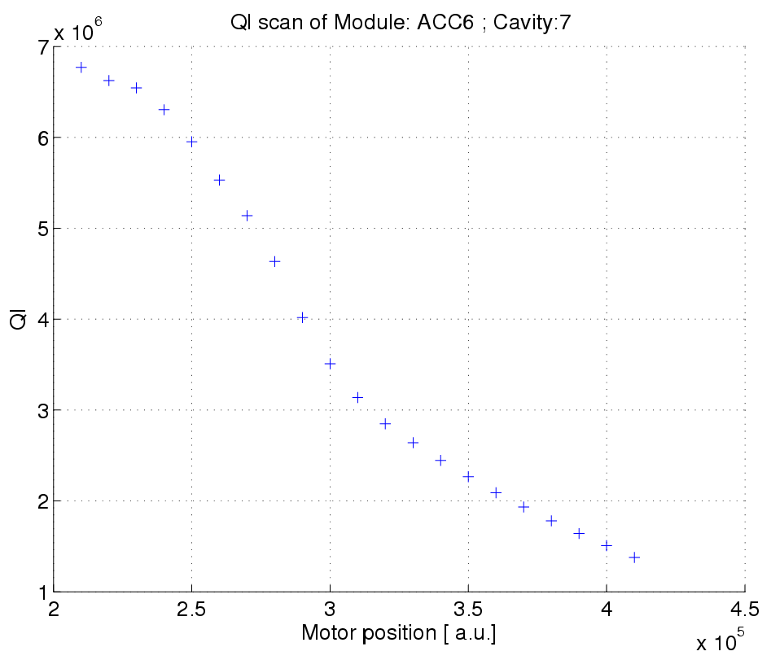
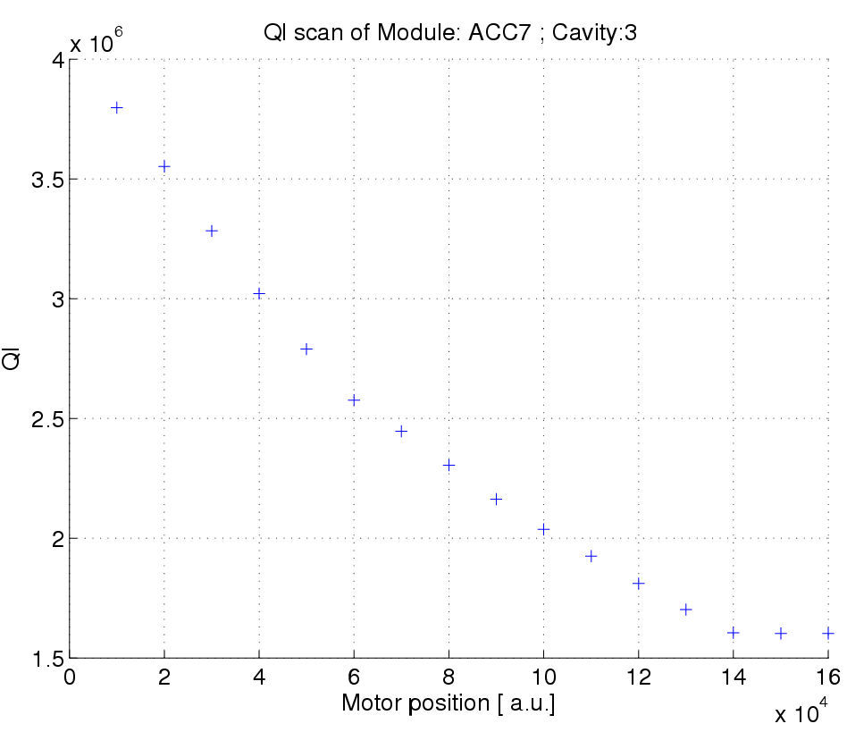
ACC6 & ACC7 Q_{L} settings limits
ACC6 | cav1 | cav2 | cav3 | cav4 | cav5 | cav6 | cav7 | cav8
Q_{L} min [x10⁶] | 1.2 | 1 | 1.2 | 1 | 1.5 | 1.5 | 1.5 | 1
Q_{L} max [x10⁶] | 7 | 5 | 7.5 | 5.5 | 8.5 | 7.5 | 6.5 | 4
not “hard” limits
ACC7 | cav1 | cav2 | cav3 | cav4 | cav5 | cav6 | cav7 | cav8
Q_{L} min [x10⁶] | 1.1 | 1.8 | 1.6 | 1.3 | 1.1 | 1.4 | 1.7 | 2.1
Q_{L} max [x10⁶] | 3.4 | 3.8 | 3.7 | 3.6 | 3.3 | 3.3 | 3.3 | 4.6
Notes:
First shift: assess ranges of Ql.
Low limit is around 1e6,
high limit is lower for ACC7 than ACC6 (not a hard limit on this plot, limitation in the automated measurement technique)

Slide 11
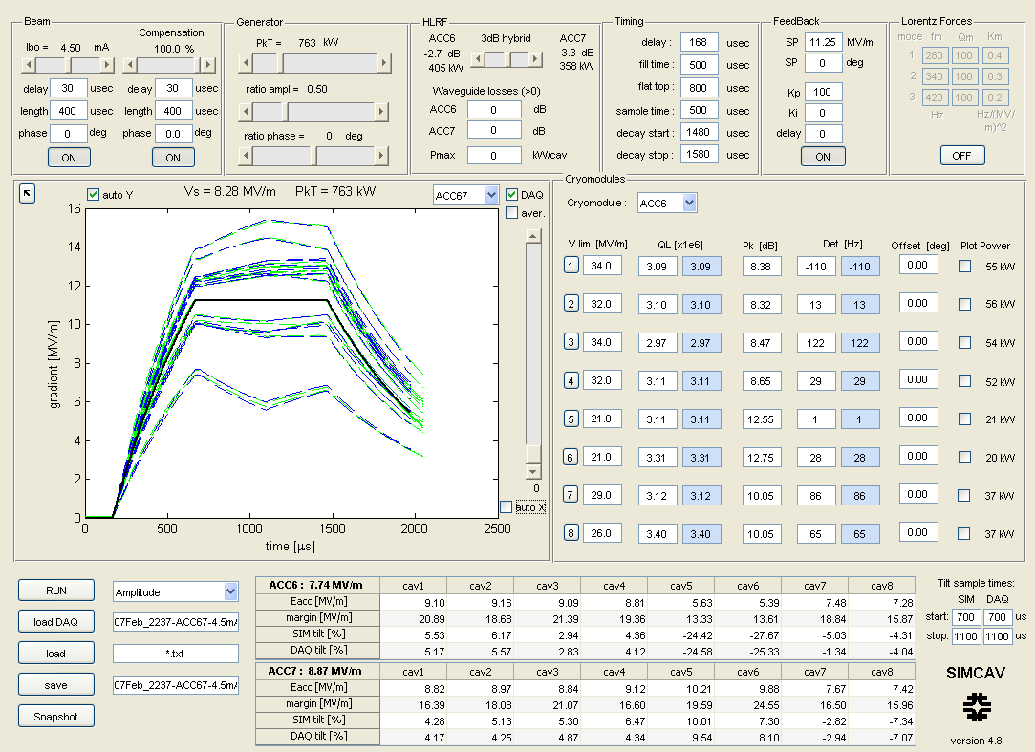
Fermilab Beams Doc database: Beams-doc-3794
Notes:
Made use of a 16 cavity simulator (requires MATLAB, available for download)
Includes beam compensation, prop and integr. FB, static and dynamic LFD, QL and Pk adjustments, loads FLASH data from DAQ

Slide 12
Fermilab Beams Doc database: Beams-doc-3794
Notes:
Beam loading adjustments
QL and detuning measurements of experimental data and plug in into simulator

Slide 13
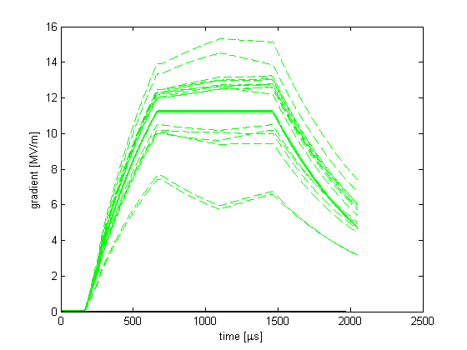
Calibration procedure
DAQ data: Feb. 07 2011, 22:37
Load V_{cav} from DAQ
Compute actual Q_{L} , P_{K} and Δ_{f} from DAQ data
Type in Q_{L}, P_{K} and Δ_{f} into simulator
Check agreement between simulated and FLASH data
Adjust Q_{L} in simulator to flatten tilts
Implement Q_{L} corrections in FLASH
Check gradient flatness
FLASH DAQ data
(retune cavities if needed)
I_{b} = 4.5 mA
Notes:
How did we proceed to flatten individual cavity gradients: knobs we used are: adjusting QLs and setting cavity on resonance
Step 1: load DAQ data, decay measurement

Slide 14
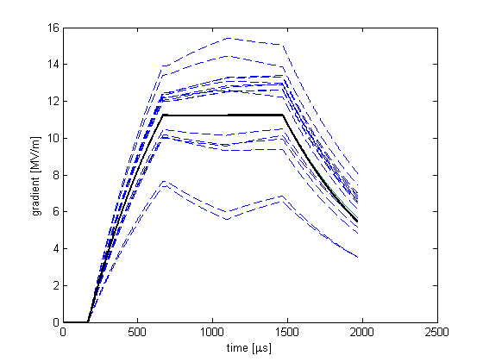
Calibration procedure
Load V_{cav} from DAQ
Compute actual Q_{L} , P_{K} and Δ_{f} from DAQ data
Type in Q_{L}, P_{K} and Δ_{f} into simulator
Check agreement between simulated and FLASH data
Adjust Q_{L} in simulator to flatten tilts
Implement Q_{L} corrections in FLASH
Check gradient flatness
simulated data
vector sum
(retune cavities if needed)
Notes:
Step 2: simulate

Slide 15
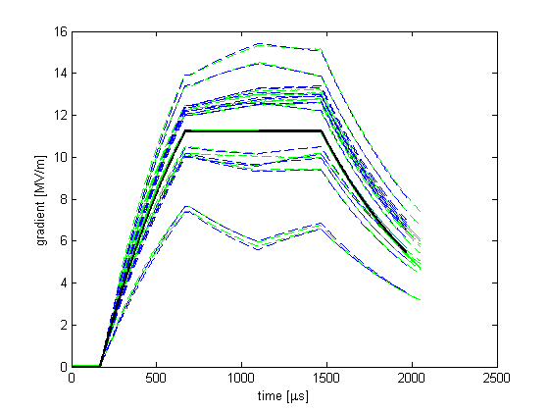
Calibration procedure
Load V_{cav} from DAQ
Compute actual Q_{L} , P_{K} and Δ_{f} from DAQ data
Type in Q_{L}, P_{K} and Δ_{f} into simulator
Check agreement between simulated and FLASH data
Adjust Q_{L} in simulator to flatten tilts
Implement Q_{L} corrections in FLASH
Check gradient flatness
FLASH DAQ data
simulated data
vector sum
(retune cavities if needed)
Notes:
Check agreement between simulation and experimental data

Slide 16
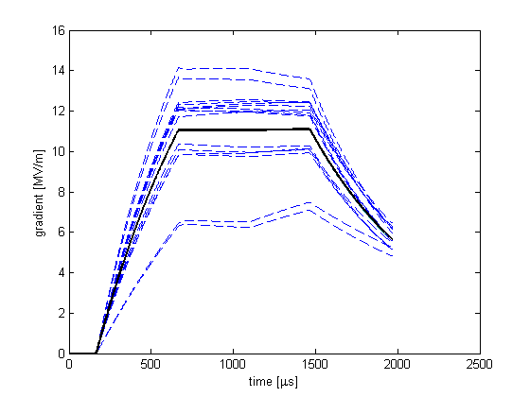
Calibration procedure
Load V_{cav} from DAQ
Compute actual Q_{L} , P_{K} and Δ_{f} from DAQ data
Type in Q_{L}, P_{K} and Δ_{f} into simulator
Check agreement between simulated and FLASH data
Adjust Q_{L} in simulator to flatten tilts
Implement Q_{L} corrections in FLASH
Check gradient flatness
simulated data
vector sum
(retune cavities if needed)
Notes:
Adjust QL using simulator “by eye”

Slide 17
Calibration procedure
Load V_{cav} from DAQ
Compute actual Q_{L} , P_{K} and Δ_{f} from DAQ data
Type in Q_{L}, P_{K} and Δ_{f} into simulator
Check agreement between simulated and FLASH data
Adjust Q_{L} in simulator to flatten tilts
Implement Q_{L} corrections in FLASH
Check gradient flatness
simulated data
vector sum
(retune cavities if needed)
Notes:
Note that while adjusting the QL flattens cavity gradients during beam time, it also introduces a tilt when beam is OFF

Slide 18
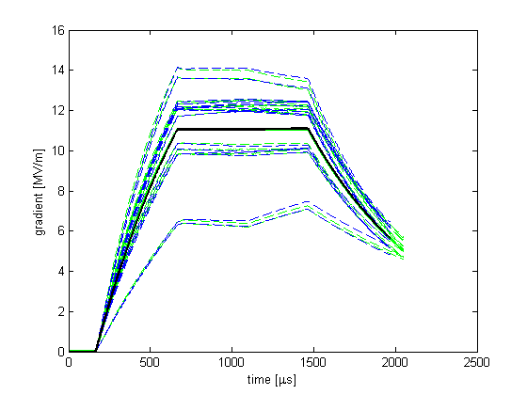
Calibration procedure
Load V_{cav} from DAQ
Compute actual Q_{L} , P_{K} and Δ_{f} from DAQ data
Type in Q_{L}, P_{K} and Δ_{f} into simulator
Check agreement between simulated and FLASH data
Adjust Q_{L} in simulator to flatten tilts
Implement Q_{L} corrections in FLASH
Check gradient flatness
FLASH DAQ data
simulated data
vector sum
(retune cavities if needed)
Notes:
Verify benefits (in tilts) of the Ql change (retune cavity after QL adjustments)

Slide 19
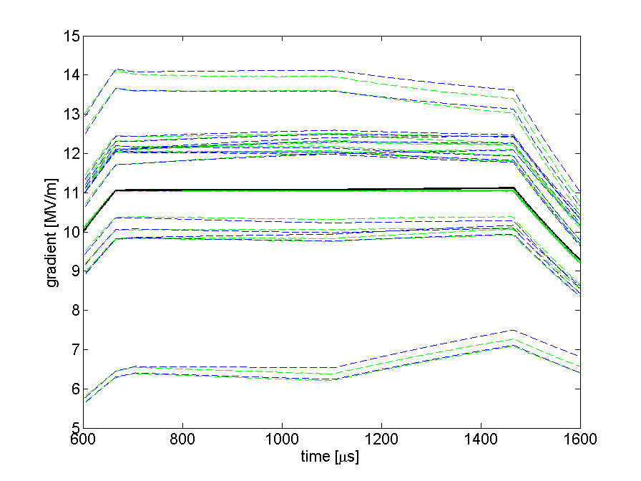
Calibration procedure
Load V_{cav} from DAQ
Compute actual Q_{L} , P_{K} and Δ_{f} from DAQ data
Type in Q_{L}, P_{K} and Δ_{f} into simulator
Check agreement between simulated and FLASH data
Adjust Q_{L} in simulator to flatten tilts
Implement Q_{L} corrections in FLASH
Check gradient flatness
FLASH DAQ data
simulated data
vector sum
(retune cavities if needed)
Notes:
Close up on simulation vs. experiment data: discrepancies are due to:
Inaccuracy in assessing power distribution
Inaccuracy in the Ql estimate “by eye”
Inaccuracy in setting up the Ql (settings + measurement)
Inaccuracy in cavity tuning (static + dynamic)

Slide 20
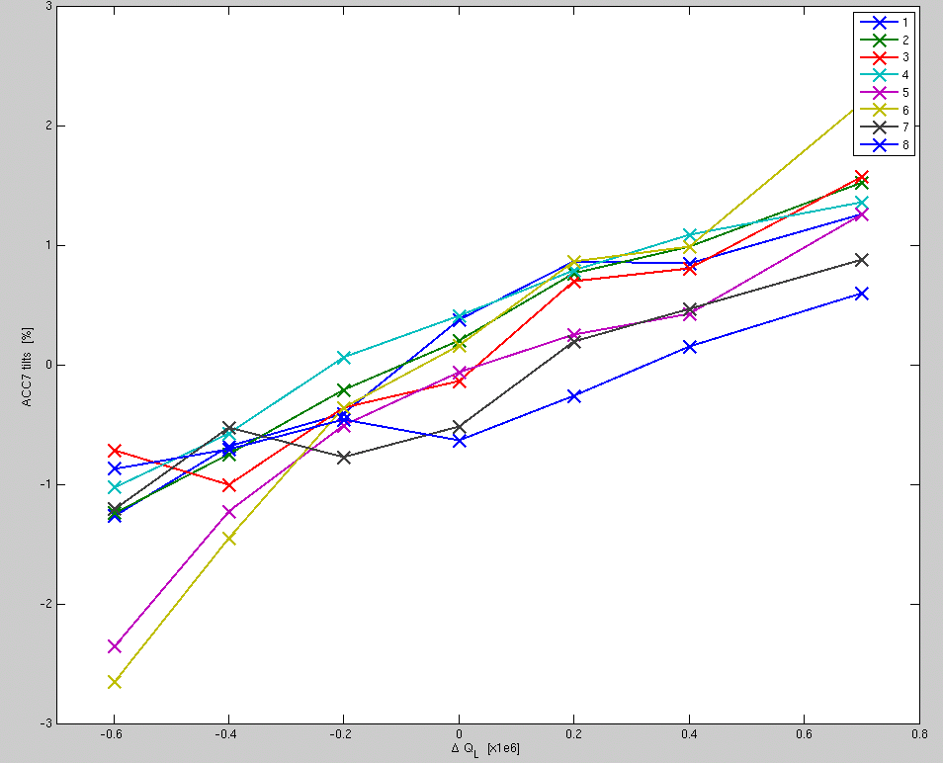
Assessing the accuracy of the model
Q_{L} scan
  → Keep beam current constant but walk Q_{L}’s around optimized value
I_{B} scan
  → Keep optimized Q_{L}’s but ramp beam up/down
3
2
1
0
-1
-2
-3
gradient tilts [%]
-0.6 -0.4 - 0.2 0 0.2 0.4 0.6 0.8
ΔQ_{L}
Notes:
Checking if the Ql settings are indeed optimal

Slide 21
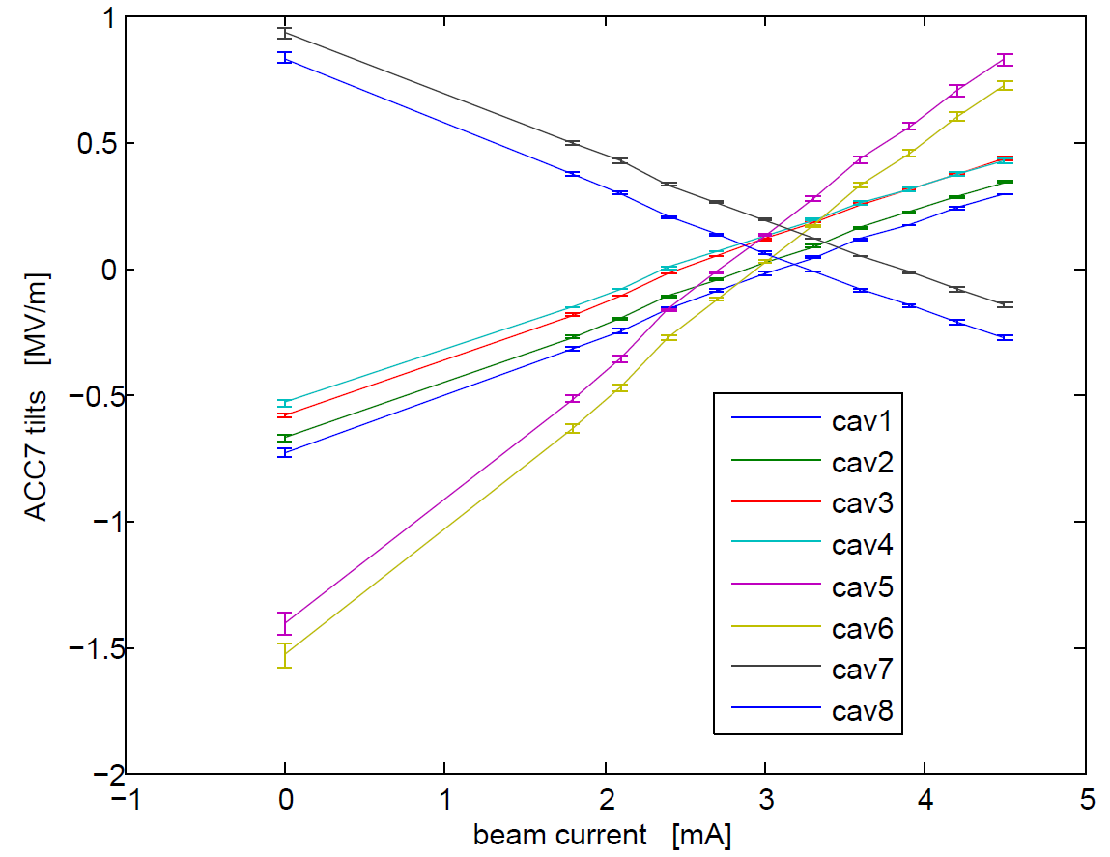
Assessing the accuracy of the model
Q_{L} scan
  → Keep beam current constant but walk Q_{L}’s around optimized value
I_{B} scan
  → Keep optimized Q_{L}’s but ramp beam up/down
Notes:
Checking the impact of beam change on tilts (Qls are optimized for 1 beam current, not any other beam current)

Slide 22
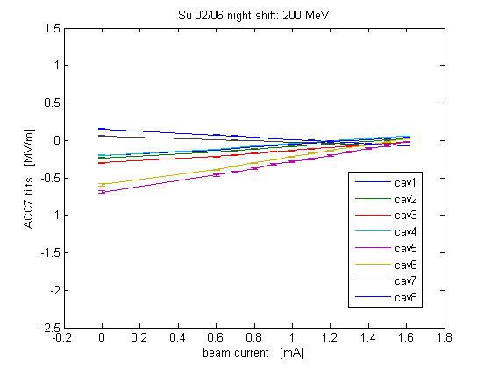
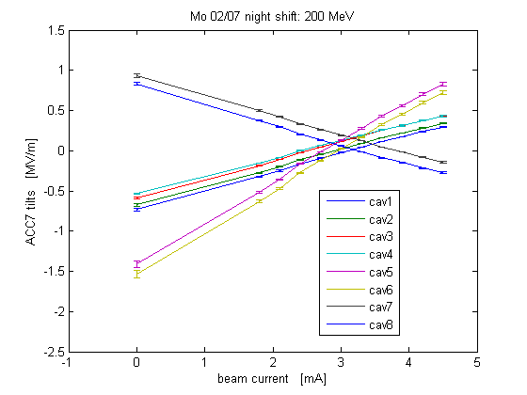
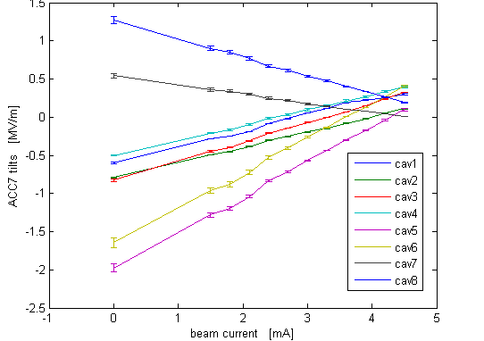
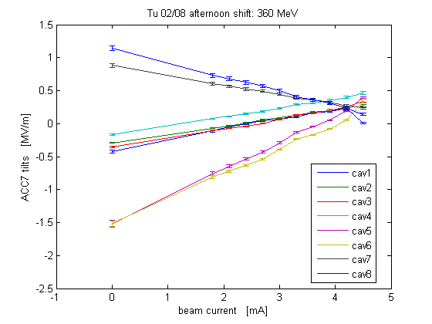
Beam scans
Su 02/06 night shift
Mo 02/07 night shift
200 MeV
1.6mA
200 MeV
3.0mA
Mo 02/07 night shift
Tu 02/08 afternoon shift
300 MeV
4.5mA
360 MeV
4.5mA
Notes:
Repeated these beam scan during the different shifts (higher beam current, optimized for 3 for 4.5)
Higher gradients, we can see the limits of this calibration by the spread of the tilts
For the last scan, we also used an analytical calculation of the optimal QL (instead of tuning it with the simulator “by eye”)
But analytical solution also assumes perfect tuning, and feed forward only, so still not perfect

Slide 23
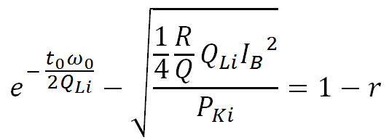
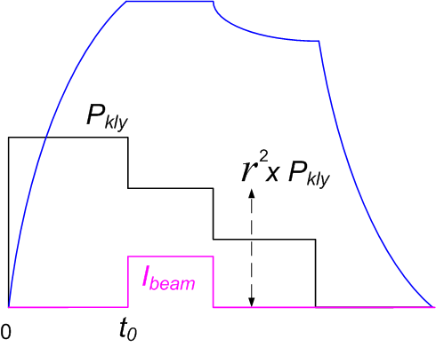
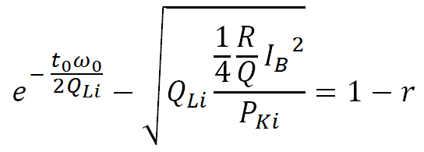
The analytical solution
Given a fixed power distribution, a known beam current and beam compensation, find individual Q_{L}’s that will flatten cavity gradients during beam time
*
→ assumes “perfect” tuning
→ solve for Q_{Li} when possible
cavity i loaded Q
cavity i forward power during fill time [W]
DC beam current [A]
fill time (∼ beam arrival time) [s]
fill time to flat top voltage ratio
(including beam compensation)
  * “Note on solving QL for flat gradients at FLASH ACC6 and ACC7”, J. Branlard, Feb 2011, FNAL Beams-doc-3796
  “Analytical solution to the cavity tilt problem.docx”, G. Cancelo, Feb 2011
Notes:
An analytical solution can be calculated using this equation (cf reference for details) but some limitations of this approach are:
Inaccuracy of assessing power distribution (same problem as simulator)
Assumes perfect tuning of the cavity (same problem as simulator)
Inaccuracy of setting and reading Qls (same problem as simulator)

Slide 24
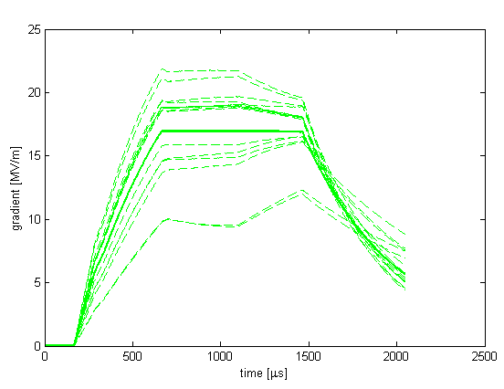
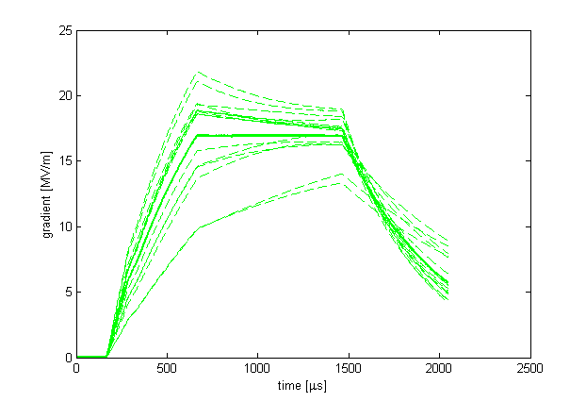
Beam ON/OFF
DAQ data 02/08 5:46:14
DAQ data 02/08 5:51:36
Ib = 4.5 mA
Ib = 0 mA
Cavities below vector sum rise without beam
Cavities above vector sum drop without beam
Need for an automatic safety feature to shorten RF pulse to prevent quench
Notes:
This also exposed the issue of what happens when the beam loading isn’t what it’s expected to be
Low cavities tilts up, high cavities tilts down → need to shorten pulse length to prevent quench

Slide 25
Study insights
What went well
Very stable machine → long study time
Motorized couplers / tuners → optimal study conditions
automated scripts + skilled operators
Simulator proved to be very useful
Predicted optimized Q_{L} values were accurate → to 0.2e6
Successfully implemented the tuning plan → tilts < 0.1MV/m
What we’ve learnt
Cavity resonance control is crucial for gradient tilts
Limitations to the simulation approach:
  How accurately can we measure the power distribution? → John’s slide
  How accurately can we compensate for LFD OR include in model? → next slide
  How accurately can we measure and set Q_{L}’s → +/- 2 to 5%
  Fine tuning “by-eye” is compromised by operating in closed loop
What is still unanswered
No proposed solution for high beam currents (>6mA) implementable at FLASH
There is not always a solution to flatten all cavities
(especially when gradient spread is large)
No solution to bring up the machine at its highest gradient

Slide 26
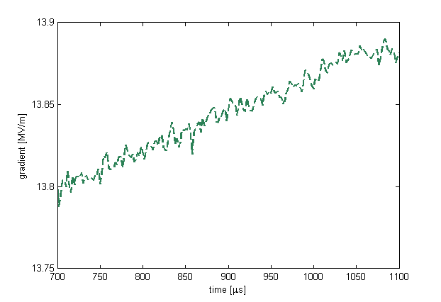
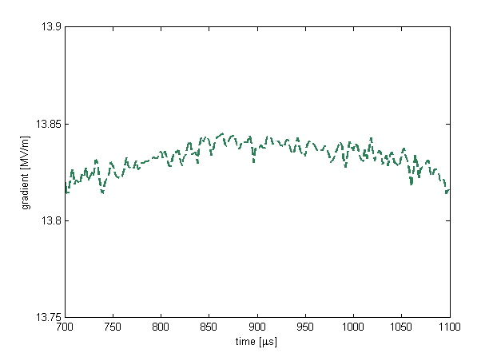
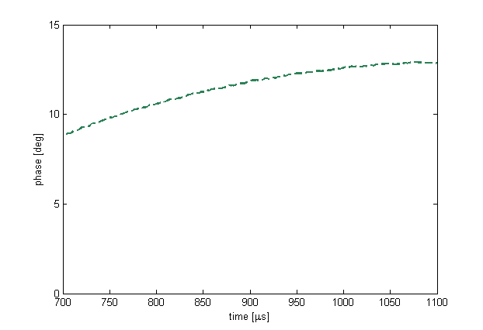
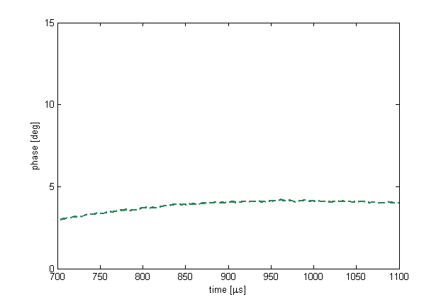
Before freq. tuner adjustments
After freq. tuner adjustments
AMPLITUDE
AMPLITUDE
~ 0.1 MV/m
Q_{L} = 1.58x10⁶
Q_{L} = 1.58x10⁶
PHASE
PHASE
Δf = 70 Hz

Slide 27
Bringing up a linac
Traditional approach (i.e. FLASH)
Make target gradient with FF
Turn FB on
Compensate for LFD
Send a couple of pilot bunches (~10)
(automated beam loading compensation)
Minimize losses
Gradually increase bunch length to full train
(while minimizing beam losses)
Learning feed forward
One “possible” scenario for flat gradients
Bring cavity to their nominal gradient
  ➔ typically: quench gradient -2-3 MV/m
2. Adjust Q_{L} so cavities are flat with beam
  cavity will quench (because no beam)
3. Shorten pulse length to avoid quench
  typically <200 usec for high beam currents Q_{L}’s
  can’t see LFD effects (can’t compensate for LFD)
  can’t walk pilot bunch across flat top
4. As you increase bunch length
  increase flat top length
  compensate for LFD
  minimize losses
5. The LLRF quench monitoring system should
  truncate the flat top length to prevent quenches
  every time bunch train is shorter than expected

Slide 28
References
“RF Distribution Optimization in the Main Linacs of the ILC”, Bane, Adolphsen, Nantista - WEPMS037.pdf
“Optimal Coupler and Power Settings for Superconductive Linear Accelerators”, J. Branlard, B. Chase, Linac 2008
“Optimizing Cavity Gradient in Pulsed Linacs Using the Cavity Transient Response”, G. Cancelo, A. Vignoni, Linac 2008
“Effect of Cavity Tilt and RF Fluctuations to Transverse Beam Orbit Change in ILC Main Linac”, K. Kubo, Jan. 2010
“PkQl-like control for ACC6/7 at FLASH” S. Michizono, PkQl_FLASHver3.docx, Sept. 2010
  “To flatten the cavity gradient for ACC6/7” S. Michizono, FLASH101022BV2.pdf, Nov. 2010
  “Analytical solution to the cavity tilt problem.docx”, G. Cancelo, Feb 2011
  “Note on solving QL for flat gradients at FLASH ACC6 and ACC7”, J. Branlard, FNAL Beams-doc-3796
  SIMCAV version 4.8 (FLASH ACC6 and ACC7 16 cavity MATLAB simulator), FNAL Beams-doc-3794

Slide 29
THANK YOU

Slide 30
BACKUP SLIDES

Slide 31
SUMMARY
Why do we care about individual flat gradients?
  KEK paper
What can we actually implement at FLASH?
  No P_{K} adjustments
  Only Q_{L} can be changed
  Limited range in Q_{L} changes
What solutions were offered to achieve flat gradients with beam loading?
  SLAC paper , using Q_{L} and P_{K} adjustments
  Shin’s solution with square P_{fwd} pulse
  Shin’s solution with step ratio P_{fwd} pulse
What approach have we followed during the FLASH test studies?
  Procedure (issues with adjusting Q_{L} when beam is OFF)
  When beam is ON, beam compensation is ON too
  Which tools did we use
  The analytical solution
Results of the P_{K} |Q_{L} studies
  Assess Q_{L} ranges
  Low gradient / mid gradient
  Low beam / mid beam current
  Beam scans
  Q_{L} scans
Conclusions and lessons learnt
  How accurate were the tuning adjustments?
  What limited the accuracy of tuning adjustments?
  Difference between solving the problem open / close loop
  Impact of detuning on tilts (static & dynamic)
  No solution to bringing the machine up to its maximum gradient

Slide 32
Shift-by shift highlights

Slide 33
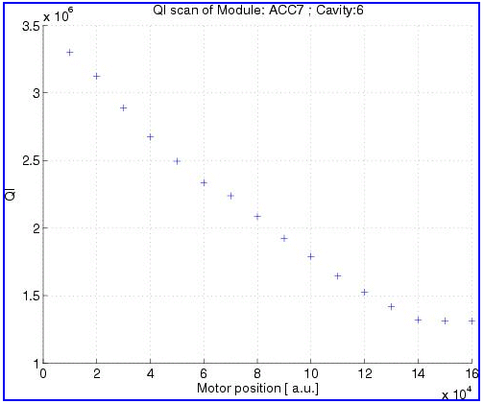
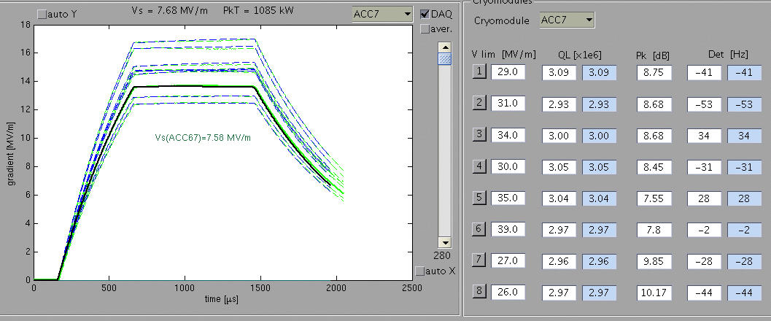
Friday 2/4 night shift – highlights:
no beam
ACC6/7 vector sum calibration 100 bunches, 1 MHz, 1.6 nC
Q_{L} tuners characterization for ACC6/7
simulator calibration to reflect ACC6/7 power distribution

Slide 34
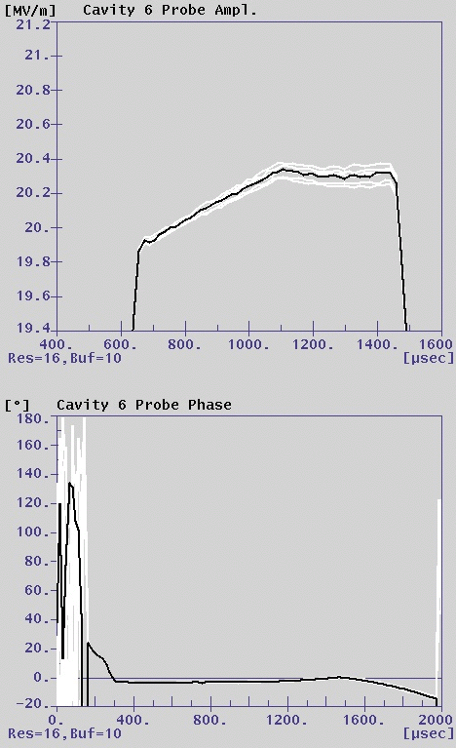
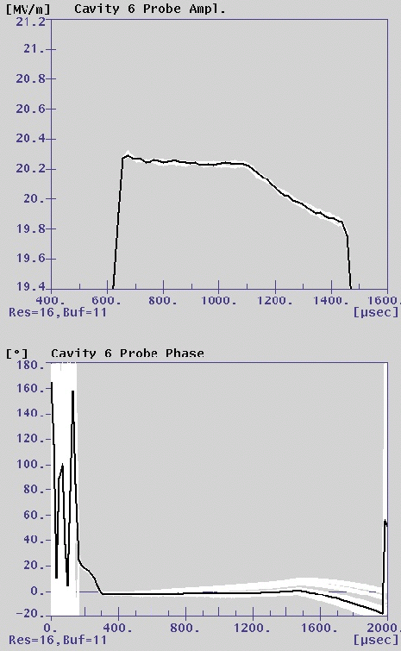
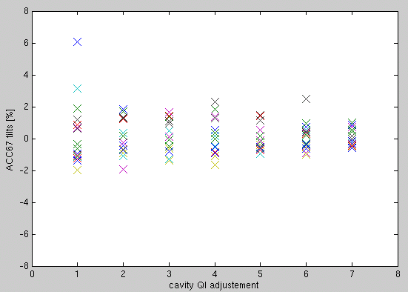
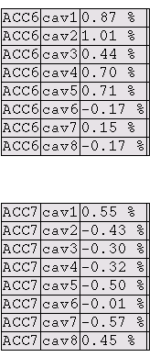
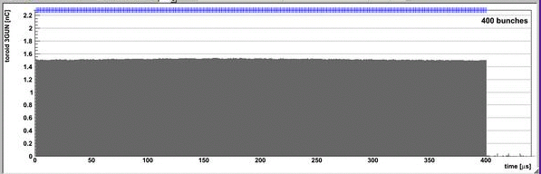
Saturday 2/5 night shift – highlights:
1mA beam, low gradient (100–200 MeV)
Successfully implemented QL adjustments to flatten cavity gradients
beam loading tilts correction (all tilts below 1%) using simulator predicted values
Simulated values are reliable
Q_{L} = 3e6
Q_{L} = 2.65e6

Slide 35
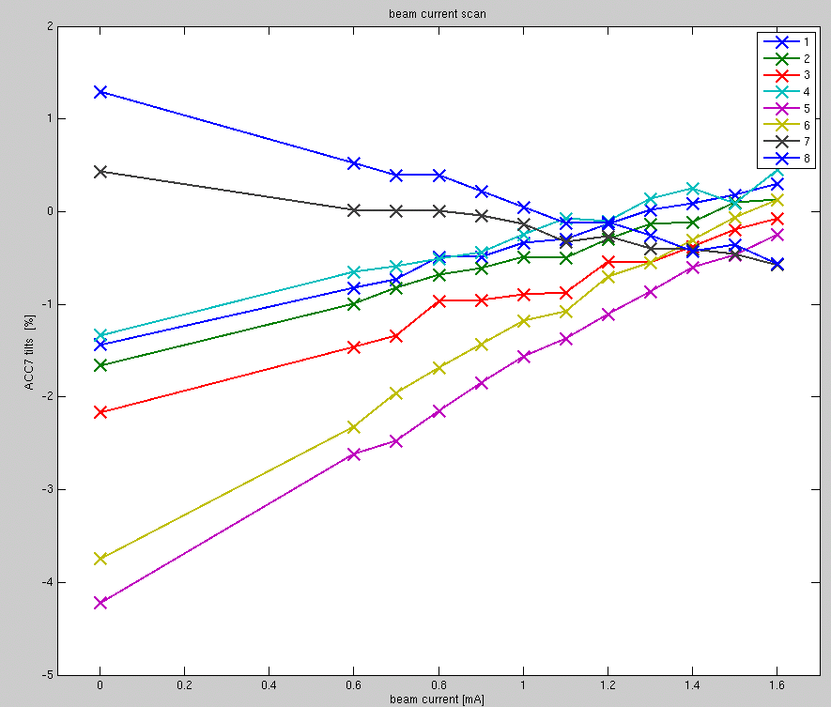
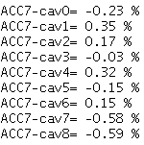
Sunday 2/6 night shift – highlights:
1.6mA beam, low gradient (200 MeV)
beam loading tilts Q_{L} correction (below 1%)
(several cavities at once, with beam on)
beam current scan
Q_{L} scan
Ql config is for ACC7:
cav1 : 2.8 e6
cav2 : 2.8 e6
cav3 : 2.8 e6
cav4 : 2.8 e6
cav5 : 2.5 e6
cav6 : 2.5 e6
cav7 : 3.1 e6
cav8 : 3.2 e6

Slide 36
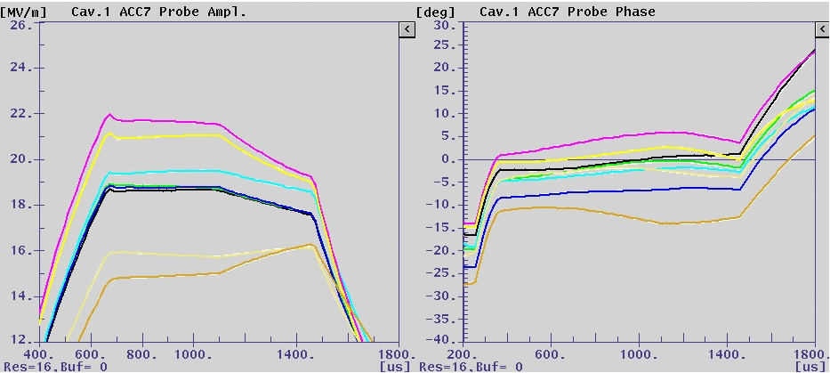
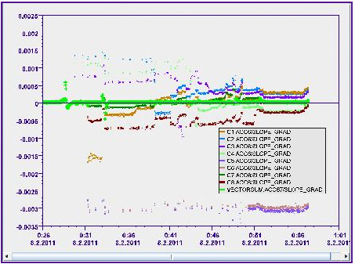
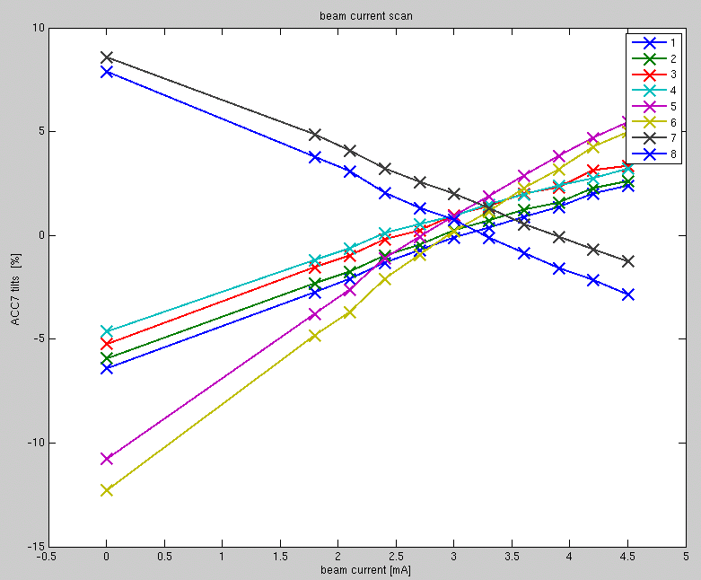
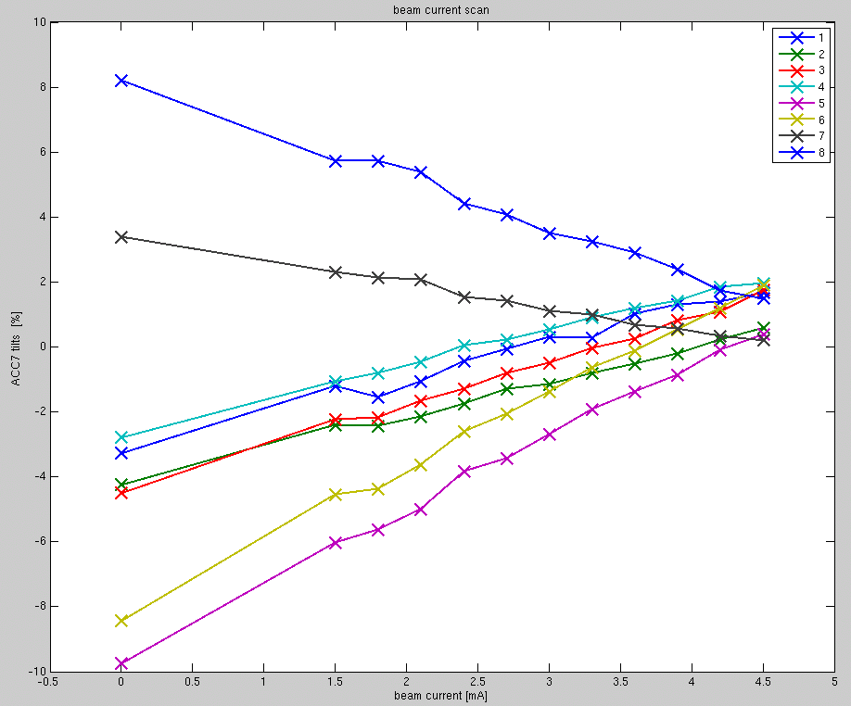
Monday 2/7 night shift – highlights:
3.0mA beam, 200 MeV
Q_{L} adjusted for gradient flat at 3mA
beam scan from 0.9 to 4.5 mA
4.5mA beam, 300 MeV
QL adjusted for gradient flat at 4.5 mA
beam current scan

Slide 37
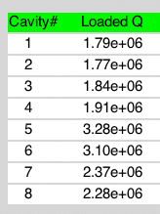
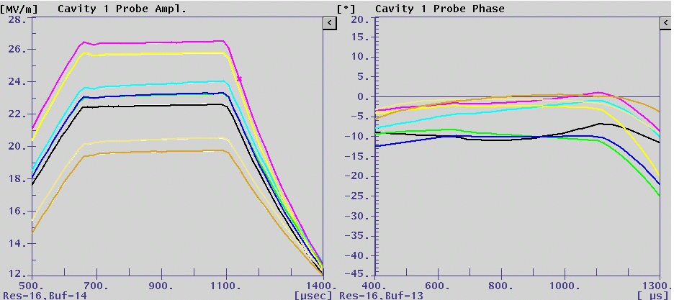
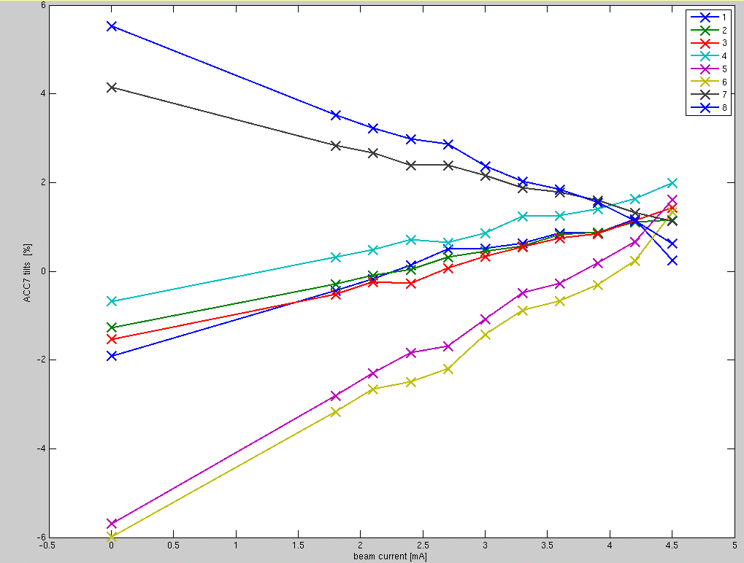
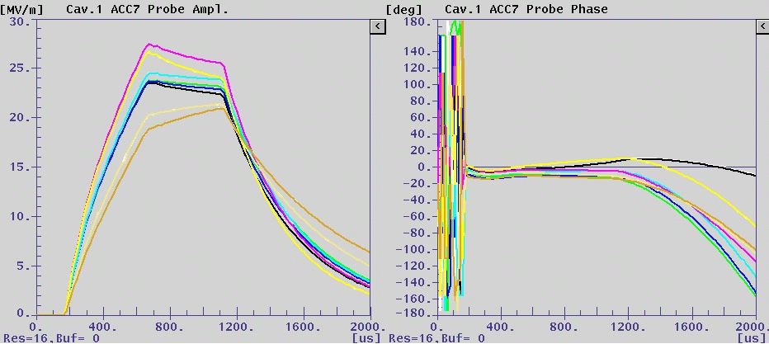
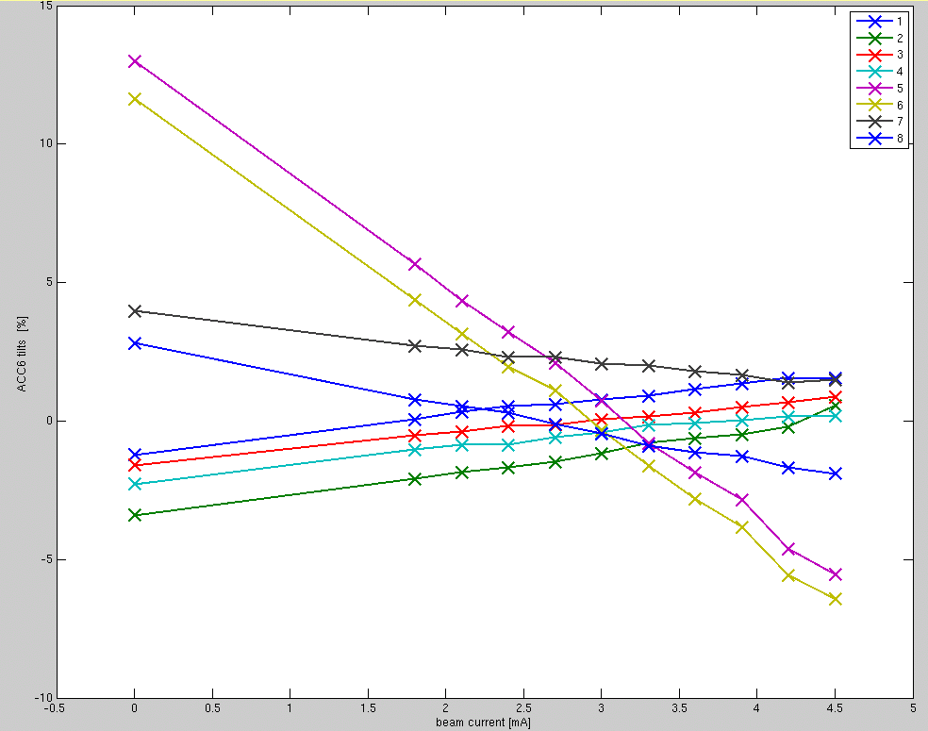
ACC7 Q_{L} values
Predicted Implemented
cav1. 1.78 e6
cav2. 1.74 e6
cav3. 1.85 e6
cav4. 1.88 e6
cav5. 3.25 e6
cav6. 3.12 e6
cav7. 2.37 e6
cav8. 2.40 e6
Tuesday 2/8 afternoon shift – highlights:
4.2mA beam, 360 MeV
Lorentz force detuning compensation
Use calculator to predict QL → very accurate prediction
Flatten ACC6/7 gradients tilts to ~ 1.5% (tuned for 4.2mA)
beam current scan to 4.5 mA
Beam ON
ACC7
ACC6
Beam OFF

Slide 38

Power ratios
Power ratio (dB)

Slide 39

Power coupling between adjacent cavities
3 sequences of detuning: cav1, then cav2 then cav3.
when we reach the end of the detuning range of one cavity, the detuning of the adjacent cavity is affected
Q_{L} changes with the detuning for all three cavity (cav1 and 2 in one direction, cav3 in the opposite direction)
We see that Q_{L}(cav1) and Q_{L}(cav2) are coupled.
Similarly, Q_{L}(cav3) and Q_{L}(cav4), but no cav3-cav1 coupling

