Slide 1
ILD and SiD detectors for 1 TeV ILC some recommendations following experience from the CLIC detector study
http://lcd.web.cern.ch/LCD/

Slide 2
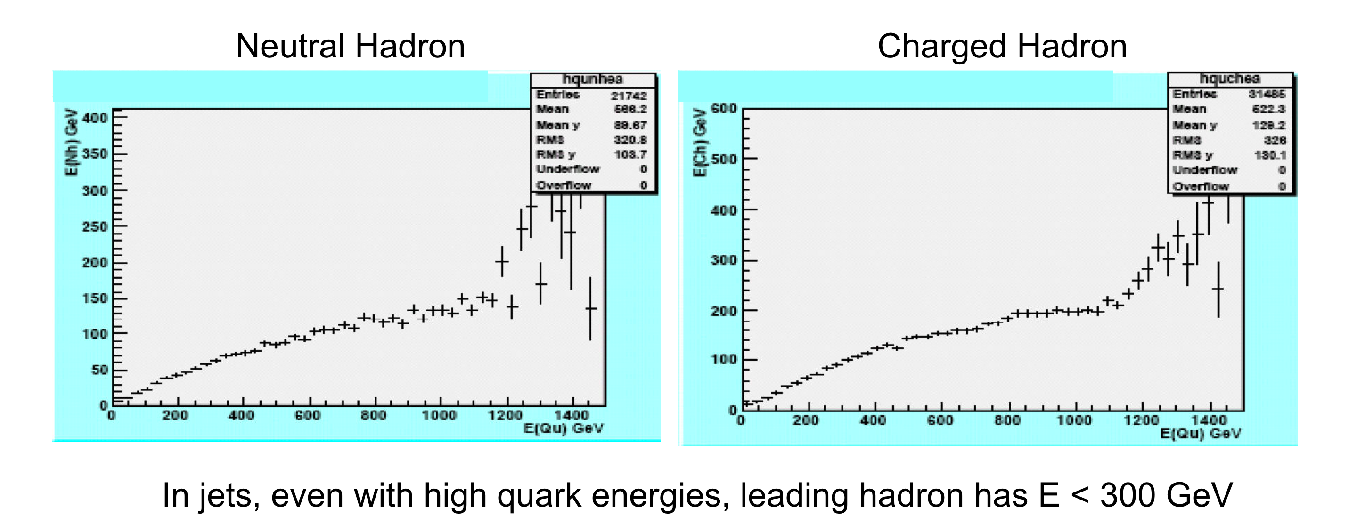
Physics observables
Get overview of physics observables at 1 TeV
(just to get familiar with the new domain)
  e.g. jet energies and particle energies in jets
  Minimal distances between leading particles in jets
  Evolution of angular coverage of the physics wrt 500 GeV case
CLIC example: ttbar events at 3 TeV

Slide 3
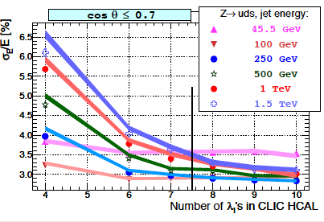
Study calorimeter requirements
Assess calorimeter performance for the 1 TeV case
Mostly to ensure that calorimeter depth is sufficient and that confusion remains limited (in fact already proven for the CLIC case)
PFA study
Full ILD-type detector
barrel with tungsten HCAL absorbers
Solid lines: not tails catcher Markers: with tail catcher

Slide 4
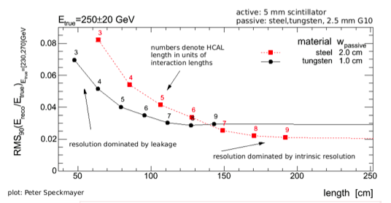
Tungsten for HCAL barrel?
Required resolution reached at smaller HCAL outer radius for tungsten than for steel absorber

Slide 5
Machine-induced backgrounds
Understand the main machine backgrounds:
Overall limited impact expected given the favorable ILC bunch structure
Coherent pairs
Ensure that outgoing beam pipe opening and crossing angle of 14 mrad are safe with respect to coherent pairs
Incoherent pairs
Study of lumical at 1 TeV => may require change in angular range for lumical
Study optimal geometry for beamcal
Trade-off between acceptance and backscattering
Optimise beam-pipe layout (can have a function of absorbing back-scattered background)
Verify occupancy in the vertex detector and tracking detectors
For direct hits (influence of B-field) and backscattered hits
Inner vertex layer may have to be moved to somewhat larger radius
γγ to hadron background
Only few events/bx expected, though with significant energy/bx (few-10 GeV)
Study P_{t} cuts and optimal jet reconstruction algorithm to suppress this background

Slide 6
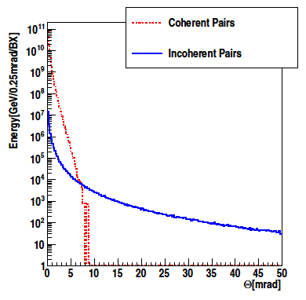
Coherent pairs and opening angle
CLIC example:
Sharp angular cut-off in coherent pairs drives choice of beam pipe opening and choice of crossing angle
Thoughts for ILC:
“easier” bunch structure, but:
long integration times –
only a few readouts per train
The total occupancies due to all background processes must be evaluated
Multi-hit readout capabilities of the on-detector electronics (event buffers) have to be evaluated
The electronics shall record the time of each hit
(with ~300 ns precision)

Slide 7
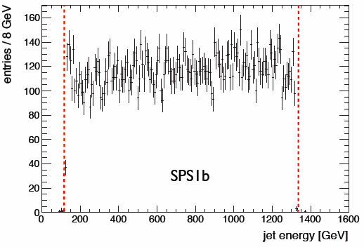
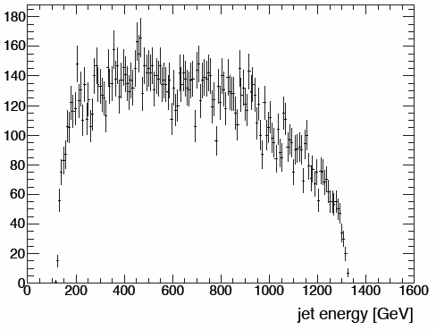
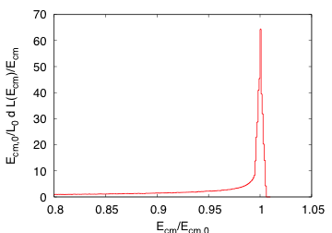
Luminosity spectrum
Influence of luminosity spectrum on physics performance:
E.g. Influence in measuring masses from and-point spectra
Example: CLIC luminosity spectrum and squark end-point spectra

Slide 8
Software for CLIC
For the CLIC CDR: Simulation and Reconstruction needed for 3 TeV
Example: ILD - Several issues encountered, all fixed
  ILD tracking code: Hard-coded momentum “sanity check” caused high energy tracks to disappear
  Excessive reconstruction times
  ...
PandoraPFA for CLIC
Background overlay
  less of a concern for ILC, but due to long readout times, some background will be accumulated: Needs to be studied!
➫ Simulation and Reconstruction proven in multi-TeV environments!

