Slide 1
TeV Upgrade
N. Walker (for PMs)
ALCPG, Univ. of Oregon, Eugene
21.03.2011

Slide 2
Content
From 500 to 1000 GeV – the Gradient Question
Overall layout and impact on accelerator systems
Parameters
Cost & Schedule
Proposal for White Paper as part of TDR

Slide 3
From 500 to 1000 GeV
15.4 km
(site length ~31 km)
1.1 km
10.8 km
1.3 km
2.2 km
Main Linac
BDS
e+ src
IP
bunch comp.
Main Linac
<G_{cavity}> = 31.5 MV/m
G_{eff} ≈ 22.7 MV/m
(fill fact. = 0.72)
central region

Slide 4
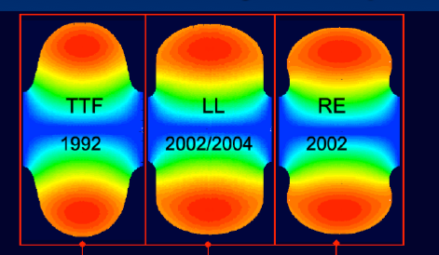
From 500 to 1000 GeV
<26 km ?
(site length <52 km ?)
1.1 km
<10.8 km ?
10.8 km
1.3 km
2.2 km
Main Linac
BDS
e+ src
IP
bunch comp.
Main Linac
<G_{cavity}> = 31.5 MV/m
G_{eff} ≈ 22.7 MV/m
(fill fact. = 0.72)
central region
Snowmass 2005 baseline recommendation for TeV upgrade:
G_{cavity} = 36 MV/m ⇒ 9.6 km
(VT ≥ 40 MV/m)
Based on use of low-loss or re-entrant cavity shapes

Slide 5
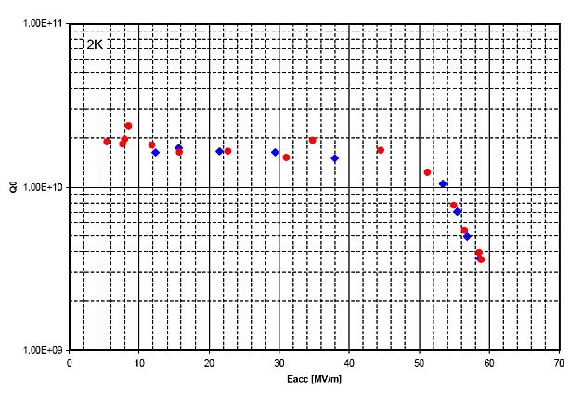
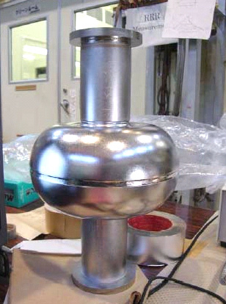
Ultra-High Gradient Cavity R&D
10¹¹
Single-cell re-entrant
cavity design achieved
~59 MV/m (cw)
  Cornell/KEK collaboration
In principle, multicells
with 60 MV/m could be
possible
  < 6 km additional linac (total site length ~ 43 km)
Overall cost-effective solution must be found
  Q₀ ⇒ required cryogenic cooling
  cost/cavity for increased performance
  site constraints!
10¹⁰
10⁹
40
50
60 MV/m

Slide 6
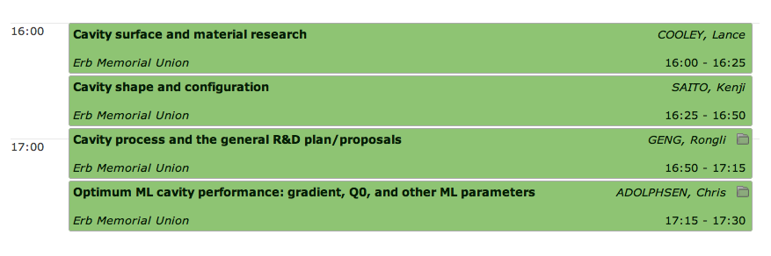
Cavity R&D Prospects
Special GDE plenary yesterday to discuss prospects and future directions

Slide 7
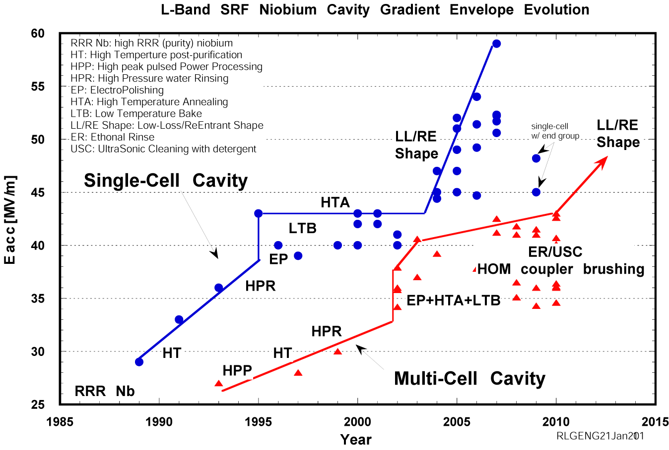
SRF R&D Behind Gradient Progresses
Shaping
Processing
Material
Understanding in gradient limits and inventing breakthrough solutions are responsible for gradient progresses. This has been a tradition in SRF community and rapid gradient progress continues. Up to 60 MV/m gradient has been demonstrated in 1-cell 1300 MHz Nb cavity. 45-50 MV/m gradient demonstration in 9-cell cavity is foreseen in next 5 years.

Slide 8
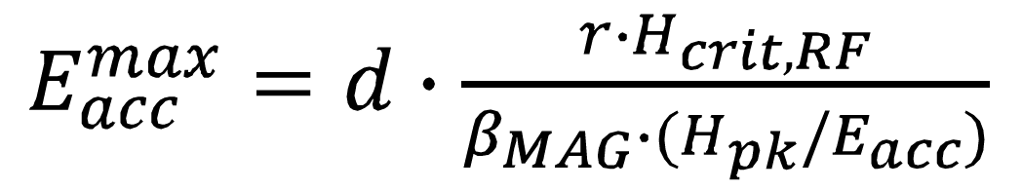
Main Issues at Very High Gradient (3)
“Knobs” for improved reproducibility in overcoming local quench at very high gradient of 40-50 MV/m
Material
Nb: > 2000 Oe (exp.)
2400 Oe (the.)
Nb₃Sn: > 4000 Oe (the.)
Achievable gradient
Cavity surface chemistry
Cavity wall
thermal conductance
Cavity surface smoothness
Cavity shape
Alternate cavity shape for reduced Hpk/Eacc ratio. In hand (LL, RE, LSF).
Uniform cavity processing for reduced local “bad” spots. In hand (EP).
Smooth surface for reduced local magnetic field enhancement. In hand(CBP & derivative + EP).
Improved wall thermal conductance for increased local heating tolerance.
  Cavity heat treatment optimization for “phonon peak engineering”
  Use Nb/Cu composite material (such as explosion bonded material)
(5) The game-changing knob is a Nb replacement material (such as Nb₃Sn or Mg₂B w/ multi-layer).

Slide 9
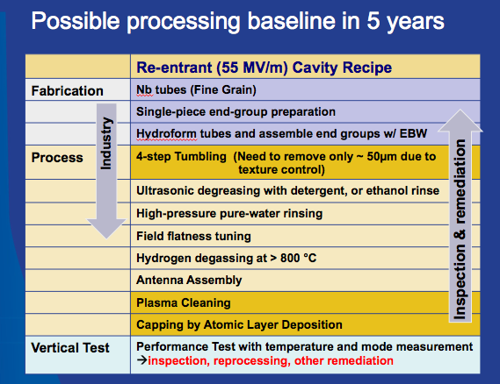
Possible processing baseline in 5 years

Slide 10
Upgrade Cost Estimate
For the TDR, an approximate cost for the upgrade is needed
Zeroth-order estimate: current cost of main linacs ~ 3 BILCU
  roughly ½ RDR total project cost
  Consider this an upper limit ?
Most difficult question will be cost of “upgraded” main linac technology
  cost of ultra-high gradient cavities?
  Re-designed cryomodule?
  Updated HLRF?
  CFS solution
  …
Forward looking R&D required for proof-of-principle
Cost effectiveness needs to be kept in mind
Notes:
It will be very difficult to put a cost on something which still required proof-of-principle R&D
We can make forward-looking assumptions, such as the cost per cavity remains unchanged (to first order)
We should assume that the 3.3 BILCU (or whatever it will eventually be) is an upper limit.
For the TDR, we can only produce simplistic cost models following scaling laws.

Slide 11
Linac Cost Optimisation
For a fixed energy gain:
simplistic – there are other terms!
higher component cost
(e.g. cavity, tunnel)
An overall cost-optimum should exist
Above model naïve since cavity/CM cost assumed independent of gradient
High-gradient R&D must also push Q₀ for optimum cost
cost
increasing Q₀
gradient
Notes:
Possible we could replace simplistic cartoon with an updated analysis based on current costs/design?

Slide 12
Cost Scaling
Relative Linac Cost
Qo = 2e9
Qo = 1e10
Cryo-Plant Cost
~ (Load)^1.0
Qo = 5e10
~ (Load)^0.6
Linac Gradient (MV/m)
C. Adolphsen
http://ilcagenda.linearcollider.org/sessionDisplay.py?sessionId=2&confId=4572#20110320

Slide 13
RDR Power Estimate
nb full 9mA
Doubling linac ⇒ 216 MW → 352 MW

Slide 14
Efficiency and Power
nb 5 Hz rep. rate
efficiency %
Total AC Power MW
half-power (SB2009)
half-power (SB2009)
Gradient MV/m
Gradient MV/m
Simples scaling – needs more detailed analysis

Slide 15
Other Accelerator System Impacts
Damping Ring and electron source remain essentially unchanged
  Notwithstanding a chance in relevant parameters
  not considered further in this report
Primary Main Linac concern is choice of technology, but
  Beam dynamics issues (higher wakefields in new cavity shapes)
  Existing ML lattice now has to transport higher-energy beam
  …
In the following, briefly consider impact to the following:
  RTML / Bunch Compressor
  Beam Delivery System
  Positron Source

Slide 16
Bunch Compressor (RTML)
21-25 km
(site length 42-50 km)
1.1 km
6-10 km
10.8 km
1.3 km
2.2 km
Main Linac
BDS
e+ src
IP
bunch comp.
central region
Bunch compressor (and turn-around) must move!
During upgrade we can consider various design scenarios:
  stay with single-stage
  Include two-stage compressor
  (even) consider three-stage compressor
Evaluate (physics) gain.
Impact of energy spread etc.
shorter σ_{z}
larger Δp/p
increased length,
complexity (and cost)

Slide 17
Beam Delivery System
21-25 km
(site length 42-50 km)
1.1 km
6-10 km
10.8 km
1.3 km
2.2 km
Main Linac
BDS
e+ src
IP
bunch comp.
central region
TDR BDS geometry already accommodates
1 TeV upgrade
  Upgrade requires additional dipole magnets
Primary beam dumps rated for 500 GeV 9mA beam @ 4 Hz
  18 MW average beam power
  Assumed not easy to ‘upgrade’

Slide 18
Positron Source
21-25 km
(site length 42-50 km)
1.1 km
6-10 km
10.8 km
1.3 km
2.2 km
Main Linac
BDS
e+ src
IP
bunch comp.
central region
Undulator-based positron source probably requires most attention

Slide 19
Positron Source (cont.)
Simplistic (first-order) approach: use existing location and drive with 500 GeV beam
  reduce undulator length to ~10-18 m (or reduced field by ÷4)
  photon cone (spot size on target) reduced by ÷2
  photon energy (1st harmonic) ~ 112 MeV
  Impact on energy spread? Challenge for polarisation (photon collimator)?
What are the alternatives?
  construct new undulator source at new 250GeV point ??
  construct completely new source (alternative, such as Compton)??
  …
Physics requirements: Z running (or in general E_{cm} <300 GeV) still required??

Slide 20
1 TeV Parameters
Current “official” parameter set in EDMS*.
Should still be considered tentative, pending review and further study.
Understanding (and updating) these parameters is our job for the next ~6 months.
* EDMS Doc ID: D*925325
http://ilc-edmsdirect.desy.de/ilc-edmsdirect/file.jsp?edmsid=*925325&fileClass=ExcelShtX

Slide 21
1 TeV Parameters
Working assumptions:
  2625 bunches restored ← Site power! Careful consideration.
  2×10¹⁰ particles per bunch (no change from 500GeV)
  Reduced collision rate 5 → 4 Hz (AC/Cryo power)
Considerations
  N ∝ 1/n_{b} for fixed current
    beam-beam → stronger focusing; source/injector issues
    Requirements on bunch compressor
    (cf alternative parameter proposal from J. Gao, SLAC BAW)
  Reduced repetition rate?
    25% luminosity, but at a cost (increase AC/cryo power)

Slide 22
1 TeV Parameters
Working assumptions:
  bunch length unchanged
  polarisation unchanged
  energy spread scaled (simplistic)
Considerations
  bunch compressor options, possible shorter σ_{z}.
  electron energy spread
  positron polarisation
  energy spread (general)
    bunch compressor options
    linac technology for upgrade (wakefield)
Strongly influenced by design choices for positron source

Slide 23
1 TeV Parameters
Working assumptions:
  Horizontal β-function increased to limit beamstrahlung at ~5%
  (Vertical reduced to increase partially compensate)
  High disruption parameter regime (stability)
  (Normalised) emittances assumed unchanged
Considerations
  N ∝ 1/n_{b} (see slide 20) beam-beam tradeoffs
    This includes bunch length
  Vertical emittance – beam dynamics studies required
    influence of linac upgrade tech. choice and bunch compressor options

Slide 24
1 TeV Parameter with Travelling Focus
If Travelling Focus proves tractable, then it can equally be applied for the upgrade
Same caveats apply as for current ≤500 GeV parameter sets

Slide 25
Construction Scenario(s)
500GeV operations
start civil construction
BC
Main Linac
BDS
e+ src
IP
civil construction + installation
500GeV operations
BC
Main Linac
BDS
e+ src
IP
Installation/upgrade shutdown
BC
Main Linac
BDS
e+ src
IP
final installation/connection
removal/relocation of BC
Removal of turnaround etc.
Installation of addition magnets etc.
Commissioning / operation at 1TeV
BC
Main Linac
BDS
e+ src
IP
Notes:
An obvious possible approach to minimizing downtime for physics.
Assume something like a total of 5 year construction with perhaps 12-18 months with no physics??

Slide 26
The TDR Upgrade Study
Begins this workshop (next slide)
Limited resources means only a very conceptual study
  design parameters
  scaling of 500GeV designs
  Working assumptions on ML technology
SCRF Tech. will define forward looking R&D
  beyond 2012
  upgrade scenarios can be ‘aggressively optimistic’ at this stage.
An AD&I activity – including physics & detector
Proposal to produce a White Paper by early 2012
  Will eventually be part of TDR
Primary editors (tentative – needs discussion):
  3 PMs
  1 Integration
  1 Parameters
  3 reps from physics and detectors (2 detectors + theory)
  1 cost & schedule
Note that 500GeV remains our primary focus for the TDR
Expected to drive the study and write the White Paper
Notes:
The editors

Slide 27
Next Steps
Each TAG needs to produce a comprehensive list of issues/questions
  this workshop
Formation of the White Paper task force
Early initial review of top-level parameter(s)
  working assumptions for remainder of studies
Identification of key studies and deadlines for reports
  integrated into monthly AD&I meetings
Outline of white paper and writing assignments

