Slide 1
Benchmark Processes for the DBD
Tim Barklow (SLAC)
Mar 23, 2011

Slide 2
Outline
DBD Benchmarks with Baseline Detector
DBD Benchmark Event Generation
CLIC Benchmarking Participation by SiD
Benchmarking for Detector Optimization

Slide 3
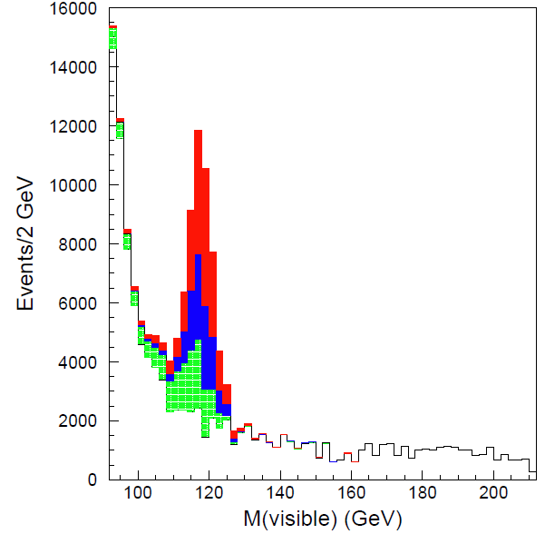
Barklow, hep-ph/0312268

Slide 4
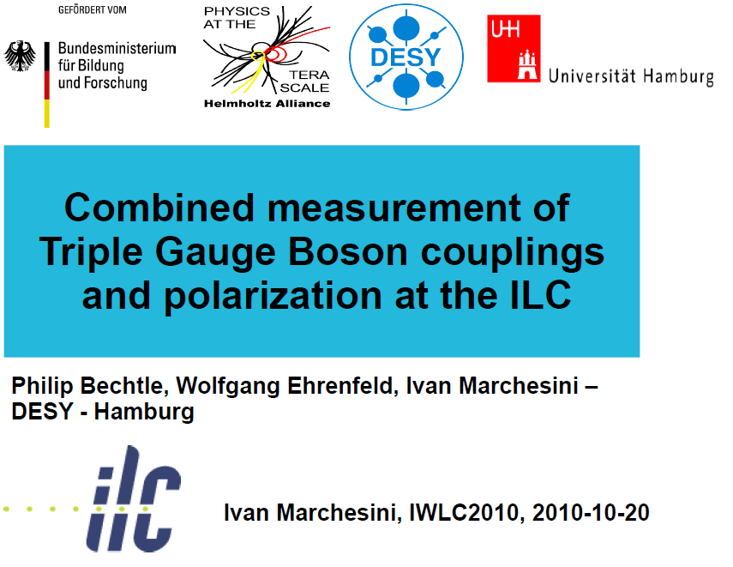
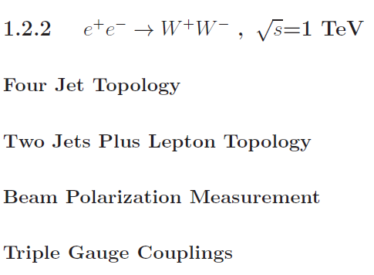
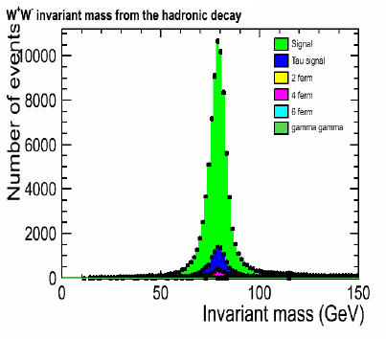

Slide 5
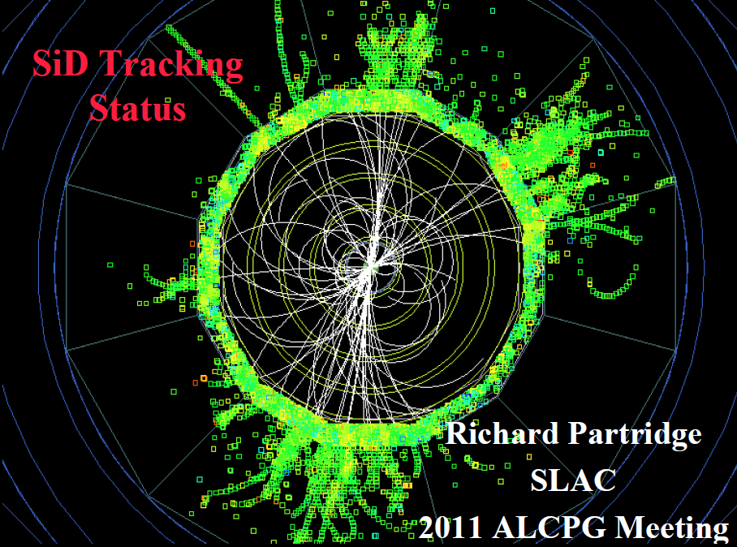

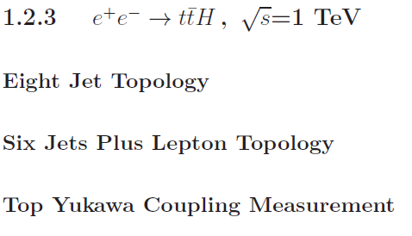

Slide 6
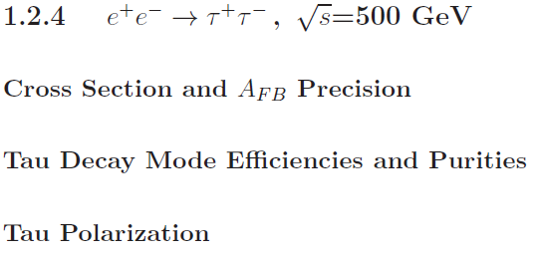
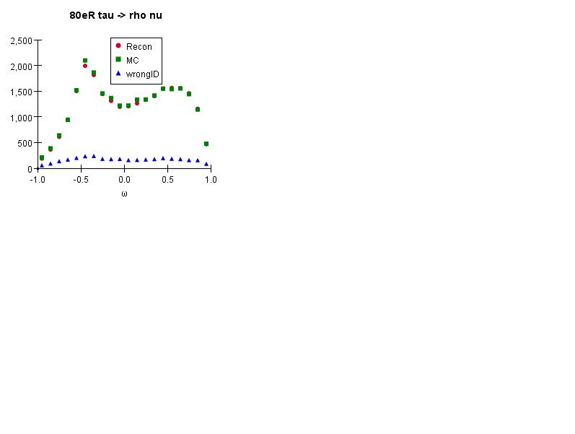
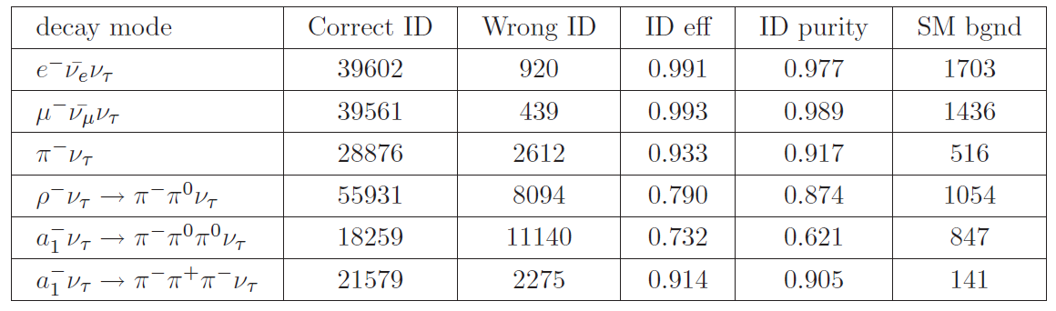
SiD LOI

Slide 7
Event Generation Changes Since the LOI
Distribute Event Generation between KEK, DESY and SLAC
Include initial state particles and final state polarization and color flow in event record
Improved data base for event generation information
Include amplitudes with CKM-suppressed vertices in event generation
Use particle aliasing to reduce the number of distinct WHIZARD processes (let the WHIZARD program do the flavor sums)

Slide 8
Aliasing
alias q u:d:s:c:b:U:D:S:C:B
alias r u:d:s:c:U:D:S:C
alias e e1:E1
alias l e2:e3:E2:E3
alias v n1:n2:n3:N1:N2:N3
alias x u:c:U:C
alias y d:s:D:S
alias k b:B
bbxxyy_o e1,E1 k,k,x,x,y,y omega w:c,c
bbxxby_o e1,E1 k,k,x,x,k,y omega w:c,c
bbxxbb_o e1,E1 k,k,x,x,k,k omega w:c,c

Slide 9
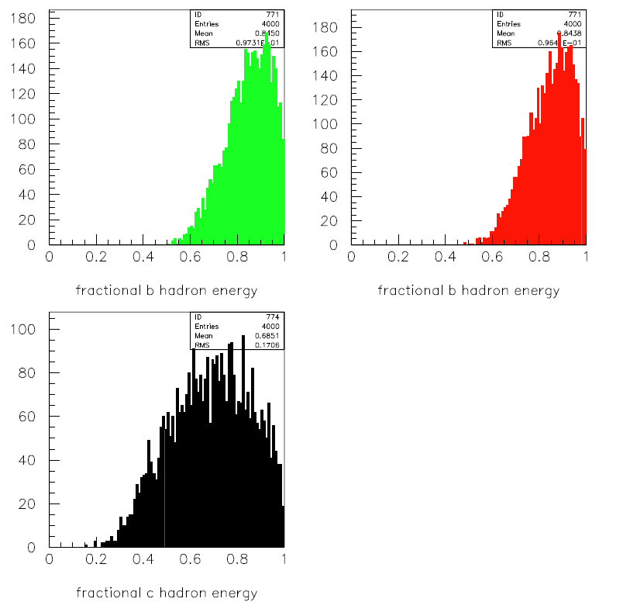
m_{b}=5.5 GeV
m_{b}=0
m_{c}=0

Slide 10
4-Fermion Production
With aliasing, number of processes changed from 45 without CKM-suppressed final states to about 18 including CKM-suppressed final states
Mikael Beggren has created a script that can generate all 4-fermion events with a specified lumi, fill a status file, copy stdhep files to grid and output other info (.log, .in, .out, .prc.,… files ) to a web directory.
Mikael recently tested the script by generating all 4-fermion processes excluding those with final state electrons and produced 1 ab-1 equiv on DESY batch system overnight.

Slide 11
6-Fermion Production
Aliasing has allowed us to consolidate the processes
Compilation and MC integration take much longer than before because of the CKM-suppressed vertices. However, compilation and integration only has to be done once, so this ultimately should not hold us up.

Slide 12
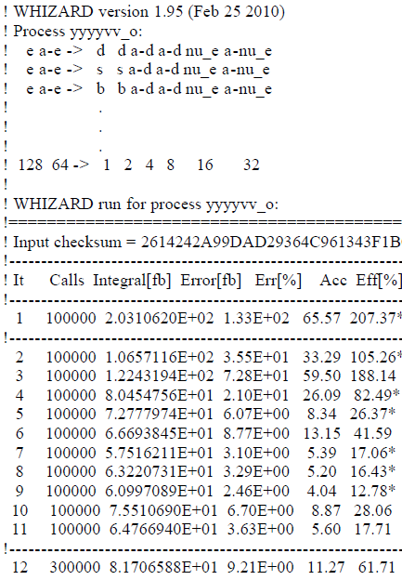
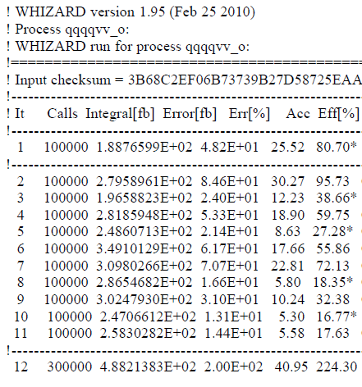

Slide 13
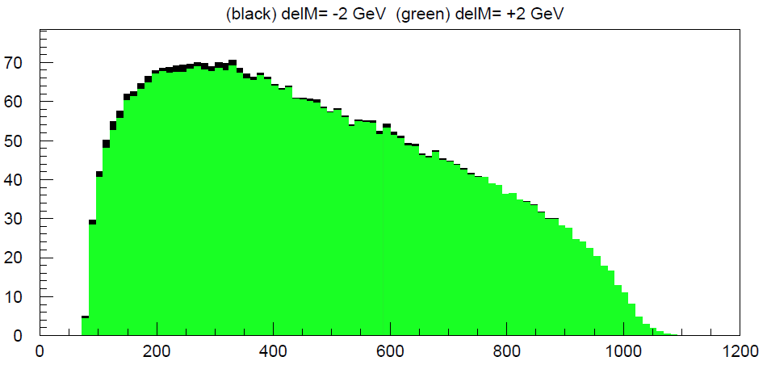
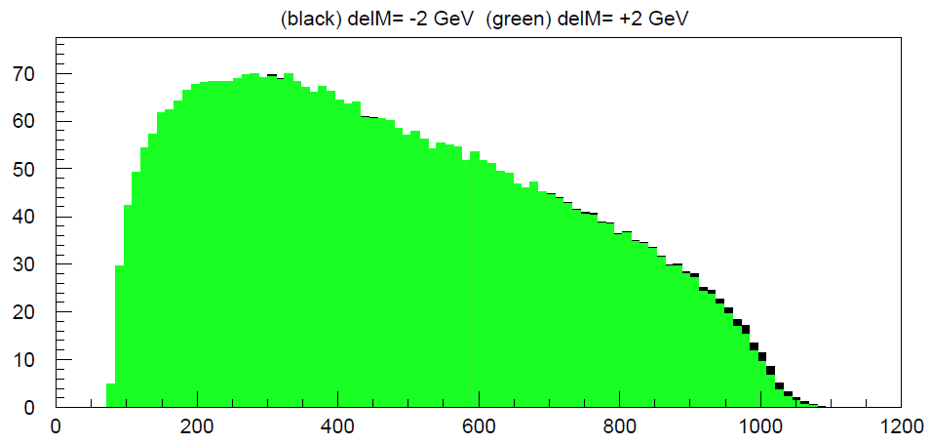
SiD Participation in CLIC Benchmarking: Chargino Mass and Cross Section

Slide 14
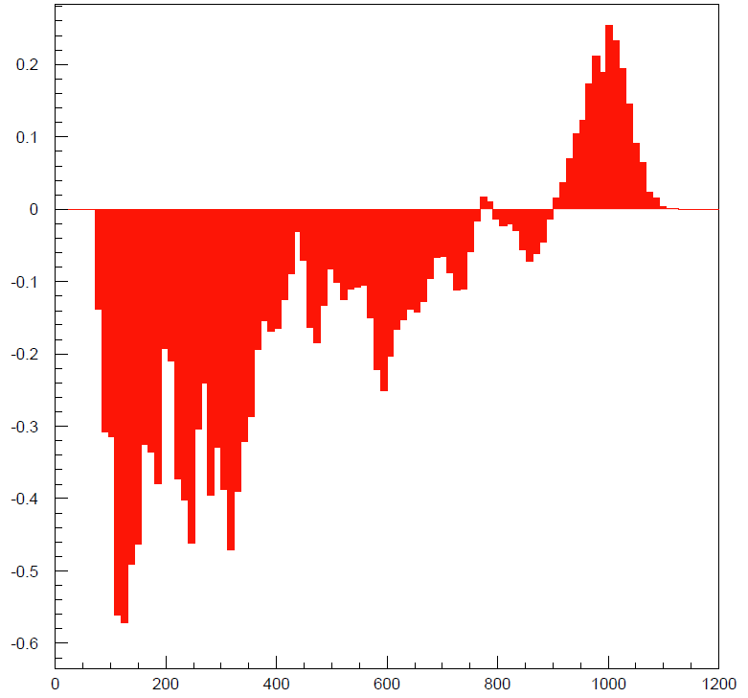
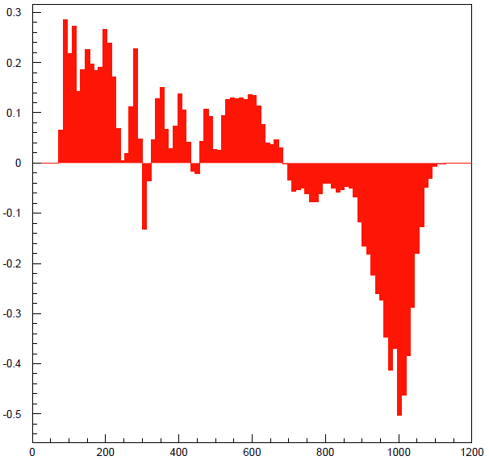

Slide 15
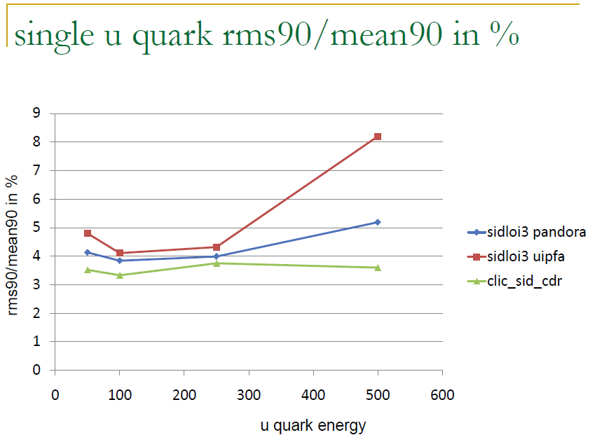
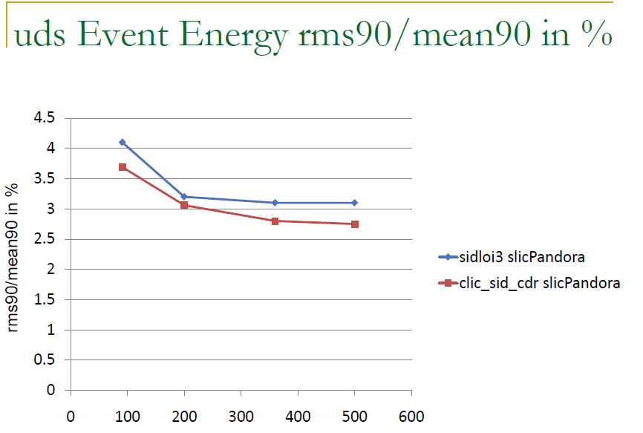
Benchmarking for Detector Optimization

