Slide 1
Ground Motion + Vibration Transfer Function for Final QD0/SD0 Cryomodule System at ILC
Glen White, SLAC
ALCPG11, Eugene
March 21, 2011

Slide 2
Simulation Overview
Lucretia simulation of ILC BDS
  ILC2006e (RDR) lattice and beam parameters
  Reduce Nb 2625 -> 1320 for luminosity calculation with fast feedback to more closely mimic SB2009 parameter set
  Electron and positron beamlines
Ground motion applied to all ILC elements plus transfer function (TF) between ground and QD0/SD0/OC0 system.
50 consecutive pulses (10s) modelled with ground motion + pulse-pulse feedback.
  Results shown for GM models ‘A’, ‘B’ and ‘C’
  QD0 system TF calculation for SiD “rigid support from platform” (Marco).
Fast IP position feedback for tolerance estimates.
Simplifications
  RTML and Linac excluded from tracking simulation
  Incoming beam perfectly aligned with first element (upstream FFB)
  No intra-pulse misalignments
  No other mechanical noise model of magnets applied

Slide 3
Simulation Parameters
Initially perfect lattice.
BPMs
  Cavity systems throughout BDS
    Resolution = 100nm
    Scale factor error = 1%
  Stripline BPMs for fast feedback
    Resolution = 2um
    Scale factor error = 1%
  Corrector magnet field errors 0.1%
5 Hz feedback
  Simple gain feedback, convergence 50 pulses
Intra-pulse feedback
  Based on detection of beam-beam kick at IP for small offsets using downstream stripline BPM and correction using stripline kicker system between QF1 & QD0 cryomodule systems
  Feedback is PID controller using linearised look-up of beam-beam kick to IP beam offset model (up to turn-over point). Feedback convergence ~20 bunches for offsets left of turn-over point.

Slide 4
IP Region Final Doublet
BPM
BPM
SF1
QF1
SD0
QD0
IP ->
IP FB Kicker
OCT
OCT
TF to ground
(from detector model)
This and other magnets assumed
rigidly attached to ground

Slide 5
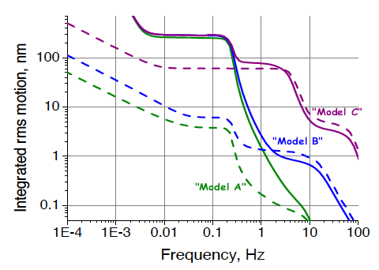
Ground Motion Spectra
The simulation applies offsets due to ground motion according to Model ‘A’, ‘B’ or ‘C’
The spectra for these models indicative of ‘quiet’, ‘average’ and ‘noisy’ sites, mainly in terms of the magnitude of high frequency noise, are shown above

Slide 6
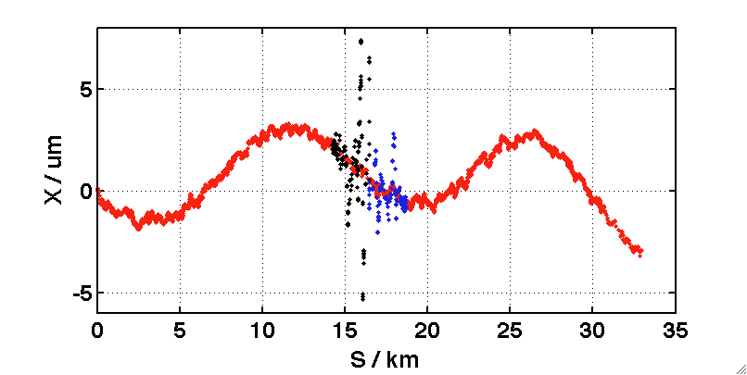
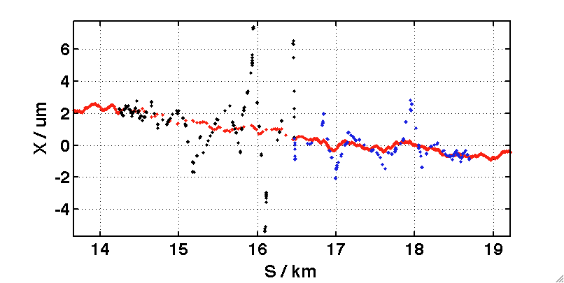
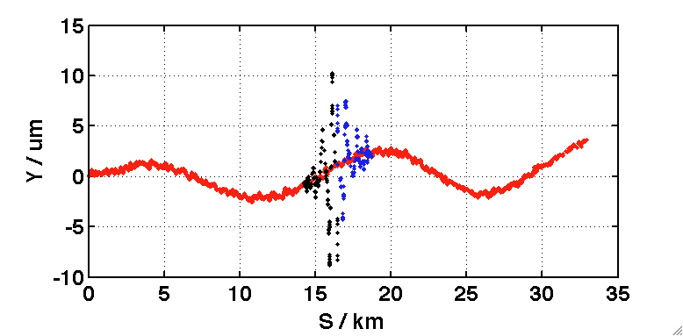
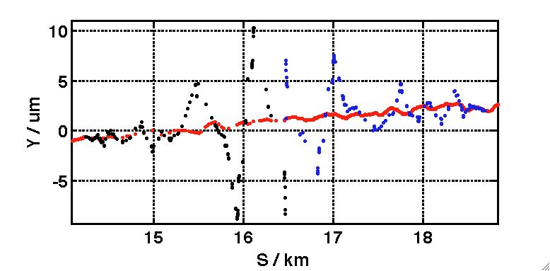
Simulated GM Example (‘C’)
10s of ‘C’ GM showing ground position change and beam orbits
Tracking studies focused on BDS section

Slide 7
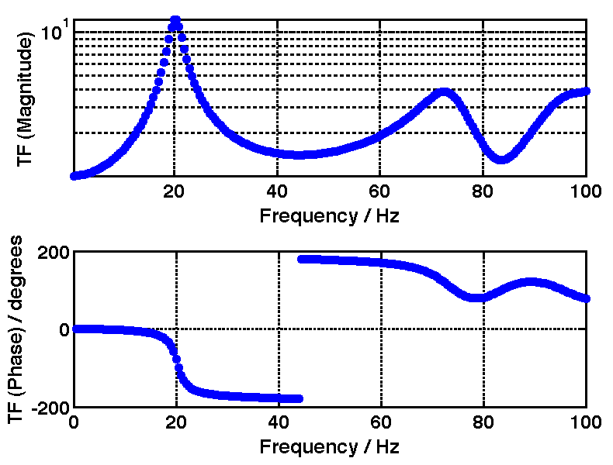
QD0 TF
“Rigid support structure” model from SiD group (Marco). QD0 rigidly attached to detector platform.
Apply to simulation girder element attached to SD0/OC0/QD0 cryomodule.

Slide 8
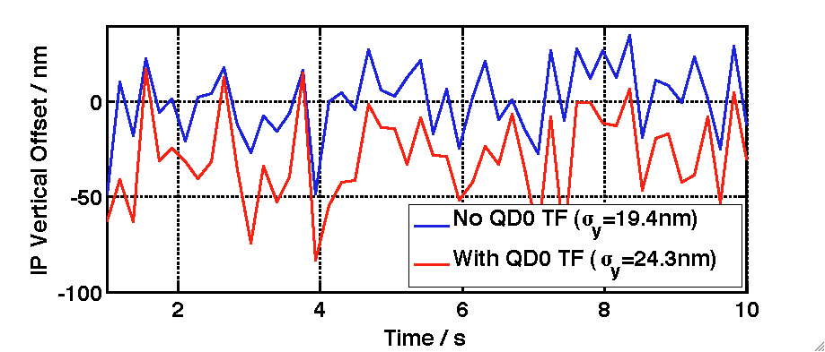
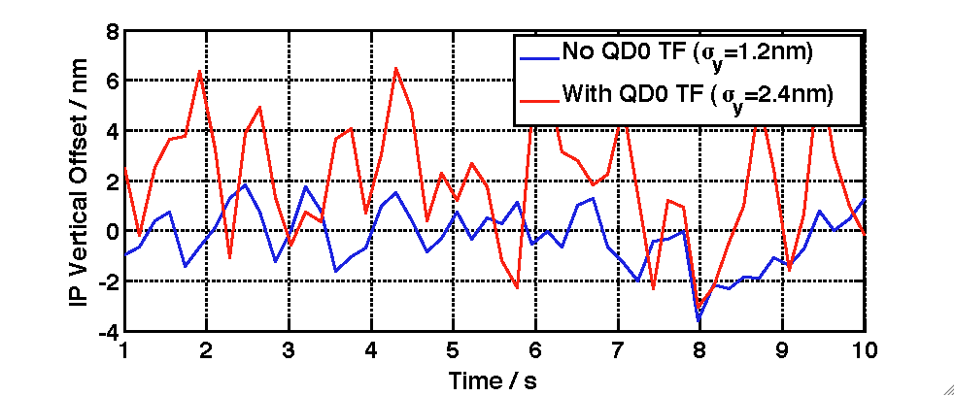
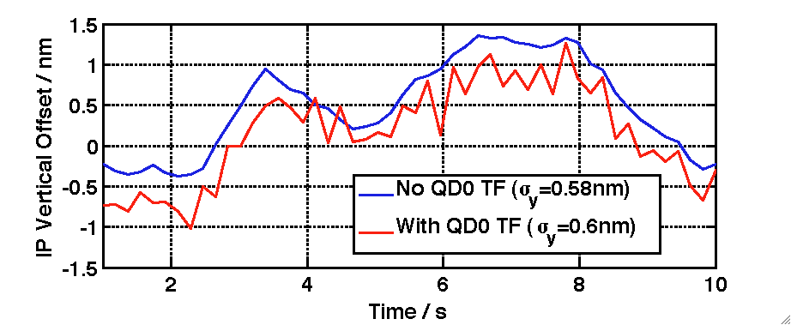
GM Induced Jitter @ IP (Vertical Offset between e- and e+ beams at IP) with and without QD0 TF
GM ‘C’
GM ‘B’
GM ‘A’

Slide 9
Luminosity Loss Mechanisms and Preventative Feedbacks
Ground motion causes misalignment of all BDS magnets, causing growth of beam orbit over time
2 mechanisms for Luminosity loss
  Beamsize growth at IP
    Orbit generates emittance growth due to dispersive kicks along the beamline
    Offsets in non-linear elements cause larger beamsize at IP through introduction of linear and higher order aberations (mainly waist offset, dispersion and coupling)
  Beams move out of collision in position and angle at IP
Slow orbit feedbacks keep beamsize effects from becoming too large
  Still residual pulse-pulse jitter at IP, this must keep within the tolerances of the intra-pulse feedback system (ideally ~<200nm)
Intra-pulse feedbacks keep beams in collision.
  Depends on shape of pulse train, incoming conditions etc which are hard to model. Model a conservative case tuned to deal with harsh conditions.
  Performance limited by speed of convergence (governed by intra-pulse jitter conditions and pulse shape reproducibility) and beamsize growth due to correction kick induced offset through SD0 (depends on the size of the required correction (IP offset)).

Slide 10
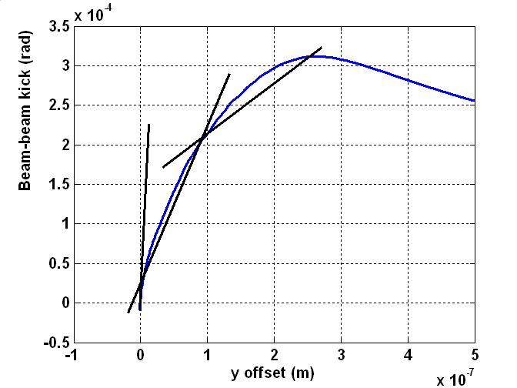
Intra-Pulse IP Feedback
Use ILC IP FFB, tuned for ‘noisy’ conditions (like those simulated for TESLA)
Assume BDS-entrance FFB has perfectly flattened beam train (flat trajectory into Final Doublet).
No systematic or random intra-pulse distortions.
Calculate Luminosity from measured bunches, with mean of last 50 weighted to account for the rest of the beam train (1320 bunches).

Slide 11
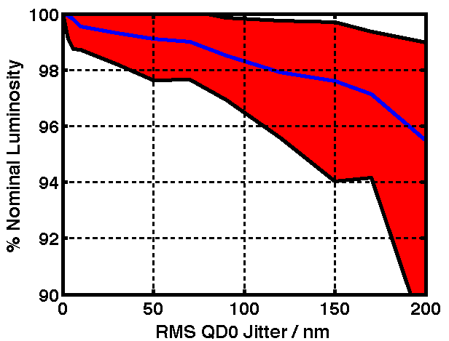
Luminosity Loss vs. QD0 Jitter
Data shown gives % nominal luminosity for different levels of uncorrelated QD0 jitter.
  100 pulses simulated per jitter cases with FFB
  Mean, 10% & 90% CL results shown for each jitter point from 100 pulse simulations
Tolerance to keep luminosity loss <1% is <50nm RMS QD0 jitter.

Slide 12
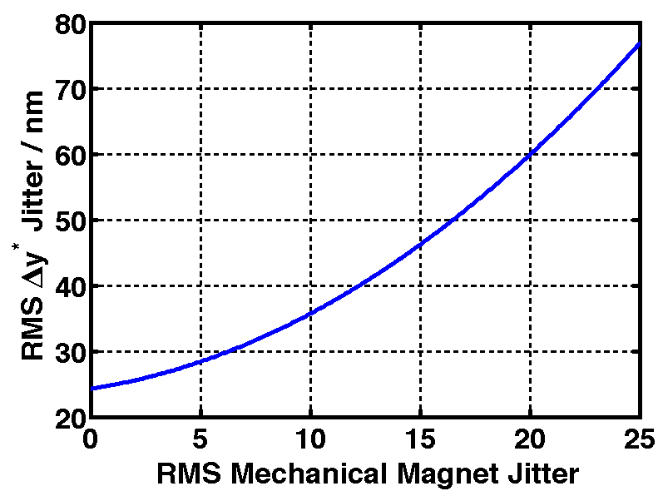
Mechanical Jitter of Magnets
GM ‘C’ + QD0 TF + mechanical jitter added to all BDS magnets
Could tolerate -> 17nm RMS additional mechanical magnet jitter.
/ nm

Slide 13
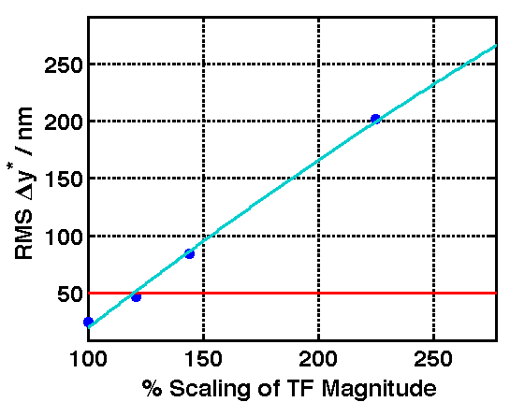
Scaling of TF Magnitude
Scale magnitude of TF attached to QD0
Can be scaled by -> 120% before required 50nm RMS IP offset jitter exceeded.

Slide 14
Conclusions
In the worst GM model considered (‘C’), the QD0 TF studied increases expected jitter of QD0 magnet from 19.4 -> 24.3 nm
  The effect in GM Models ‘A’ and ‘B’ is negligible.
The jitter tolerance to keep luminosity loss <1% is <50nm RMS
  The TF studied meets this requirement in the worst studied GM case.
  Can scale magnitude of provided TF up to 120% before exceeding tolerance.
This assumes no other mechanical vibration
  For GM ‘C’ and the studied TF, up to a further 17nm RMS jitter can be tolerated whilst keeping within the 50nm tolerance.

