Slide 1
Recent Status of ATF
N.Terunuma, KEK
R&D highlights
  3.5 cells RF Gun
  Upgrade of the DR BPM Readout
  Fast Kicker
  4-mirror Compton Generation
Hardware maintenance issues
Brief report on the fire accident and the earthquake
22/Mar/2011 ATF/ATF2 session@ALCPG11, Eugene, OR

Slide 2
2010 Autumn/Winter Run
Beam operation: 7 weeks
  Fast kicker mode … 2 weeks
  ATF2 continuous run … 1 week
2011 before summer
?
?
First priority is ATF2-37 nm until the end of March.
… 7 weeks

Slide 3
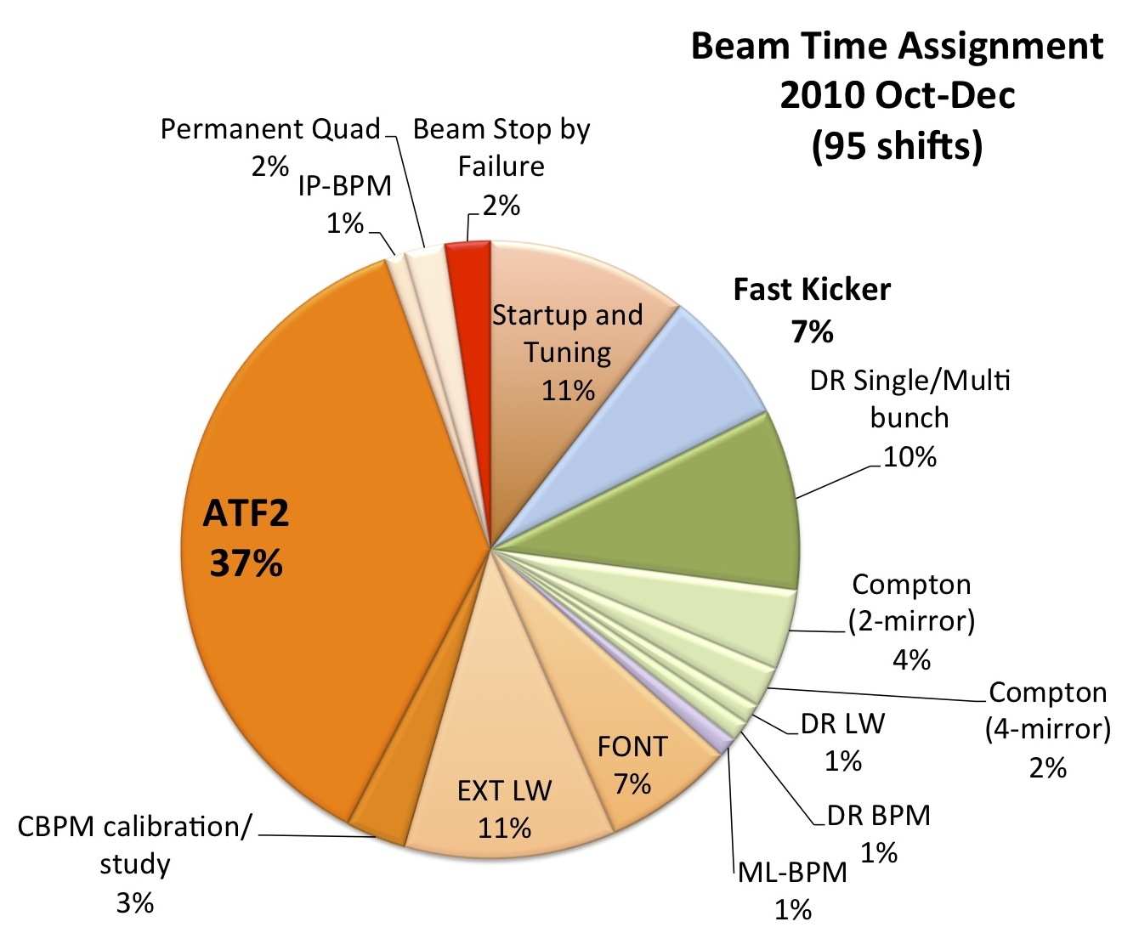

Slide 4
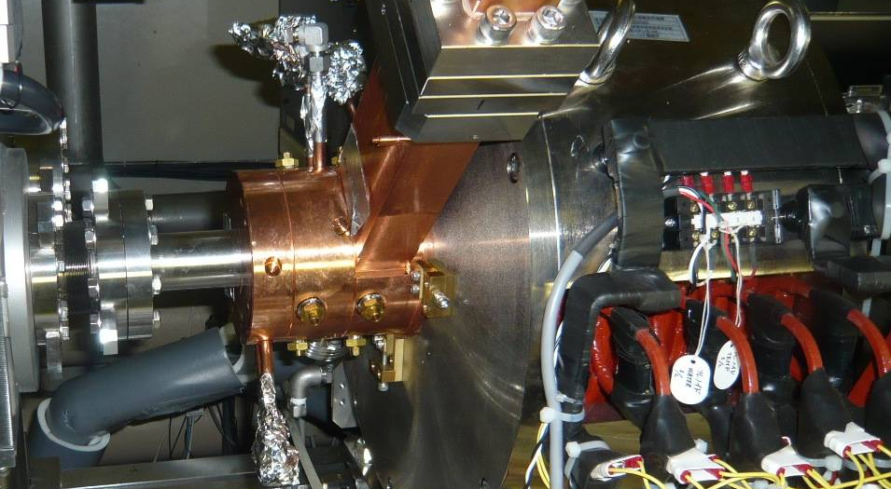
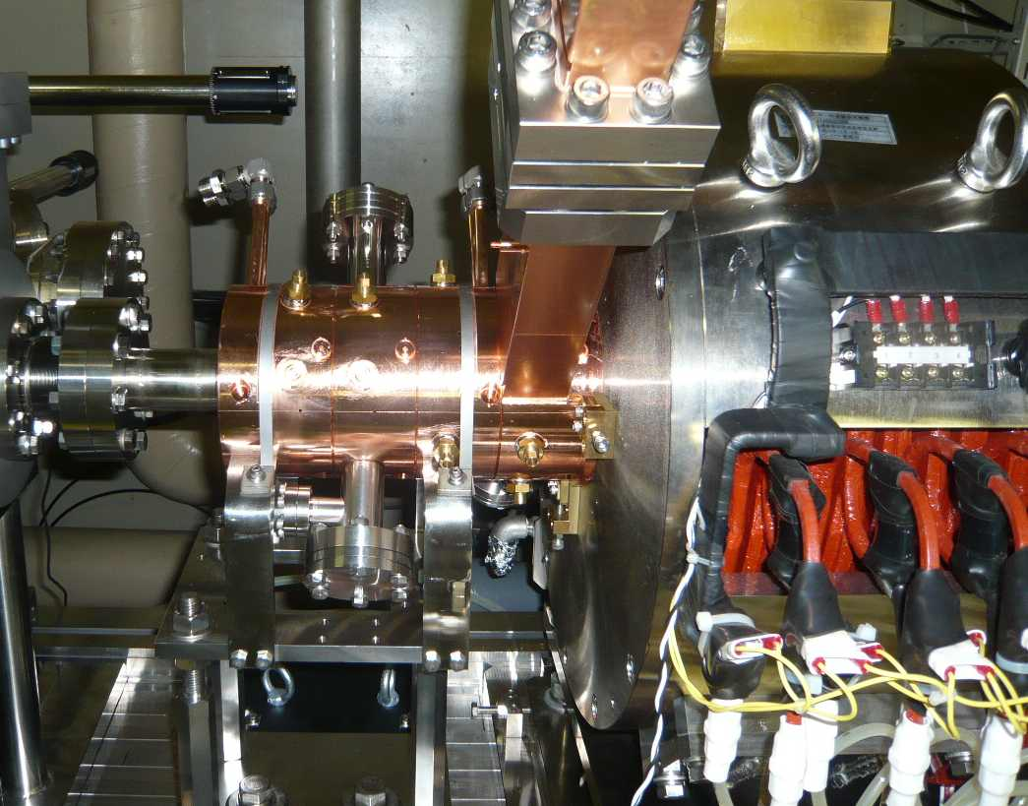
RF Gun Renewal
2009 Oct: Upgraded 1.6 cell RF gun was installed.
2010 Oct: New 3.5 cell RF gun was installed to assist the developments on Compton X-ray program (LUCX).
It is a mode-separated RF gun based on the LUCX RF-gun (1.6 cell) installed in 2009.
Increase the tolerance of phase stability
Aim to increase the beam energy 5→10 MeV

Slide 5
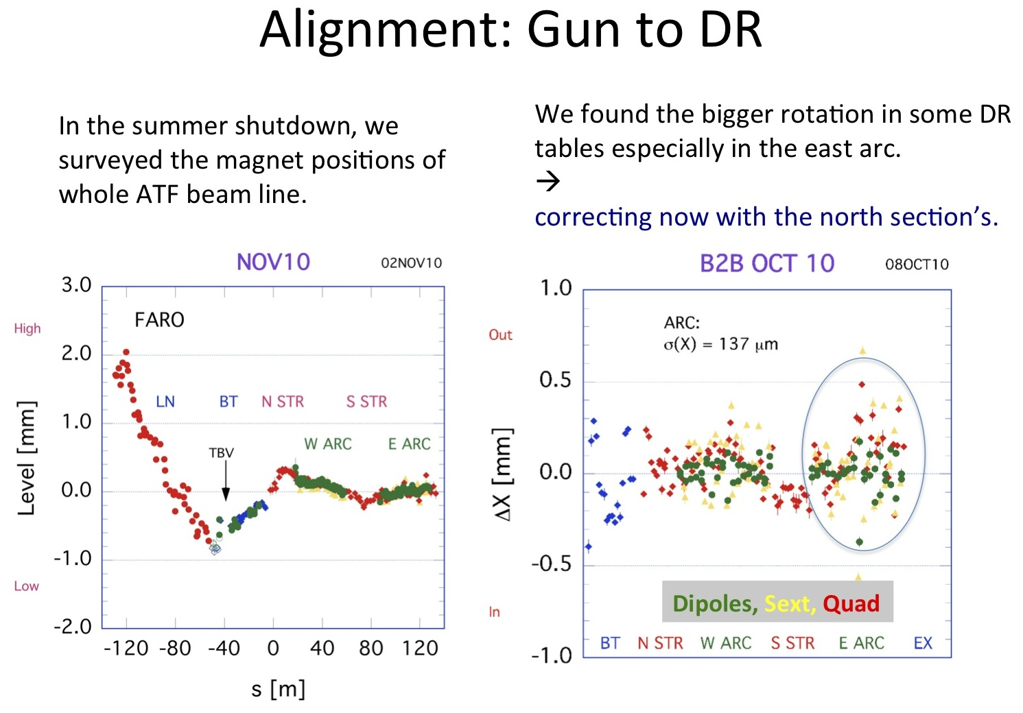
East to north section was corrected in Jan. 2011

Slide 6
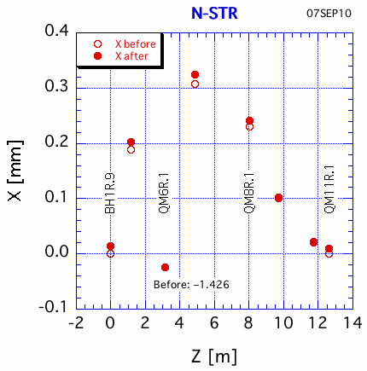
Alignment: DR North(Inj/ext)
During the survey of the magnet positions in summer, we found a huge position shift on QM6R.1 (just after the ext-kicker); X~1.4mm, Y~0.25mm.
We do not know when it happens.
during the fast kicker installation in July??
Corrected in September.

Slide 7
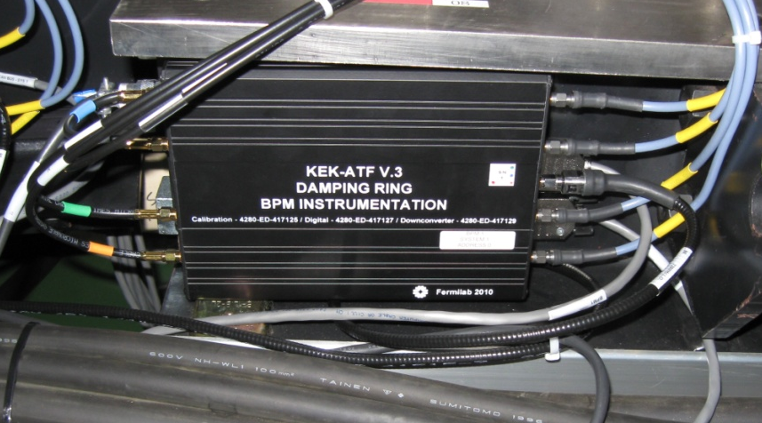
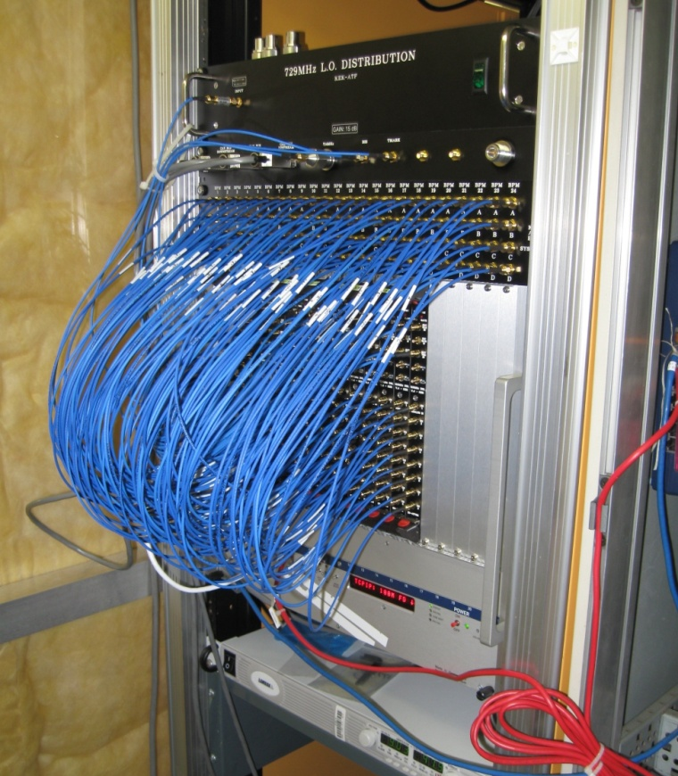
ATF DR BPM Hardware
Analog downconverter
(located in the tunnel)
  CAN-bus controls, IF filter, remote diagnostics, etc.
RF, DC & CAN-bus distribution.
Grounding of tunnel hardware.
In-house VME digitizer
  8-ch. ,125 MSPS ADC (serial outputs), Cylcone III FPGA, PLL-locked CLK distribution
  Able to measure Injection TBT, narrowband orbit,
  narrowband CAL orbit, and last turn on every injection
Downmix &
Calibration
LO & CAN-bus
Distribution
Timing Module &
Custom Digitizers
DC PS &
Distribution

Slide 8
Digital Signal Processing
No Modes - on external trigger processes data in parallel
  TBT Filter
    provide magnitude per turn for position & intensity
  Narrowband processing (Filter & Decimate)
    Provide magnitude of I,Q for position & intensity
    Store array of I,Q per channel for readback
  Raw ADC data to RAM
    diagnostic readback
  Programmable trigger delay per channel (adc samples)
Any data type (NB, TBT, Raw) can be readback after each trigger
  All data will be read out as I,Q pairs
  Caveat: The CAL tone has to be disabled for TBT data
  Each board pulls IRQ when data is ready

Slide 9

Fast kicker study
Machine Time
2011/10/18~10/29(2 weeks)
TB meeting
2011/01/14 T.Naito

Slide 10
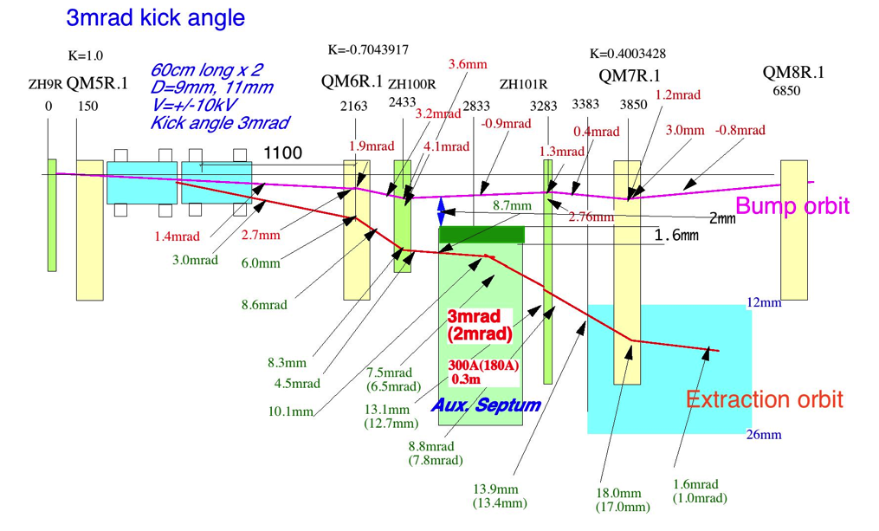
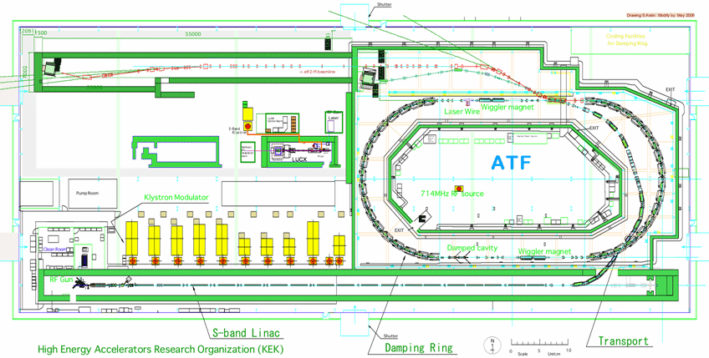
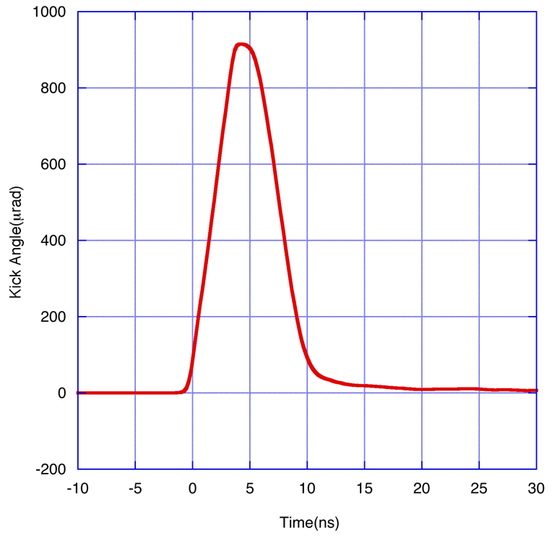
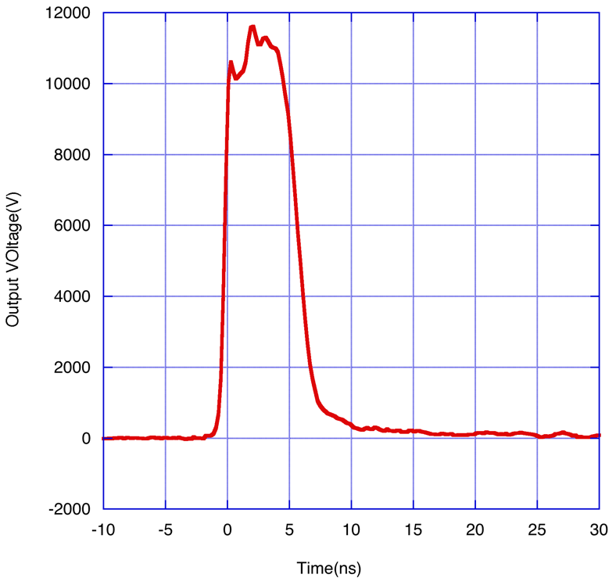
Beam extraction test(1)
The beam extraction test was carried out to confirm the performance of the strip-line kicker.
The pulsed magnet kicker was replaced to two units of 60cm long strip-line kicker.
To help the lack of the kick angle, a local bump orbit and an auxiliary septum is used.
Extraction kicker
ATF2 Extraction line
Damping Ring
Kicker pulse
(10kV)
Kicker field

Slide 11
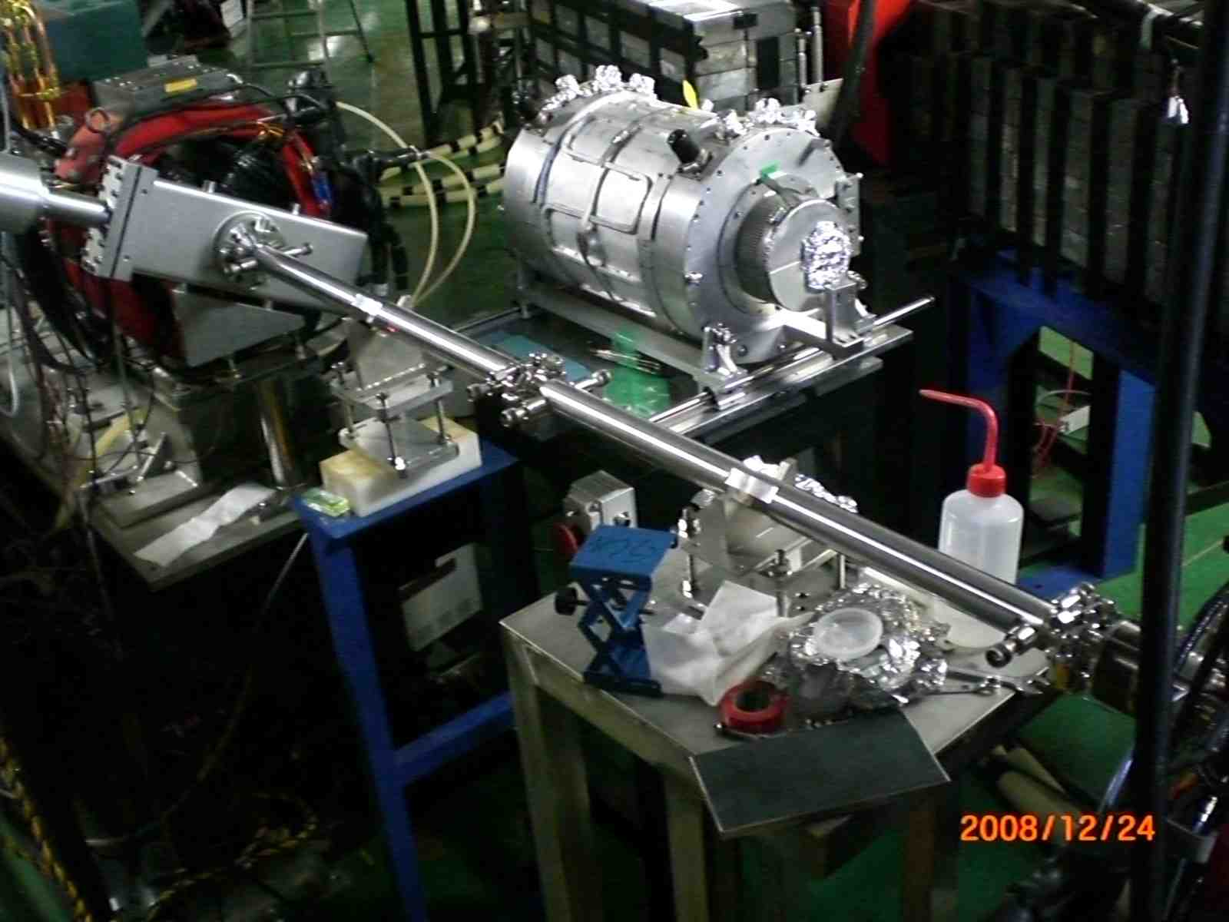
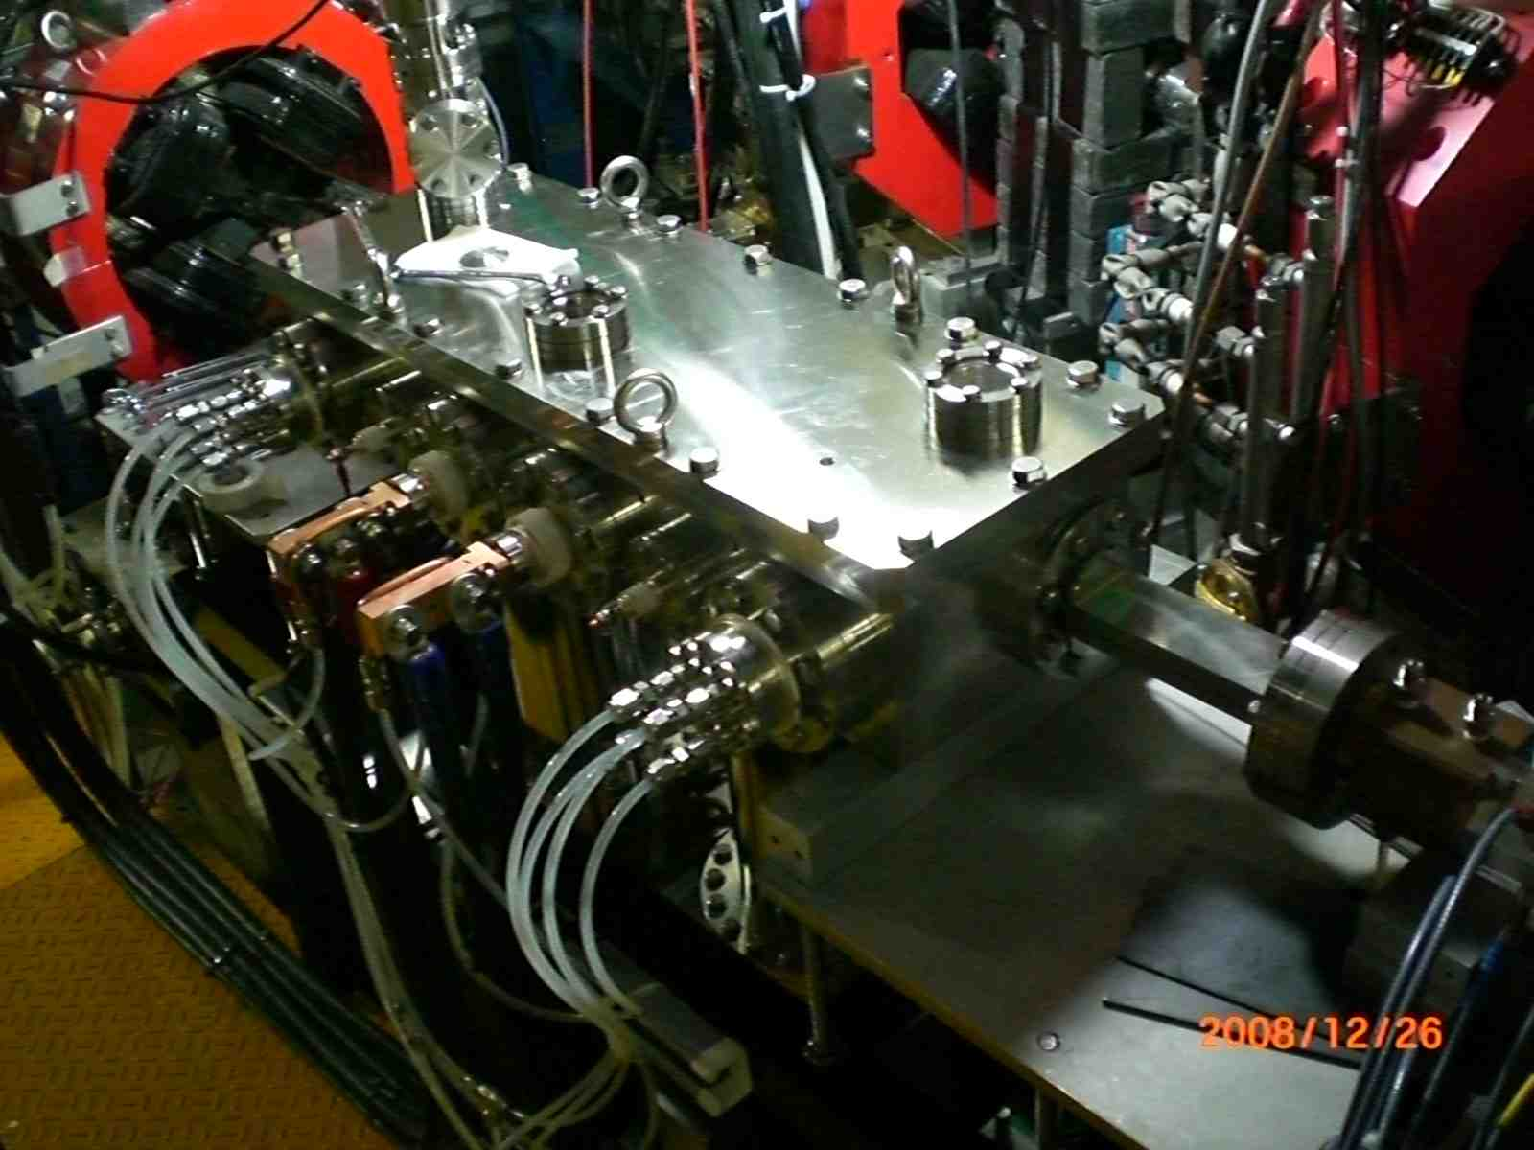
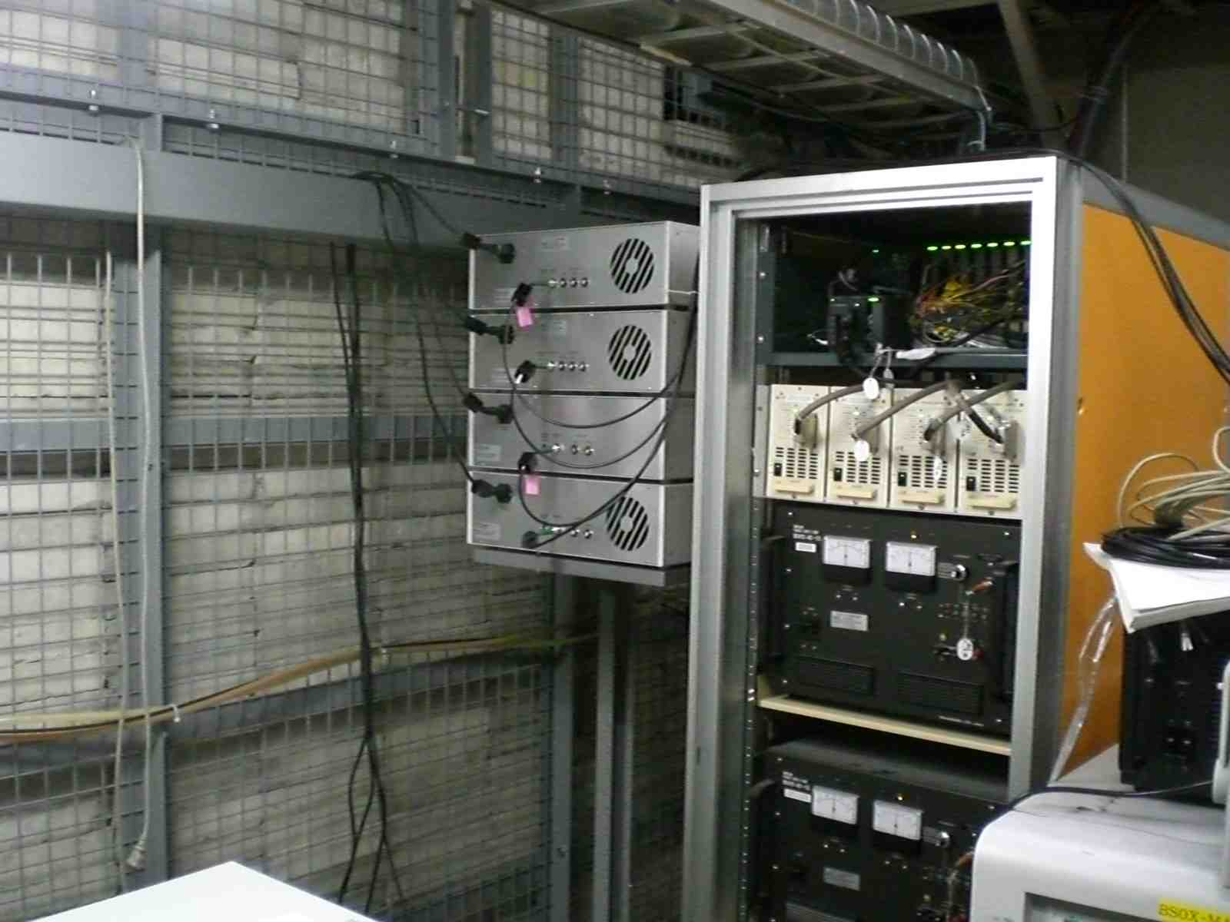
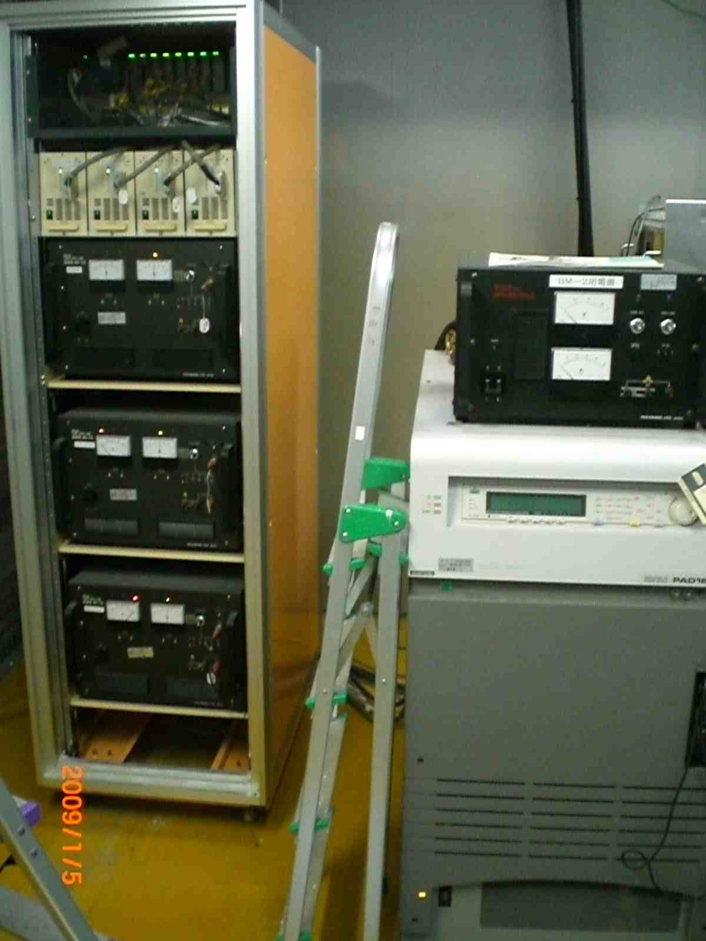
Pictures of the installed components
Strip-line electrodes
Aux. Septum
FDI pulsers
Bump PS and Septum PS

Slide 12
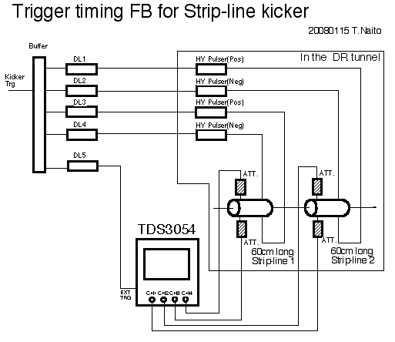
Programmable
Digital delay
Precise triggers for each pulser and the timing control is required. The pulse measurement by the scope and the timing control by digital delays consist the trigger timing feedback. The step of the digital delay is 60ps. The trigger system could keep the pulse timing in the range of 200ps.

Slide 13
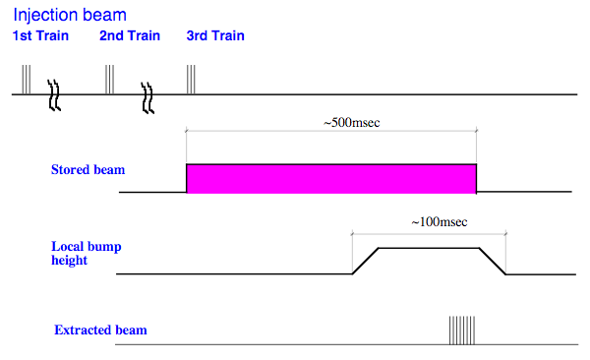
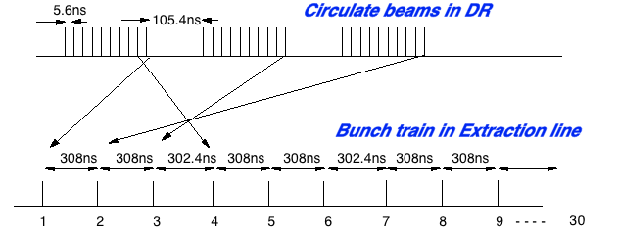
Beam extraction test(2)
The time sequence is that ,
10 bunches with 5.6ns bunch spacing beam is injected to the DR three times, 30 bunches total.
The local bump orbit is excited gradually after all of beam is damped.
The beam is kicked out bunch-by-bunch by the strip-line kicker.
The local bump orbit is return to zero.

Slide 14
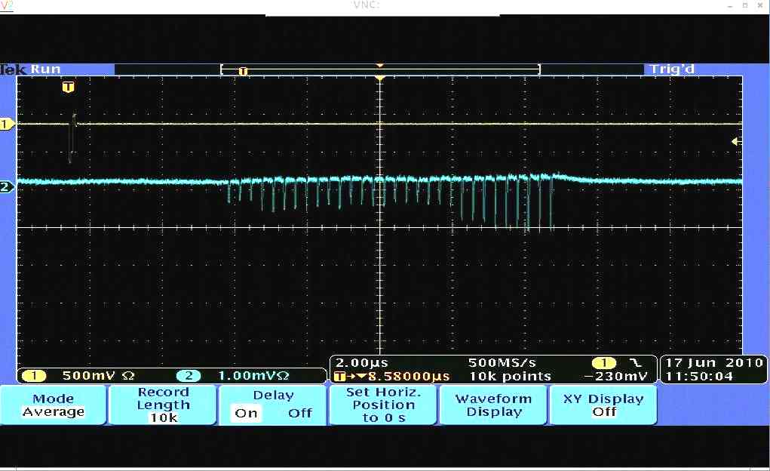
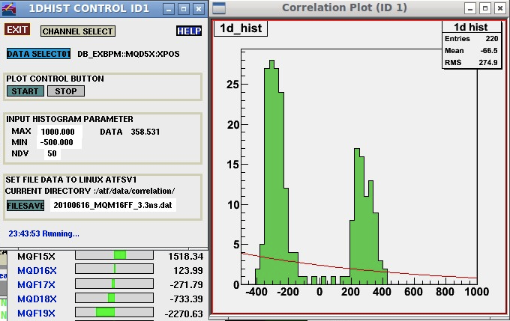
Multi-bunch extraction (30 bunches) with 308ns bunch spacing
2010/06/17
The intensity of each bunch is not flat and unstable.
The horizontal beam position was distributed to two position.

Slide 15
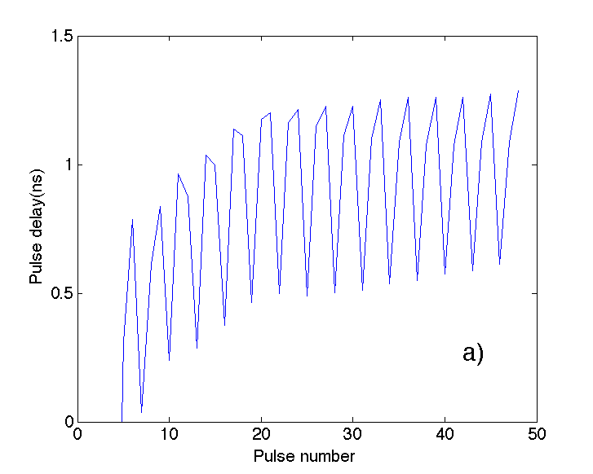
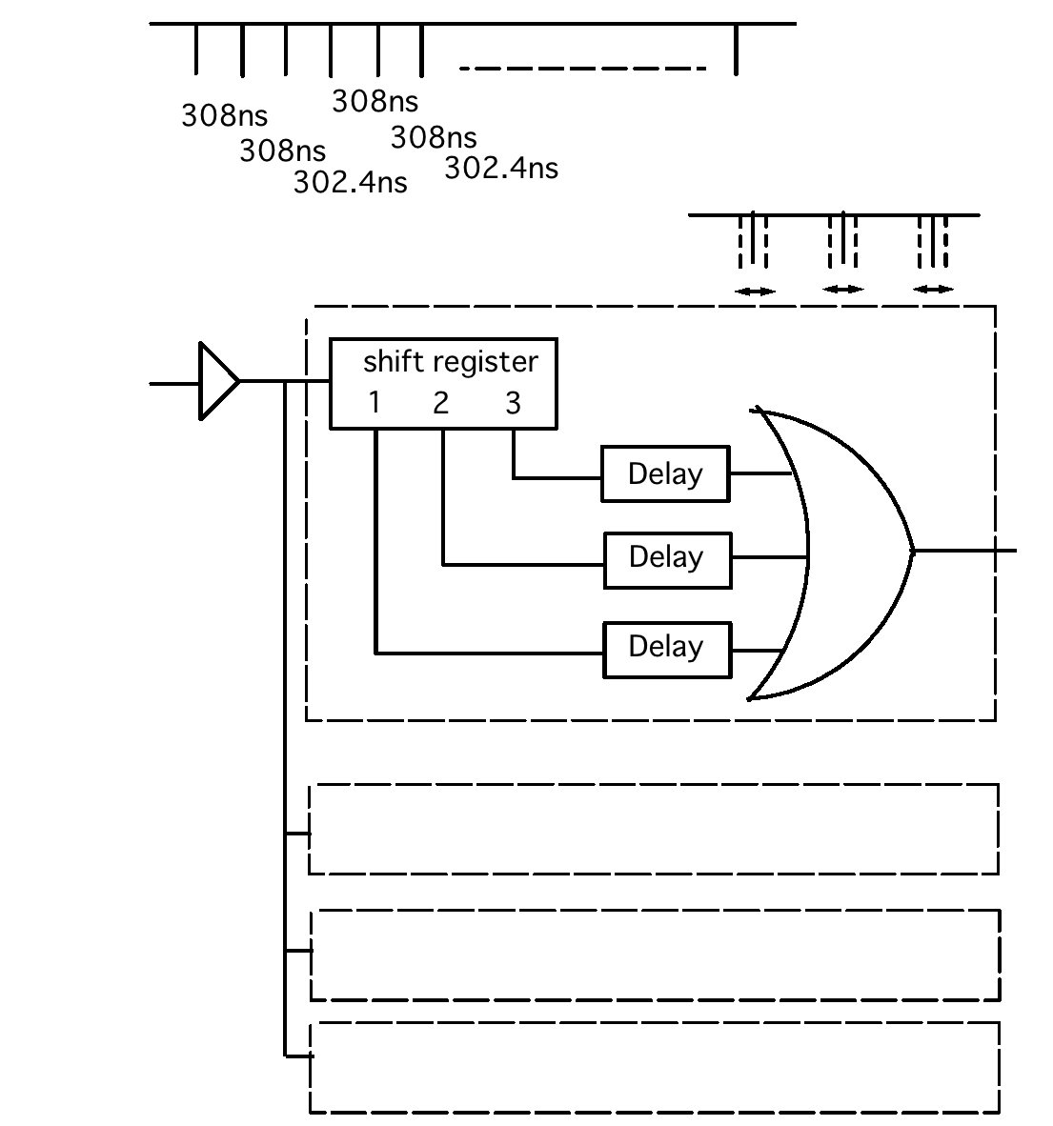
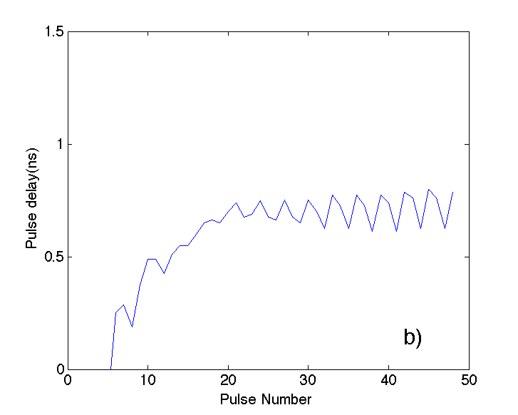
Pulse train delay adjustment circuit
w/o delay
with delay
Use for beam extraction

Slide 16
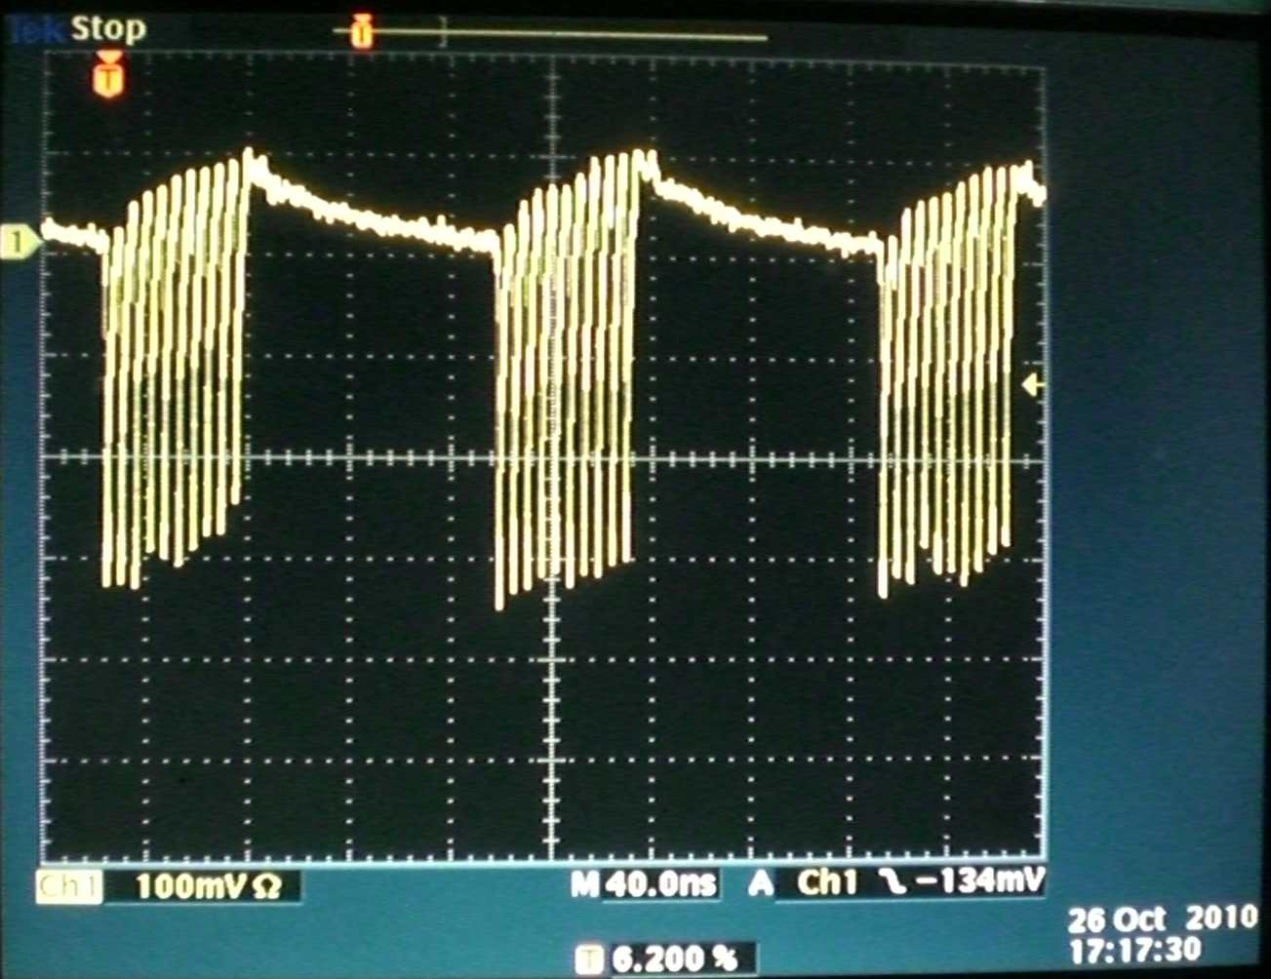
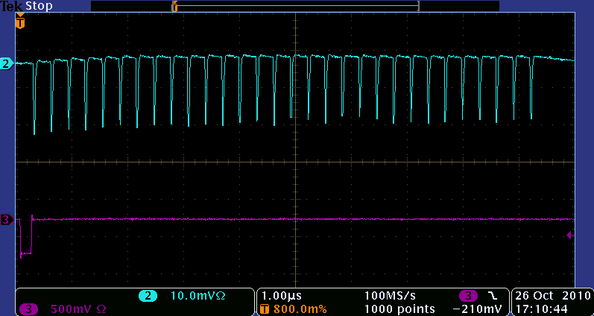
Multi-bunch Beam in the DR and the extraction line
30 bunches of the beam are stored to the DR, stably.
Stable beam extraction was confirmed at the extraction line. The beam reach to the beam dump without any beam loss.
2010/October

Slide 17
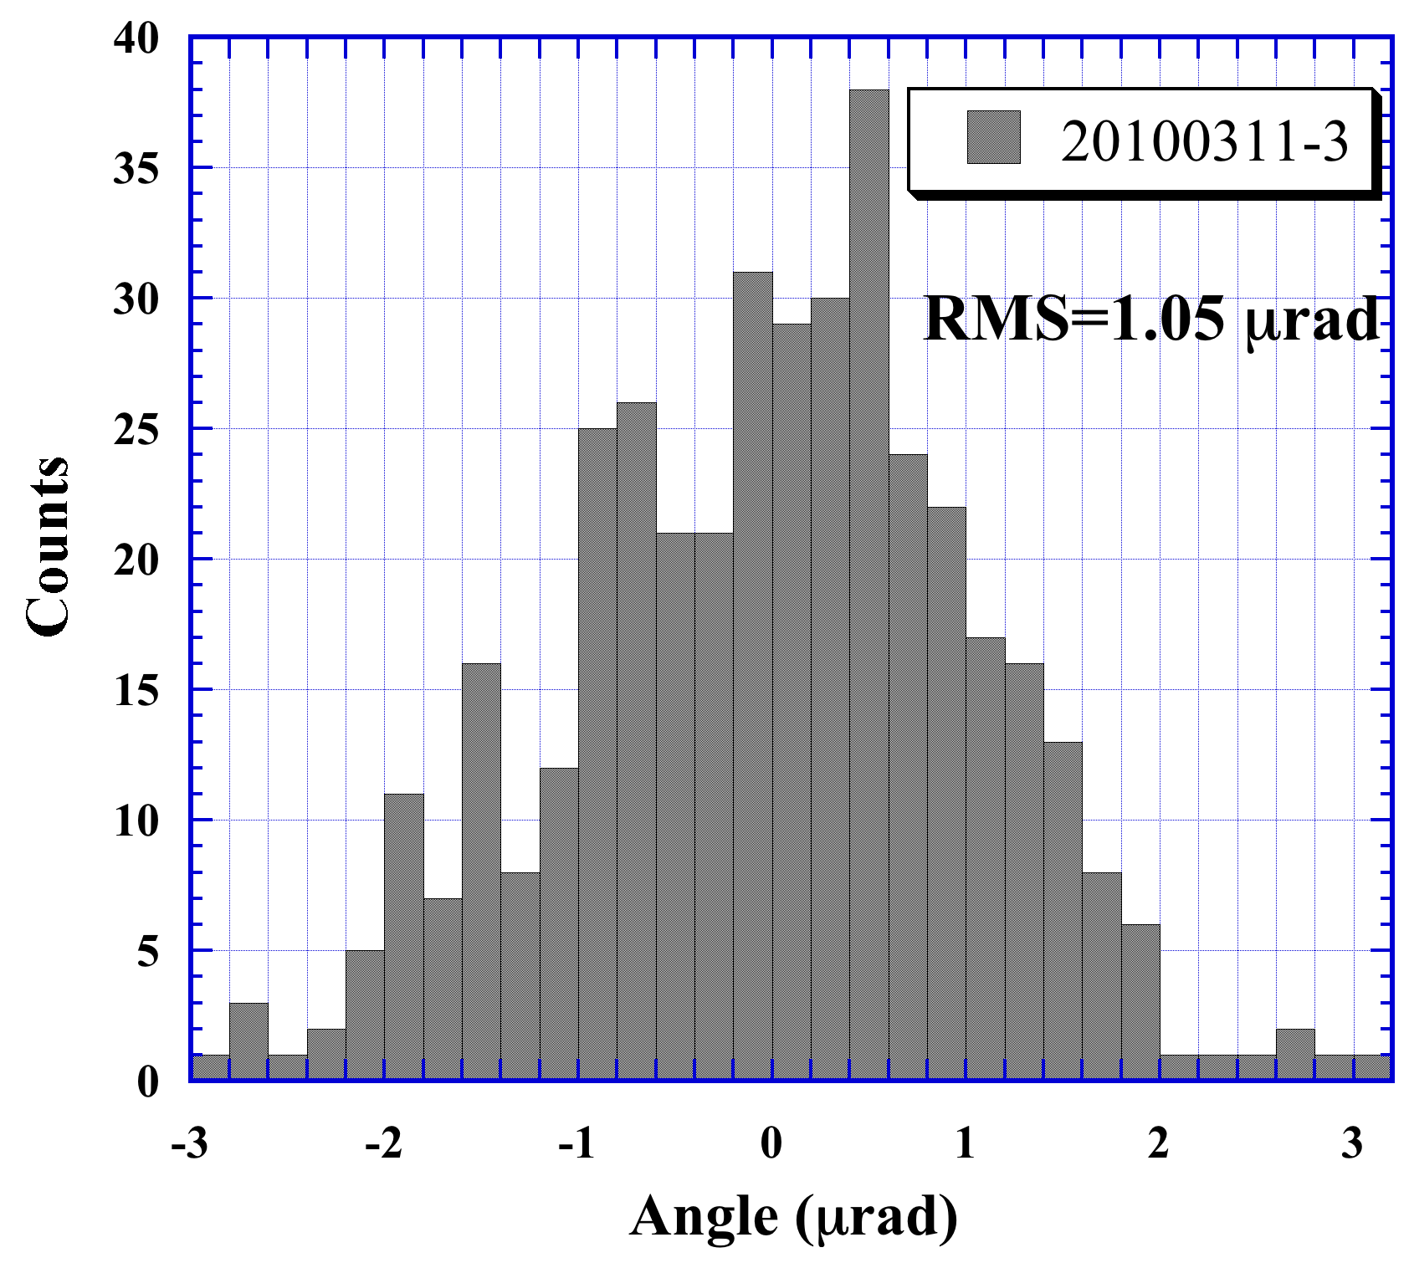
Kick Angle Stability
Kick angle stability was evaluated by the cavity BPMs at ATF2.
1.05 μrad/4.6 mrad
= 3.5x10⁻⁴
It still has a jitter due to the timing jitter.
Comparable to that of the conventional Pulse Kicker
Ex: ATF double kicker
2.8x10⁻⁴
(single: 9.4x10⁻⁴)

Slide 18
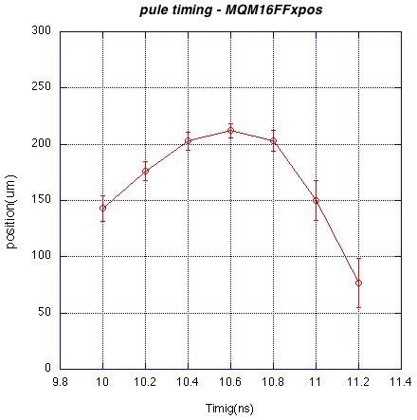
Profile of the kick field and the jitter
Plot shows the beam position at MQM16FF BPM, when scanned the kicker pulse timing. There is no flattop of the kick field and the jitter increased at the both side of the peak.
To make stable beam kick, careful timing adjustment of four pulses is needed.
200ps

Slide 19
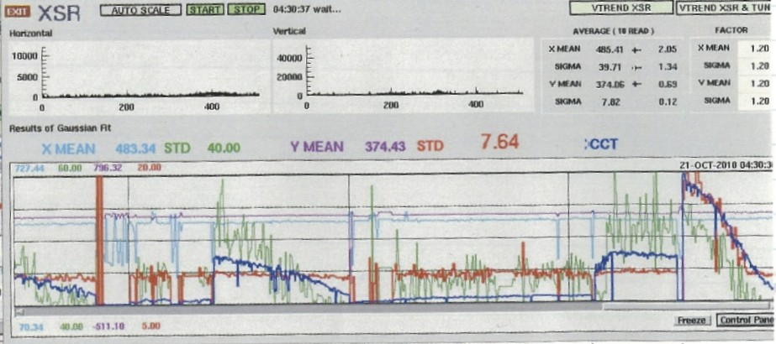
Problem: Stored beam intensity in DR
2hour
Blue line: current
Red line: v size (XSR)
single bunch
1 train
9 bunch
1 train
Itot=2x10¹⁰
9 bunch
3 train
Itot=6x10¹⁰
The stored current decreased gradually when the multi-bunch operation. The current decrease depends on the stored current. Several minutes after the beam stop, the situation recovered. We suspect the heating of the strip-line electrode made such a happeninig.
ATF geometrical constraints → shorten the electrode gap to get a sufficient kick

Slide 20
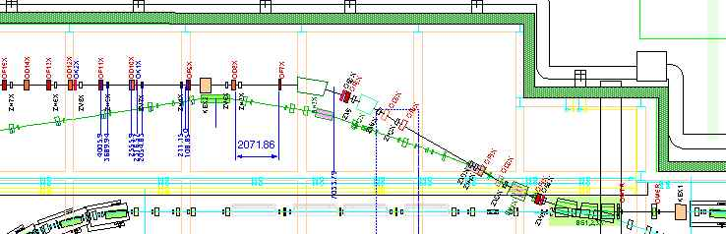
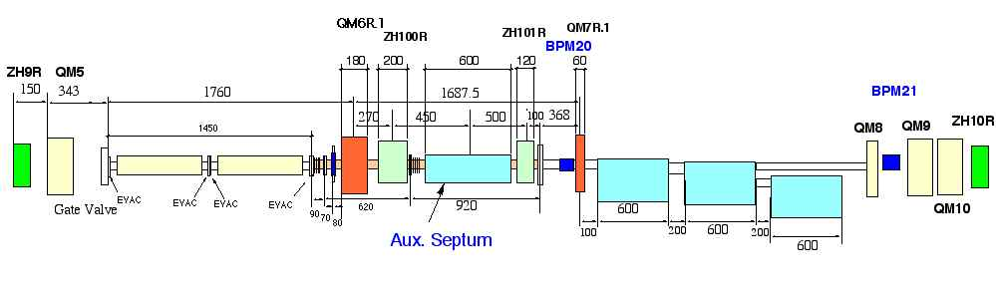
Kicker and PS location
6m cables
Steer Mag(5mrad)
The drive pulsers are located to the outside of the shielding.
Strip-line kicker 60cm
9mm gap, 11mm gap

Slide 21
Summary and Next step
Fast kicker performance was confirmed by the multi-bunch beam extraction from the ATF-DR to the ATF2 extraction line.
The kick angle stability 3.5x10⁻⁴ was measured for the single bunch beam. The multi-bunch kick angle and the stability were measured.
For the next step, we have to clear following problems,
High current beam storage is limited by the horizontal aperture of the strip-line(9mm).
The stored current reduction have to cure.

Slide 22
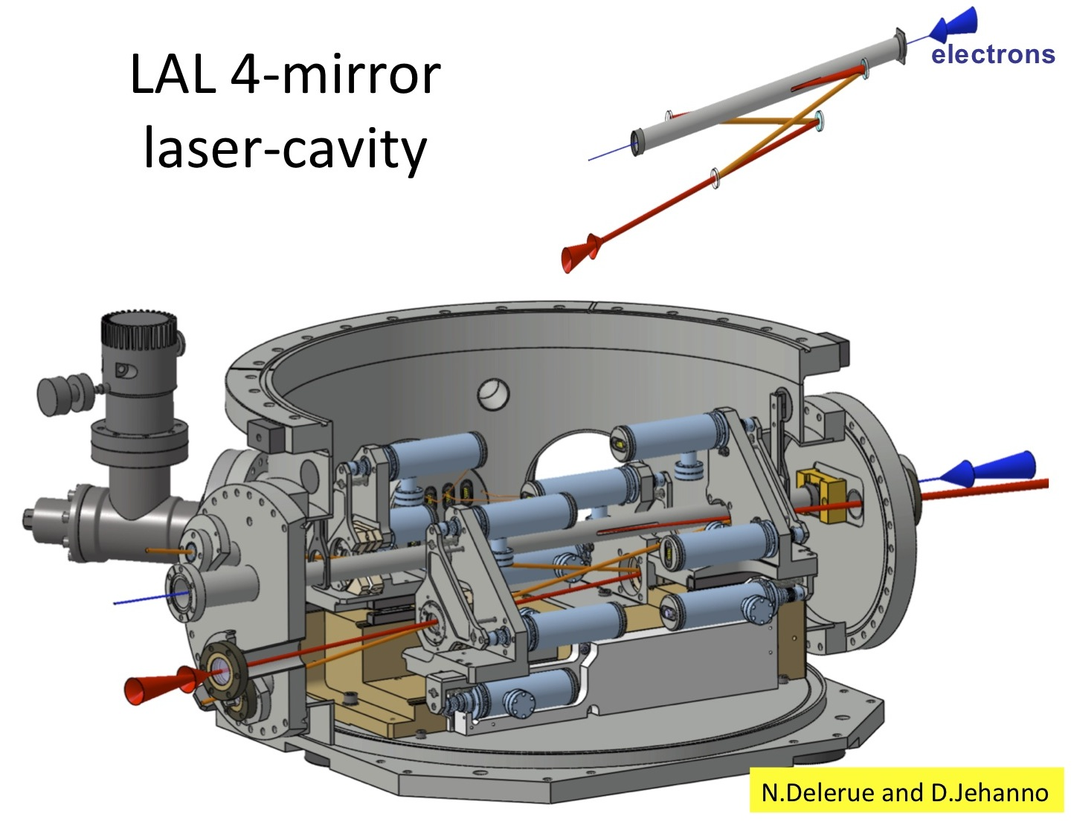

Slide 23

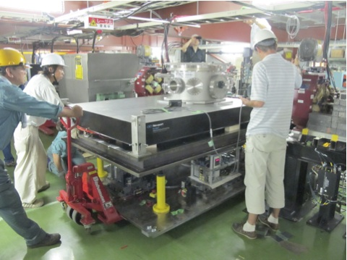
Mightylaser Milestones
2010
08
09
10
11
12
Installation
No laser
No laser
07/27
08/21
Laser shipped
to Zurich
Laser shipped
to Zurich
Laser locked to 4M cavity
HW update
08/30
11/17
4M cavity alignment to beam
Laser repaired
12/20
09/06
4M cavity locked to ATF Clock
4M cavity connected to beam
09/24
10/25
1st Compton gamma observed
11/01
Laser Failure
12/08
Compton gamma observed
N.Delerue and D.Jehanno

Slide 24
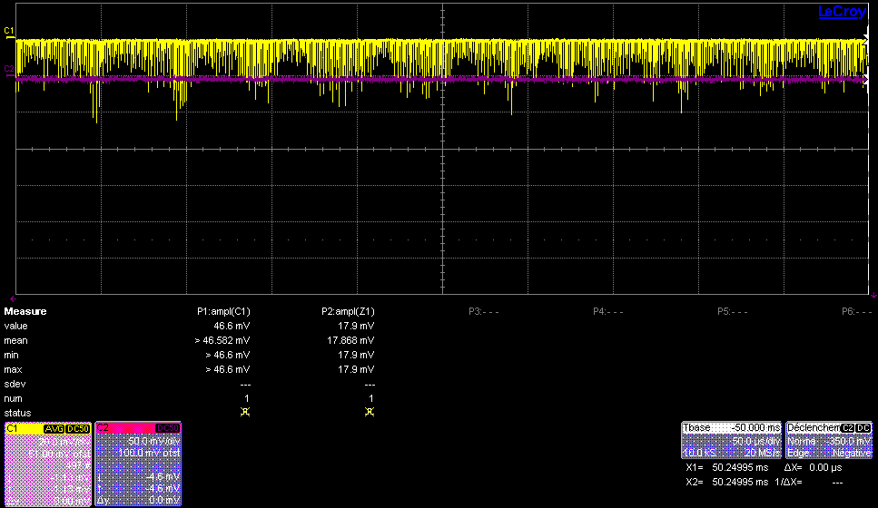
Compton production
Production of Compton photons (yellow trace) achieved regularly during weeks where the laser was available.
Our cavity can remain locked on the ATF beam for more than one hour.
However we see laser power fluctuations in the cavity indicating that our locking must be improved.
N.Delerue and D.Jehanno

Slide 25
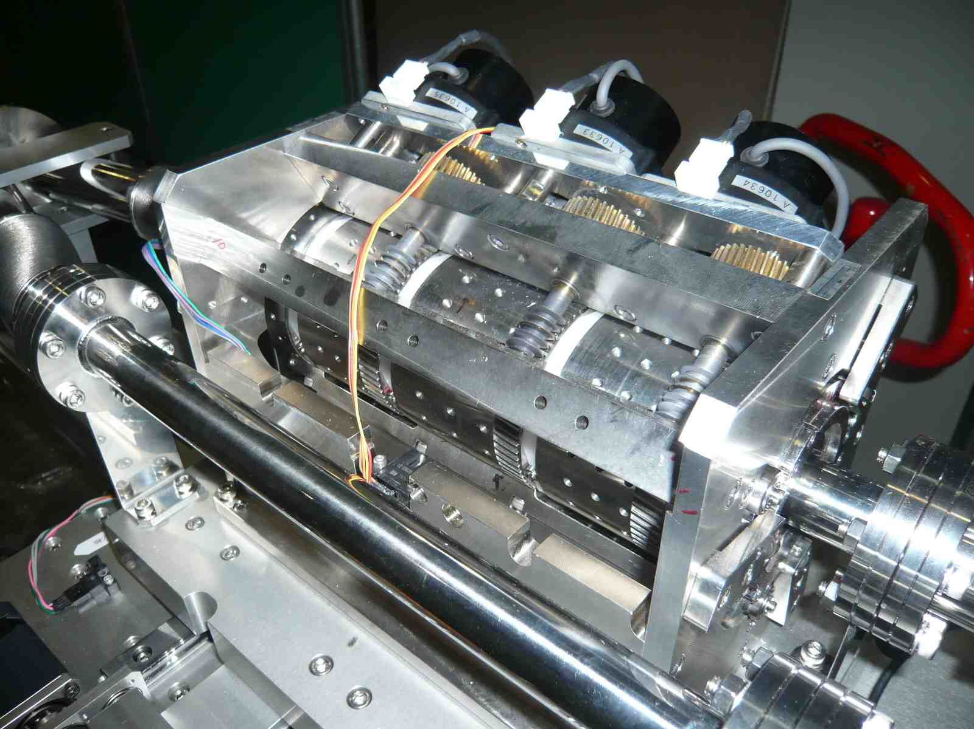
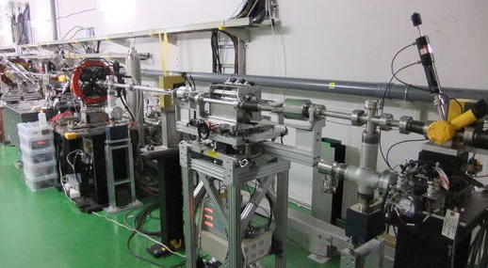
Extra beam operation on Dec 23rd
Permanent Magnet Final-Quad (Kyoto Univ.)
The magnet was assembled in Kyoto Univ in last fall.
It was delivered to KEK from Kyoto in the end of November.
Field measurement by a rotating coil was done.
It was temporally installed in ATF2 line from Dec. 21st to 25th.
Demonstration with beam was done on Dec. 23rd for the master thesis.
Results should be reported in next meeting (ATF2 or TB).

Slide 26
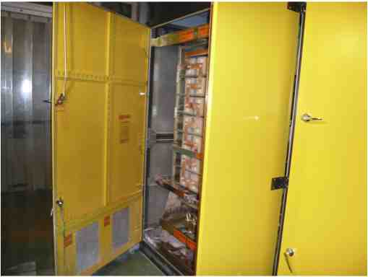
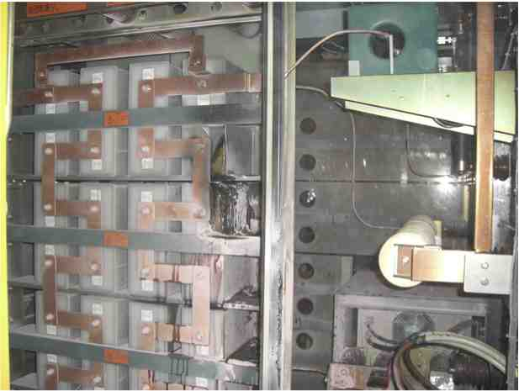
Fire Accident on the LINAC Klystron Modulator
A PFN capacitor of the renewed #0 modulator exploded and burned out on Feb. 16, 2011. (only~1,200 hours operation)
We needed three weeks to recover the accident.
Exchanged the modulator #0 ← #10(ECS)
Improved the failure sequence of the new modulators (i.e. for #8 operation).
A beam came back on March 10!
But… about a day later,
  Terrible Earthquake (M9.0) hit Japan.

Slide 27
Damage on the ATF facility
M9.0 Earthquake on 2011/Mar/11
Very quick investigation
with a flashlight under a power outage
N.Terunuma, KEK

Slide 28
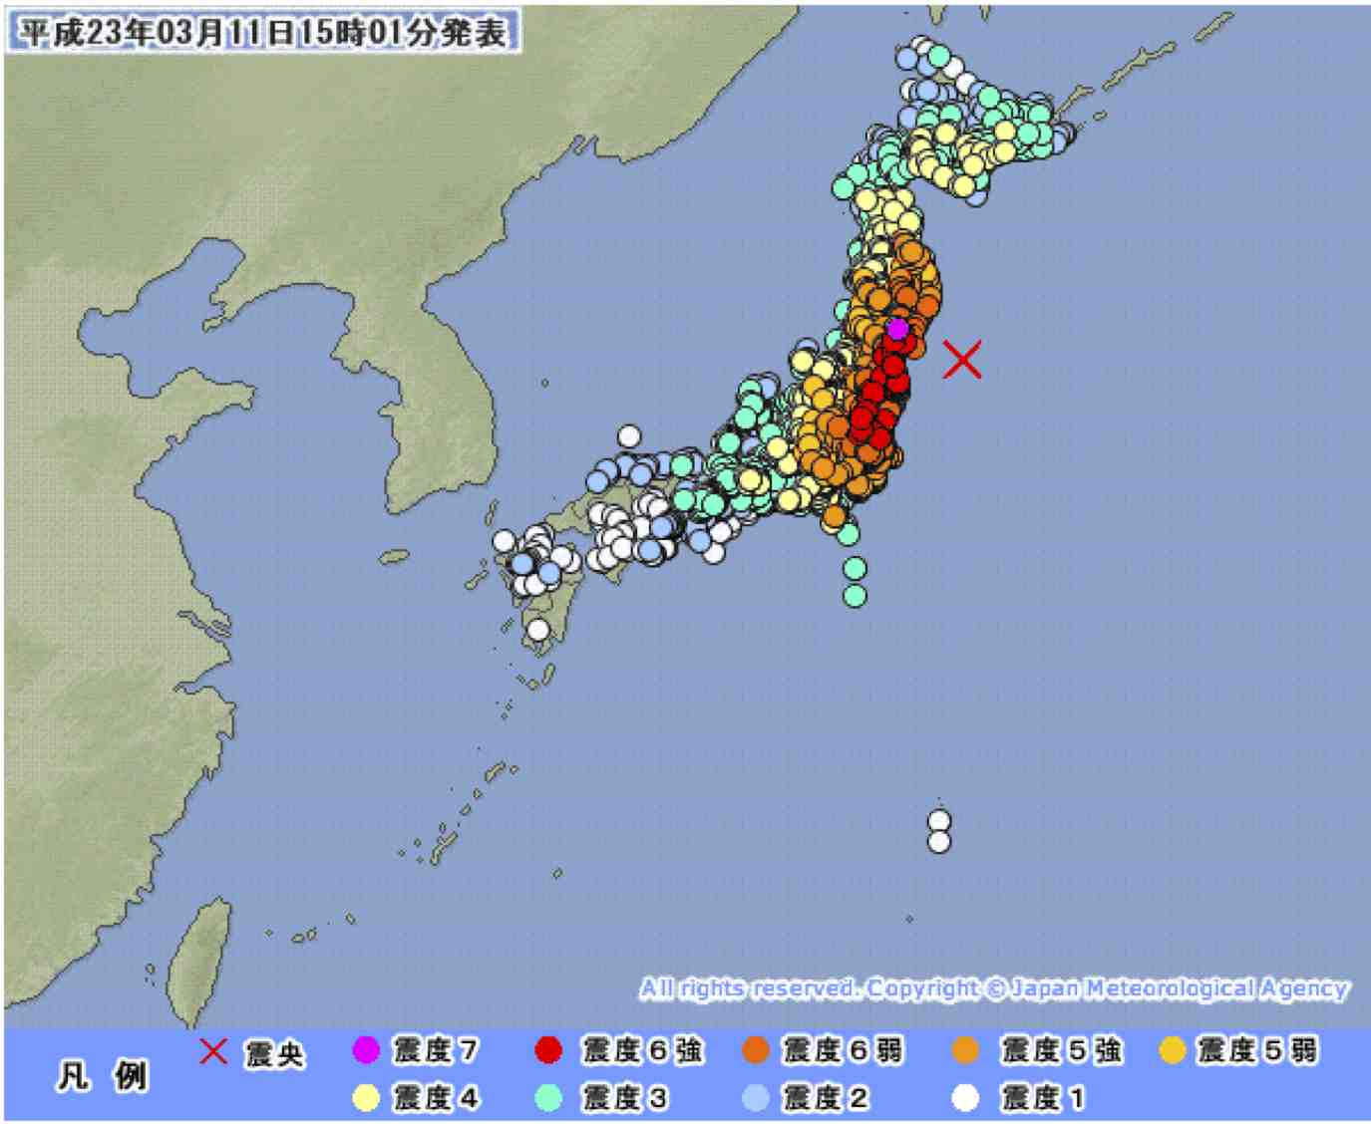
M9.0
Japanese Seismic Intensity

Slide 29
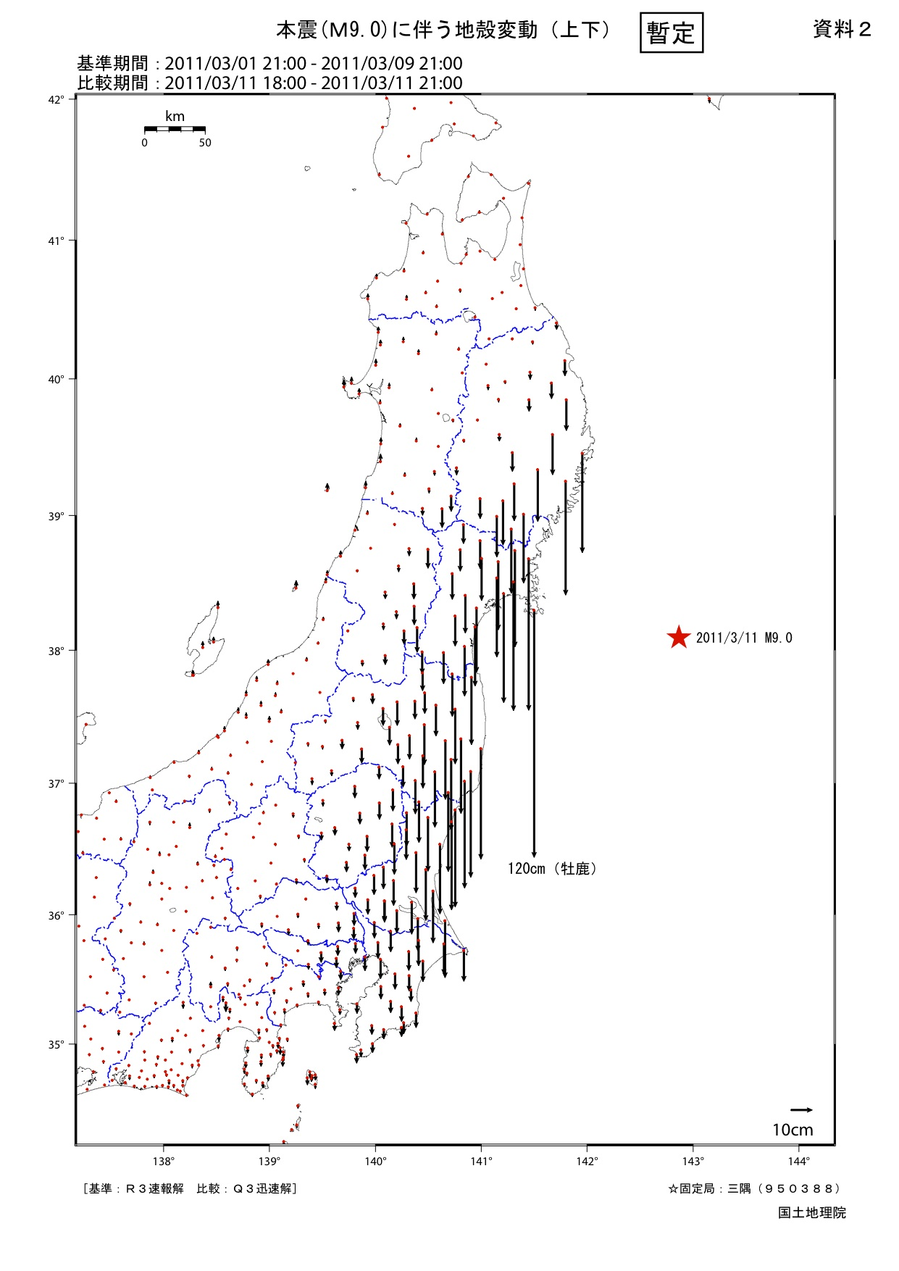
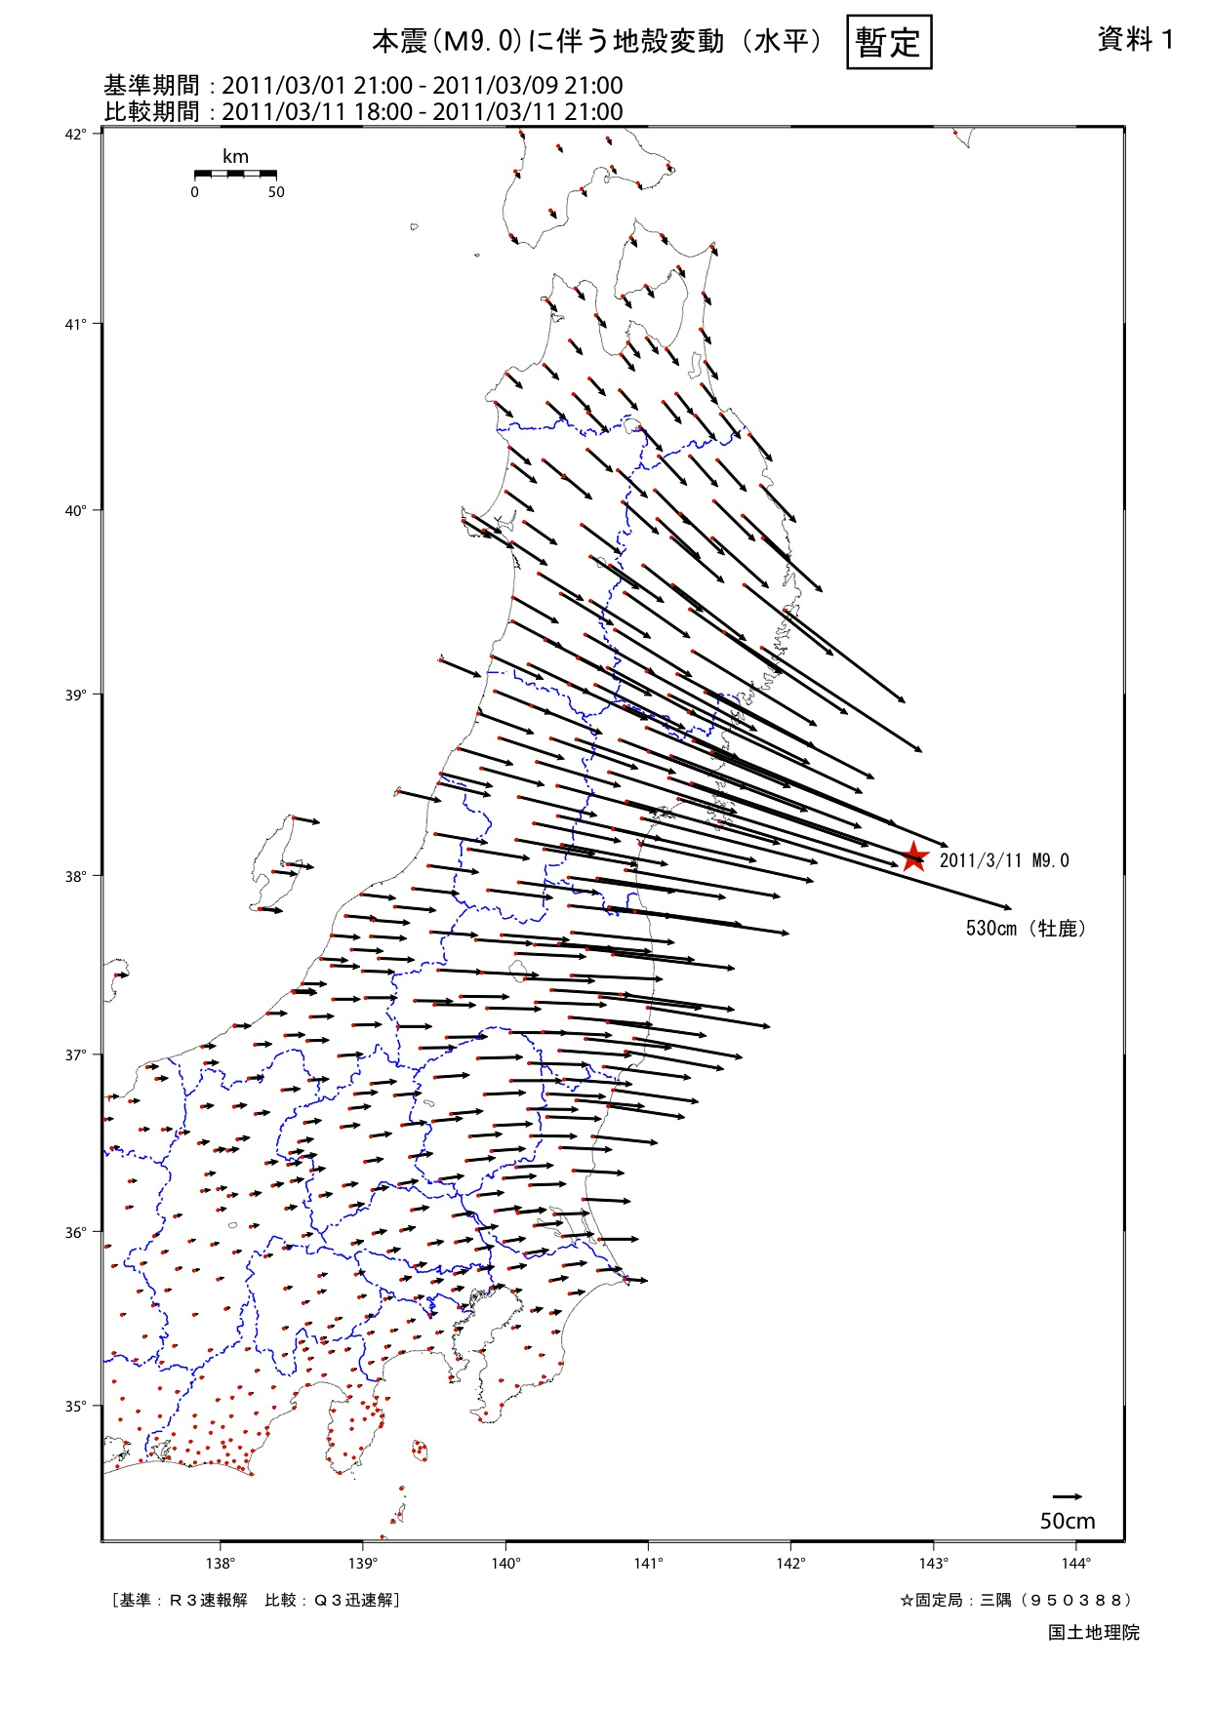
GPS by the National Geographical Survey Institute
VERTICAL
HORIZONTAL
Max. 5.3 m
KEK
10cm down
KEK
50cm to East

Slide 30
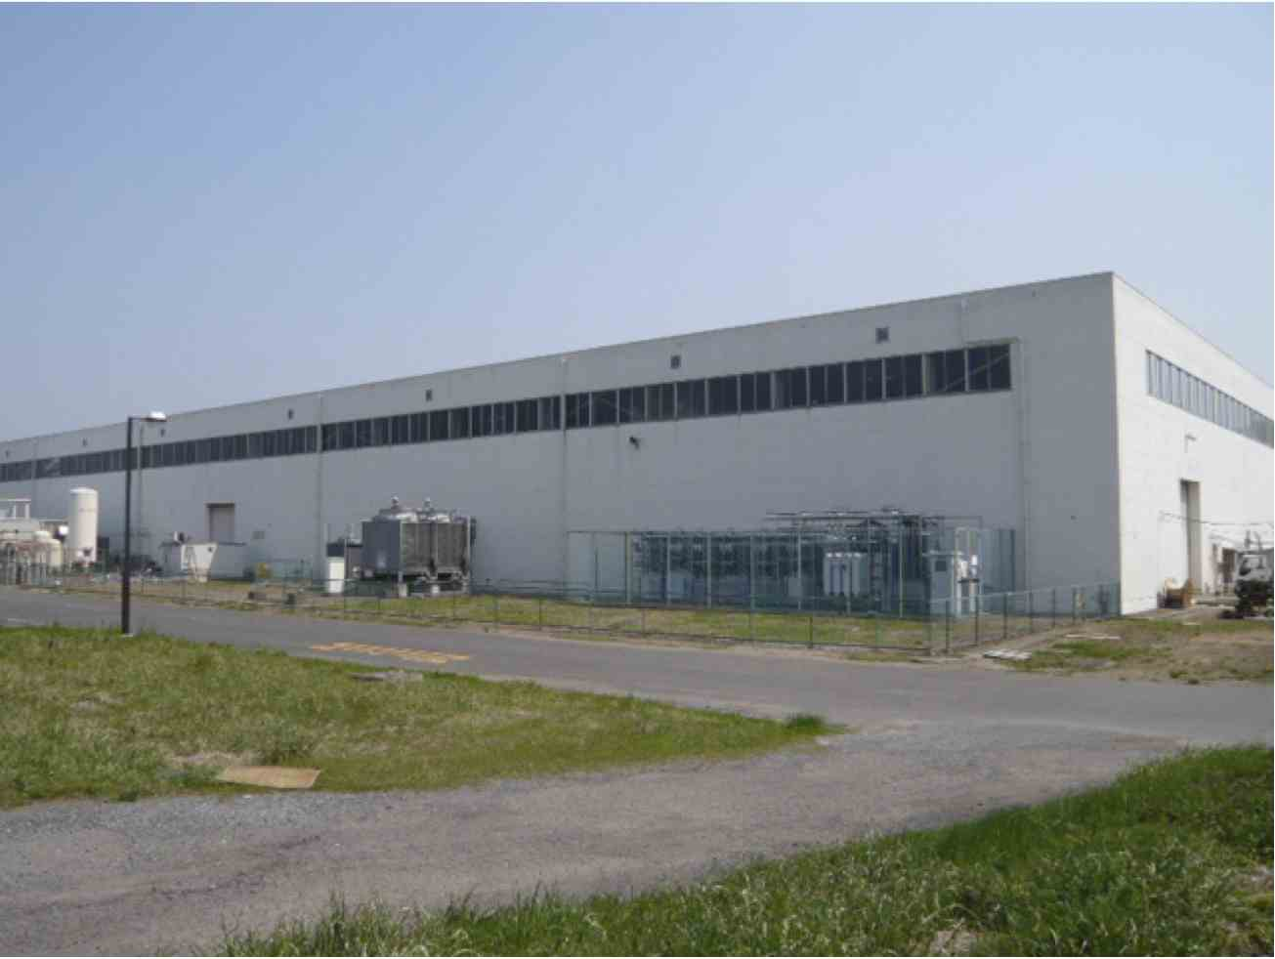
ATF Building looks fine…

Slide 31
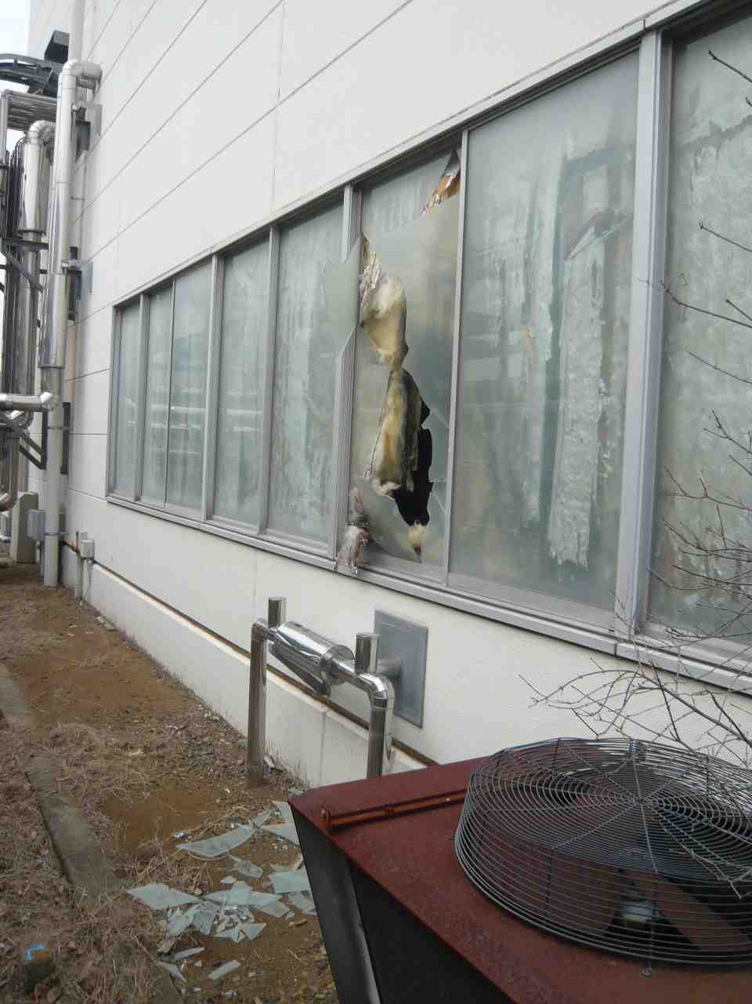
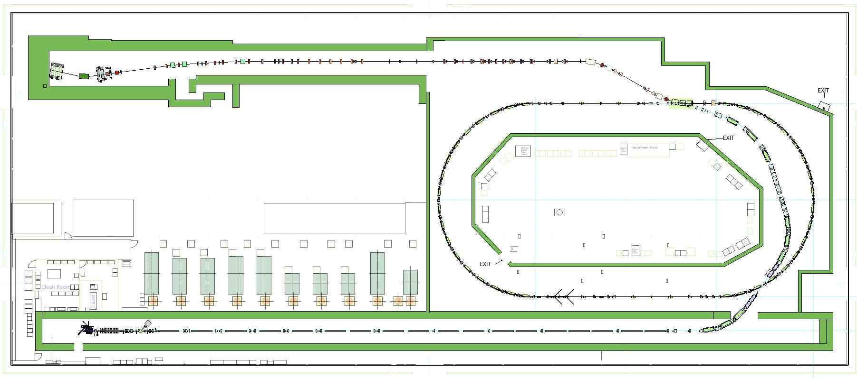
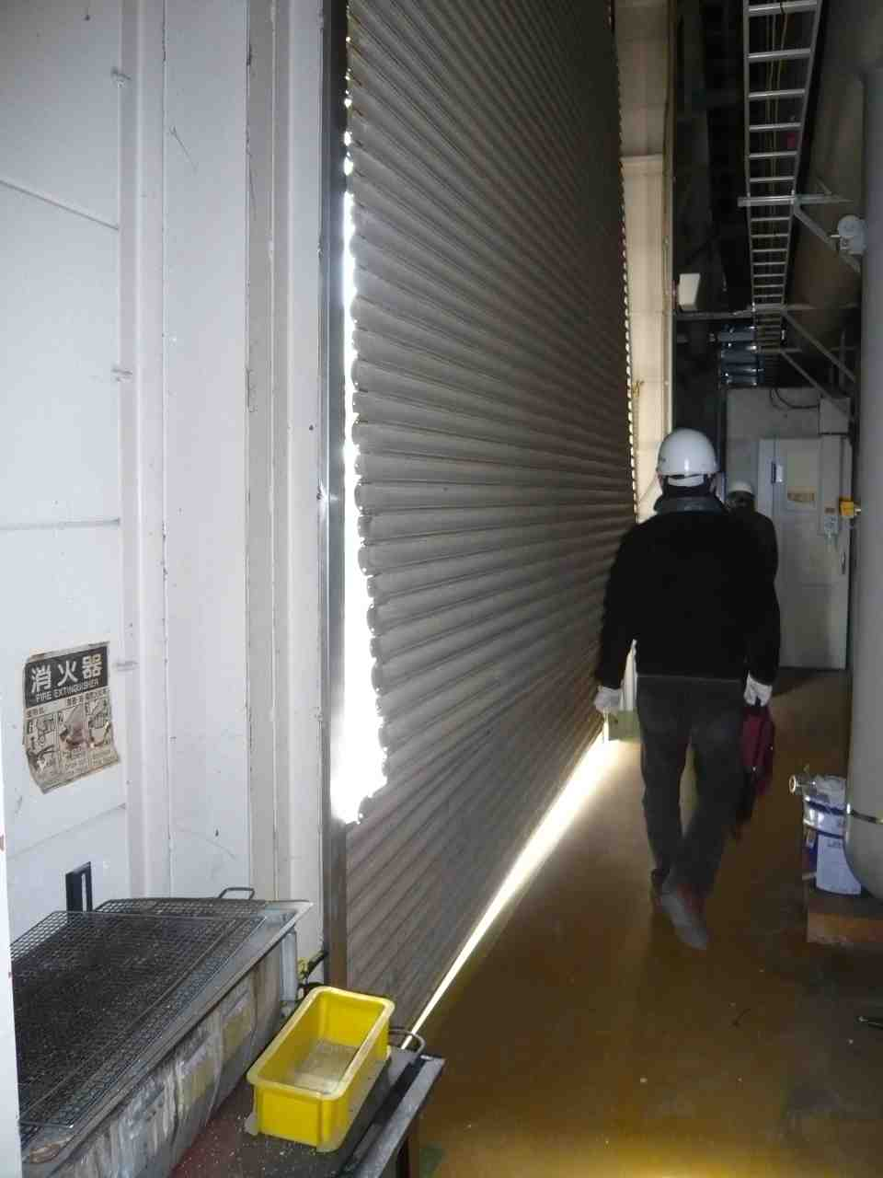
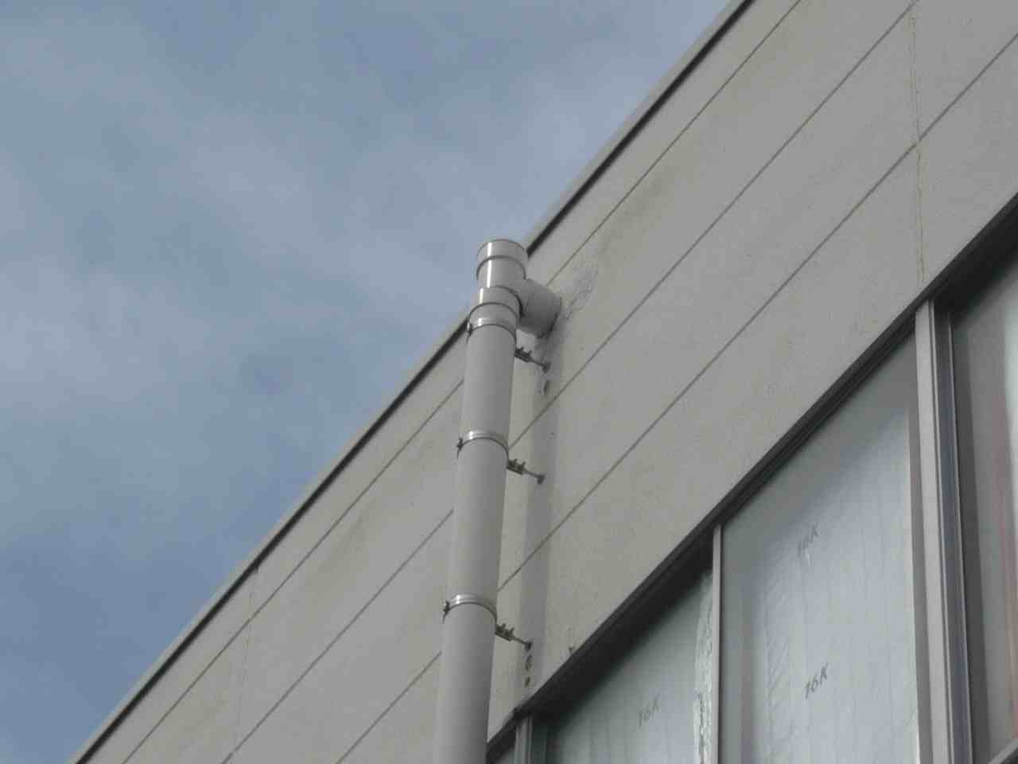
Facility Outside Damages
Shutter x6
Drain pipe x ?

Slide 32
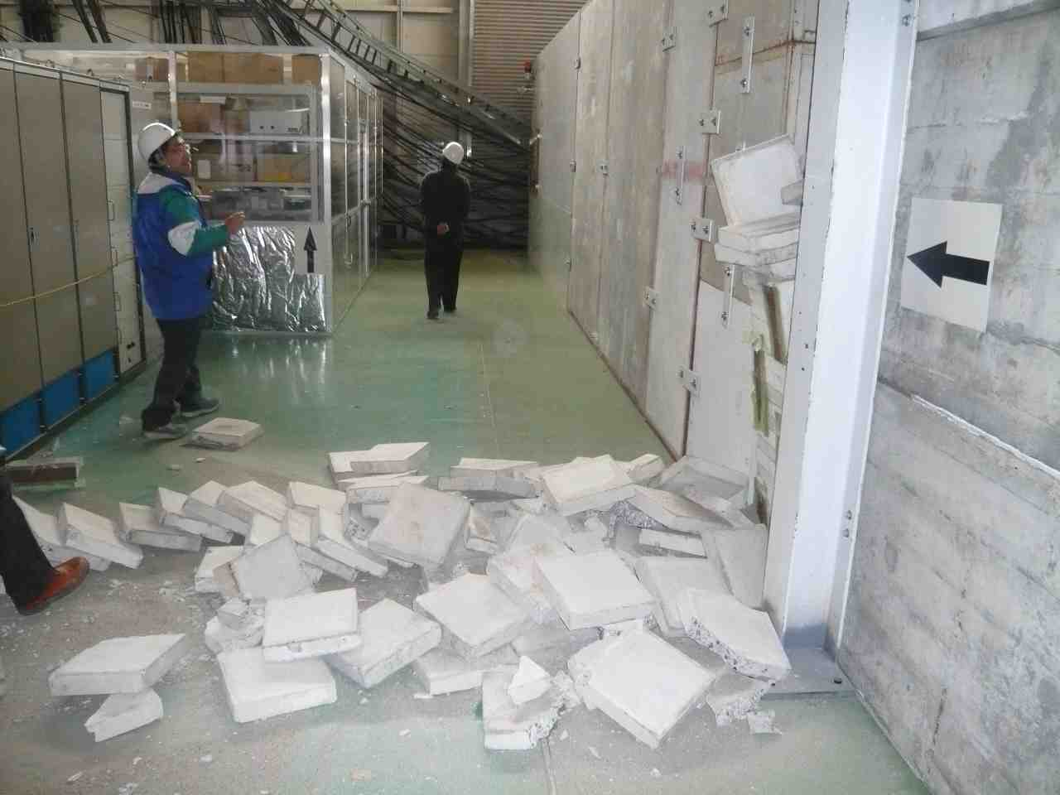
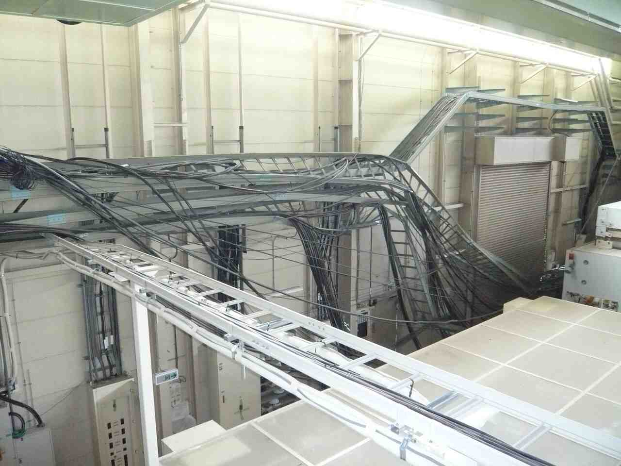
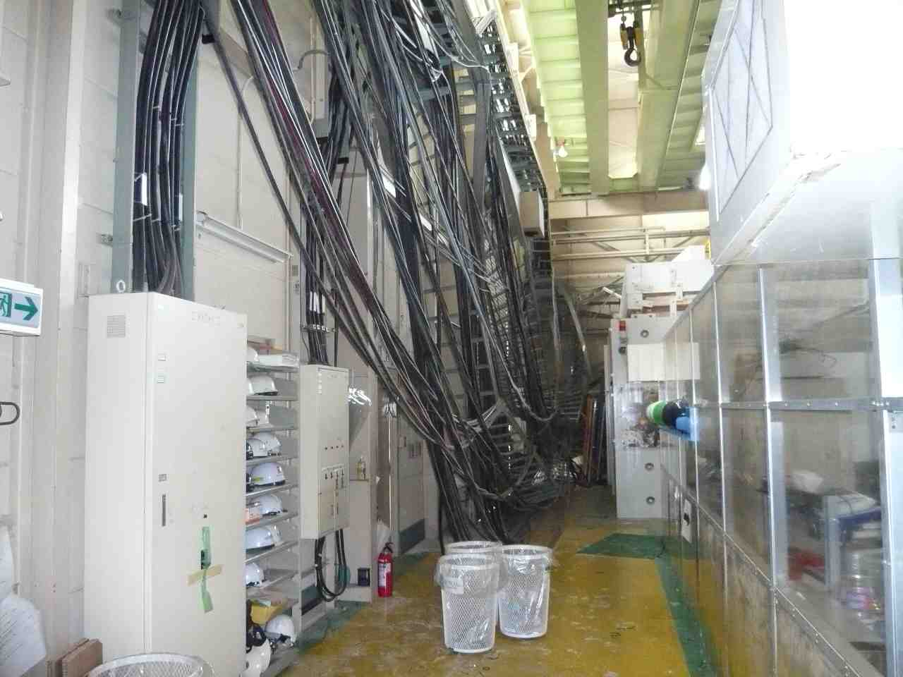
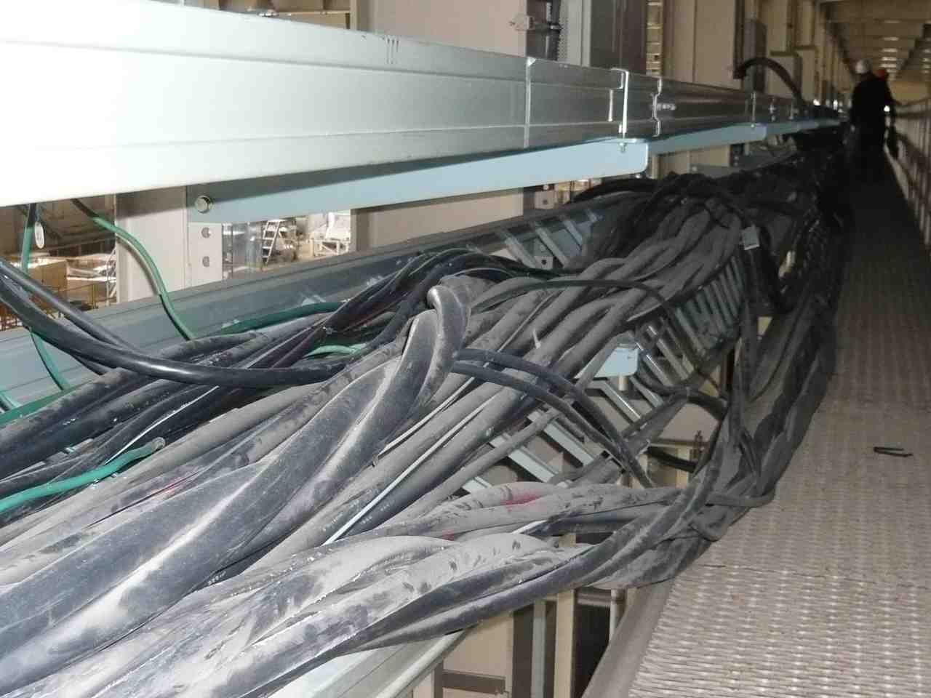
Facility Damages
Not well fixed blocks.
Main power cables for the ATF building

Slide 33
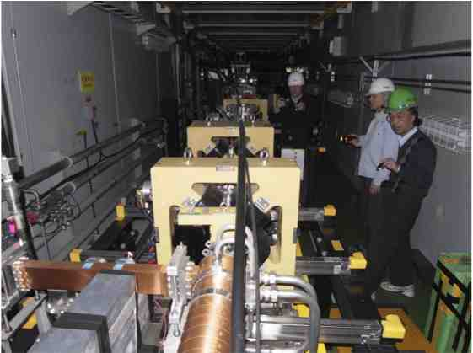



ATF LINAC
It looks NO severe physical damage except for the end section.
A small table moved then connections were broken. It seems easy to recover.

Slide 34




BT/DR(half)
Half of the DR, deep side, could not survey because of the safety.
It looks NO severe physical damage on the beam line.
  Minor damages:
  Expanded bellows of the ceramic chamber for SLAC kicker
  Fallen Pb blocks and fluorescent lights

Slide 35




ATF2 beam line
It looks NO severe physical damage on the beam line.
  Minor damages:
  Some of the mount-safety wires for magnets were broken.
  Side-shield blocks moved max.~10 cm.
10 cm move. of 1m-wide blocks

Slide 36
Recovery procedure…
Now the access to the ATF building is temporary inhibited.
The KEK Facility division will do…
inspection of the building safety
re-establishing the power line (cables)
Then, a detail investigation and repairs for the ATF accelerator will be started step by step.
We will do our best to recover as soon as possible,
But the followings should be taken into account.
Priority to recover other facilities in KEK;
    i.e., Photon Factory including KEKB linac, J-PARC, etc.
Public power outage

