Slide 1
CLIC Benchmark Analysis of Cross Section and Masses in Chargino and Neutralino Production
Tim Barklow (SLAC)
Mar 22, 2011

Slide 2
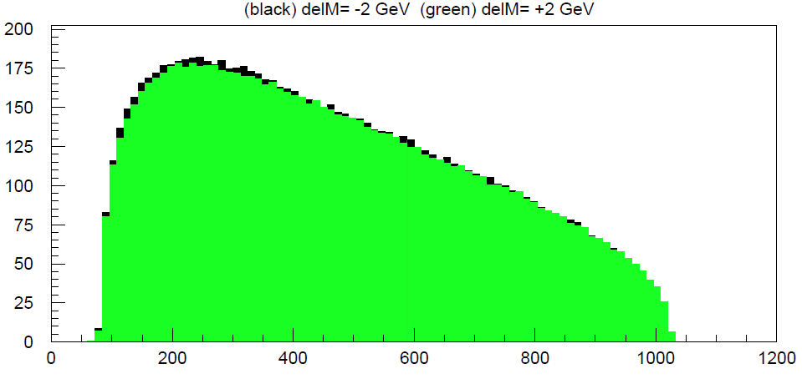
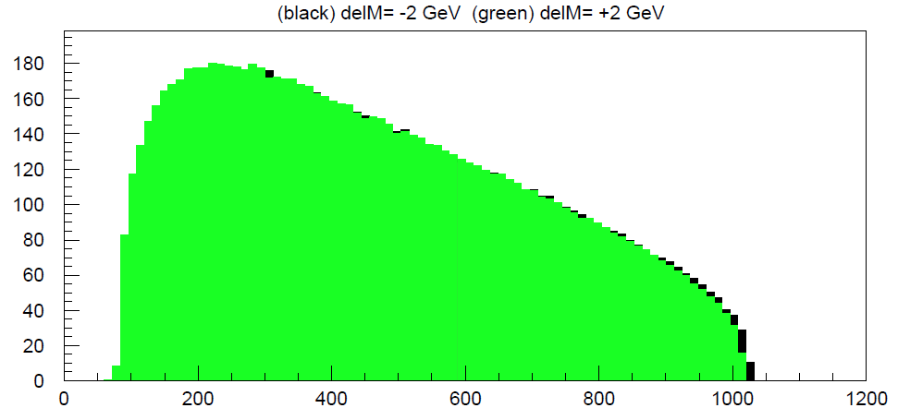
Chargino Production

Slide 3
Neutralino Production

Slide 4
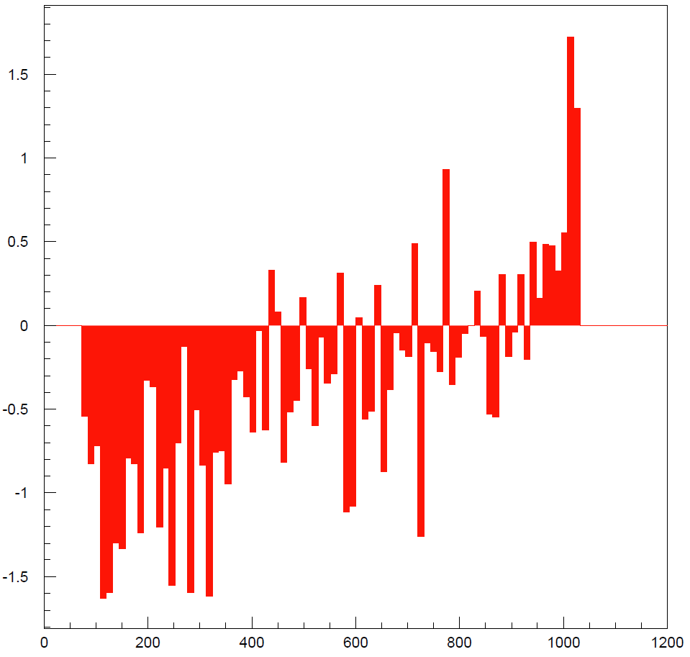

Slide 6
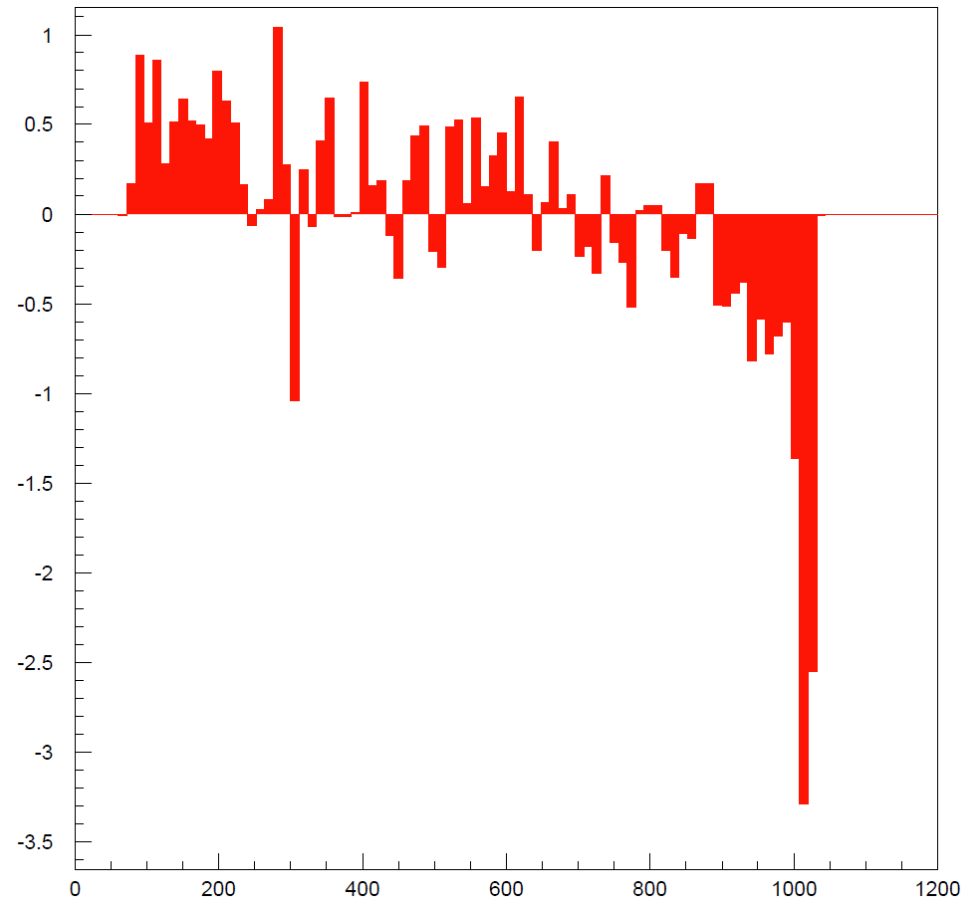

Slide 8
Incorporating Detector Effects

Slide 9
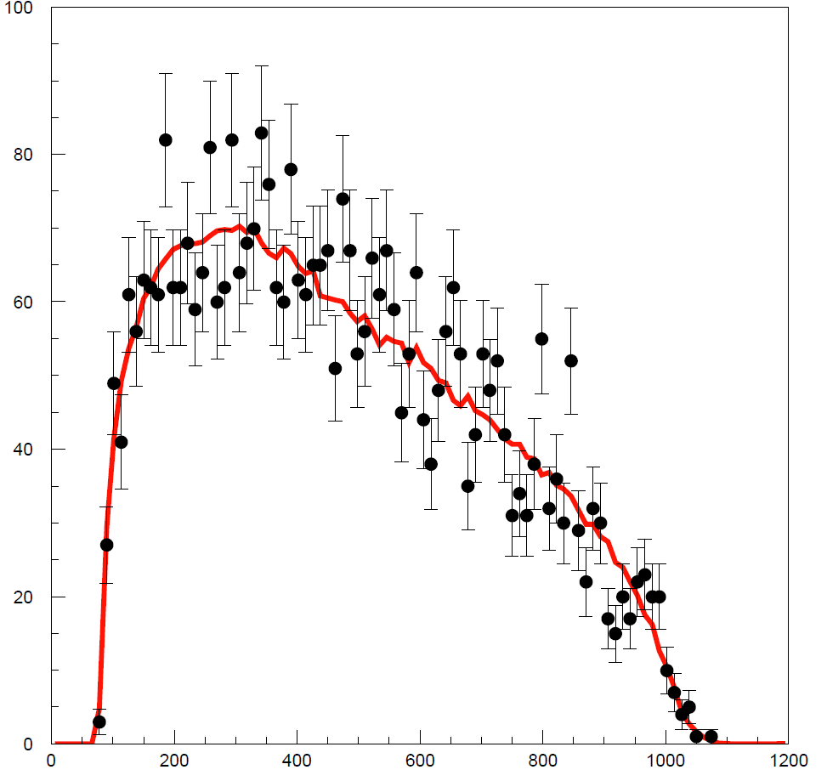
FastMC Simulation

Slide 10
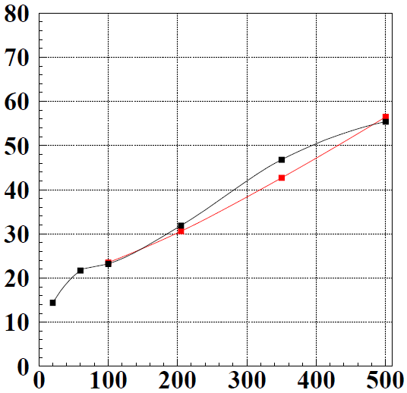
FastMC Response Light quark jets ee→qq
PandoraPFA v02-01
FASTMC with
E_{cm} (GeV)
E_{cm} (GeV)

Slide 11
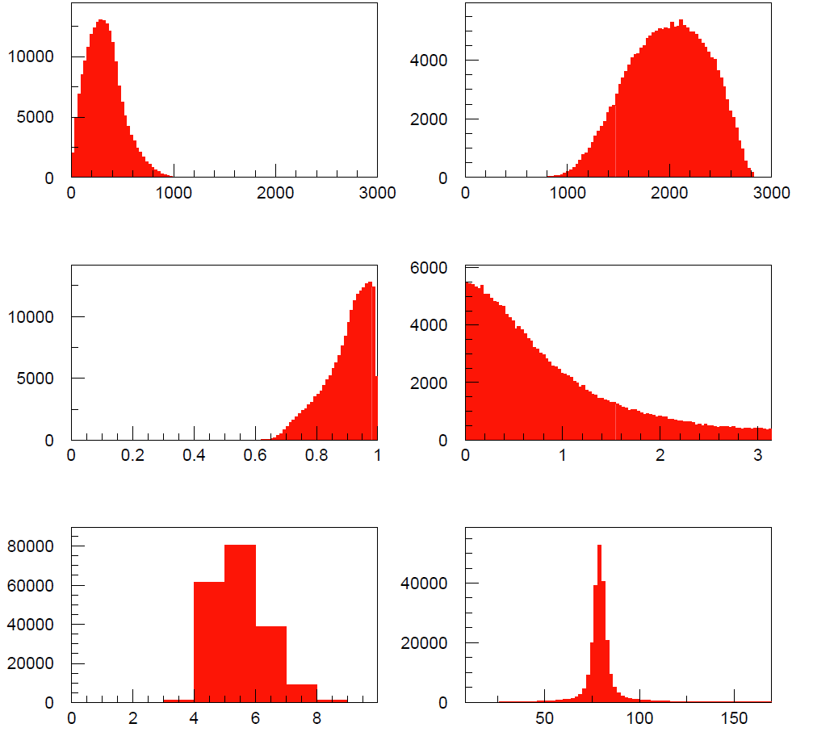

Slide 12
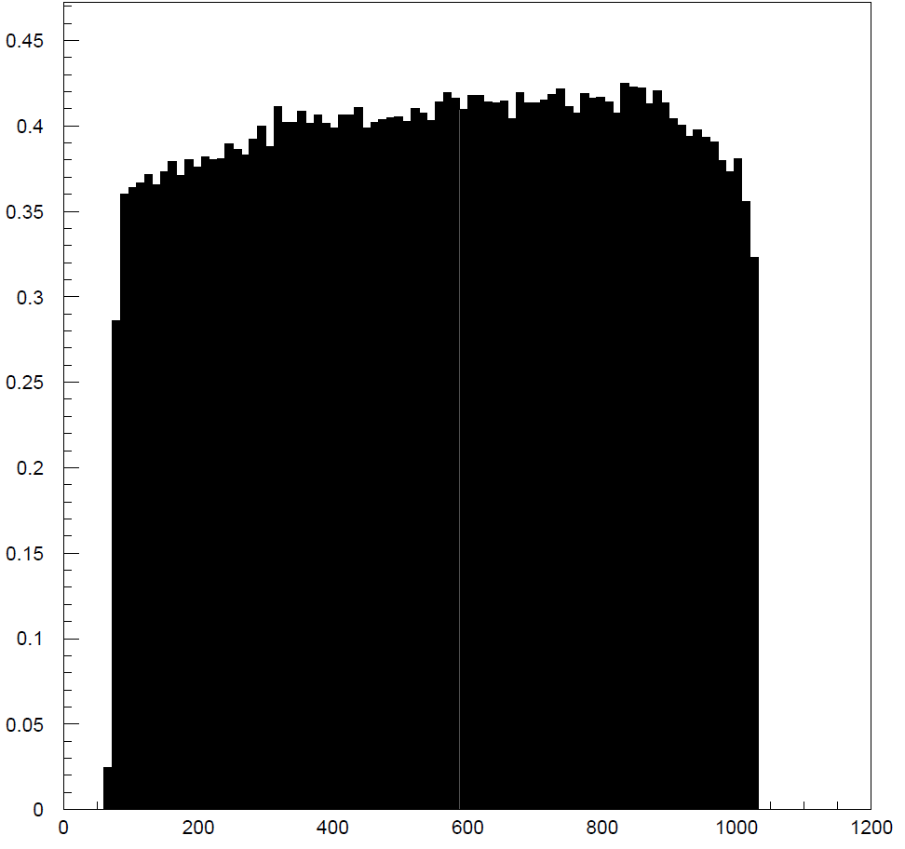

Slide 13
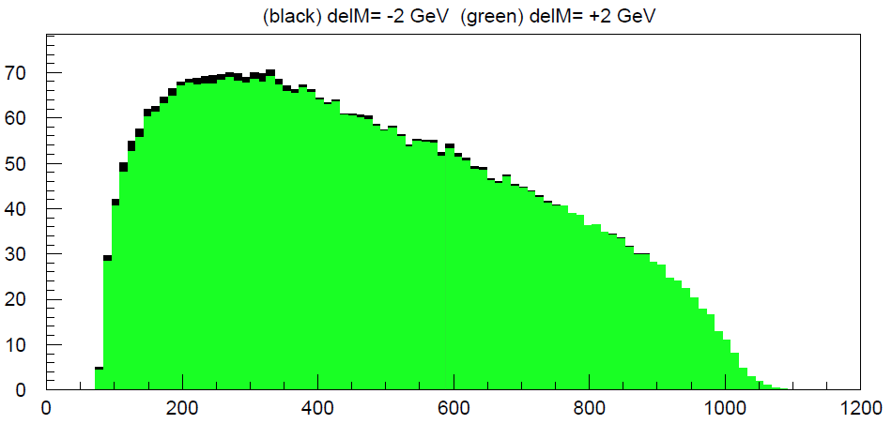
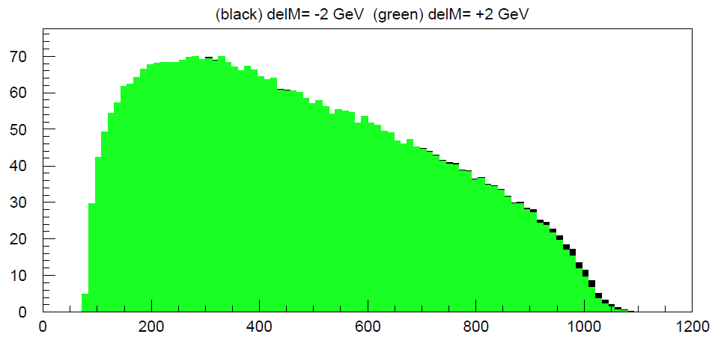
FastMC Simulation

Slide 14
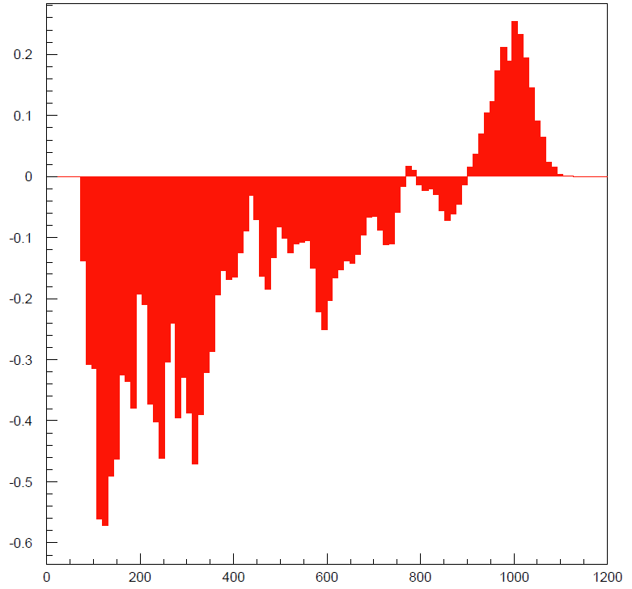
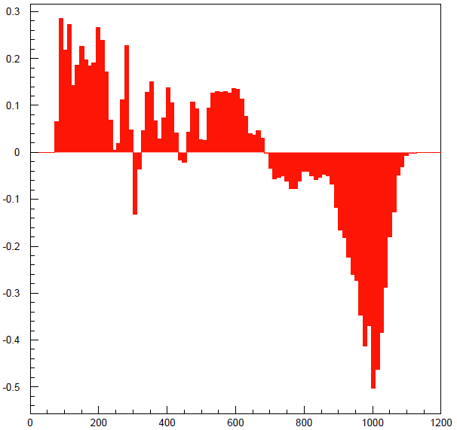

Slide 15
Minimum Set of MC Samples

