Slide 1
slicPandora: slic + pandoraPFANew
Norman Graf & Jeremy McCormick
(SLAC)
ILD Software Workshop
DESY, July 6, 2010

Slide 2
slic + PandoraPFANew
PandoraPFA was rewritten to make it modular and framework & detector independent.
We present a binding between the slic LCIO output and the compact.xml geometry description and this new package.
Developed and implemented an xml format for geometrical information needed by pandoraPFA.
Developed C++ front end to read lcio files + geometry.xml + pandoraPFA.xml and process events.

Slide 3
Architecture
lcio
pandora
CalorimeterHit
CaloHit
Track
Track
ReconstructedParticle
ParticleFlowObject
Package provides access to events processed with slic (not necessarily SiD).
Access to the detector geometry is via xml.
  Parse compact.xml natively to produce the information required by pandoraPFA.
  Use existing tinyxml parser bundled with pandoraPFA.
Access to the event is through lcio.

Slide 4
Architecture
lcio
slicPandora
lcio
xml file
org.lcsim
pandoraPFANew

Slide 5
Pandora Geometry Format
Generated by GeomConverter from compact.xml
  ~500 Java lines of code
Adds additional extension classes/objects to basic Pandora geometry API
Calorimeters
  type
  envelope parameters
  cell sizes
  hit collection
  ID description (layer, etc.)
  layer
    radiation/interaction lengths
    cell thickness
    sampling fractions (basic, EM, HAD)
Coil / B-field
Tracking envelope

Slide 6
GeomConverter
Small Java program for converting from compact description to a variety of other formats
LCDD
slic
lcio
GODL
lelaps
lcio
GeomConverter
Compact
Description
HEPREP
wired
Existing Geometry Clients
org.lcsim
Analysis &
Reconstruction
6

Slide 7
GeomConverter
LCDD
slic
lcio
Small Java program for converting from compact description to a variety of other formats
GODL
lelaps
lcio
HEPREP
wired
GeomConverter
Compact
Description
GEOM
pandora
lcio
Simply extend this model to provide
an xml file for the pandora client.
org.lcsim
Analysis &
Reconstruction
7

Slide 8
slicPandora
Provides interface between slic output and lcsim geometry and PandoraPFA reconstruction.
  ~2500 lines of C++ code
  xml format defines geometry and additional required information, e.g. sampling fractions
Input Tracks and TrackStates provided by org.lcsim track reconstruction.
Tracks + CalorimeterHits fed to pandoraPFA.
Pandora ParticleFlowObjects (PFO) converted to LCIO ReconstructedParticle.

Slide 9
slicPandora Testing
Developed a number of detectors using analog scintillator readout in the hadron calorimeters
  will investigate digital readout when the code binding has been fully debugged and understood.
Focusing on analysis of single particle response.
Using tagged, stable version of pandoraPFA
  will move to head version before production.
Using pandoraPFA as a “black box”
  will investigate tuning parameters once binding verified

Slide 10
Optimization Tools
Code being written to automate standard procedures needed for new detectors:
  Sampling Fraction determination
    MIP most-probable-value determination
    EM shower sampling fractions for Ecal, Hcal, Barrel, Endcap
    Had shower sampling fractions for Ecal, Hcal, Barrel, Endcap
  EM shower covariance matrices for particle ID
  Standard energy and position resolution plot generation.

Slide 11
Optimization Data Sets
Single μ±, γ, K⁰_{L}, at fixed angles and energies for sampling fraction determination.
Single particles (as above, plus e±, π± ,K± ,p±,…) at variable angles and energies to study clustering and tracking efficiency and resolution.
Simple resonances (π⁰,η,ρ±) to study efficiency and resolution of two-particle states.
Single quarks at fixed energies to study jet energy resolution (u,d,s).
Single Z⁰ at fixed energies to study dijet mass resolution.

Slide 12
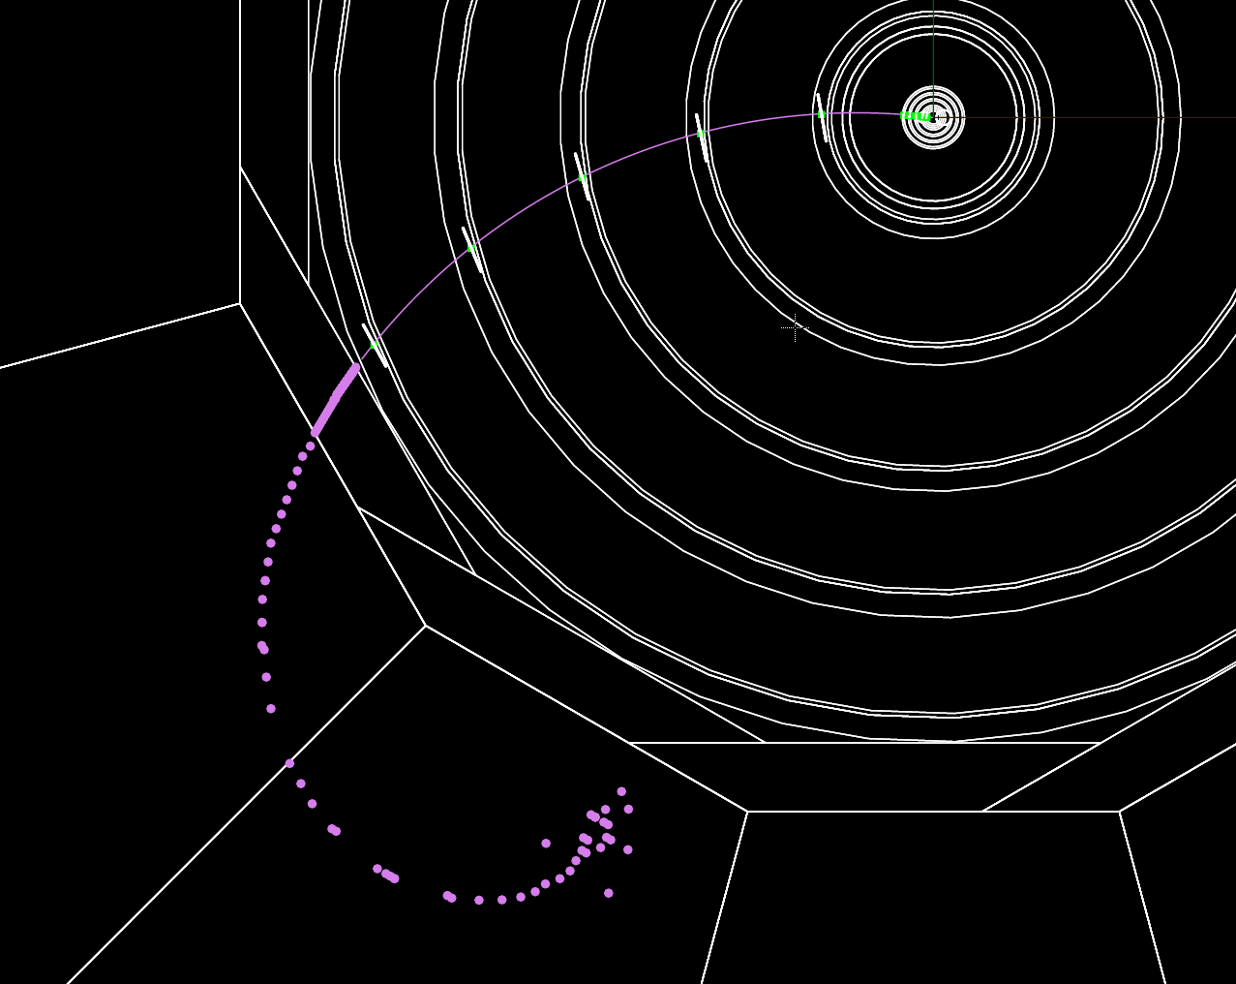
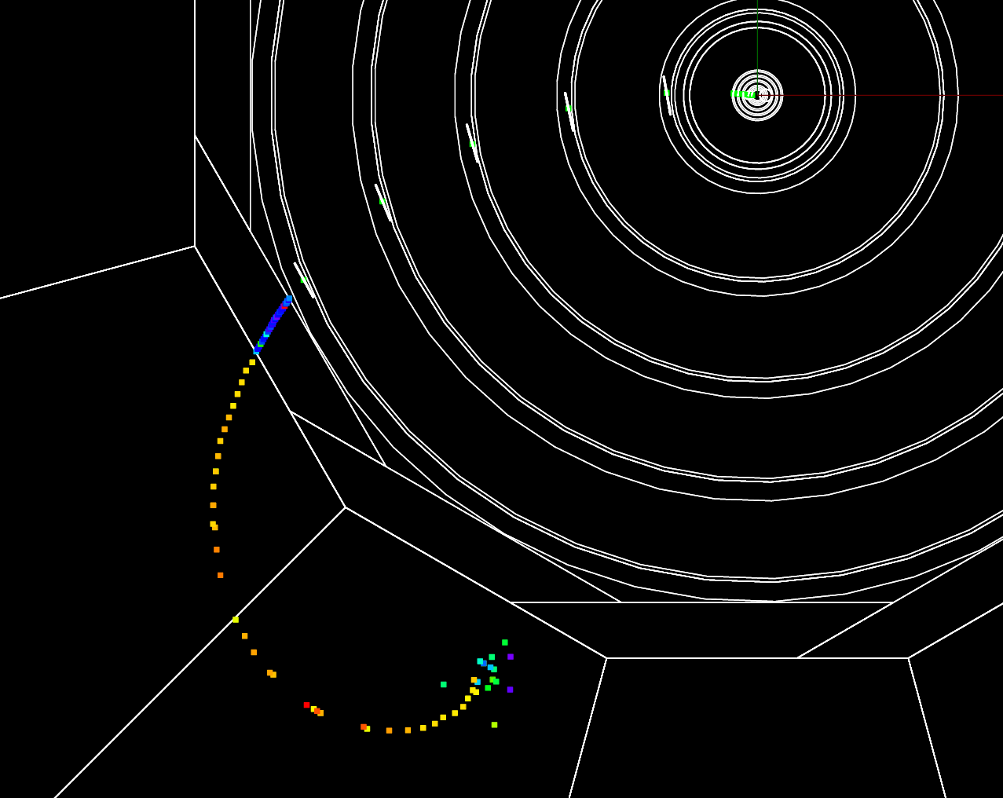
Single Muon Test
Single PFO tests:
Track and TrackState definition
Cluster association across calorimeter types (EM & Had) and across module boundaries.
Track Cluster association.
MIP sampling fraction and hit isolation calculation.

Slide 13
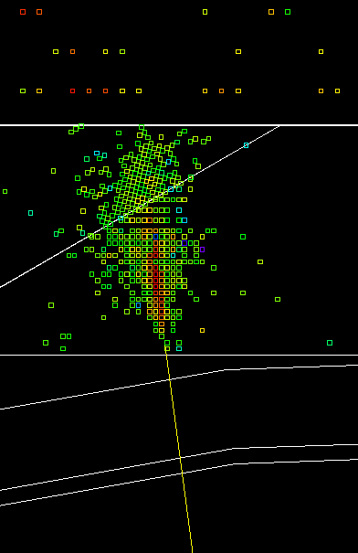
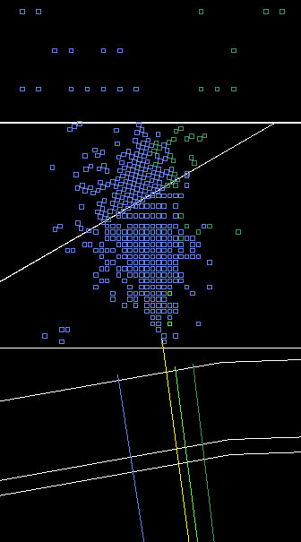
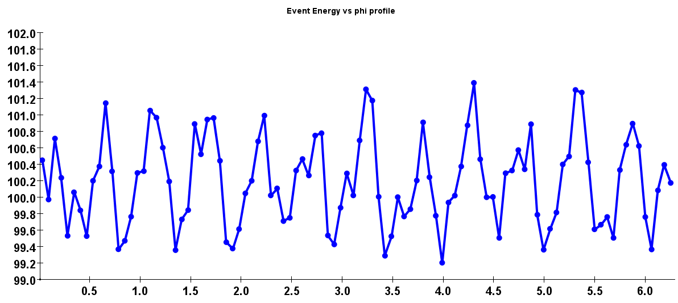
Clustering across modules
Efficiency of cross module
clustering.
geometry
Particle ID efficiency as a
function of phi.
shower shape
Energy resolution as a
function of phi.
sampling fractions
Thick
absorber
Thin absorber
100 GeV photons
Energy
+/- 1%
Phi

Slide 14
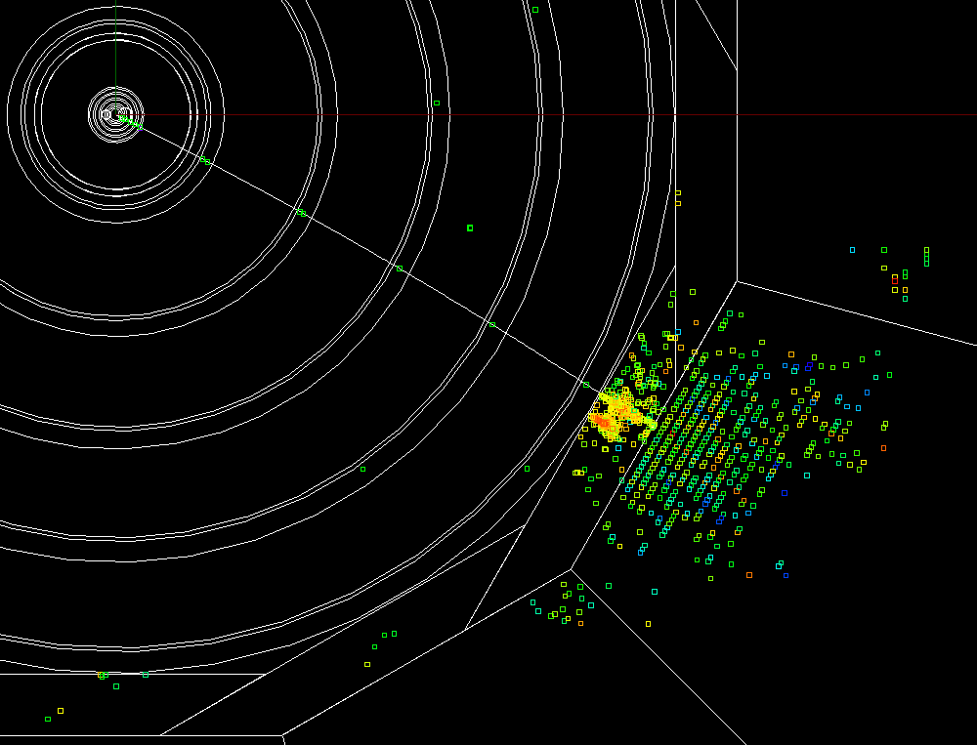
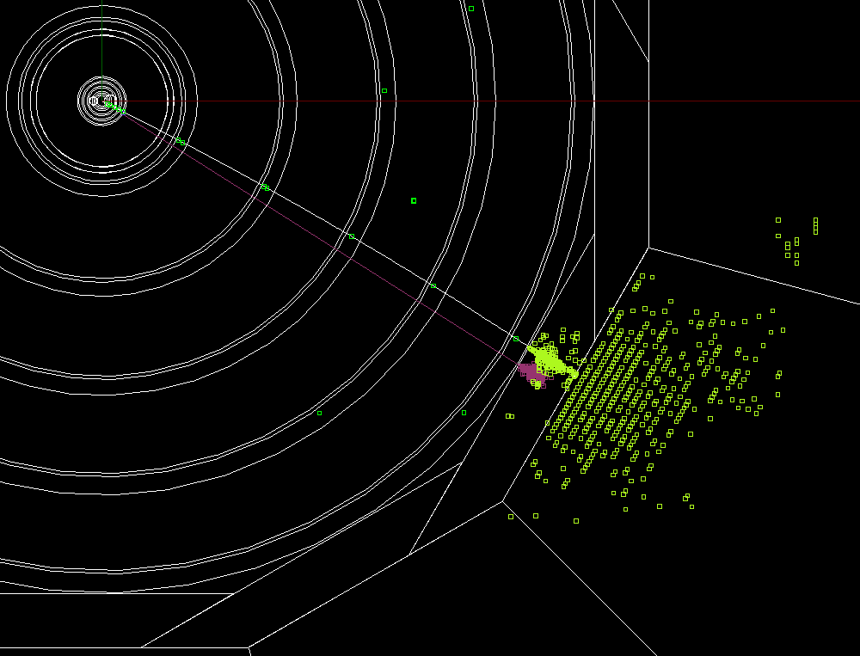
π⁰→γγ, ρ±→π±γ / π±π⁰
Tests charged / neutral clustering
in locally dense environment.
Resonance mass is performance metric.

Slide 15
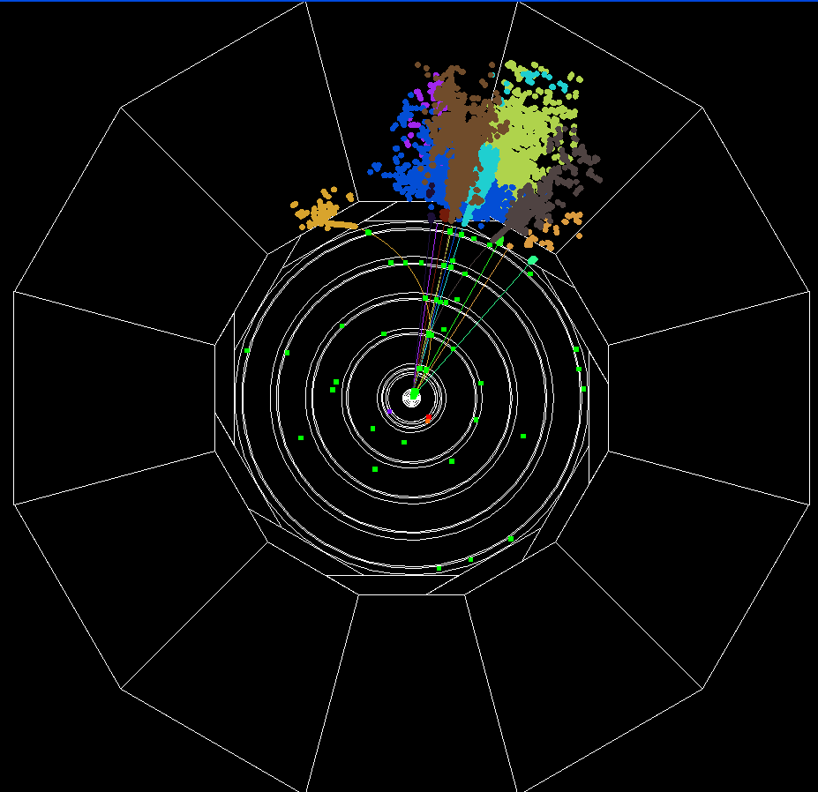
Jets
Single quarks
(u,d,s) at fixed
energies and
angles.
Tests energy
resolution in
controlled
environment.

Slide 16
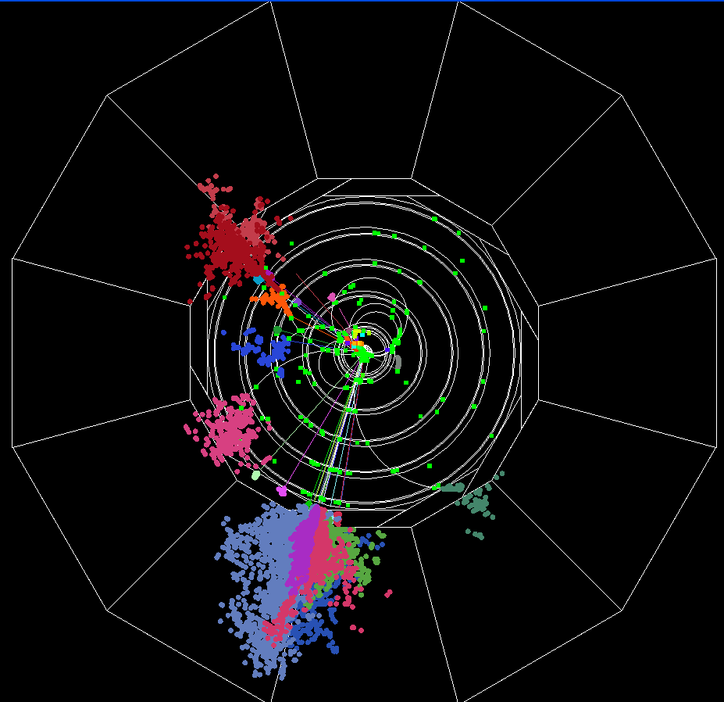
Z⁰→qq
Single boson
decaying to
light quarks at
fixed energies
and angles.
Tests invariant
mass resolution
as function of
boson energy.

Slide 17
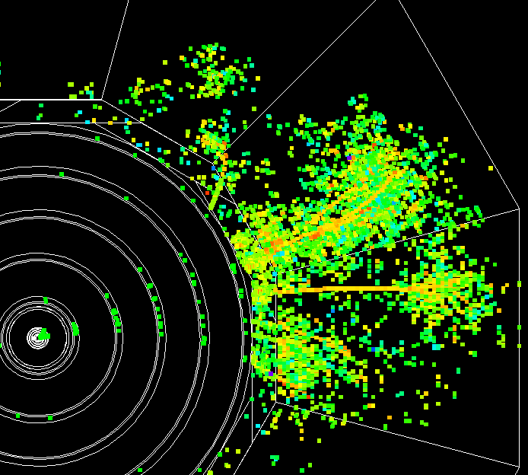
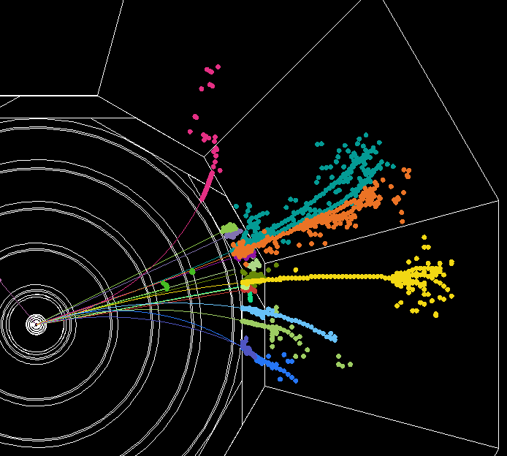
Timing and isolation cuts

Slide 18
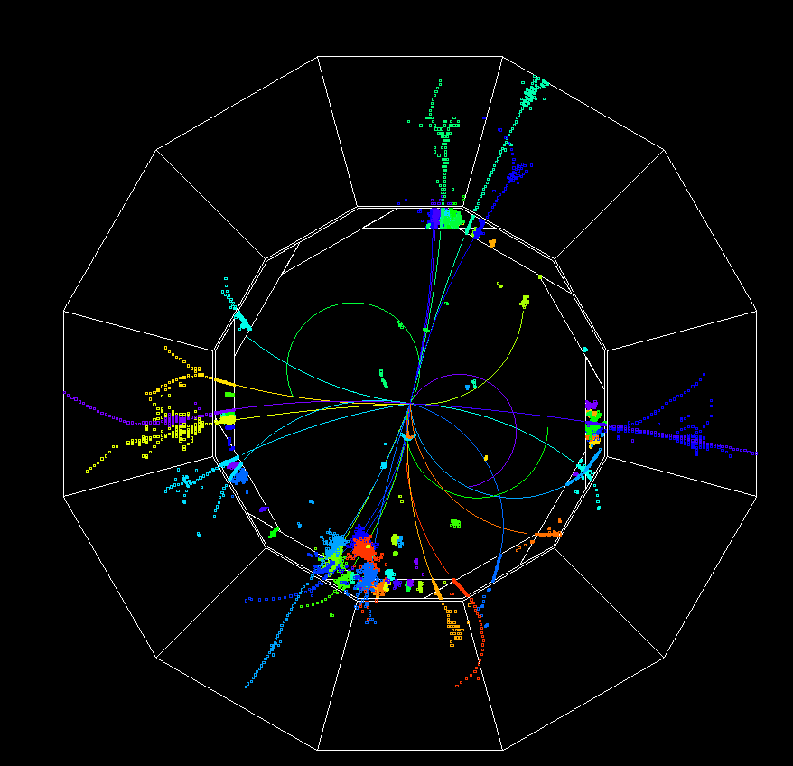
tt event processed in SiD detector by slic,
reconstructed using pandoraPFANew.

Slide 19
Current Status
Connection between slic output and pandora library was established during recent visit to Cambridge (albeit by hardcoding geometry) and first simple events processed.
Have since developed and implemented an xml format for all the geometrical information needed by pandora and automated procedure to create it.
Developint automated QA procedures to ensure that all interfaces are understood and correctly implemented.
Characterization and optimization next.

