Slide 1
Charge to the Workshop
Akiya Miyamoto
6-July-2010
DESY
ILD software workshop

Slide 2
Task of ILD Software WG
Workshops and (Pre-)Meetings since the submission of LOI last year.
  TILC09 (April 2009), ALCPG09(Oct. 2009), ILDWS(Jan. 2010),
  LCWS2010(Mar. 2010).
Towards DBD by 2012
RD’s request
  Develop a simulation model including faults and limitation
  Simulate and analyze updated benchmark processes incl. 1 TeV.

Slide 3
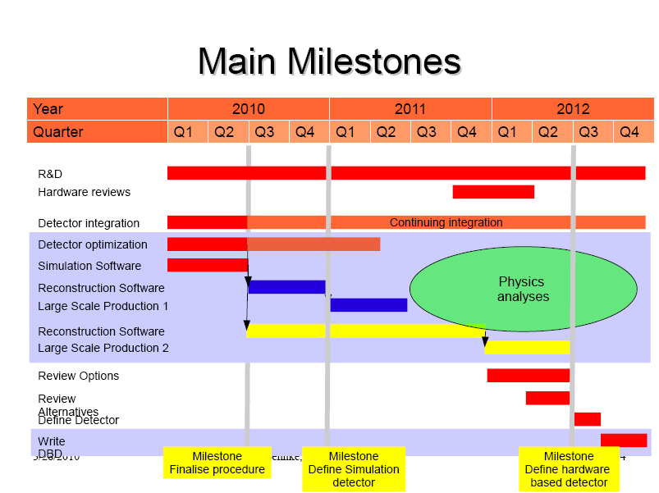
from T.Behnke, LCWS2010
re-baseline

Slide 4
Goal of the Workshop
Simulation
  Increase realism of sub-detector drivers and add alternatives/options
    according to reports from sub-group contacts in mid. March, most of them are aiming to deliver improvements by this summer(Now)
    New ILD integration WG has been formed to address issues related to services/cables.
  Review status of improved drivers and options/alternatives. Readiness and scheduling for the next step.
Reconstruction/Analysis/Core tools
  Improved drivers needs improved reconstruction tools
  Review status of tools and news/updates of tools
MC Production
    ➔ Review status of tools and news/updates of tools

Slide 5
Workshop program
Status of software tools
  core
  reconstruction
  analysis and optimization
Status of detector simulation
  increased level of realism
  services in simulation
Integration issues
  real estates and no-go holes
  services
  push-pull
Monte Carlo production
  Benchmark reactions
  SB2009
  ILD roadmap for DBD
6-July
7-July Morning
7-July Afternoon
8-July
Very busy program, but please leave enough time for discussion
Let’s have a fruitful workshop

