Slide 1
PFA studies
Remi Zaidan
The University of Iowa

Slide 2
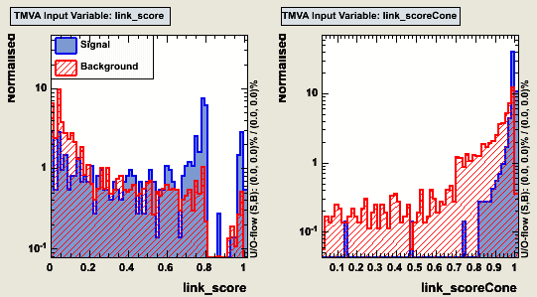
Introduction: the problem.
The first cone is needed to
allow the shower to develop deeper into the calorimeter.
However it’s too strong:
The only way for stopping the development from going too far is by the E/P constraint.
The E/P constraint needed for that effect is too tight...
The first cone algorithm is doing what it is supposed to do for signal but not for background

Slide 3
Introduction: The idea
Relax the E/P requirement: up to 5 sigma's
Try to apply the first cone in a less aggressive way: Don’t modify the score, instead apply a cut on the score given by the cone algorithm.
Allow sharing of clusters between tracks and resolve ambiguities based on the E/P balance and geometrical (cone) considerations.

Slide 4
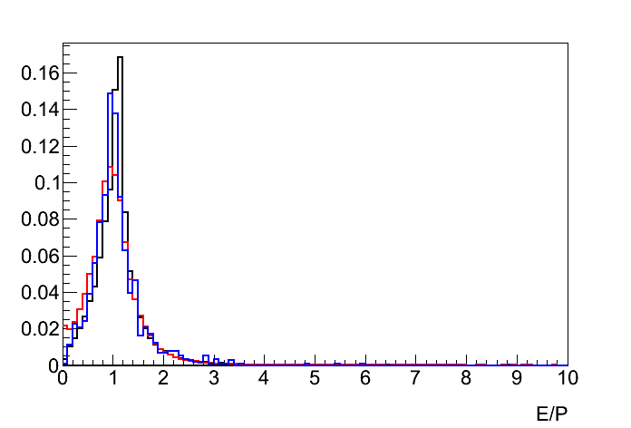
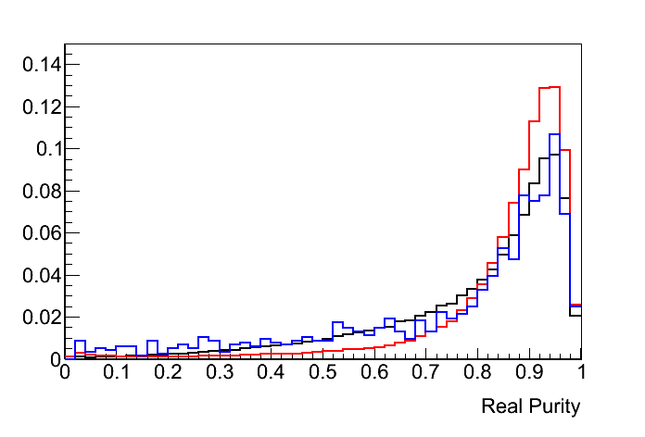
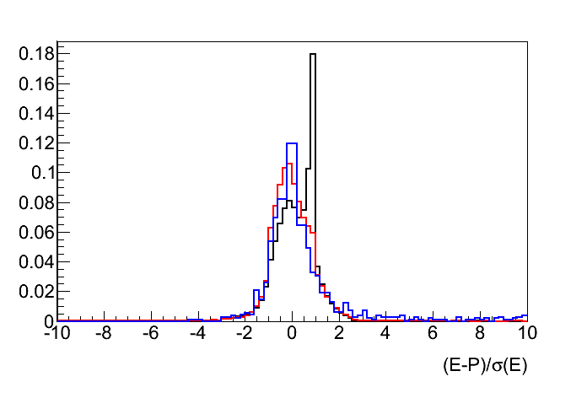
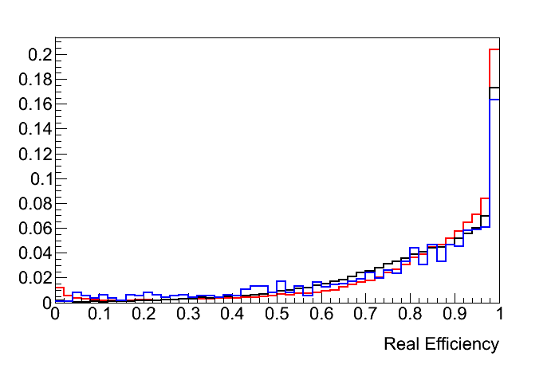
Understanding the intermediate steps
Baseline
No first cone
Sharing clusters + new cone.

Slide 5
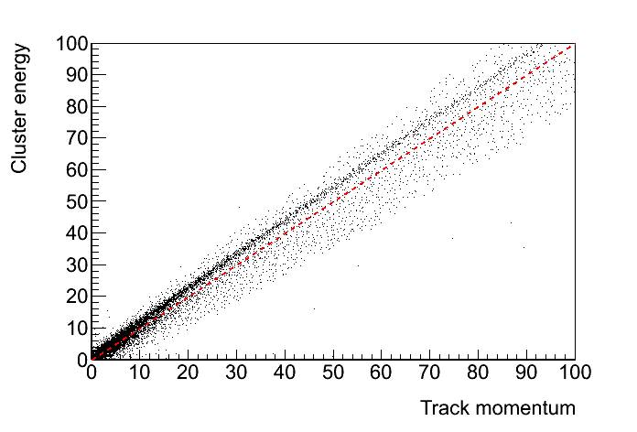
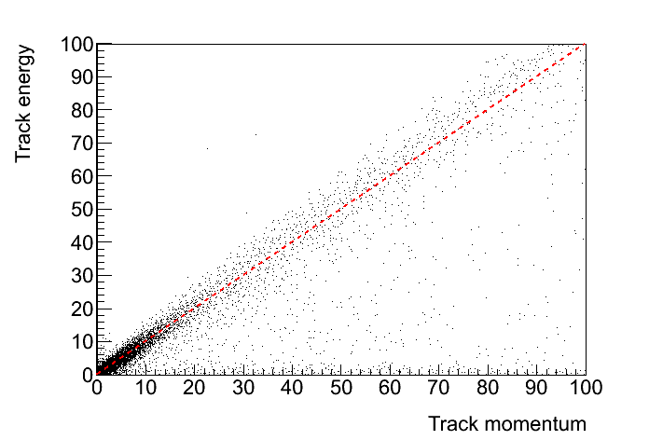
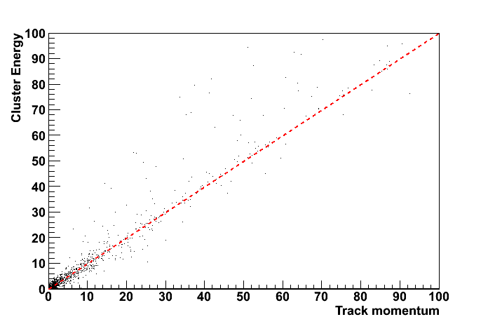
Understanding the intermediate steps
Baseline
No first cone
The baseline performance suffers from an artificial E/P constraint:
E ~ P + 1 σ(E)
Removing the first cone stop showers from developing:
E<<P
Relaxing the E/P constraint, showers tend to over-develop:
E>>P
Sharing clusters + new cone.

Slide 6
Conclusion
Need an independent way than the E/P constrain to separate charged from neutral energy.
Need to be able to quantify the amount of charged/neutral confusion.

