Slide 1
Preliminary Micromegas Data Analysis Results
D. Attié, P. Colas, M. Dixit,
M. Riallot, Yun-Ha Shin, S. Turnbull, W. Wang

Slide 2
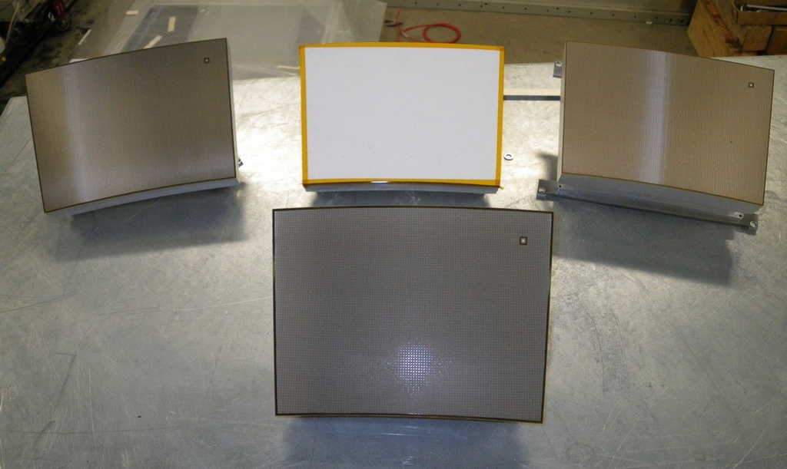
Detector modules
2 Resistive Kapton
~3 MΩ/□
Resistive Kapton
~5 MΩ/□
Standard
Resistive ink
~2(?) MΩ/□

Slide 3
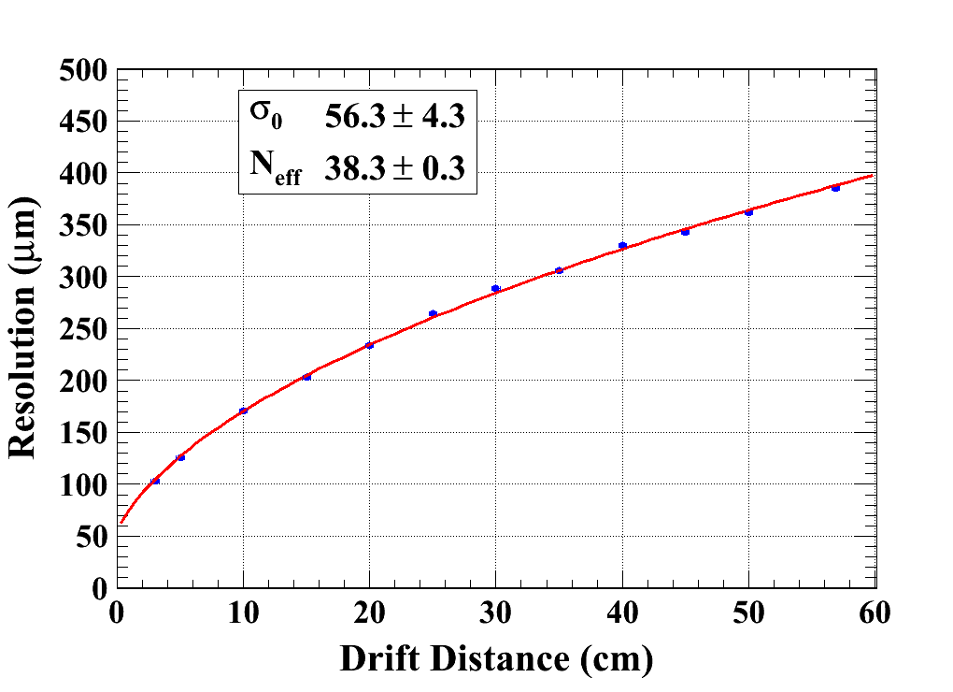
Preliminary Data Analysis Results (B=0)
Module_4
Peaking time = 200 ns
V_{mesh} = 381 V
χ² /Ndf = 15.7 / 10

Slide 4
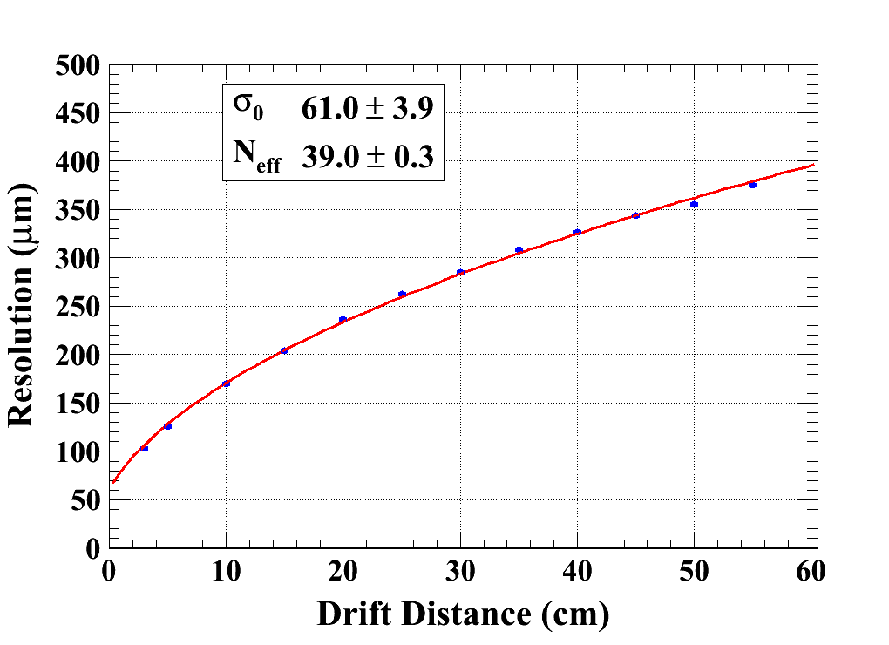
Preliminary Data Analysis Results (B=0)
Module_5
Peaking time = 200 ns
V_{mesh} = 381 V
χ² /Ndf = 13.6 / 9 (removing the point d=50cm)

Slide 5
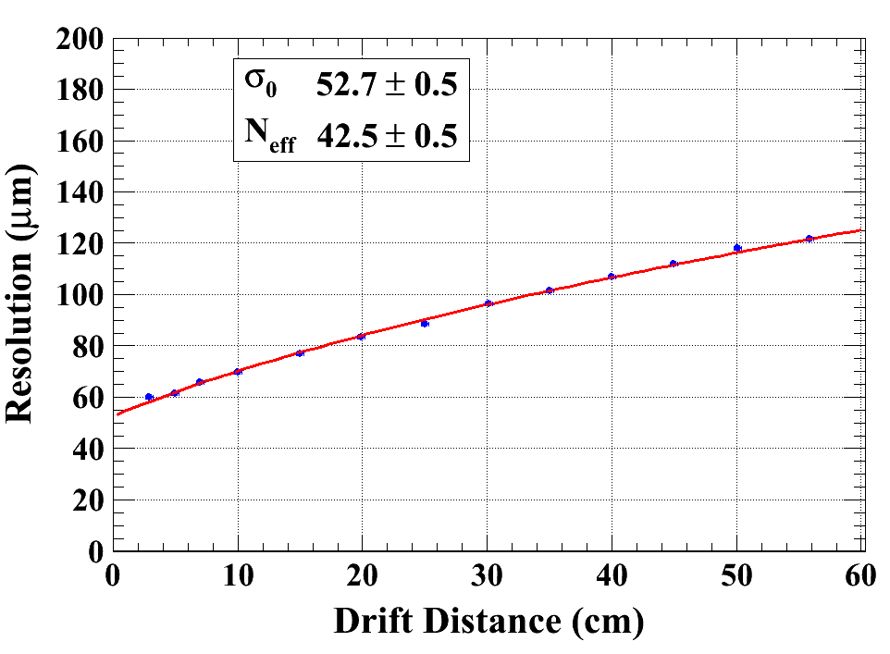
Preliminary Data Analysis Results (B=1)
Module_CLK
Peaking time = 500 ns
V_{mesh} = 380 V

Slide 6
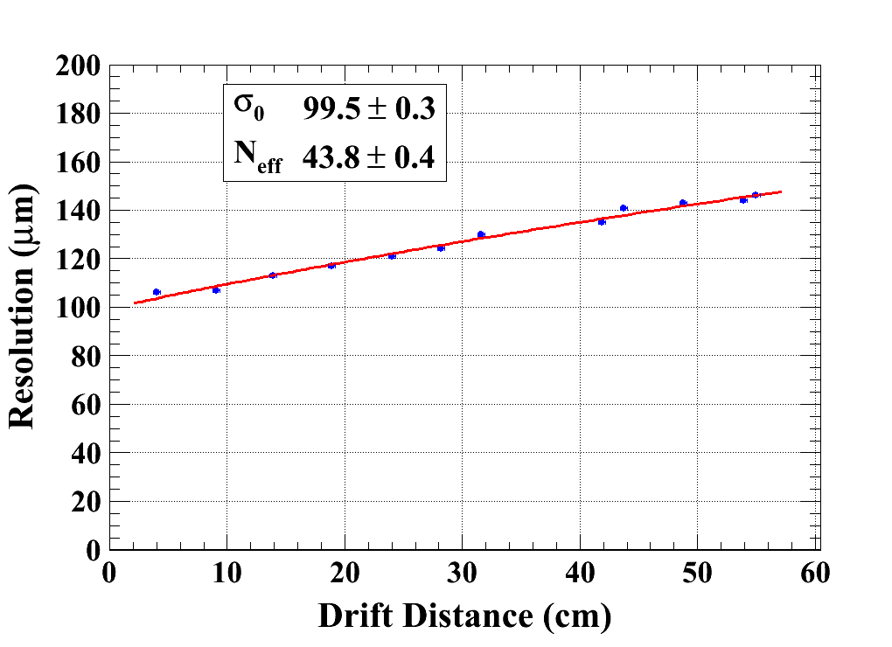
Preliminary Data Analysis Results (B=1)
Module_INK
Peaking time = 500 ns
V_{mesh} = 380 V

Slide 7
Last year December and this year March, four modules were tested without or with magnetic field respectively. Among these modules, two modules which were tested without magnetic field last year, were made by same material (resistive Kapton of ~ 3 MΩ/□ )with different routings. Two modules which were tested with B=1T this year, were made by resistive Kapton of ~5 MΩ/□ and resistive ink of ~ 2 MΩ/□ respectively. The preliminary analysis results of resolution are shown as follows:
 | Magnetic field | Peaking time | Resolution | N_{eff}
Module_4 resistive Kapton of ~ 3 MΩ/□ | B=0T (December 2009) | 200ns | 56 μm | 38.3
Module_5 resistive Kapton of ~ 3 MΩ/□ |  |  | 61 μm | 39
Module_CLK resistive Kapton of ~ 5 MΩ/□ | B=1T (March 2010) | 500ns | 53 μm | 42.5
Module_INK resistive ink of ~ 2(?) MΩ/□ |  |  | 100 μm | 43.8
Expected : Neff = 47.7 * <G>² / <G²> . Leads to (too?) high values of θ

Slide 8
Systematics?
Maybe information from neighbouring rows increases artificially Neff, but this would introduce a correlation between neighbouring rows : not observed (skipping 2 lines every 3 does not change Neff measurement)
Neff is stable with cuts
At B=1 T, uncertainties from B (assumed to be 0.98 T) and C_{D}

