Slide 1
‘Overhead and Margin’ – an attempt to set standard terminology
Marc Ross
Nick Walker
Akira Yamamoto

Slide 2
Highest Gradient Operation
Gradient
Quench Gradient
Feed-back Limit
( LLRF )
V-Sum Feed-back Margin
1 ~ 2 MV
Operating Gradient
Lorentz Detuning Compensation Error
Q_{L} = 3x10⁶, Δf = 50 Hz, ψ = 13°ーー→ ΔV = - 5 %
QL = 2.0x10⁶, Δf = 50 Hz, ψ = 8.7°→ ΔV = - 2.3 %
Time

Slide 3
Cavity Characteristics
From its first cold power-on test through to its operation with beam we should track:
gradient performance and
field emission
  (also Q_0).
Gradient limit(s) and perceived origin of the limit
  (precision to be discussed and defined)

Slide 4
Gradient Performance
(Field emission is similar)
In vertical dewar low power ‘CW’ test, a maximum gradient (and an associated Q_0) is observed and recorded:
‘vertical test observed gradient limit’,
  And observed Q_0 at the limit.
in subsequent testing:
‘horizontal test observed gradient limit’ and
‘cryomodule test observed gradient limit’
  (Noguchi: ‘Quench Gradient’)
  are recorded
  in general, are each different .

Slide 5
Operation
in operation,
  (administratively controlled):
‘operational gradient limit’ beyond which the cavity should not be routinely operated.
  (Noguchi: ‘Feedback Limit’)
Furthermore:
‘power-limited gradient’ beyond which the capabilities of the RF power source (and power distribution system) are exceeded.
Others:
  limitations due to cryogenics, controls, coupler, and etc)
This defines the maximum capability of the linac - but not how it is stably operated: CONTROLS

Slide 6
Controls
(‘Feedback and Control Margin’)
Proper control of the cavity accelerating voltage includes control of:
1) the RF power source,
2) the power distribution system and coupler,
3) the cavity frequency resonance, and
4) beam current.
In general, closed – loop feedback (or trim) with adequate control actuator range, setting precision and bandwidth is required for each.
To know the effectiveness of the voltage control, the performance of each should be examined.

Slide 7
Selected terms (1):
Observed Gradient limit | The observed limit for steady superconducting operation in Vertical Low Power test, Horizontal test, cryomodule test and linac operation
Operational Gradient limit | Cavity should not be operated beyond this limiting voltage after installation in the linac; the limit may depend on duration/time
Cryomodule assembly Gradient limit change | The difference between the vertical test Observed Gradient limit and the cryomodule test Observed Gradient limit.
Matched Condition | Beam current and input power match – no reflected power
Gradient slope | Change in cavity voltage between the first bunch and the last bunch- typ P/P

Slide 8
Selected Terms (2):
Lorentz Force Detuning | Cavity resonant frequency shift due to 1.3 GHz RF energy ‘pressure’
Pre-detuning | intentional cavity tuning offset used to achieve partial LFD compensation and minimize LFD compensation mover stroke amplitude
Pulse to pulse fluctuation/pulse to pulse stability | Distribution characteristics for a sequence of machine pulses; bunch intensity, average beam current, HLRF modulator pulse, etc RMS vs P/P
Within the pulse fluctuation

Slide 9
Selected Terms (3):
Loaded Q – Q_l | (Loaded Quality factor)
External Q | (External Quality factor)
P_k | Input forward power
Pulse to pulse fluctuation/pulse to pulse stability | Distribution characteristics for a sequence of machine pulses; bunch intensity, average beam current, HLRF modulator pulse, etc
Within the pulse fluctuation

Slide 10
Others:
Tuning Overhead
Energy overhead
Microphonics
Residual vibration
Vector Sum
Slow tuner
Fast tuner
Cavity Grouping
Gradient spread
Klystron saturation

Slide 11
Our task:
Develop an optimized cost-conscious ILC linac design
We know too little about optimizing high – gradient, 9 mA, CM performance
To Note:
  P_k/Q_l (Michizono)
  RDR DESIGN INCLUDES P_k/Q_l remote control via 3 stub tuner motors
  (and Q_l control via coupler)

Slide 12
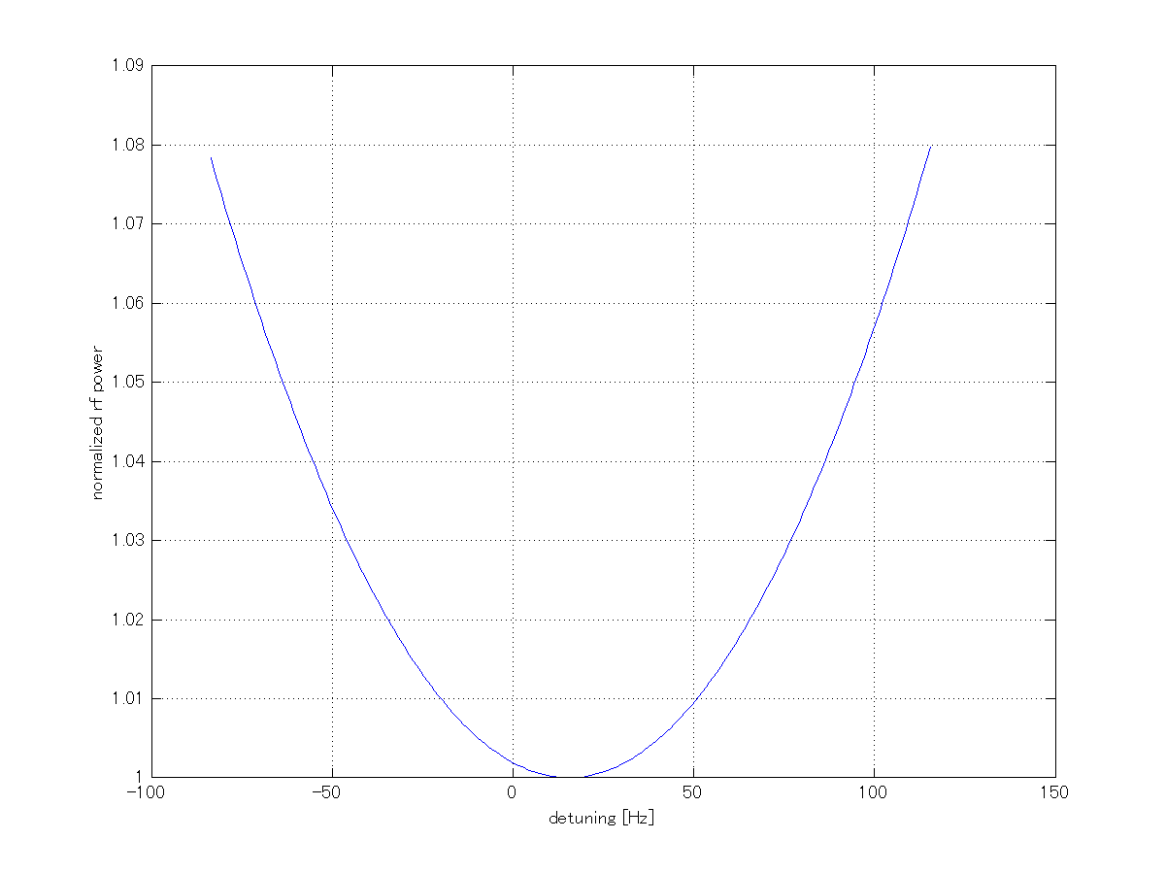
Detuning , Ql tolerance
2% additional power
50 Hz
50 Hz detuning requires additional 2% rf power
+/-15% Ql difference requires 0.6% additional power.

Slide 13
Summary – Shin Michizono
 |  | RDR | DRFS (PkQl) | DRFS(Cavity grouping)
 | Operation gradient | Max. 33 MV/m | Average 31.5 MV/m | Max. 38 MV/m
 | RF source | 10 MW |  | 800 kW
 | Waveguide loss | 8% power | 2% power | 2% power
 | Static loss (Ql, Pk) | 2% power | 2% power | 2% power
 | Kly Hv ripple | 2.5% power | 2.5% power | 2.5% power
 | Microphonics | 2% power | 2% power | 2% power
 | Reflection | 0% power | 14% power | 0% power
 | Other LLRF margin | 10% power | 10% power | 5%~10% power
 | Ql tolerance |  | 3% (2) | 3% (2)
 | Pk tolerance |  | 0.2dB (2) | 0.2dB (2)
 | Detuning tolerance |  | 15Hz rms(3) | 20Hz rms (3)
 | Beam current offset |  | 2% rms (3)
RF power
Tolerance
LLRF overhead ~5%
Cavity gradient tilt (repetitive) ~5%
Pulse-to-pulse gradient fluctuation ~1%rms
We have to examine these numbers experimentally.
Tolerance should be discussed with cavity and HLRF group. If the tolerance is smaller, better gradient tilt would be possible.

Slide 16
‘LFD Compensation’
(Noguchi: DLD compensation)
Warren Schappert and Yuriy Pischalnikov
  Piezo control using Least-Square minimization
  Of Finite Impulse Response Calibration Matrix

Slide 17
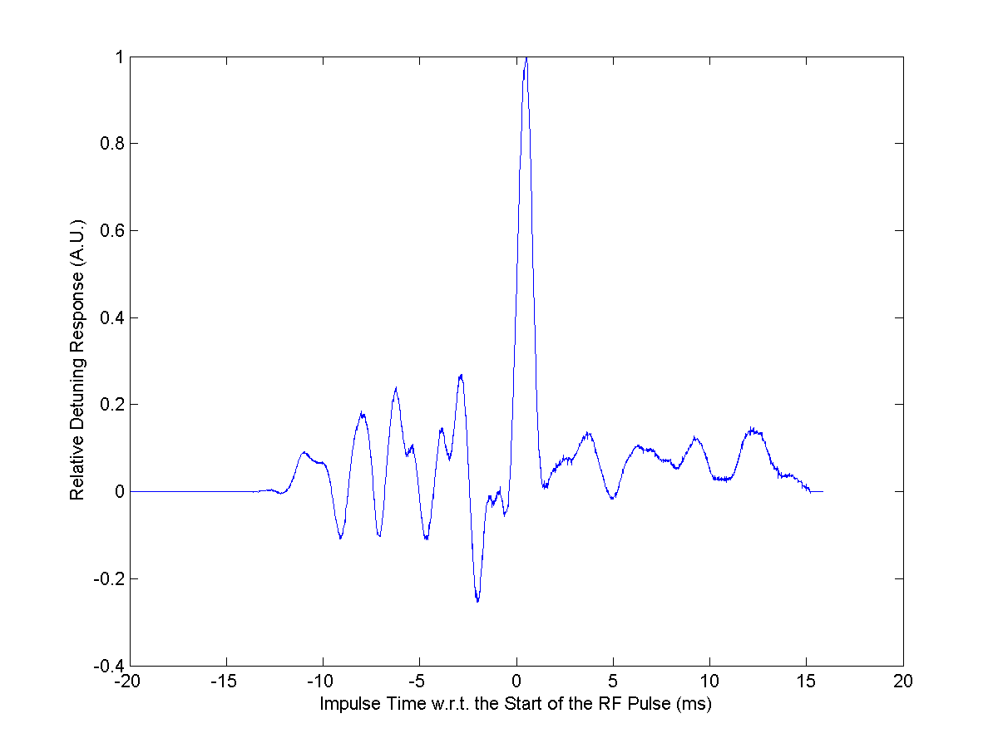
Schappert
Pischalnikov
Fermilab TD
Detuning Response to Piezo pulse time

