Slide 1
Cavity performance vertical test → horizontal test → CM test
C.M. Ginsburg
On behalf of the ILC Database Group
with special thanks to Detlef Reschke, Lutz Lilje and Jim Kerby for their assistance
Baseline Assessment Workshop, Tsukuba/WebEx
September 10, 2010

Slide 2
Cavity performance vertical test -> horizontal test -> cryomodule test
At IPAC10 in May 2010, for the Sept.9-10 Baseline Assessment Workshop, the ILC Database Group was charged to provide data on performance change
vertical test (VT) -> horizontal test (HT) -> cryomodule (CM) test
using:
(1) Existing data from DESY (e.g., Denis Kostin, SRF2009)
(2) Additional data from Fermilab/JLab for vertical test -> horizontal test
This is a status report. The work is in progress.

Slide 3
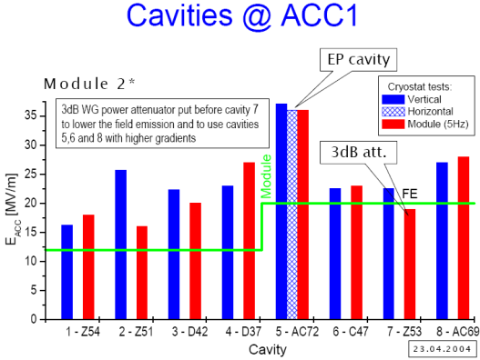
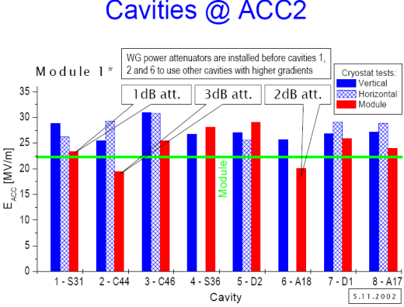
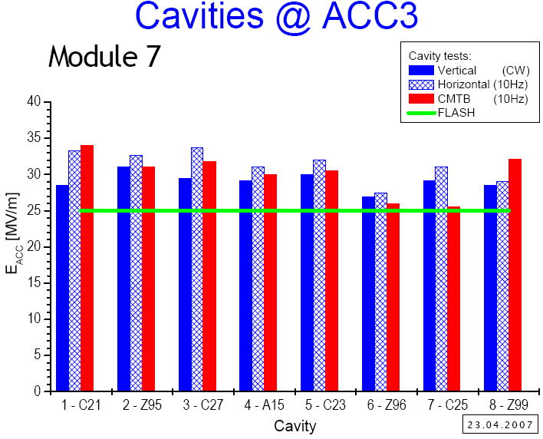
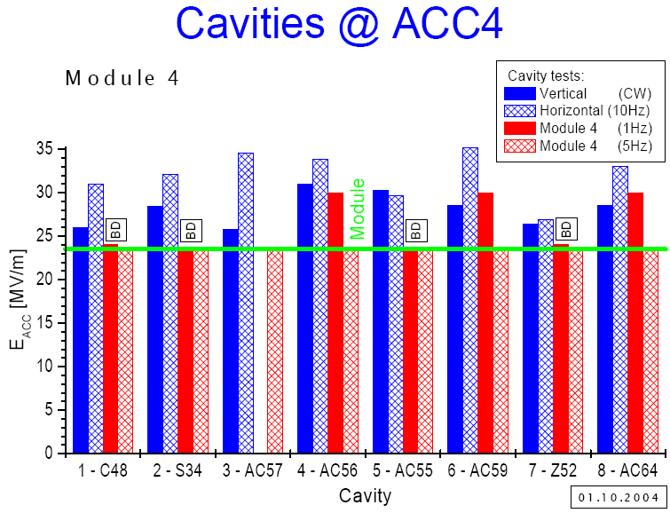
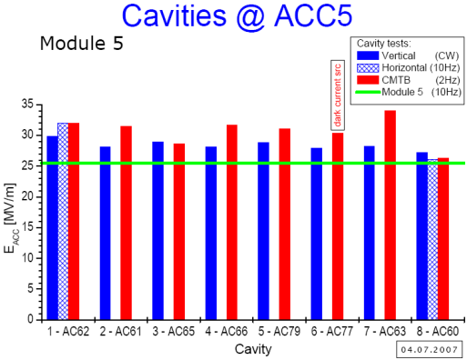
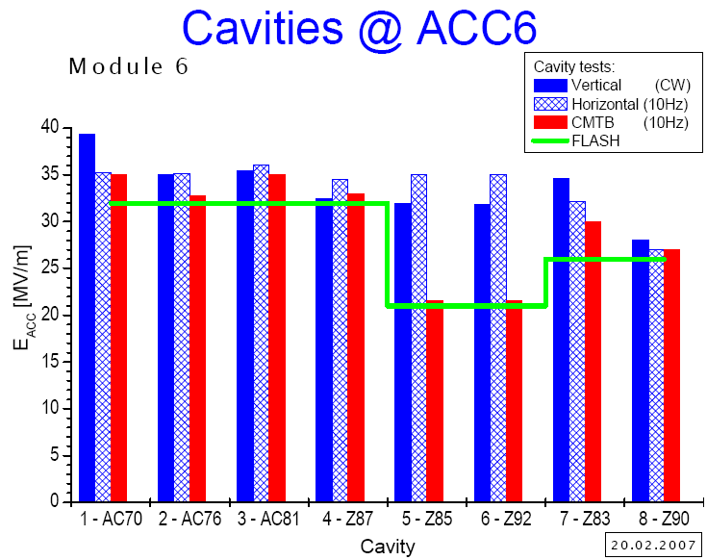

DESY/FLASH Cavity Performance
These cavities are installed in FLASH; the data are easily accessible
Data are courtesy of DESY
Source: D.Kostin, Grömitz 2008
https://indico.desy.de/getFile.py/access?contribId=28&resId=0&materialId=0&confId=1433

Slide 4
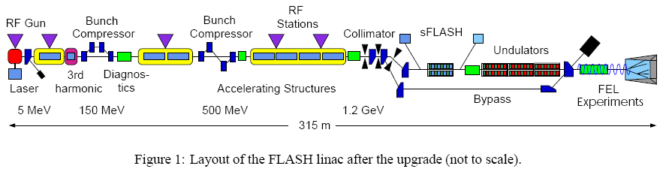
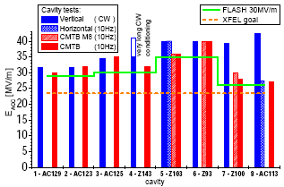
DESY/FLASH upgrade module
Cavities@ACC7
PXFEL1
These cavities are installed in FLASH; the data are easily accessible
Data are courtesy of DESY
Source: D. Kostin et al., SRF2009
http://cern.ch/AccelConf/SRF2009/papers/tuppo005.pdf

Slide 5
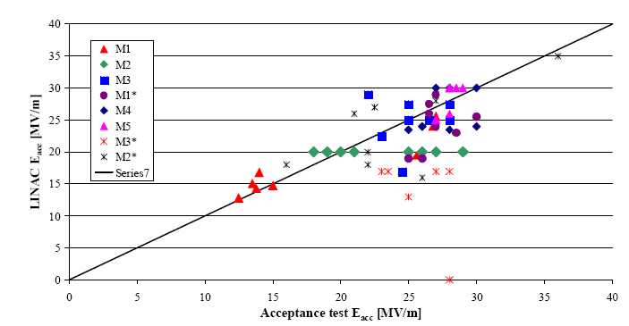
DESY VT vs. CM Test Performance
Four CM from p.2: ACC1=M2*, ACC2=M1*, ACC4=M4, ACC5=M5 included here
Additional data exist, but are less easily accessible.
Have to be careful not to double-count cavities for re-assembled CMs
Our goal is to make a similar updated plot, to compare performance
Data are courtesy of DESY
Source: L. Lilje et al., EPAC 2006
http://accelconf.web.cern.ch/AccelConf/e06/PAPERS/MOPCH155.PDF

Slide 6
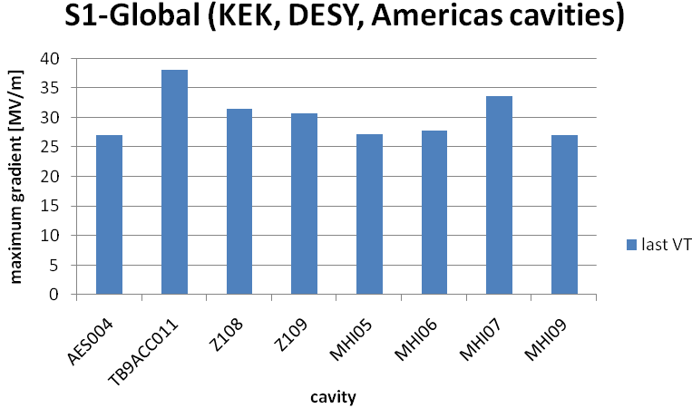
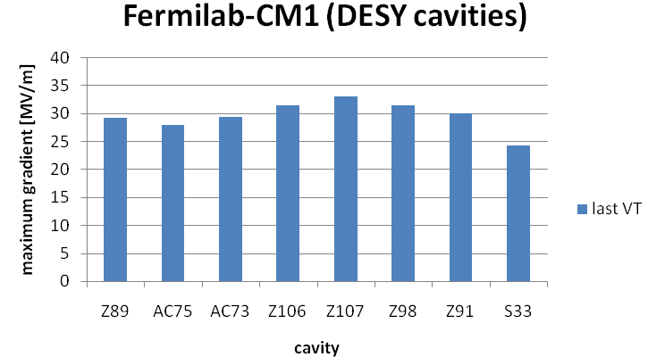
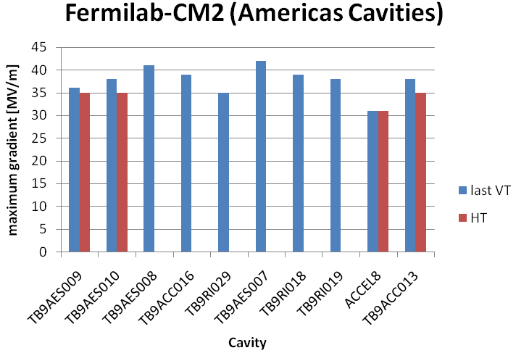
more international data available soon
backup
S1G: CM test by end-Sept.2010
CM1: CM test by end-Dec.2010
CM2: horizontal tests by Dec.2010; CM test in 2011

Slide 7
VT/HT/CM Test Comparison Summary/Plans
Available data
  56 cavities from 7 cryomodules easily accessible
    M1*, M2*, M4, M5, M6, M7, PXFEL1
  Comparing VT/CM test: 20 gradients go up, 25 go down, 11 are mixed or same
  Several types of surface processing (#bcp=35, #ep=17, #ep+=4)
      All cavities have VTs and CM tests; some do not have HTs
  <56 add’l cavities from 7 cryomodules available, but data less accessible
    M1, M2, M3, M3*, M3**, M8; must be careful not to double-count any cavities
    PXFEL2 results not yet publicly available
    Near-future data: PXFEL3, S1-Global, Fermilab-CM1, Fermilab-CM2
Issues
  Surface processing type: We assume this comparison is a test of the assembly rather than surface processing, and we use all process types for comparison
  Gradient meaning limits comparison
    Get different gradients for different input power (CW, pulsed w/different rep rates)
    Field emission effects not included so far
    Measurement error in gradient: 10-16% HT, 5-10% in VT
Plan
  Sebastian is getting the DESY data and confirming consistency of the data set with DESY colleagues, then the ILC database group will make requested plots

