Slide 1
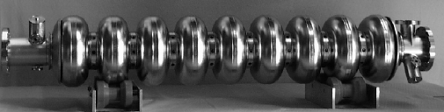
Preparation for ILC SCRF Cavity
Industrialization and Cost Evaluation Update
Communication with Industry
Akira Yamamoto
KEK, ILC-GDE
To be reported at BAW1, at KEK, Sept. 10, 2010

Slide 2
SCRF-ML Technology Required
RDR Parameters | Value
C.M. Energy | 500 GeV
Peak luminosity | 2x10³⁴ cm⁻²s⁻¹
Beam Rep. rate | 5 Hz
Pulse time duration | 1 ms
Average beam current | 9 mA (in pulse)
Av. field gradient | 31.5 MV/m
# 9-cell cavity | 14,560
# cryomodule | 1,680
# RF units | 560
RDR → SB2009

Slide 3
Industrialization Models
Global Vendors/Consortiums/Laboratories
  Research Instruments (ACCEL) and Zanon in Europe
  AES, Niowave/Roark, and PAVAC in Americas
  MHI, (Hitachi, Toshiba, and others ) in Asia
Production Models and Rate of SCRF Cavities
Project | # of Cavities assumed | # of Vendors | Production period (years) | Production Rate: (Cavities/day/vendor) (at 200 ~ 250 work-days/yr)
SNS | ~ 110 (including +20%) | 1 | 3 | 0.2 ~0.15
XFEL | (~640) | (1) (2) | (3) (3) | (1.1 ~ 0.85) (0.55 ~ 0.43)
ILC | (~ 18,000) (including +10%) | (1) (3) (6) | (5) (5) (5) | (18 ~ 14.4) (6 ~ 4.8) (3 ~ 2.4)

Slide 4
Global Plan for SCRF R&D
Year | 07 | 2008 |  | 2009 |  | 2010 |  | 2011 | 2012
Phase | TDP-1 |  |  |  |  |  | TDP-2
Cavity Gradient in v. test to reach 35 MV/m | → Yield 50% |  |  |  |  |  | → Yield 90%
Cavity-string to reach 31.5 MV/m, with one-cryomodule |  | Global effort for string assembly and test (DESY, FNAL, INFN, KEK)
System Test with beam acceleration |  |  | FLASH (DESY) , NML (FNAL) STF2 (KEK, test start in 2013)
Preparation for Industrialization |  |  |  |  | Production Technology R&D
Communication with industry: | 2009: 1st: Visit Venders (2009) 2010: 2nd : Organize Workshop (2010) ~ 2011: 3rd: Issue specification and receive response (Plan)

Slide 5
Prepare for ILC-scale Industrialization
Learn from previous efforts and current status:
  Industrialization study for TESLA (1990’s)
  Recent R&D progress (in ~ 10 years)
  Current status in industries (in progress)
Learn from industrialization of XFEL Project
Encourage Laboratory / Industry partnerships
  Realized in all 3 regions
  Prepare for cost-effective production and quality control in cooperation with industries

Slide 6
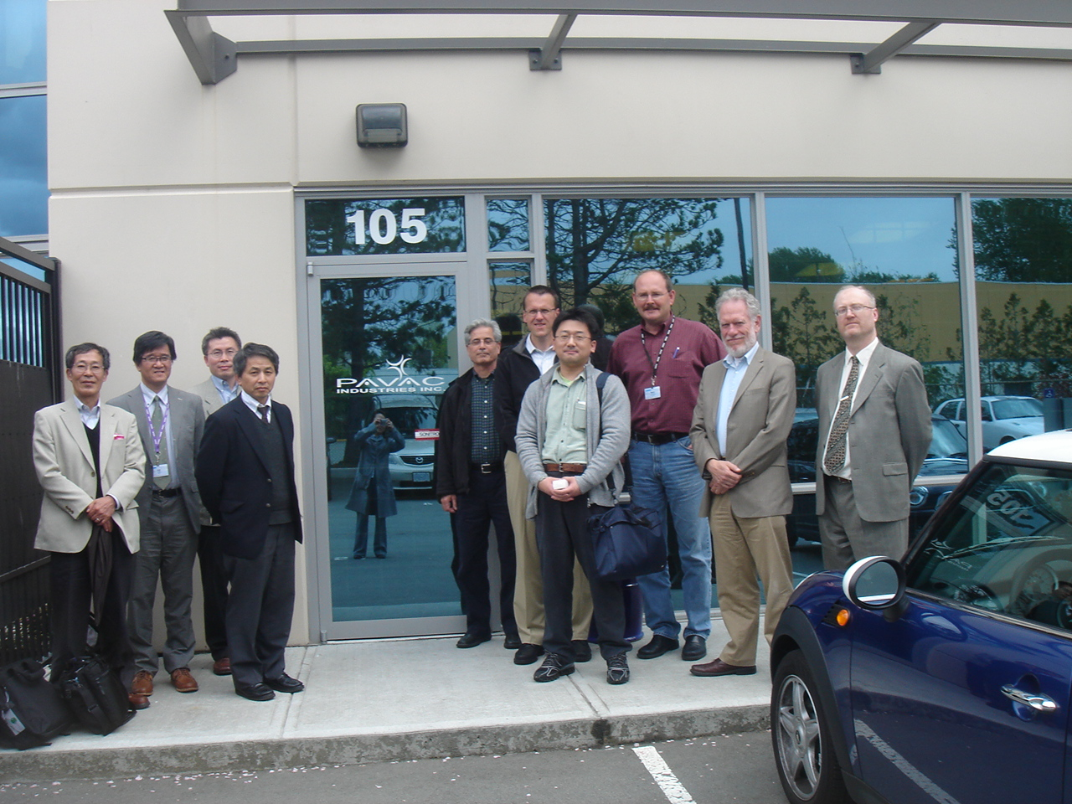

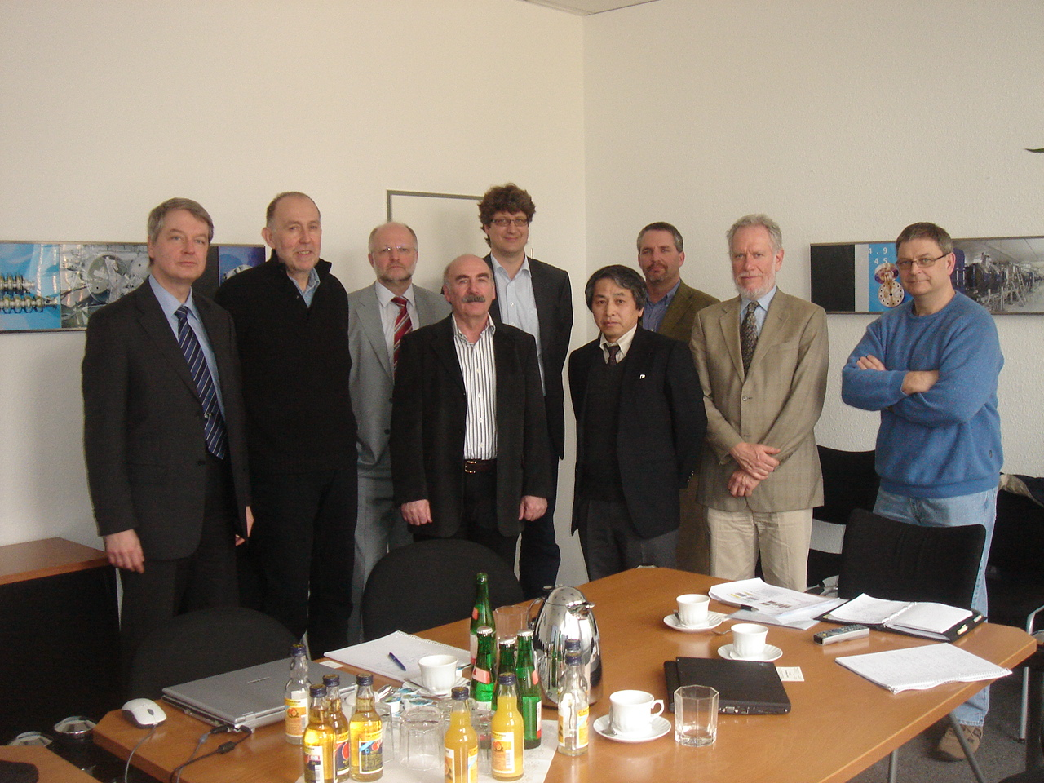
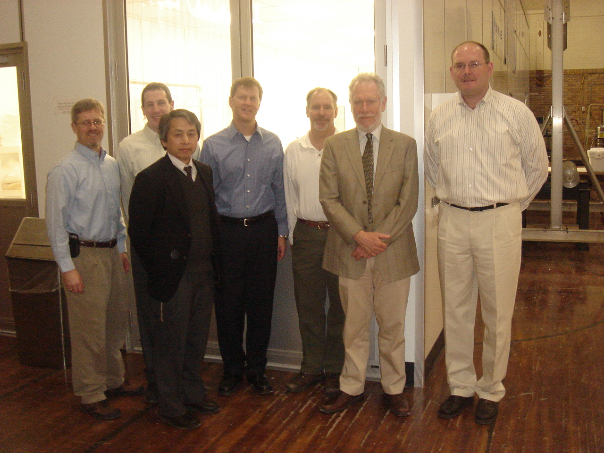
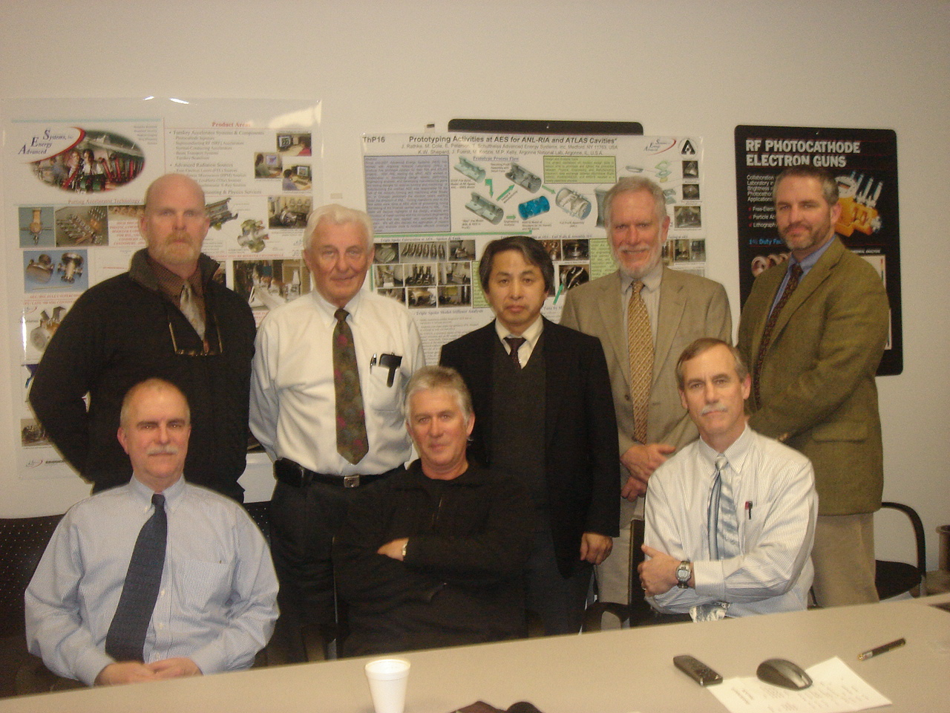
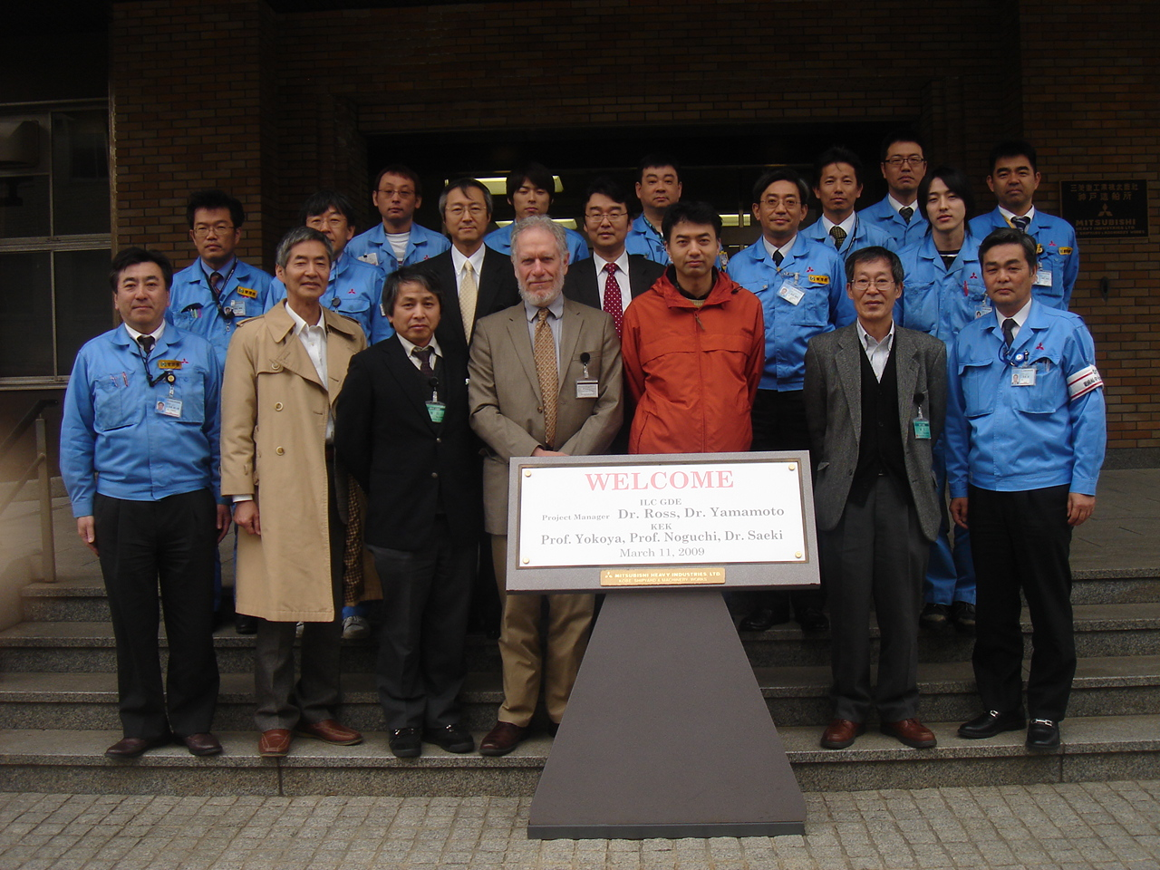
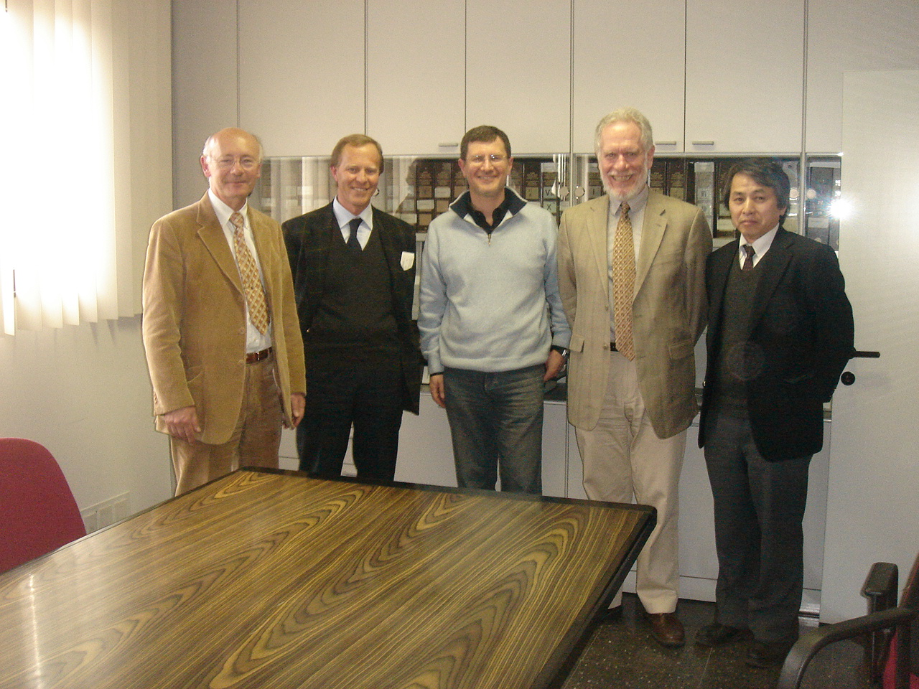
Visits to SC Cavity Manufacturers in Global Industry: 2009
Europe:
RI (ACCEL)
ZANON
Americas:
AES
NIOWAVE
PAVAC
Asia
MHI
HITACHI (expected)
TOSHIBA (expected)
Notes:
AES: Advanced Energy Systems
RI: Research Instruments (previously, ACCEL)
MHI: Mitsubishi Heavy Industries

Slide 7
A Model for Industrialization
Total numbers of SCRF 9-cell cavities required for ILC (Main Linac +Damping Ring + others)
  15,764
A model for 9-cell cavity productions
  15,764 + spare + production back-up (~ 10%)
  → ~ 18,000 cavities / 4~ 5 years
Possible models for manufacturing
  Single consortium/vendor
  Three regional consortiums/vendors
  Six (or more) consortiums/vendors
    < 3,000 > cavities / vendor
    < 3 > cavities / day / vendor (assuming 5 yrs & 200 days/yr)

Slide 8

A Satellite Meeting at IPAC-2010
SCRF Cavity Technology and Industrialization
Date : May 23, 2010, a full-day meeting, prior to IPAC-2010
Place: Int. Conf. Center, Kyoto, Japan
Organized by: ILC-GDE Project Managers,
Objectives:
To discuss and exchange information on:
  preparation for the ‘ILC SCRF Cavity’ industrialization between industries and laboratories,
  Industrialization plan to be reported by laboratories, and
  Comments/advices given by industries,

Slide 9
Agenda
09:00 ~ 09:35 Introduction
09:00 Opening Remarks (15') A. Yamamoto (KEK, ILC-GDE)
09:15 Current Status of SCRF Cavity development (20') R.Geng (JLab), J. Kerby (FNAL)
09:35->10:30 Industrialization Experience at European Laboratories
09:35 European XFEL cryomodule production model and status (20') O. Napoly (CEA/Saclay)
09:55 CERN Industrial Experience with LHC Construction (35') P. Lebrun (CERN)
10:45->12:15 Laboratory Plans in the American and Asian Regions
10:45 American Region Laboratory Plans (45') B. Kephart (FNAL)
11:30 Asian Region Laboratory Plans (45') H. Hayano (KEK)
13:15->15:30 Industrial Experience / Studies / Advice
13:15 European industrial experience with large international projects (30') W. Walter (Babcock Noell)
13:45 From Americas region (1h00')
* Industrial studies of ILC cavity and component production in the Americas (30') T. Favale (AES)
* The interim US market for SCRF accelerator technologies (30') Ken Olsen (SPAFOA)
14:45 From Asian region (45')
* Industrial studies with Japanese industries (30') E. Kako (KEK and J. Industries)
* Efforts with the Advanced Accelerator Science/Technology Association (15') M. Ono / A. Yamamoto (AAA)
16:00->16:40 Nb Material Supply
16:00 Industrial comments on the material requirements for the ILC (25') H. Umezawa (Tokyo Denkai)
16:25 High pure Nb; Indust Alt. Production and Strategic Cooperation (15') B. Spaniol (Heraeus)
16:40 General Discussion (35') All
17:15 Summary (15') J. Kerby (FNAL)
17:30 End

Slide 10
Next Step
Action:
  Prepare for Preliminary “Cavity Specification” and ask responses/advices from possible cavity/cryomodule venders (6 ~ 10 companies/laboratories), in parallel to our own industrial R&D efforts,
Period:
  2010 – 2011
Objectives
  Seek for the most practical industrial model including cost evaluation,
    Single (1), regional (3), and multiple venders (6) vender models,
  Establish a plug-compatible specification (possively ‘process specification’, and hear of advices from industries including cost-effective manufacturing and quality control,

Slide 11
Backup
TDP and beyond

Slide 12
Technical Design Phase and Beyond
change control process
AAP
PAC
TDP Baseline Technical Design
TDR
RDR Baseline
SB2009 evolve
TDP-1
TDP-2
Beijing Workshop
CERN Workshop
Change
Request
RDR ACD concepts
R&D Demonstrations
AD&I studies
2009
2010
2011
2012
2013
Notes:
12

