Slide 1
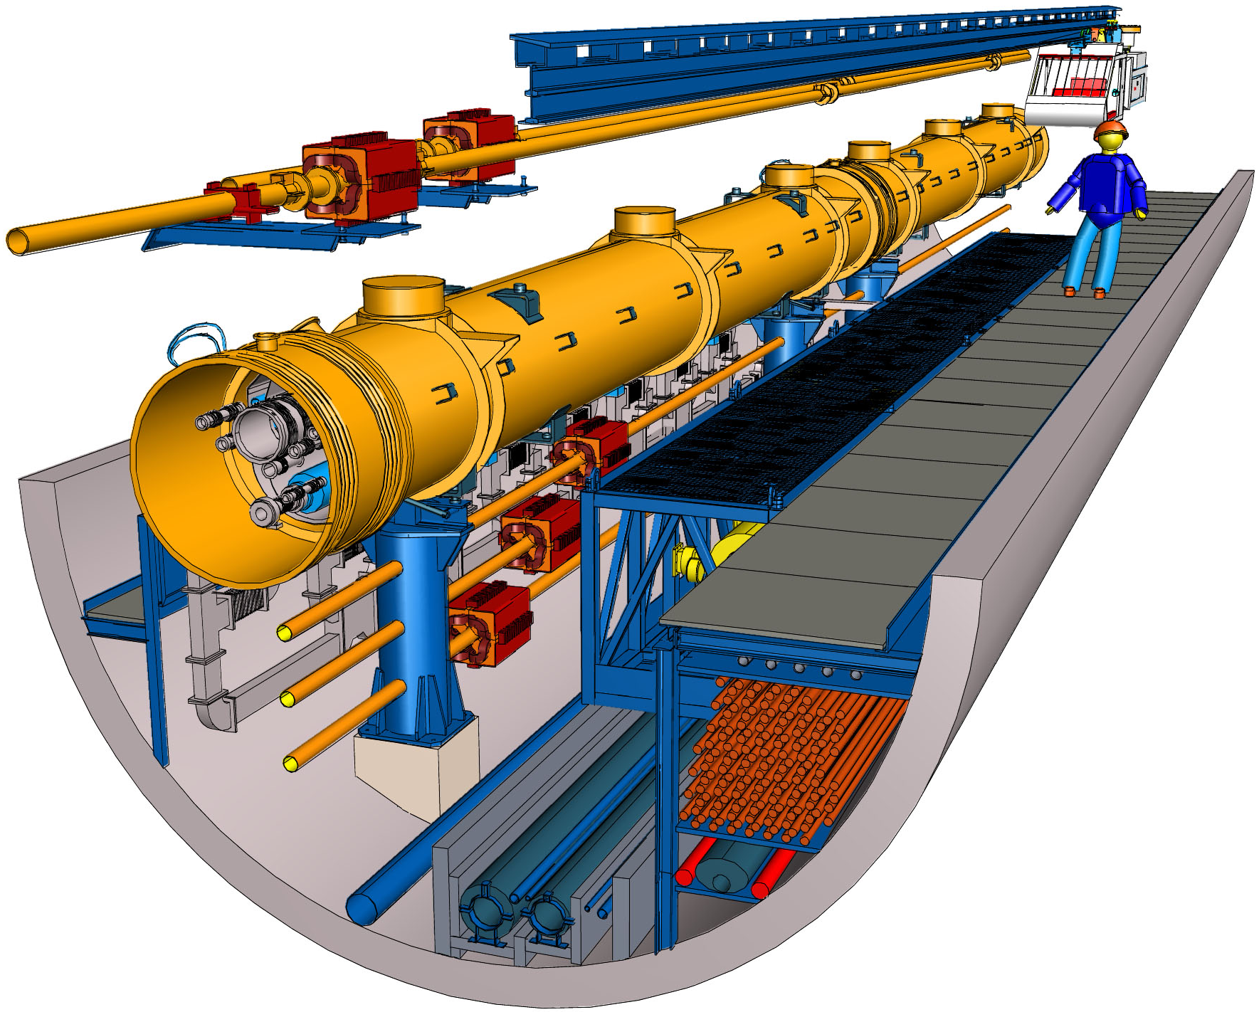
Experience from the European XFEL.
Installation of HLRF in a Single Tunnel
First Baseline Assessment Workshop
BAW · KEK · Tsukuba, Japan
September 7 to 10, 2010
Wilhelm Bialowons · DESY & GDE

Slide 2
Outline
Introduction
  References
  The European X-Ray Free Electron Laser Facility
    Overview
    Parameter List
    Tunnel Layout
    Tunnel Construction Progress
High Level RF for European XFEL
  Modulator
  Pulse Cable
  Pulse Transformer and Klystron
  Wave Guide Distribution

Slide 3
Outline
HV Pulse Cable Test
Procurement Procedure
  Specification and Procurement
  Production
Test and Test Facilities
  Wave Guide Assembly and Test Facility
  Modulator Test Facility
  Klystron Test Facility
Installation and Commissioning
Adoption to the Japanese Single Tunnel Solution
Summary

Slide 4
Introduction: References
Stefan Choroba, Design and Status of the XFEL RF System, 22nd Particle Accelerator Conference, June 25 to 29, 2007, Albuquerque, New Mexico, USA (JACoW: TUXC03).
Valery Katalev and Stefan Choroba, Waveguide Distribution System for FLASH, 6th Workshop on CW and High Average Power RF, May 4 to 7, 2010, ALBA, Barcelona, Spain (InDiCo.cern.ch: 73280).
Stefan Choroba, Specification, Procurement, Production, Assembly, Testing, Installation and Commissioning (of the XFEL RF System), unpublished.
Jörg Eckoldt, Pulse Cables for XFEL, September 5, 2007, XFEL Project Meeting (DESY EDMS: 933641).

Slide 5
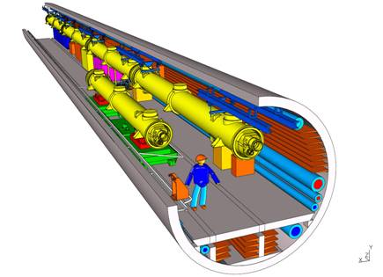
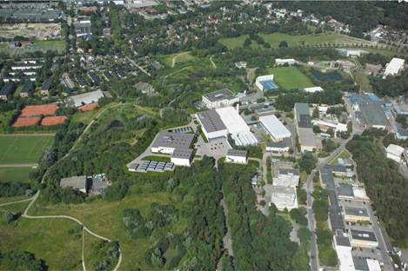
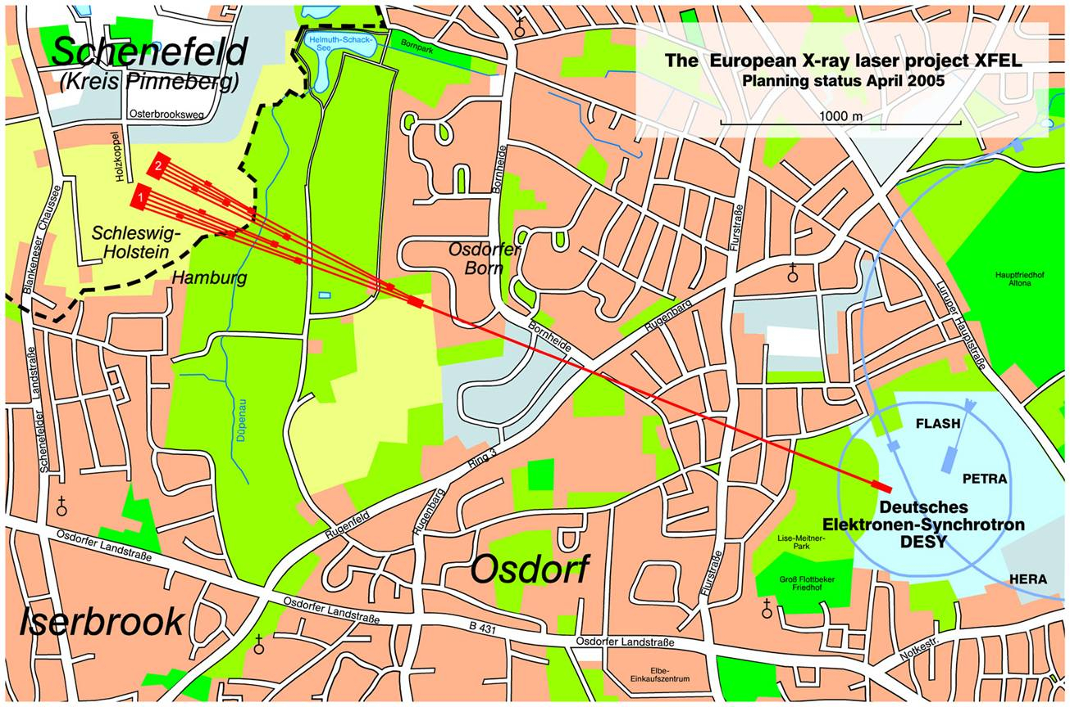
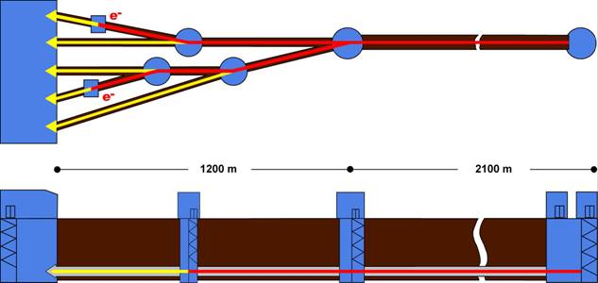

Introduction: XFEL Overview
Beam energy: 14 GeV (17.5 GeV)
No. of active ML klystrons: 18+2+2 (23+2+2)
Wavelength: down to 0.1 nm
Beam pulse length: 650 μs
Repetition rate: 10 Hz (30 Hz at low energy)
No. of bunches per pulse: 3250
Bunch to bunch spacing: 200 ns
Bunch charge: 1 nC
DESY Site
Schenefeld Site

Slide 6
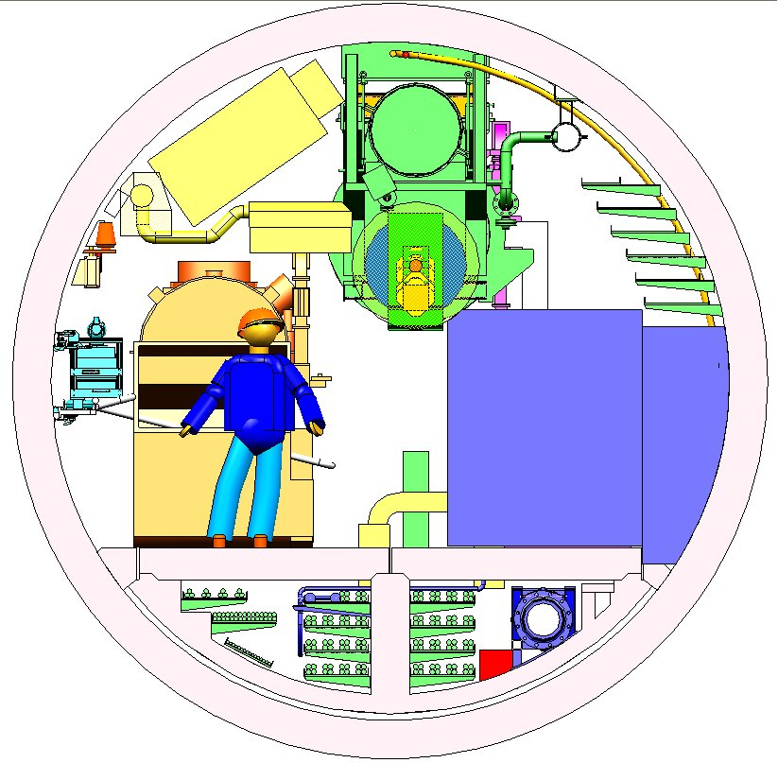
Introduction: ML Tunnel Cross Section

Slide 7
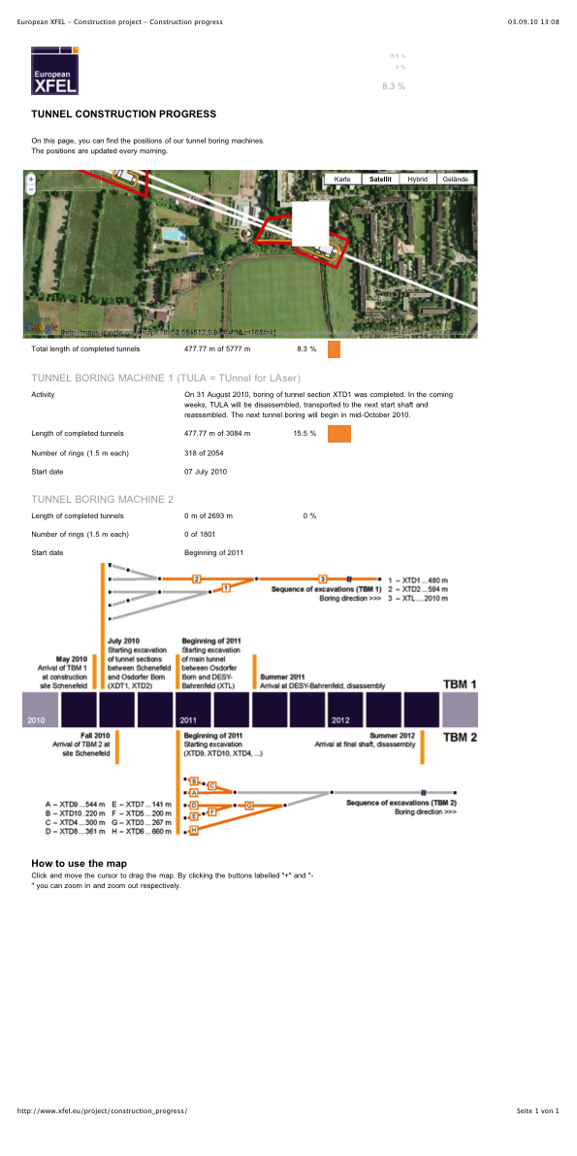
XFEL: Tunnel Construction Progress

Slide 8
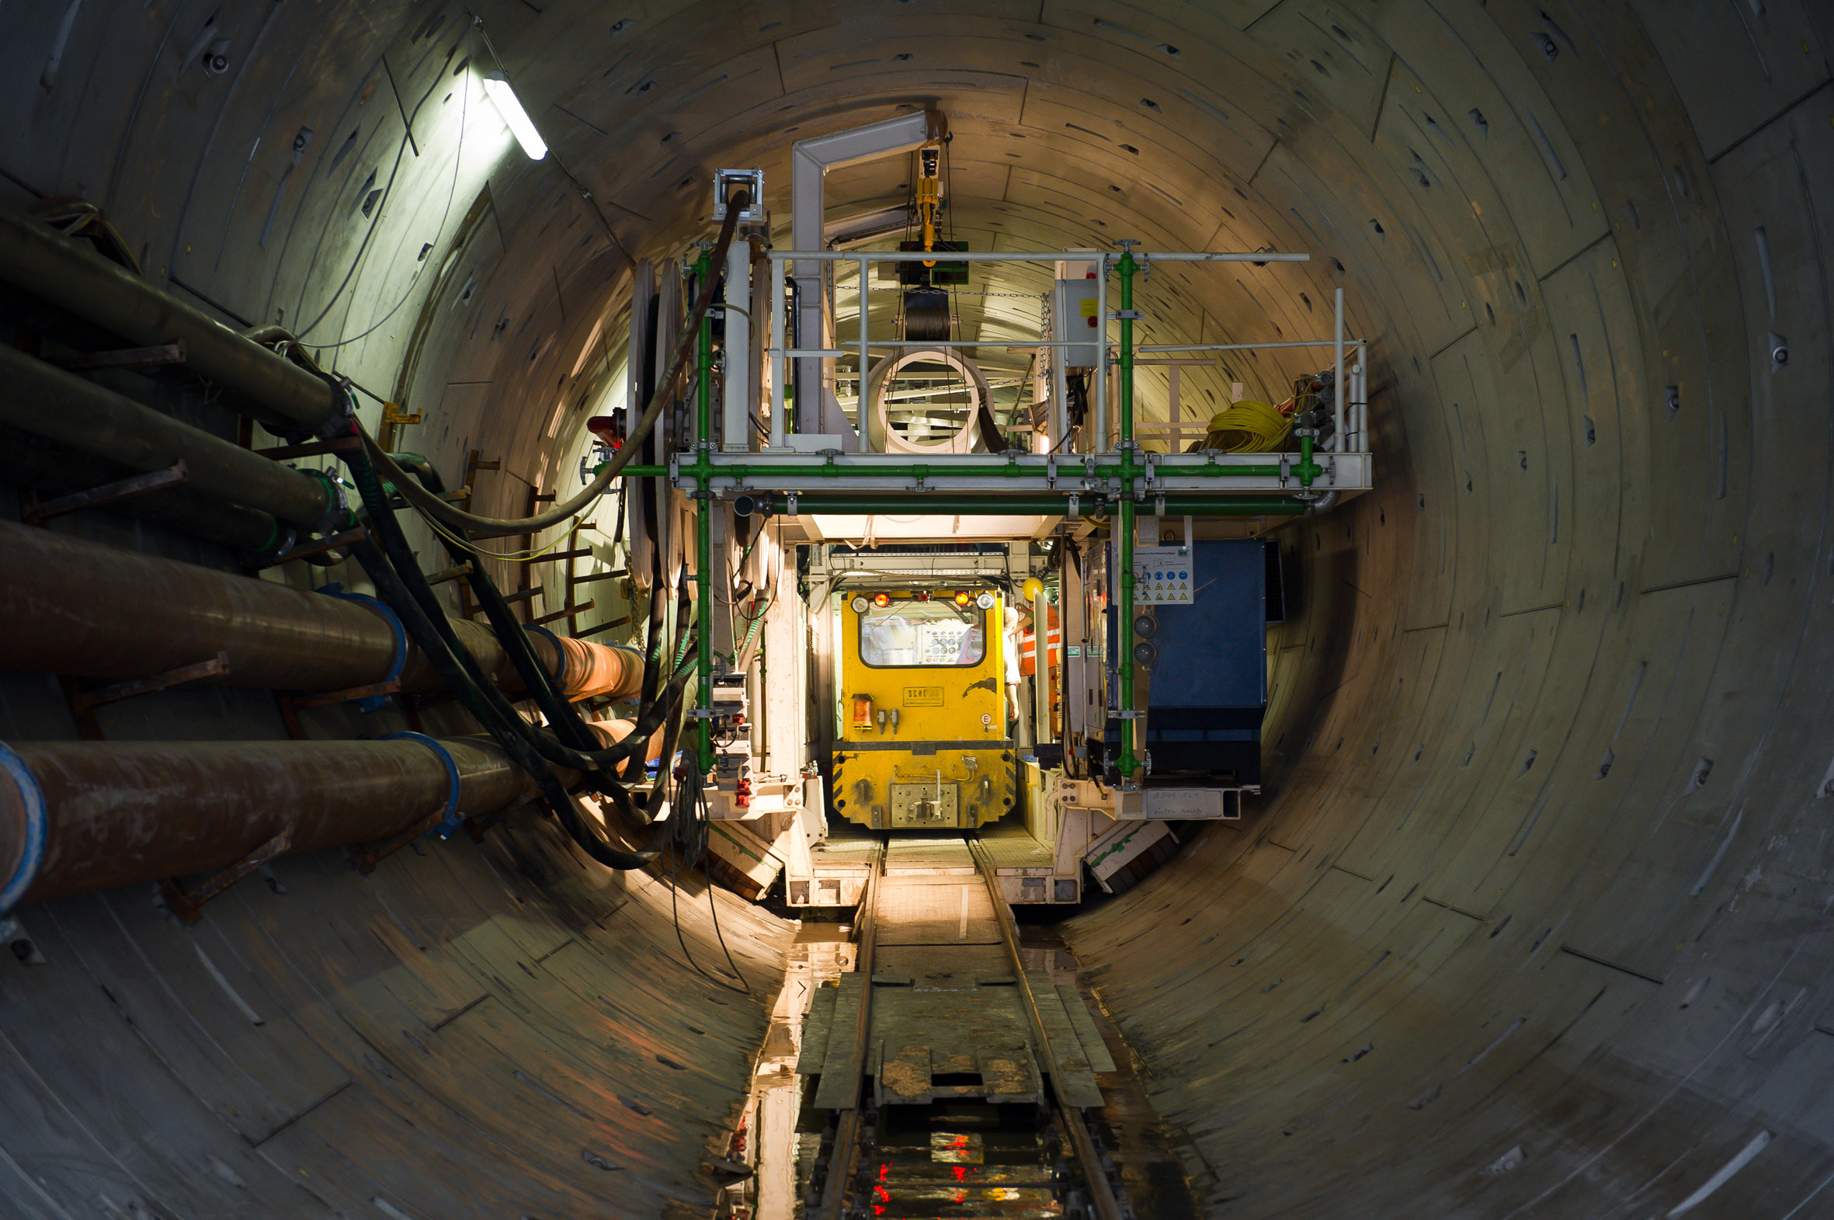
XFEL: Tunnel Construction Progress

Slide 9
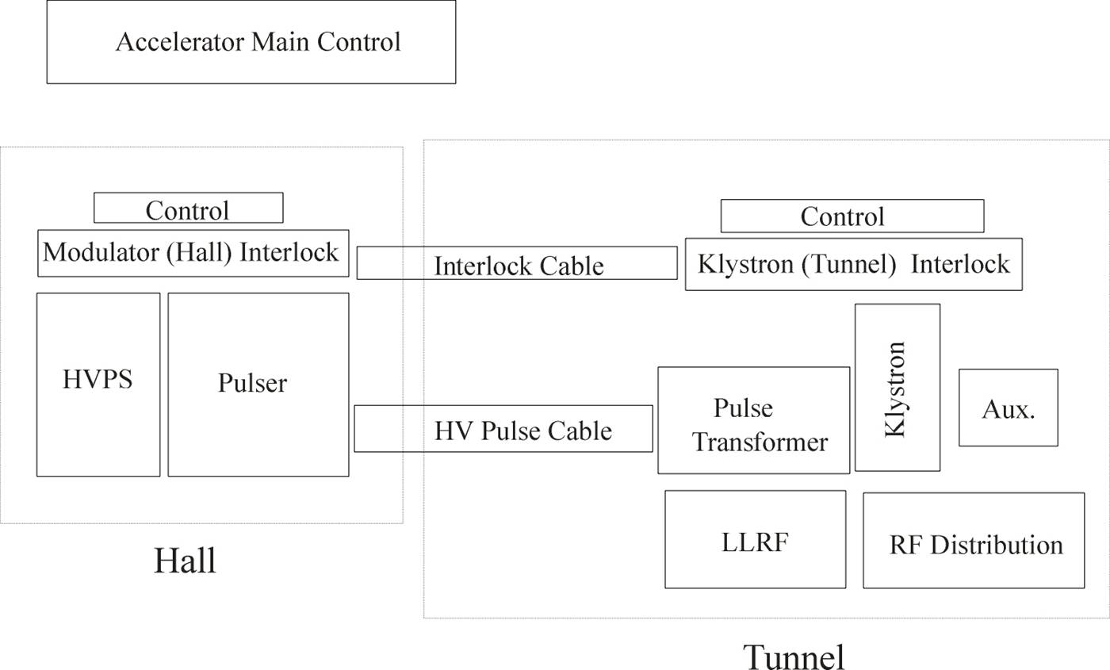
XFEL RF System Requirements
Layout of one RF Station
Accelerator Tunnel
Modulator
27 x 4 Cable
Modulator Hall
V ≈ 30 m x 40 m x 4 m
for 30 Modulators

Slide 10
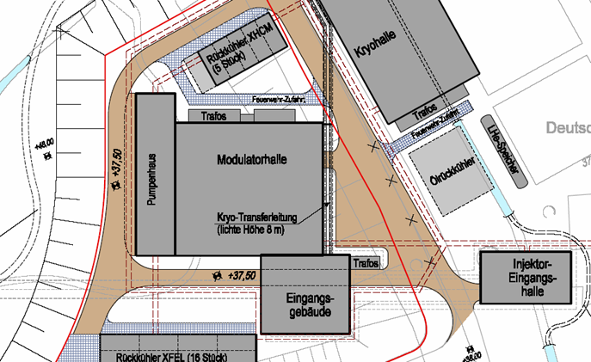
XFEL RF: Modulator Hall
~ 30 m
~ 40 m
~ 8 m
Maintenance and Repair will be possible during Operation.

Slide 11
Modulator Requirements
Modulators must generate HV pulses up to 120 kV and 140 A, 1.57 ms pulse length and 10 Hz (30 Hz) repetition rate
The top of the pulse must be flat within 1 %
The bouncer type modulator with its simple circuit diagram was chosen

Slide 12
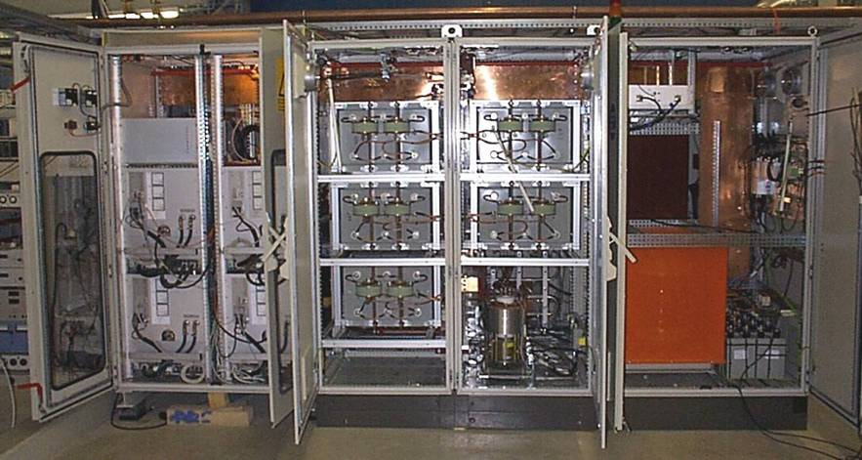
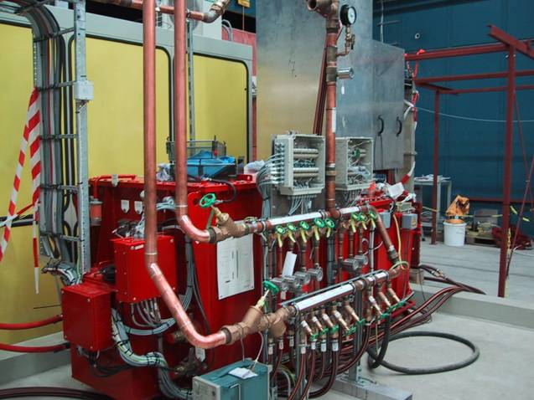
XFEL: Bouncer Modulator
Industry made subunits (PPT (General Vendor), ABB, FUG, Poynting)
Constant power power supply for suppression of 10 Hz repetition rate disturbances in the mains
Compact storage capacitor bank with self healing capacitors
IGCT Stack (ABB); 7 IGCTs in series, 2 are redundant
Low leakage inductance pulse transformer (ABB) L < 200 μH resulting in shorter HV pulse rise time of < 200 μs
Light Triggered Thyristor crowbar avoiding mercury of ignitrons

Slide 13
XFEL: Modulator
Qualification of additional vendors
Bouncer Modulator by Imtech/Vonk?
PSM Modulator by Thomson BM✓
Installation at DESY, location Zeuthen

Slide 14
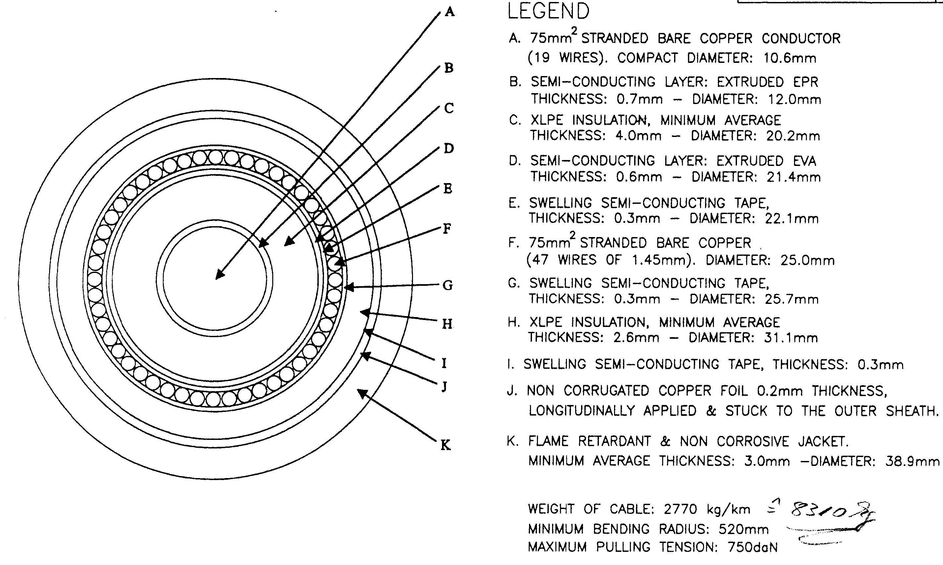
XFEL: Pulse Cable Design

Slide 15
XFEL: Pulse Cable Parameter
Maximum Cable Length w/o connections l = 3 000 m
Cross-Section A = 75 mm² Cu.
Four Cables parallel.
Losses per Cable per Meter without Skin Effect at
10 MW Pulse Power, 65 % Klystron Efficiency,
10 kV Voltage, 1.5 ms Pulse Length and 10 Hz Repetition Rate:
P/l = 0.5 W/m.
Cable Cost see SLAC WBS Tool used for the RDR.

Slide 16
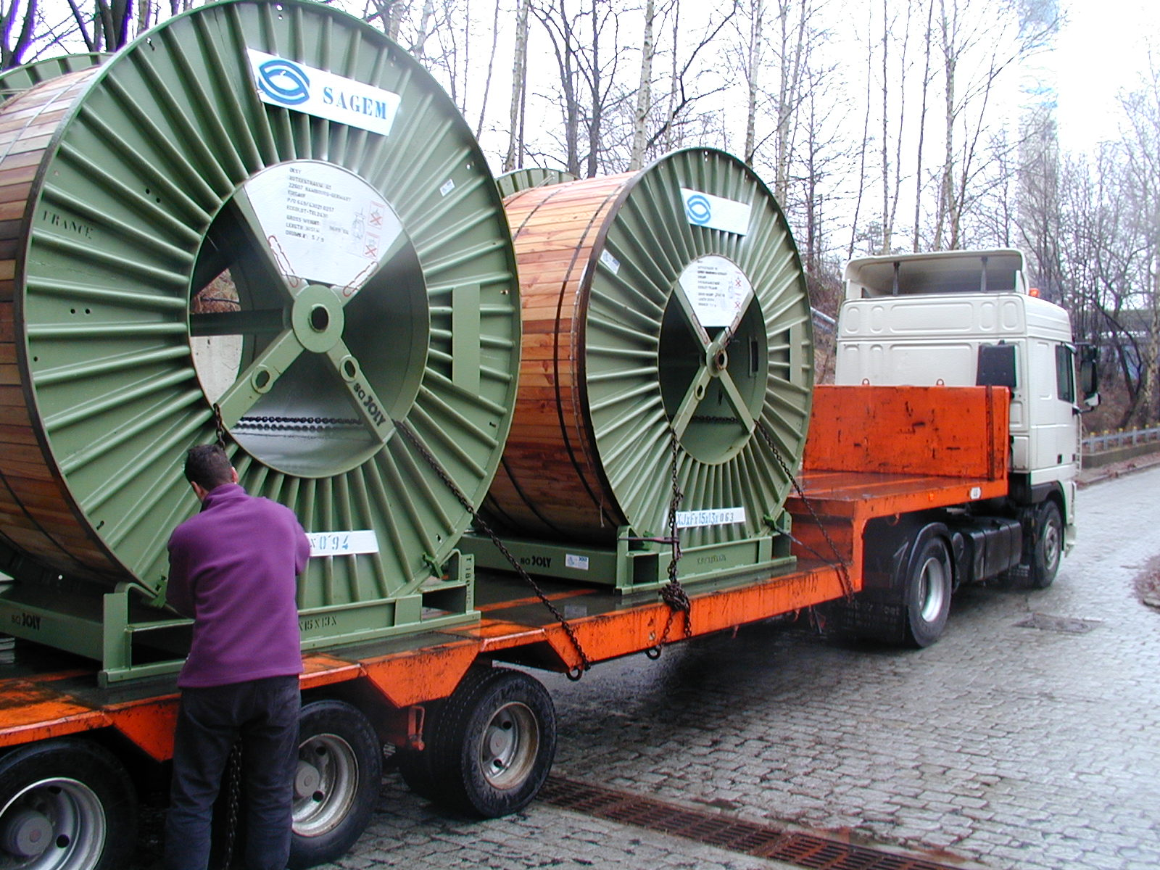
XFEL: Pulse Cable
Transport of drums with 3 km HV Pulse Cable

Slide 17
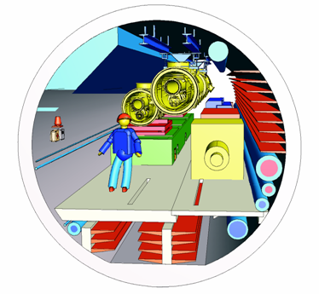
XFEL RF System Requirements
Layout of the RF Station in the Accelerator Tunnel
Tunnel components (klystrons, pulse transformers, auxiliary power supplies etc.) will be installed under the cryogenic module.
The waveguide distribution will be installed on the side of the cryo module.
These components are not accessible during accelerator operation.

Slide 18
XFEL Accelerator Tunnel: Cross Section

Slide 19
XFEL Accelerator Tunnel: Cross Section

Slide 20
RF High Power Source
Requirements
Operation Frequency: 1.3 GHz
Cathode Voltage: < 120 kV
Beam Current: < 140 A
Max. RF Peak Power: 10 MW
RF Pulse Duration: 1.5 ms
Repetition Rate: 10 Hz
RF Average Power: 150 kW
Efficiency: 65 %
Solenoid Power: < 5.5 kW
Length: 2.5 m
MultiBeam Klystron (MBK) was chosen

Slide 21
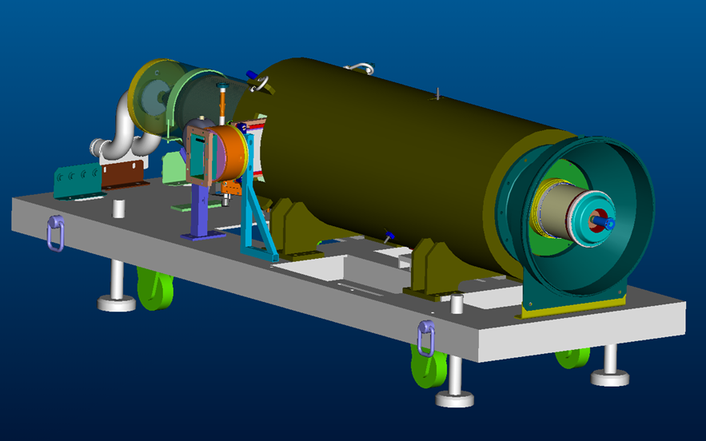
Horizontal MBK
Horizontal MBK Prototypes
All 3 Vendors (CPI, THALES and TOSHIBA) have been pre-qualified for delivery of a horizontal MBK.
All horizontal Prototypes (one per vendor) have been tested at DESY.
THALES TH1802
TOSHIBA E3736H

Slide 22
Wave Guide Distribution
Fixed Phase Shifters
AST
Shunt Tee
with Phase Shifters
Isolators
Bellow

Slide 23
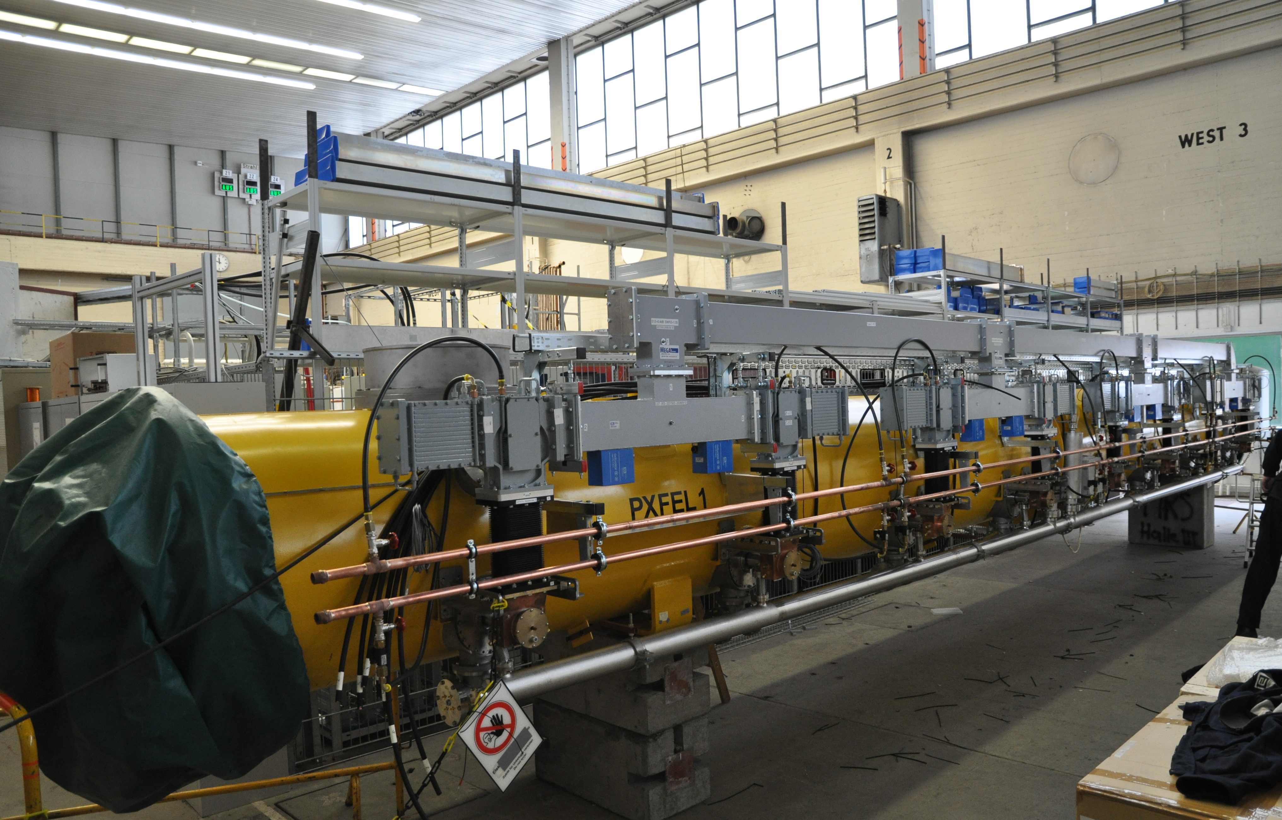
XFEL Type Wave Guide Distribution for ACC7

Slide 24
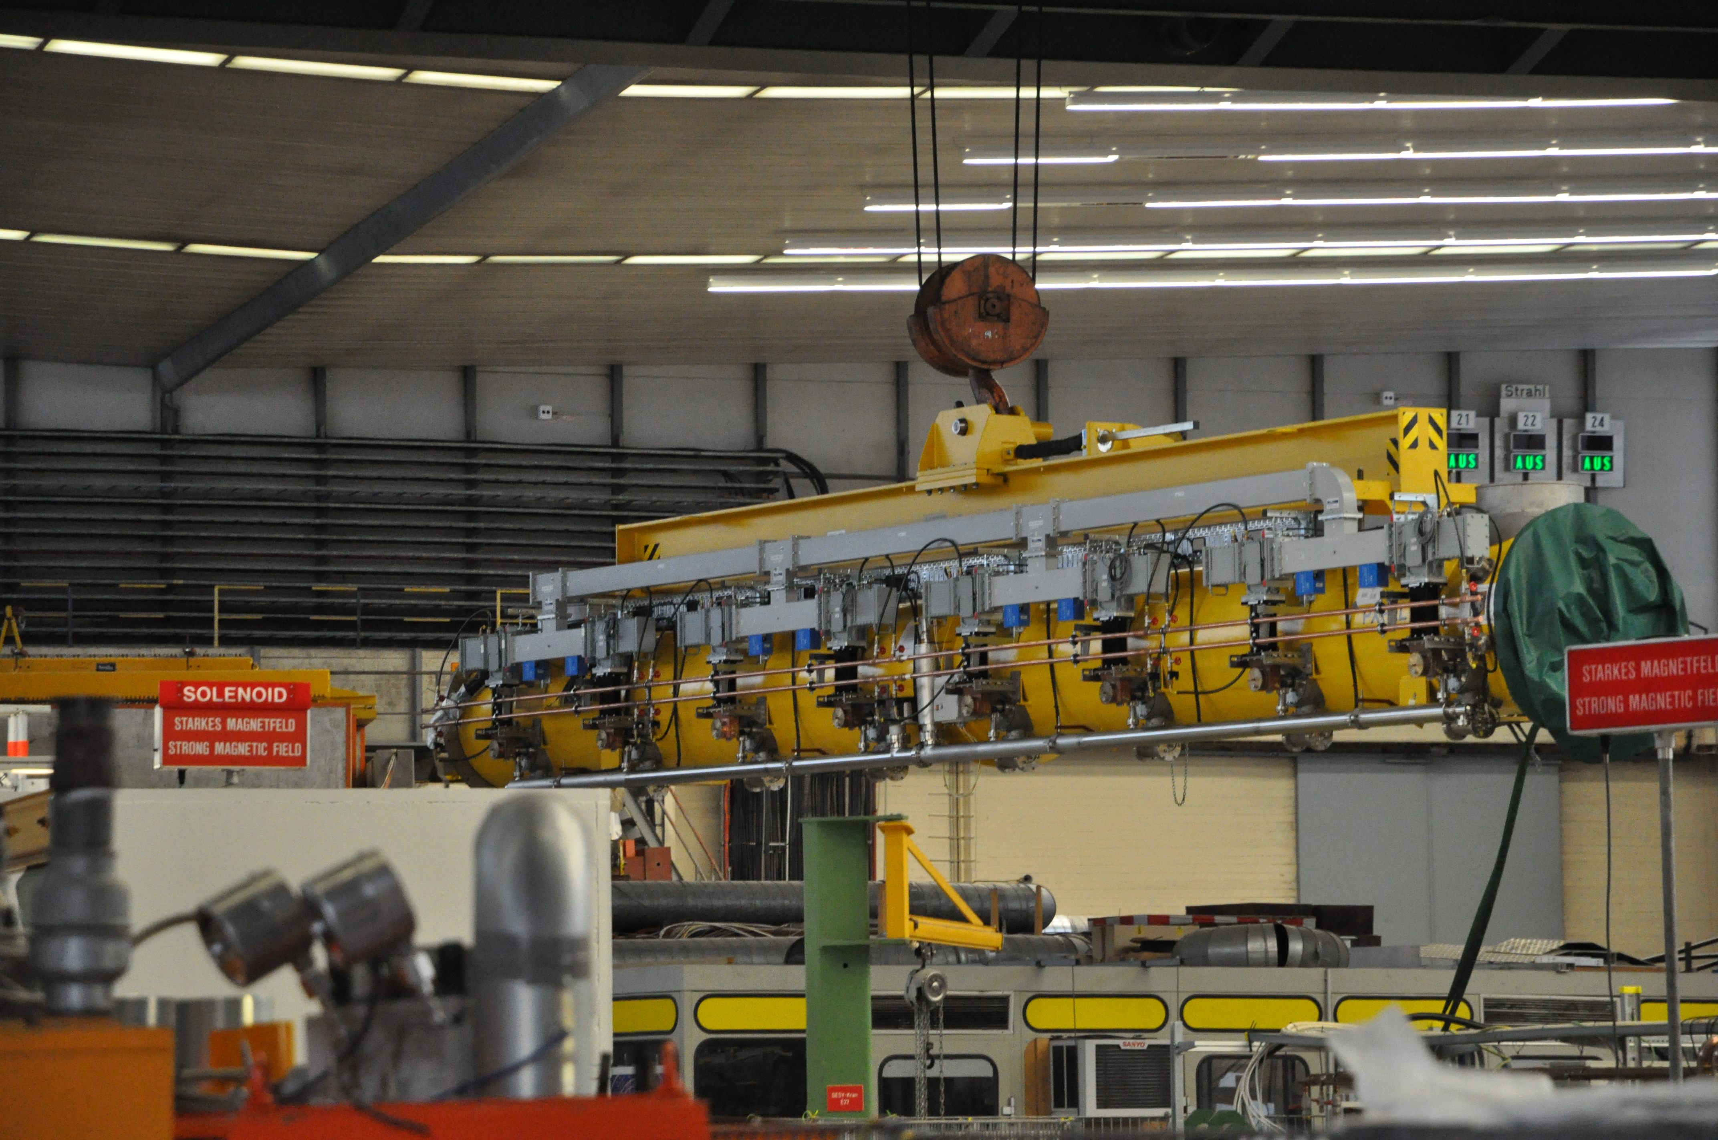
Transport of ACC7 with Wave Guides

Slide 25
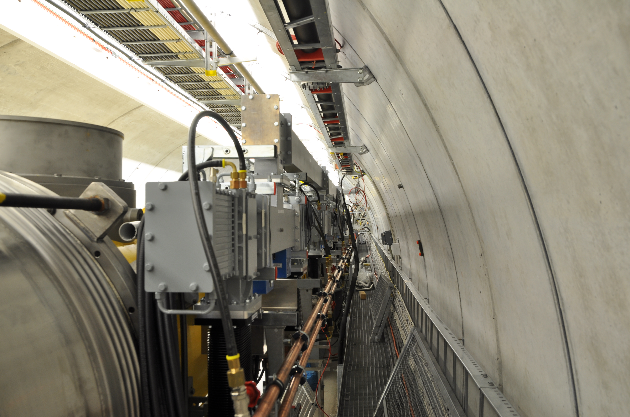
Wave Guide Distribution in Flash
Compact 2D system – it needs small space
Flexible – adjustable RF power for each cavity
Pretuned phase
Possibility of preinstallation at the cryomodule
Works since 2008 on the FLASH

Slide 26
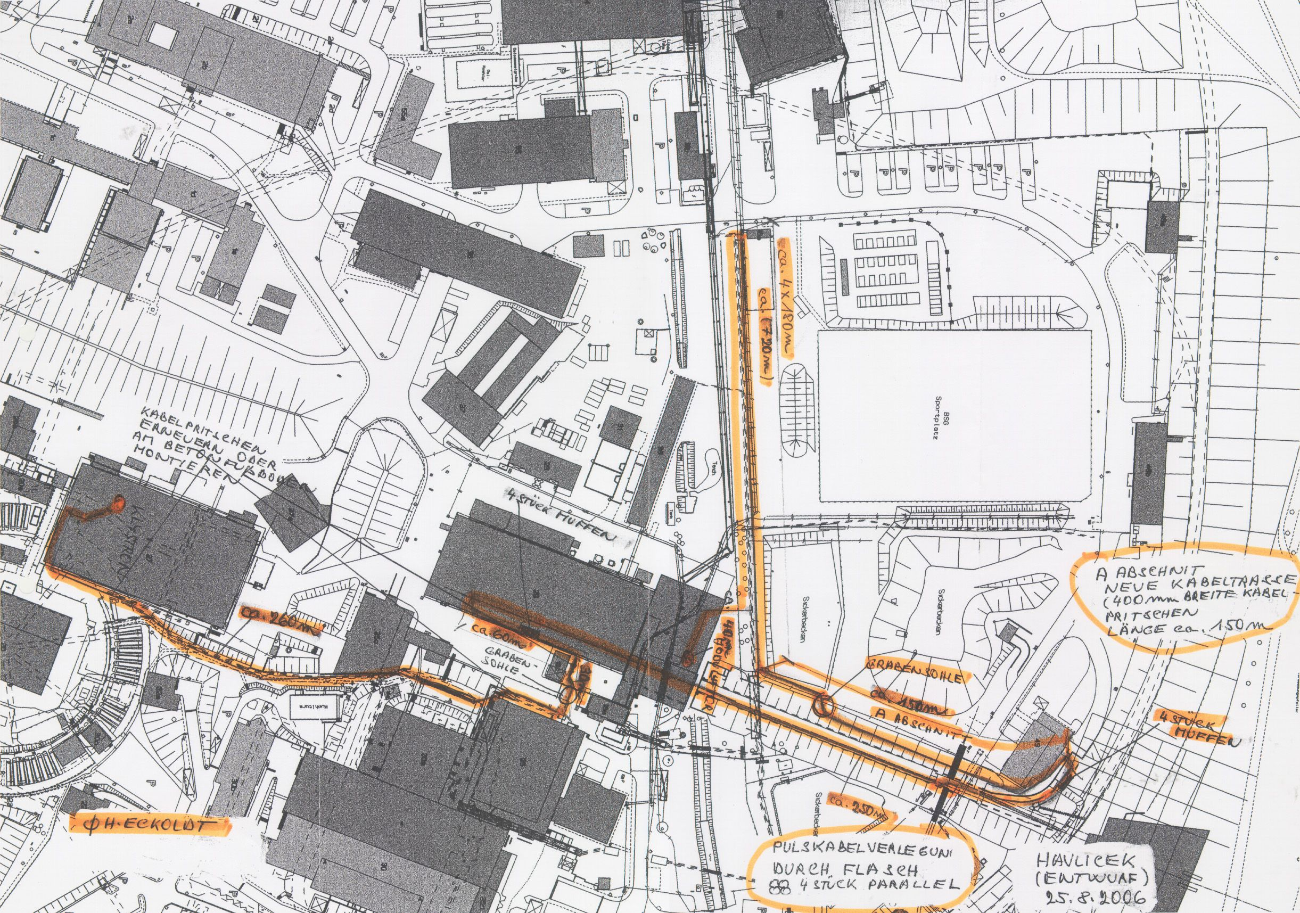
Installation for Pulse Cable Test
Modulator in
Hall II
Pulse Transformer
in Hall III
Splices
Pulse Cable
Parallel to FLASH

Slide 27
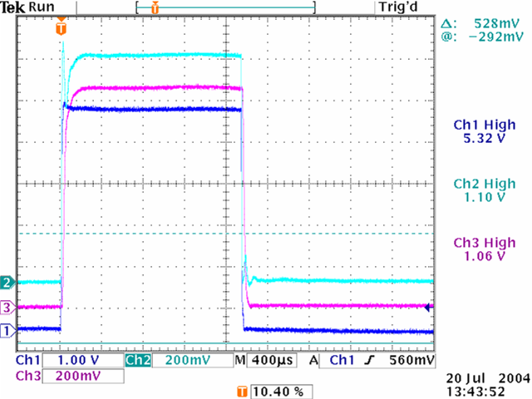
HV Pulse Cable Test
Primary Current 1.1 kA
Klystron Voltage 128 kV (1 : 12)
Primary Voltage 10.6 kV @ Modulator
5 MW Single Beam Klystron 3 Cable parallel

Slide 28
Specification and Procurement
Principal layout and design of the RF system components has been finished and prototypes have been constructed and tested.
Final specifications will be finished soon taking into account prototype test results and results of the details of the interfaces with other work packages and installation requirements of the tunnel and other XFEL buildings.
Restricted Call for Tender.
Only qualified Venders are allowed to bid.
Number of Vendors are not fixed in advance.

Slide 29
Production
After placement of contracts with manufacturers or start of production in laboratories the production process must be monitored. All components for the XFEL will be shipped to DESY. After a first inspection and specification check, the components will be assembled into subunits and tested. Until final installation they must be stored.
The HV pulse modulators will be delivered by the manufacturers and installed in the modulator hall.
Klystrons, pulse transformers and connection modules from Industry will be tested at the klystron test facility.

Slide 30
Production (continued)
In addition the other components as auxiliary power supplies, preamplifiers and RF interlocks also from industry must be installed in racks and tested.
The components for the waveguide distribution will be shipped to DESY after successful factory acceptance test. They will be inspected, measured, cleaned and assembled for installation to a specific cryogenic module in the waveguide assembly and test facility, WATF. The average production rate will be one waveguide module distribution per week.

Slide 31
Wave Guide Assembly and Test Facility
Special Facility for Assembly and Test of Waveguides
Components from Industry and Laboratories
Input Control of Mechanical and Electrical Parameters
Assembly to Wave Guide Distributions
The distributions and waveguide components will be tested at low and high power.
At the end they will be installed at the cryogenic modules or directly at the final installation.

Slide 32
Wave Guide Assembly and Test Facility

Slide 33
Modulator Test Facility

Slide 34
Klystron Test Facility
It was already necessary to test vertical and horizontal multibeam klystron prototypes delivered to DESY intensively under different operation conditions and to perform a number of different measurement which will usually not be done during normal operation at an accelerator. A dedicated facility has been set up at DESY, Hamburg, and all prototype klystrons have been tested there.
Although all series klystron will be delivered fully tested by the klystron manufacturer they will be tested after delivery to DESY. The existing facility must be extended in order to allow for testing of one klystron per month. Possible problems which might not be observed at the klystron vendors productions site could be detected as early as possible before the klystrons will be installed in the accelerator tunnel or the klystron installation floor in the injector building.

Slide 35
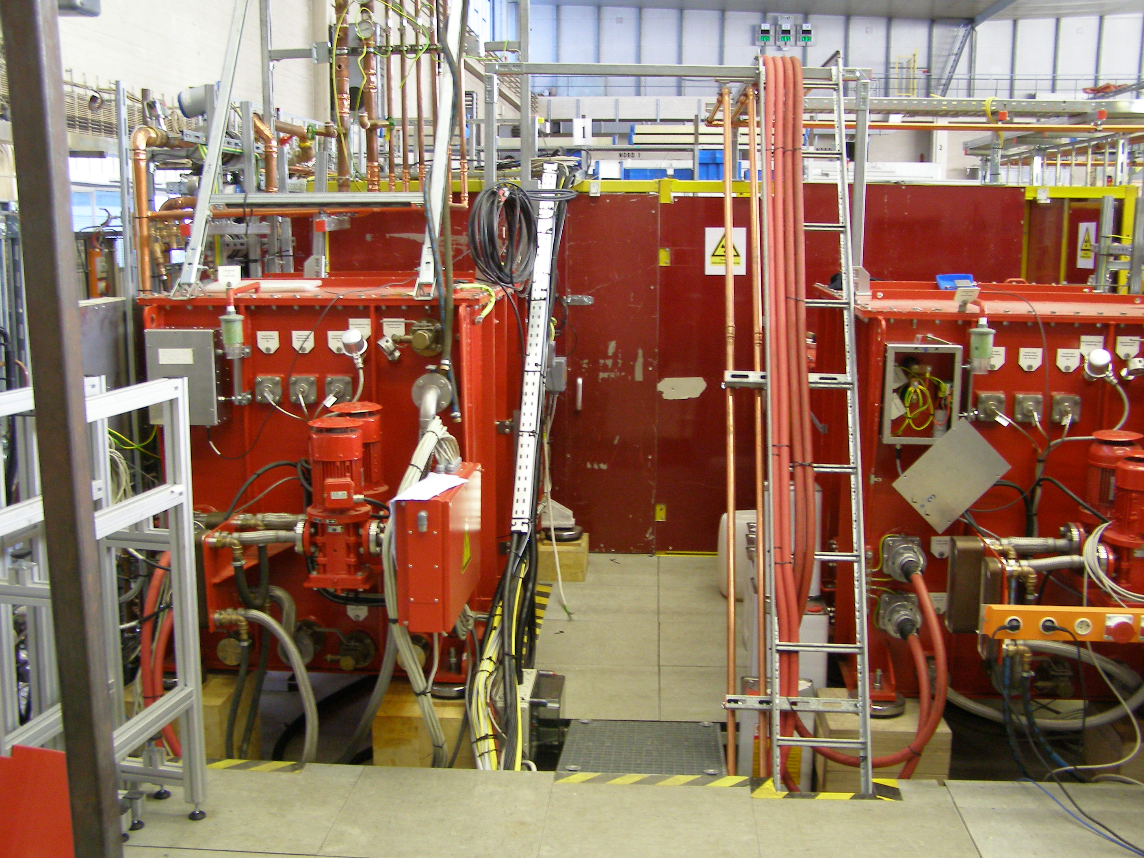
Klystron Test Facility in DESY Hall II

Slide 36
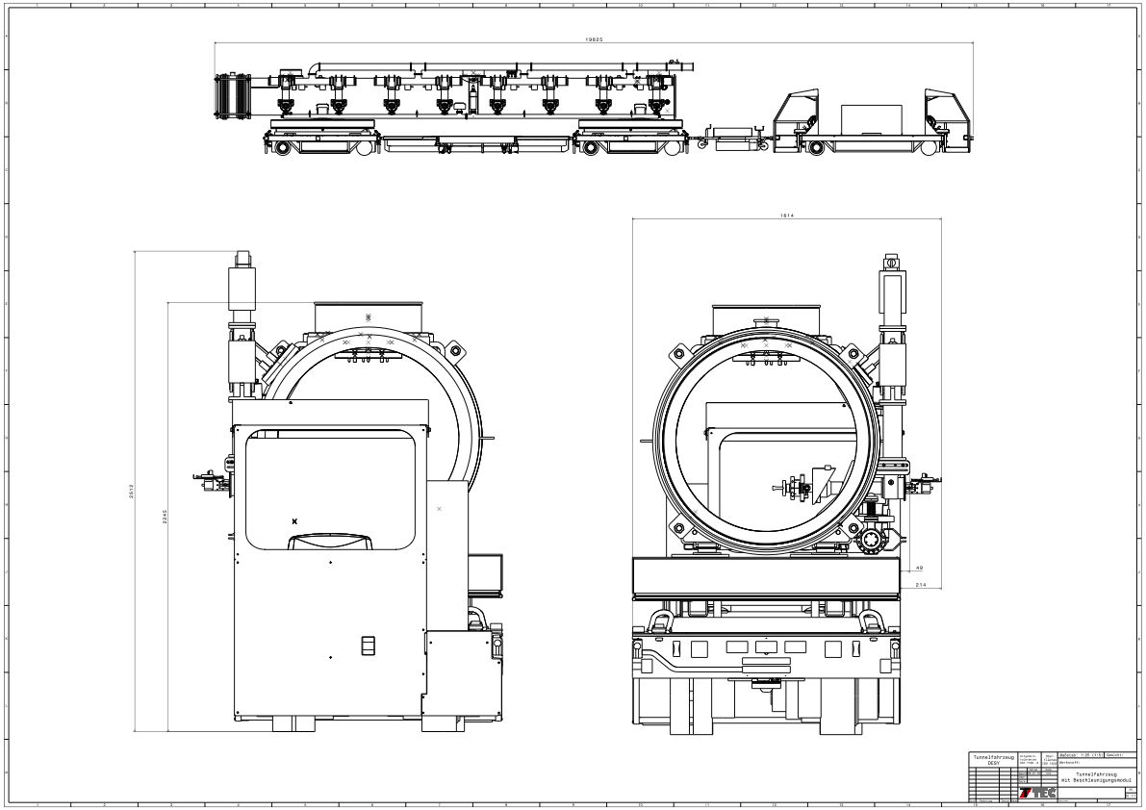
Installation and Commissioning
Tunnel Vehicle with Cryo Module and Wave Guide Distribution

Slide 37
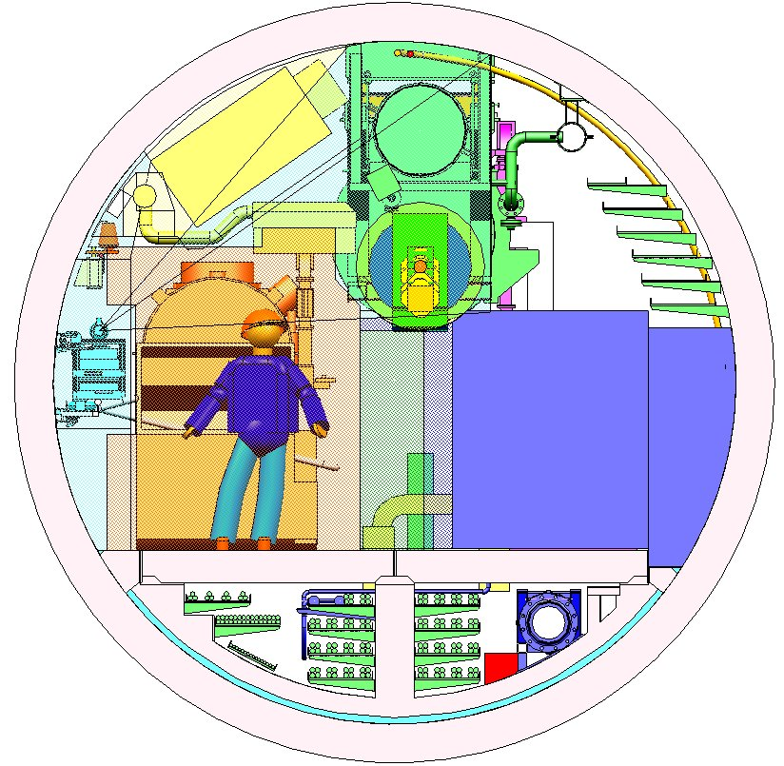
Installation and Commissioning

Slide 38
Adoption to the Single Tunnel Solution
The Tunnel Design can be adopted one to one.
Only the Modulators need either additional Surface or Underground Halls.
The Maximum Length of one Linac Section is defined by the Pressure Drop in the Gas Return Pipe and should be in the Order of 2.5 km. Therefore the Cryo Plants must be distributed along the Linac.
The Space for the modulators can be combined with Space for the Cryo Plants.

Slide 39
Summary
All components for the XFEL RF system have been designed and constructed during the last years.
Modifications of some components allowing the installation in the accelerator tunnel and qualification of additional vendors are being continued.
Determined by the XFEL schedule first RF system components are delivered currently for the various component test facilities.
The components for the XFEL injector must be received only shortly after. However delivery of the major amount of all components is planned for 2011 to 2012.
The European XFEL HLRF design can be adopted easily to all ILC single tunnel solutions and be used as fall back solution.

