Slide 1
PFA studies
Remi Zaidan
The University of Iowa

Slide 2
Introduction:
Test A:
  Run normal PFA: don’t allow the cone algorithm to modify the score unless the new score is above 0.99.
Test B:
  Normal shower building is run without the first cone.
  Loop again on tracks and associate clusters by applying a cut on the score given by the cone algorithm: > 0.99.
  If a cluster can be associated to two tracks: give to the one with highest score (cone) as long as the E/P balance is respected: tolerance 1 σ.

Slide 3
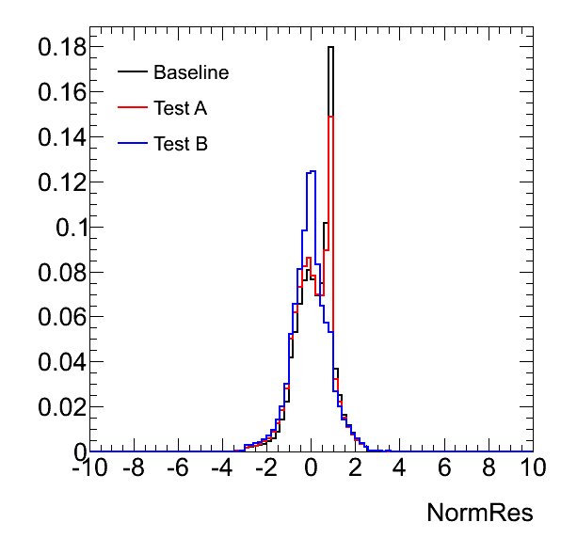
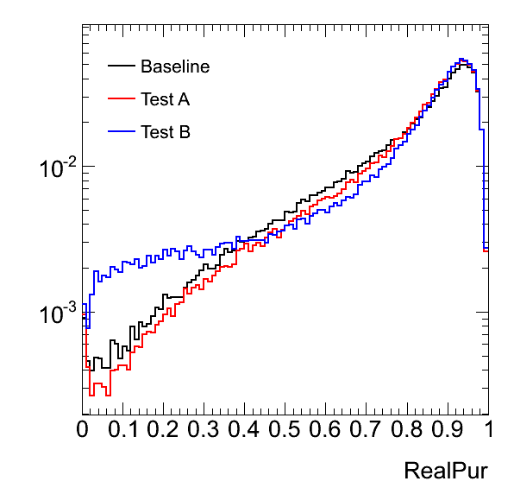
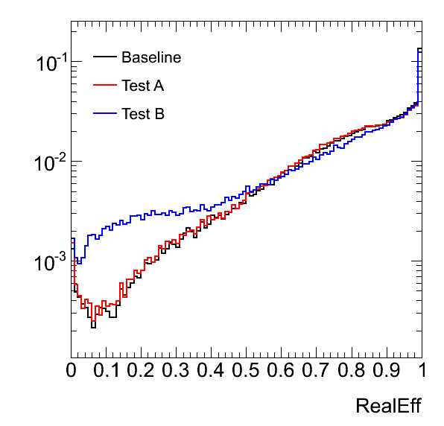
PFA performance:
Need to understand how and why the spike in the Energy/momentum residual is being formed:
  A change in the way the association is being done can make it disappear.
  In this case it was on the expense of more confusion.
 | Resolution (RMS 90)
Baseline | 3.4%
Test A | 3.4%
Test B | 3.7%

Slide 4
Charged/neutral confusion
Baseline | From neutral | From charged | Purity
Reco as neutral | 153.46 | 27.8 | 85%
Reco as charged | 38.29 | 258.93 | 87%
Efficiency | 80% | 90%
Test A | From neutral | From charged | Purity
Reco as neutral | 154.12 | 30.56 | 83%
Reco as charged | 37.45 | 255.41 | 87%
Efficiency | 80% | 89%
Test B | From neutral | From charged | Purity
Reco as neutral | 145.97 | 37.72 | 80%
Reco as charged | 46.27 | 250.37 | 85%
Efficiency | 76% | 87%

Slide 5
Conclusion
Need an independent way than the E/P constrain to separate charged from neutral energy.
Need to understand in details the behavior of the PFA at each step of the algorithm flow and search for steps where the PFA is not behaving as expected or steps where we can use more information.
Planning to implement a likelihood instead of the cone scoring that would take into account the cone score as well as other topological variables.

