Slide 1
TTF/FLASH:
Injector Performance
Dark Current
Video ‘flags’
Comments based on Desy visit,
5th May, 2010

Slide 2
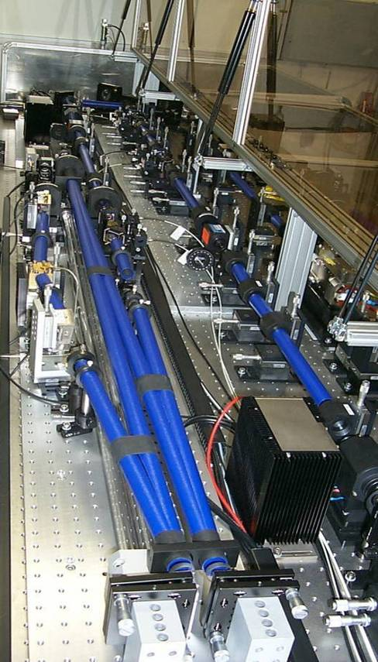
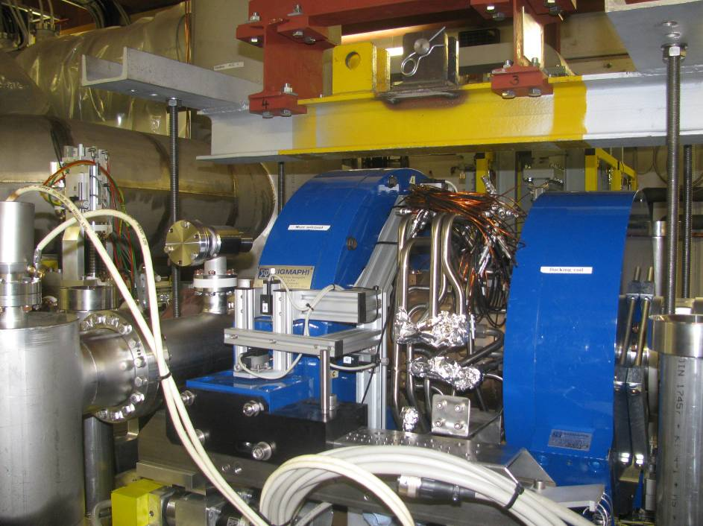
Electron Source: RF-Gun and Laser
New RF-Gun from PITZ with strongly reduced darkcurrent
– by a factor of ~10 (at 3.8 MW)
Prepared for higher RF power > 5 MW
– once a 10 MW klystron is available
Two fully diode pumped laser systems
– replacing the old flash lamp pumped heads
10 Hz operation
Improved low level RF controls of RF Gun and 1st accelerating module
New synchronization system based on fiber laser reference
– phase control over bunch train
Notes:
2

Slide 3
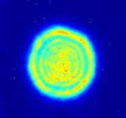
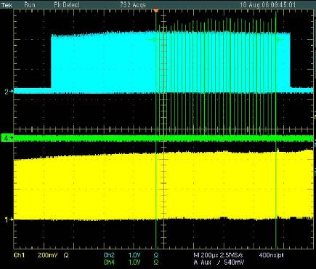
Laser System: 1 MHz Flashlamp Pumped
In cooperation
DESY/Max-Born-Institute, Berlin
Diode-pumped Nd:YLF Oscillator
Modulators (AOM EOM AOM) 108 MHz 1.3 GHz 13.5 MHz
Now being replaced by fully diode pumped system similar to 3 MHz laser
Piezo tuning of cavity length
Faraday isolator
Pulse picker Pockels cell
f_{round trip}= 27 MHz
E_{pulse}= 0.3 µJ
Remote controlled mirror box
Stabilized by quartz tubes
Fiber-coupled pump diodes
Diode pumped Nd:YLF amplifiers
E_{pulse}= 6 µJ
Imaging to the cathode
Fast current control
Pulse picker
Faraday isolator
Flashlamp pumped Nd:YLF amplifiers
Beam shutter
Relay imaging telescopes
Fast current control
E_{pulse}< 0.3 mJ
LBO
BBO
Remote controlled attenuator
IR→ UV
3 MHz Laser
E_{pulse}< 50 µJ
Photodiode

Slide 4
Exception Handling with Long Bunch Trains
How should the adaptive feed forwards and other beam based feedbacks react on an exception?
On what should it act, what should it limit or modify?
Examples of issues which came up:
  1. loss in the middle of the train produces an exception which switches off ACC1
  problem: darkcurrent now is transmitted in a way, that it produces a series of trips
  solution: better not to switch ACC1, but the gun (darkcurrent is from gun)
  problem: recovery of the gun takes 10 to 20 min to settle temperature
  2. loss triggers the 3 MHz laser to cut the train
  problem: laser shows severe beam loading effects and produces new loss trips
  3. feed forward overwrites some tables and produces large forward power in ACC1
  no exception is triggered, the couplers run into severe trips
  4. some cavities are starting to quench
  problem: cryogenic system itself reacts too late and gets instable

Slide 5
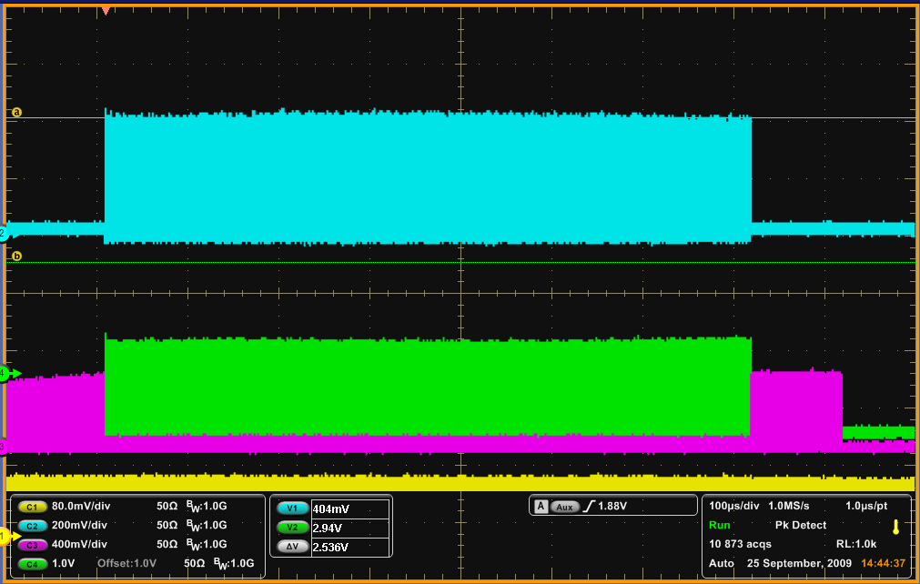
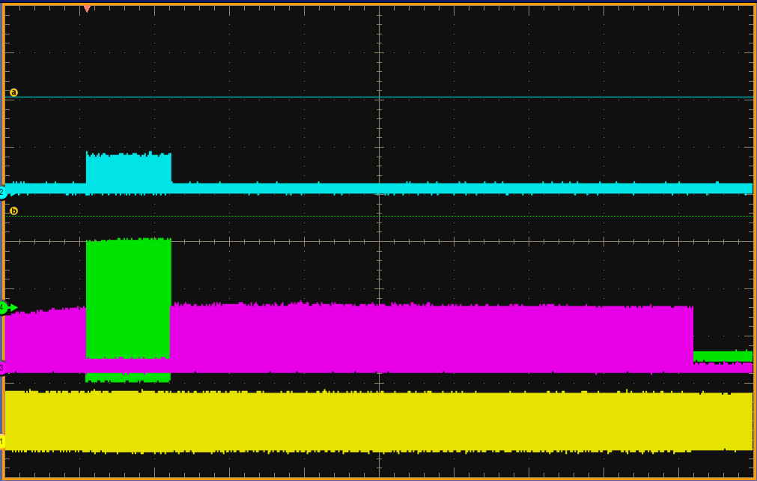
The MPS acts on both Lasers
On an MPS fast trip, the 2nd pulse picker Pockels cell is switched off within ~ 3 us, the slow system closes the beam shutter
MPS trip
Diode pumped Nd:YLF pulsed oscillator
Pulse picker Pockels cell 1
Diode pumped Nd:YLF amplifiers
Pulse picker Pockels cell 2
Beam shutter
LBO
BBO
Flashlamp pumped Nd:YLF amplifiers
IR→ UV
3 MHz Laser

Slide 6
Effect of MPS trips on the 3 MHz laser 2
Laser 2 runs with flat train, 3 MHz, 800 us length
After MPS trip: UV out decreases by a factor of ~2
MPS trip
UV (262 nm)
Green (532 nm)
Following an MPS trip signal to the pulse train
Due to phase mismatch in the BBO doubling crystal
Tuning the BBO would bring the energy back
If one now switches back to a long train, the energy would not recover immediately
It requires a couple of minutes to stabilize before the initial energy is back
IR (1047 nm)
before
after trip

Slide 10
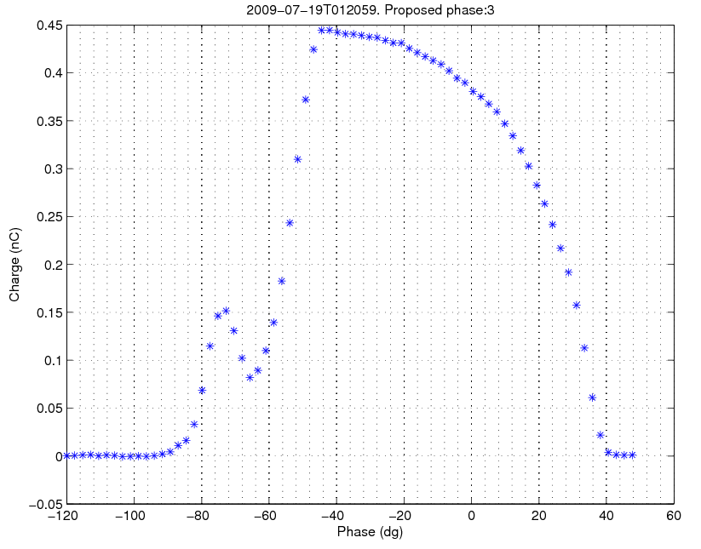
Problem: phase slopes along pulse train
The laser pulse train has an estimated phase slope of 2 ps/800 µs
The rf gun field may have a phase slope and has a knob to preset the slope
Phase slopes of gun rf and/or laser produce a charge slope on the train
charge T1 (nC)
nominal phase
← phase laser/gun (dg)

Slide 11
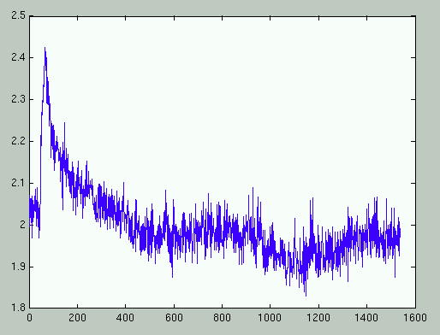
Recovery time of laser
Example (data from the same time slot as of Gustavos analysis
Charge (nC)
100 sec
320 sec
Time (5 Hz ticks)

Slide 13
“Beam Arrival Monitor”
Laser phase
Laser phase + ‘BC2’
Laser phase + BC2 + BC3
2.1 ps/degree
2% Voltage / 0.2deg P_f

Slide 15
Simulation parameters to match phase / amplitude changes observed

Slide 17
Gun and RF
Laser bunch-bunch phase tolerance:
  Better than 0.3 ps rms(0.15 deg L-band 1.3GHz)
  (original spec 1997 – 1 ps rms)
RF phase stability also ~ 0.1 deg L-band

Slide 18
Dark Current - cavities
(A primary source of radiation in high gradient linac)
  Natural cryogenic limit
Evgeny Negodin
Routine radiation monitoring of VTS / HTS has never found (measurable) residual activation

Slide 23
n dosimetry suited to the effect of concern: semiconductor memory ‘Single Event Upset’

Slide 24
1.5R/hour – beam on – in the bunch compressors
10 to 100 mRad/hour – beam on near downstream modules – cavity dark current??

Slide 25
0.1 Mrad integrated over 10 yr near bunch compressors

Slide 26
1.2 Mrad/10 yrs

Slide 27
FLASH Profile monitors - 2005
Energy / Energy spread monitors require(d) improvement for routine operation
Trigger system based on Fermilab distributed ‘composite’ clock
Bunch image ID checked empirically – no integrated system

Slide 28
OTR mechanical
(from Katja Honkavaara)
K.Honkavaara et al.
"Design of OTR Beam Profile Monitor for the TESLA Test Facility, Phase2"
PAC 2003, Portland
A.Cianchi et al.
"Commissioning of the OTR Beam Profile Monitor at the TTF/VUV-FEL injector"
EPAC 2004, Lucerne, Switzerland
A description of emittance measurementsusing the OTR monitors at FLASH is in the Master-thesis of Florian Loehl:
F.Loehl
"Measurements of the transverse emittance at the VUV-FEL"
DESY-Thesis 2005-014, TESLA-FEL 2005-03
and in a PRST-AB article (available on-line)
F.Loehl et al,
"Measurements of the transverse emittance at the FLASH injector at DESY"
Physical Review Special Topics - Accelerators and beams 9, 092802 (2006)

