Slide 1
Single cell coordination

Slide 2
Single Cell Cavity Activity Outline
ANL EP optimization (TE1AES005)
R&D cavities
A. Tumble, 2 cavities (TE1ACC004, NR-6, TE1CAT001, TE1CAT002)
B. Laser re-melting, 2 cavities (TE1ACC003)
C. CMP process, 1-2 cavities (TE1ACC002)
D. ECS investigation, 2 cavities (TE1ACC005, TE1ACC006)
E. manufacturing optimization, 2 cavities
F. Atomic Layer Deposition (ALD) cavities
  G. Traveling wave cavity, 2 cavities (TW1AES001, TW1AES002)
Vendor qualification
RRCAT Collaboration, 2 cavities (TE1CAT001, TE1CAT002)
ABLE EP 2 cavities (NR-4), 3 TE1PAVxxx cavities are being CMM insp.
Infrastructure support
Furnace verification, 1 cavity. (completed)
Diode T-map and second sound development 1 cavity (TE1ACC001)
ANL HPR water verification 1 cavity (TE1ACC001)
X-ray at NorthStar (TE1ACC004)
5. Basic R&D
A. EP cavity Q-slope studies
B. General Q-slope studies (TE1AES002)
C. Cut-out study (TE1AES004)

Slide 3
Single cell list
Number | Current location | Main purpose | Latest Activity | Current status | Notes
TE1AES004 | A0 | Equator quenching, T-map | HPR clean assembly | In queue for RF test
TE1AES005 | ICB | CMP, EP, ABLE |  | To be HF rinsed
TE1ACC001 | ICB
TE1ACC002 | CABOT | CMP |  | RF test done, to be polished at CABOT
TE1ACC003 | ANL | laser remelting | Molding extraction | In queue for HPR
TE1ACC004 | IB4 | Tumbling | Inspected/replicated | Tumble media verification for 9-cell
TE1ACC005 | ICB | Eddy current scanning | Molding | Optical inspected and one final EP (40micon)
TE1ACC006 | ICB | Eddy current scanning | Molding | To receive progressive EP
NR-1 | ANL | ANL RF commissioning | RF tested
NR-4 | IB1 | ABLE EP | 120 C baking | In queue for RF test
NR-5 | FNAL/ICB | E-beam remelting on Pit |  | inspected, to be processed
NR-6 | IB1 | Tumble | RF test done | In queue for RF test (100K 8h)
TE1PAV001 | PAVAC |  | Incoming inspection | three inside weld | This wk
TE1PAV002 | PAVAC |  | Incoming inspection
TE1PAV003 | PAVAC |  | Incoming inspection
TE1PAV004 | PAVAC |  |  | Three normal weld
TE1PAV005 | PAVAC
TE1PAV006 | PAVAC
TE1CAT001 | IB1 | RRCAT collaboration | RF test done | In queue for RF test (100K 8h)
TE1CAT002 | IB4 | RRCAT collaboration | Tumble polishing | In queue for EP
TW1AES001 | MDTL | Traveling wave prototype | RF test
TW1AES002 | IB1 | Traveling wave prototype | RF test | RF test with more T-map, and NbTi flanges

Slide 4
For next two weeks
TE1ACC003 (Laser)
  HPR to remove cracked molding material residual
TE1ACC005&006 (ECS)
  Replica done, in queue for EP (ANL)
TW1AES001&002 (traveling wave)
  TW2 RF test done (IB1), NbTi flanges in progress
TE1CAT001/NR-6 (Tumble Polishing)
  RF test done, in queue for Q-disease test
TE1CAT002 (RRCAT collaboration)
  Tumble polishing, in queue for EP
TE1AES004 (basic SRF)
  RF test done at A0 with active pumping, in queue for IB1 test (Q verifi.)
NR-4 (ABLE electropolishing)
  in queue for RF test and H bakeout
TE1PAVxxx incoming inspection and optical insp.

Slide 5
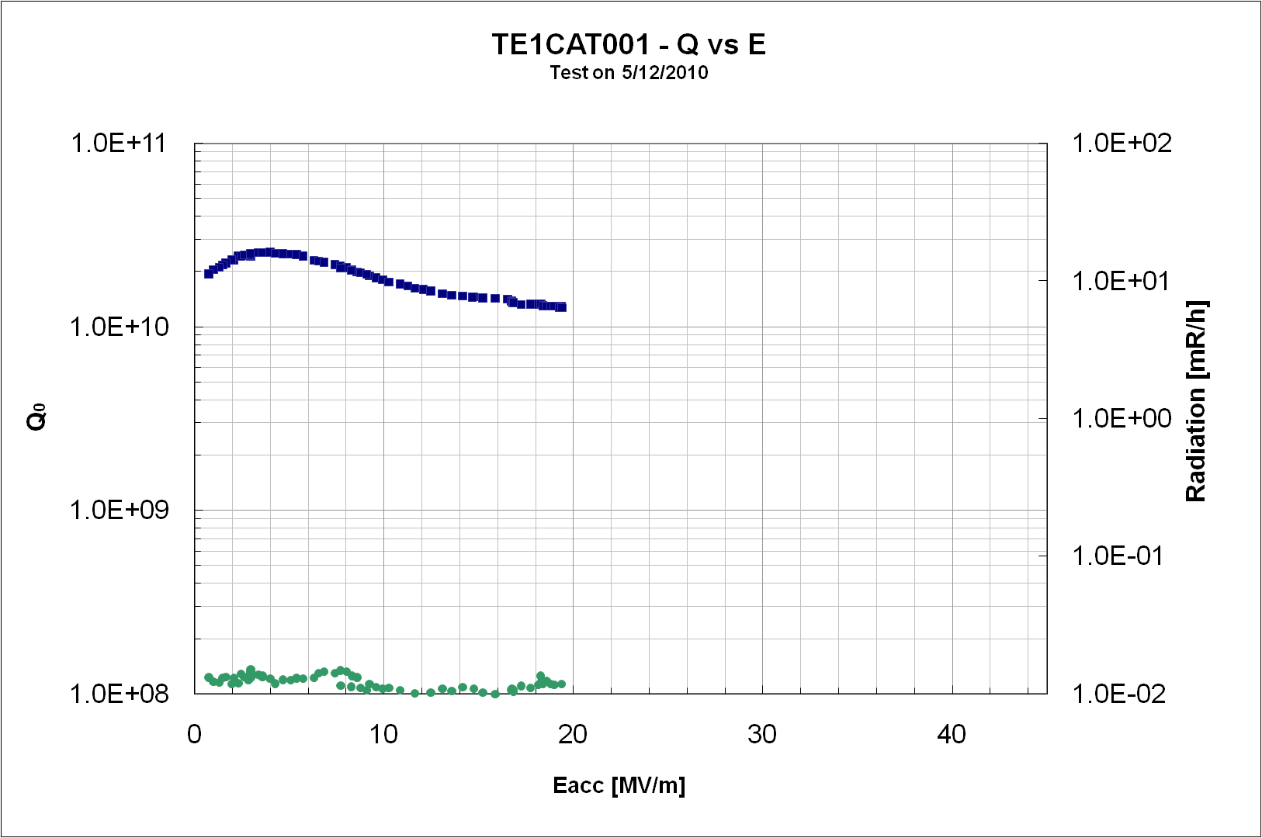
Ozelis, Wu, Cooper

Slide 6
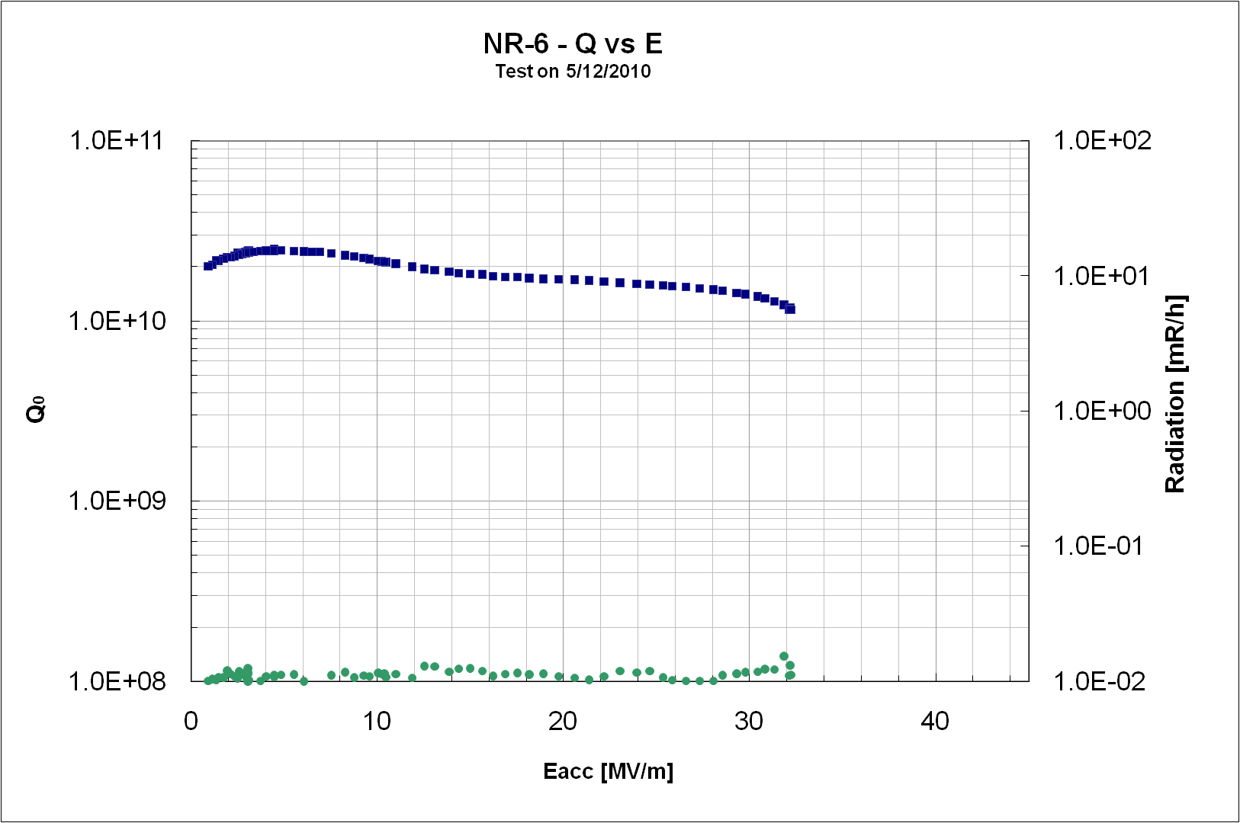
Ozelis, Wu, Cooper

Slide 7
