Slide 1
Recent 9-Cell Cavity Test Results
Joe Ozelis
Fermilab/TD/T&I
SRF Integration Meeting
May 24th, 2010

Slide 2

Recent Cavity Test Subjects
TB9RI024 – new cavity fabricated by RI, bulk EP performed at RI, remainder of processing at FNAL/ANL and JLab (800°C H de-gassing). First test w/OST’s (second-sound sensors).
TB9RI026 – new cavity fabricated by RI, all processing at FNAL/ANL (bulk and final EP, HPR, etc.) except 800°C H de-gassing at JLab. Cavity sat in the Dewar at 4.5K for ~2 weeks due to cryoplant compressor failure/replacement.
TB9ACC014 – dented cavity, re-test w/second sound sensors and RTD’s for quench localization.
TB9AES003 – defect repaired by grinding at KEK, reached 34MV/m after additional HPR, re-test after light EP.
Note: all tests performed at 2K with cavity actively pumped, fixed input coupling (typically between 6x10⁹ to 1x10¹⁰). Cooldown is fast - 1 to 2 minutes between 140-100K. Full cable calibrations performed for each test – reproducibility of calibration 3-4%.

Slide 3
Cavity History : TB9RI024
Fabricated by RI
Bulk (130μm) EP at RI
Inspections (visual, CMM, RF, optical)
H de-gassing (800°C, 2 hours) @ JLab
Light EP (70 minutes), HPR, assy
120°C bakeout (63hrs)
Vertical test
May 24, 2010
J. Ozelis SRF Integration Meeting

Slide 4
Cavity Performance : TB9RI024
Low field Q₀ = 1.75 x 10¹⁰
Quench at 28.8 MV/m, Q₀ at quench = 6.5 x 10⁹
FE onset at 23.6 MV/m, radiation levels moderate. Fairly strong Q-slope beginning at ~ 20MV/m, even without presence of FE.
May 24, 2010
J. Ozelis SRF Integration Meeting

Slide 5
Cavity Performance : TB9RI024
Cells 2/8 lowest performing, quench at 24MV/m.
Four OSTs’ (second sound) were mounted on the test stand insert, preliminary data suggest cell #2.
May 24 2010
J. Ozelis SRF Integration Meeting

Slide 6
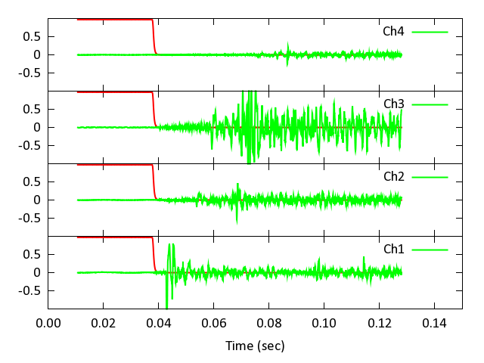
Cavity Performance : TB9RI024
Signals during a quench in the 8π/9 mode from 4 OST’s mounted vertically along cavity cage. Channel 1 is at cell #1, channel 4 is at cell #9, channels 2 & 3 are roughly equidistantly placed between them.
Green traces are OST signals, red is the cavity transmitted power.
Data is taken at 1.85K, at 25.6kHz.
Shortest signal delay is on channel 1, indicating that in the 8π/9 mode, cell #1 (rather than cell #9) is the quench source.
(D. Sergatskov)
May 24, 2010
J. Ozelis SRF Integration Meeting

Slide 7
Cavity Performance : TB9RI024
Residual resistance = 6.6 nΩ – somewhat on the high side for EP 9-cell cavities, but a generally good value.
May 24, 2010
J. Ozelis SRF Integration Meeting

Slide 8
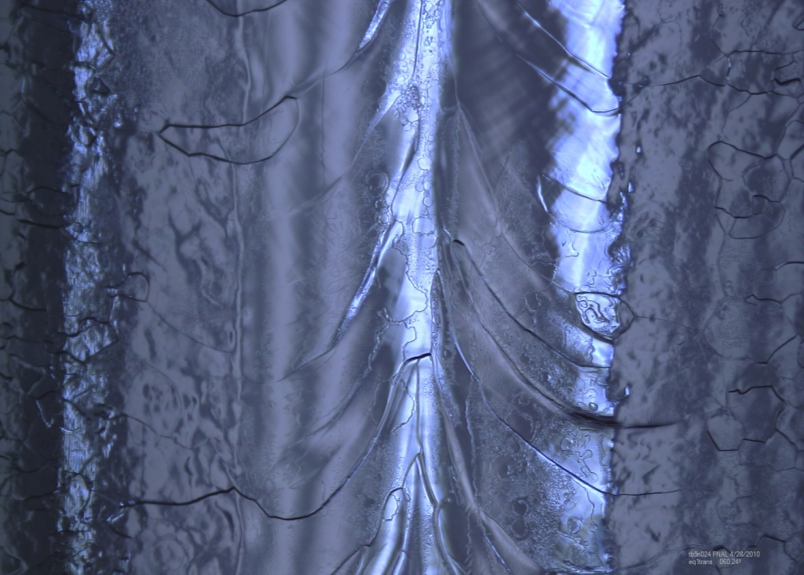
Cavity Performance : TB9RI024
Optical inspection performed after vertical test - no obvious defect observed on cell #2. Overall surface appears “etched” (somewhat high residual surface resistance?).
Next steps :
Light EP (~ 20μm)
HPR/assy
120°C bake
Vertical test
Photo courtesy D. Sergatskov
May 24 2010
J. Ozelis SRF Integration Meeting

Slide 9
Cavity History : TB9RI026
Fabricated by RI
Inspections (visual, CMM, RF, optical)
Bulk EP (2x, 80μm + 70μm)
US cleaning, HPR
Optical inspection
H de-gassing (800°C/2 hrs) @ JLab
Tuning
Light EP (26μm), HPR, Assy
120°C bake, 63 hrs
Vertical test
May 24 2010
J. Ozelis SRF Integration Meeting

Slide 10
Cavity Performance : TB9RI026
Initial low-field Q₀ = 1.8 x 10¹⁰
Initial FE onset at 25MV/m (after a few “bursts” at 20MV/m), increased with gradient until cavity reached 29MV/m. Quenched from FE at 29MV/m, then much reduced field (16-17MV/m, then down to 14MV/m) and higher FE. Cavity now limited by FE – FE increased sharply while testing.
May 24, 2010
J. Ozelis SRF Integration Meeting

Slide 11
Cavity Performance : TB9RI026
Mode measurements show FE in all modes, least in π/9 (cell 5 only), highest in 2π/9 and 3π/9 (cell pairs 3/7 and 2/8). Individual mode gradient limits are due to FE behavior, and not intrinsic (defect) limitations.
Some evidence of emitter processing was observed while performing mode measurements so π-mode checked again…
May 24, 2010
J. Ozelis SRF Integration Meeting

Slide 12
Cavity Performance : TB9RI026
After mode measurements where FE processing was observed, cavity now reached 19.6MV/m in the π-mode (up from 14MV/m, but well below initial run to 29MV/m).
Limited by strong FE/Q-drop.
Comparison of initial (pre strong emitter turn-on) and final (post mode meas.) Q₀ vs E curves. Low-field Q₀ behavior is unchanged, but Q₀ drops sharply at 16MV/m due to strong FE (FE onset 15 MV/m).
May 24 , 2010
J. Ozelis SRF Integration Meeting

Slide 13
Cavity Performance : TB9RI026
Residual surface resistance = 10.4nΩ – a rather high value compared to typical (good) EP’d 9-cell cavities (4.5 – 6.0 nΩ). Is the degradation due to the activation of a strong emitter, which subsequently globally affects the cavity surface? Q₀ vs T measurements are performed at low fields (3-4 MV/m) where FE is not active, so it does not affect the Q₀ vs T measurement.
May 24, 2010
J. Ozelis SRF Integration Meeting

Slide 14
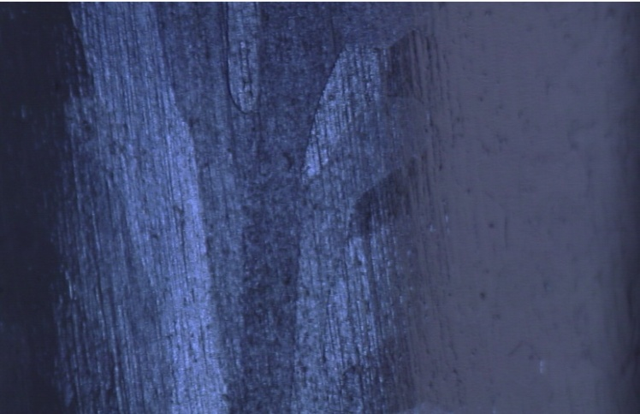
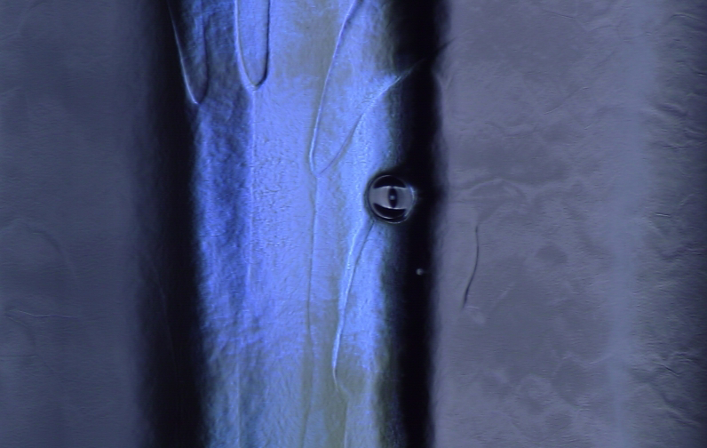
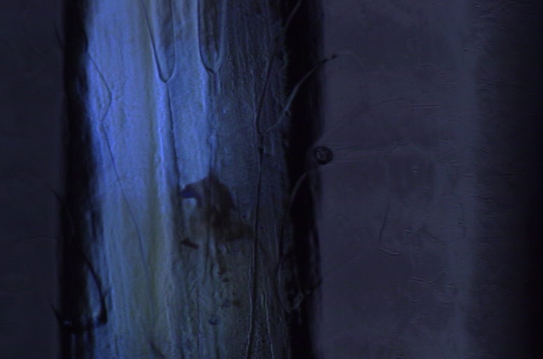
Cavity Performance : TB9RI026
Optical inspections (D. Sergatskov) revealed the evolution (growth) of a feature on the iris between cells 8 &9 :
As received
After 2nd EP
Diameter ~ 350-400 μm
After 1st EP
May 24, 2010
J. Ozelis SRF Integration Meeting

Slide 15
Cavity Performance : TB9RI026
Cavity is (severely) FE limited. Significant change in performance after reaching 29MV/m implies something drastic happened.
Mode measurements support (not very strongly) problem may be in ends.
Was the feature on the iris between cells 8 & 9 the source? Did it “turn on” after reaching some threshold, then “process” or evolve into a bad (worse) emitter? Optical inspection to follow vertical test.
The high surface resistivity and severe performance degradation suggest that additional HPR alone will not be sufficient to improve cavity performance significantly. Additional EP is warranted - but EP has been making the defect larger! Wait for optical inspection results.
May 24, 2010
J. Ozelis SRF Integration Meeting

Slide 16
Cavity History : TB9ACC014
Cell #9 de-tuned ~20%
HPR/assy
Tested 2/10/10
Reached 29 MV/m, limit appeared to be cell #9 (mode meas & FTS)
FE present
Sat at IB1 > 2 mos (under vaccum)
Prepped for test w/FTS around dent and OST’s
Sat in Dewar cold ~2 weeks (compressor replacement)
May 24, 2010
J. Ozelis SRF Integration Meeting

Slide 17
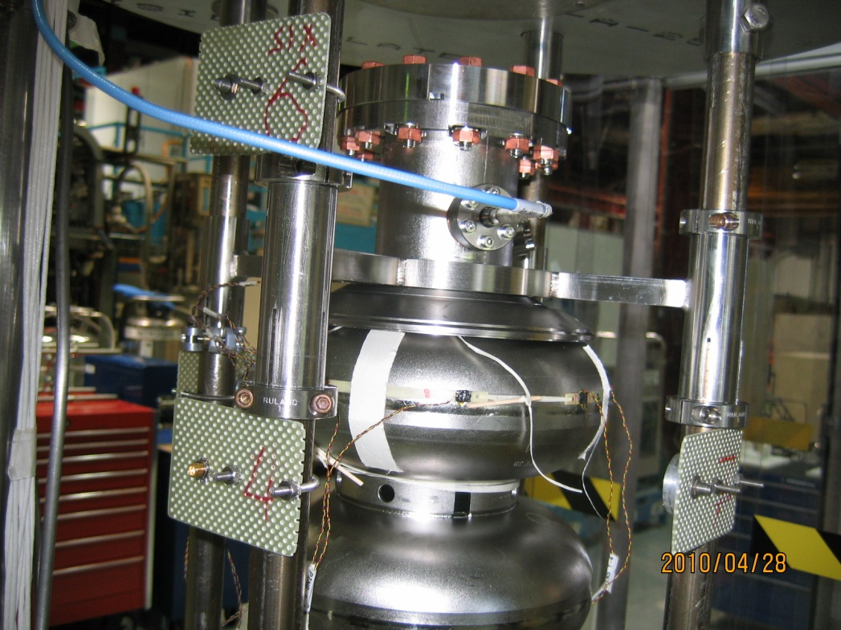
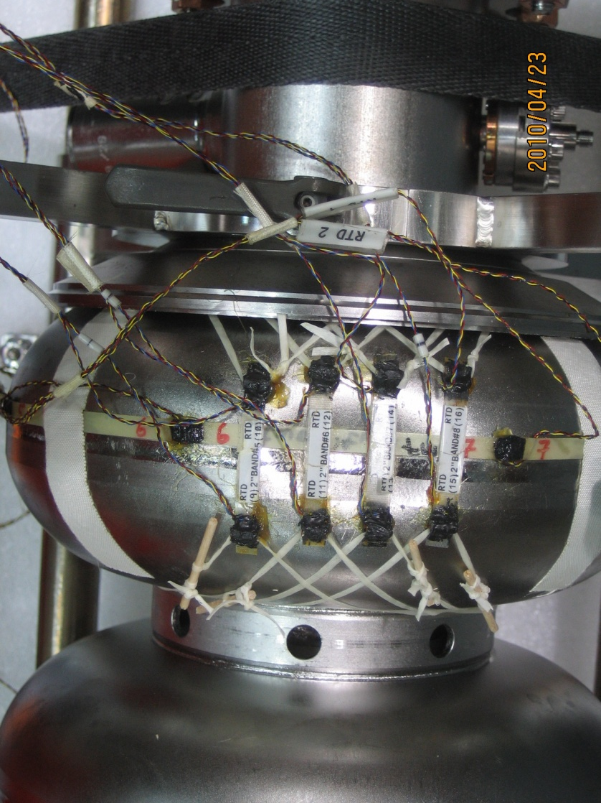
Cavity Instrumentation : TB9ACC014
Second sound sensors
RTD’s (Cernox)
(D. Sergatskov)
May 24, 2010
J. Ozelis SRF Integration Meeting

Slide 18
Cavity Performance : TB9ACC014
Low field Q₀ = 2.3 x 10¹⁰
Some FE processing occurred while performing scans of SS sensors while quenching at T < 2K
Quench at 34.4 MV/m, Q₀ at quench = 1.2 x 10¹⁰
FE onset at 22 MV/m, radiation levels moderate (~6mR/hr).
In π-mode the SS sensors indicate quench at cell #1.
May 24, 2010
J. Ozelis SRF Integration Meeting

Slide 19
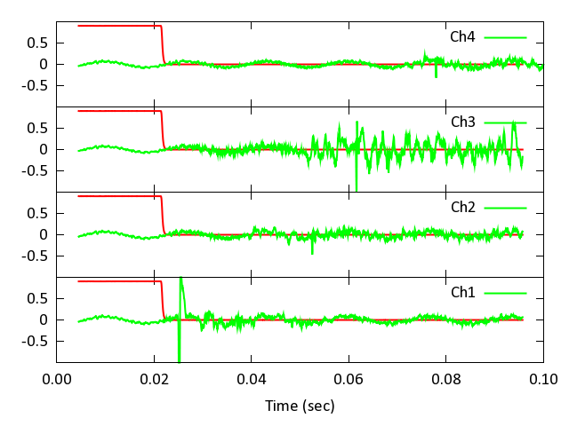
Cavity Performance : TB9ACC014
(D. Sergatskov)
In the π-mode, the quench location is in cell #1, nearest the FPC (not the “dented” cell!)
Response of OST’s when cavity was quenching at 34MV/m in the π-mode. Channel 1 is located nearest cell #1, channel 4 is nearest cell #9. Channels 2 and 3 are located approximately equidistant between channels 1 and 4.
May 24, 2010
J. Ozelis SRF Integration Meeting

Slide 20
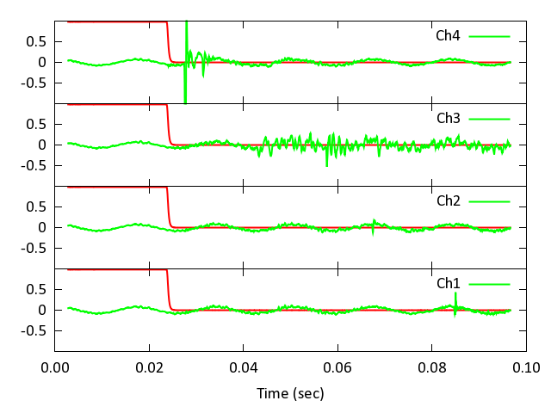
Cavity Performance : TB9ACC014
(D. Sergatskov)
Quench location shifts when in 8π/9 mode – now it is cell #9 (the “dented” cell)
In this mode, cells 1 & 9 see ~ equal fields, in π-mode, cell 1 detuned by ~20%.
Response of OST’s when cavity was quenching at 34MV/m in the 8π/9 mode. Channel 1 is located nearest cell #1, channel 4 is nearest cell #9.
May 24, 2010
J. Ozelis SRF Integration Meeting

Slide 21
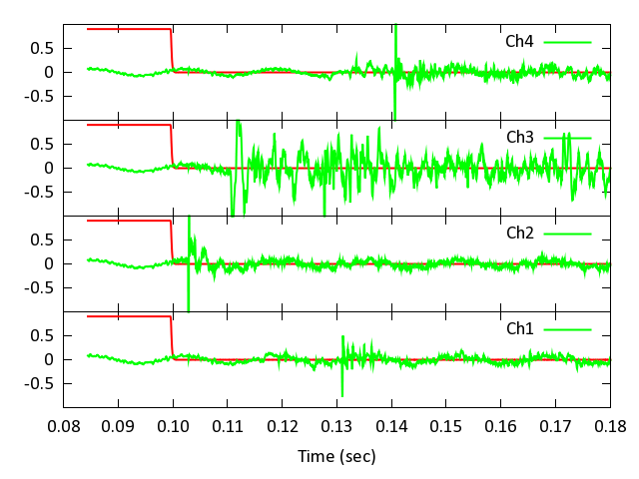
Cavity Performance : TB9ACC014
(D. Sergatskov)
Quench location in the π/9 mode is between cells #4 and #5 – closer to cell #4.
In this mode, the fields in cells 4 & 5 are essentially equal.
Response of OST’s when cavity was quenching in the π/9 mode at ~45MV/m. The quench signals arrive at channels 2 and 3 first, and significantly earlier in channel 2, indicating that the quench location is not cell #5 but cell #4. Cavity performance is limited by both end cells (~34MV/m).
May 24, 2010
J. Ozelis SRF Integration Meeting

Slide 22
Cavity Performance : TB9ACC014
How does this test compare to previous test?
Q₀ vs E curves are nearly identical (low field Q₀ “hump” and Q-slope) - would not be expected if there were a calibration error (P_{loss} would be wrong).
Cavity showed a 20% improvement in maximum gradient during this latest test.
Field probe calibration differed by ~8% → ~4% change (increase) in gradient.
Improvement in gradient to 34.4MV/m from 29MV/m is real - result of cumulative FE processing during the two test cycles ?
Initial FE during this test was actually higher than the initial FE during the last test!
May 24, 2010
J. Ozelis SRF Integration Meeting

Slide 23
Cavity History : TB9AES003
Cavity tested 1/12/20 after HPR/assy at ANL (after grinding and EP (50μm) @ KEK)
Reached 30 MV/m (FE and RF limit)
Additional HPR, then retested 1/26/10
Reached 34.5 MV/m (quench limited)
Optical inspection,“horseshoe” stain observed (iris, cell #1 and BP), polished away w/ AlO₂ paper
Cavity re-tuned (FF 87% → >98%)
Additional light EP (20μm), then HPR/Assy @ ANL
120°C bake at IB1
Vertical test 5/4/2010
May 24, 2010
J. Ozelis SRF Integration Meeting

Slide 24
Cavity Performance : TB9AES003
During initial power rise, note error in P_{ref} measurement. Suspect cable/connector heating (later verified – vent holes in connector improperly drilled).
Periodic re-cal of cable when lowering power fixes this.
No error on E (P_{tran} used only). Q₀ error up to 25% if not corrected.
Low field Q₀ = 1.9x10¹⁰ , quench at 32.2 MV/m, Q₀ at quench = 5.6x10⁹ . FE onset at 23 MV/m, radiation increasing, then processed away. Still see Q-drop at ~27-28 MV/m even w/o FE loading, with 120°C bake. Mode measurements suggest cells 4/6 lowest performers.
May 24, 2010
J. Ozelis SRF Integration Meeting

Slide 25
Cavity Performance : TB9AES003
Comparison w/ earlier tests – see ~7% decrease in maximum field (within meas error and retuning effects).
Additional EP of this cavity has not yielded any improvement.
Residual surface resistance = 6.7nΩ; last time was 6.0nΩ .
Essentially no change/improvement, consistent with other good cavities.
May 24, 2010
J. Ozelis SRF Integration Meeting

Slide 26
Summary
Cavity TB9RI024 is quench limited to 29MV/m, limiting cell identified as cell #2 using second-sound technique. No obvious feature observed in quenching cell (cell #2). Cavity was processed again (light EP) and is undergoing HPR & assy, in preparation for 120°C bakeout and vertical test.
Cavity TB9RI026 is field emission limited to 19.6 MV/m, after initially reaching 29 MV/m. The source of the FE may be in the ends. A feature on the iris between cells 8 & 9 was observed during the latest pre-vertical test optical inspection. Additional optical inspection will be performed next, followed probably by additional light EP (and perhaps optical inspection to document the evolution of this feature after additional EP), then 120°C bakeout and re-test (w/ thermometry and OST’s).
May 24, 2010
J. Ozelis SRF Integration Meeting

Slide 27
Summary
Cavity TB9ACC014 is quench limited to 34MV/m (up from 29MV/m) and still has some FE. Limiting cells are cell #1 in π-mode & cell #9 in 8π/9 mode (essentially same gradients), verified using second-sound technique (and also thermometry on cell #9).
Cavity TB9AES003 is quench limited to 32.2 MV/m, with little/no FE present. Limiting cells are cells 4/6 – note that cell 4 was site of original 20MV/m quench limit. Additional EP did not improve performance. Noticeable high-field Q-drop even with 120°C baking and absence of FE loading – correlated with surface roughness?
May 24, 2010
J. Ozelis SRF Integration Meeting

Slide 28
Cavity History : TB9RI029
Fabricated by RI
Bulk (140μm) EP at RI
Inspections (visual, CMM, RF, optical)
H de-gassing (800°C, 2 hours) @ JLab
Tuning
Optical inspection
Light EP (22μm), HPR (2x), assy
120°C bakeout (48hrs)
Vertical test
May 24, 2010
J. Ozelis SRF Integration Meeting

Slide 29
Cavity Performance : TB9RI029
Low field Q₀ = 1 10¹⁰
Quench at MV/m, Q₀ at quench =
FE onset at MV/m, radiation levels moderate. Fairly strong Q-slope beginning at ~ MV/m, even without presence of FE.
May 24, 2010
J. Ozelis SRF Integration Meeting

