Slide 1
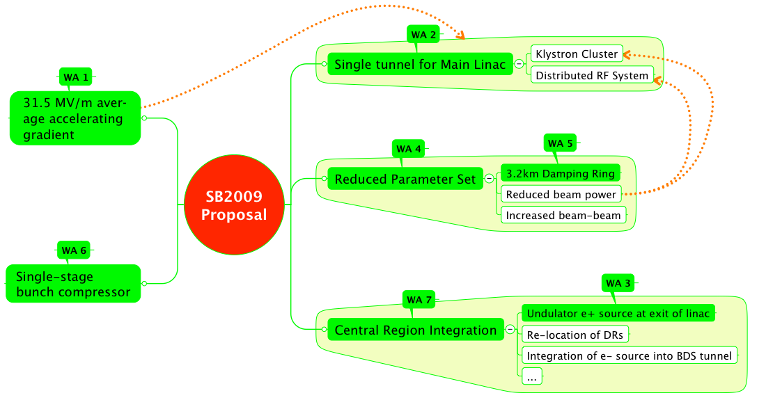
TLCC Themes

Slide 2
TLCC Themes
Potential Physics Impact

Slide 3
TLCC Themes
HLRF System Impact

Slide 4

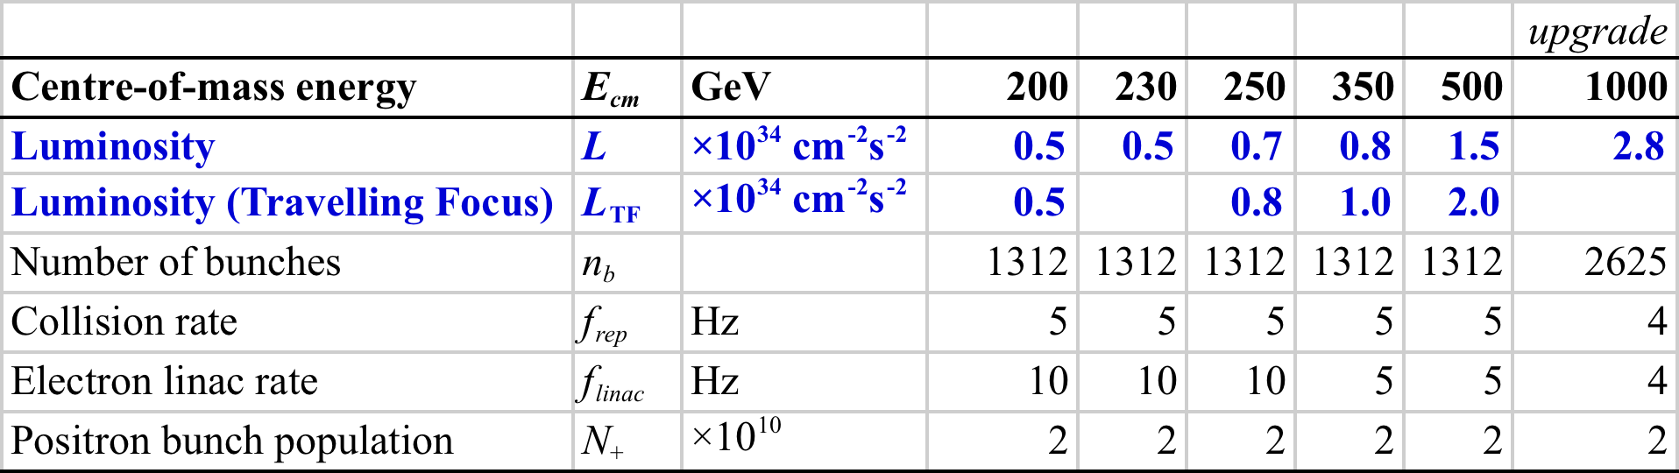
BAW-2 Themes
Reduction of # bunches (2625 → 1312)
  Reduced beam power → reduced RF
  Smaller damping rings (6.4 km → 3.2 km)
  Regain luminosity via stronger focusing at IP
Re-location of e+ source to end of Main Linac
  Better integration (central campus) – higher overhead (at 500 GeV running) ⇒ reduced risk
  Issues of running for Ecm < 300 GeV
Thursday & Friday

Slide 5
Approach to finding 15%
Reduce Ecm to 350 GeV
Find 8 ~2% effects
Find many (hundreds) ppm savings

Slide 6
Approach to finding 15%
Reduce Ecm to 350 GeV
Find 8 ~2% effects
Find many (hundreds) ppm savings
Not an option

Slide 7
Approach to finding 15%
Reduce Ecm to 350 GeV
Find 8 ~2% effects
Find many (hundreds) ppm savings
Not an option
VALUE engineering
Insufficient resources!

Slide 8
Approach to finding 15%
Reduce Ecm to 350 GeV
Find 8 ~2% effects
Find many (hundreds) ppm savings
Not an option
Any one saving may seem small
But all are required to achieve the target
Adopted approach
VALUE engineering
Insufficient resources!

Slide 9
SB2009 Cost Increments
Low-P largest fraction
Total: ~13% RDR Total Project Cost

Slide 10
Costing effort: 2011-2012
TDR will reflect SCRF and CFS progress
  (beyond RDR 2007)
  Technical advancement (esp. R & D)
  Project strategy (design, industrialization, siting)
  AND COST
Balance performance scope and accelerator system design against these cost drivers
Motivation for Cost – Containment
  Development of SCRF 2007→
  Siting 2010 →

Slide 11
Cost Containment Estimated Impact:
RDR ML Technical Cost:
  2/3 cold SCRF
  1/3 Modulator/infrastructure, Klystron, Power Distribution
    ½ Modulator
    ¼ Klystron
    ¼ PDS
Half-Power ~ 16% ML technical reduction
Could offset up to ~25% cold SCRF ‘increase’
TDR cost breakdown will differ → 2011

Slide 12
Scope of Proposal 1/2
A reduction in Main Linac beam current, and therefor beam power, and an associated reduction in the number of klystrons, modulators and power supplies (primary cost saving).
  Key conventional facilities support for the full RDR RF power will be installed upfront during construction, in support of future possible upgrade to higher bunch numbers (risk mitigation).
A corresponding reduction in the circumference of the damping rings from 6476 m to 3238 m (i.e. 50%), while maintaining the DR current approximately constant. This includes the associated reduction in DR RF power by approximately 50% (primary cost saving).
Primary Cost Scope
Notes:
Reduced bunch charge parameter set is still consistent with this

Slide 13
Scope of Proposal 2/2
The reduction in current will be achieved by reducing number of bunches per pulse (n_{b}) by a factor of two from 2625 to 1312.
  increasing the linac bunch spacing
An increase in the DR tunnel diameter to accommodate the possibility of installing a third damping ring (second positron damping ring) at some later date, if required (risk mitigation).
Adoption of stronger focusing at the interaction point (enhanced beam-beam) – including the possibility of travelling focus – to provide the required luminosity (maintaining performance at higher risk).

Slide 14
Low Power Parameters
Parameter | unit | RDR (nom.) | TLCC
E_{cm} | GeV | 500 | 500
Rep. rate | Hz | 5 | 5
Q_{bunch} | nC | 3.2 | 3.2
Bunches/pulse |  | 2625 | 1312
LINAC RF parameters:
RF pulse length | ms | 1.6 | KCS: 1.6 DRFS: 2.2
Beam current | mA | 9 | KCS: 6 DRFS: 4.5
Damping Ring:
Circumference | m | 6476* | 3238
Avg. Current | mA | 388 | 390
Damping time | ms | 21 | 24
RF power | MW | 3.97 | 1.76
Focus on 500 GeV centre-of-mass
  Low E_{cm} →cf ‘Positron Source Relocation’
Different parameters for DRFS and KCS(RDR T.O.).
2x3.2km DR with reduced bunch number (@5Hz)

Slide 15
Since RDR / SB2009:
Gradient Spread (BAW 1)
  RDR design: fixed 31.5 MV/m
  TDR baseline: 31.5 avg +/- 20%
  Penalty: Increased HLRF overhead (10 - 15%)
  (offset by decreased cavity cost; model dependent)
Single Tunnel (BAW 1)
  Facilitate siting through flexible HLRF technology
  Penalty: different criteria for CFS / Cryo design
Restoration of full beam parameters
  Penalty: Identify and reserve space / support equipment needs

Slide 16
HLRF – two technical options
Both options subject to R & D; Both to be (hopefully) included in TDR
Different optimum bunch parameters
  Both have reduced plug–to-beam efficiency

Slide 17
Damping Ring
(Susanna, Mark and Junji)
Reduce Circumference 2x:
Design of 3.2 km DR
(including component counts, cost savings and upgrade path configurations with 2 and 3 rings)
Evaluate e+ instability thresholds for
increasing the number of bunches at a later stage
Electron cloud issues at 1312 and 2625 bunches
DR cost ~ 10% RDR (1/3 CFS)
  Technical cost does not scale → some component counts are fixed

Slide 18
BDS
50% reduction P_{beam} ⇒ ×2 L recovery via enhanced beam-beam (BDS)
  stronger focusing (tighter tolerances, see below)
  higher disruption / beamstrahlung etc.
  travelling focus
  Collimation depth issues
  Modular FD concept (for low Ecm running)
Cost neutral
  travelling focus hardware has negligible cost
Concern with operational aspects and tighter tolerances
  Collision (luminosity) stability
  more demands on beam-beam feedback
  Emittance preservation in RTML, ML and BDS
  Overall tuning strategies and integrated luminosity performance
A higher risk scenario?
Note reduced average beam power reduces risk in many subsystems

Slide 19
Luminosity @ 500 GeV cm
TF parameter set is self consistent with 2×10³⁴ cm⁻² s⁻¹
  based on ‘built-in’ TF model in GUINEA PIG
Advanced studies have only now just started.
  Understanding how to generate the crab-waist
  Understanding what the realistic impact of this is
  Closer look at tolerances etc.
Achieving and stabilising this 2×10³⁴ cm⁻² s⁻¹ under this regime will be very challenging
  Top ~30% of the luminosity ‘risky’
started late ☹
Notes:
Not enough work done on this subject since January (resources). More to be demonstrated

Slide 20
Luminosity @ 500 GeV cm
RDR 2×10³⁴ cm⁻² s⁻¹
50% P_{beam} 1×10³⁴ cm⁻² s⁻¹
High Disruption 1.5×10³⁴ cm⁻² s⁻¹
Travelling Focus 1.5-2.0×10³⁴ cm⁻² s⁻¹
(Alt. Low-Q 2.0×10³⁴ cm⁻² s⁻¹ )
400-550 ILCU

Slide 21
Bunch number “restoration”
Important to discuss scenarios for increasing the bunch number 1300→2600
  At some later date, after initial construction.
Damping Ring:
  Additional 3.2km ring for positrons → no parameter changes
  2625 bunches in single (existing) electron ring
    780 mA avg. current
    4.84 MW power
  Tunnel/alcoves spec’d for 3 stacked rings.
HLRF
  Add klystrons/modulators/power supplies
  Scenarios for CFS support
    what must we invest in up-front to support this
Complete studies left for TDP-2
  but qualitatively, scenarios need to be discussed at BAW-2

Slide 22
+ / - Reduced Beam Parameters
Pro’s:
  Largest single-item cost impact
  Minimum technical risk for the change itself
  Manageable restoration path
    KCS, DRFS, DR
Con’s:
  Luminosity reduction to be compensated in BDS
  Reduced ML efficiency
  Significant cost penalty to maintain restoration path
    DR, CFS

Slide 23
TLCC-3 Proposal Document
Authored by PMs
Scope points from slides 12 & 13
More detailed description of technical scope
  DR and HLRF parameters
  Component count tables
Issues
  Luminosity performance
Physics impact (short summary)
Cost Summary
To be submitted to Director by end of next week

