Slide 1
ILC Cavity Gradient R&D Plan Proposal for Release 5
Rongli Geng for ILC Cavity Group
2jun2010
ILC SCRF WebEx Meeting

Slide 2
TDP-1 Cavity Gradient Goal Achieved
50% yield at 35MV/m with Q0>=8E9 for vertical acceptance test with up to 2nd-pass processing.
  “global” data
  32/27 cavities built by 3 vendors (Zanon, ACCEL, AES)
  Processed and tested in 2 labs (DESY, JLab)
FY09-FY10 subset data demonstrated 75% yield at 35 MV/m with Q0>=8E9 up to 2nd-pass processing.
  12 cavities built by 2 vendors (ACCEL, AES)
  Processed and tested in 1 lab (JLab)

Slide 3
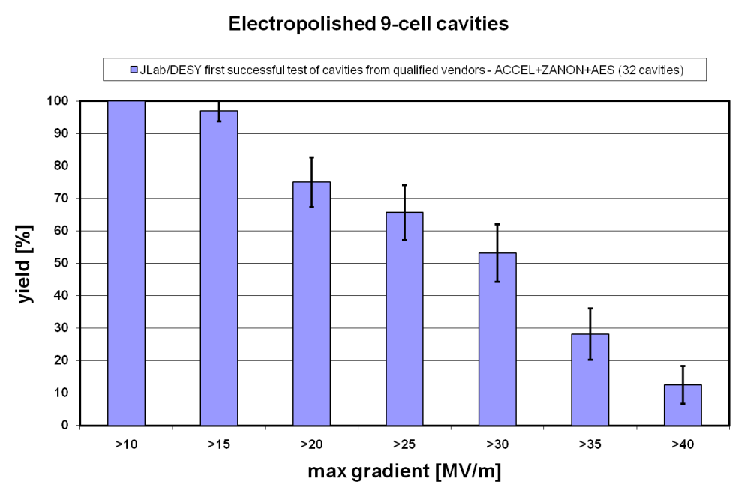
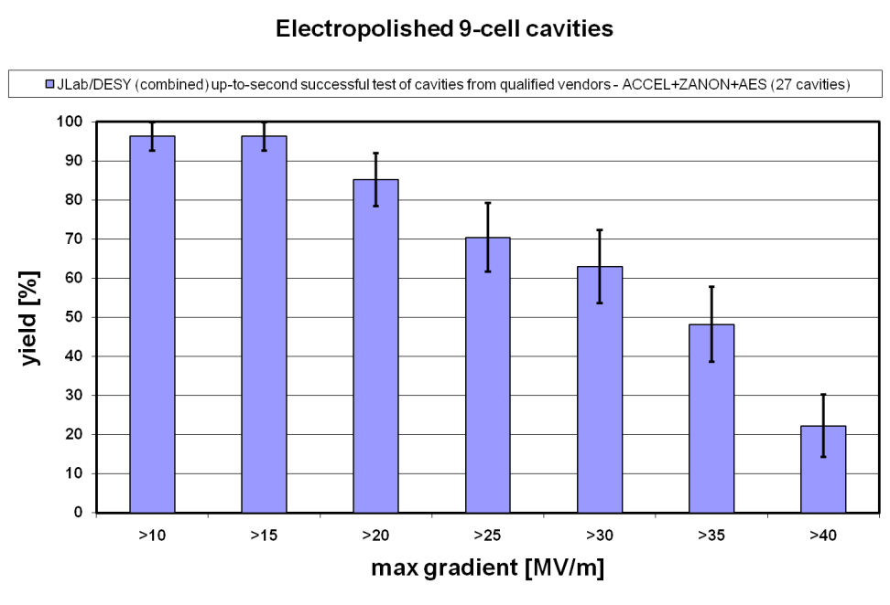
“Global” Data first-pass and second-pass yield
TDP-1 goal

Slide 4
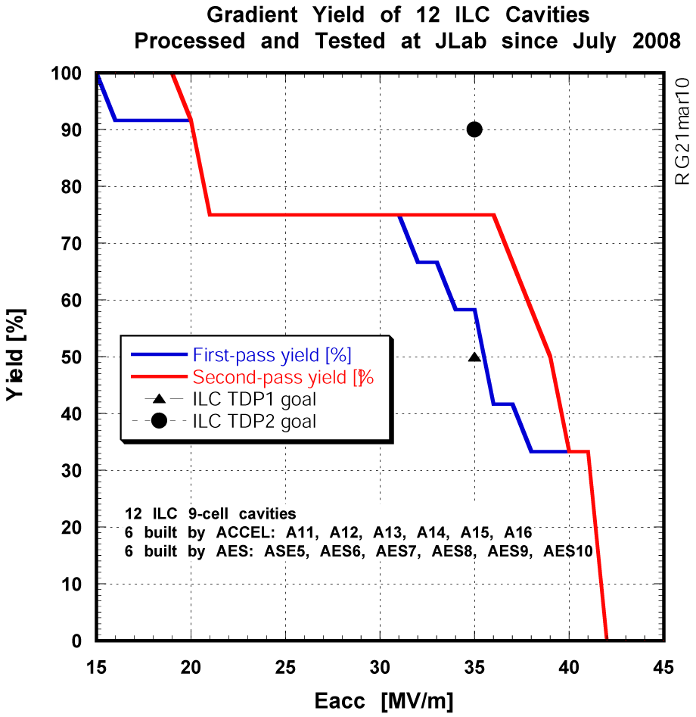
FY09-FY10 Subset Data

Slide 5
Globally Coordinated S0 Effort a Success
Gradient limit by field emission much reduced.
  Post-EP rinsing
  Optimal EP
  Streamlined assembly procedure
Key sources of FE on EP’ed surface understood.
  Sulfur
  Nb_{x}O_{y} granulus
Optimal EP.
  Simplicity demonstrated
  Repeatability demonstrated
  Transferability across facilities demonstration in progress

Slide 6
Gradient Scatter Remains
Yield drop at 15-20 MV/m a major issue.
  30% rejection up to 2nd–pass processing, even if all cavities passing 25 MV/m will be used.
    It means 43% overproduction needed.
    This is unlikely acceptable for mass production.
Source of problem is local defect near (within a few cm from seam) equator EBW.
  One small defective area ( <1mm dia. ) limits entire cavity.
  Superior surface area outside defect reaches very high surface field already.

Slide 7
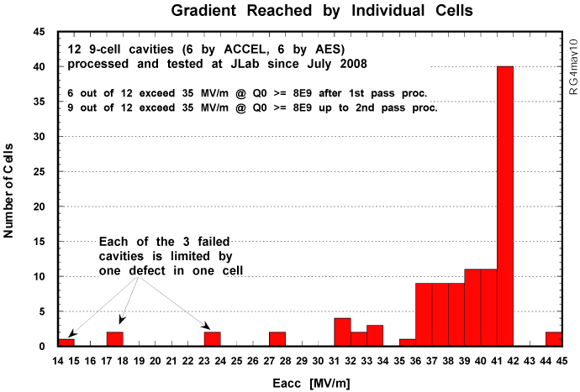

Slide 8
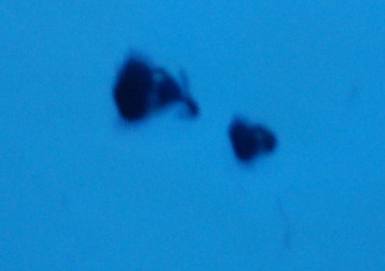
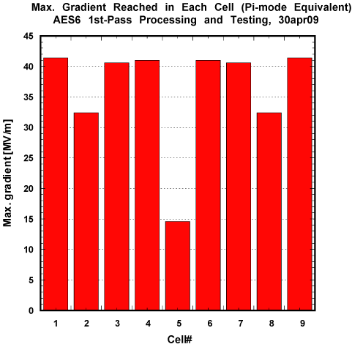
Twin defects 300-500μm dia.
8mm from equator EBW seam
quench

Slide 9
Local Defects Responsible for
Quench Limit at 15-20 MV/m
Strong evidence to show these defects have origin from fabrication and/or material.
  Re-EP ineffective in curing defective cell for raised quench limit.
  Local treatment (grinding) found effective in raising quench field from ~ 20 MV/m to > 30 MV/m without losing performance of healthy cells.
Abating these defects with cavity mass production in context requires improvements/changes in fabrication and material.

Slide 10
Strategy for TDP-2 centered on BCD and oriented for impact in TDR
Fabrication QA/QC
  Improve tools for QC
    DESY: Cavities for XFEL and ILC-HiGrade, mass production aspect
Fabrication improvement/optimization
  Forming/Machining
    FNAL/PAVAC: smart cups
    KEK: Forming optimization with pilot plant
  EBW
    KEK: EBW optimization with pilot plant
    FNAL/JLAB/Cornell/Industry: build and test “destructible” bare 9-cell cavities
    JLAB: EBW optimization by build bare 9-cell cavities with in-house welder
Mechanical polishing prior to heavy EP
  Eliminates weld irregularities
  Reduce (or may even eliminate the need of ?) surface removal by heavy EP
    FNAL: raw 9-cell mechanical polishing before main chemistry
    Cornell: 9-cell tumbling for cavity recover
Large-grain material (directly sliced from ingot)
  Eliminates rolling in standard sheet material
    KEK: large-grain cavities and multi-wire slicing
    DESY: processing and evaluation of 8 existing 9-cell large grain cavities
    JLab: in-house fabrication and test 2 9-cell large grain cavities
Seamless cavity
  Eliminates weld prep machining and EBW
    DESY in collaboration with JLab: hydrofrom and test multi-cell cavities
    FNAL/industry: hydroform and test multi-cell cavities
Material improvement/optimization
  For example Nb with low Ta concentration
    FNAL: material characterization and 1-cell cavity testing
    JLab: material characterization and 1-cell testing
Post heavy EP heat treatment optimization
  Engineering thermal and metallurgical properties
    JLab: 1-cell, 9-cell experimenting with associated material characterization
Post vertical test local treatment
  Rapid quench limit improvement with small incremental cost
    KEK: local grinding
    FNAL: local re-meting with laser beam
    JLab: local treatment/re-melting with electron beam

Slide 11
Strategy beyond TDP-2
ACD shape cavity
  Extends 1-cell cavity success to 9-cell cavity
Nb-Cu clad material cavity
  Yield improvement potential due to increased thermal stabilization
  Cost reduction
Thin film cavity
  Significant cost reduction potential
  Very high gradient breakthrough potential by using unconventional material

