Slide 1
S1-G Webex meeting; June 1,2010

Slide 2
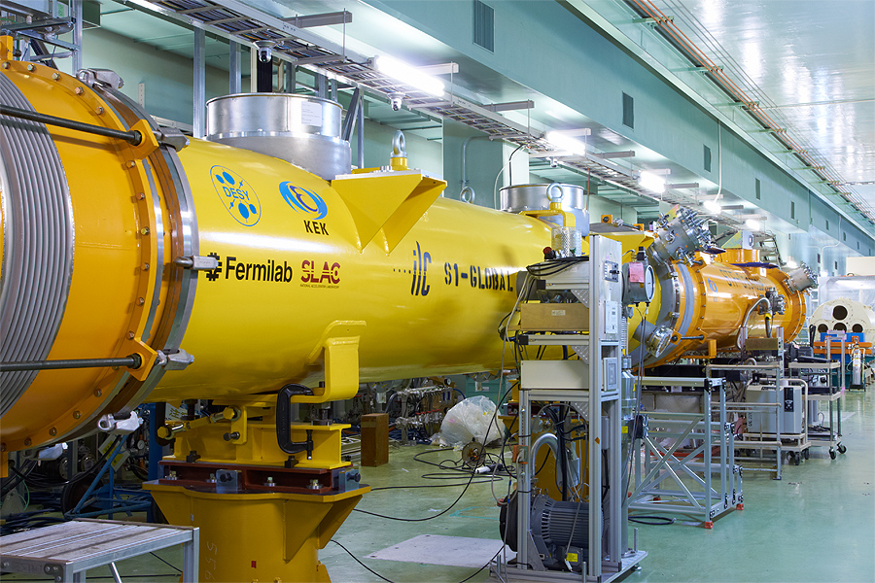
Agenda
1. Cavity/coupler assembly: Eiji Kako
2. Cryomodule assembly: Norihito Ohuchi
3. Others,
N. Toge, 05/22/2010

Slide 3
Next meeting;
June 15, Tuesday:
SLAC 6:00 – 7:00
FNAL/ANL 8:00 – 9:00
JLab/Cornell 9:00 – 10:00
DESY/INFN 15:00 – 16:00
KEK 22:00 – 23:00

