Slide 1
CHIPS: new hadron interaction MODEL?
Adam Para
June 1, 2010

Slide 2
Using GEANT4 to Evaluate High Resolution Hadron Calorimeter?
So far: QGSP_BERT is the only model which conserves energy event-by-event
But the model is valid only at low energies. Other models are phased in somewhere around 10 GeV.
Nuclear interactions in all other models include (too) large missing energy, not correlated with the number of produced nucleons ➔ lower response, artificially poor resolution
(just above) Transition region: the worst case as some of the interactions are produced one or another model and difference in the mean values leading to a very poor (apparently) resolution

Slide 3
New Developments: CHIPS
Chirally Invariant Phase Space
(allegedly) Complete physics model
Valid uniformly at all energies
Conserving energy
Still under tuning, but let’s take a look anyway..
Take a case of 50 GeV protons in BGO

Slide 4
Inelastic Processes Simulated
no baryon interactions (other than protons and neutrons)
(not shown) pion captures
no neutron capture. Perhaps it is a matter of nomenclature and neutron captures are simulated as neutron interactions?

Slide 5
Low Energy Neutron Interactions

Slide 6
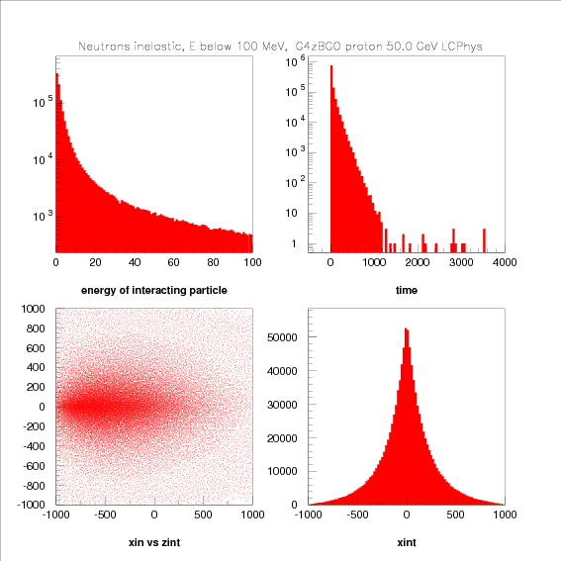
Space-Time Characteristics

Slide 7
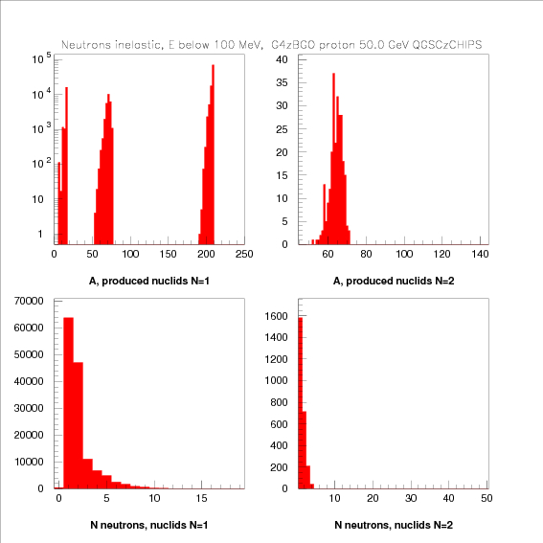
Nuclear Processes

Slide 8
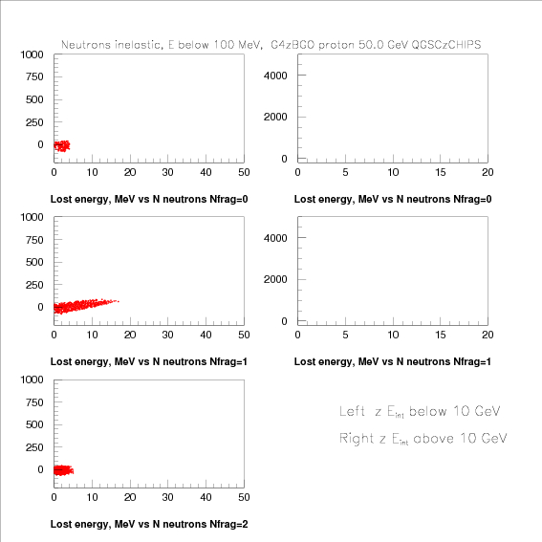
Binding Energy Losses

Slide 9
High Energy Protons

Slide 10
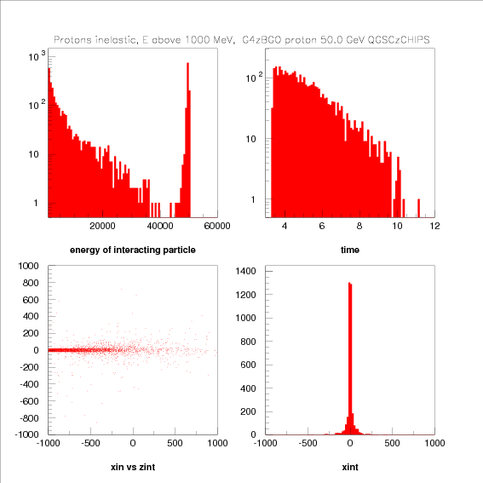
Space-time Characteristics

Slide 11
Spectra of Produced Particles

Slide 12
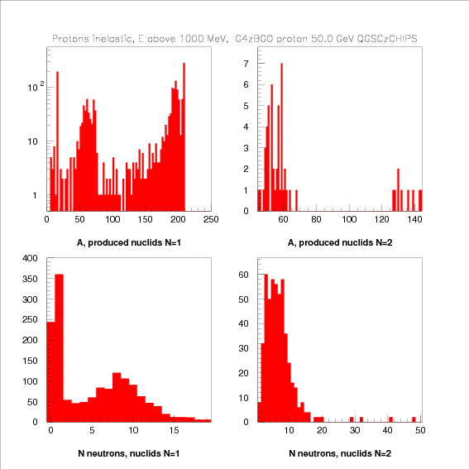
Nuclear Reactions
No fission!

Slide 13
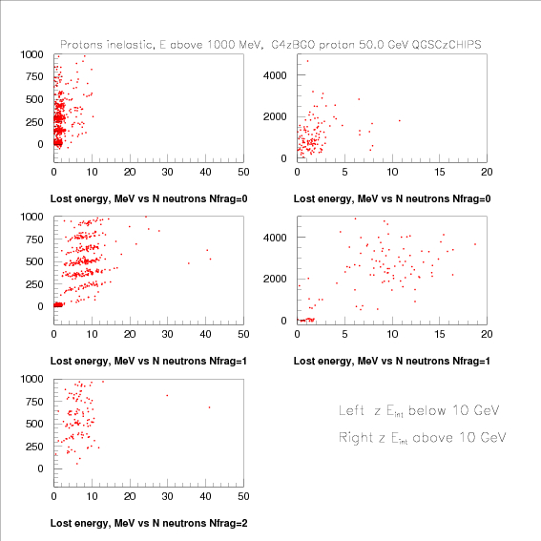
Binding Energy Losses?

