Slide 1
Proposed machine parameters
Andrei Seryi
July 23, 2010

Slide 2
Assumptions:
  Starting point: parameters developed by the Physics Questions Committee (B. Foster, A. Seryi, J. Clarke, M. Harrison, D. Schulte, T. Tauchi) in December 2009.
  Take into account progress on 10Hz rep rate for low E achieved after LCWS10
    There are issues with DR duty cycle that are being studied, however assume that they will be solved
  Assume that we will develop and use new universal FD that gives additional luminosity improvement (only) for 200 and 250 GeV energies
  Consider the following energies: 200, 250, 350, 500 GeV CM
  Assume single stage bunch compressor (min sigma_z=230um – will use 300um and consider 230 as an overhead or safety margin)
  Assume 10Hz and 1300 bunches
  Consider separately the cases with and without Travelling Focus
  Energy and rep rate:
    E= 200 250 350 500 GeV CM
    IP rep rate 5 5 5 5 Hz
    Linac rate 10 10 5 5 Hz
        ( double pulsing )
        (gray area)

Slide 3
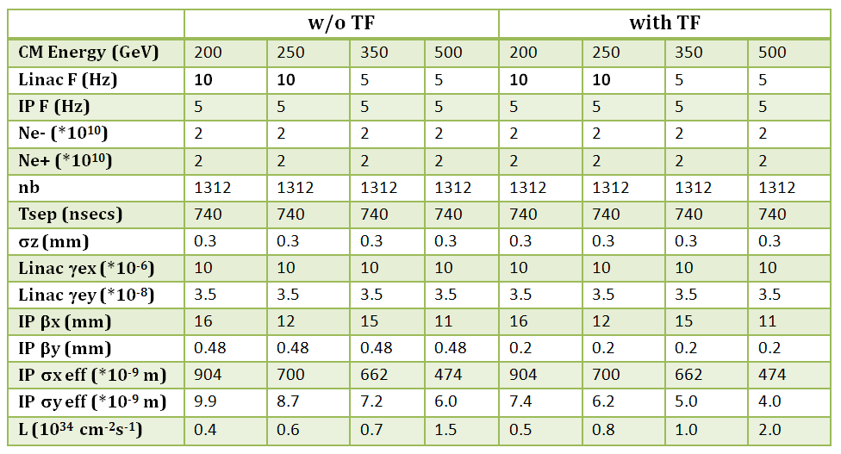
Proposed new parameters

Slide 4
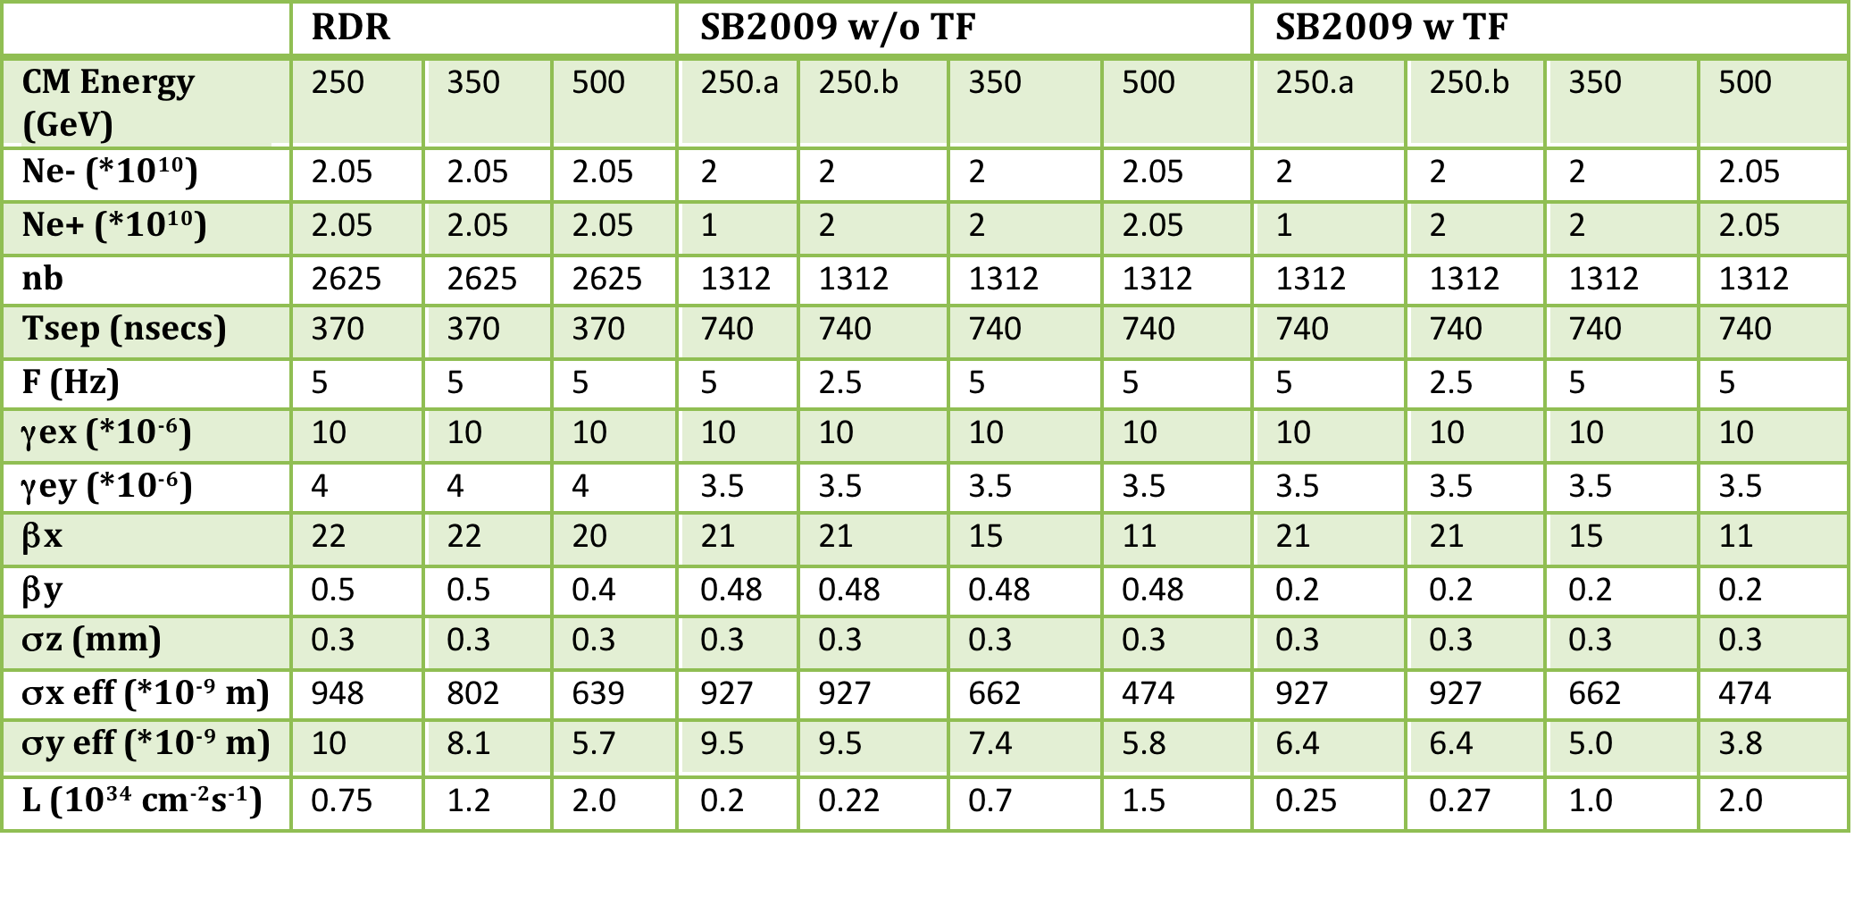
Parameters ~January 2010

Slide 5
Comparison with Jan-2010
January 2010: 0.22 0.7 1.5 0.27 1.0 2.0

Slide 6
Further studies
Design of the universal final doublet
Collimation depth optimization
Study of FF tuning with needed beta*
Detailed beam-beam studies
…

Slide 7
Backup info: slides from LCWS 2010

Slide 8
Beam Parameters
SLIDES FROM LCWS2010
Rate at IP = 2.5Hz,
Rate in the linac = 5Hz (every other pulse is at 150GeV/beam, for e+ production)
Low luminosity at this energy reduces the physics reach

Slide 9
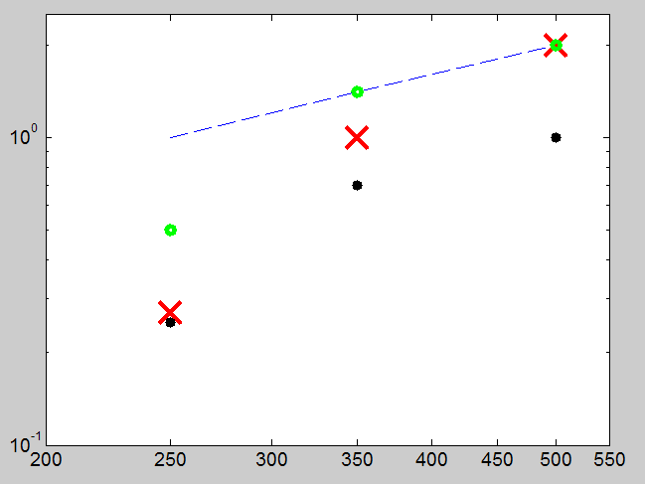
SLIDES FROM LCWS2010
SB2009 Lumi
1/E
L,E34
Rate at IP = 2.5Hz, Rate in the linac = 5Hz (every other pulse is at 150GeV/beam, for e+ production)
Low luminosity at this energy reduces the physics reach
0.5/E
0.5/E
Actual luminosity
0.25/E
E CM

Slide 10
Lumi(E) dependence in SB2009
SLIDES FROM LCWS2010
Factor determine shape of L(E) in SB2009
  Lower rep ( /2) rate below ~125GeV/beam
  Collimation effects: increased beam degradation at lower E due to collimation wakes and due to limit (in X) on collimation depth
Understanding the above limitations, one can suggest mitigation solutions:
  1) Consider doubling the rep rate at lower energy
  2) Consider Final Doublet optimized for 250GeV CM

Slide 11
Work on mitigations of L(E) with SB2009 during ILC2010
Have initiated discussion of double rep rate ~month before the ILC2010
Doubling the rep rate (below ~125GeV/beam)
  BDS WG discussed implications with other Working Groups:
    DR => OK! (new conceptual DR design was presented!)
    Sources => OK!
    Linac, HLRF, Cryogenics => OK!
FD optimized for ~250GeV CM
  Shorter FD reduce beam size in FD and increase collimation depth, reducing collimation related beam degradation
  Will consider exchanging FD for low E operation or a more universal FD that can be retuned
SLIDES FROM LCWS2010

Slide 12
Emittance damping
SLIDES FROM LCWS2010
S. Guiducci (LNF)
t/τ_{x}
8 damping times are needed for the vertical emittance
5 Hz ⇒ τ_{x} = 26 ms
10 Hz ⇒ τ_{x} = 13 ms

Slide 13
DR Parameters for 10 Hz Operation
SLIDES FROM LCWS2010
S. Guiducci (LNF) et al
Energy = 5 GeV
DR (3.2km) at 10Hz is feasible

Slide 14
Double rep rate: Sources
SLIDES FROM LCWS2010
Electron Source:
  doubling rep rate is not critical
  [Axel Brachmann, Tsunehiko Omori et al]
Positron Source:
  For SB2009 250b case there should be no issues
    For 250a, which is not a preferred solution, the most important consequence of the increased rep rate will be the increased average power on the positron target
    Even for this case there is a hope that it can be managed, but need more detailed studies [Jim Clarke, Wei Gai, et al]

Slide 15
Linac and double rep rate
SLIDES FROM LCWS2010
At lower gradient, considering the cryo load (which should not be exceeded) and the efficiency of rf power sources (their efficiency decreases with power) concluded, that at 125 GeV/beam one can work at 10Hz rep rate in the linac
At 150GeV/beam one can work at 8Hz in the linac
  And this is possible only because the e+ source is at the end of the linac!
Chris Adolphsen, et al
=> SB2009 OK for linac rep rate 10 Hz for 125 GeV/beam & 8 Hz for 150 GeV/beam

Slide 16
Linac OK for double rep rate
SLIDES FROM LCWS2010
Chris Adolphsen:
At lower gradient, it would be easy to increase the rep rate of the cavities to maintain a constant cryo load (the rep rate scales roughly as 1/gradient^2). However, one cannot readily increase the rep rate of the rf power sources as their efficiency decreases with power. In particular the klystron output power scales as V^3.5 where V = the modulator voltage while the power flow in the modulators and klystrons scales as V^2.5, and their rep rate scales as 1/(flow*pulse width) (limited mainly by the site power capacity and the modulator charging supply ratings). For example, at half the gradient, the klystron voltage could be lowered to .5^3.5 = .82 of its nominal value and rep rate could then be increased by a factor of 1/.82^2.5 = 1.64 times the pulse width factor of ~ 1.6/1.3 (due to the shorter filling time) for a net factor of 2.0 (up to 10 Hz).
There would be some additional costs associated with designing the modulators to run at a variable rep rate. However, I believe the main problem would be in the damping rings as the beams need 200 ms to be fully damped (one would need to increase the damping rate with more undulators). And of course, at low beam energy, half the pulses have to run at 150 GeV or above to generate photons to produce positrons (although such pulses probably do not have to be fully damped, the modulators would probably need to run at a constant pulse spacing). Thus with damping times of 5/8 nominal, one could perhaps run 4 Hz at 150 GeV (for e+ production) interleaved with 4 Hz of luminosity production (vs 2.5 Hz in the report) at < 150 GeV per beam. Also, for beam energies of 250 GeV down to 150 GeV, all pulses would be for luminosity and the rep rate would increase from 5 Hz to 8 Hz (which is an advantage of putting the undulators at the end of the linacs)
=> SB2009 OK for linac rep rate of 10 Hz for 125 GeV/beam & 8 Hz for 150 GeV/beam

Slide 17
Cryo load is OK
SLIDES FROM LCWS2010
 | #1 | #2
 | G=31.5 MV/m | G=15.75 MV/m
 | Nb=2625 | Nb=1312
 | Ne+=2E10 | Ne+=2E10
2K | 8.6 W | 5.5 W
4K | 8.2 W | 7.7 W
40K | 131 W | 106.8 W
Total per cryomodule | 9.8 kW | 8.2 kW
Ratio:
Total (#2)/ (#1) = 0.73
8 Cavity losses:
#1: 5.98 W (out of 8.6)
#2: 2.99 W (out of 5.5)
Notes:
Qext(#1)=Qext(#2)
Conversion:
2K=> 703 W/W
4K=> 197 W/W
40K=> 16.45 W/W
Nikolay Solyak:

Slide 18
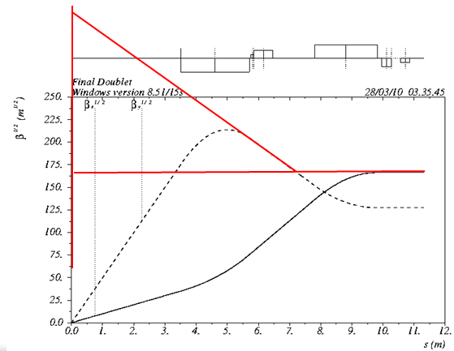
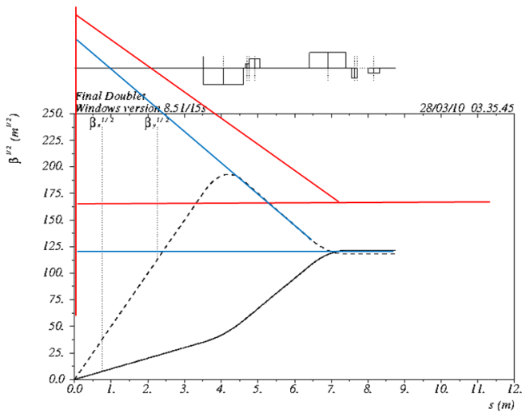
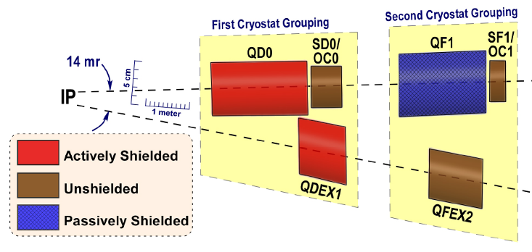
FD for low E
SLIDES FROM LCWS2010
FD optimized for lower energy will allow increasing the collimation depth by ~10% in Y and by ~30% in X (Very tentative!)
One option would be to have a separate FD optimized for lower E, and then exchange it before going to nominal E
Other option to be studied is to build a universal FD, that can be reconfigured for lower E configuration (may require splitting QD0 coil and placing sextupoles in the middle)
Nominal FD & SR trajectories
FD for 1/2E & SR
trajectories

Slide 19
Beam Parameters & mitigation
SLIDES FROM LCWS2010
Tentative! At 250 GeV CM the mitigations may give
  * 2 L due to double rep rate
  * about 1.4 L due to FD optimized for low E

Slide 20
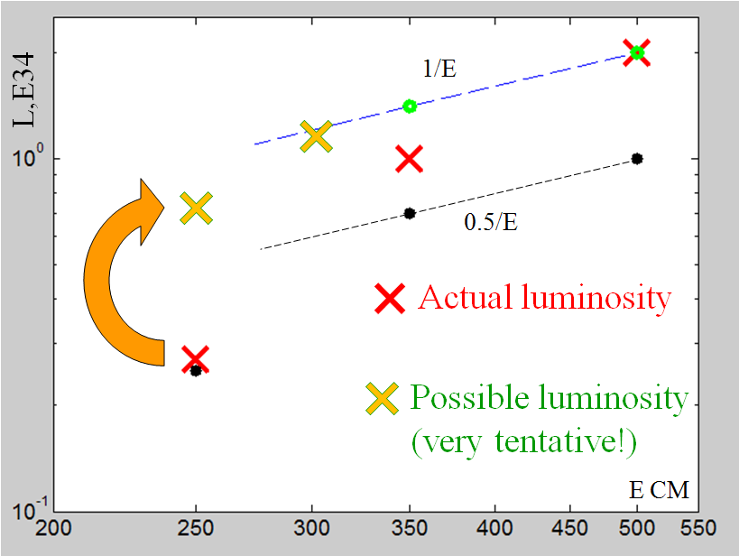
SLIDES FROM LCWS2010
SB2009 Lumi
Linac & IP rates are 8Hz
Linac rate 10Hz
(IP rate 5Hz)
and special FD

