Slide 1
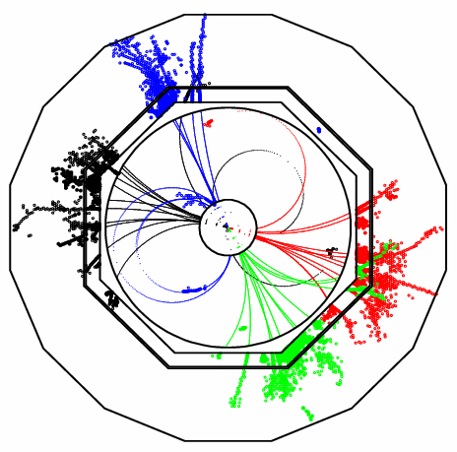
Redesign of
Pandora PFA
John Marshall,
University of Cambridge
ILD Software Meeting, June 9 2010

Slide 2
Pandora Redesign
Whilst the Pandora algorithms work very well, the old code reached a point where it was extremely difficult to extend. It was not flexible enough to try out new ideas and improvements...
ILD Letter of Intent version of Pandora was frozen and a new version written from scratch.
This is much more than just a re-implementation, it is a major redesign; Pandora is now a framework for running decoupled particle flow algorithms:
  Increased flexibility, designed to make it easy to try out new ideas
  Independent of any specific software framework and any specific detector details
  Properly designed code, taking findings from previous PFAs into account, makes it easier to maintain
  Easier for other people to get involved; users can register and run their own algorithms
  Pandora framework helps separate physics in particle flow algorithms from C++ memory management
The new Pandora is a separate library, with no dependencies. A user application, in any framework, accesses the library via a simple C++ API (application programming interface).
Will now give a brief overview of the PandoraPFANew framework and give details of the first release candidate. For those unfamiliar with the project, several helpful links can be found here.

Slide 3
New Pandora Structure
User Application:
Pandora Framework, treat as “black box”:
Pandora Algorithms:
Create Calo Hits
Specify Geometry
Create Tracks
Register User Content
Create MC Particles
Clustering Algorithm
Topological Association Algorithms
Statistical Reclustering Algorithm
Fragment Removal Algorithms
PFO Construction Algorithm
Photon Recovery
Algorithm
Track-cluster Association Algorithms
Pandora
Algorithm Manager
Calo Hit Manager
Cluster Manager
Geometry Helper
Pandora Settings
Track Manager
Particle Flow Object Manager
MC Manager
Pandora API
Pandora Content API
Get Particle Flow Objects

Slide 4
Pandora API
User Application, e.g. MarlinPandora
To run Pandora, a user needs to write a small application in their chosen software framework.
This application uses the PandoraAPI to supply Pandora with details of the detector geometry and of the calo hits and tracks in each event.
Pandora then builds its own simple objects.
Construction of these objects is easy; the user makes a Parameters class, fills the member variables and then calls the API Create function.
Example member variables for a track:
d0, z0, track state at start, track state at ECal, etc.
All member variables must be specified, or an exception will be thrown when Create is called.
The user can provide this information in any order, then call the API ProcessEvent function.
Finally, user calls the API GetParticleFlowObjects function.
  PandoraApi::Track::Parameters parameters;
  parameters.m_d0 = ...;
  ...
  PandoraApi::Track::Create(pandora, parameters);
Pandora API
Pandora
Calo Hit Manager
Cluster Manager
Track Manager
Particle Flow Object Manager
MC Manager

Slide 5
Pandora Objects
Calo Hit
Position + normal vectors
Track
Associated MC particle
Cluster
List of constituent calo hits, ordered by pseudolayer
Time of first energy deposition
Calibrated energy (mip equivalent, EM, Had)
Layer + pseudolayer
Hit type + detector region
Associated MC particle
Associated user object
Associated user object
2D impact parameters
Surrounding energy
Start track state
End track state
ECal track state
Associated cluster
ReachesECal flag
List of track state projections to calorimeter surfaces
Mip fraction
EM energy measure
Had energy measure
Initial direction
Energy-weighted centroid
ShowerStart layer
List of associated tracks
Particle Flow Object
PDG Code
Charge
Mass
Energy
Momentum
List of tracks
List of clusters
IsDigital, IsIsolated + IsPossibleMip flags
Calorimeter cell size
Absorber material in front of cell
Density weight
Momentum at d.c.a
Particle mass
Charge sign
Current direction
Result of linear fit to all hits in cluster
PFO formation flag
“Clusterless” PFO formation flag
Shower profile properties
Corrected energy estimates
Mixture of properties specified by user and value-added properties, but all simple and well defined physics quantities for use in particle flow algorithms.

Slide 6
Pandora Managers
Pandora
Calo Hit Manager
Cluster Manager
Track Manager
Particle Flow Object Manager
MC Manager
Pandora Managers are designed to store named lists of their respective objects.
These objects can be accessed by the Pandora Algorithms, which perform the reconstruction.
The algorithms interact with the Managers in a controlled way, via PandoraContentAPI, and the Managers perform the memory management.
At any instant each Manager has a “current” list, which can be accessed by an algorithm.
Parent algorithms can manipulate the current list in order to control scope and behaviour of daughter algorithms.
The Managers store information about currently running algorithms so they can keep track of lists.
Algorithms can use the PandoraContentAPI to modify lists and/or save new lists.
Pandora Content API
e.g. Clustering Algorithm
Algorithms can use the API without worrying about how the managers work – separation of physics and C++ memory management!

Slide 7
Pandora Algorithms
In the new Pandora framework, the algorithms contain almost exclusively physics-driven code, alongside the following typical usages of the PandoraContentAPI:
  Create new clusters and particle flow objects
  Modify clusters, by adding hits, merging or deleting
  Access the current lists of Pandora objects
  Save new lists of clusters, calo hits or tracks
  Run a daughter algorithm, etc...
Static helper functions are provided to perform tasks that are useful to multiple algorithms, and the Pandora algorithms are configured via xml and can be swapped in/out without recompiling.
Development of PandoraPFANew algorithms has been described throughout the past year in numerous presentations. Now all the algorithms required to reproduce the old Pandora performance have been completed and fully tested.
Therefore announced the first PandoraPFANew release candidate last week. This provides the same physics performance as the old code, is considerably faster and offers many new features and advantages: all users are encouraged to upgrade.
PandoraPFANew and its MarlinPandora application will also be part of the next ILCSoft release.

Slide 8
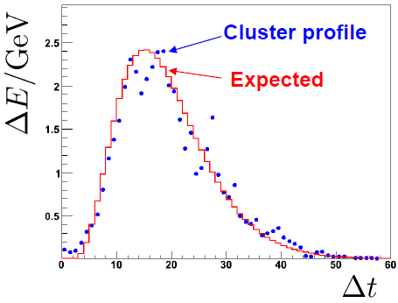
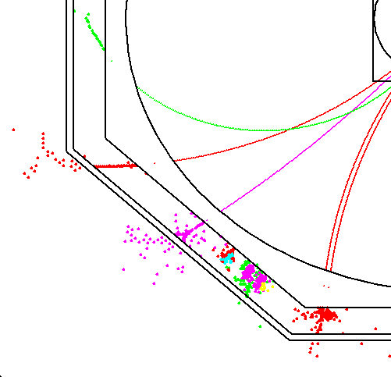
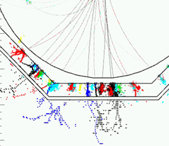
Pandora Algorithms
Clustering Algorithm
Topological Association Algorithms
Fragment Removal Algorithms
PFO Construction Algorithm
Photon Recovery Algorithm
Track-cluster Association Algorithms
Cone-based forward projective method
Cone associations
Back-scattered tracks
Looping tracks
6 GeV
3 GeV
9 GeV
6 GeV
9 GeV
9 GeV
Layers in close
contact
Fraction of energy
in cone
Projected track position
Cluster first
layer position
Neutral hadron
Photon
Charged hadron

Slide 9
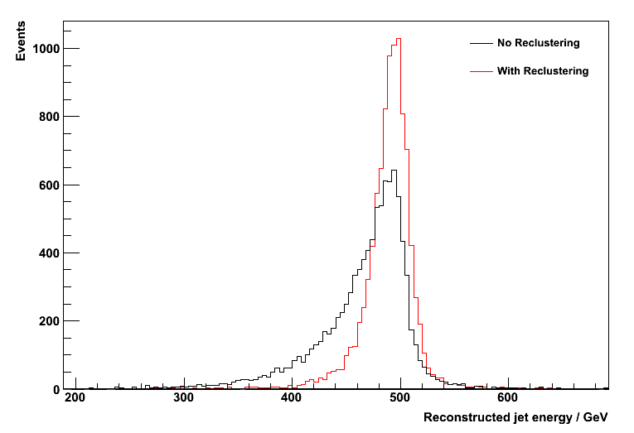
Reclustering
At high jet energies, performance degrades due to increasing overlap between hadronic showers from different particles:
e.g.
If these hits are clustered together with
these, lose energy deposit from neutral hadron (now part of track particle) and ruin jet energy measurement.
Pandora addresses this problem with statistical reclustering:
    Incorrectly merged clusters are identified via consistency of cluster energy and associated track momentum.
    Attempts are made to redistribute the hits by using different clustering parameters or entirely different algorithms.
E_{Z} = 500GeV
38 GeV
18 GeV
12 GeV
32 GeV
30 GeV Track

Slide 10
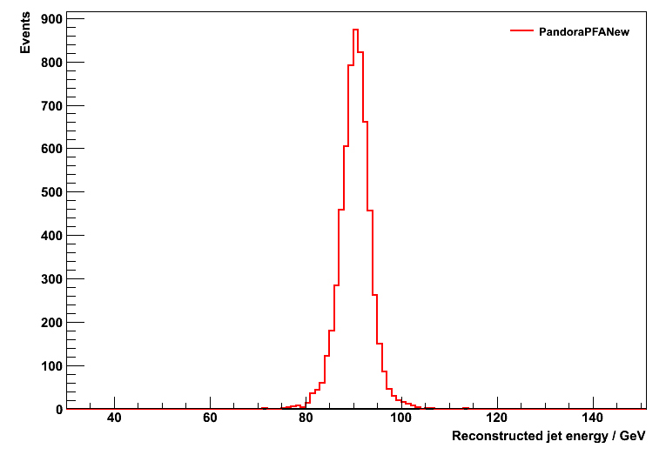
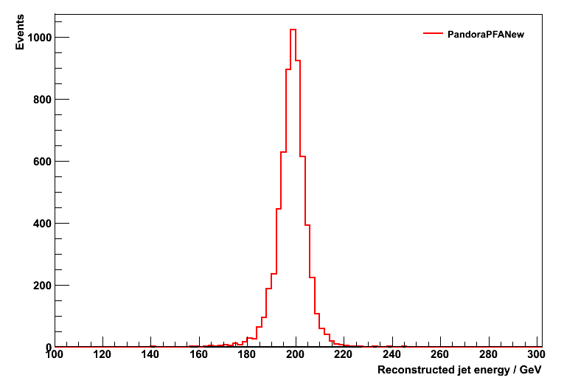
Reconstruction Performance
Performance has been studied for the ILD detector concept, using MC samples of approximately 10,000 Z → uds generated with the Z decaying at rest, with E_{z} = 91.2, 200, 360 and 500GeV.
The performance is quoted in terms of rms₉₀, defined as the rms in the smallest range of reconstructed energy containing 90% of the events. A cut on the polar angle is applied to avoid the barrel/endcap overlap region: |cos θ| < 0.7
For each set of events, the total energy was reconstructed and the jet energy resolution obtained by dividing the total energy resolution by √2.
E_{j} = 45GeV
E_{j} = 100GeV
rms₉₀(E_{j}) / E_{j} = 3.63 ± 0.05
rms₉₀(E_{j}) / E_{j} = 2.94 ± 0.04

Slide 11
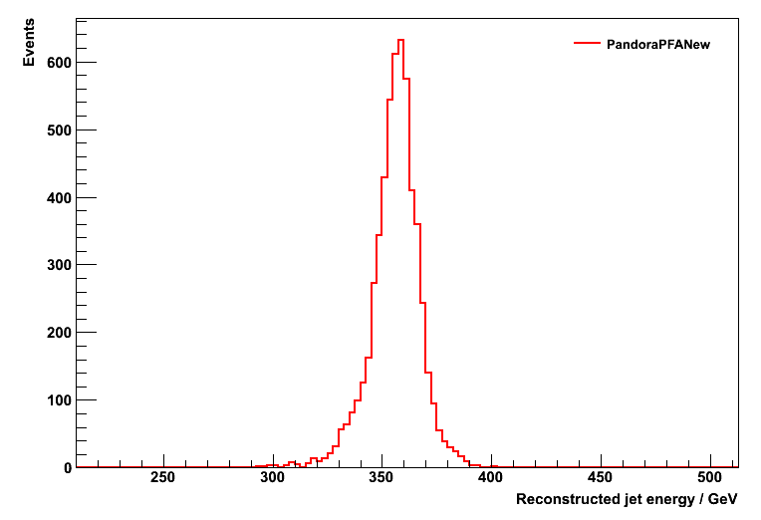
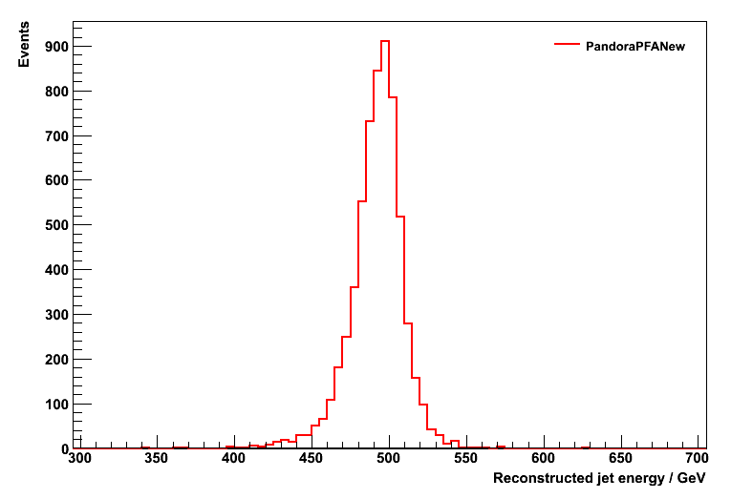
Reconstruction Performance
E_{j} | 45GeV | 100GeV | 180GeV | 250GeV
PandoraPFANew, rms₉₀(E_{j}) / E_{j} | 3.63 ± 0.05 | 2.94 ± 0.04 | 3.09 ± 0.04 | 3.32 ± 0.04
Original Pandora, rms₉₀(E_{j}) / E_{j} | 3.66 ± 0.05 | 2.99 ± 0.04 | 3.13 ± 0.04 | 3.31 ± 0.05
Note: these are results obtained without PhotonClustering algorithms.
E_{j} = 180GeV
E_{j} = 250GeV
rms₉₀(E_{j}) / E_{j} = 3.09 ± 0.04
rms₉₀(E_{j}) / E_{j} = 3.32 ± 0.04

Slide 12
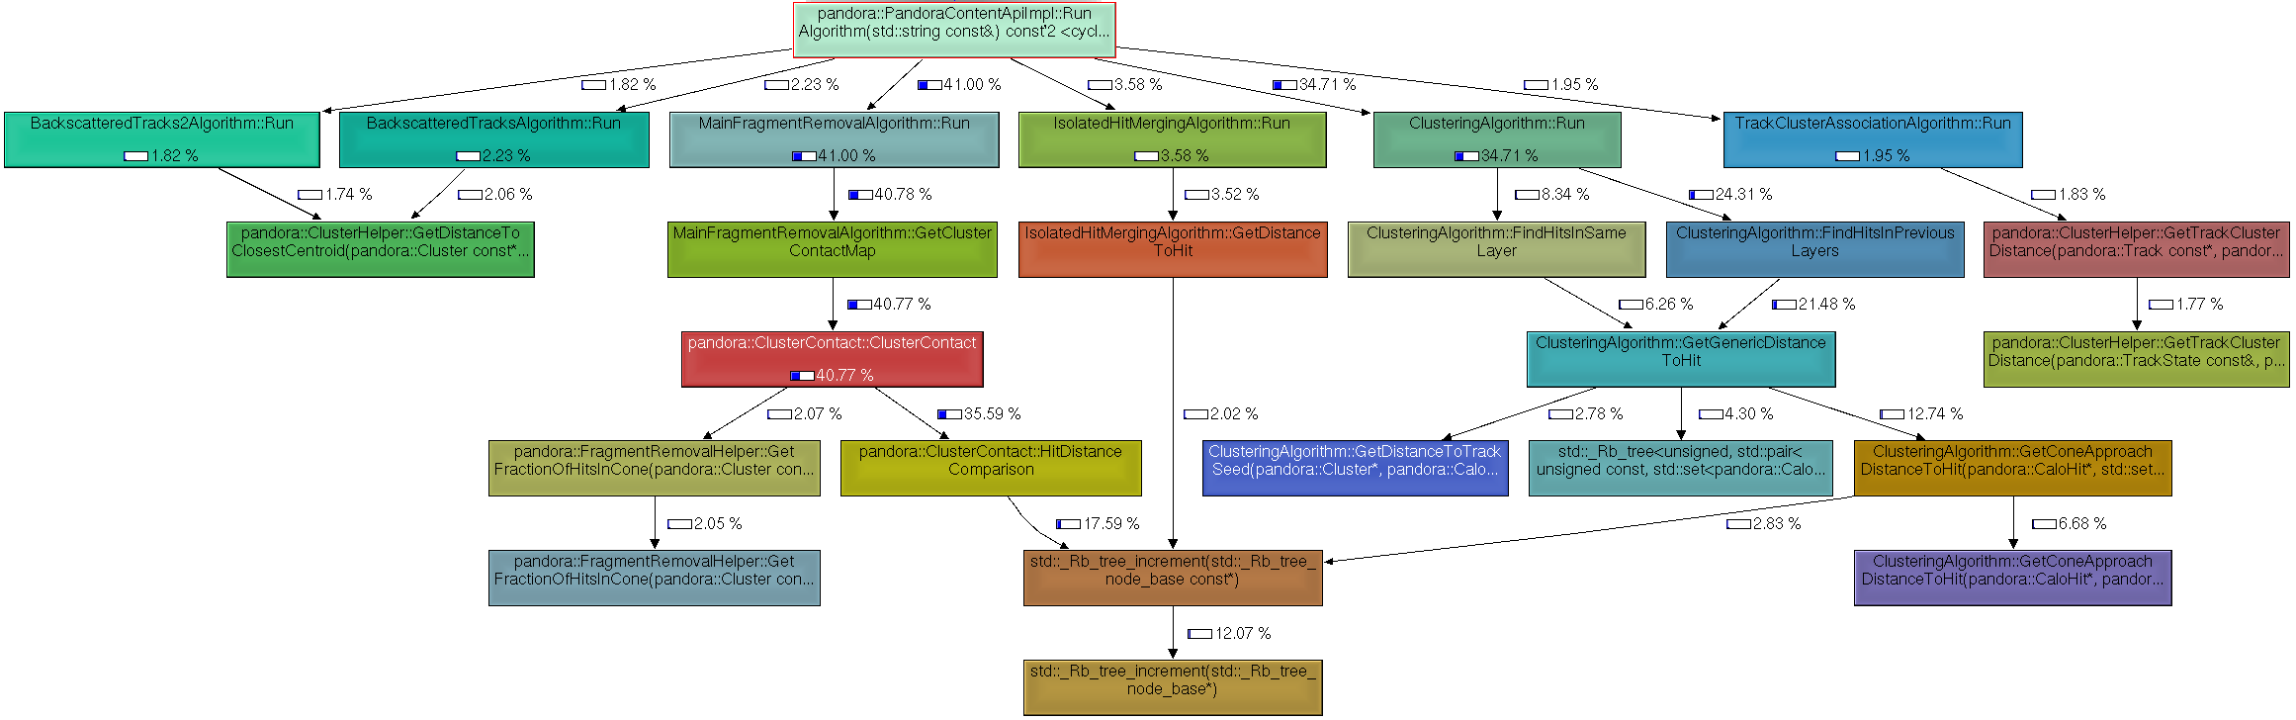
CPU/Memory Performance
Performance of PandoraPFANew has been examined using the Valgrind callgrind tool, an invaluable tool for identifying the performance-critical sections of the code.
Huge performance gains were obtained by optimising several FragmentRemovalHelper functions, which were called for many different permutations of CaloHits and Clusters.
With recent improvements, PandoraPFANew is 2-3 times faster than old code. It is also encouraging to see that framework makes negligible contribution to reconstruction time – time is spent in physics algorithms, performing nested loops.
*For KinkFinder, V⁰Finder, MarlinPandora and LCIO output processors on Intel E8500 @ 3.16GHz
Valgrind memcheck tool gives PandoraPFANew a clean bill of health.
It appears that the memory footprint is rather small. Will try to disentangle from the memory used by Marlin, but it looks like PandoraPFANew requires only a trivial amount (order of tens of megabytes).
Running KinkFinder, V⁰Finder, MarlinPandora and LCIO output processor uses less than 250MB on typical SLC5 machine.

Slide 13
Pandora Plugins
PandoraPFANew has been designed to make it easy for people to get involved and try out new ideas. Users can therefore register and use their own content, including:
  Particle identification helper functions,
  Hadronic and electromagnetic energy correction helper functions,
  Particle flow algorithms, allowing for a completely different reconstruction.
Existing Pandora algorithms and functions have been written to ensure they have no dependencies and that they are (subject to changing steering parameters) largely detector independent, this need not apply to custom content, which will not be compiled as part of the Pandora library.
Registering custom functions/algorithms has been made as easy as possible and simple templates are provided. For example, consider a custom particle id function. This function must conform to the following prototype:
  static bool MyClass::MyParticleIdFunction(const pandora::Cluster *const pCluster);
After the user has implemented the function logic, the function is registered under a specific name, as follows:
  PandoraApi::RegisterParticleIdFunction(pandora, “MyFunctionName”, &MyClass::MyParticleIdFunction);
Finally, in the PandoraSettings xml file, the named particle id function is assigned to one of a number of pandora particle id “slots”. The list of slots is expected to grow, but currently consists of:
  PhotonFast, PhotonFull, ElectronFast, ElectronFull, MuonFast, MuonFull.
These functions are then called by the pandora algorithms, which perform the reconstruction.

Slide 14
Pandora Plugins
Registration of energy correction functions is very similar, although there is a different function prototype and any number of separate hadronic and electromagnetic correction functions can be registered. The PandoraSettings xml file specifies the names (and the order) of the correction functions that will be applied.
The ability to plug-in user helper functions to the pandora reconstruction is extremely powerful. However, the range of functions currently provided is quite small and we are looking for more people to get involved and bring new ideas.
  Current particle id functions:
    A fast photon id function, equivalent to that used in the old version of Pandora,
    A fast electron id function, based on that used in old Pandora,
    A new fast muon id function, recently provided by Mark.
  Current energy correction functions:
    Two functions that remove the effects of CaloHits with anomalously high energies,
    A correction for energy loss in the coil,
    Work is underway to investigate a software-compensation based correction (Katja and Frank).
Finally, creating a custom algorithm allows access to the full range of functions in the PandoraContentAPI. This allows implementation of almost any conceivable particle flow algorithm.
Simply need to copy and rename the provided TemplateAlgorithm files, use the RegisterAlgorithmFactory API and add the new algorithm to PandoraSettings xml file.

Slide 15
Summary
The first release of PandoraPFANew (and its associated MarlinPandora processor) is now available. This is a complete replacement for the old version of Pandora and all users are encouraged to upgrade.
The PandoraPFANew framework offers a great deal of flexibility for investigating new ideas and, in particular, allows for custom energy corrections, particle id and implementation of custom algorithms.
The existing particle identification and energy correction functions are quite simplistic and are only placeholders. We are going to be looking for new ideas, so please get in touch if you’d like to be involved...
Immediate plans now concern improving the reconstruction at high energies. Also have many other interesting ideas for moving forwards and improving Pandora within the new framework:
  New clustering algorithms,
  Topological association improvements,
  Improved treatment of leakage.
Finally, should advertise fact that Norman Graf and Jeremy McCormick are working on a SlicPandora application:
  With MarlinPandora (ILD) and SlicPandora applications, every algorithm in the PandoraPFANew library is automatically and instantly available for both ILD and SiD concepts.

