Slide 1
TD Phase 2 Planning
NW for the PMs
Accelerator Systems TAG Leaders Meeting
18.06.2010

Slide 2
Release 5
Major re-write from Release 4
Re-evaluation of ‘where we are’
  end of TDP-2
Re-assessment of where we want to go
  TD Phase 2 (and beyond)
Focus on consolidating effort towards the TDR
  Clearer picture of what the TDR is

Slide 3
Five (Six*) Themes to Develop
Remains special case
Industrialisation
in-kind contribution models
Site requirements
Project Schedule
Remaining Technical activities
*Project Implementation Plan
>2012

Slide 4
Risk Mitigating R&D
Focus Theme of TD Phase (and TDR)
High priority (high visibility) R&D for AS:
  Damping Rings
    CesrTA for e-cloud
    Fast kicker development (ATF/DAPHNE)
    Low Extracted Emittance (ATF)
  BDS
    Demonstration of demagnification (ATF2)
    Demonstration of 35nm beam size (ATF2)
    Demonstration of stabilisation (ATF2)
    Demonstration of FD technologies (ATF2)
  Positron source
    Feasibility studies for Flux Concentrator
    Target survivability / Eddy current / Rotating Seal
    Alternative sources (Liquid and hybrid targets
  Electron source
    Polarised cathode charge limit demonstration(s)
  RTML
    Beam dynamics (emittance preservation)
    Amplitude & phase stability demonstration (TTF2/FLASH)

Slide 5
Risk Mitigating R&D
Focus Theme of TD Phase (and TDR)
High priority (high visibility) R&D for AS:
  Damping Rings
    CesrTA for e-cloud
    Fast kicker development (ATF/DAPHNE)
    Low Extracted Emittance (ATF)
  BDS
    Demonstration of demagnification (ATF2)
    Demonstration of 35nm beam size (ATF2)
    Demonstration of stabilisation (ATF2)
    Demonstration of FD technologies (ATF2)
  Positron source
    Feasibility studies for Flux Concentrator
    Target survivability / Eddy current / Rotating Seal
    Alternative sources (Liquid and hybrid targets)
  Electron source
    Polarised cathode charge limit demonstration(s)
  RTML
    Beam dynamics (emittance preservation)
    Amplitude & phase stability demonstration (TTF2/FLASH)
Are the goals on track for completion within TDP-2?
How do the goals relate to the accelerator baseline decisions
  critical (must have)
  soft (lower risk)
If beyond 2012, what are the ramifications for the TDR design?
  Can adopt choice with confidence (low risk)
  Still uncertain parameters can be achieved (medium risk)
  Can’t honestly make a choice (high risk)
  Fall-back cost (mitigation) in design?
→Risk Assessment
“One man’s risk, is another man’s R&D programme”

Slide 6
Accelerator Design & Integration
Designing the ILC
  Completing baseline process begun with SB2009
  Further design work where necessary
    cost impact
    technical risk impact
  Updating the VALUE estimate
  Providing input for SCHEDULE
  Providing and Maintaining FORMAL DOCUMENTATION
  (→ ILC-EDMS)
Phases
  TLCC (BAW-1, BAW-2, concludes at ALCPG meeting 19-23.03.11)
  Design & documentation consolidation (also ALCPG)
  Revising VALUE estimate with possible iteration (scope = resource limited)
  Developing Risk Assessment
Not sequential!

Slide 7
Special Relationship to CFS
SB2009 (ADI) activity mainly focused on reducing CFS costs.
AS must produce enough design information (requirements) for CFS to do their work
  Layout and Geometry (lattice files, component counts…)
  Space requirements
  Power, cooling and HVAC requirements
  …
AS needs to review status design status:
  Is this information available?
    YES →document! Iterate with CFS
    NO →when can it be available?
Top level role of integration (PM)
  Broad picture (top level Parameters)
  What parts of the puzzle are missing?
  Is the integrated design consistent and functional?
AS design and costing resources are ‘scarce’. Need to use cost leverage to prioritise (level of detail)

Slide 8
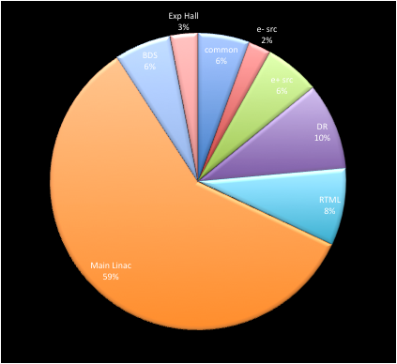
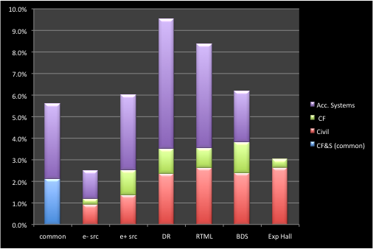
Accelerator Systems VALUE
Everything except the Main Linac
  i.e. ~40% the RDR VALUE estimate
Expect to use RDR unit costs and scale by component count for most of the work

Slide 9
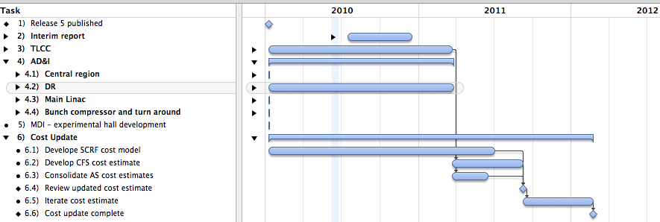
Top Level Schedule (not R&D)

Slide 10
Top Level Schedule (not R&D)
ALCPG (3.2011)
TDR Baseline Established
Baseline Documentation in ILC-EDMS

Slide 11
Top Level Schedule (not R&D)
ALCPG (3.2011)
TDR Baseline Established
Baseline Documentation in ILC-EDMS
Consolidating (AS) VALUE estimate
Iterating VALUE estimate

Slide 12
Top Level Schedule (not R&D)
Further design work
(refinement)
Resources! PMs need to know people (skills) that are missing.

Slide 13
SB2009 (ADI) Configurations
Currently several possible configurations being discussed
Formal baseline will not be adopted before ALCPG
However, need to make ‘working assumptions’ earlier (i.e. now)
  Similar to SB2009 WA
  DR work to focus on 3x3km rings in single tunnel
    one ring for ‘upgrade’ to full power
TDR can contain ‘variants’ but we want to minimise them
  Main Linac will have two site-driven designs
  Goal is to have AS the same across regional sites
Interaction with CFS / Siting

Slide 14
Next Steps
Develop top-level milestones
futher (← your input!)
Include / update R&D (← your input!)
Draft text for outline
Review and iterate plans with
TAG leaders (← your input!)
  and EC!
Final editing and publication
Plan still end of this month
  but realistically probably July

