Slide 1
9mA meeting on gradient tilts
J. Carwardine
15 June 2010

Slide 2
Agenda
Quick recap
Modeling & simulation (Julien Branlard)
Revisiting error budgets
Studies…
FEL long bunch-train studies schedule

Slide 3
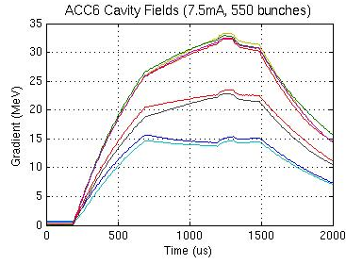

Issue
Gradient deviations on individual cavities cause emittance growth
Minimize gradient deviations for individual cavities over the bunch-train
  ‘Working spec’ from Beam Dynamics Group: 1% max deviation
Deviations from vector sum are a consequence of running different gradients on different cavities in the same vector sum
Linear slope due to beam-current mis-match with gradient, Pk, Qext
Curvature due to LFD (gradient dependent)

Slide 4
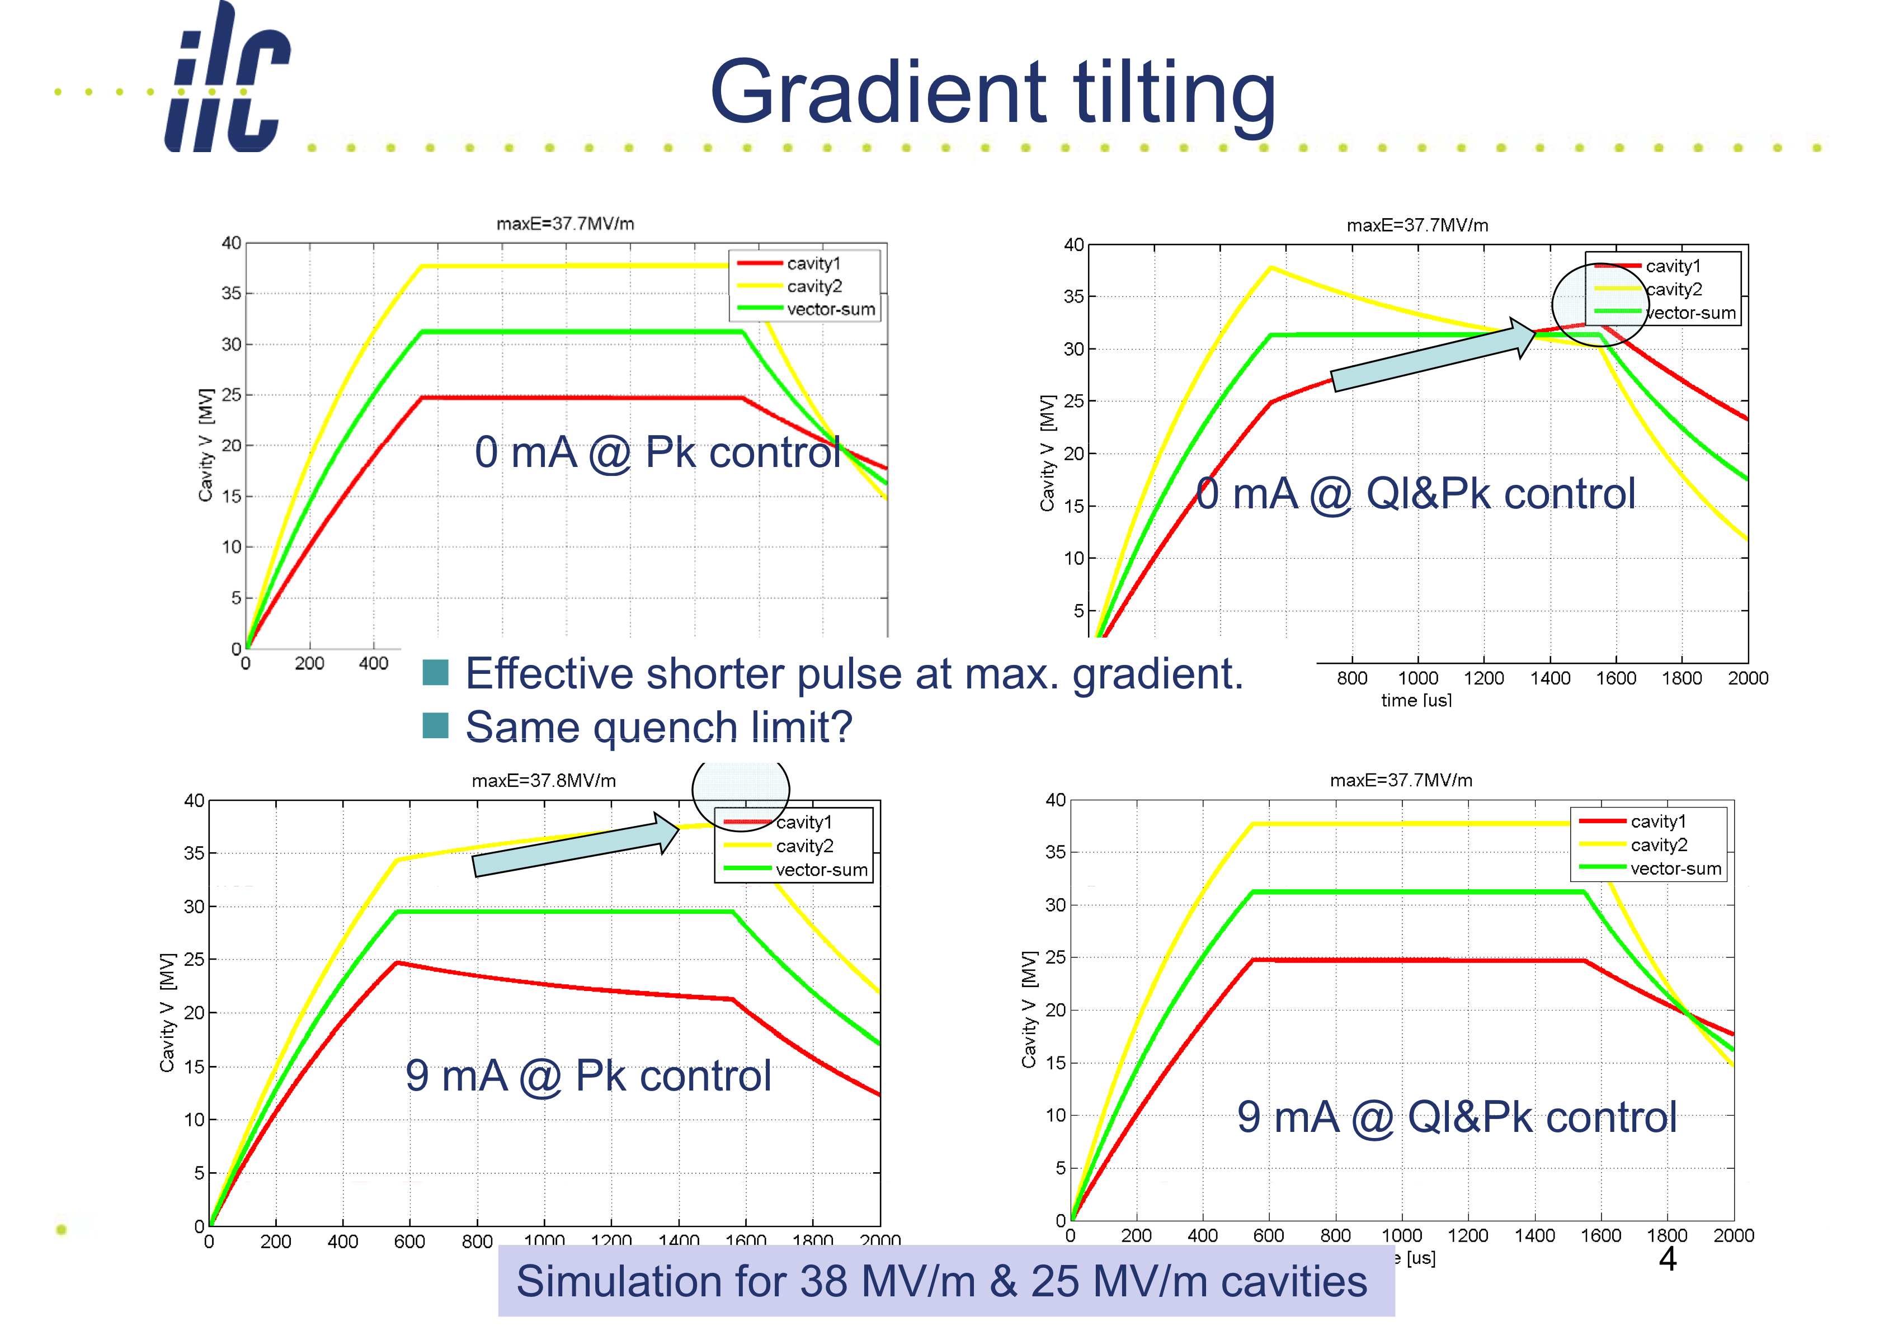
Cavity gradient tilts: RF distribution schemes
FLASH standard setup
ILC Reference Design
S. Michizono

Slide 5
Sources of Errors
No feedback
Lorentz Force Detuning (20%, 20deg)
  A function of gradient and various cavity parameters
Cavity P_{k}, Q_{l} and beam loading (2%, 2deg)
  Test with simulator
Microphonics (2%, 5 deg)
Static detuning (1%, 2deg)
Beam loading variation
Vector sum calibration errors and drifts (1%, 1deg)
Receiver linearity
Noise
Residual loop error (.2%, .2deg)
Reference line drifts (0%, .3deg)
Initial estimates!
B. Chase (18 May)

Slide 6
Error Budget
Discussion on 1 June
Lorentz Force Detuning (.2%, .2deg)
  A function of gradient and various cavity parameters
Cavity P_{k}, Q_{l} and beam loading (.2%, .2deg)
  Test with simulator
Microphonics (.2%, .2 deg)
Static detuning (.1%, .1deg)
Beam loading variation (.1%, .1deg)
Vector sum calibration errors and drifts (.1%, .1deg)
Receiver linearity (.1%, .1deg)
Noise (.02%, .02deg)
Residual loop error (.1%, .1deg)
Reference line drifts (.1%, .1deg)
B. Chase (18 May)

Slide 7
Extras

Slide 8
Categorize into ‘static’ and ‘dynamic’
Repeatable pulse to pulse
  Common effects across cavities
    Fully or partially detectable on vector sum
    LLRF system with feed-forward compensation
  Individual cavity effects
    Not detectable on vector sum
    Fast orbit kickers with feed-forward compensation
Random pulse-to-pulse
  Common-mode – detectable on vector sum
    LLRF system with feedback regulation
  All cavities different – not detectable on vector sum
    Fast orbit kickers with feedback regulation

Slide 9
Issues for study
  Optimum tuning / setup for ‘zero’ tilt at nominal beam current
  Cavity Pk / Qext
  Cavity tuning
LFD feed-forward compensation using piezo tuners
Dynamic effects
  Beam current variations from nominal
  Microphonics (unique by cavity, common to all cavities in a cryomodule)
How well can we measure…?
  Measurement errors (calibration, noise)
How well can we set up Pk / Qext?
Sensitivites to various effects & errors… Model first, then study

Slide 10
LFD compensation with piezo tuners
‘Residual errors are at the same level as the microphonics’
  Can we always correct to this point, or is it that the microphonics are higher than expected?
Quantify microphonics on test stands (FLASH, HTS)

Slide 11
Studies
Piezo tuner studies
  FLASH (16 cavities)
  Fermilab HTS (single cavity)
  KEK – ‘S1-global’
  What issues to address?
HLRF Pk/Qext setup at FLASH
  Study scenario
  Min beam current for meaningful studies/
  What can we do without beam…?
Microphonics characterization
  FLASH

