Slide 1
JRA1 Data Acquisition
Past – Present - Future
Daniel Haas
Hamburg, Sep 2010
The initial concept
Main Ingredients:
  EUDRB + TLU (Hardware)
  EUDAQ (Acquisition Software)
  EUTelescope (Analysis Framework) -> Ingrid
Past & Present
Some numbers
Outlook to AIDA

Slide 2
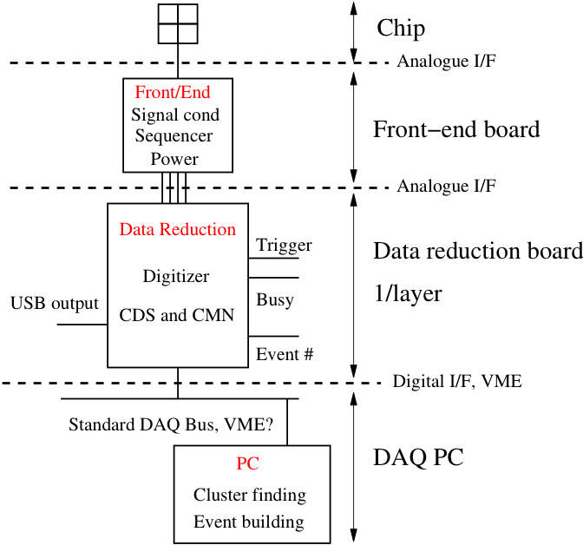
The initial concept...

Slide 3
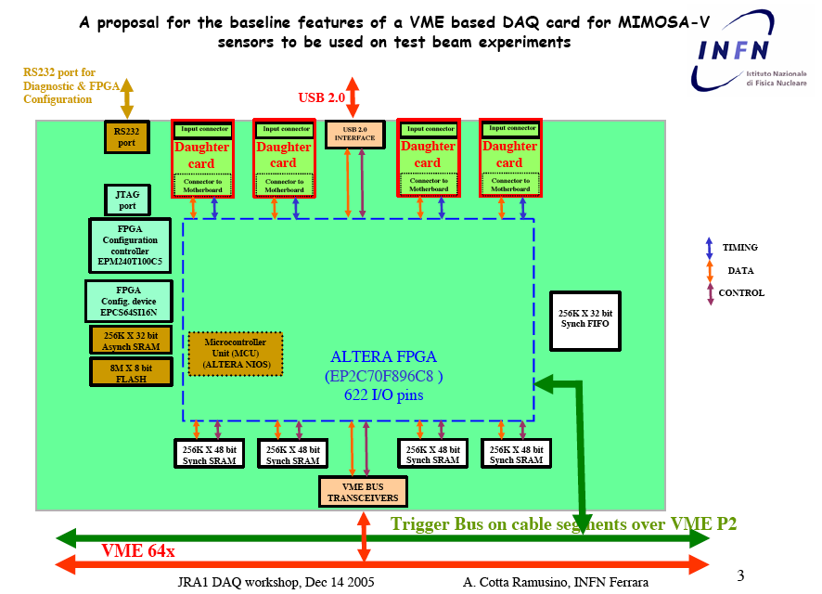
...The initial concept...
Key Ideas:
  Frontend on daughter cards (adoptable to
  Pixel-DUTs)
  Readout by VME and/or USB

Slide 4
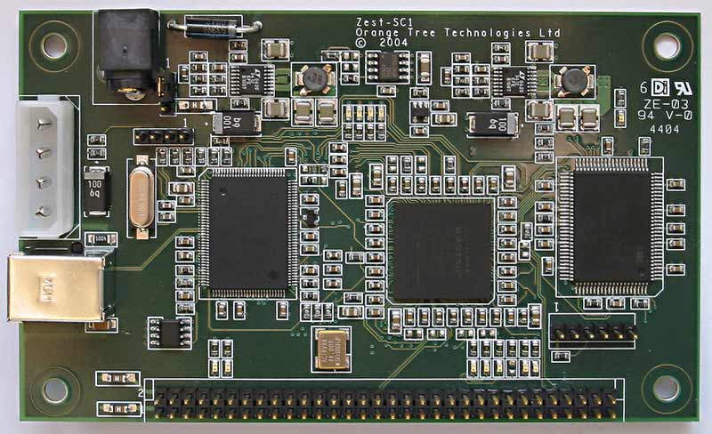
...The initial concept...
Orange Tree ZestSC1:
USB FPGA board
49 I/O pins
TLU
reset
module 1
trigger
busy1
PC
USB?
module 2
busy2
maybe one reset/trigger
output per module is better !

Slide 5
...The initial concept...
Baseline: Depfet Bonn solution
Missing:
  Overall control task
  (flush buffers, start/stop run,…)
  TCP/IP communication
  Detector configuration
Modular, flexible, OS-independent
Based on DEPFET ‘Mini-DAQ’
(P. Fischer/H. Krüger)
Hardware
Hardware
Hardware
telescope
‘producer’ task
DEPFET
‘producer’ task
other
‘producer’ tasks
DAQ buffers
Writer task
file
Monitoring
buffers
Monitoring task 1
Monitoring task 2

Slide 6
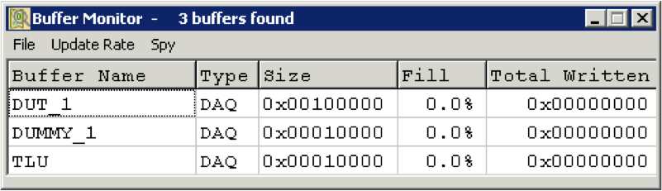
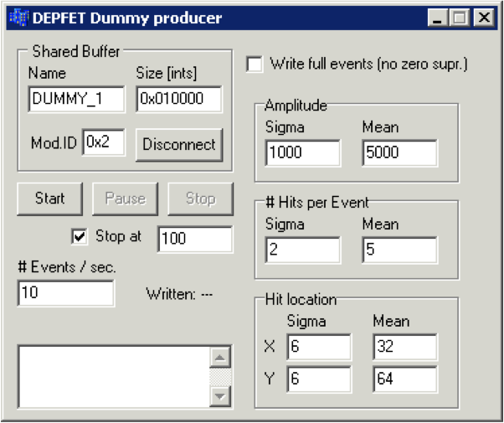
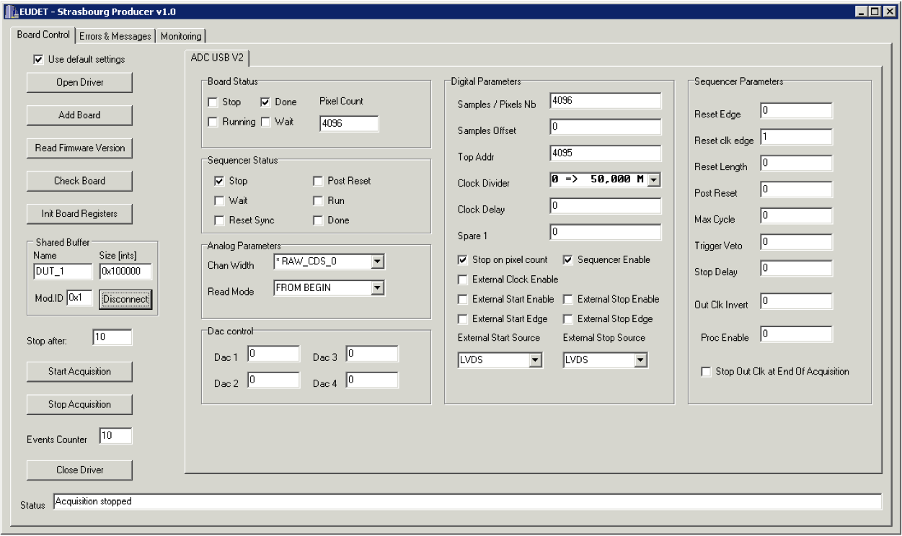
...The initial concept...
Proof of principle: Hacked DEPFET DAQ
running on multiple machines

Slide 7
...The initial concept
Magnet @ DESY
Magnet available
2006
2007
2008
2009
Demonstrator
Available
Final Telescope Available
Demonstrator
Integration Starts
CERN test beam
Aggressive initial timeline and Milestones have been
respected and maintained over the full time

Slide 8
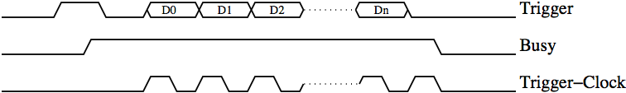
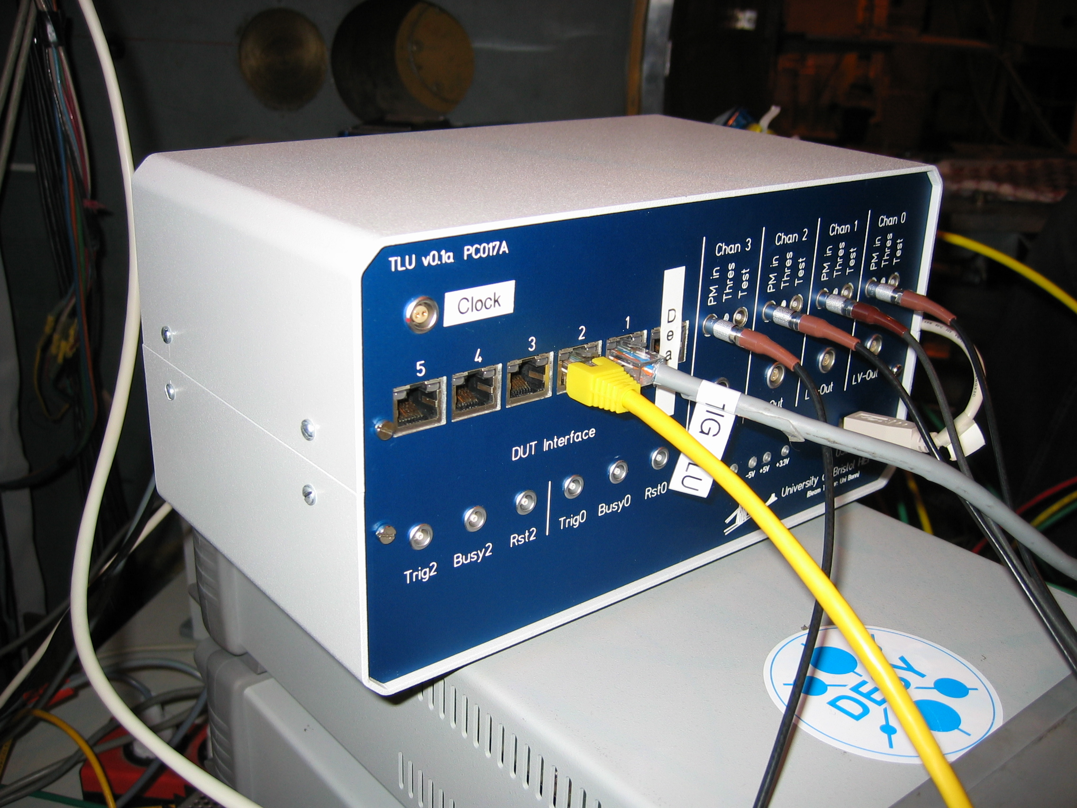

Main Ingredients - TLU
Trigger Logic Unit
Two handshake modes
  Simple handshake (Trigger/Busy/Reset)
  Trigger data handshake incl. event number
Timestamp and event-number via USB
LVDS via RJ45, NIM and TTL via Lemo
(Software-Selectable)
Inputs for four trigger signals
(ANDed, ORed, VETOed)
Internal trigger mode and scalers for testing
Low voltage power supply for PMTs
Special needs for special demands:
  Low Jitter mode (for TPCs etc.)
  ‘LHC’-users: increased timestamp resolution,
  central clocking
Busy acknowledges
the Trigger
Bristol Univ.

Slide 9
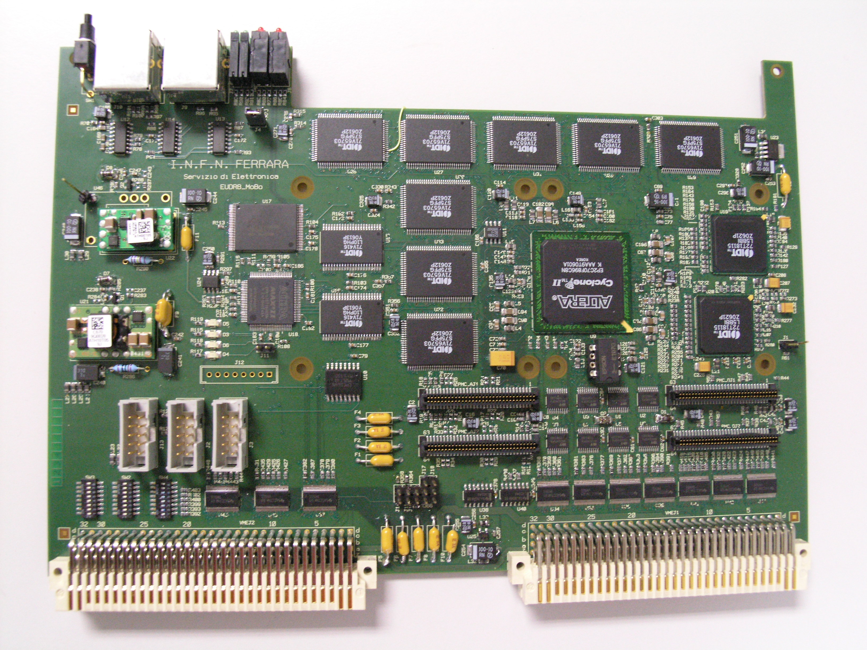

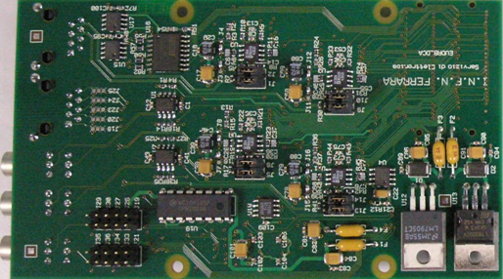
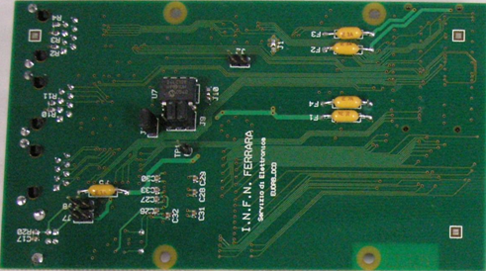
Main Ingredients - EUDRB
EUDET Data Reduction Board:
Mother board with ALTERA CycloneII FPGA (clock: 80MHz) hosts core resources and Interfaces (VME64X slave, USB2.0,
EUDET trigger bus)
2 Daughter cards (analog + digital)
NIOS II, 32 bit “soft” microcontr. (40Mz) for diagnostitics, pedestal+noise calculation and remote configuration
Two readout modes: Zero Suppressed for normal data taking, raw readout of multiple frames for debugging or off-line pedestal and noise calculations
INFN Ferrara
Analog Daughter card based on the successful LEPSI
and SUCIMA designs clock rate up to 20 MHz
Digital daughter card drives/receives control signals
for the detectors and features a USB 2.0 link

Slide 10
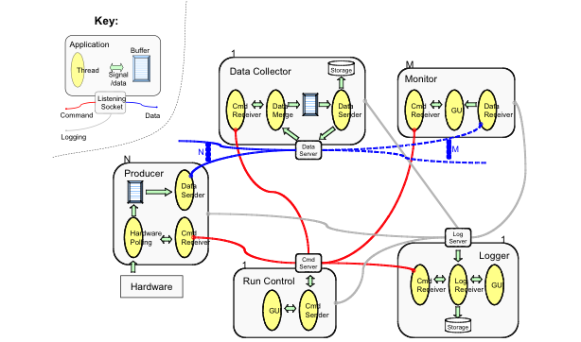
Main Ingredients – Acquisition SW

Slide 11
Main Ingredients – DUT Integration
How to integrate the DUT hardware with the EUDET beam telescope?
  different groups with different detector technologies and different, pre-existing DAQ systems
Use completely different hardware and DAQ for the DUT and the telescope
Two levels of integration possible:
  “easy” solution: at trigger level
  full integration on DAQ software level
DUT
telescope
Trigger
Logic
Unit
DAQ
DAQ
or
intfc
PC
intfc
PC
tel. ctrl
DUT ctrl
file
file

Slide 12
Main Ingredients – DUT Integration
Usage of EUDAQ
Altro - Bonn (Martin Killenberg)
APIX - Atlas Pixels (Georg Troska)
DEPFET - Bonn (Julia Fourletova)
FORTIS/SPIDER - Bristol (David Cussans)
MimoRoma - INFN (Toto)
MVD - DESY (Silvia Bonfanti)
PixelMan - Freiburg (Uwe Renz)
SITRA - Santander (Javier Gonzalez Sanchez)
Taki - Mannheim (Christian Takacs / Ivan Peric)
Timepix - Bonn (Martin Killenberg)
Atlas TRT (Ilja Slepnev)
2010: NA62, Alfa, etc.
DUT
telescope
Trigger
Logic
Unit
DAQ
DAQ
or
intfc
PC
intfc
PC
tel. ctrl
DUT ctrl
file
file

Slide 13
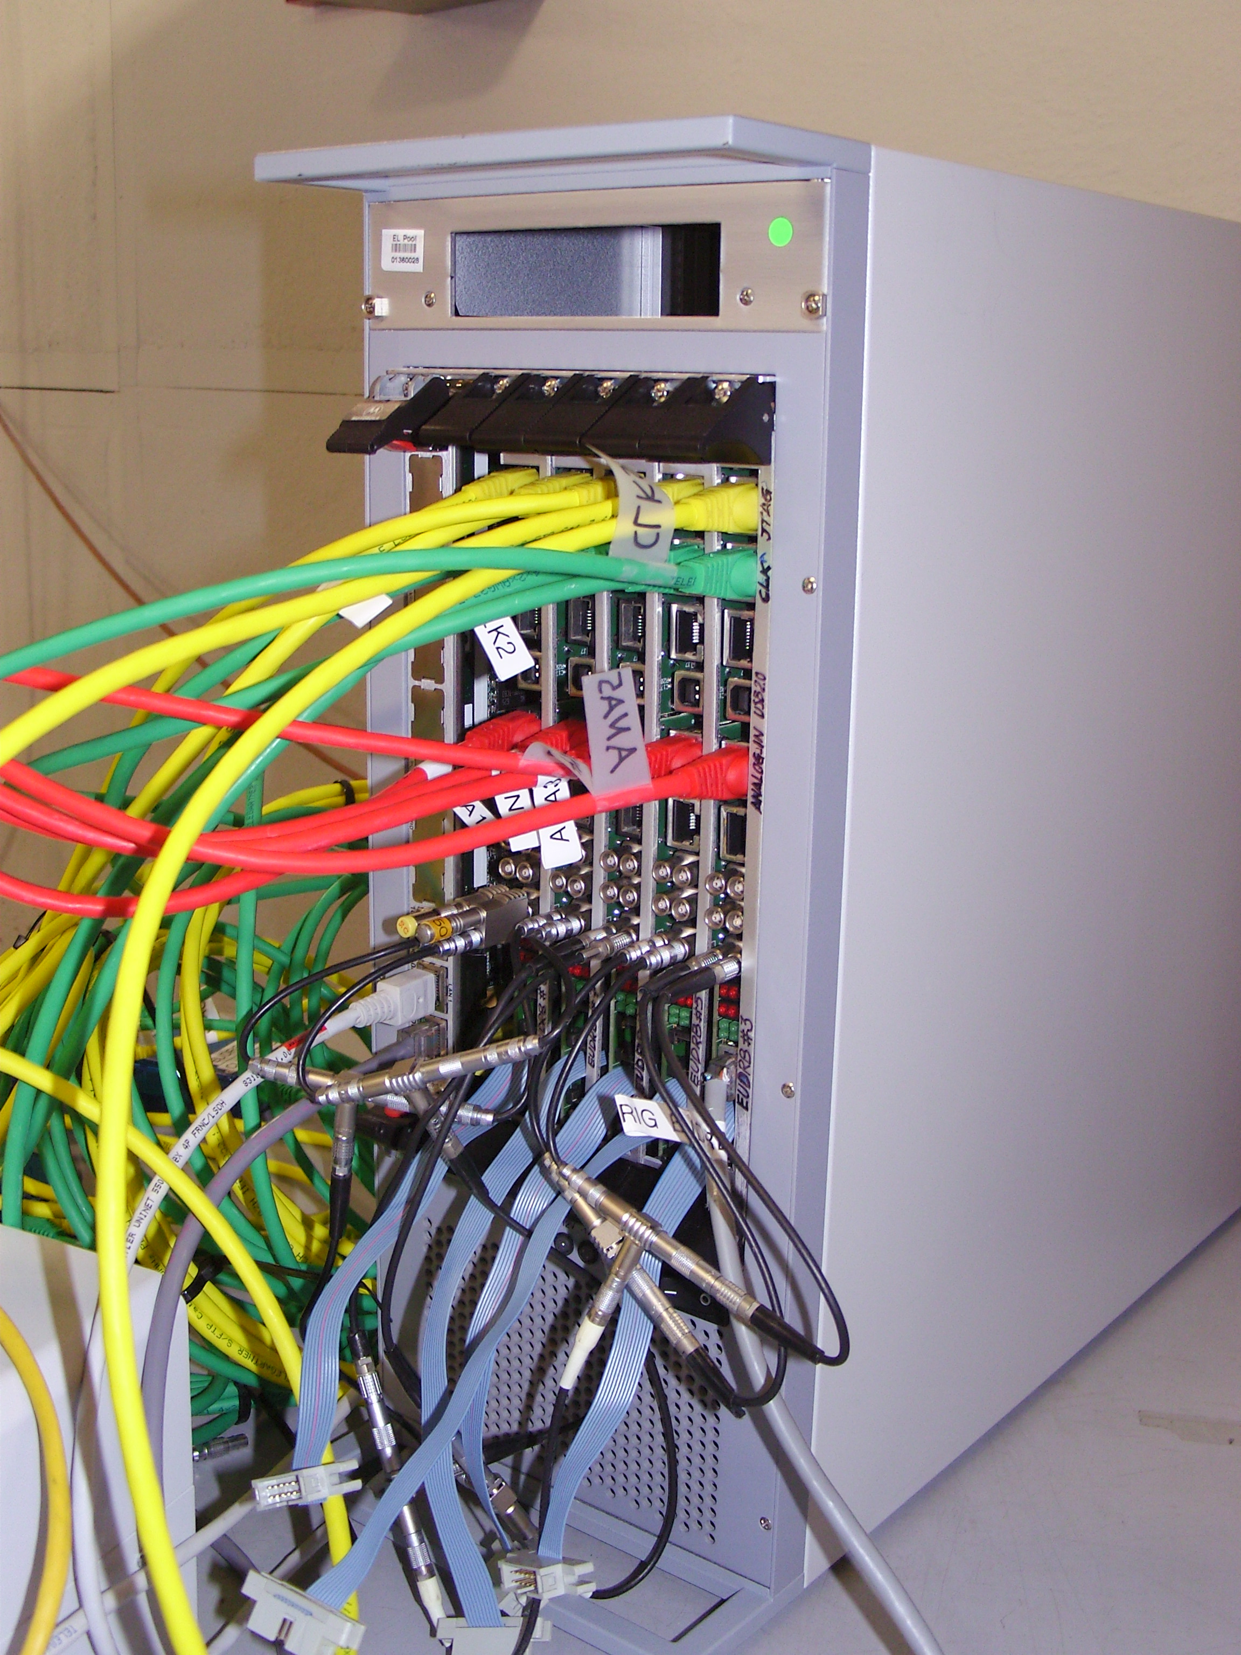
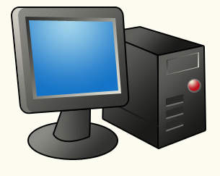
The Real Thing in the Past
AUX
board
Sensors
e⁻
ReadOut
DUT
GBIT ETH
LVDS
Mechanics to position
the sensors precisely
Sensors
Readout Boards
EUDAQ
Trigger Logic Unit
Mechanics
USB
EUDAQ
Trigger Logic Unit

Slide 14
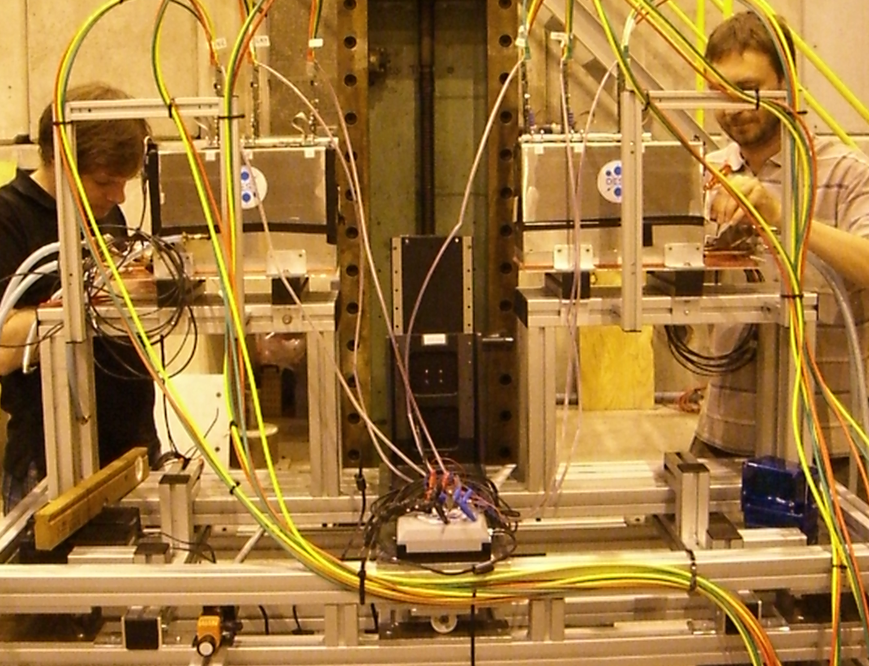
The Real Thing in the Past
DESY XY table
Box1
Box2
DUT
Rotation

Slide 15
The Real Thing in the Present
Upgrade of pixel sensor lead to:
  Major upgrade of EUDRBs
  (also needed additional hardware)
  Upgrade of DAQ Software and Analysis chain
TLU got firmware upgrades etc.

Slide 16
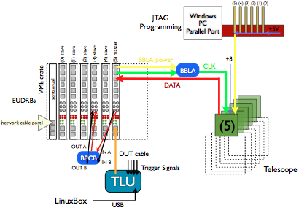
The Real Thing in the Present

Slide 17
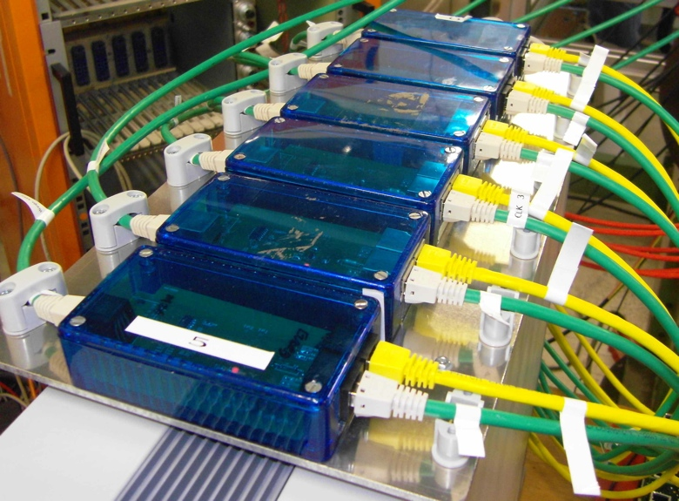
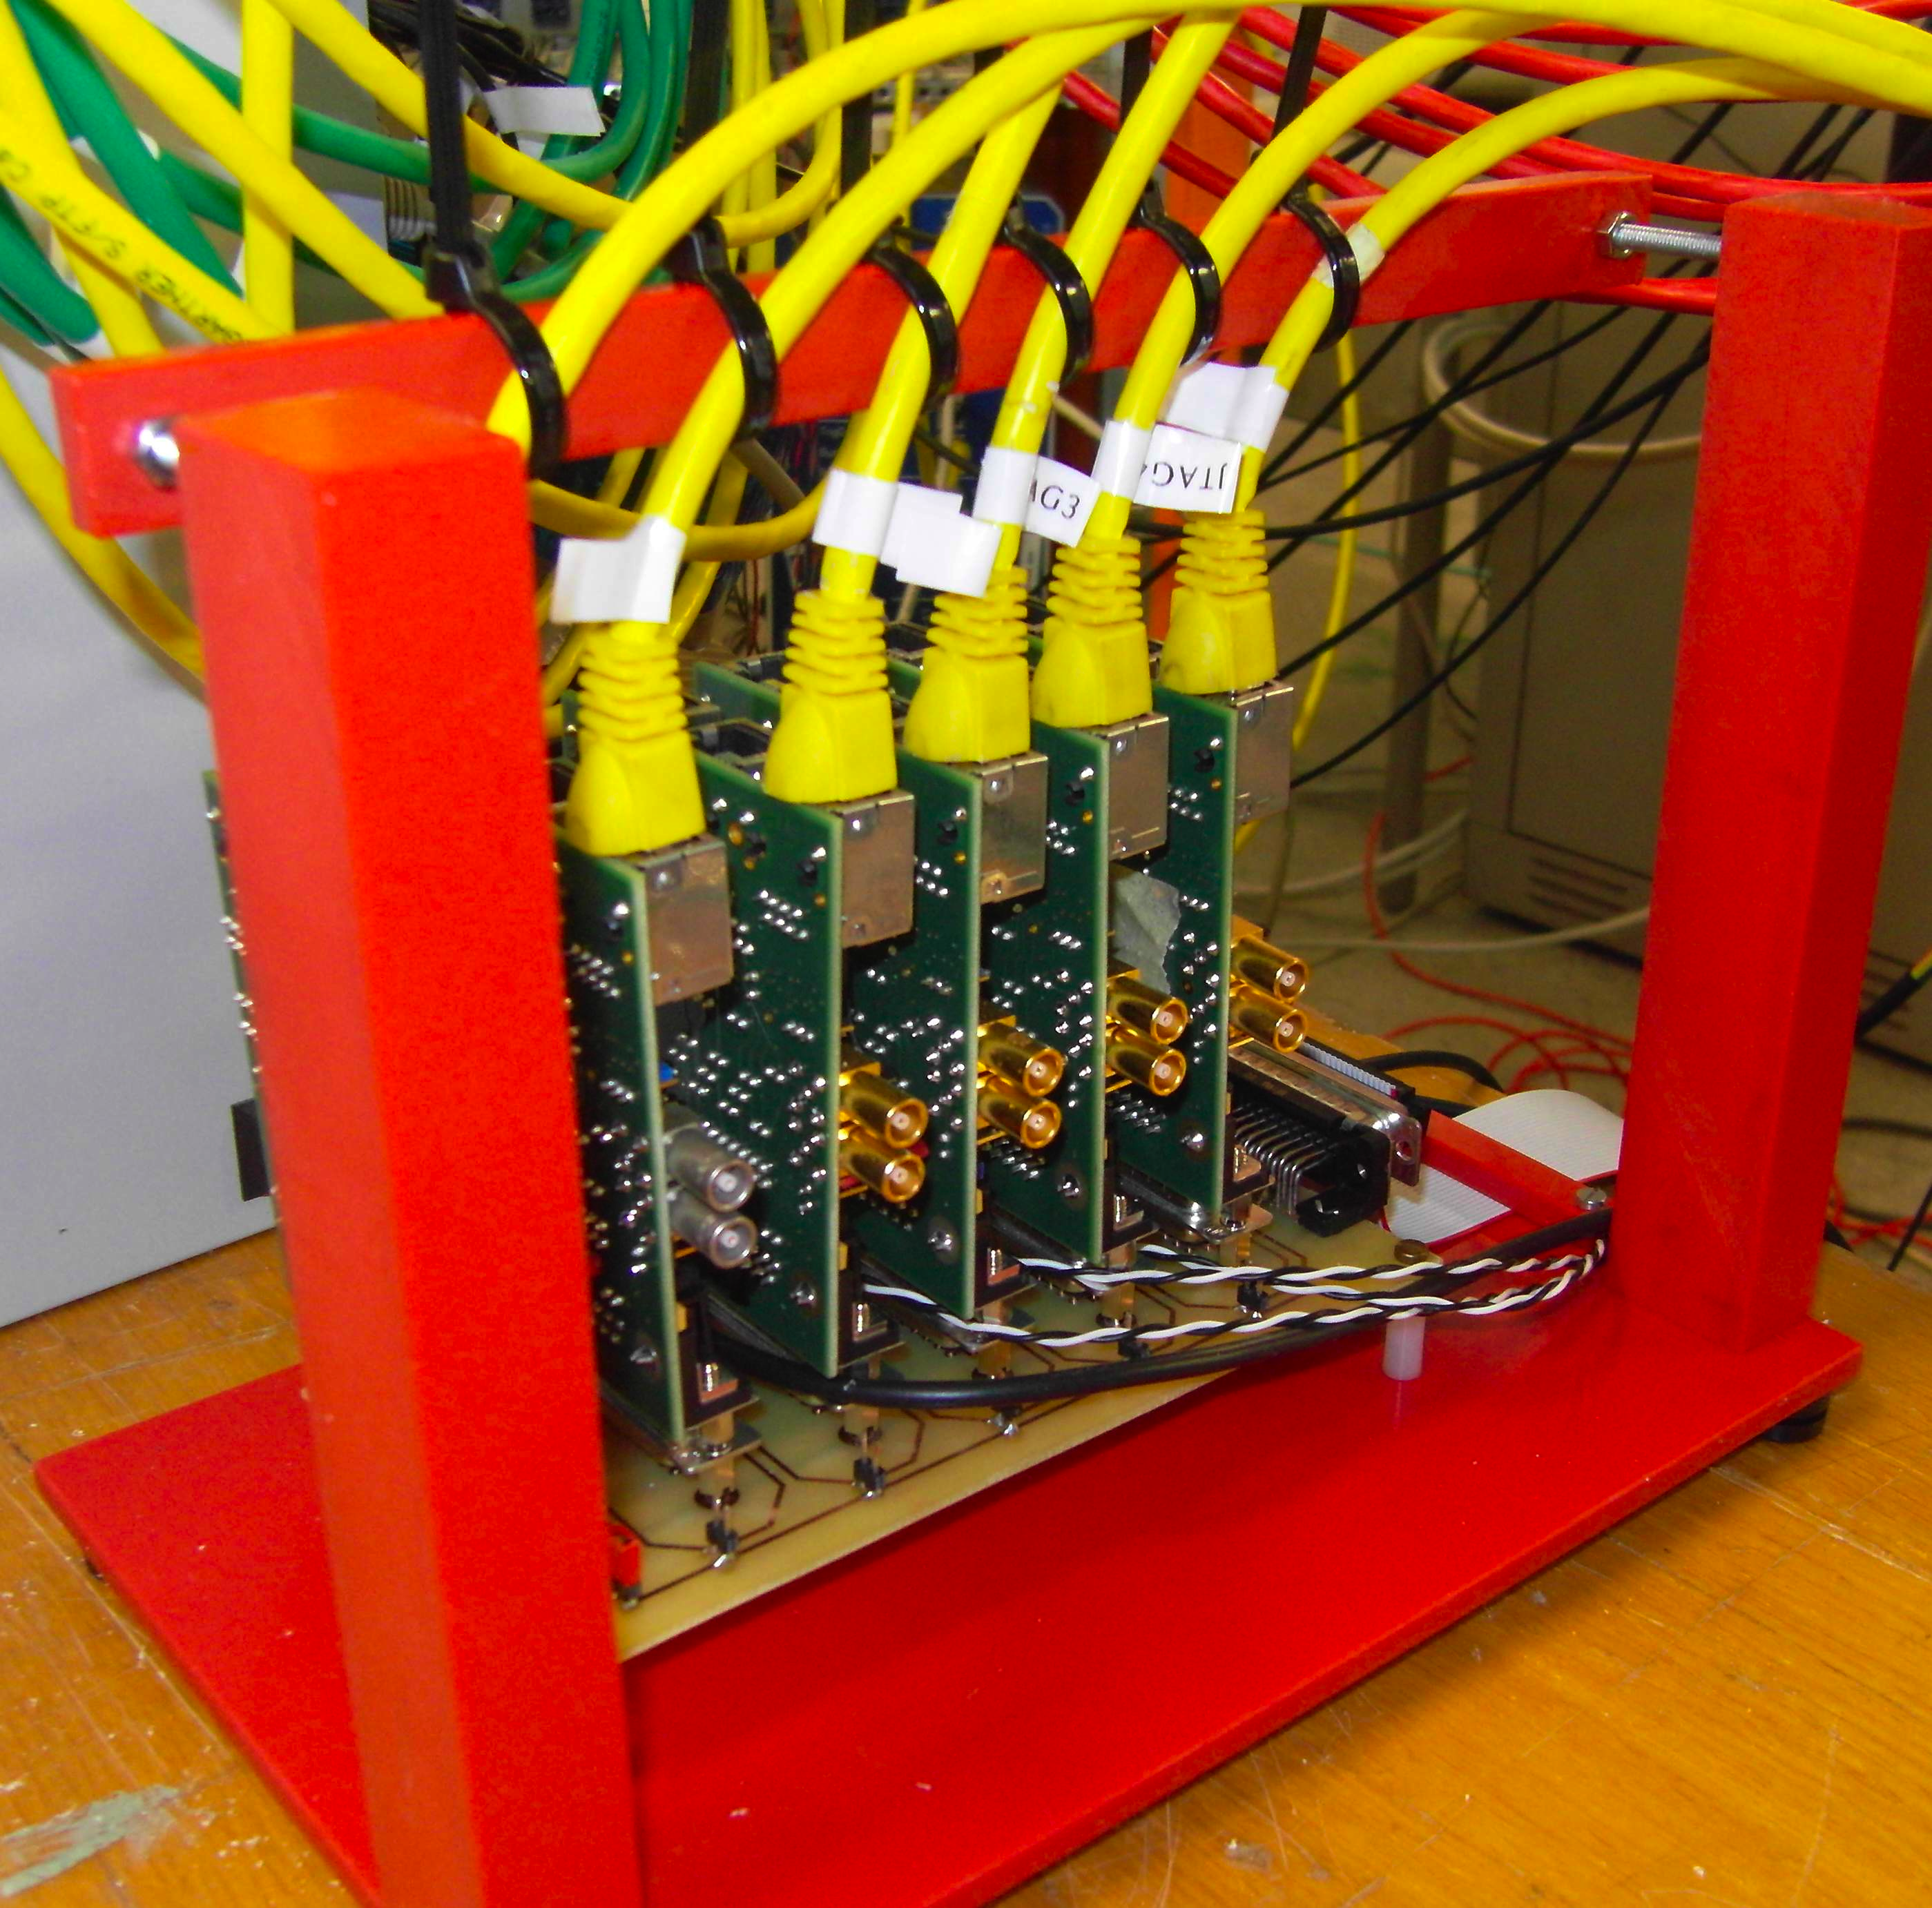
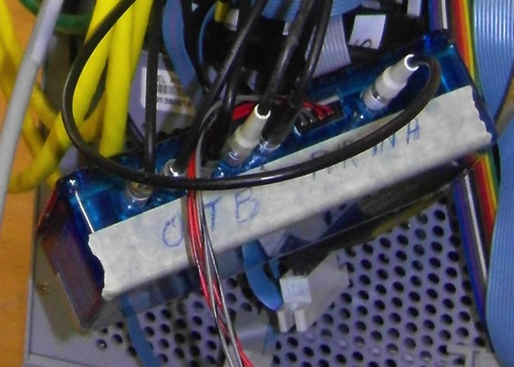
The Real Thing in the Present

Slide 18
Some numbers
Code Statistics:
First checked in to subversion repository
in Feb 2007 (~30 source files)
Now more than 350 source files in trunk
(containing > 30 kloc)
More than 1000 revisions
6 Developers registered
(+ more changes by email)
Author Commits LOC
corrin 775 45263
killenb 82 3933
phdgc 50 1448
renz 43 2132
dhaas 39 449
rubinsky 12 119

Slide 19
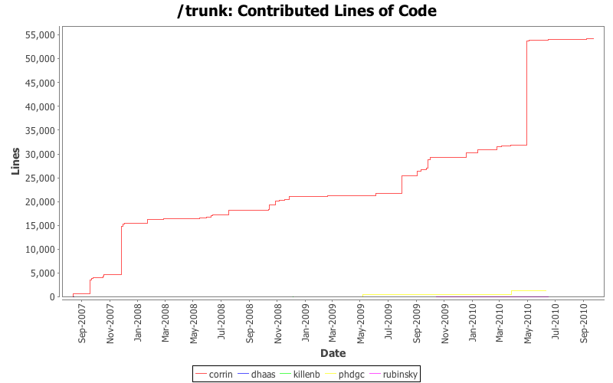
Some numbers
Mimosa26
Integrated
Towards
Final
System
TLU
v0.2
User
Manual?
Plug-in
Mechanism
Real
Development
Starts

Slide 20
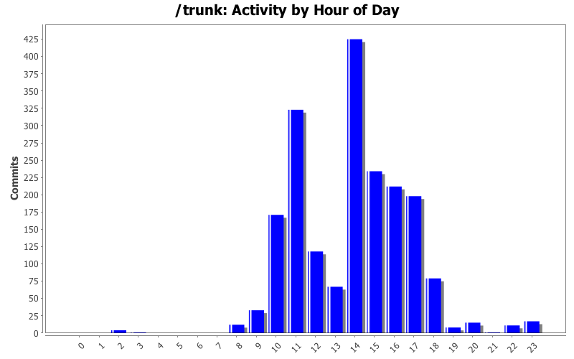
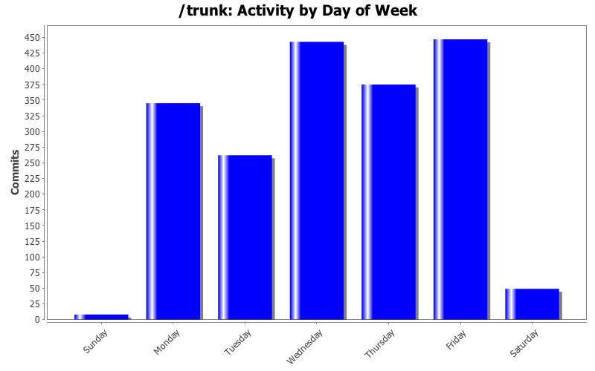
Some numbers

Slide 21
Outlook to AIDA
One order of magnitude bigger!
Implications on HW and SW:
  EUDRBs cannot scale to that level, will use ‘commercial’ readout based on NI boards (already under development)
  EUDAQ can still scale, but is now in competition with the ‘big beasts’ like XDAQ
  Common effort to streamline things should be done now!

Slide 22
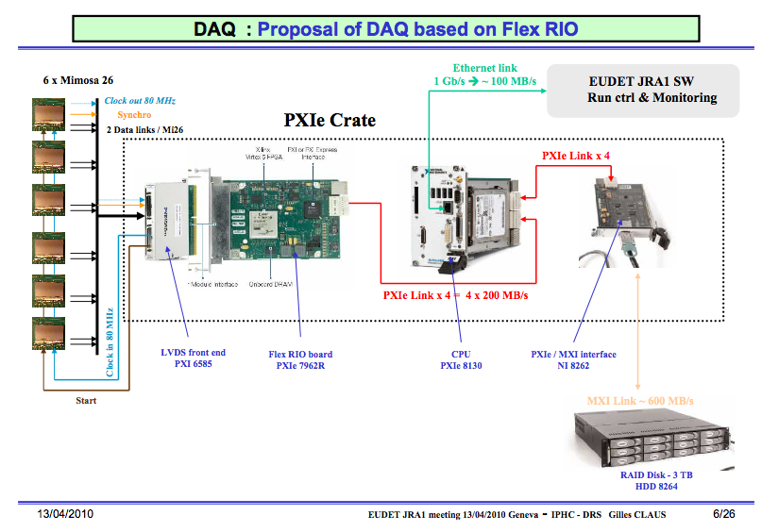
Outlook to AIDA

Slide 23
Conclusions
FAQ (2005-2010): Why do you want to build a beam telescope, everybody can do this/has done this!
Answer (2010): Yes, true, but ours has been integrated and used 84 weeks by ~30 different users in 3.5 years (>300 MEvents in 2010 alone) and basically running non-stop at CERN and DESY in the last 3-4 testbeam seasons

Slide 24
Conclusions
TLU is a real ‘seller’: Common starting point of integration
EUDAQ was extremely successful: Up to 8 DUTs, sometimes 2 different DUTs from different communities – Integration to the DAQ framework was standard in the last 2-3 years
Copies of the telescope will be prepared, ‘old’ MVD-telescope runs with EUDAQ

Slide 25
Conclusions
Activities in JRA1 have been a lot of fun and (even) a lot (more) of work
Community building/transnational access has been eyed suspiciously in the beginning, but proven very productive for JRA1
AIDA will continue the efforts of EUDET and can hopefully profit from the achieved results

