Slide 1
EUDAQ Status Report
Emlyn Corrin, 29 September 2010
Recent Improvements
Future of EUDAQ
Summary
Some Statistics

Slide 2
Recent Improvements
  Log Message Sorting
  Run Control Status Display
  Stability
  TLU Synchronization
  User Manual
Future of EUDAQ
Summary
Code Statistics

Slide 3
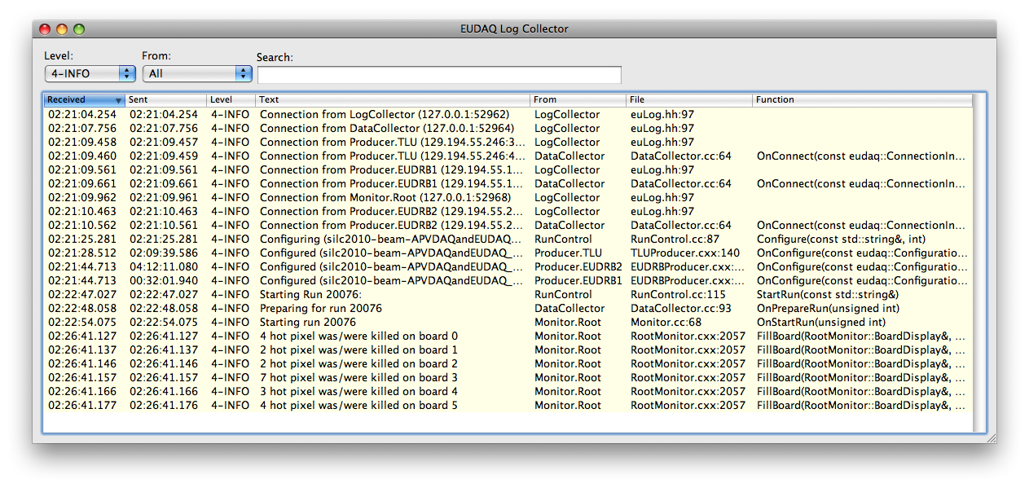
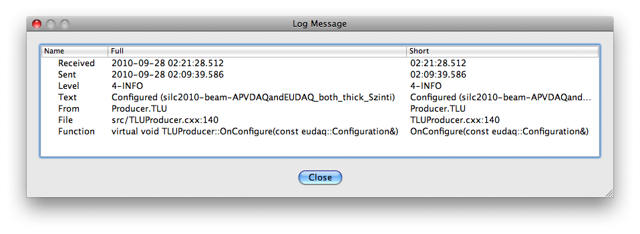
Log Message Sorting
Log message sorting was by time sent, needing all clocks to be well synchronised
Now sort by arrival time, not send time
Also take date into account, so running over midnight does not loop around
Double-click a message to show more info

Slide 4
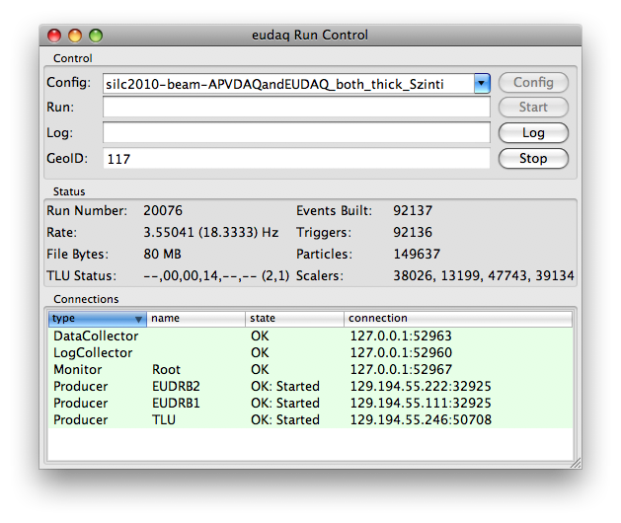
Run Control Status Display
Run Control shows state of all Producers
If re-configuring, there was no feedback
(state did not change)
Added new state (Wait) while configuring
Also display state of all DUT connectors in TLU, helps debug when run hangs

Slide 5
Stability
Early this season DAQ would crash at start of new run with ~50% probability
Caused by resetting TLU timestamp counter at beginning of run
Now back to state where it can be left to run unattended overnight (and have a reasonable expectation of some data in the morning)
Still a few crashes, but seem to be due to hardware (fixed by reprogramming sensors)

Slide 6
TLU Synchronization
TLU Handshake should protect against a DUT missing a trigger
But it can happen that a DUT sees a spurious trigger (e.g. due to noise)
Data files then get out of sync
Tool written to correct this offline
  Either as a separate step
  Or during the conversion to LCIO

Slide 7
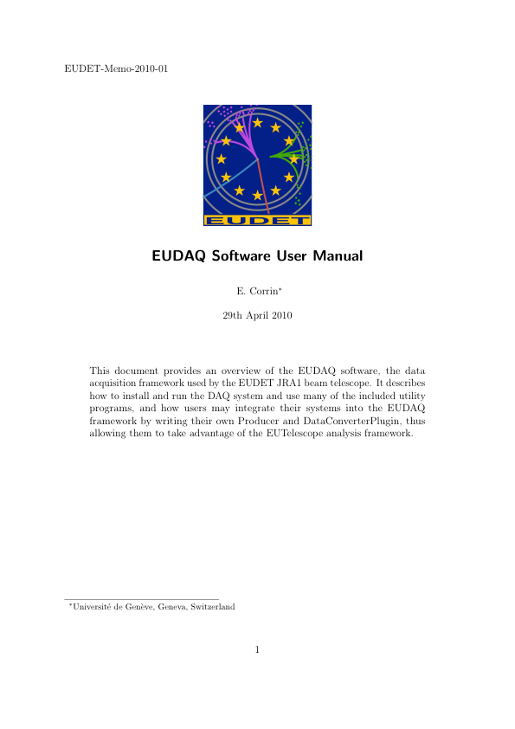
User Manual
Finished (at last)
early this year
Recommended reading
for anyone interested
in EUDAQ
EUDET Memo 2010-01
http://www.eudet.org/e26
/e28/e86887/e86890/
EUDET-Memo-2010-01.pdf

Slide 8
Recent Improvements
Future of EUDAQ
  Monitoring
  JTAG Programming Sensors
  Data Collector
  Others
Summary
Code Statistics

Slide 9
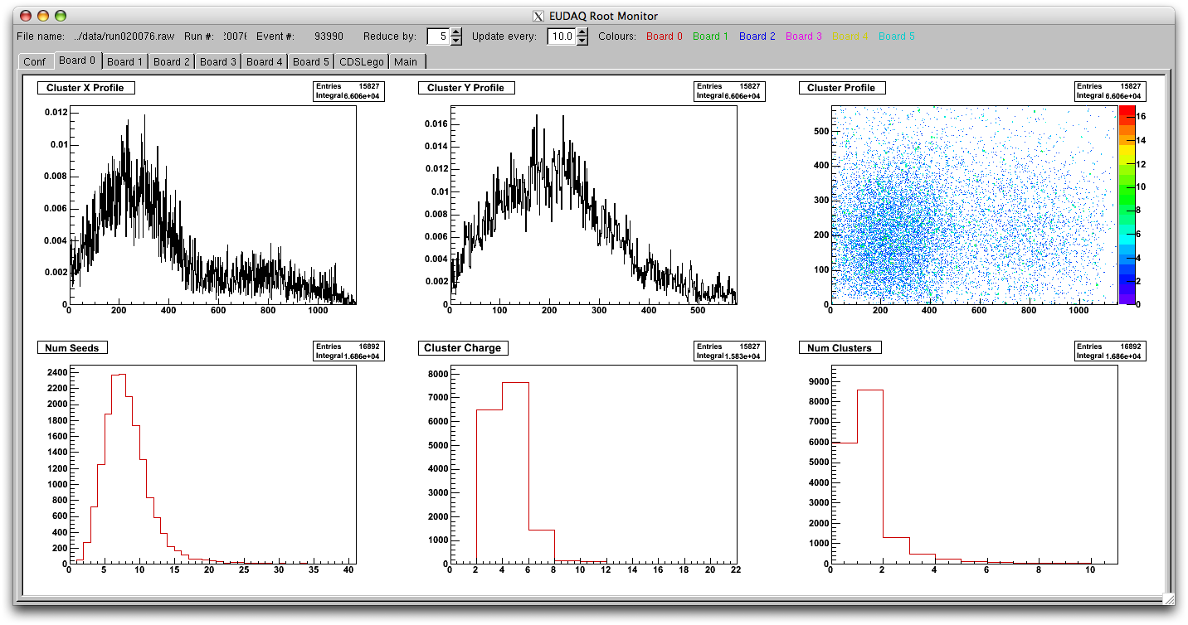
Monitoring
Separate histogramming from UI
One process receives a subset of data from Data Collector and generates histos
Separate process(es) can connect and display the histograms
Plugin-like mechanism for adding new plots

Slide 10
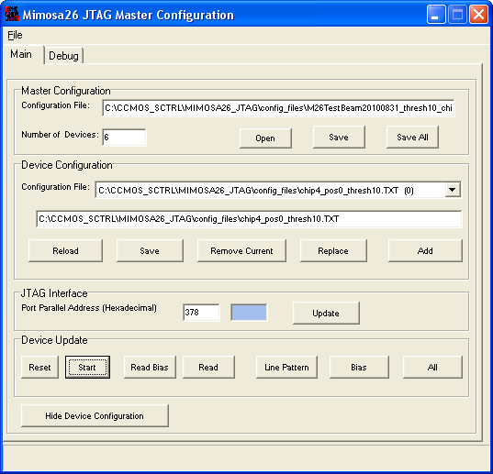
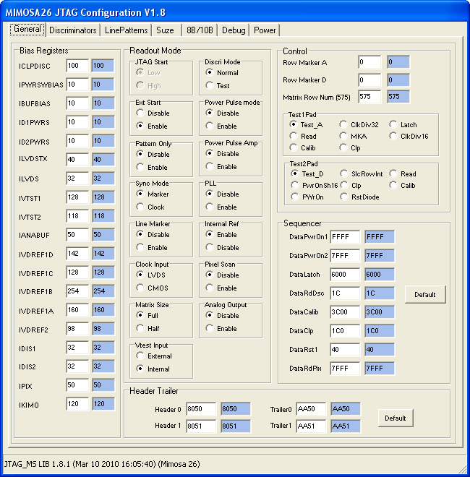
JTAG Programming
Currently in a completely separate GUI
JTAG settings are not stored in the run
Should implement a process that listens to Run Control for the config command
Wouldn’t need separate VNC window for configuring sensors
JTAG configuration would then be stored in each run

Slide 11
Data Collector
Currently just blindly takes all events in the order they arrive without looking at them
  Can get desynchronised
  At end of run some producers can have extra events remaining in the buffer
Should at least check for errors
Could also fix the most obvious problems
  At least combine the EOREs properly

Slide 12
Others
Configure script
  Installation currently requires some manual editing of Makefiles
Testing framework
  Allow automated checking of the code
  Prevent regressions of bugs once fixed
Distributed version control (git/mercurial?)
Explicit license terms (GPL?)

Slide 13
Recent Improvements
Future of EUDAQ
Summary
Code Statistics

Slide 14
Summary
Limited new functionality
  Concentrated on Usability/Stability
  User Manual at last!
Some improvements still needed
  Monitoring needs rewriting
  JTAG should be integrated into DAQ
  Data Collector could be more intelligent
  Configure script
  Automated testing framework?

Slide 15
Recent Improvements
Future of EUDAQ
Summary
Code Statistics

Slide 16
Code Statistics
First checked in to subversion repository
in Feb 2007 (~30 source files)
Now more than 350 source files in trunk
(containing > 30 kloc)
More than 1000 revisions
6 Developers registered
(+ more changes by email)
Author Commits LOC
corrin 775 45263
killenb 82 3933
phdgc 50 1448
renz 43 2132
dhaas 39 449
rubinsky 12 119
Notes:
svn log https://svn.hepforge.org/eudaq --quiet | awk '/^r/ {print $3}' | sort | uniq -c | sort –r
svn ls -R | grep -i -e "\.[ch][a-z]*$” | wc -l
svn ls -R | grep -i -e "\.[ch][a-z]*$” | xargs svn blame | awk '{print $2}' | sort | uniq -c | sort –r

Slide 17
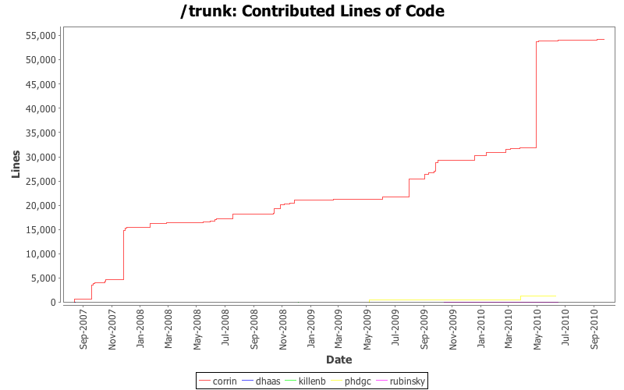
Mimosa26
Integrated
Towards
Final
System
TLU
v0.2
User
Manual?
Plug-in
Mechanism
Real
Development
Starts

Slide 18
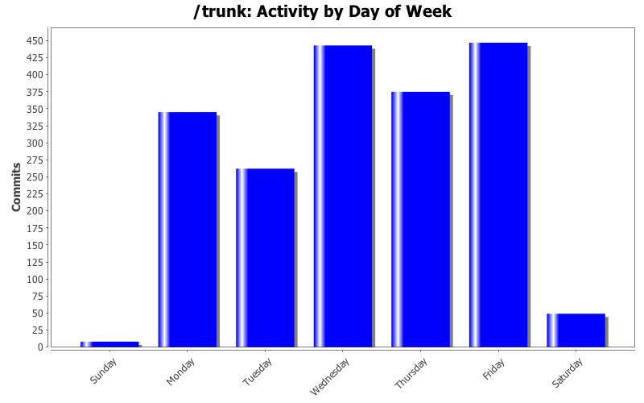

Slide 19
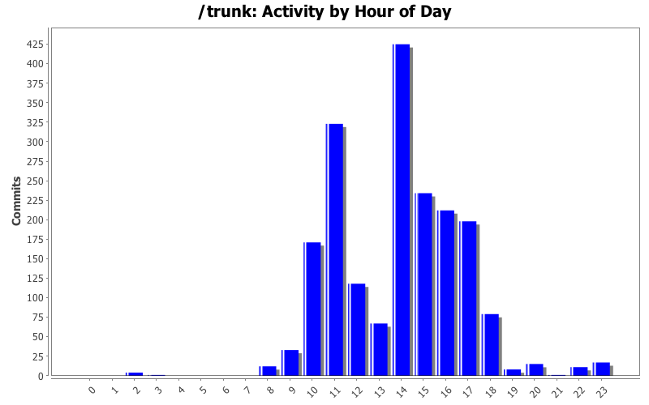

Slide 20
