Slide 1
1.3-GHz Cavity Vacuum Furnace at IB4
Designed to hold a 1.3-GHz nine-cell cavity
Bake at 600° - 800°C at 1x10⁻⁷ torr
  Max working temperature 1000°C
Dimensions:
  Hot zone 12” x 12” x 72”
  SS vacuum chamber 30”ID x 100” L
Temperature uniformity within hot zone within ±3°C
SRS RGA
From drawing 481188

Slide 2
Located at IB4
From drawing 481301
Use existing utilities (chiller, electrical, purge gas piping)
Extend existing clean room (Class 1000)
16’ clearance between IVI and new furnace to access cavity clean room

Slide 3
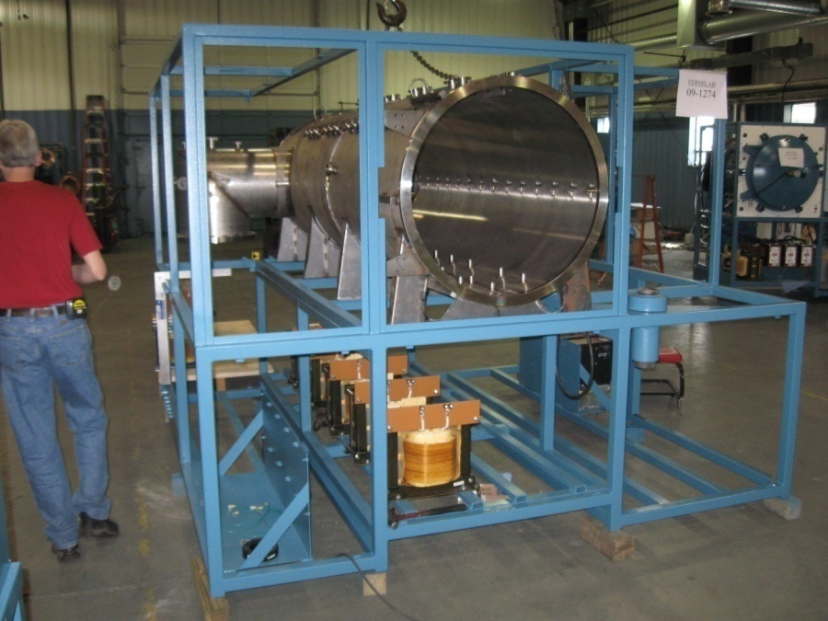
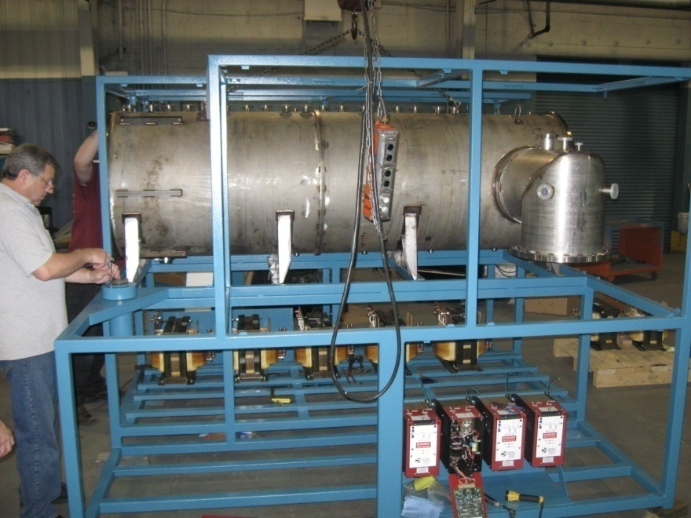
Current Status of Furnace
Transformers, SCR, Control and power boxes are complete
Vacuum chamber electropolished
Next steps
  Install power feedthroughs, thermocouples
  Install valves, instrumentation
Awaiting moly shields, rough and cryopumps
Acceptance testing tentatively scheduled week of July 12

Slide 4
Installation at IB4 – Before delivery
Floor repairs complete this week
Upgrade utility lines
  Water lines (extend along wall)
  Air lines (extend along wall)
  Inert gas lines (modify to supply chamber purge, partial pressure gas supply, cryopump purge)
Scheduling, purchase parts for utility hook-ups
  Support Dept / Facility (Gary L, Miguel, T&M)
  Tooling Group (Rick)

Slide 5
Acceptance Test Plan
A leak check based on the mass spectrometry (Helium leak detector), the acceptance criteria will be 1x10⁻⁹ TORR x liter per second Helium leak
A control of the ultimate vacuum pressure 1x10⁻⁸ torr-L/sec (empty, clean, cold furnace)
A leak check based on the static pressure increase method (rate of rise measurement)
A hot test with the temperature at 600° and 1000°C with measurement of the working vacuum pressure.
  At 600°C: Oxygen partial pressure: less than 1 x 10⁻⁸ TORR; Hydrocarbon amount: less than 1 x 10⁻¹³ mol; Hydrogen pumping speed: 500 liter / second
  RGA measurements at room temperature, 600° and 1000°C
A mechanical and electrical function test
A test of the pumping sequence in automatic and manual mode
The temperature uniformity shall also be evaluated at the process temperatures according to a procedure that will be defined by FNAL and agreed by the vendor.
  No hot spots shall occur on the vessel or on the piping leading towards the vacuum pumps.
  Temperature uniformity within hot zone measured with test piece (Procedure not yet defined, but will use a test piece made of 304SS pipe, electropolished and cleaned)
After cool-down, open chamber and inspect hot zone for thermal shorts, warped heat shields or other signs of heat related failure.
Acceptance test at T-M Vacuum and repeated at Fermilab

Slide 6
Training
Training will take place at vendor site during week of acceptance testing
Who will be trained?
  M. Wong
  CAF (B. Smith)
  Cavity Processing Group
Training procedure at Fermilab based on vendor training procedure

Slide 7
Installation at IB4 – After delivery
Furnace Delivery – July 23 (tentative date)
Installation (Support Dept/Facility, T&M, Tooling Group, CIS)
  Utility hook-up (chilled water, electrical, air, inert gas)
  Computer LAN connection
  Connect rough pump and compressors to furnace system
  Extend fire protection system
  Install/extend softwall cleanroom
  Install bollards
Final acceptance test with vendor representative
ORC Review
End of August: Ready for cavity commissioning – Cavity Processing Group

Slide 8
Back-up Power
Short power outage (<15 minutes): Computer and controls on UPS power
Long power outage
  Chiller and water pump on back-up generator
  After 1 hour, estimate that hot zone at 1.3x10⁻³ to 4x10⁻³ mbar, 300°C
  Confirm rate of pressure rise, temperature drop when system arrives
Generator installation is decoupled from commissioning of furnace

Slide 9
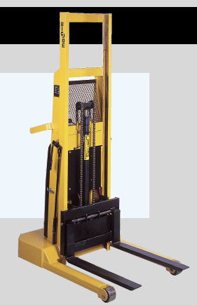
Loading cavity into furnace
Hot zone boundary
12” x 12”
Place cavity onto moly hearth with brackets
Use lift truck to guide cavity/hearth into vacuum chamber
Moly hearth rests on rails within chamber
Moly hearth with brackets
Moly rails at
Bottom of
chamber
Forks of lift truck
Lift truck is guided by rails
at the bottom of the furnace frame

