Slide 1
TE1AES004 JLAB T-map test
G. Ciovati, M. Morrone, G. Wu

Slide 2
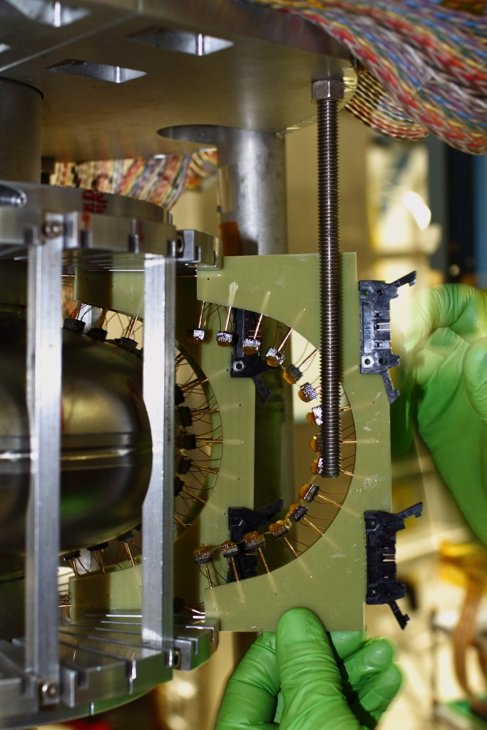
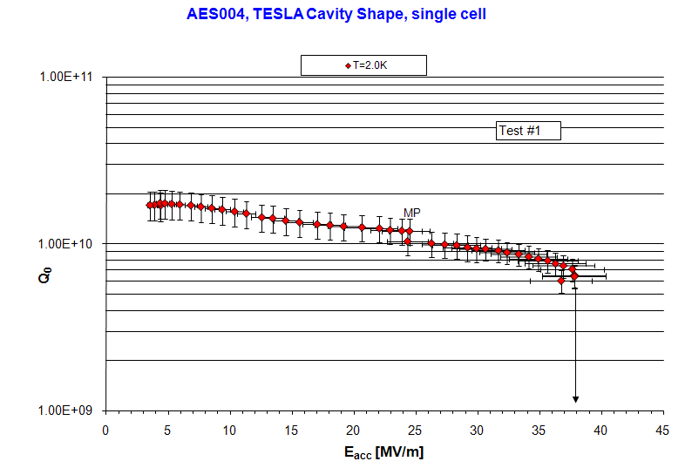
Cavity see no chemical etching since 2008,
Only see HPR and molding.
Cavity last tested at A0 (40 MV/m)
No active pumping since A0 RF test.
No x-ray was detected at JLAB (38 MV/m)
Three hot spots and one quench site located
Geometric defect showed no heating at all
Previous quench site (A0) was a hot spot
Quench had pre-heating
Cavity sealed on 6/7,
T-map installed on 6/8,
RF tested on 6/9,
Disassembled on 6/10,
Shipped back on 6/11.

Slide 3
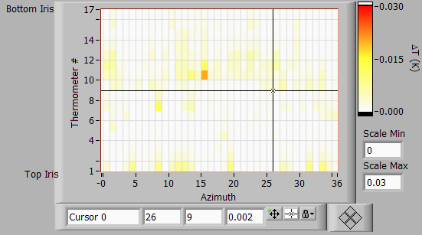
Defect
Previous quench site

Slide 4
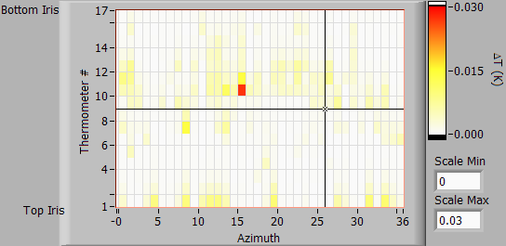
Defect
Previous quench site

Slide 5
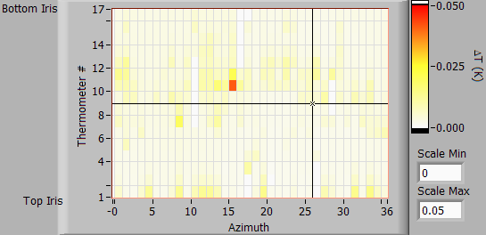
Defect
Previous quench site
Right before MP

Slide 6
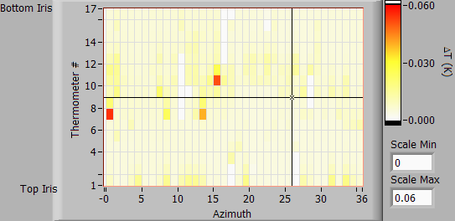
Defect
Previous quench site
Right after MP

Slide 7
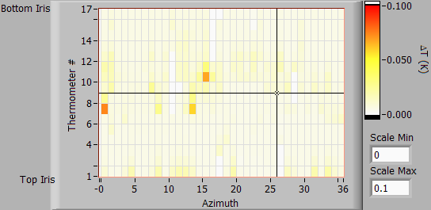
Defect
Previous quench site

Slide 8
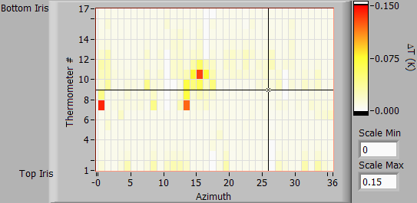
Defect
Previous quench site
31.63 MV/m

Slide 9
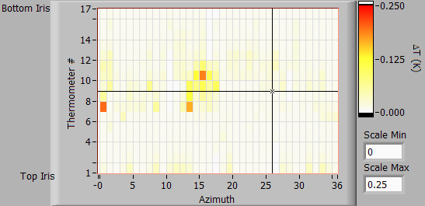
Defect
Previous quench site
34.86 MV/m

Slide 10
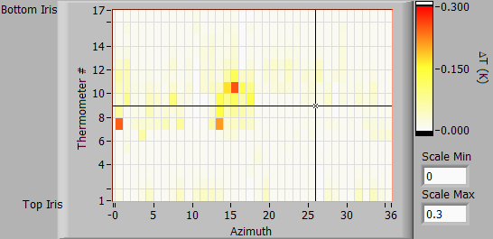
Defect
Previous quench site
36.83 MV/m

Slide 11

Defect
Previous quench site
37.56 MV/m

Slide 12
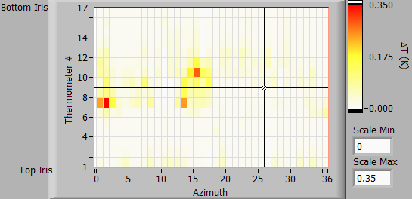
Defect
Previous quench site
37.72 MV/m

Slide 13
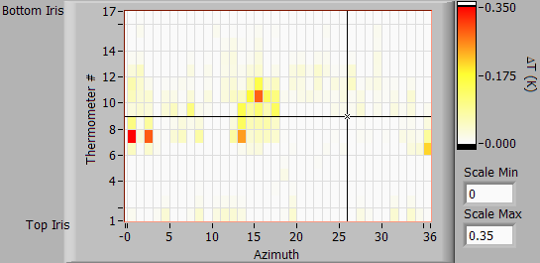
Defect
Previous quench site
37.85 MV/m

Slide 14
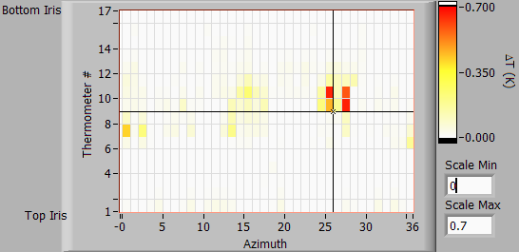
Defect
Previous quench site
36.75 MV/m

Slide 15
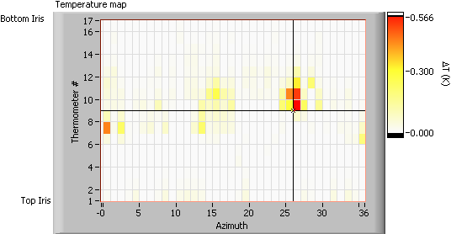
Defect
Previous quench site
36.75 MV/m

Slide 16
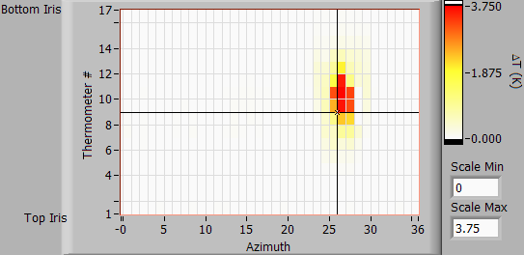
Defect
Quench at new location
Previous quench site
Right after quench

Slide 17
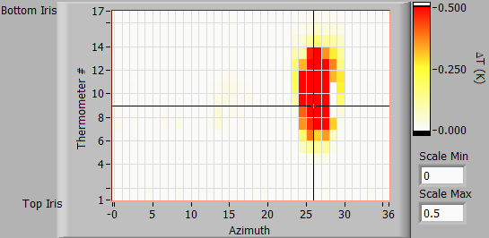
Right after quench

Slide 18
Summary
No x-ray was detected at JLAB (38 MV/m)
Three hot spots and one quench site located
Geometric defect showed no heating at all
Previous quench site (A0) was a hot spot
Quench had pre-heating
Why is the quench site changed test after test?
- Cut out may tell us why.

