Slide 1
PAVAC cavity 001, 002, 003 optical inspection report
Mingqi Ge and Genfa Wu

Slide 2
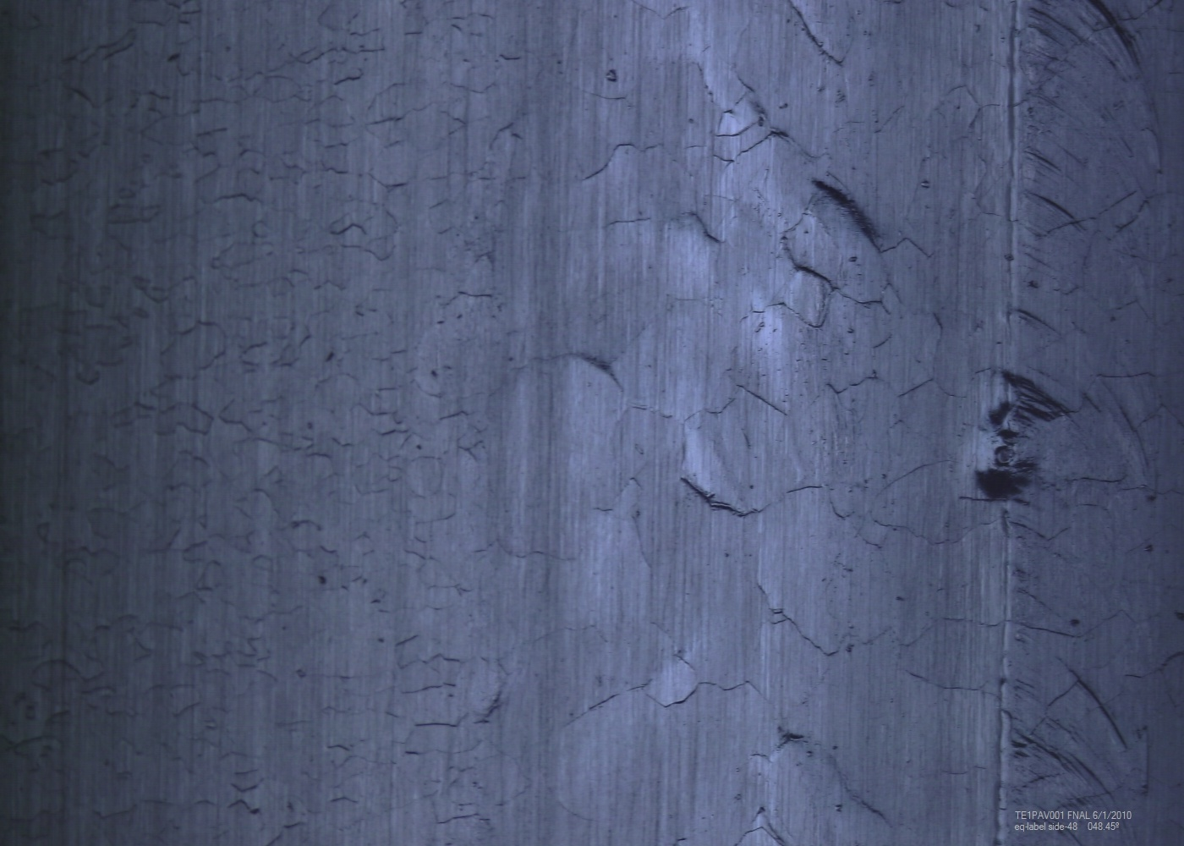
TE1PAV001 – area 1

Slide 3
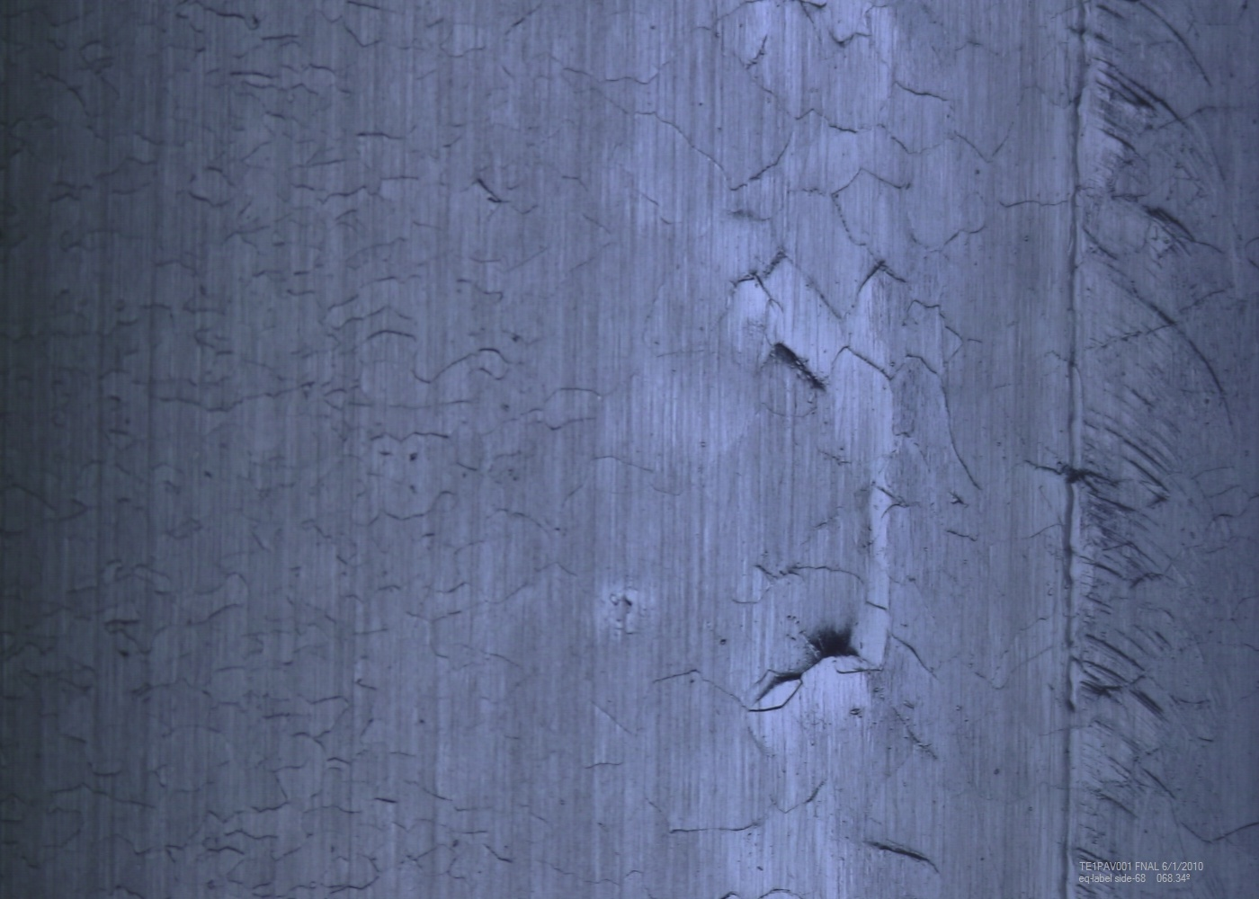
TE1PAV001 – area 2

Slide 4
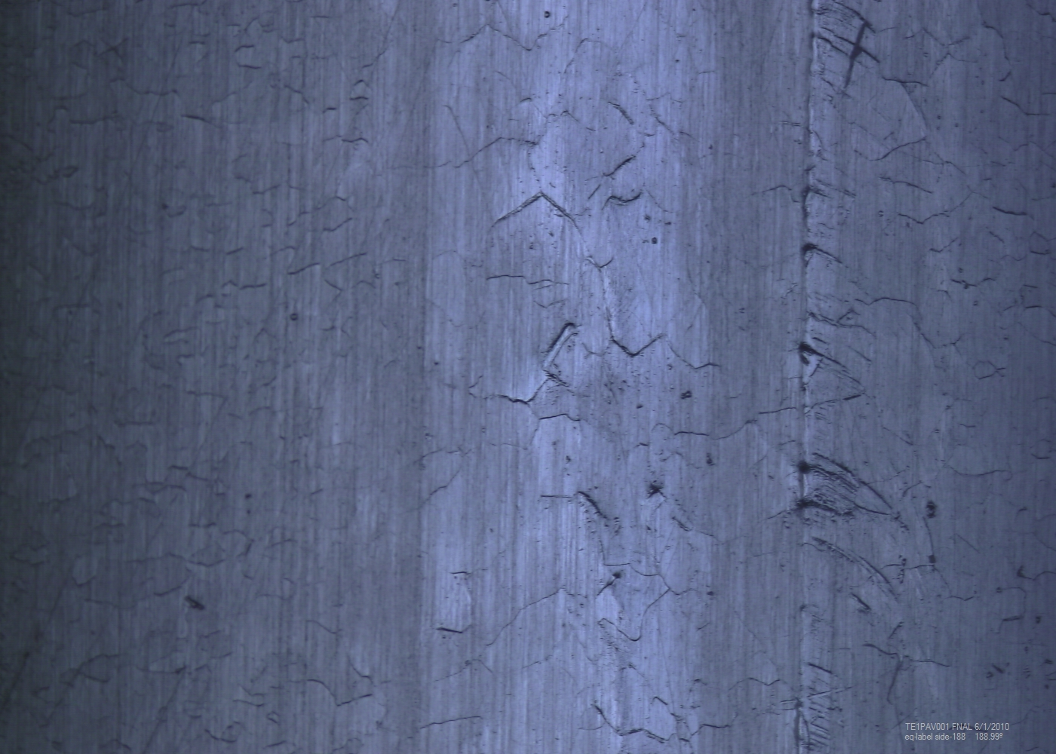
TE1PAV001 – area 3

Slide 5
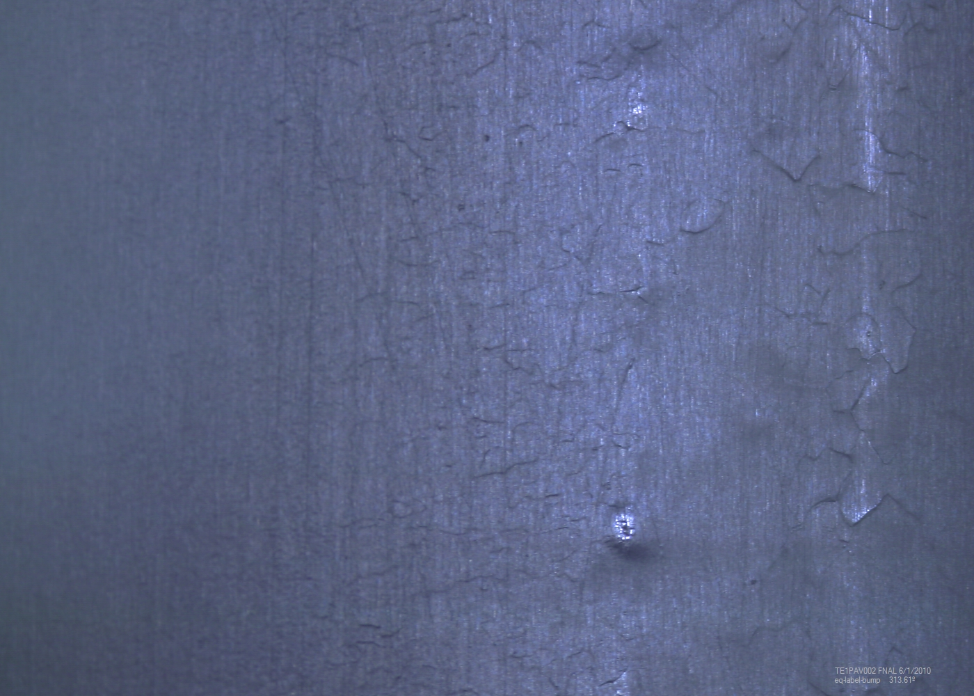
TE1PAC002 area 1

Slide 6
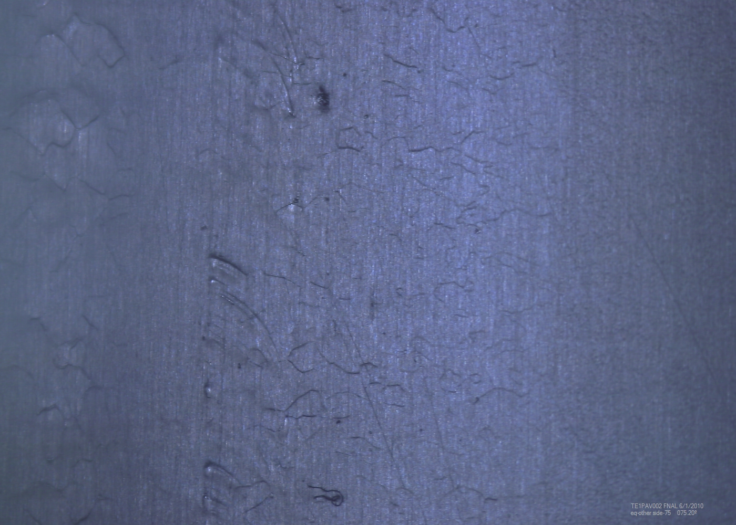
TE1PAC002 area 2

Slide 7
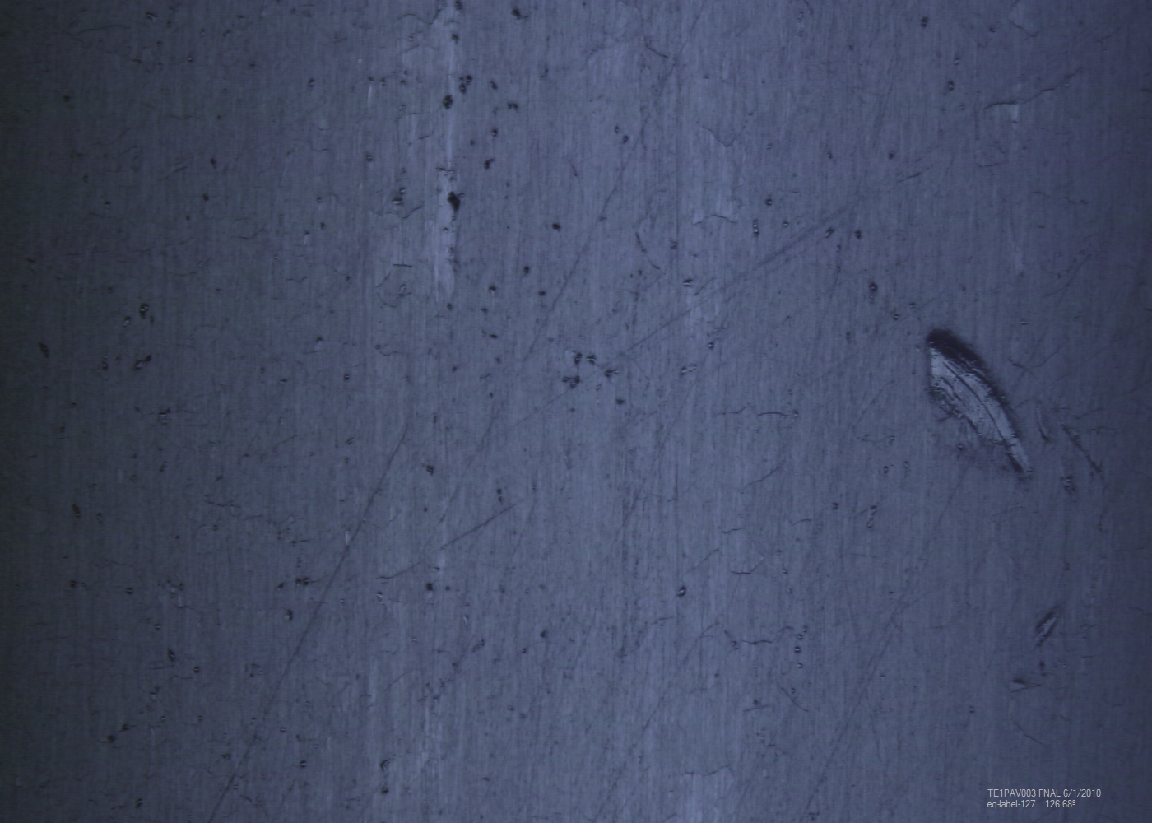
TE1PAV003 area 1

Slide 8
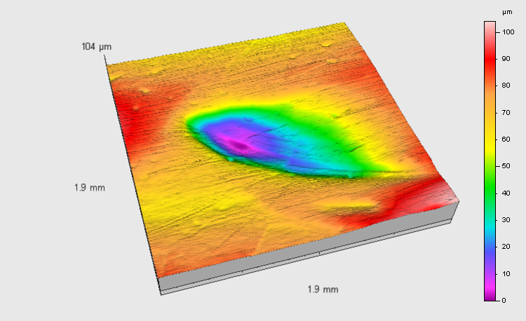
TE1PAV003 area 1 replica result
60 µm deep, sharp edged tool mark

Slide 9
Summary
Cavity equator welds were inside weld
Weld beads appear polished inside at equators and irises
Defect areas are located
No visible geometric defect at Non-RF sides of weld
002 is the best of the three optically
In queue for EP.

