Slide 1

Plans for
AIDA WP9.5
In Bergen
G. Eigen, U. Bergen
Notes:
1

Slide 2
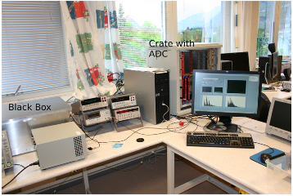
AIDA Plans for WP9 in Bergen
In an HCAL for ILD we have ~10⁶ channels ⎝ corrections due to
temperature changes (ΔT) need to be done automatically online
Collaborate with Prague on development and testing of a controller
that automates corrections due to ΔT by adjusting the overvoltage ΔV
We will hire a postdoc for three years starting May 2011
7 months EU, rest NFR
We try to get master
students in the fall
In Bergen, we have a
well-equipped lab
We have a setup for
testing SiPMs
We have MPPCs, SiPMs
tiles

Slide 3
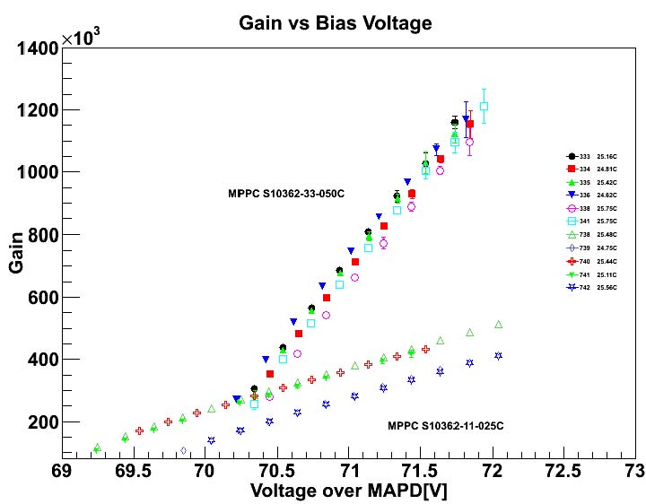
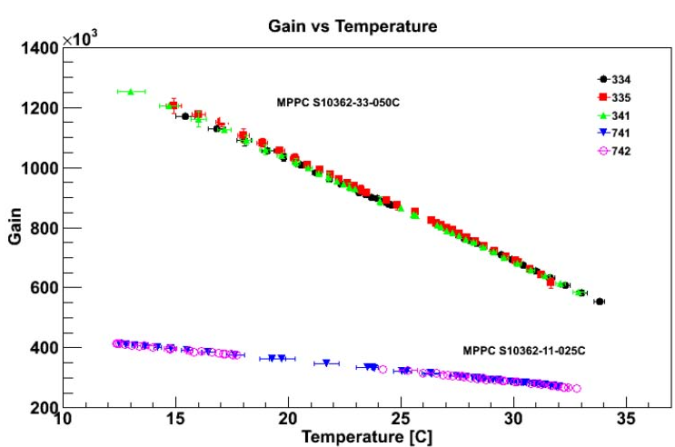
AIDA Plans for WP9 in Bergen
The gain of SiPMs depends on overvoltage ΔV and temperature T
(both dependences are linear over a wide range)
By changing ΔV as a function of T we can keep the gain constant
We have measured V and T dependence of gain in Bergen for MPPCs
3x3mm², 3600 pixels
3x3mm², 3600 pixels
1x1mm², 1600 pixels
1x1mm², 1600 pixels
1/G*dG/dT=-2.2%/1ºC

Slide 4
AIDA Plans for WP9 in Bergen
Perform initial measurements to determine algorithm (Bergen)
  SiPM gain versus overvoltage
  SiPM gain versus temperature
  Parameterize dependences by simple algorithms for ΔV=f_{V}(T)
Build controller (Prague)
➔ buy power supply, temperature sensors
Test controller with various SiPMs (Bergen, Prague)
⎝ need new SiPMs
Issues
  Where do we need to measure the temperature?
  How many sensors?
  How do we handle multiple corrections in one power supply?
  (power supply feeds several SiPMs which may have different
  V_{break} and ΔV dependence)

