Slide 1
SCRF Monthly WebEx Meeting
June 30, 2010
Agenda
Report from PMs (5 min.)
General Report from Group Leaders (15 min.)
Special Discussions
  TDP R&D Plan (Rel. 5) Preparation (30 min.)
  BAW-1 Preparation (10 min.)
  Others
    Next meeting, July , 28

Slide 2
Report from PMs
GDE meeting held,
  ADI meeting: June 23
    10 Hz Low-Energy Operation
      10 Hz is for e- linac for producing e+, and
      5 Hz for e+/e- collision,
CFS Integration workshops (planned) in July and August
  Daresbury Laboratory: July 12 – 13,
    E+ source, damping ring, BDS, and Detectors,
  SLAC: Aug. 2-3,
    E- source, RTML, ML, and Detectors,
      ML utility (water, and electricity) to be discussed,
ICHEP High Energy Conference, >> Transition from TDP-1 to TDP-2
  Held at Paris, July 22 -
Baseline Assessment Workshop (BAW) – 1, planned
  Held at KEK on Sept. 7 – 10,
    Single tunnel HLRF (Sept. 7 – 8)
    Accelerating Cavity Gradient (Sept. 9- 10)
FLASH workshop
  Held at DESY on Oct. 4 – 7,
ILC-CLIC collaboration meeting
  Held at CERN on Oct. 18 – 22

Slide 3
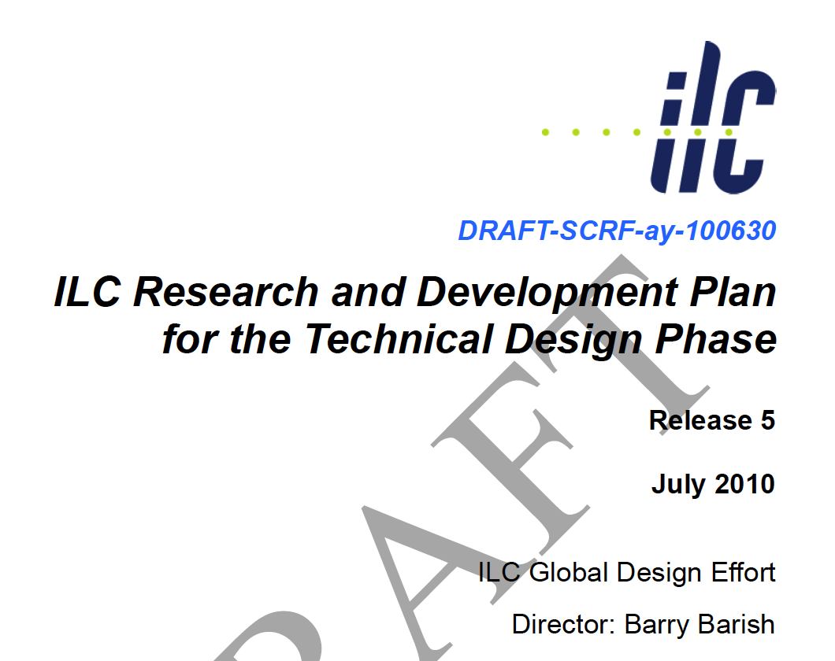
TDP R&D Plan Rel-5: Draft
Discuss it, today
Notes:
Leaving PIP aside for the moment – however this is an important TDR deliverable. How does it integrate with the above?
R&D should feature more prevalently: TDR will contain quite some detail on the results and achievements of the R&D programme
Need better word than ‘Remaining’ – motivation for further work, not a sense of ‘OK we are done’.

Slide 4
SCRF Main Subjects
1a. Request for Rongli G.:
Proposal for R&D plan and strategy for improving the cavity gradient, Q0, and radiation,
Proposal for the way of evaluation in terms of radiation which also cause the limit of the gradient,
1b. Request for Camille G.:
Proposal for further evaluation of the cavity performance based on the current status of the production yield plot,
  spread of cavity gradient and the quantitative evaluation with a new plot and width (RMS),
  Q0 value evaluation at G = 31.5 MV/m,
1c. Request for Akira in communication with Jim K
Proposal for re-arrangement for the cavity/cryomodule cavity gradient specification for the iLC accelerator components and for the operation

Slide 5
SCRF Major Subjects
2a. Request for Hitoshi H.;
Proposal for R&D plan for the cavity integration including tuners and input couplers, including a systematic test plan for S1-Global, which contain these evaluation,
Proposal for a cavity fabrication (and industrial R&D) facility to be estalished at KEK as an approach,
2b. Request for Jim K. in communication with Bob K. :
Proposal for R&D plan for the cavity mass production in the US,
2c. Request for Akira (myself) in communication with DESY (Nick will help me),
Input and reflection of the progress in XFEL mass production program,

Slide 6
SCRF Major Subjects
3. Request for Norihito and Tom in cooperation with Harry and Hirotaka
Proposal for R&D plan for the cryomodule integration, including the cryomodule assembly and cryogenic test plan for S1 Global and for further (S2 cryomodule),
4. Request for Shigeki F. and Chris N. ;
Proposal for R&D plan for KCS and DRFS in single tunnel - Further proposal for ACD RF such as Marx Generators,
5. Request for Chris A. in communication with Jim K., and Vladimir K.
Proposal for R&D plan for split-quadrupole in cryomodule,
Proposal for R&D plan for cavity alignment and tolerances,
6. Any others, if they should be included.

Slide 7
R&D Plan To be updated
Draft due: June 11 from Group Leaders and Collaborators
SCRF Draft Completion; June 30

Slide 8
1st BAW
Announced, May 3
Date: Sept. 7 – 10, 2010
Place: KEK
Subjects:
  Single tunnel HLRF systems (Sept. 7 – 8)
  Accelerating gradient (Sept. 9-10)
Announcement
  Distributed to GDE mailing list including physics/detector executive members,
URL and Indico Agenda including registration
  Still to be prepared, and ask for Tetsuo’s cooperation

Slide 9
Preparation for the 1st BAW
May 7: SCRF webex meeting and homework assignment
May 26: AD&I meeting
June 2: SCRF webex meeting and progress report from each collaborator,
June 23: AD&I meeting
June 30: SCRF webex meeting and preliminary draft report to be distributed >>> in progress, assuming R&D plan draft can be partly used.
July 21: AD&I meeting
July 28: SCRF meeting and draft report to be distributed,
Aug. 25: SCRF meeting and the final report (prior to the 1st BAW) to be distributed

Slide 10
Discussion Topics: Single-tunnel HLRF system in the 1st BAW, Sept. 7-8, 2010
KCS:
  RF power margin required for cluster operation, including gradient spread, as consistent with cavity production strategy,
  Tuning and control strategy, including impact on high gradient operation and required gradient operational margin
  RF amplitude and phase performance tolerance within a cluster; allowed common-mode and normal-mode fluctuations,
  R&D required, including demonstrations of component performance and demonstrations with small clusters
DRFS:
  Cavity and klystron sorting and resulting required RF power margins
  Installation strategy; needed tunnel infrastructure and access
  RF amplitude and phase performance tolerances, including gradient spread, as consistent with cavity production strategy,
  R&D required in the remaining half of the TDP (and beyond) including radiation shielding, klystron lifetime, redundancy strategies
Backups:
  Original RF system in RDR, in single tunnel, just in case, as a backup,

Slide 11
Discussion Topics: Accelerating Gradiet
1st BAW, KEK, Sept. 9-10, 2010
Gradient Improvement Studies:
  material/fabrication, surface processing, instrumentation and repair
  strategy to overcome 'quench', and 'field emission' and to maintain moderate cryogenic load,
  improvement of gradient and achievement of adequate yield,
Strategy for Average Accelerating Gradient in the ILC:
  Overview and scope of 'production yield' progress and expectations for TDP, including acceptable spread of the gradient needed to achieve the specified average gradient,
  Specifications of Gradient, Q0, and Emitted Radiation in vertical test, including the spread and yield,
  Specifications of Gradient, Cryogenic-load and Radiation, including the gradient spread and operational margin with nominal controls, in cryomodule test,
  Specifications of Gradient, Cryogenic-load and Radiation, including the gradient spread and the operational margin with nominal controls in beam acceleration test,
  Strategy to define and specify 'Emitted Radiation', (Radiation that may result in increased cryogenic-load and usable gradient limitations),
  Strategy for tuning and control, including feedback, control of ‘Lorentz force detuning’, tolerances and availability margin,
  Impact on other accelerator systems: CFS, HLRF, LLRF, Cryogenics, and overall costs.

Slide 12
2010 TLCC timeline
PAC Review
  May (Valencia)
  November (Eugene)
Assignment of LoI and MDI contact persons
Wednesday Webex meetings – (all or part)
  SRF, CFS, AS, AD&I
  preparation for Baseline Workshops
ECFA LC Workshop - together with CLIC team (Geneva)
Baseline Workshops
  September 7-10, 2010 (KEK)
  January 18-21, 2011 (SLAC)
  Each Workshop is to culminate in a document, to be submitted to the Project Director
  Requires Preparation / discussion in advance

Slide 13
Next SCRF WebEx
July 28
  Draft report for BAW-1.
  Please help us to prepare for the meeting to be successfully carried out

