Slide 1
Single Cell Cavity Activity Outline
ANL EP optimization (TE1AES005)
R&D cavities
A. Tumble, 2 cavities (TE1ACC004, NR-6, TE1CAT001, TE1CAT002)
B. Laser re-melting, 2 cavities (TE1ACC003)
C. CMP process, 1-2 cavities (TE1ACC002)
D. ECS investigation, 2 cavities (TE1ACC005, TE1ACC006)
E. manufacturing optimization, 2 cavities
F. Atomic Layer Deposition (ALD) cavities
  G. Traveling wave cavity, 2 cavities (TW1AES001, TW1AES002)
Vendor qualification
RRCAT Collaboration, 2 cavities (TE1CAT001, TE1CAT002)
ABLE EP 2 cavities (NR-4), 3 TE1PAVxxx cavities
Infrastructure support
Diode T-map and second sound development 1 cavity (TE1ACC001)
ANL HPR water verification 1 cavity (TE1ACC001)
X-ray at NorthStar (TE1ACC004, TE1CAT002) (completed)
1-cell cavity for Dubna (NR-6)
5. Basic R&D
A. EP cavity Q-slope studies
B. General Q-slope studies (TE1AES002)
C. Cut-out study (TE1AES004)

Slide 2
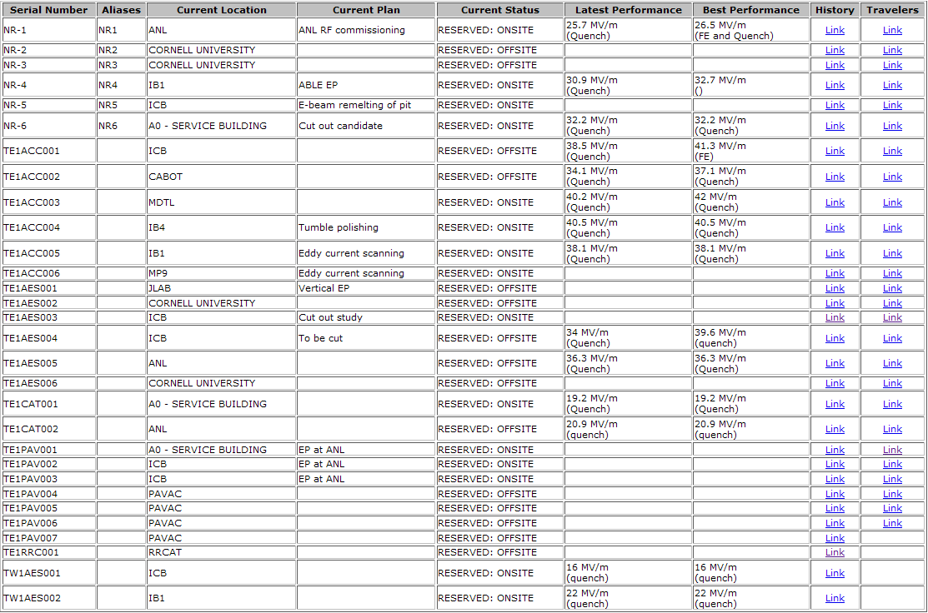

Slide 3
For next two weeks
TE1ACC003 (Laser)
  HPR did not remove cracked molding residual, in queue to cut open
TE1ACC005&006 (ECS)
  TE1ACC005 EP (ANL) completed, in queue for 120C bake
TW1AES001&002 (traveling wave)
  TW2 RF test done (IB1), NbTi flanges in progress
TE1CAT002 (Tumble Polishing)
  EP completed, in queue for H-bake out.
TE1AES004 (basic SRF)
  In queue to cut open
NR-4 (ABLE electropolishing)
  in queue for optical inspection and H bake out
TE1PAVxxx incoming inspection and optical insp. Done.
  TE1PAV002&003 in queue for EP, TE1PAV001 in queue for 120C bake.

