Slide 1
DTree clusters at
Ecal/Hcal boundaries
Remi Zaidan
The University of Iowa

Slide 2
The problem
DTree clusters are reconstructed in each sub-detector individually.
In the PFA scoring algorithm, a penalty is applied for links that belong to different DTree clusters:
  As a consequence, clusters belonging to different sub-detectors receive a penalty no matter how strongly they are linked.

Slide 3
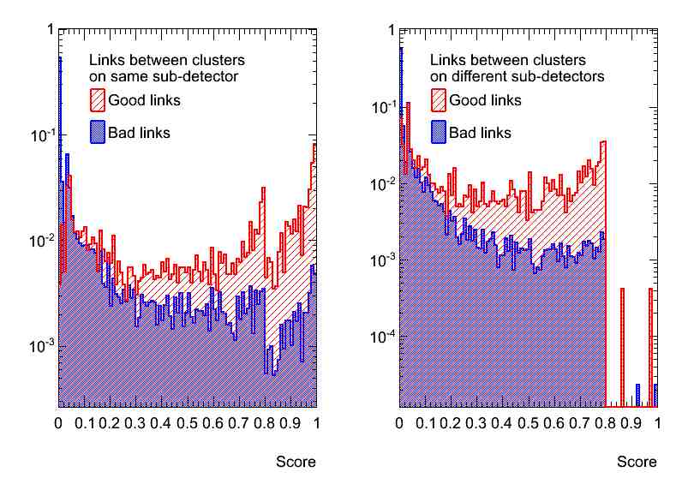
The problem
The shower propagation would stop at Ecal/Hcal border:
  Problem not affecting the final resolution since the first cone is recovering the Hcal part of the sower.
  The first cone is not intended for this purpose.

Slide 4
Tests for solutions
Two tests made to be compared with the baseline:
  Remove the penalty from the scoring algorithm without modifying the DTree reconstruction.
  Merge The DTree clusters that overlap at the Ecal/Hcal borders (not worrying about Barrel/Endcap crossover for the moment).
Compare PFA performance with and without the first algorithm.

Slide 5
Merging DTree across
Ecal/Hcal boundary
Matching:
  Find a DTree cluster A with hits on the last Ecal layer and a cluster B with hits on the first Hcal layer.
  Compute span of clusters A and B on border layers in θ and φ:
  Compute an overlap factor:
  Maximize overlap factor to match A and B, attempting to match larger clusters first.

Slide 6
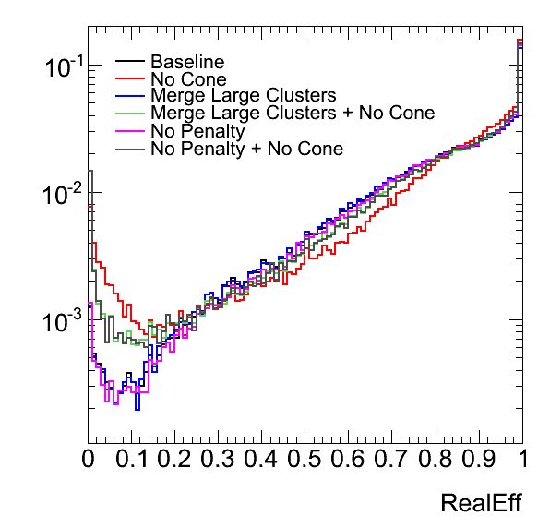
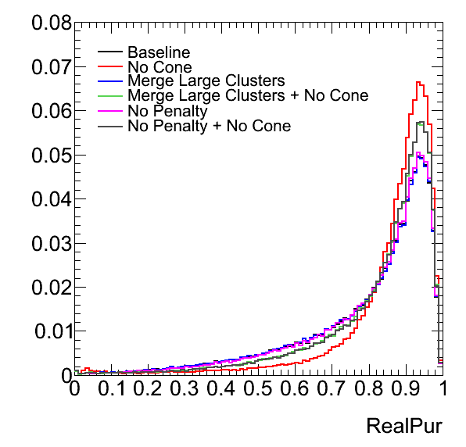
PFA performance
Removing the penalty factor completely gives similar performance to merging DTree cluster across Ecal/Hcal borders.
Resolution | Baseline | No Penalty | Merge DTrees
With first cone | 3.4% | 3.5% | 3.4%
Without first cone | 5.7% | 5.2% | 5.2%

Slide 7
Conclusion
A problem in the PFA scoring due to DTree’s being reconstructed in each sub-detector individually was found:
  No big effect on overall performance since the first cone algorithm was “fixing” and hiding the problem.
  The cone algorithm is not intended to fix this problem: fixing the problem was done by merging DTree clusters at the Ecal/Hcal borders.
Still need to implement the merging at Barrel/Endcap crossover:
  More complicated matching algorithm.

