Slide 1
ILC CFS AND GLOBAL
SYSTEMS MEETING
CONVENTIONAL FACILITIES
AND SITING GROUP
CFS Summary
V. Kuchler, J. Osborne, A. Enomoto

Slide 2
KEK Single Tunnel Review
  The Review was Very Successful and Informative to Not Only the Asian CFS Group but to the Global CFS Group as Well
  Draft Report Internally Distributed to Review Panel Members on June 21
  All Panel Comments were Incorporated Into the Final Review Report
  Final Review Report was Delivered to M. Ross, S. Yamaguchi and A. Yamamoto on June 30

Slide 3
CFS Workshop @ Daresbury, UK
  July 12-13, 2010
  Specific Focus - Mechanical and Electrical Criteria
  Also Review any Changes to Tunnel/Enclosure Requirements from Existing SB 2009 Baseline
  Area Systems to be Discussed
    e+ Source
    Damping Ring
    BDS
    MDI and Detectors
  CFS Group has Prepared Questions and Spreadsheets that will be Distributed to Area Systems Representatives

Slide 4
Daresbury Attendees
  Project Management
    M. Ross, N. Walker, E. Paterson
  CFS
    V. Kuchler, L. Hammond, R. Wielgos, A. Enomoto,
    M. Miyahara, M. Terunuma, M. Gastal
  e+ Source
    J. Clarke, N. Collomb
  Damping Ring
    S. Giuducci (via Webex), M. Palmer
  BDS
    D. Angal-Kalinin
  MDI and Detectors
    A. Seryi, P. Burrows, TBD Representative of
    K. Buesser

Slide 5
Daresbury Agenda
  Monday Morning Session
    e+ Source
  Monday Afternoon Session
    Damping Ring
  Tuesday Morning Session
    BDS
  Tuesday Afternoon Session
    MDI and Detectors

Slide 6
CFS WORSKHOP @ DARESBURY (Jul 12/13 2010) and SLAC (Aug 2/3 2010)
LIST OF QUESTIONS (CFS mechanical / electrical)
1 What 1. are the heat loads to be used per area system? (page 3 to 9)
2. What are the electrical power loads per area system? (page 2, 4 to 9)
3. Where are these loads? Approximate locations? (page 4 to 9)
4. How are they distributed? Assumed uniformly distributed? (page 4 to 9)
5 What SB2009 features we need to use?
MAIN FOCUS
5. are the a) DR circumference 3.2Km or 6,4 Km
b) DR low power or full power
c) Service tunnel only in central region and none in other area
d) Undulator in end of ML?
6. What portion of the BDS is the stringent temperature stability applicable? All of it? (page 11 to 12)
7. Does the loads in central region varies a lot? (critical to the BDS tight temperature stability)? (page
11 to 12)
8. Are the BDS components at constant load? (page 11 to 12)
9. When can we freeze the information/criteria?
10. Does the RF distribution in the ML (KCS) need to be changed? (page 13)
11. In KCS, what portion of the racks (power/heat) remain in the tunnel?
12. What are the demarcation points of responsibility for the electrical and process water?
13. What voltage regulation is required for proper operation?
14. Will the individual components contribute to poor overall power quality?
15. What is the criteria for ventilation? ODH purge, Activated Air purge? Smoke purge? (page 10)

Slide 7
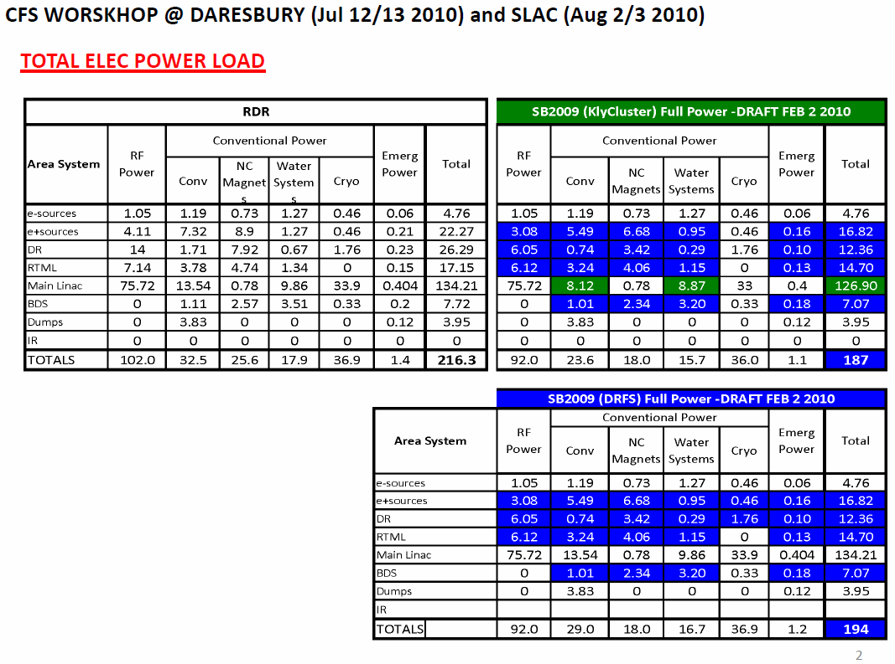

Slide 8
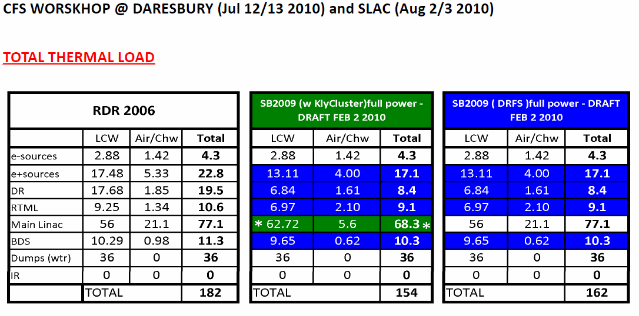

Slide 9
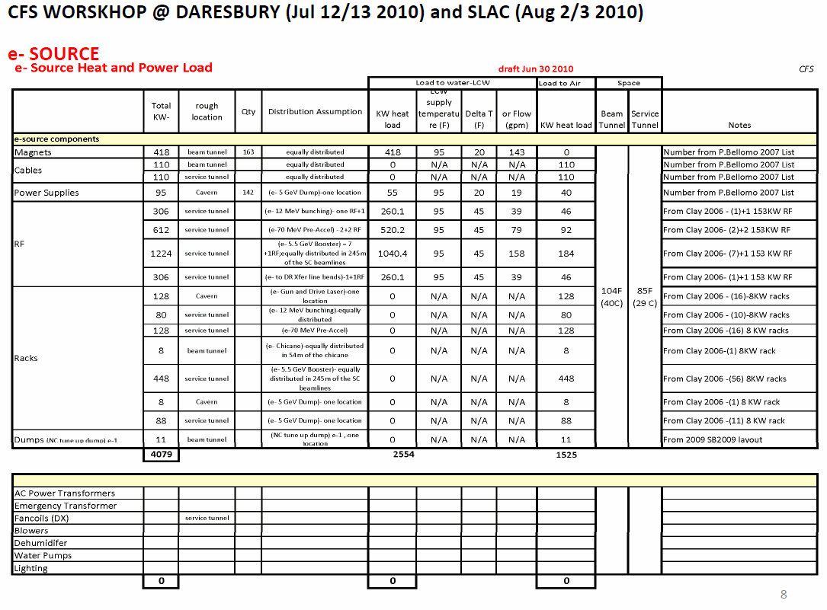

Slide 10
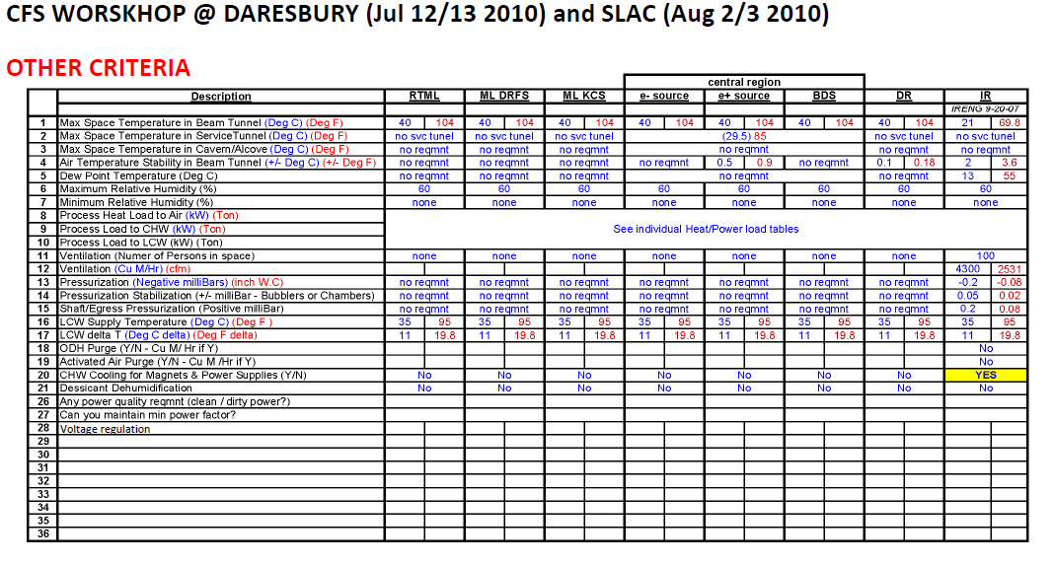

Slide 11
CFS Workshop @ SLAC
  August 2-3, 2010
  Specific Focus - Mechanical and Electrical Criteria
  Also Review any Changes to Tunnel/Enclosure Requirements from Existing SB 2009 Baseline
  Area Systems to be Discussed
    e- Source
    Main Linac
    RTML
    MDI and Detectors
  Use Questions and Spreadsheets Prepared for the Daresbury Workshop
  Attendees TBD

