Slide 1
FLASH 9mA report
J. Carwardine
7 July 2010

Slide 2
Two topics
FLASH status and schedule
Modeling/simulations for cavity gradient tilt studies

Slide 3
FLASH studies update
RF gun coupler window was replaced ~ 3 weeks ago
  Conditioning is still ongoing: 100us rf pulse length, 4MW
  Began re-establishing beam operation 6th July
Studies schedule has to be modified as a result of the ~3 weeks of machine commissioning/studies time lost
  FEL studies / lasing with long bunch trains remains a high priority topic
First block of FEL studies with long bunch trains next week
  Pulse length will be limited by the gun conditioning, initially 100us

Slide 4
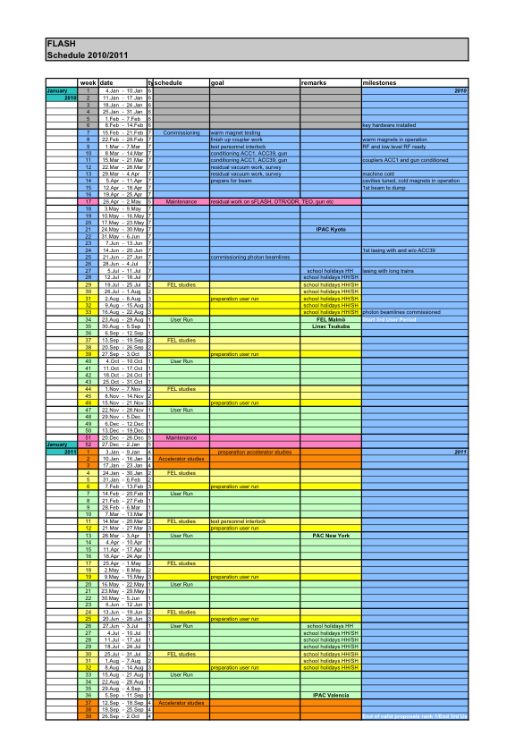
Current published FLASH operations schedule
9mA studies (?)

Slide 5
Cavity gradient tilt studies
Design criteria for ILC: operate with highest possible gradient on all cavities simultaneously
  Techically not trivial when many cavities fed from the same RF source operate at different gradients (RDR: 26 cavities / 1 klystron)
To study at FLASH:
  Minimizing gradient tilts over bunch train
  Lorentz-force detuning compensation using piezos
  Characterization of requried gradient and rf power overhead
FLASH ACC6/7 (subject of study)
  Max average gradient: approaching 30MV/m
  Gradient spread: 18MV/m – 39MV/m (similar to ILC)

Slide 6
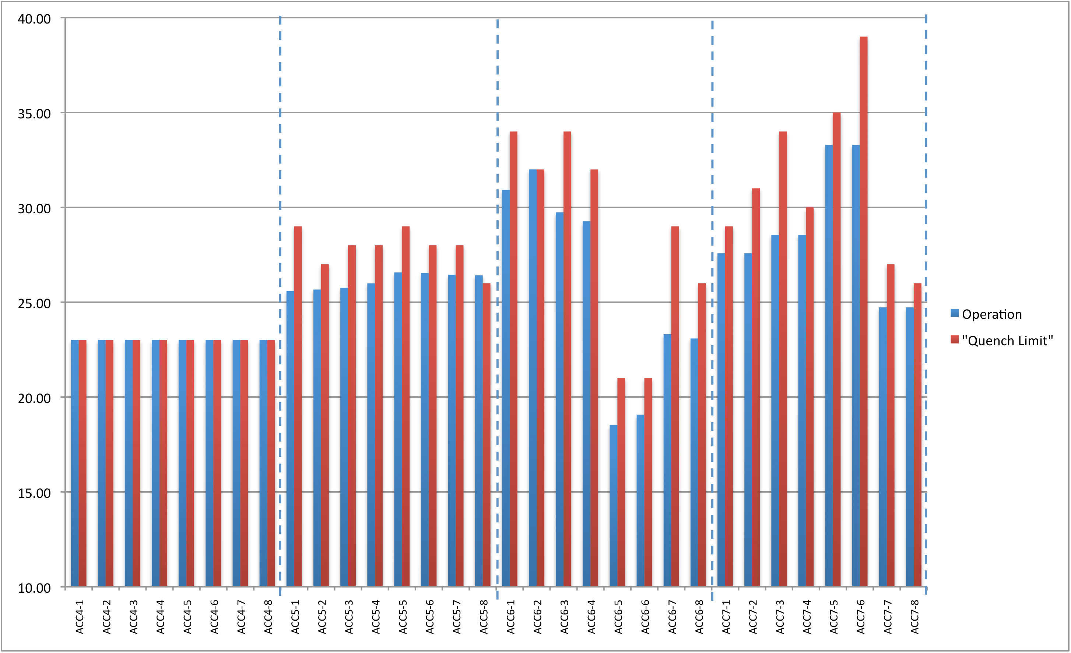
ACC4-7 cavity quench limits and nominal gradients for FEL operation (2010 configuration)
4.6 MW klystron power (est.)
5.5 MW klystron power (est.)
23.0 MV/m
26.1 MV/m
25.7 MV/m
28.5 MV/m
RF distribution configuration for flat gradients without beam

Slide 7
Issues for study
  Optimum tuning / setup for ‘zero’ tilt at nominal beam current
  Cavity Pk / Qext
  Cavity tuning
LFD feed-forward compensation using piezo tuners
Dynamic effects
  Beam current variations from nominal
  Microphonics (unique by cavity, common to all cavities in a cryomodule)
How well can we measure…?
  Measurement errors (calibration, noise)
How well can we set up Pk / Qext?
Sensitivites to various effects & errors… Model first, then study

Slide 8
Minimizing gradient tilts over bunch train requires individually settable loaded Q and forward power ratios for each cavity
FLASH ACC6/7 (subject of study)
  Piezo tuners on all cavities
  Loaded Qs are adjustable (motorized couplers)
  But …forward power ratios are predefined and fixed by rf waveguide distribution

Slide 9
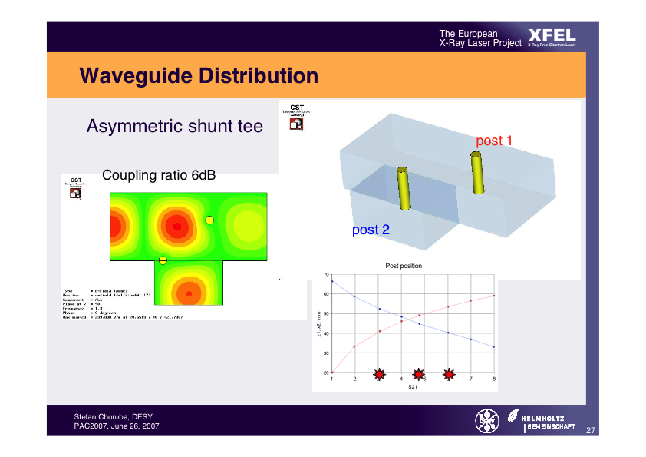
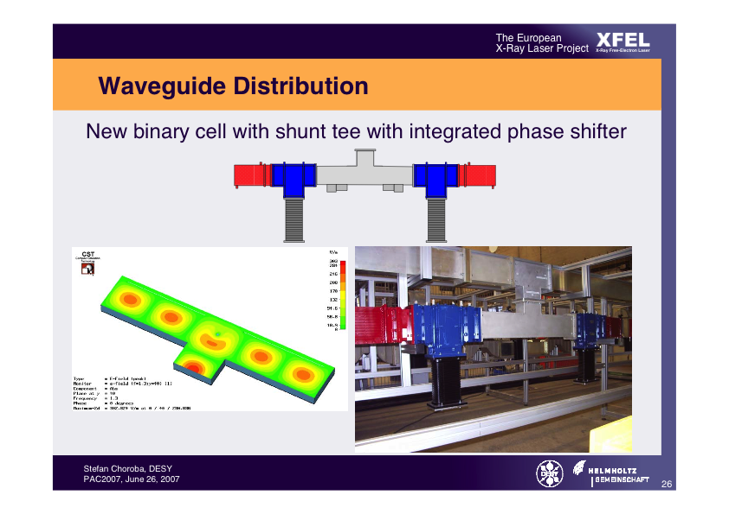
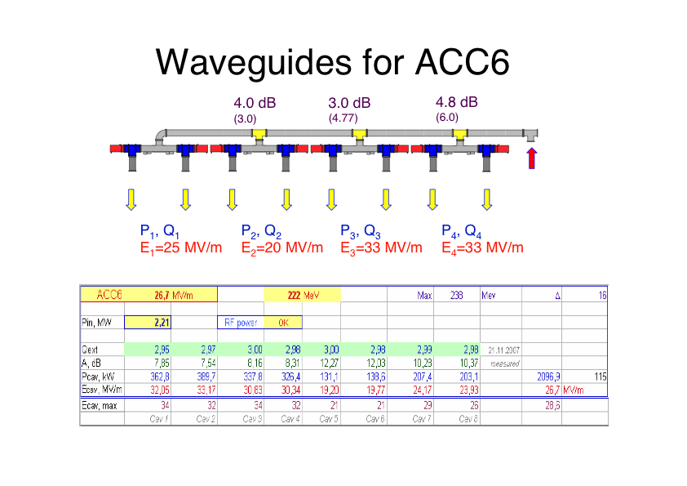
Waveguide distribution system for ACC6 (ACC7 similar)
Asymetric Shunt Tee
P₁, Q₁
E₁
P₂, Q₂
E₂
P₃, Q₃
E₃
P₄, Q₄
E₄
Shunt tee with integrated phase shifter
Posts in AST are fixed in place during manufacture – locations are determined analytically from the desired power ratio.
Measured power ratio is typically within +/-0.1dB of the design value
To change the power ratio, would have swap out the ASTs with a new set (requires 2-3 days tunnel access)

Slide 10
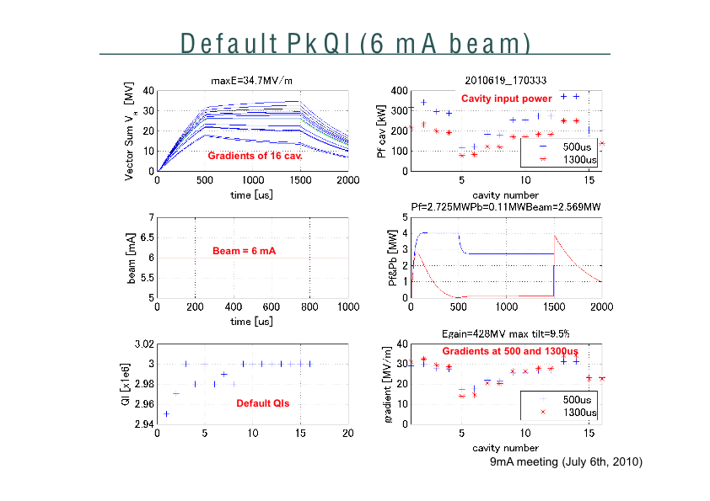
S. Michizono

Slide 11
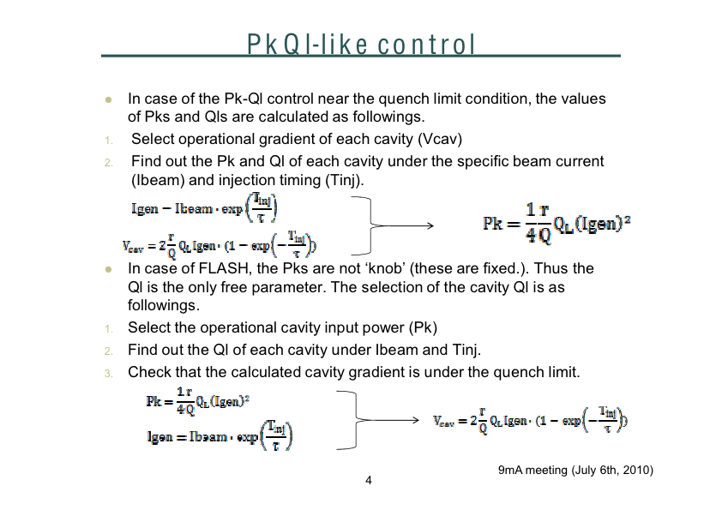
S. Michizono

Slide 12
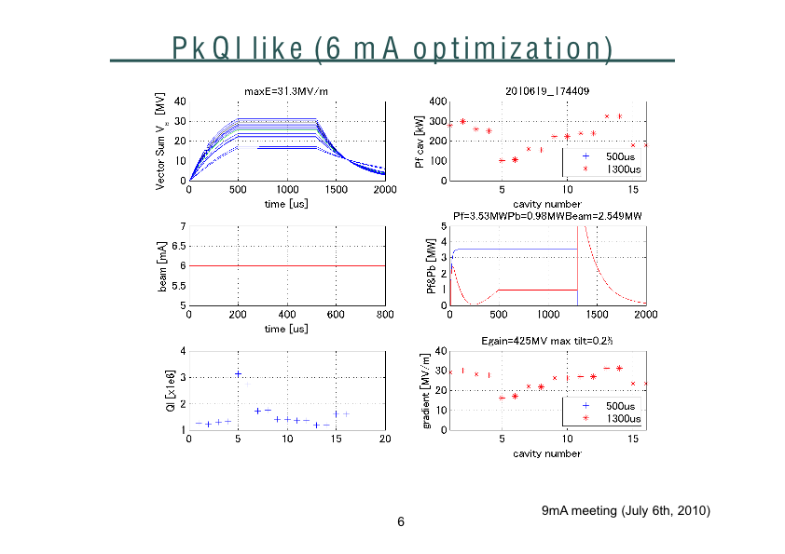
S. Michizono

Slide 13
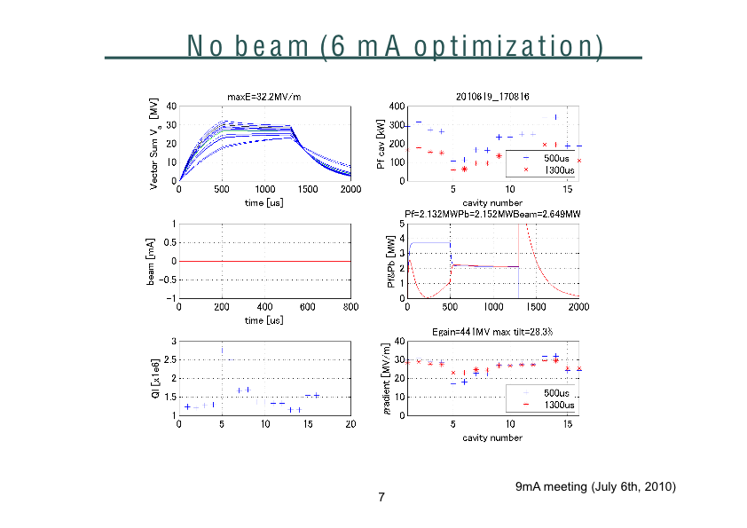
S. Michizono

Slide 14
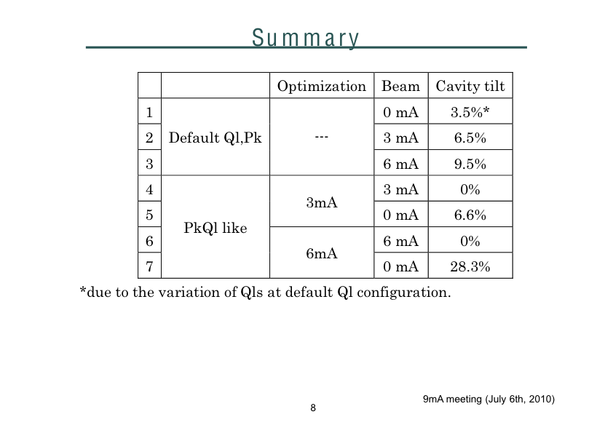
S. Michizono

Slide 15
Issues – mostly practical
How to get from zero current to full current and full gradient without quenching cavities…
Adjustment resolution of Loaded Qs…?
What can be done with less than ~6mA
Measurement sensitivity – can we even measure tilts of ~1%?
  Aim to use the upcoming FEL studies with long bunch trains (0.5-1mA)

