Slide 1
13th MDI: Latest news on civil engineering and services First draft concept for the ventilation system in the CLIC experimental area
Contributions from
DGS-SC
F Corsanego
EN-CV
M Nonis
EN-MEF
M Gastal
GS-SEM
J Osborne
N Baddams
A Kosmicki
PH-CMX
A Gaddi
H Gerwig
A Herve
N Siegrist

Slide 2
Towards an integrated design:
Collect input from all actors
Detector community (H Gerwig, A Gaddi, A Herve et al)
Service groups (CV, EL, HE, ASE...)
Safety bodies (RP, SC...)
Modify Civil Engineering layout accordingly
Step 1: Basic requirements for detector
See Talk by A Gaddi presented at MDI on 23/04
Step 2: Produce 1st 2D CE drawings
See Talk by J Osborne presented at MDI on 07/05
Step 3: Collect input from EN-CV on ventilation
See Talk by M Nonis presented at CES on 09/05
Step 4: Present an updated CE layout and ventilation concept

Slide 3
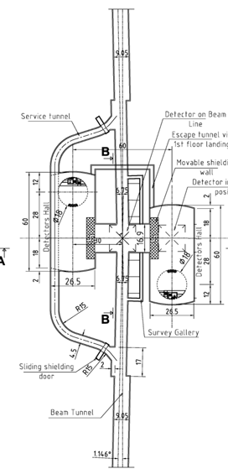
First draft Experimental area layout as presented at CES
Emergency escape tunnel
No Alcoves
Machine By-Pass added
To be moved away from cavern volume
Survey gallery added

Slide 4
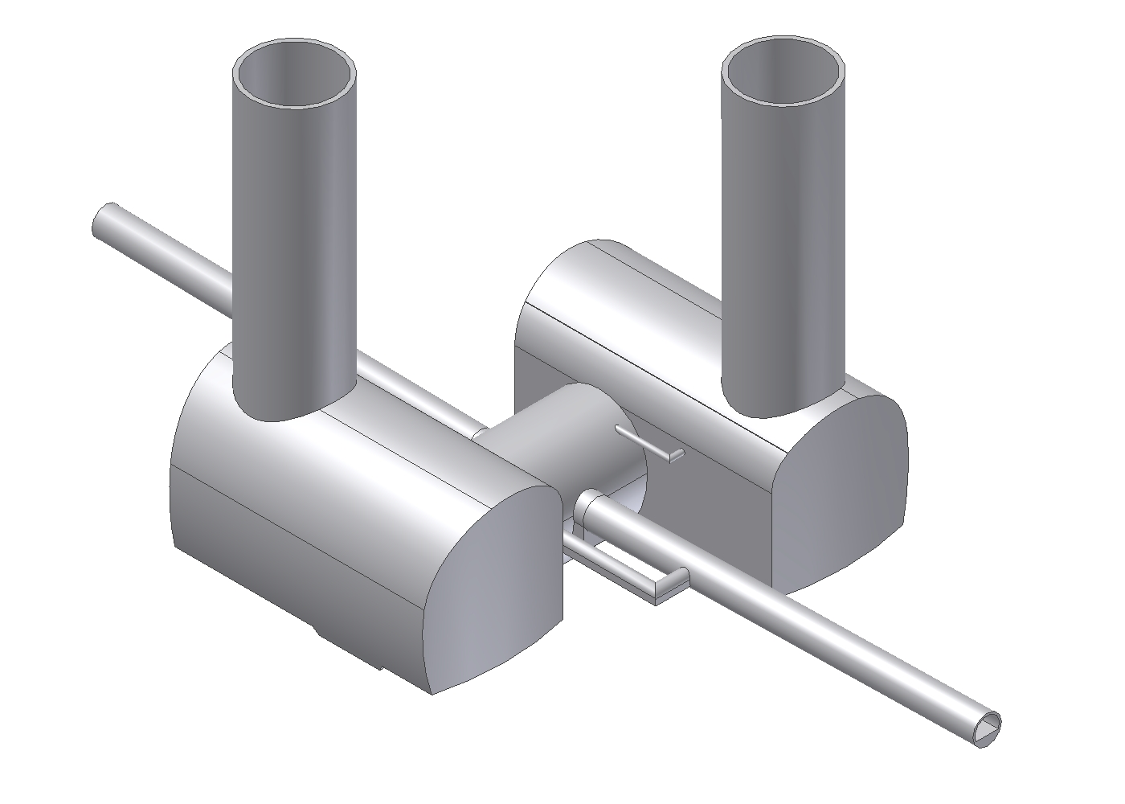
For CDR proposal of a cavern in a deep CERN type clay
Transfer tunnel
with IP
Hall
Experiment 2
Hall Experiment 1
Excavated volume is less than for a standard hall
Flat walls on
tunnel sides
Discussed with J. Osborne & M. Gastal
Alignment Tunnel
7 May 2010
H. Gerwig - 13th MDI
4

Slide 5
First draft concept for the ventilation system in the CLIC experimental area
Warning:
“The following ventilation concept is a first answer that needs to be confirmed and validated when details on geometry, thermal charges, fire safety and RP issues shall be communicated.
At the present stage is not possible to size the installations, therefore major modifications can intervene”
M Nonis

Slide 6
FUNCTIONNALITIES ENSURED BY THE VENTILATION:
Provide fresh air for personnel.
Treat air according to need: heating, conditioning, dehumidify.
Evacuate thermal charges.
Ensure dynamic confinement between machine and accessible areas where 100% air tightness cannot be achieved
Provide extraction capabilities
Filtering exhaust air before releasing into the environment.
Purge of areas (after fire).

Slide 7
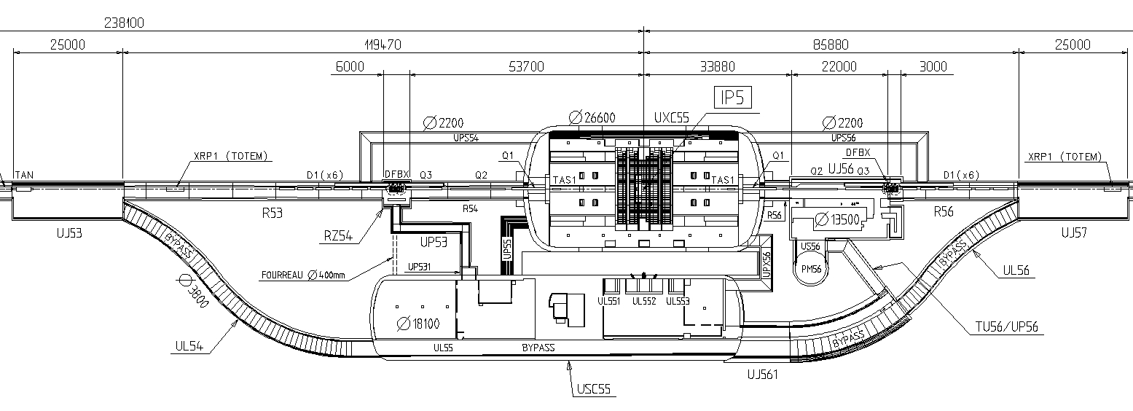
Assumption critical for the concept to be validated:
→ The airtight sealing of both experimental caverns should maintain a leak rate compatible with the establishment of a pressure differential with respect to the interaction region
Scheme at CMS
P_{UXC55} – P_{S45} = 20Pa
P_{UXC55} – P_{S56} = 20Pa
P_{Shelter} – P_{USC55} = 20Pa
P_{USC55} – P_{UXC55} = 20Pa

Slide 8
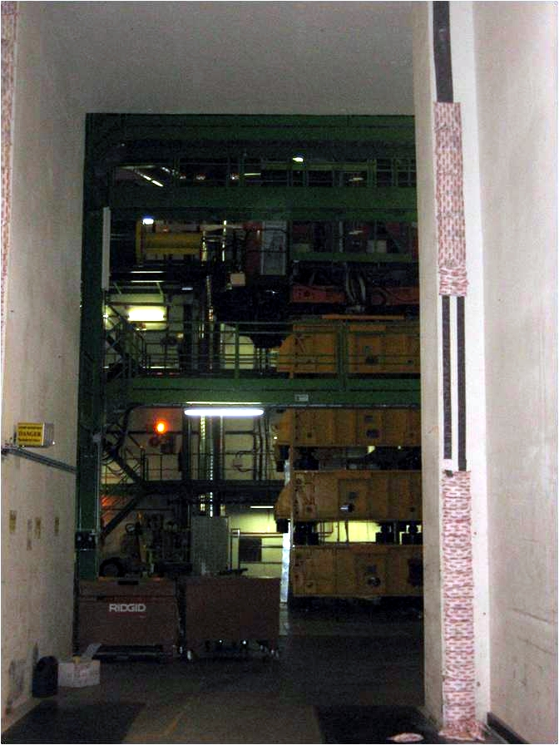
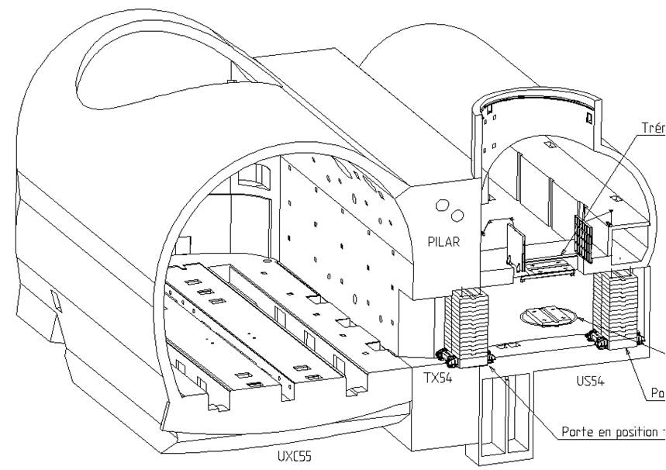
First idea:
Use of mobile shielding in conjunction with inflatable seal and expanding fire proofing sacks (TX54)

Slide 9
First idea:
For CLIC moveable shielding walls, the cavern side of the opening to the transfer tunnel could be equipped similarly
1st layer of sacks
Inflatable Seal
Transfer
Tunnel
2nd layer of sacks

Slide 10
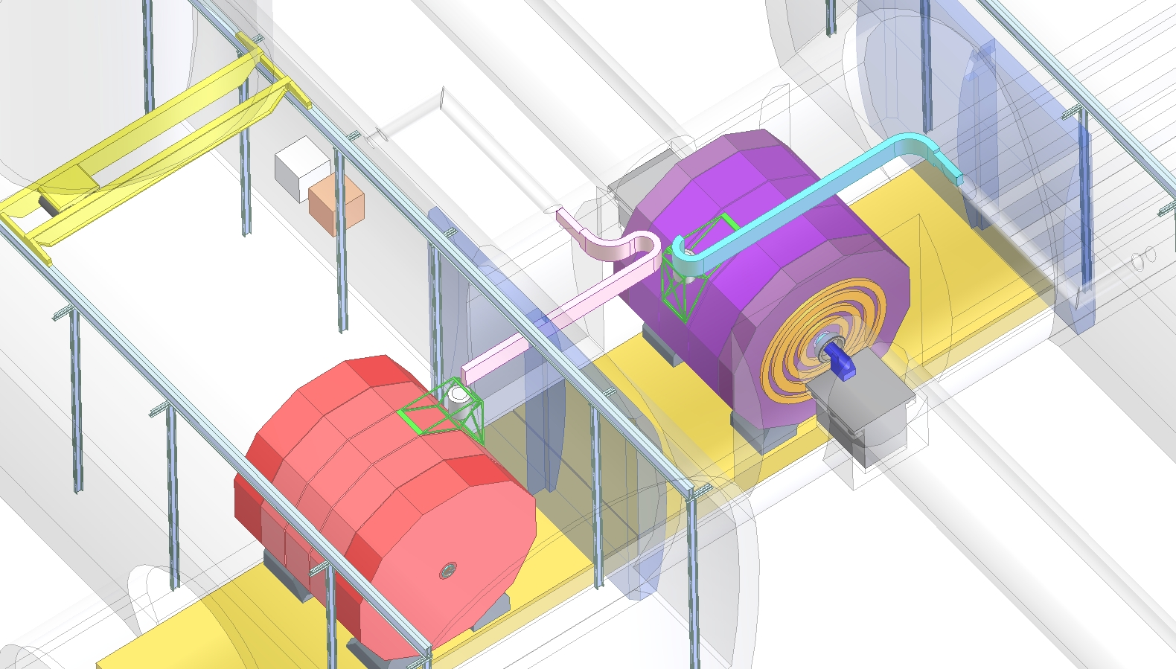
The detector would be moved into beam position on a moving platform
The concept could be similar to the PX56 plug (2200 tons)
N Siegrist – PH-CMX

Slide 11
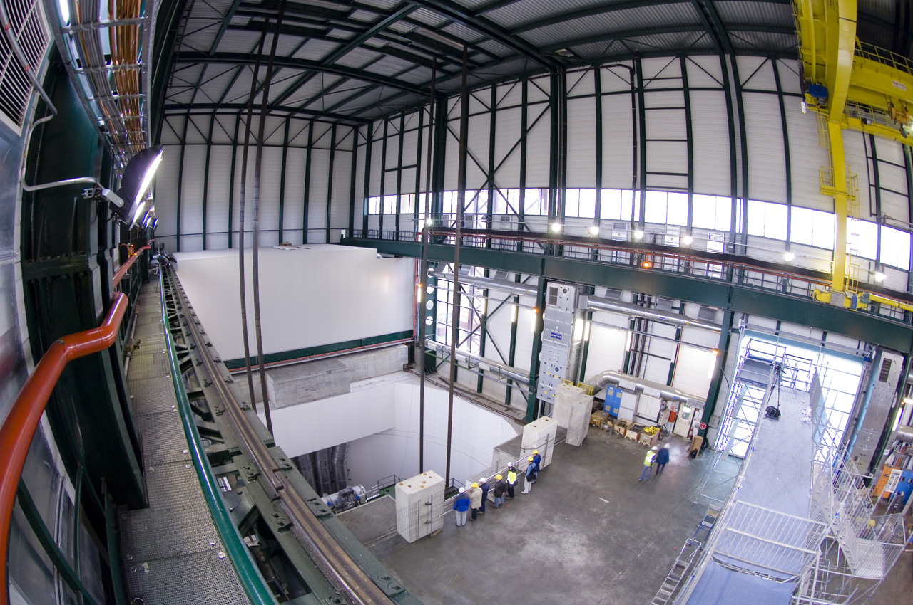
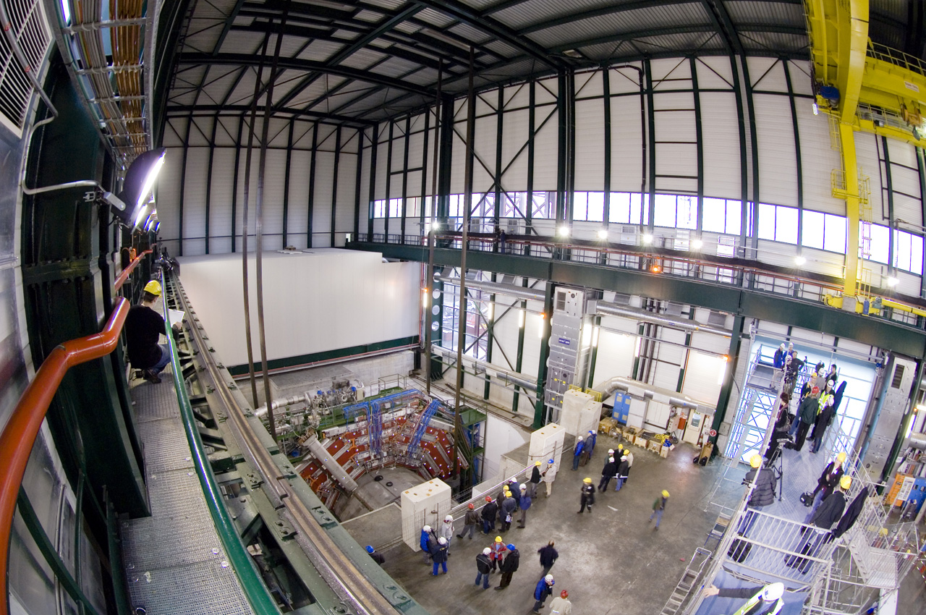
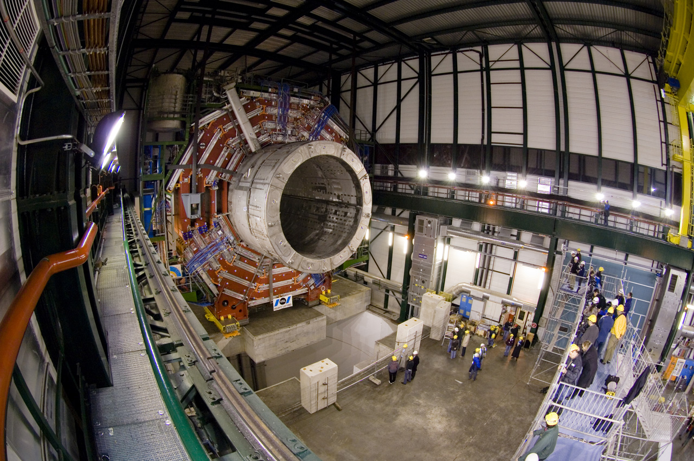
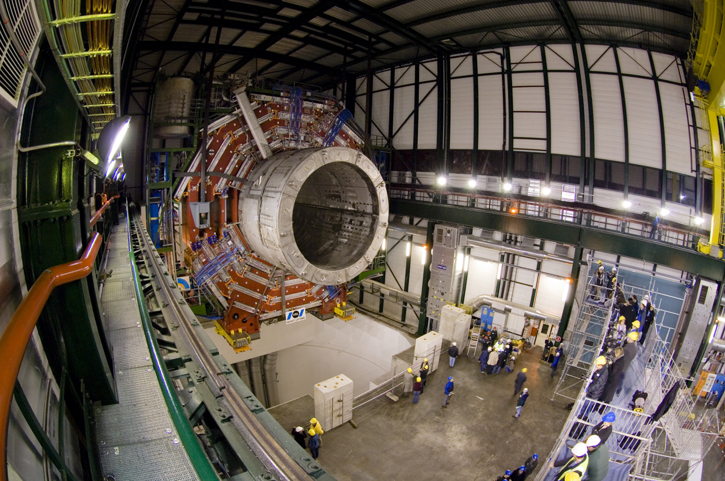
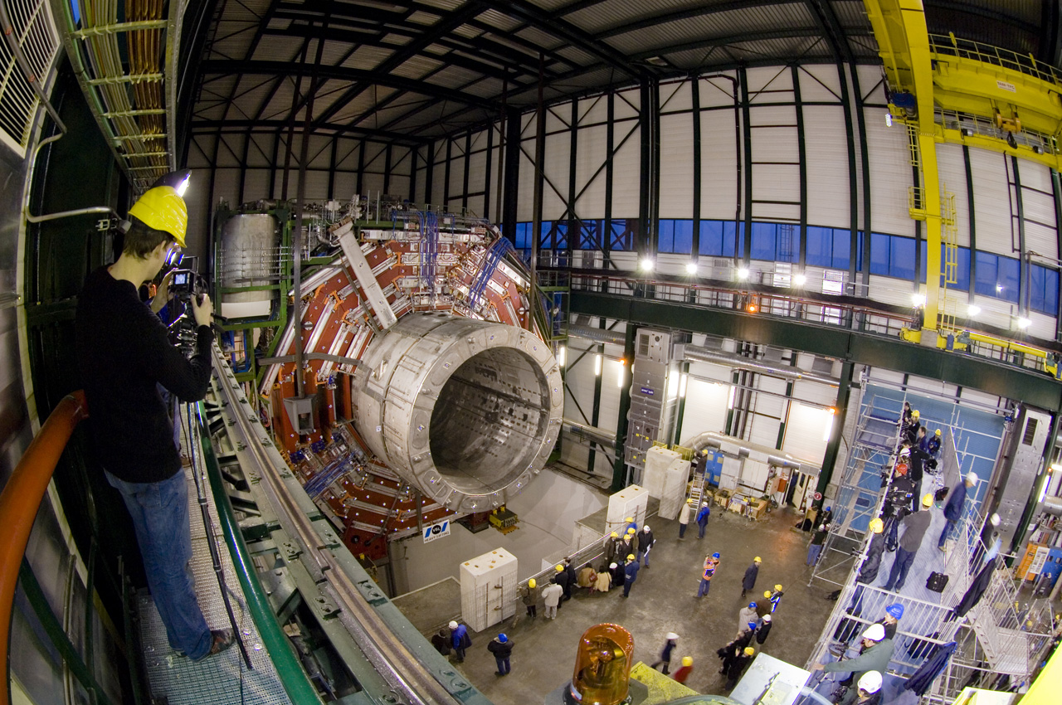
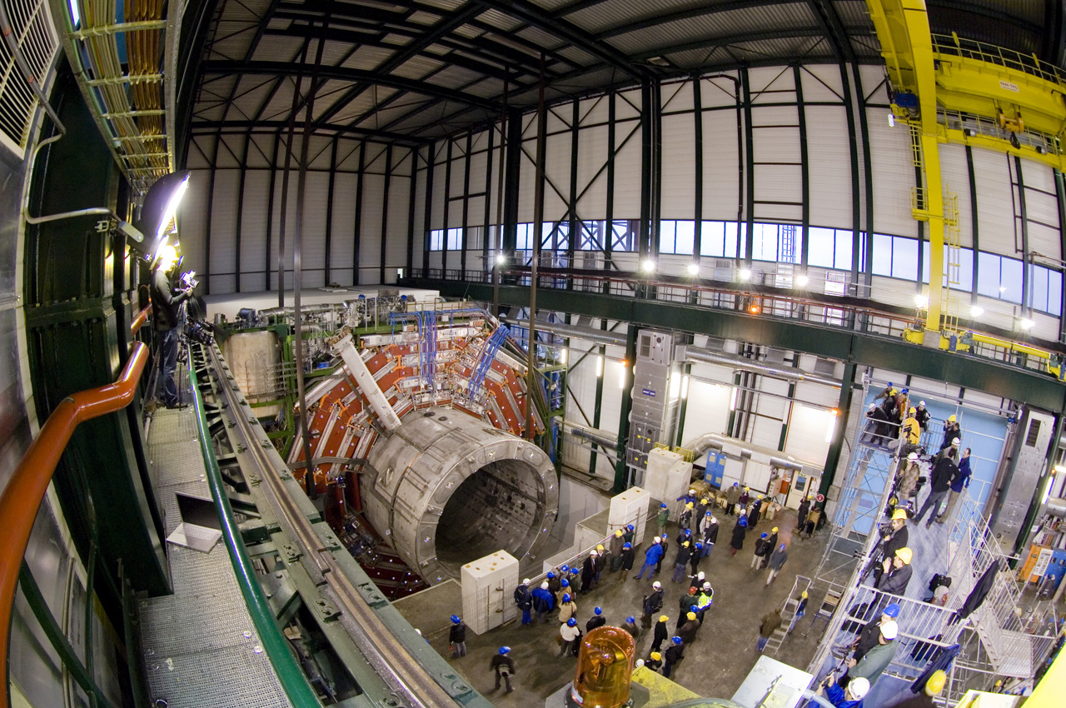
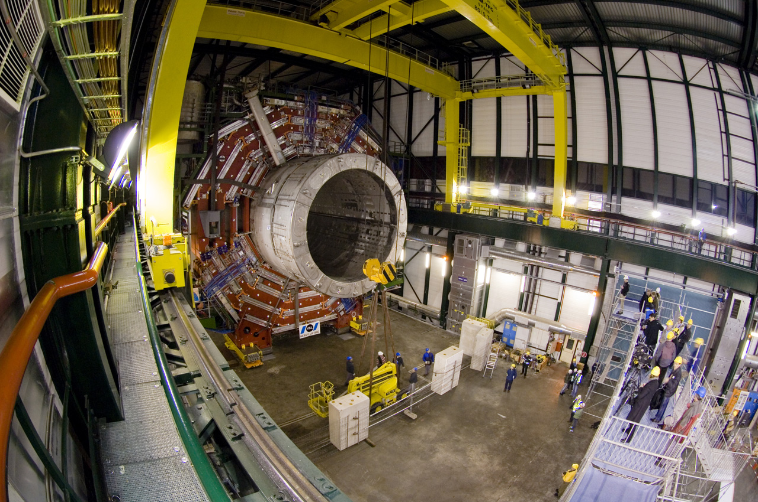

Slide 12
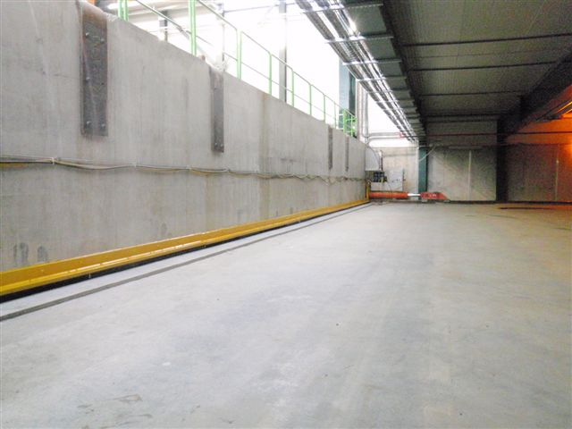
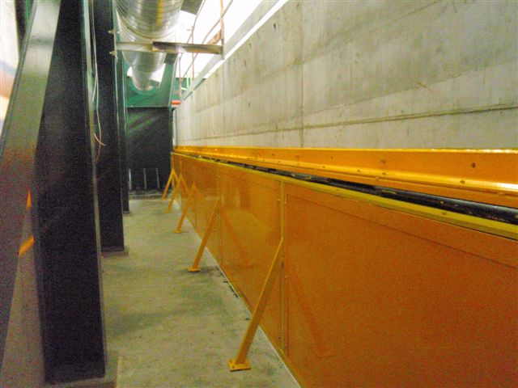
Solutions to seal off a moving platform the size of the PX56 plug have been successfully implemented.
→ Area between the platform and the floor of the interaction region would have to be made airtight

Slide 13
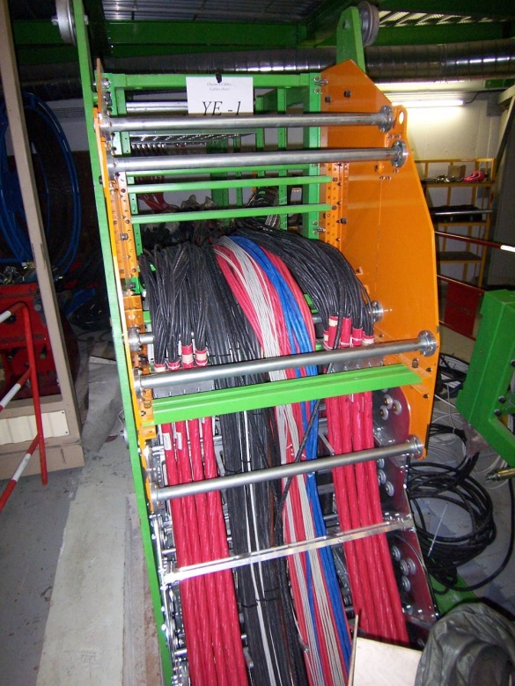
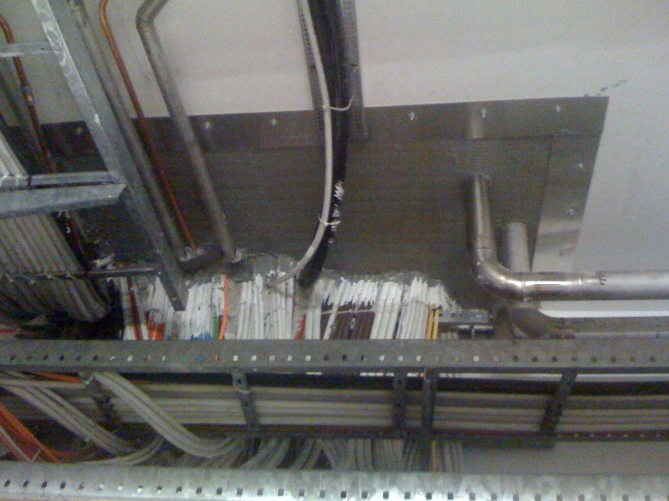
Since the services should not be disconnected, Cable chains will have to be used.
Sealing off moving cable chains will be challenging
Option to study:
→Trenches could be closed in an airtight fashion using appropriate cover plates

Slide 14
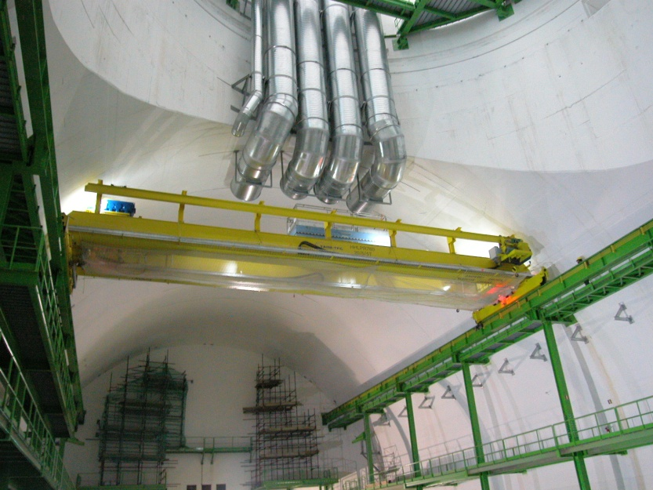
Ventilation sectors:
The underground area shall be divided in the following sectors:
Cavern A
Cavern B
Bypass and interaction region
Emergency escape tunnel
Pressurised areas in shaft (2)

Slide 15
Ventilation sectors:
The underground area shall be divided in the following sectors:
Cavern A
Cavern B
Bypass and interaction region
Emergency escape tunnel
Pressurised areas in shaft (2)

Slide 16
The standard ventilation scheme foreseen for the tunnel shall stop before the bypass junction.

Slide 17
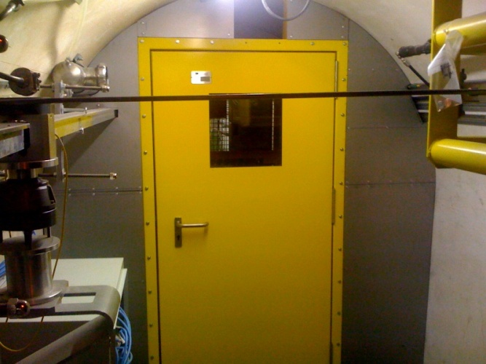
Ventilation sectors:
The underground area shall be divided in the following sectors:
Cavern A
Cavern B
Bypass and interaction region
Emergency escape tunnel (2) (changed at CES)
Pressurised area in shaft (2)
Suggestion from DGS-SC: Each escape
gallery should connect directly into a shaft
shelter area

Slide 18
For each sector it is foreseen:
fresh air supply,
extraction system,
redundant AHUs located on surface,
air recycling,
ducts via existing shafts.

Slide 19
Basic data to be provided in order to reach a more detailed proposal
Geometry of each area
Models by GS-SEM to be provided shortly
Thermal charges:
equipment, personnel…..
their localisation
specific cooling needs in closed premises
1st order number should be 125kW for each detector (A Gaddi)
Radioprotection:
confirm air tightness between different sectors - caverns and interaction area (shielding, cable trays, drills etc.)
Confirm the need of an overpressure between areas (20 Pa)
Can we assume that the same air goes through the bypass and interaction region?
Can it be accepted that when the mobile shielding structures are open no ∆P can be maintained?
Need for dedicated gas extraction in some areas?
Need of secure network (UPS, diesel)

Slide 20
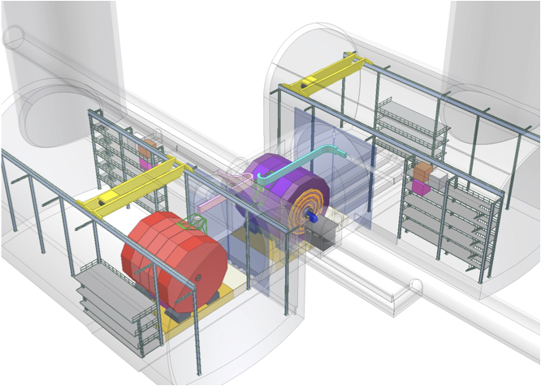
Experimental Area Organization
Power supply Slow dump resistor Breakers Cold box
Flexible sc bus-bars Flexible transfer lines
Fast dump resistor
Dewar
Services at end of Cable Chains
Potentially closed
A Gaddi
20

Slide 21
In the past, it had been suggested to use the water from Lake Geneva mainly because cooling towers have a high environmental impact.
Should this option be considered for the CDR, GS-SEM would suggest adding a new cavern .
Shaft + Cavern would allow:
Space for machine equipment
Connection with water transfer tunnel
Take the bypass off the volume of the experimental cavern
Hosting of ventilation ducts for interaction region
Installation of heavy vibration equipment
Setup and removal of TBMs still being considered
Point of attention
→ Equipment in new cavern should not introduce vibration in the EA
To be confirmed
Water transport tunnel
Lake
GVA

Slide 22
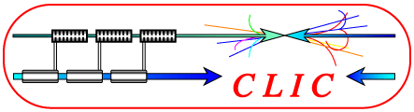
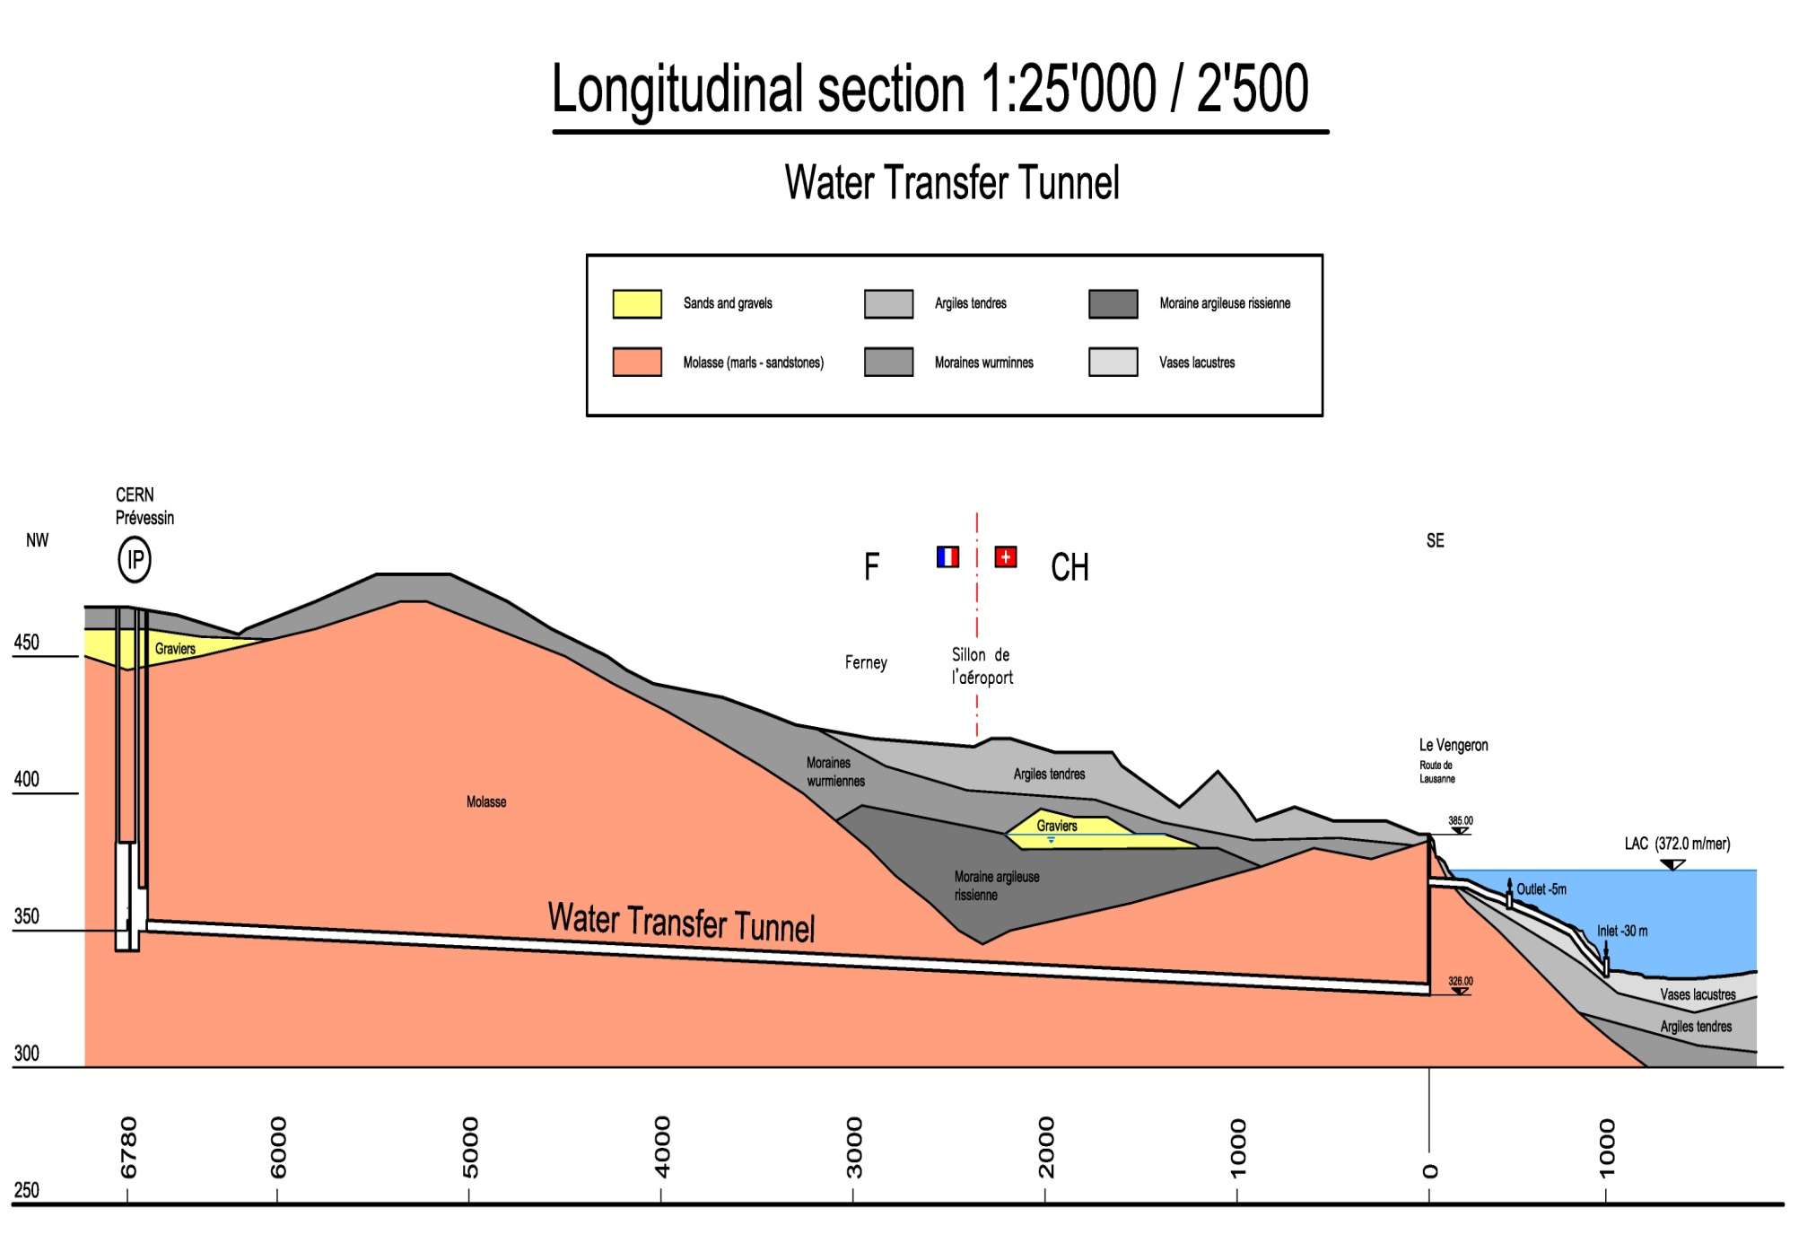
CLIC WORKSHOP - Cooling
Cooling Production
Pumping
station
JIGolfin

Slide 23
Summary
This very first concept of ventilation in the experimental area has led to consider modifications in the CE layout. More modifications are expected as constraints from other services groups are consolidated.
CE modifications to appear in next version of 2D drawings:
Bypass out of volume of experimental caverns
2 Escape galleries connecting to the shaft shelters
Request for services from the detector community are educated guesses only
Designing the CLIC experimental area will pull together resources from different departments: Feedback on proposal welcome
In these areas detector, machine, infrastructure and construction issues are inter-related.
All stakeholders are encouraged to provide initial estimates of the characteristics of the equipment they plan to have running in the experimental area

Slide 24
Latest News
Feedback from accelerator community
Foresee an additional tunnel for 500GeV option to be used as delay loop
Necessity of a 3rd shaft for the accelerator has to be assessed
Feedback from Detector community
A dew point regulation system should be foreseen – humidity control
T=20°C, Humidity [40%-60%]
Heat load in experimental hall = 125kW +/- 50%
Dynamic confinement might not be needed, more radiation protection studies needed
Purge system might not be needed
Gas extraction system has to be foreseen. Should be the same as for CMS
Pumping station has to be far enough from the IP as to not introduce vibration. Maybe, should they be installed at the extremity of the main linac.
Next steps:
Come up with a draft shaft cross section including lift, ventilation ducts, elements of detector, staircase, cable trays
Come up with a draft layout of surface assembly halls. One idea to investigate would be to have only one gantry crane

