Slide 1
RTML layout in SB2009
Nikolay Solyak
CFS/Area system Workshop 2,
SLAC, August 2-3, 2010

Slide 2
Major modifications to the RTML lattice are:
Single-stage bunch compressor (shorter by ~314 m)
Remove 15 GeV extraction line and beam dump (ELBC2)
Redesigning of the second extraction line (after single-stage bunch compressor) to accommodate larger energy spread (4% vs. 2.5%)
Re-designing of the RTML lattice in central integration area, associated with new layouts of the DR, electron and positron sources and BDS
    S-shape curved DR-to-Linac transition (in horizontal plane)
    Vertical dogleg (different for e+ and e-)
    Extraction line in
    Correction, Diagnostics and Collimation sections in BDS straight tunnel
Notes:
2

Slide 3
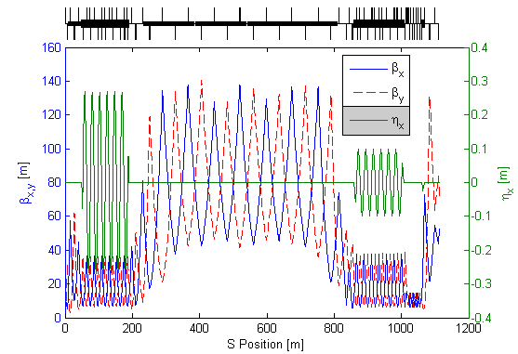
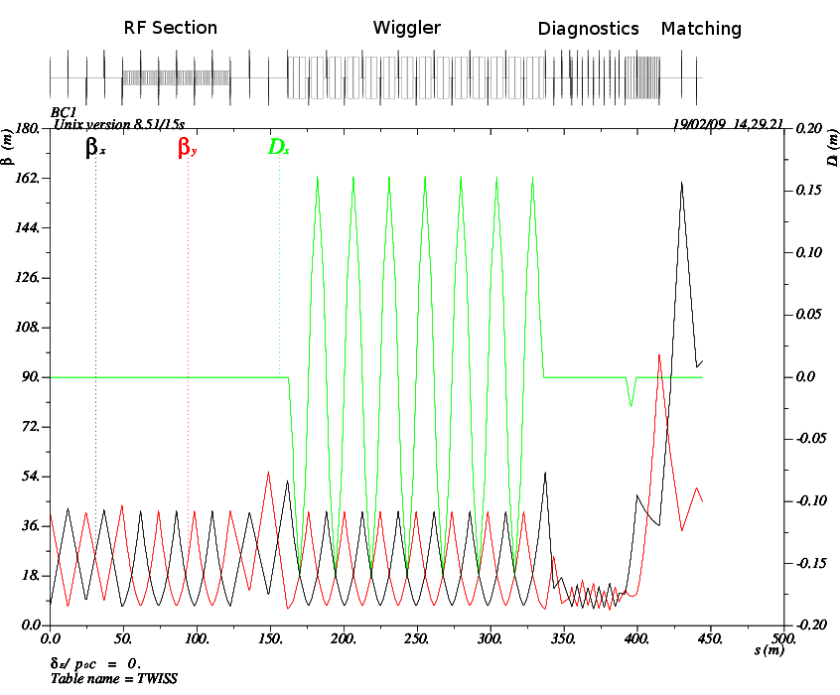
RDR 2-stage BC vs. SB2009 single-stage BC
RDR
RF1
Wiggler 1
RF2
Wiggler 2
SB2009
Pre-linac is now part of ML:
Length ~ 460 m
Acceleration: 4.3→15 GeV
36 CM’s (12 klystrons)

Slide 4
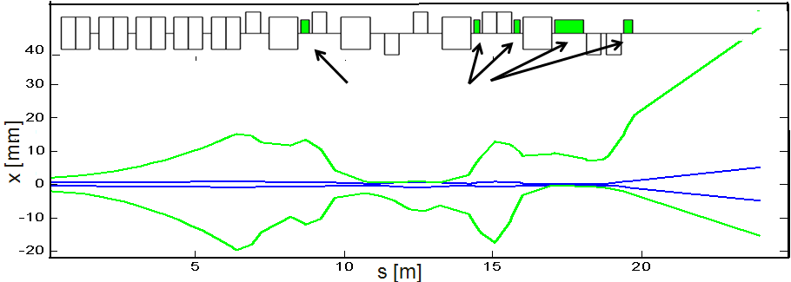
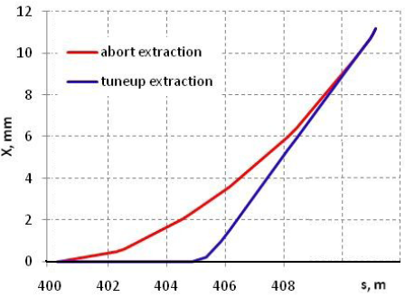
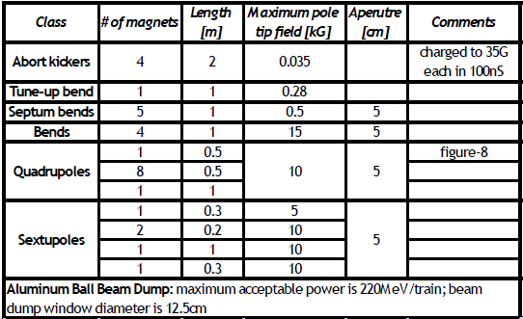
ELBC1 - Extraction Line
Sextupoles
Length = 24 m

Slide 5
Two-stage vs. single-stage BC
(BC1+BC2) vs. (BC1S + pre-Linac)
 | BC1+BC2 | BC1S+preLinac
Length [m] | 1114 | 800
RF units/klystrons | 16 | 14
Cryomodules | 48 | 42
Cavities | 414 | 360
Quadrupoles | 88 | 61
BPMs | 84 | 59
BC1 Instrumentation | BC2 Instrumentation (BC1S)
phase monitor, bunch length monitor, LOLA profile monitor | phase monitor, bunch length minitor, LOLA profile monitor
 | 4 laser wires
Notes:
5

Slide 6
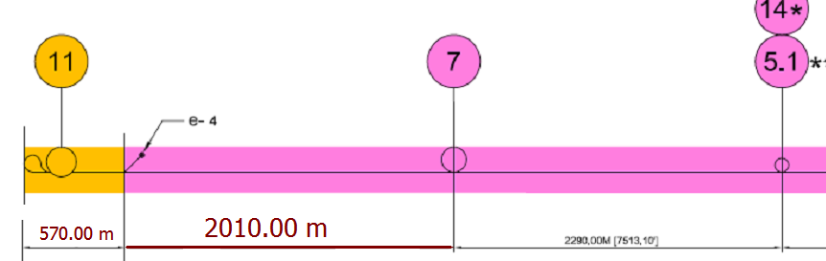
Corrections in CFS drawings (LCWS 09)
Including 460m pre-linac
Final length should be agreed with ML area

Slide 7
RTML in Central Area
In SB2009 DR circumference has been scaled down to 3.2 km
RDR design foresaw an extraction at about 1 km from the central plane (IP location) in the direction of the turnaround, now the DR exit is located at about 100 meters from the central plane ➔ RTML system longer by ~900 m, more RT magnets.
It requires redesign of the RDR beamlines. Possible simplification of overall layout due to DR in same elevation. Preliminary lattice exist, no matching and optimization done yet.
Possible risks might arise from the performances of the new system from the point of view of the low emittance transport
Notes:
7

Slide 8
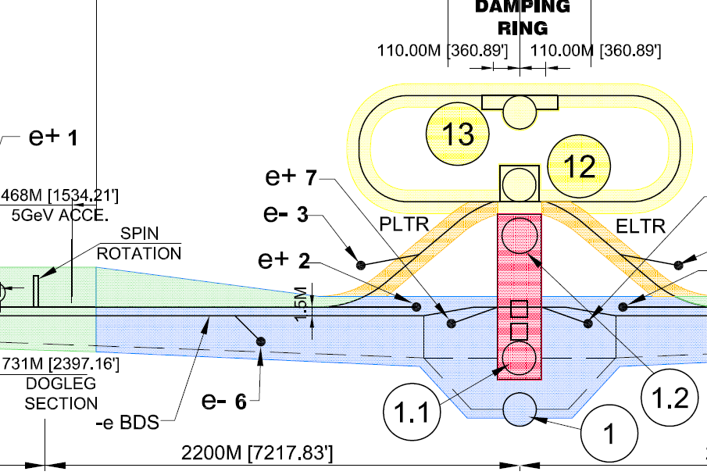
RTML configuration proposal
Straight line ~ 110m
Vertical dogleg - 50 m
Extraction Line – 25 m

Slide 9
RTML configuration proposal (2)
Skew corr. & Diagn. - 60m
Collimation – 400m

Slide 10
RTML configuration proposal (3)
RTML Return Line

Slide 11
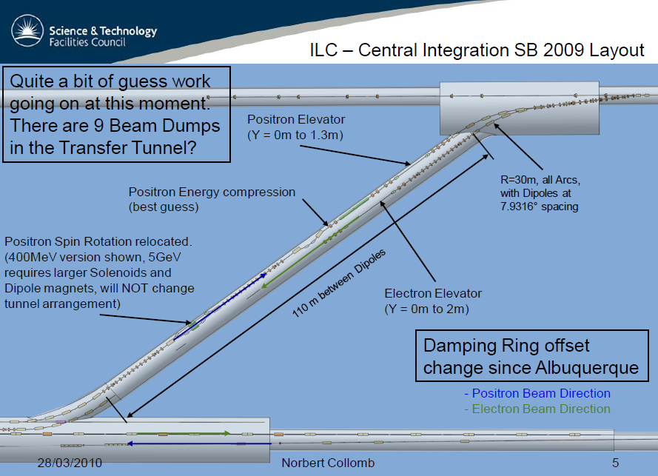
RTML in DR-BDS Transfer tunnel (SB2009)
Need more details on RTML beam-line in this Area:
Extraction line and Dump?

Slide 12
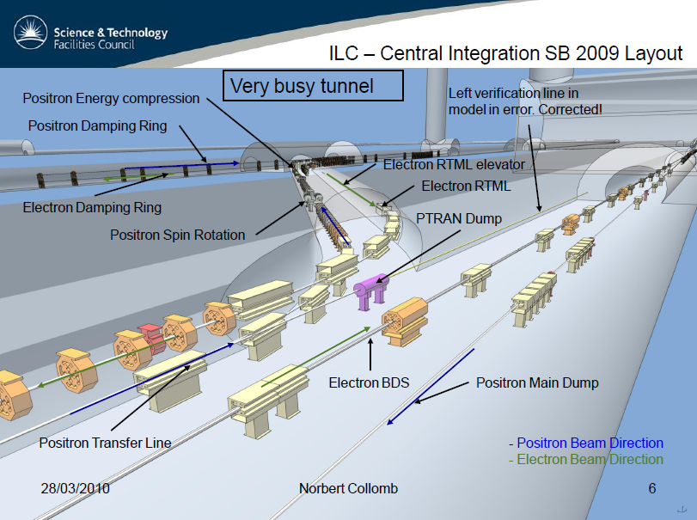
RTML already on ceiling level in BDS tunnel

Slide 13
Power, water, Cryo Tables
Some discrepancy in RTML tables were found in the table, distributed by Vick on Daresbury Workshop, July 12-13, 2010
  RF scaled properly from RDR, but our proposal is include pre-linac (36 CM’s/side) to ML budget. Only 6 CM/side needed for single stage BC. (Total RF power ML+RTML still the same)
  Same for Cryo
  Number of conventional RT magnets was increased in SB2009 because of longer RTML line. Table with magnet counts was distributed in Oct.28, 2009.

Slide 14
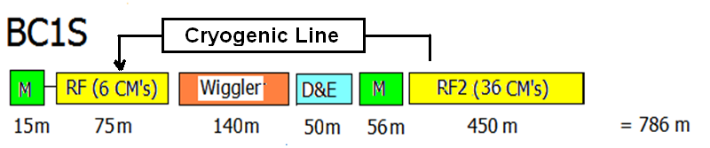
Single stage Bunch compressor
Dump
Dump
Now this is a part of ML (after conversation with Chris Adolphsen)
Length saving: 1114 - 800 ≈ 314 m
Cryogenic line for 6 CM in Bunch compressor
4 SC solenoids in Spin rotator are locally cooled by cryo-head, same as undulator (no need for cryo-line)

Slide 15
RTML Magnet Count (Oct.28,2009)

Slide 16
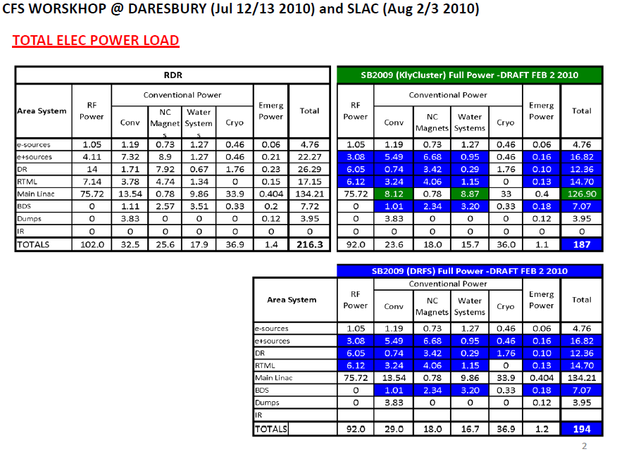
Discrepancies in RTML tabble:
No cryo power (RDR / SB2009)?
NC power increases in SB2009
Same for water
Proposal: move all cryomodules (except 6 in each side, needed for single stage BC) with RF to ML budget.

Slide 17
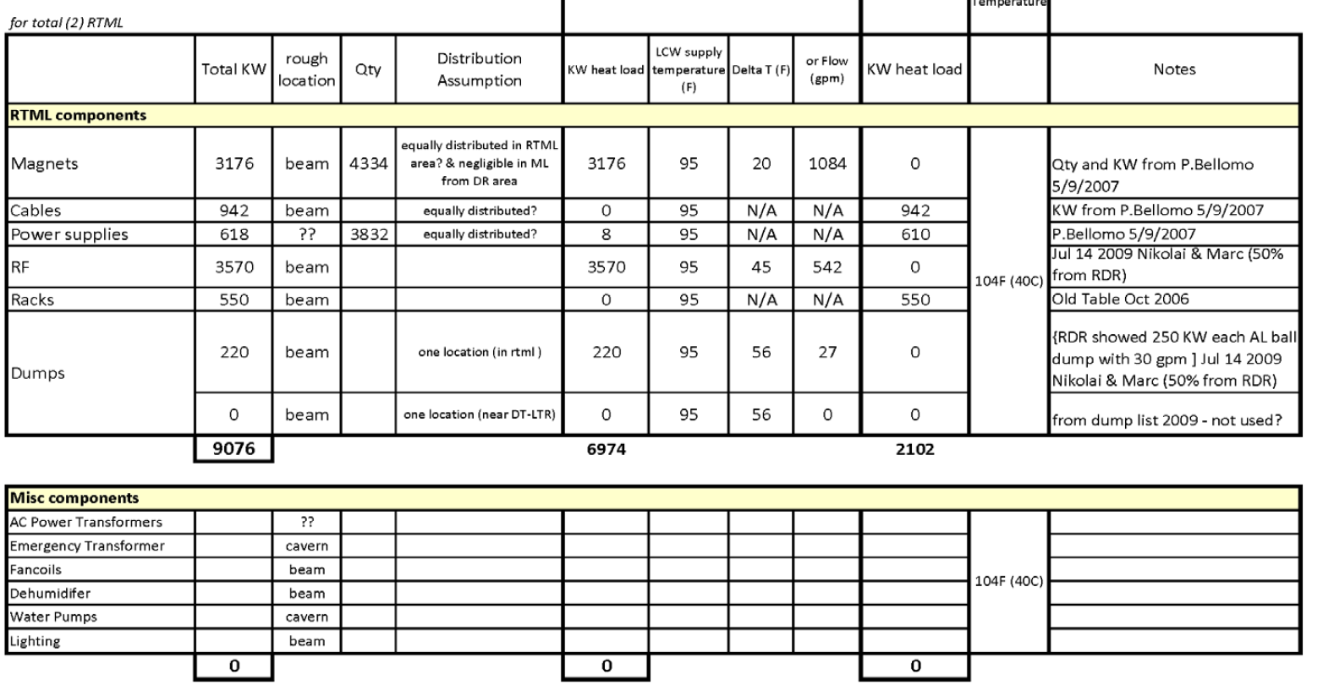
RTML tables, need correction accordingly

Slide 18
Summary
Some changes in table are needed to accommodate changes in RTML layout proposed for SB2009 baseline.

