Slide 1
S1 Global
First (Preliminary) Results of Cavities/Tuner
Transient Studies
June 5-9, 2010
KEK/INFN/FNAL joint team

Slide 2
Response of Cavity/Tuner system on “Step” function stimulus pulse on Piezo
  Capacitance of Piezoactuator for different Tuner system
    Ckek=0.2mF
    Cdesy=2mF
    CBlade=4mF

Slide 3
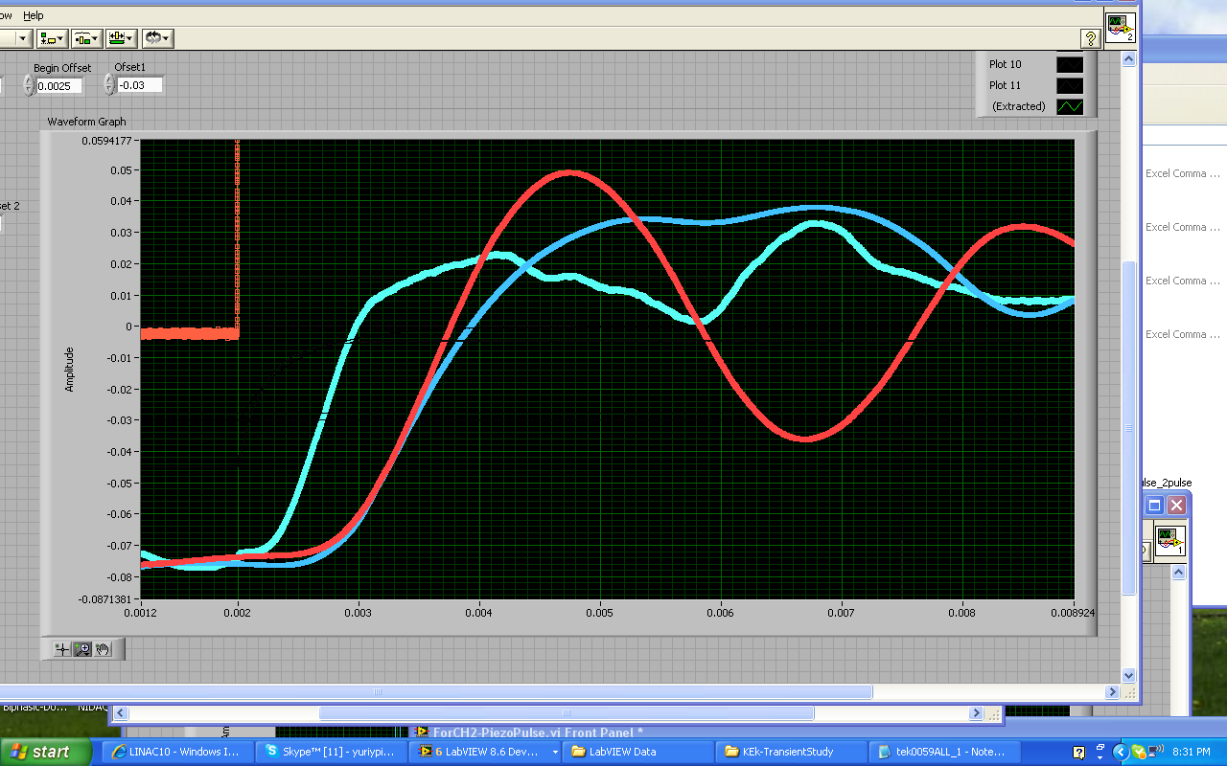
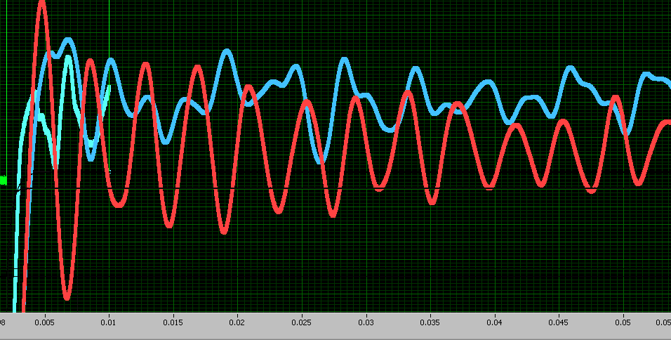
C3-DESY Tuner
Blade Tuner
A1-KEK Tuner
5ms

Slide 4
Response on large amplitude SINEwave stimulus pulse
  (FTT of cavity response)

Slide 5
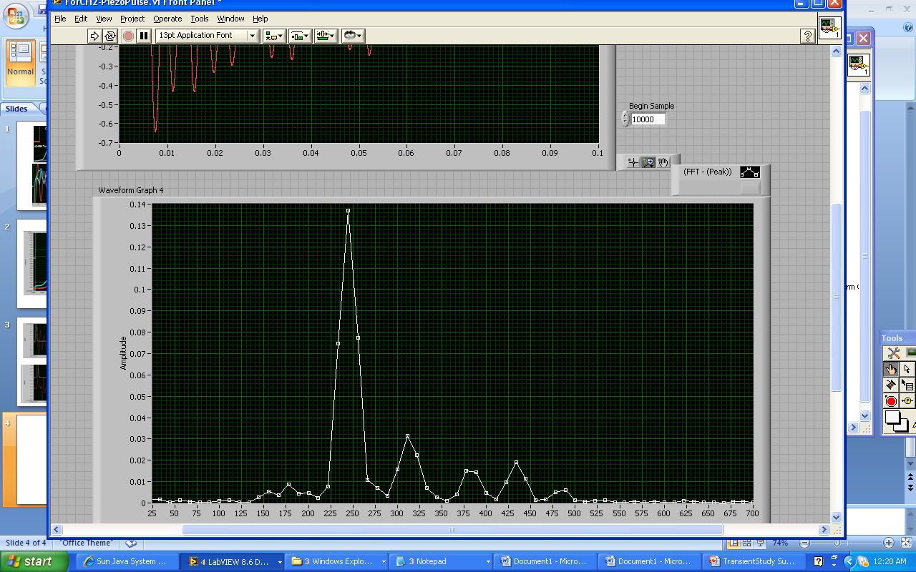
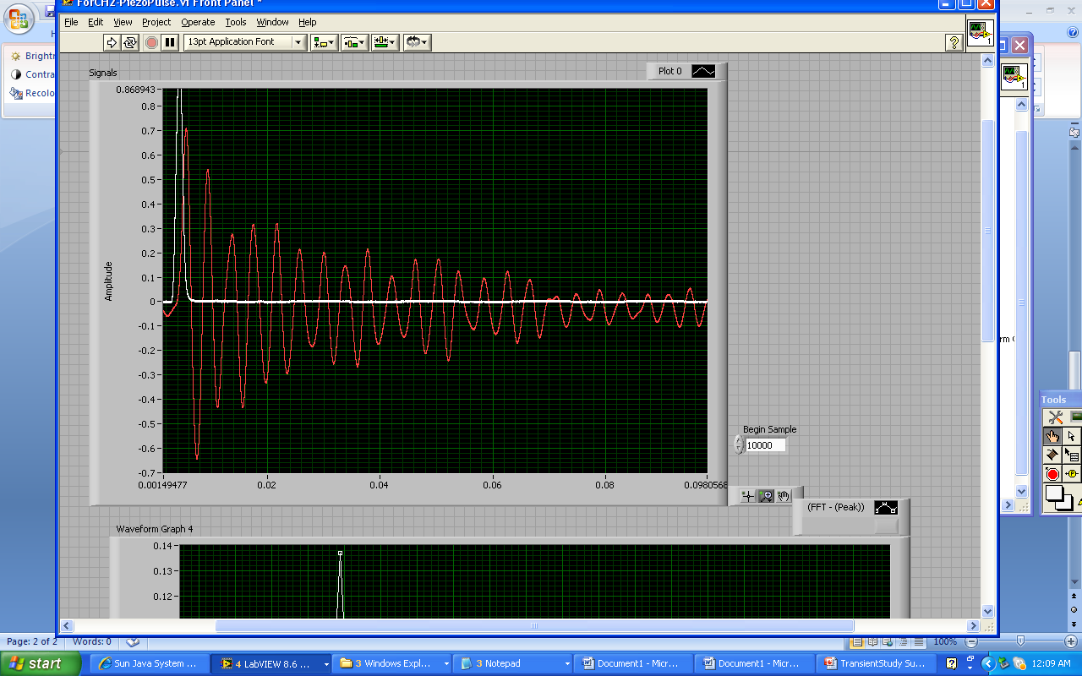
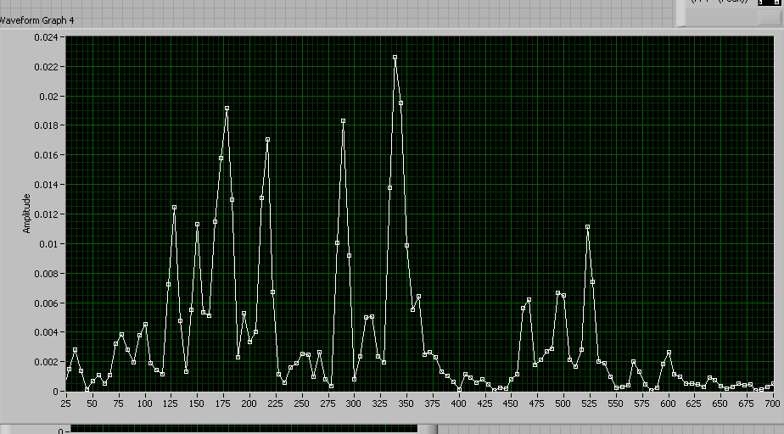
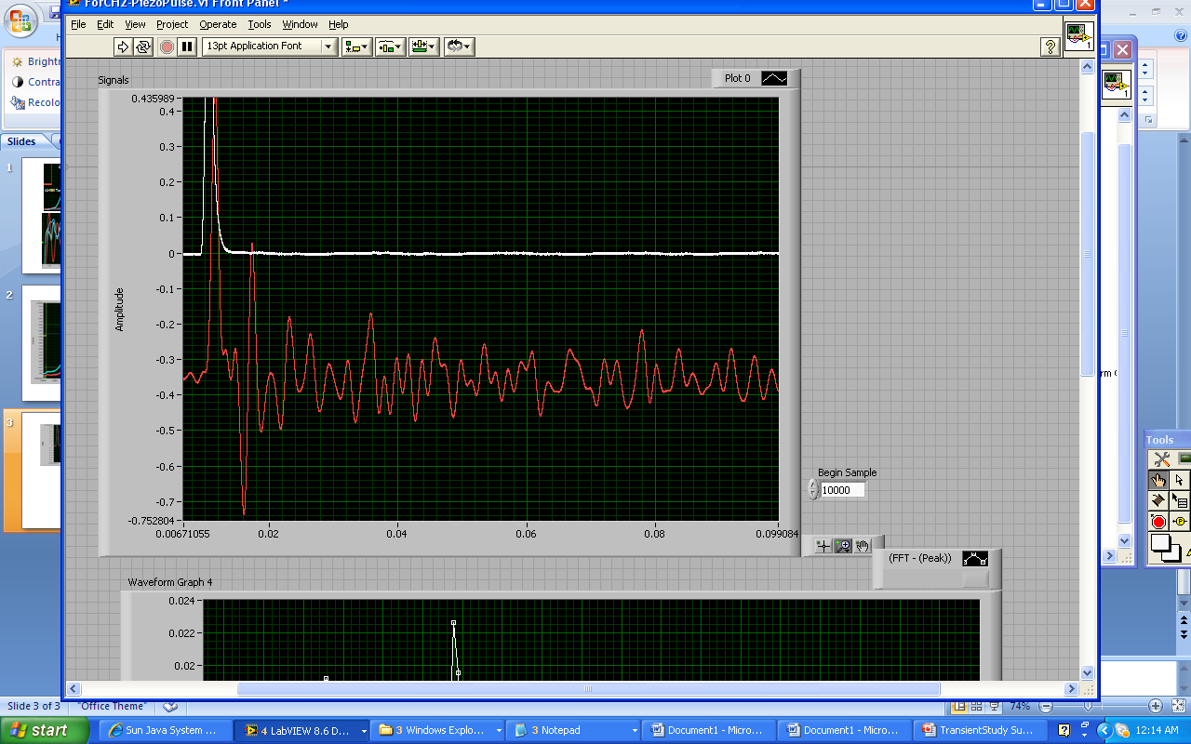
DESY
INFN/FNAL

Slide 6
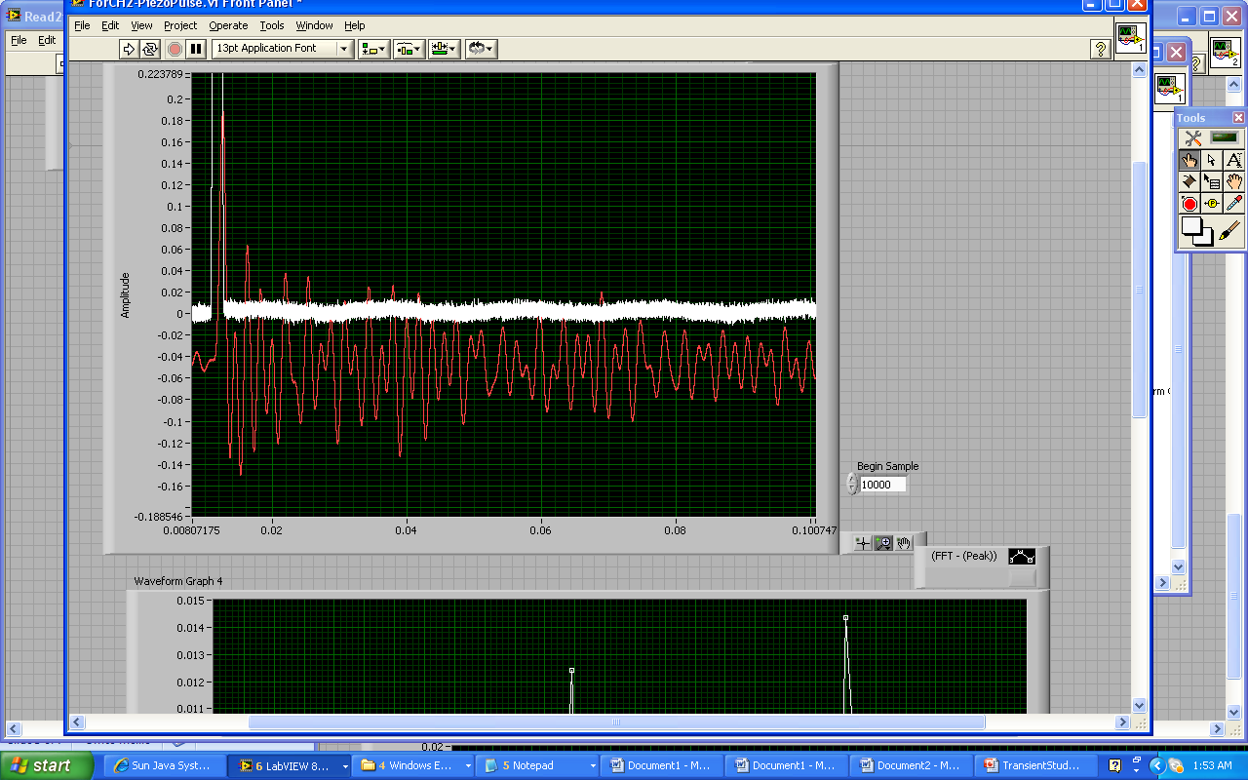
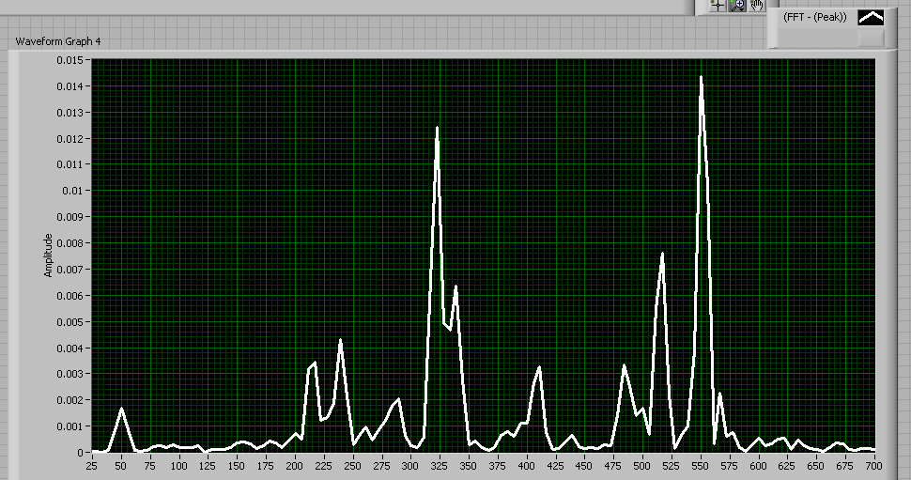
KEK Tuner/A2

Slide 7
Microphonics for each type of TUNER

Slide 8
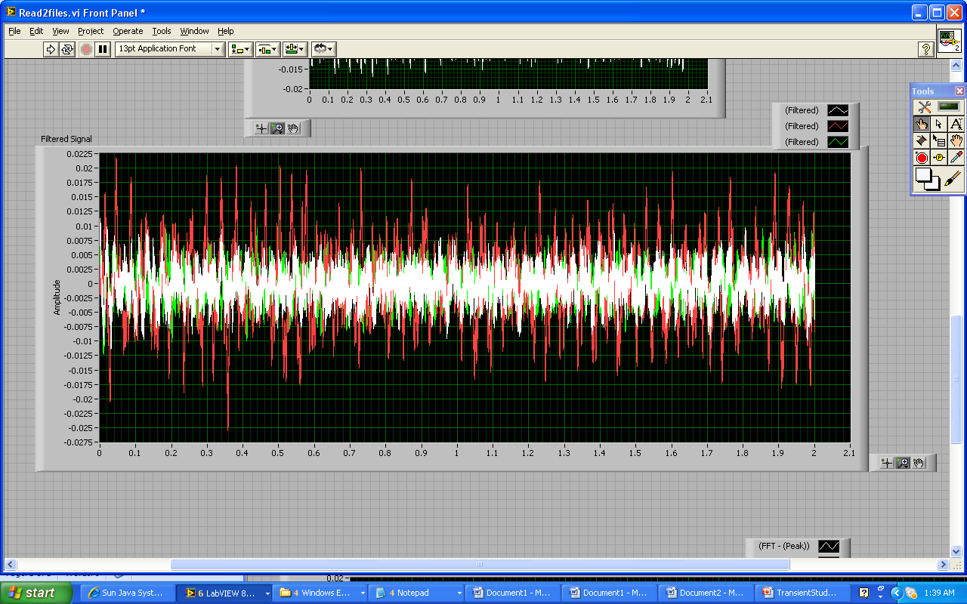
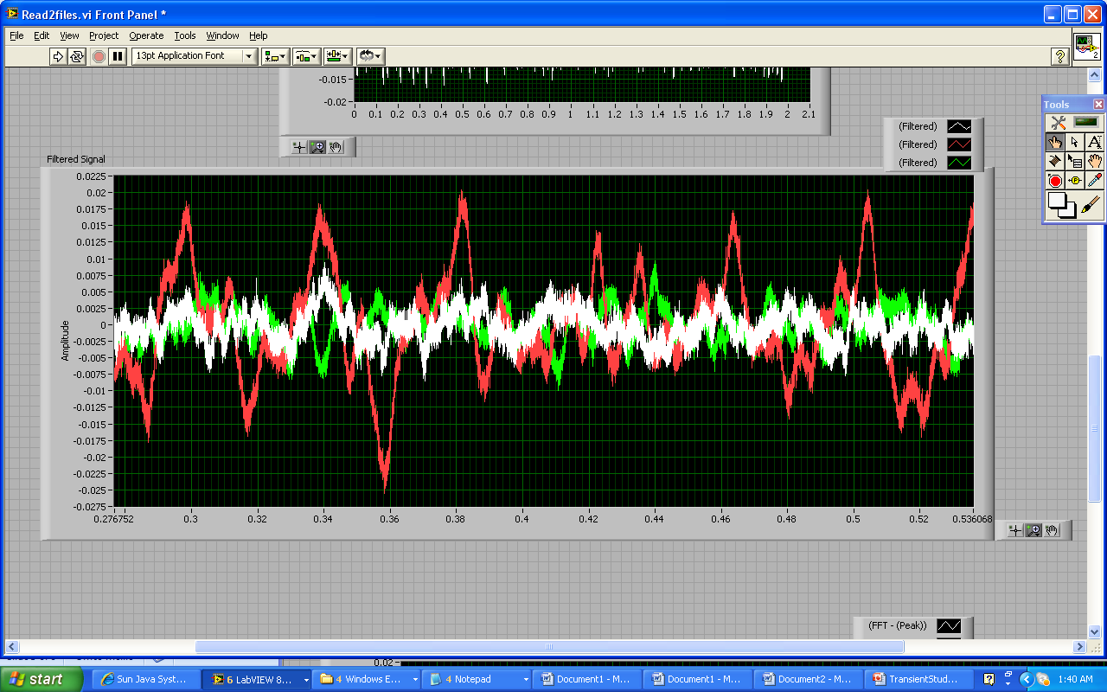
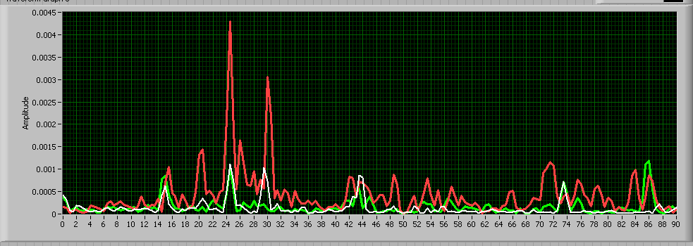
Microphonics Study
Red-Blade
White-DESY
Green-KEK

Slide 9
KEK Slide-Jack tuner

Slide 10
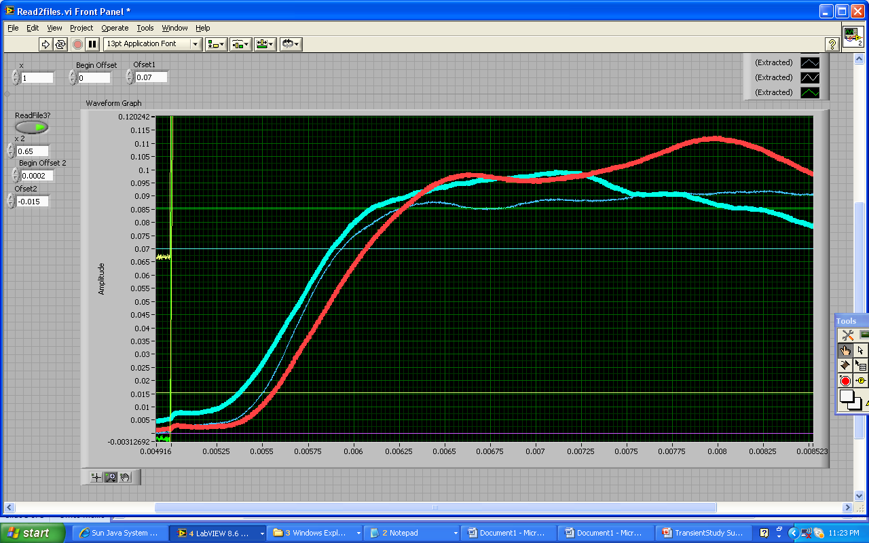
KEK Tuners-Response on 50V pulse
A-KEK TUNERS

Slide 11
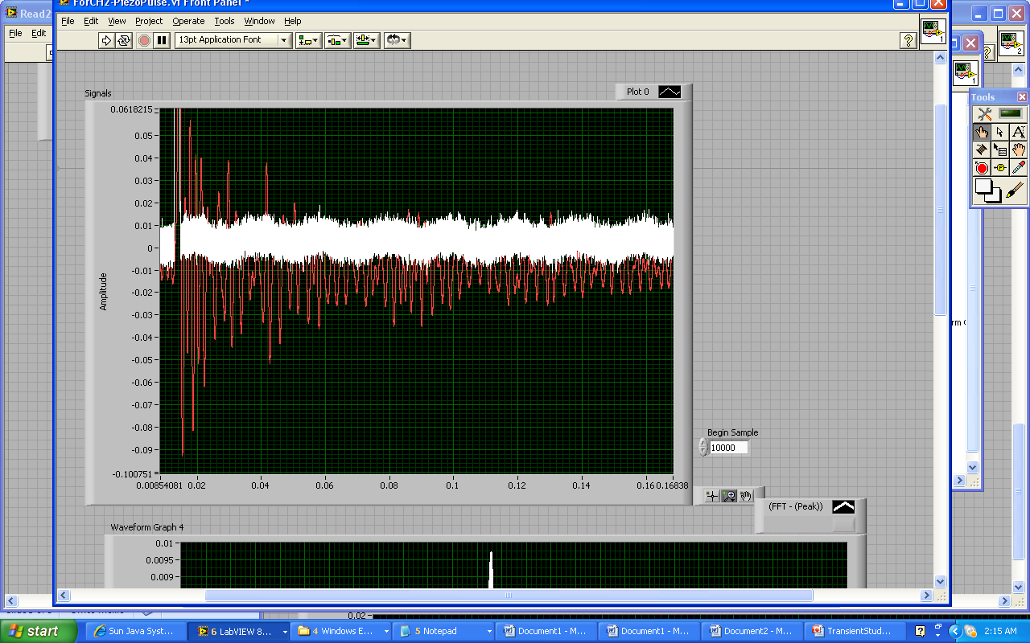
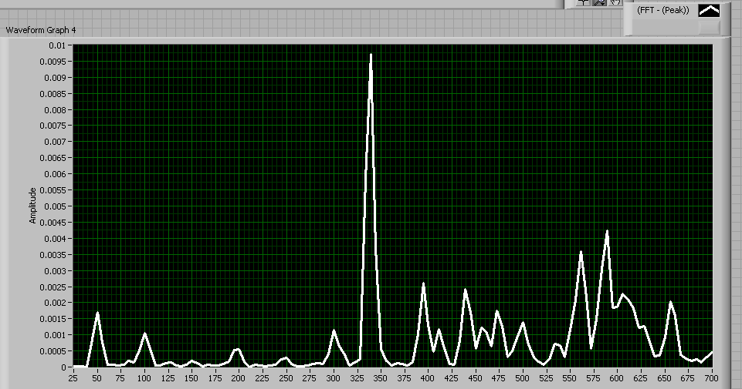
KEK/A3

Slide 12
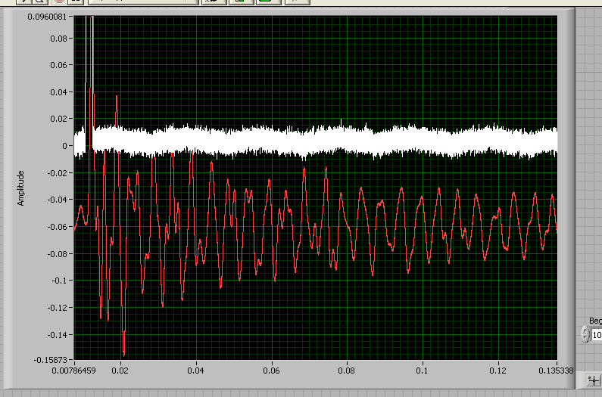
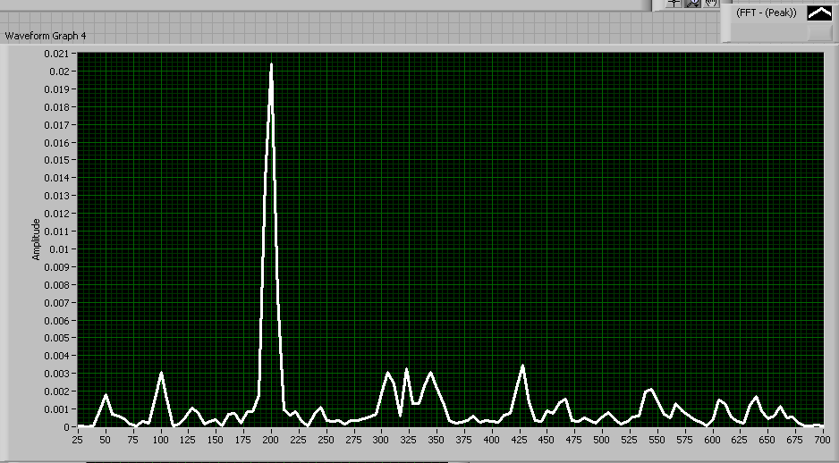
KEK/A4

